Slide 1
GeoJSON-T
Adding Time to GeoJSON
Karl Grossner University of Pittsburgh World History Center
https://github.com/kgeographer/geojson-t

Slide 2
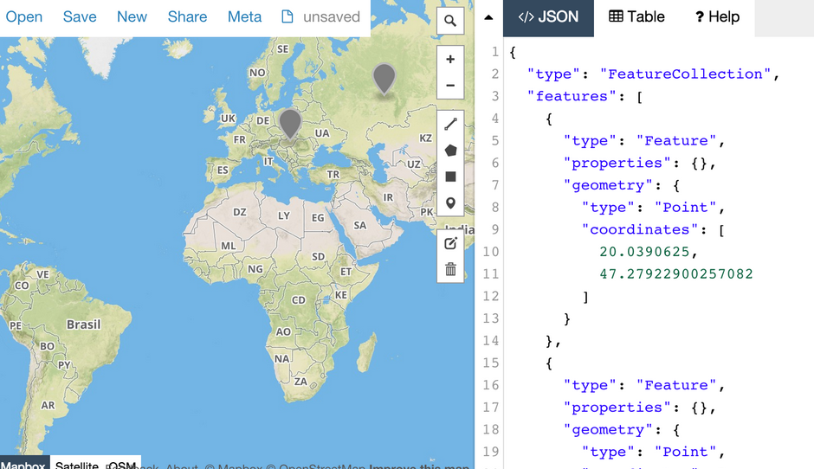
https://geojson.org/
“
geojson.io
Notes:
GeoJSON is in widespread use as a defacto data format standard for web mapping JavaScript libraries. It is also supported by desktop GIS, by GitHub -- which will render GeoJSON files as maps, onCLick() – and by tools like geojson.io
Note the tag line says “geographic data structures,” not “geographic features. GeoJSON *is* extensible, via what the spec calls “foreign members.”
GeoJSON-T was originally developed to model “event-like” features, specifically, but *all* geographic features may have temporal attributes of interest that we want to account for in map and map/timeline interfaces.

Slide 3
{
"type": "FeatureCollection",
"features": [
{
"type": "Feature",
"properties": { },
"geometry": { },
},
...
]
}
GeoJSON
Notes:
GeoJSON is a spatial data formatting standard. Wildly succesfull, due in large part to the fact people can move around and share human-intelligible text files, and there is software for making maps that interprets it – it is a widely-supported supported data format
But it doesn’t do time...

Slide 4
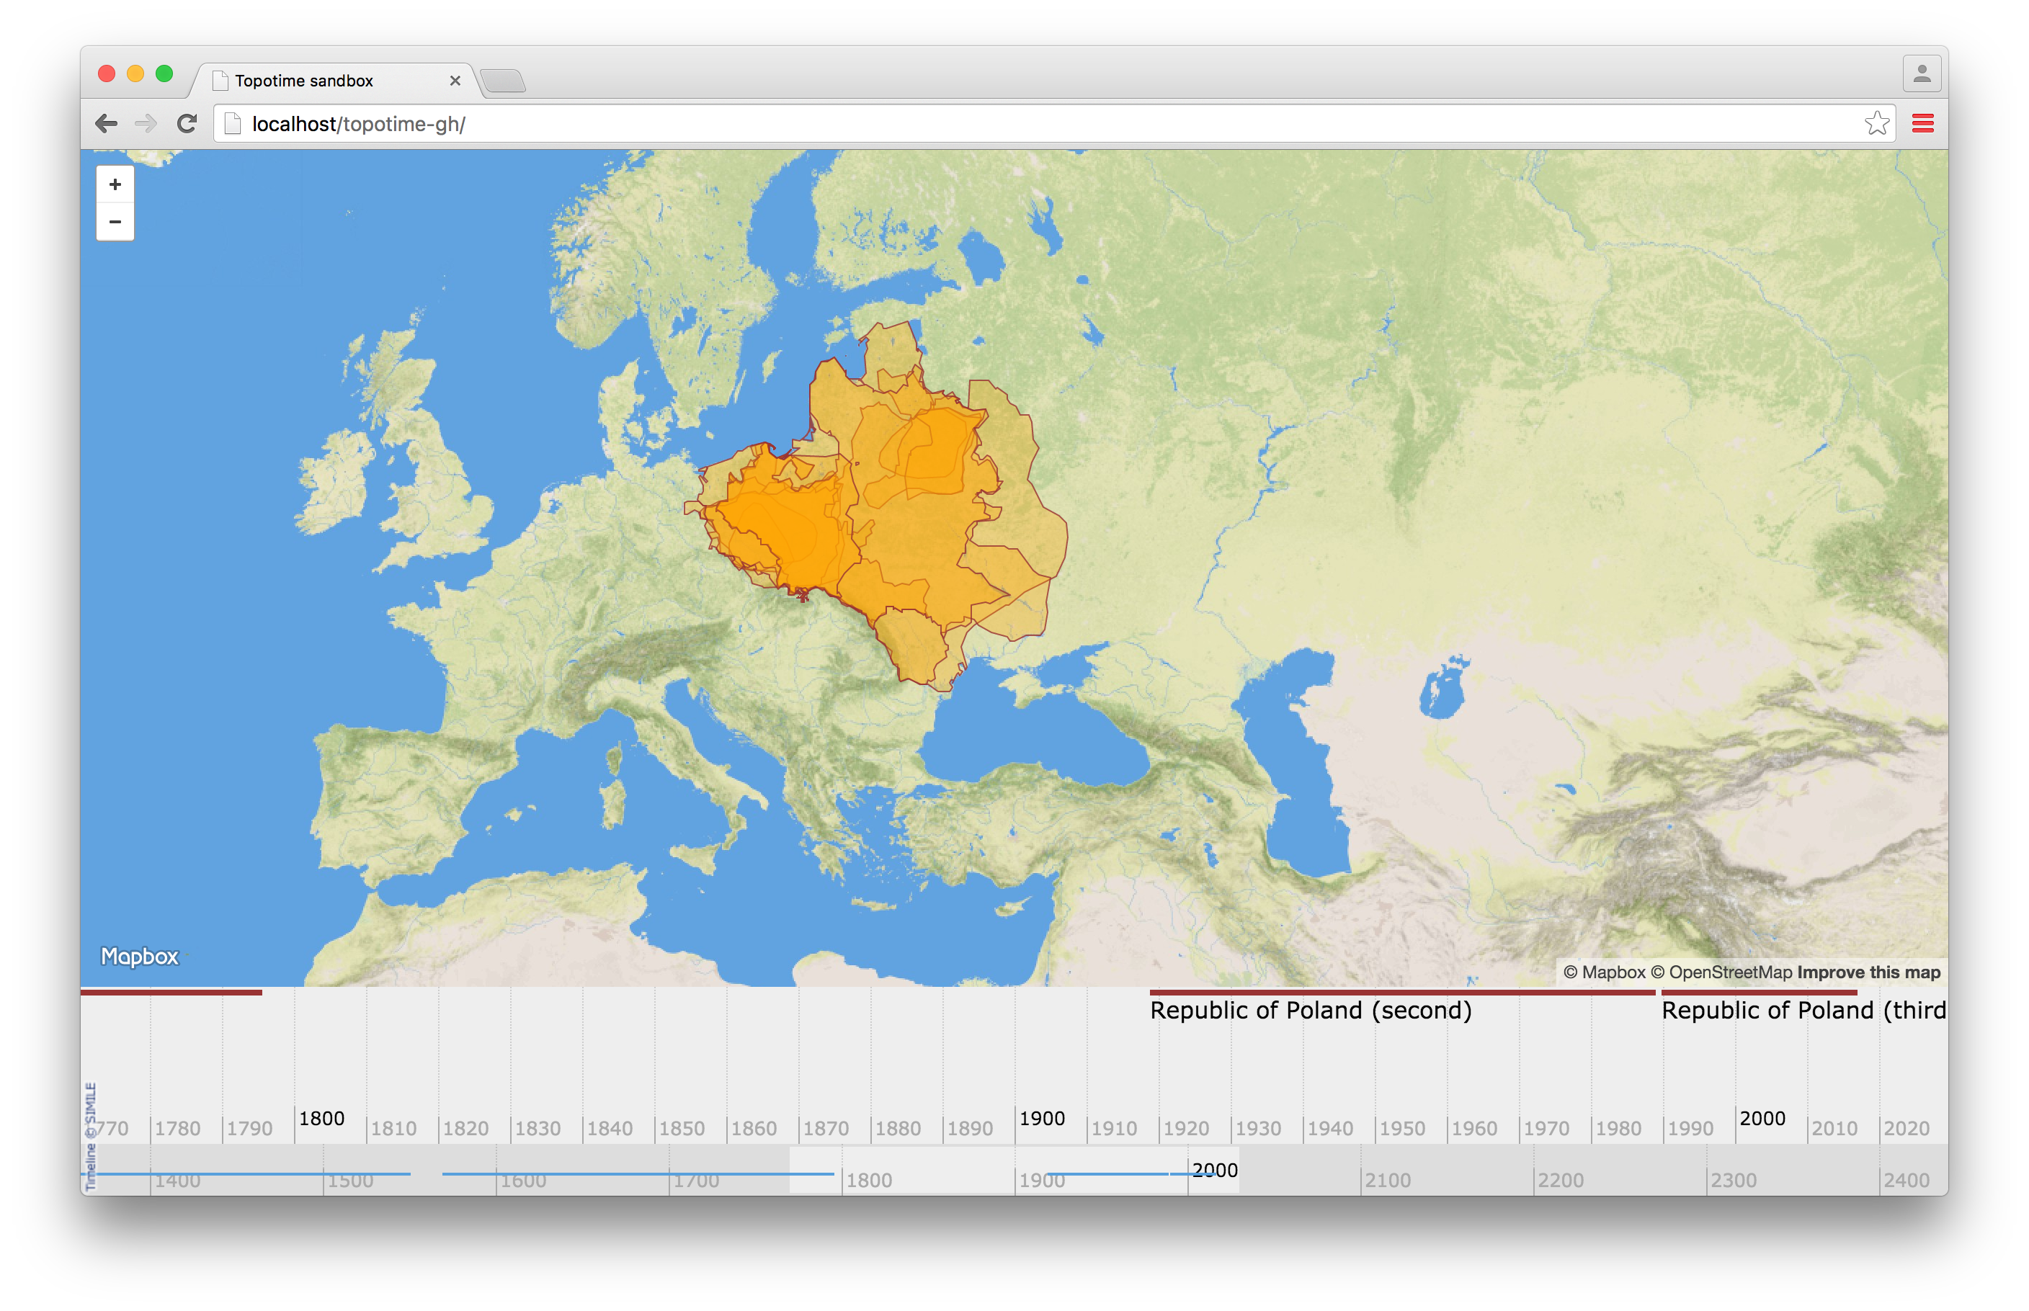
Notes:
What about the many shapes and sizes of Poland over time?

Slide 5
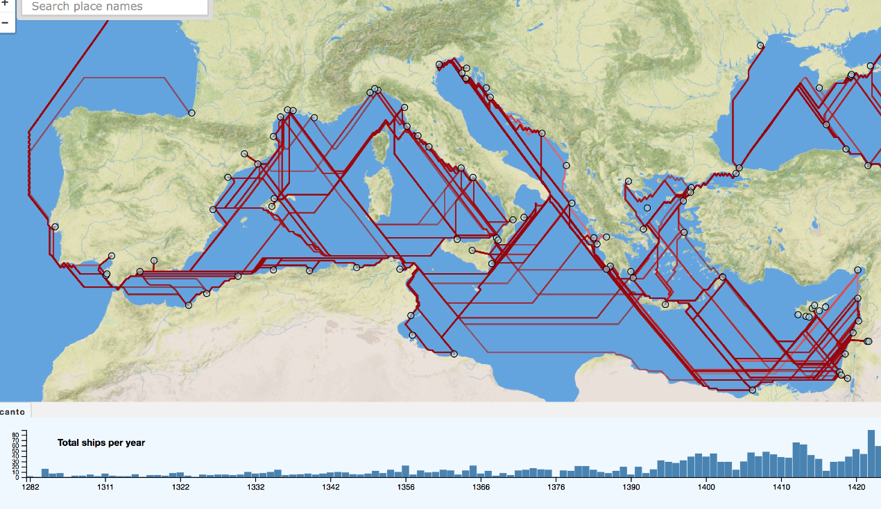
Notes:
Or commodity flows between Venics and numerous Mediterranean ports over several centuries?

Slide 6
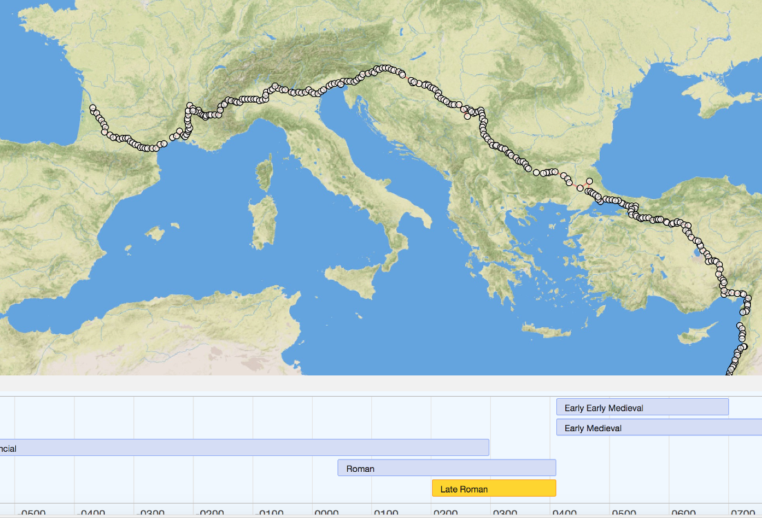
Notes:
Or a single journey taken from Bordeaux to the Holy Land *sometime during the 4th century (Late Roman Period)?

Slide 7
{
"type": "FeatureCollection",
"properties": {
"id": "euro_poland",
"label": "Admin bounds collection: euro_poland"
},
"features": [
{
"type": "Feature",
"properties": { },
"geometry": { },
"when": { }
},
...
]
}
GeoJSON-T
Notes:
Just add “when”
But it’s not that simple...best to allow “when” according to a standard syntax, and in several possible locations within the standard GeoJSON Feature object...

Slide 8
"features": [
{
"type": "Feature",
"properties": { },
"geometry": {
“type”: “GeometryCollection”,
“geometries”: [
“type”: “MultiPolygon”,
“properties”: { },
“coordinates”: [ ],
“when”: { }
]
},
},
...
]
}
GeoJSON-T
Notes:
we could represent a place (like Poland) as a single Feature, with a geometry that changes over time
or a route or journey as a single feature with its segments as geometries within a collection
waypoints could be point features in the same FeatureCollection

Slide 9
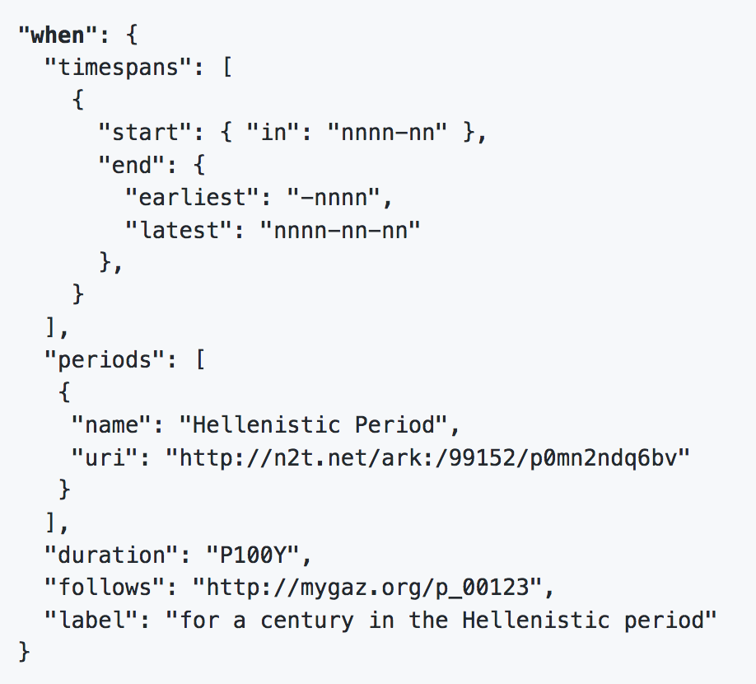
GeoJSON-T
https://github.com/kgeographer/geojson-t
https://github.com/kgeographer/geojson-t/issues/3
Notes:
what a when object looks like, at the moment. comments in GitHub issues are welcome, encouraged
See Issue #3 there: https://github.com/kgeographer/geojson-t/issues/3

Slide 10
Related Links
GitHub:
Blog post:
Demo (1):
Demo (2):
Twitter:
Email:
https://github.com/kgeographer/geojson-t
http://kgeographer.org/geojson-t-adding-time-to-geojson/
http://linkedpaths.kgeographer.org (earlier spec)
http://whgazetteer.org (uses Linked Places format)
@kgeographer
karl@kgeographer.org
Notes:
More links. Feel free to get in touch: GitHub issues, email, twitter

