Slide 1

OGC API standards for web use
Dr. Gobe Hobona
Open Geospatial Consortium
2020-09-22
W3C/OGC Joint Workshop Series on Maps for the Web
w3.org/2020/maps/

Slide 2
Overview
About OGC
Background to OGC API development
Motivation for developing OGC APIs
Overview of OGC API standards
Innovation initiatives
How to get involved
#OGCAPI
Copyright © 2020 Open Geospatial Consortium

Slide 3
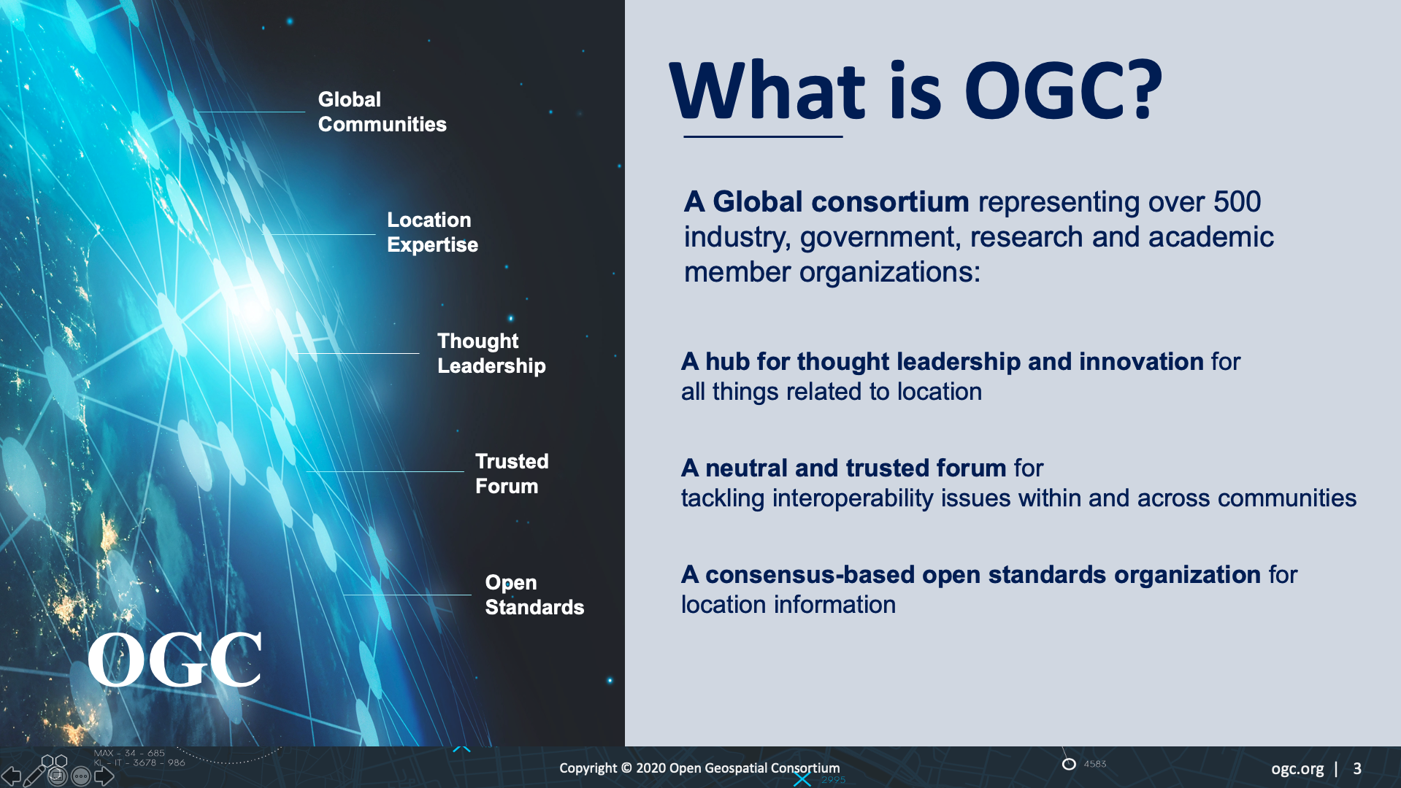
Overview
text

Slide 4

Overview
text

Slide 5
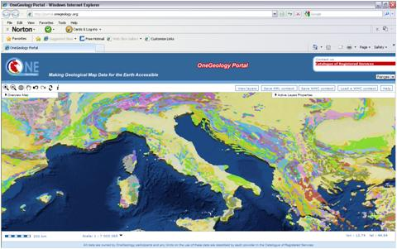
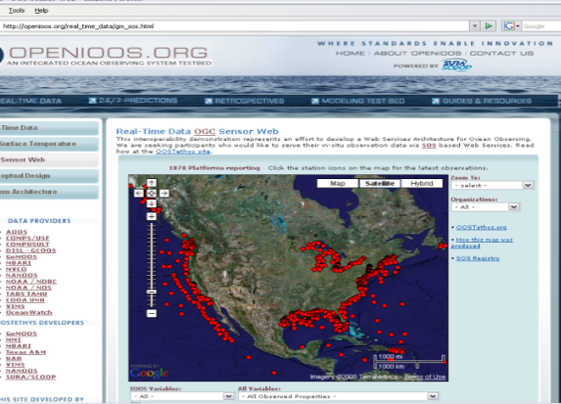
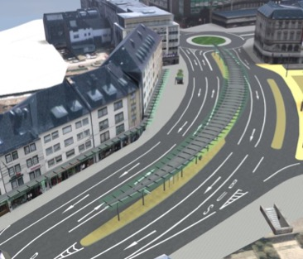
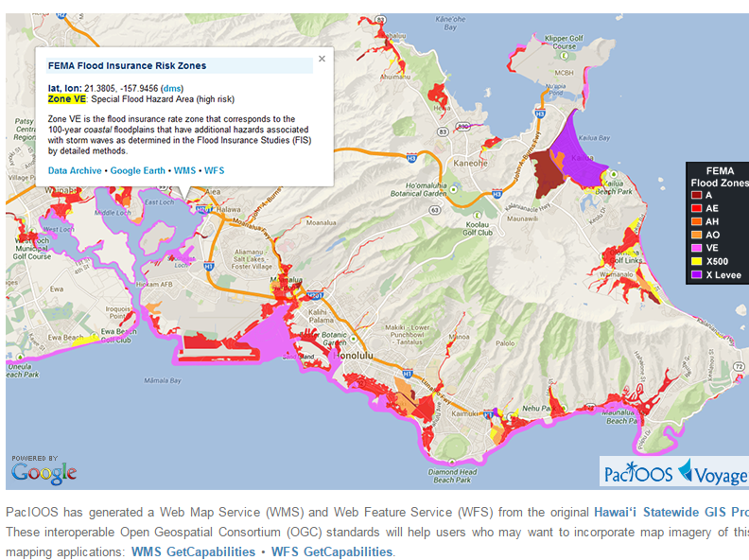
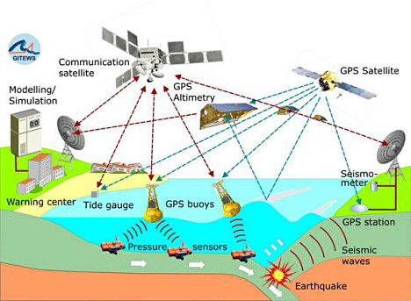

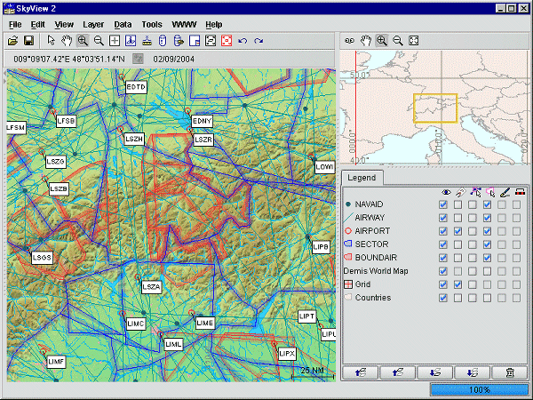
Background
OneGeology.Org
OGC Web Services (OWS)
Web Map Service (WMS)
Web Map Tile Service (WMTS)
Web Feature Service (WFS)
Web Coverage Service (WCS)
OpenIOOS.Org
Eurocontrol
“There are more than 200K OGC Web Services deployed across the Web”
- Source: GeoSeer spatial data search engine: https://geoseer.net
Copyright © 2020 Open Geospatial Consortium

Slide 6
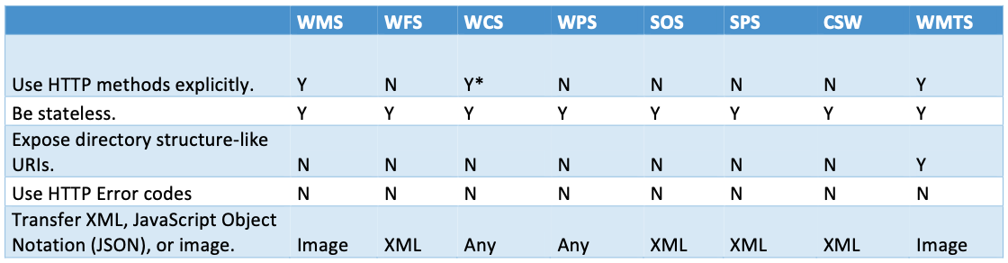
Background: OGC Web Services
Source: OGC 15-052r1r1
Copyright © 2020 Open Geospatial Consortium

Slide 7
Timeline
2015
      Testbed-11 Comparison of REST to classic OGC Web Services
2016
Testbed-12 work on a RESTful binding of the WPS
Focus of discussions shifts from REST to Web APIs
2017
OGC® Open Geospatial APIs - White Paper published
2018
Work on version 3 of the Web Feature Service (WFS3) starts
2019
WFS3 draft specification renamed OGC API - Features
OGC API – Features – Part 1: Core standard is published
Copyright © 2020 Open Geospatial Consortium

Slide 8
‘Why’ OGC APIs
APIs are a popular, effective method for rapid software development
API variations degrade interoperability
Open Standards enable interoperability of independent implementations
OGC APIs will improve interoperability between Web APIs
Copyright © 2020 Open Geospatial Consortium

Slide 9

OGC API Standards Development
Modular API building blocks;
spatially enable Web APIs in a consistent way
Spatial Data on the Web Best Practices
Leverages OpenAPI
Focus on developer experience and usability
Modular building blocks for access to spatial data that can be used in data APIs
Open development; Public GitHub, Early implementations,
In-depth validation
Copyright © 2020 Open Geospatial Consortium

Slide 10
API First Approach – using OpenAPI definitions
Copyright © 2020 Open Geospatial Consortium

Slide 11
OGC API standards
Approved
    OGC API – Features
Draft
OGC API – Common
OGC API – Coverages
OGC API – Records
OGC API – Processes
OGC API – Tiles
OGC API – Maps
OGC API - Environmental Data Retrieval
OGC API – Styles
Future concepts: DGGS, Routing
Copyright © 2020 Open Geospatial Consortium

Slide 12
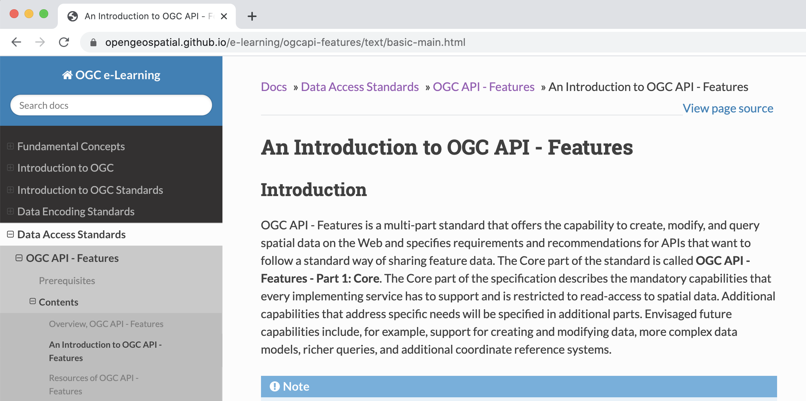
What to expect from each approved OGC API standard
Published October 2019
Tutorials & Guides
Standards document & OpenAPI definition
Executable Test Suite

Slide 13
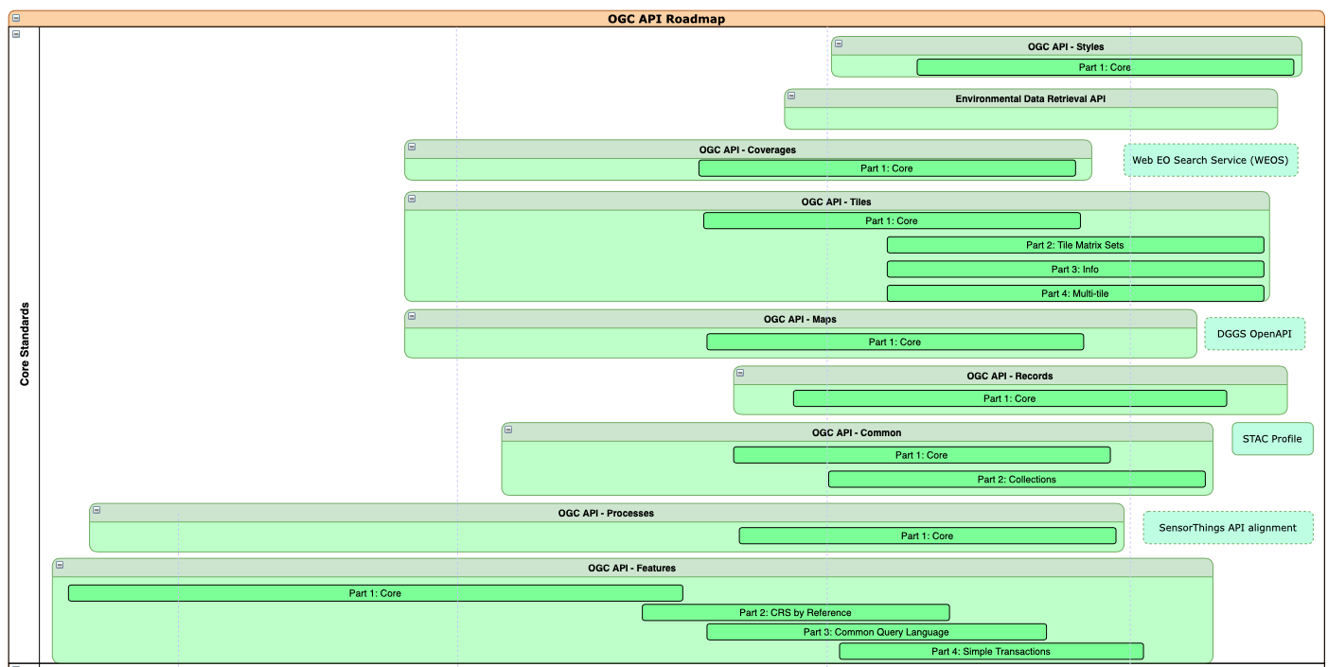
Roadmap
2017 2018 2019 2020 2021
Copyright © 2020 Open Geospatial Consortium

Slide 14
Sprints, Hackathons, Pilots, Testbeds and Innovation
Previous
OGC API Hackathon: June 2019
STAC and OGC API - Features and Catalogues Sprint: December 2019
ESIP and OGC Coverage Processing and Analysis Sprint: January 2020
Environmental Data Retrieval API Sprint: March 2020
OGC API – Tiles Sprint: April 2020
Routing Pilot, Vector Tiles Pilot
Testbeds 15 & 16 – APIs for Styles, Maps and Tiles, SWIM, DGGS
3D Data Container and Tiles Pilot
… and many more
Next up
OGC API – Common & OGC API – Features Virtual Code Sprint
On Sept 29 – 30, 2020
Register at https://portal.ogc.org/public_ogc/register/q3_api.php
Copyright © 2020 Open Geospatial Consortium

Slide 15
THANK YOU!
ghobona@ogc.org
@opengeospatial
http://ogcapi.ogc.org
#OGCAPI
2020-09-22
W3C/OGC Joint Workshop Series on Maps for the Web
w3.org/2020/maps/

