Slide 1
Embedding Rendering & Behavior Configuration in Map Data
Danielle Dupuy
Dam Nguyen

Slide 2
Why do we do this? In what ways has it been useful? How we implement it.

Slide 3
Why?
Gives non-developers more control

Slide 4
Why?
Gives non-developers more control
Limits requests to web developer

Slide 5
Why?
Gives non-developers more control
Limits requests to web developer
More control with less lines of code

Slide 6
Examples
Feature colors (fill and outlines)
Symbol types and size
Populate HTML
Determine Draw Order (Panes) for feature layers
Order of Legend Items

Slide 8
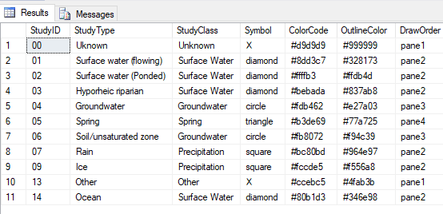
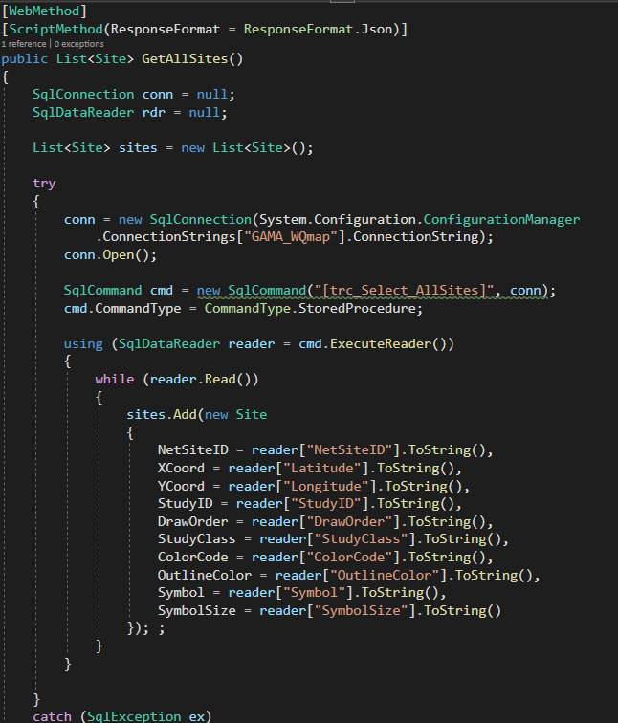

Slide 9
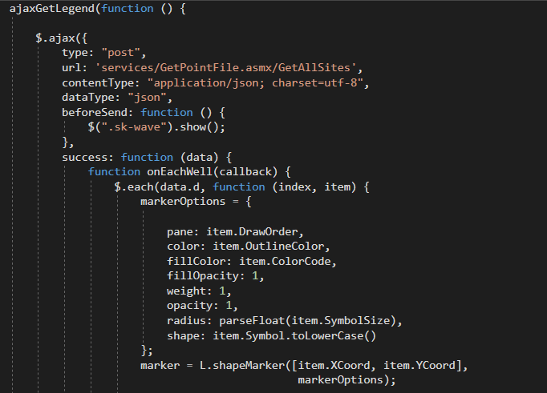
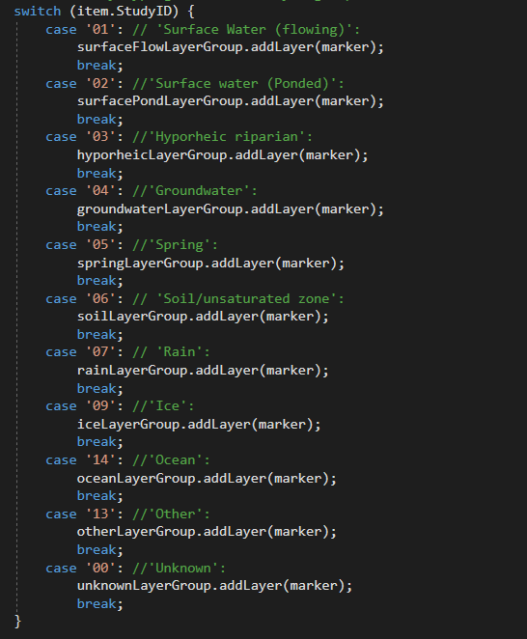
Notes:
Left: Access the stored procedure through Web Methods
Right: Use AJAX to read the data and use apply to the leaflet marker options.
I’m sure most people here are familiar with leaflet but if you’re not w
Not shown is where we create a separate layer group for each Study Type. So instead of having to make a database request for each study type or apply marker options for each study type we can do it all in one go.

Slide 11
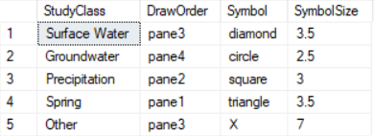
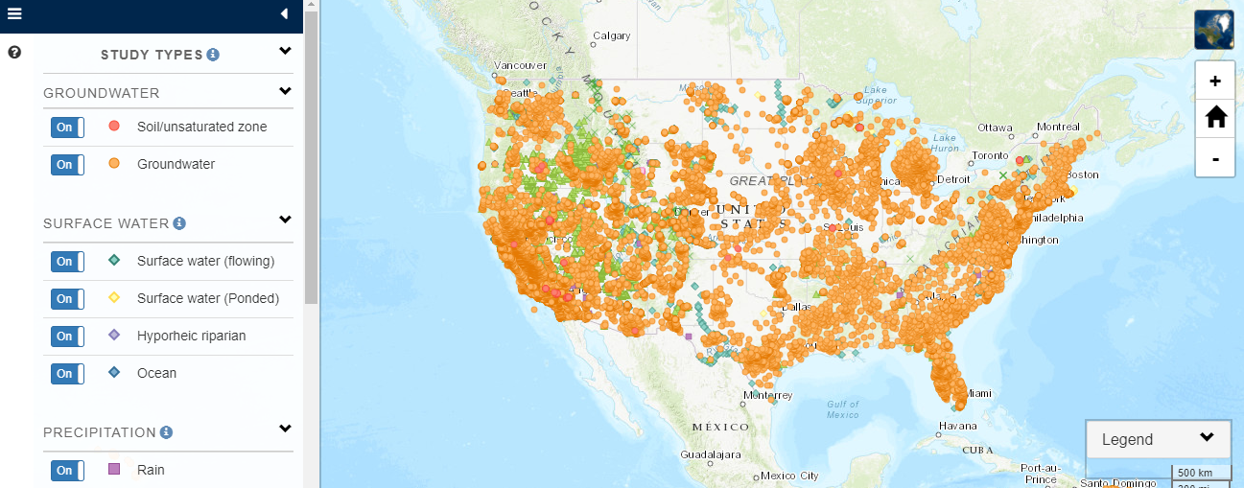

Slide 12
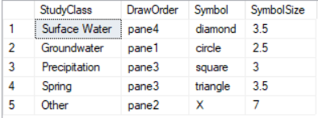

Slide 15
