Slide 1
Accessible Indoor Maps: Information Need and Automated Solutions to Address Gaps in Maps for People with Disabilities
Dr. Claudia Loitsch, Julian Striegl Dresden University of Technology
20.08.2020

Slide 2
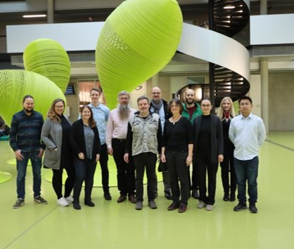
Who we are
The AccessibleMaps Consortium
International and interdisciplinary team of the Dresden University of Technology and the Karlsruhe Institute of Technology are working together on innovative and new solutions to improve mobility within buildings.
AccessibleMaps aims to develop software that automatically generates indoor maps enriched with accessibility features
Web: http://accessiblemaps.de

Slide 3
Topics of today's presentation
Outline
Motivation
Understanding the Needs and Abilities of People with Disabilities
Current Situation - Where are we now
Data Basis
Accessible Representation
Challenges
Possible Solutions For the Collection and Representation of Accessibility Information

Slide 4
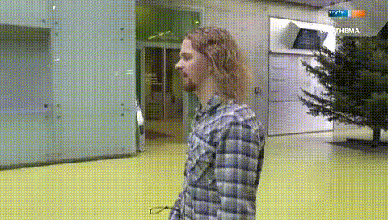
Motivation
Accessible Indoor Maps
Social relevance: Independent travelling and mobility is challenging for people with visual and mobility impairment [PC18]
Many and diverse barriers in buildings, e.g. ground level objects not detectable for blind people using a cane.
Why Indoor and why maps?
Source: TV report of our project Range-IT
Notes:
Our main motivation is the social relevance of the topic. In particular, because independent travelling and mobility is challenging for people with visual and mobility impairment
People with disabilities face several barriers when navigating to or orientating in unfamiliar buildings.
Overcoming permanent or temporary barriers is very often challenging for people with disabilities -- as for instance shown on the slide that ground level objects are sometimes not detectable for blind people using a cane.
So why do we focus on indoor maps? => Compared to outdoor and public transport, the indoor area has so far received the least attention (least in terms of data, maps, and user research)!
We believe that in addition to navigation applications, indoor maps are will help with orientation in unknown buildings.
*** no time for: ***
economic relevance:
The market sector for indoor maps will grow significantly due to an increased demand from location-based service providers [GVR19]
For instance, more and more people use their smartphones in malls for getting directions
BUT: Those applications focus almost exclusively on the mapping of POIs and are lacking information about physical accessibility
timing:
As we are still in the early stages of indoor maps ,
the question of modelling accessibility of buildings in geographical information systems and web-based maps can be raised at an early stage!
Usually, accessibility is applied as an afterthought!
Currently there are no widely accepted open standards for modelling accessibility information in indoor maps
and there is a lack of methods to assess if indoor maps comply with the requirements of people with disabilities in terms of orientation and indoor navigation
=> We will show in our presentation some of the gaps that should be addressed when conceptualising accessible maps for the web!

Slide 5
Modelling Physical Accessibility Understand the Needs and Abilities of People with Disabilities I
Modelling Physical Accessibility Understand the Needs and Abilities of People with Disabilities I
People with disabilities need granular information about the layout, orientation features (i.e. landmarks), barriers and temporal relations to find their way independently [FBC19].
Information need | Mobility impaired people | Visually impaired people
potential barriers | narrow doors or passages, lack of or non-functioning elevators and escalators, lack of handrails, uneven walking surfaces and heavy doors [TWD04] | handrails and wayfinding information (in complex and confusing buildings), or buildings with bad lighting conditions [TWD04]
accessibility features | slope of a path, floor covering, manual or automatic opening of doors, or accessibility of restrooms | availability and location of braille signs [AA15] and tactile pavings
Notes:
People with disabilities need granular information about the layout, orientation features as well as temporal relations (e.g. obstacles such as construction sites) to find their way independently.
Mobility impaired people primarily require structural information as they experience barriers such as narrow doors or passages, lack of or non-functioning elevators and escalators, lack of handrails, uneven walking surfaces and heavy doors.
Furthermore, mobility-impaired people rely on information such as slope of a path, floor covering, manual or automatic opening of doors, or accessibility of restrooms
Visually impaired people also require structural information such as handrails and wayfinding information and they can experience barriers in complex and confusing buildings or buildings with bad lighting conditions.
Moreover, information about the availability and location of braille signs is helpful.

Slide 6
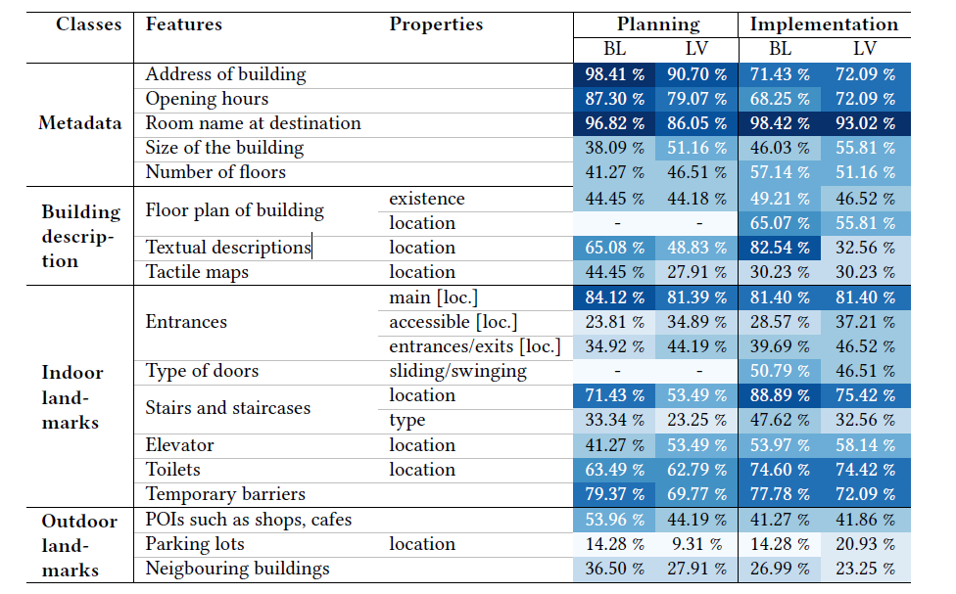
Modelling Physical Accessibility Understand the Needs and Abilities of People with Disabilities II
Diverse information need for planning a trip and its implementation [EMC20]
Problem: No common approach to collect and makes information about physical accessibility of buildings available for different user groups and for all parts of the travel chain.
Accessible indoor maps can be a solution!
Table 1. Relevance of features for blind people (BL) and people with low vision (LV) when planning and implementing a trip [EMC20]
Notes:
In addition, it is important to understand that people with disabilities have different requirements for planning of a trip and its implementation
Diverse information need is represented in Table 1; Example: information about the type of doors or the location of a floor plan are more important for the people with VI with they are in a building
Problem: no common approach to collect and makes information about physical accessibility of buildings available for different user groups and for all parts of the travel chain.
Therefore collecting those information is time-consuming or even not possible. => it requires users know were they can request their required information
Accessible indoor maps can be a solution but they must represent sufficient data about physical accessibility and they must be accessible for for diverse users and contexts!
***
Background on study:
Study with 106 people with VI
Goal: examine the strategies they use to prepare for a journey to unknown buildings, how they orient themselves in unfamiliar buildings and what materials they use.]

Slide 7
Data Basis of Indoor Maps
Collecting, Validating, and Modelling

Slide 8
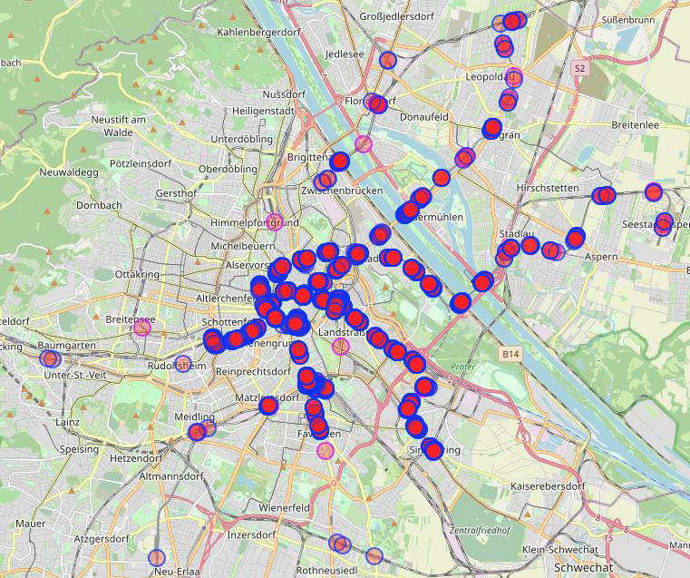
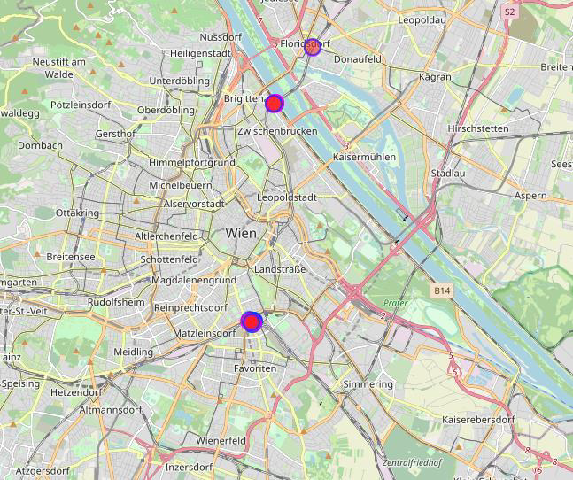
Case Study // Current State of Indoor Maps in OSM Quantitative Analysis
Currently there are no widely accepted open standards for the expression of accessibility information in indoor maps
Methodology: Requests for the Overpass API were formed based on tags specific for the mapping of indoor areas in OSM using Simple Indoor Tagging (SIT) - the currently used tagging schema for indoor maps in OSM
Minimum of required tags: min_level, max_level, level
Tags for a complete indoor map: room, area, wall, corridor
Quantitative Analysis Results [SLS20]
The number of mapped indoor environments is sparse, regardless of the used indoor tagging schema.
Even though SIT is the tagging schema currently chosen for indoor mapping by the OSM community, only a small percentage of objects have SIT associated tags.
In four major European cities on average only one building had a completely mapped indoor environment
Comparison of all objects with SIT tags and SIT complete buildings in Vienna. Overpass Turbo: http://overpass-turbo.eu/, Access date: 06.05.2020
Notes:
Currently there are no widely accepted open standards for the expression of accessibility information in indoor maps and there is a lack of methods to assess if indoor maps comply with the requirements of people with disabilities in terms of orientation and indoor navigation. In the scope of the AccessibleMaps project we therefore analyzed the quantity and quality of indoor maps exemplary for OpenStreetMap - as it is one of the most successful volunteered geographic information projects.
To analyze the quantity and quality of existing indoor maps in OSM we used the Overpass API.
The used requests were formed based on tags specific for the mapping of indoor areas with the Simple Indoor Tagging (SIT) schema of OSM, which is the currently chosen standard schema for indoor mapping in the OSM community.
The bare minimum of needed tags for a working indoor map in OSM are the min_level and max_level tag on the building polygon or the building relation and the level tag on POIs inside the building. The four basic indoor elements room, area, wall and corridor can be used to model the floorplan of a building.
As a first analysis of the state of indoor maps we looked at 4 major european cities: Berlin, Rome, Vienna, and Paris.
Two main statements can be derived from the collected data.
Firstly, for all European cities, there is a strong imbalance between the number of objects marked as buildings and the number of objects marked to be in an indoor environment with the indoor=yes key-value pair. This indicates that the number of mapped indoor environments is sparse, regardless of the used indoor tagging schema.
Secondly, even though SIT is the tagging schema currently chosen for indoor mapping by the OSM community, only a small percentage of objects have SIT associated tags.
On the left hand side you can see an example of the discrepancy between the number of buildings that have any SIT related tags and the number of buildings that are completely mapped using SIT.

Slide 9
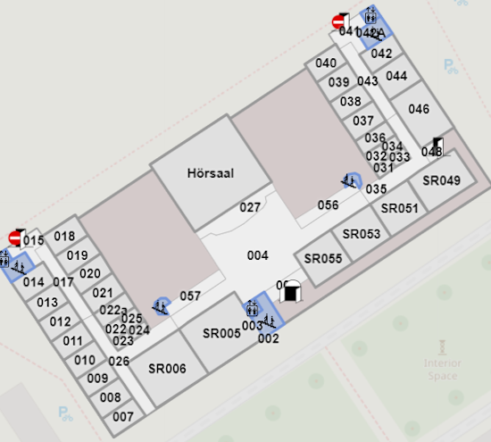
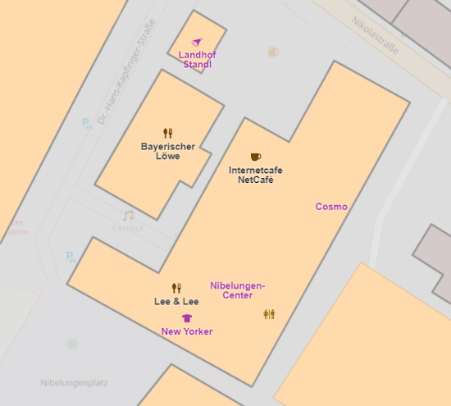
Case Study // Current State of Indoor Maps in OSM Qualitative Analysis
(state: 10.04.2020)
City | Berlin | Rome | Vienna | Paris
Buildings (SIT minimal) | 6 | 9 | 7 | 5
Buildings (SIT complete) | 1 | 0 | 3 | 0
Buildings with features for PMI | 1 | 0 | 3 | 0
Buildings with features for PVI | 0 | 0 | 0 | 0
Buildings with features for PMI & PVI | 0 | 0 | 0 | 0
PMI: People with mobility impairments, PVI: People with visual impairments
Comparison of two buildings with mapped indoor environments following the SIT schema. OpenLevelUp: https://openlevelup.net, Access date: 11.06.2020
Notes:
The quality of mapped indoor spatial information in regards to accessibility is of utter importance when analysing how existing indoor maps in OSM suit the requirements of people with disabilities. Therefore, mapped buildings were further analysed in regards to their consistency in used indoor tags, their completeness of provided indoor geospatial information and mapped accessibility specific features such as elevators, ramps, provided braille information and tactile pavings.
On average, only 6.75 buildings per city fulfilled the minimal SIT requirements and on average only one building per city met the requirements of SIT completeness
In the complete data set only four buildings included mapped accessibility features for mobility-impaired people (e.g. ramps, elevators) and none of the analysed cities had buildings with mapped accessibility features for visually impaired people (e.g. braille, tactile paving).
An example of the fluctuation in indoor map quality in OSM can be seen on the left hand side. Both depicted buildings fulfill the minimal SIT requirements. However only the upper map has sufficient information to be suitable for indoor navigation purposes for people with disabilities.

Slide 10
Accessible Representations of Indoor Maps
Address Diversity

Slide 11
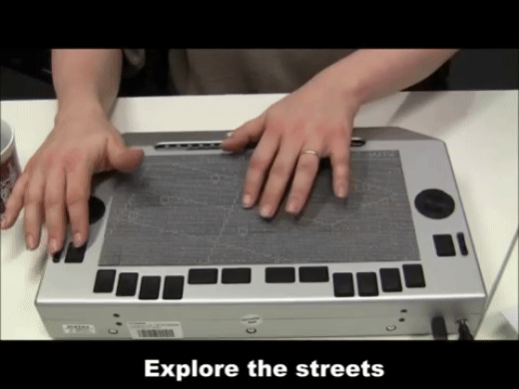
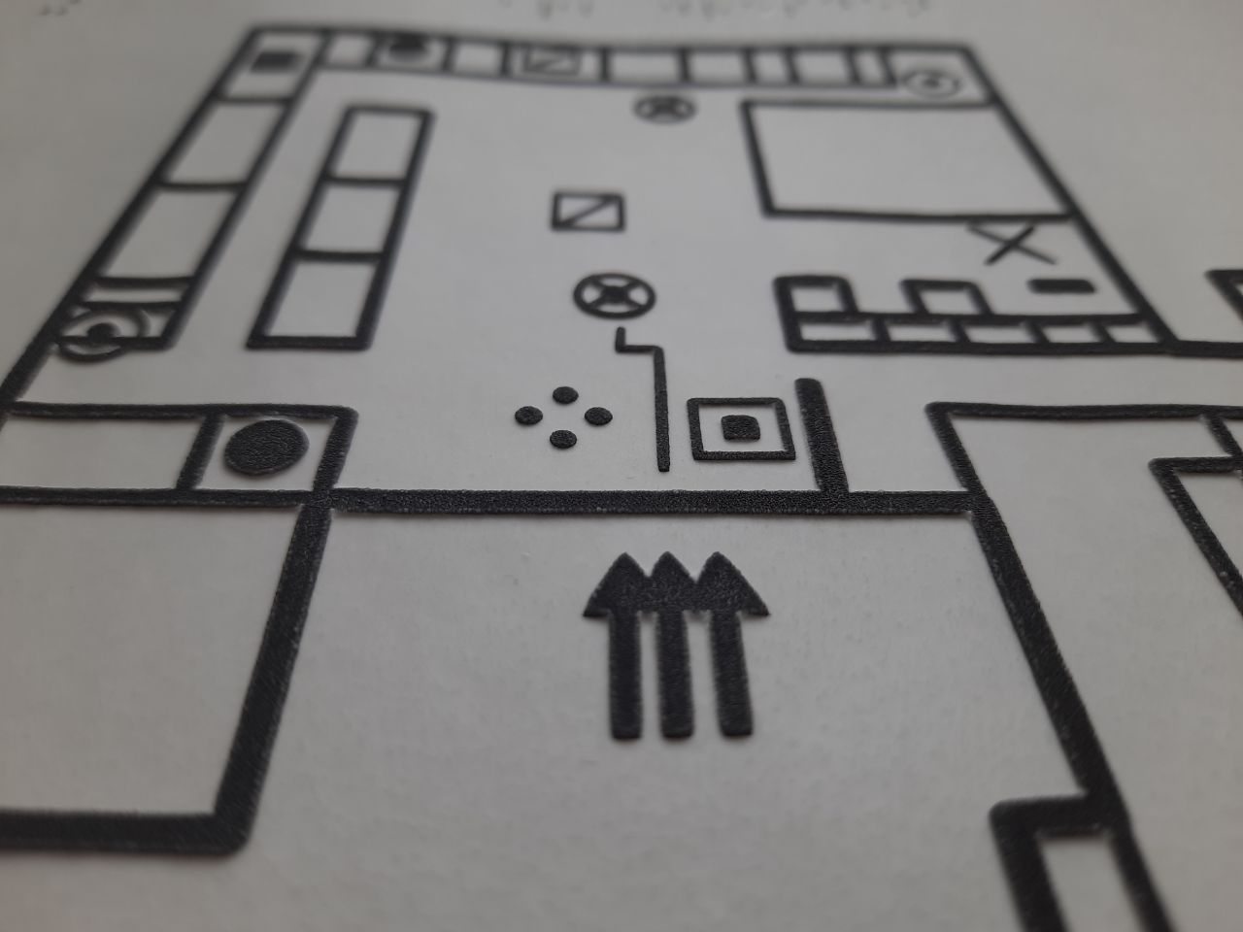
State of the Art Techniques to Make (Indoor) Maps Accessible for People with VI
Tactile Maps
Most frequently used approach; effective for learning spatial structures [EUO98, GOL18]
Virtual Acoustic Map
Conversion of map items into different sounds
Audio-Tactile Maps
Multimodal interaction techniques to augment maps with information
Example: Microsoft Soundscape - A map delivered in 3D sound
https://www.microsoft.com/en-us/research/product/soundscape/
Example: Indoor map created on swell paper
Example: Tactile Maps on the Hyperbraille Display
https://tu-dresden.de/ing/informatik/ai/mci/forschung/forschungsgebiete/tactile-maps
Notes:
There are many and diverse approaches to make visual maps accessible but manly for people with visual impairments [1]. You can see -- as examples to others -- 3 techniques:
Tactile maps are most frequently used and effective for learning spatial structures and for Orientation and Mobility training.
On the slide you can see an indoor map that is produced on swell paper
Virtual Acoustic Maps convert map items into different sounds and directly inform the user about the environment .
For instance, MS developed the app Soundscape that enables people with LW to hear landmarks around them in 3D
Audio-tactile maps is again another technique that focuses on multimodal interaction techniques to augment maps with auditive information
There are again very different approaches. On the slide you can see a refreshable and touch-sensitive Braille Display with which a bline people can explore a tactile map. Additional auditive information can be received via a tap gesture
=> There are many more techniques that address the need of people with VI.
=> The problem is that are currently no standards how maps and geographical data should be made accessible for different contexts and diverse user needs.
=> So we know less about how people with impairments in the upper body can interact with maps, or how can maps be simplified for people with mild or severe cognitive impairments
[1] [https://www.w3.org/WAI/RD/wiki/Accessible_Maps]:

Slide 12
Accessible Indoor Maps Challenges to be Addressed
Insufficient Indoor Data
Tedious Data Collection
Insufficient Knowledge
Diverse User Groups
Low coverage of indoor maps, incorrectly and inconsistently applied indoor schemes, information on accessibility features not available, lack of standardization [SLS20]
Required level of detail is too high to achieve with traditional mapping methods [LSS11], commercial platforms focus on mapping of POIs [FBC19]
Mapping community has insufficient knowledge on necessity of mapping of indoor features for people with disabilities [SLS20]
Varying sensory, physical, and cognitive abilities can lead to differing accessibility challenges with digital maps [FBC19]
1
2
3
4
Notes:
Several key challenges can be derived from the analysis of the state of the art of accessible indoor maps for people with impairments and from the analysis of the requirements of the different targeted user groups.
Firstly, there is currently a low coverage of indoor maps and indoor schemes are inconsistently and incorrectly applied. Specifically information on accessibility for indoor areas is not available for most public buildings and there is a lack of standardization for the accessibility domain.
Secondly, the data collection process for indoor accessibility information is quite tedious.
The required level of detail of indoor information is too high to achieve if traditional mapping methods
Commercial digital map platforms focus mostly on the mapping of points of interest instead of on the mapping of detailed indoor geospatial information.
Thirdly, there is a lack of knowledge concerning the information needs of people with disabilities in the mapping community.
While accessibility projects do exist in the volunteered geographic information community for the outdoors, similar projects are needed for indoor environments.
And lastly, people with disabilities are a diverse user group with varying sensory, physical and cognitive abilities that can lead to different accessibility challenges with digital maps.

Slide 13
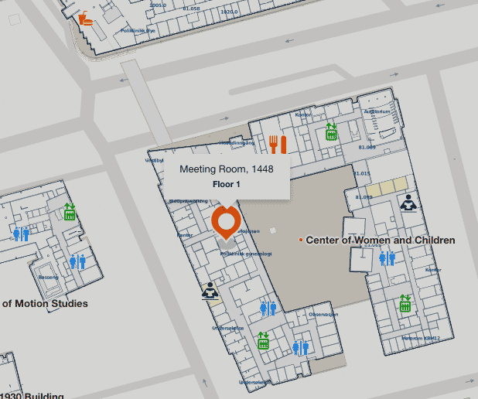
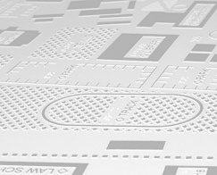
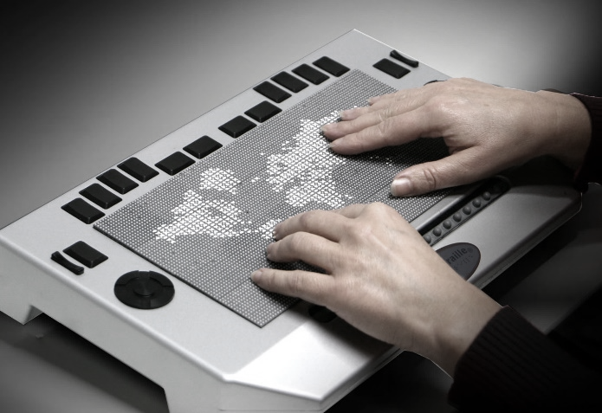
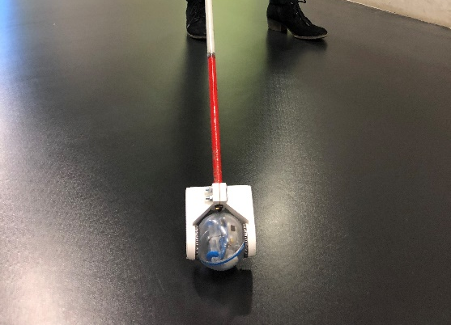
Possible Solutions For the Collection and Representation of Accessibility Information
(Semi)-Automatically creating indoor maps containing accessibility features of buildings
Automatically creating accessible and individualised representations of indoor maps
Specification of indoor mapping schema with accessibility features
Transformation of existing maps to new schema
Visual on Mobile or Desktop
Tactile Printout
Analysis Tools for the quality of accessibility information in indoor maps
(Semi)-Automatic & Crowdsourcing based approaches for data collection and map creation
Specific AT
Mobile Interaction
Notes:
To tackle those challenges, we propose the following possible solutions for the collection and representation of accessibility information for indoor areas.
To tackle the challenge of the insufficient prevalence of accessible indoor geospatial information, semi-automatic processes for the creation of said information are needed
Therefore, in a first step a vocabulary for the mapping of indoor accessibility features needs to be defined
Furthermore, existing maps in the varying schemes for indoor mapping should be transformed to one basis of data
Already existing indoor maps need to be analyzed in regards to their quality of accessibility information. Therefore, corresponding tools are needed.
Finally, semi-automatic and crowdsourcing approaches should be used for the collection of accessibility information and the mapping of accessibility features.
Based on the collected information, accessible and individualised representations of indoor maps should be generated.

Slide 14
Summary
It is currently a very good time to consider the aforementioned levels properly and to take accessibility into account at an early stage in the development of standards for web-based maps.
Our envisaged contribution:
Dedicated user research on mobility in unknown buildings
Software to significantly improve the coverage of indoor maps
Solutions for barrier-free map representations for different contexts of use
Get in touch with us for collaborations and contributions on this topic:
Claudia.Loitsch@tu-dresden.de // Julian.Striegl@tu-dresden.de // http://accessiblemaps.de/
Notes:
Finally, we would like to say, that the development of indoor maps is still in the early stages;
It is expected, that the market will grow significantly in the next years due to an increased demand from location-based service providers, who will take a more economically motivated approach, such as considering POIs instead of accessibility-related aspects
Therefore, we believe that it is currently a very good time to consider the aforementioned challenges properly and to take accessibility into account at an early stage in the development of standards for web-based maps -- and not as an afterthought as it is usually applied!
Our contributions to this area are:
Dedicated user research for mobility in unknown buildings in the AccessibleMaps project and beyond
Software to significantly improve the coverage of indoor maps
Solutions for barrier-free map representations for different contexts of use
So we would love to get in touch with you for further collaborations and contribution on this topic.

Slide 15
References
[GVR19] Grand View Research: Digital Map Data - Market Analysis From 2016 to 2027. Tech. rep. (2019)
[EMC20] Christin Engel, Karin Müller, Angela Constantinescu, Claudia Loitsch, Vanessa Petrausch, Gerhard Weber, Rainer Stiefelhagen. Travelling more independently: A Requirements Analysis for Accessible Journeys to Unknown Buildings for People with Visual Impairments; to be published in Proceedings of Assets 2020
[SLS20] Julian Striegl, Claudia Loitsch, Jan Schmalfuss-Schwarz, Gerhard Weber. Analysis of Indoor Maps Accounting the Needs of People with Impairments. to be published in Proceedings of ICCHP 2020
[LSS11] Laakso, M., Sarjakoski, T., Sarjakoski, L.T.: Improving accessibility information in pedestrian maps and databases. Cartographica 46(2), 101–108 (jan 2011)
[FBC19] Froehlich, J.E., Brock, A.M., Caspi, A., Guerreiro, J., Hara, K., Kirkham, R.,Schöning, J., Tannert, B.: Grand challenges in accessible maps. Interactions 26 (2), 78–81 (mar 2019)
[W3C20] Research and Development Working Group (RDWG) of W3C: Accessible Maps (September 2020), https://www.w3.org/WAI/RD/wiki/Accessible Maps
[EUO98] M. Angeles Espinosa, Simon Ungar, Esperanza Ochaita, Mark Blades, and Christopher Spencer. 1998. Comparing Methods for Introducing Blind and Visually Impaired People to Unfamiliar Urban Environments. Journal of Environmental Psychology 18, 3 (1998), 277 – 287.

Slide 16
References II
[GOL18] Mira Goldschmidt. 2018. Orientation and Mobility Training to People with Visual Impairments. Springer International Publishing, Cham, 237–261. https://doi.org/10.1007/978-3-319-54446-5_8
[TWD04] Thapar, N., Warner, G., Drainoni, M.L., Williams, S.R., Ditchfield, H., Wierbicky,J., Nesathurai, S.: A pilot study of functional access to public buildings and facilities for persons with impairments. Disability and Rehabilitation 26 (5), 280–289 (mar 2004)
[VKW08] Völkel, T., Kühn, R., Weber, G.: Mobility Impaired Pedestrians Are Not Cars: Requirements for the Annotation of Geographical Data. In: Computers Helping People with Special Needs. pp. 1085 — 1092. Springer Berlin Heidelberg (2008)
[PC18] Park, J., Chowdhury, S.: Investigating the barriers in a typical journey by public transport users with disabilities. Journal of Transport and Health 10 (May 2018), 361–368 (2018)
[AA15] Alkhanifer, A.A.: The Role of Situation Awareness Metrics in the Assessment of Indoor Orientation Assistive Technologies that Aid Blind Individuals in Unfamiliar Indoor Environments. Dissertation, Rochester Institute of Technology (2015)
[DPK07] Ding, D., Parmanto, B., Karimi, H.A., Roongpiboonsopit, D., Pramana, G., Conahan, T., Kasemsuppakorn, P.: Design considerations for a personalized wheelchair navigation system. In: Annual International Conference of the IEEE Engineering in Medicine and Biology - Proceedings. pp. 4790–4793 (2007)

