Slide 1
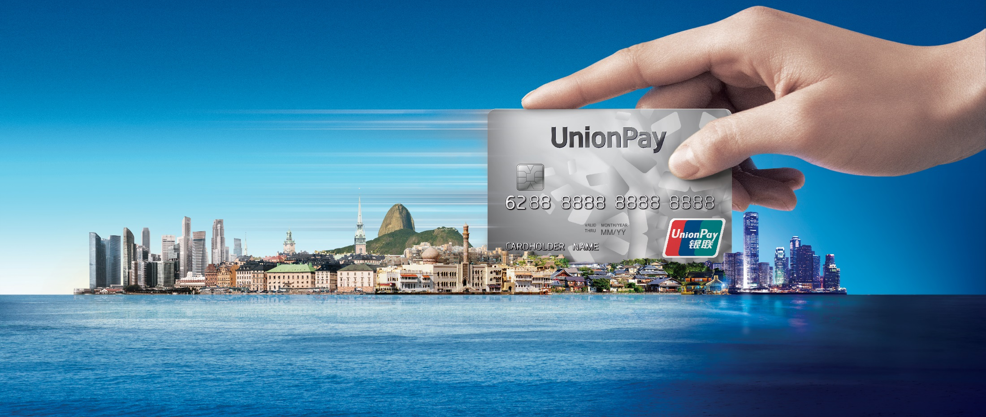


UPI Online QRC Solution
Crystal Duan
October 2020

Slide 2
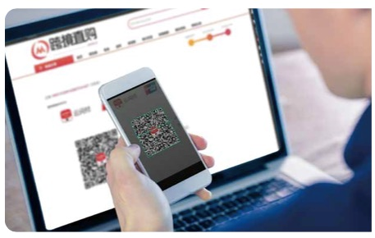
What is Online QRC Solution?
As the name suggests, online QRC is displayed on the multi-media terminals connected to the internet, such as PC，TV and even game console other than mobile phones. In this solution, consumers can scan online QRC via the Unionpay enabled wallets/APPs on their phone to complete the payment, which is fast, safe and convenient. Online QR Code is dynamic with fixed amount in the EMV QR specifications.
1.Request to generate the QRC
EMVCo-enabled APP
Merchant System
Acquirer System
Card Scheme System
Issuer System
3. Scan the QRC
4.Forward the Purchase Request
2. Send back the QRC

Slide 3
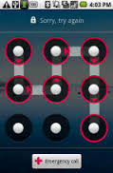
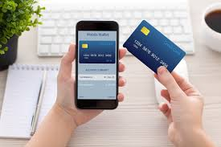
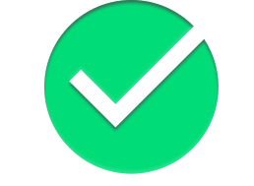
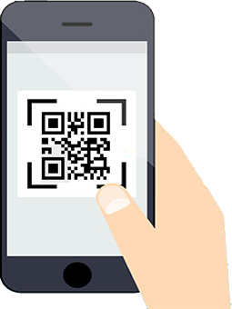
User Experience – Similar to In-store QRC
1
2
3
4
Bind UnionPay card in APP
Cardholder scans QRC on the screen
Cardholder confirms and submits payment
Payment completed. Merchant and cardholder receive notifications

Slide 4
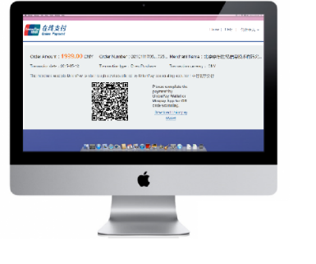

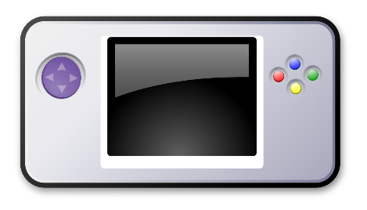

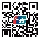
Typical Scenarios of Online QRC
Online Payment
TV Shopping
Game Console
Supporting non Face-to-Face E-Commerce payment situation.
Having two subtypes, one is Acquirer/ Merchant generates the QR Code, the other is Card Scheme system generates the QRC.
Both kinds of Online QRC are dynamic with Fixed Amount in the merchant-presented mode.

Slide 5







Two Subtypes of Online QRC
① Online Merchant QRC
QR Code generated by merchant/ acquirer and displayed on merchant’s page
→ Modification is required for acquirer and merchant
② SecurePay QRC
QR Code generated by Card Scheme and displayed on SecurePay’s page
→ No modification for SecurePay merchants
→ Modification for acquirer is comparatively simple. Most work is parameter configuration on Card Scheme side.

Slide 6
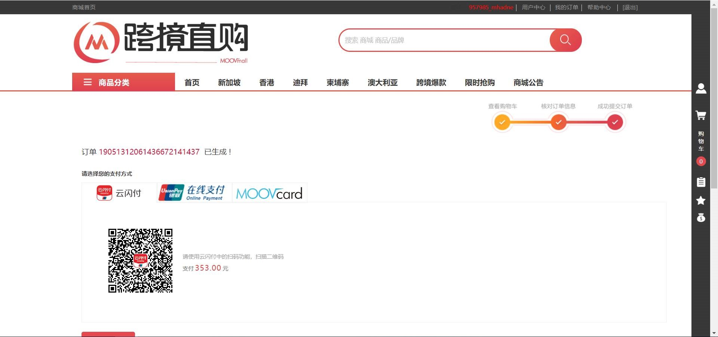
Two Subtypes of online QRC
① Online Merchant QRC

Slide 7
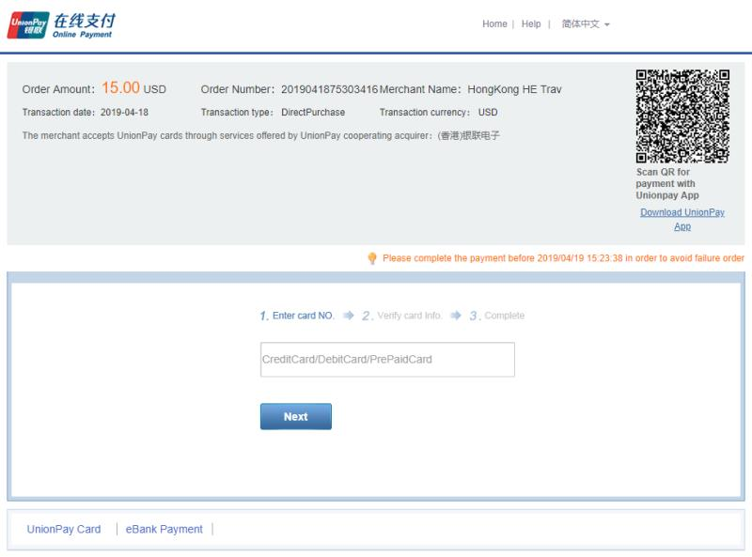
Two Subtypes of online QRC
② SecurePay QRC

Slide 8
Comparing Online and In-store QRC solutions?
Similarities
Operating Rules
User Experiences
Risk Liability (App Providers take the risk)
*QRC transaction is initiated by the Cardholders that verified by the App, that’s why issuers and acquirers not taking the risk
Differences
 | Message Format | Scenario
In-store QRC | 8583/ JSON | Supermarket/ Convenience store, Restaurant, Transportation, etc.
Online QRC | HTTP | Online shopping, OTA, Digital Content Payment, etc.

Slide 9
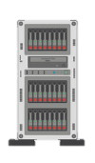
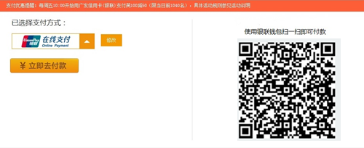
Implementation Requirements for Acquirers
--Online Merchant QRC
Online Merchant QRC requires acquirers/merchants to generate and display QRC, thus modifications/development of the following systems shall be implemented by the acquirer.
1
2
Acquirer
Host
System
Merchant
Website
QRC generation development
Display the QRC on merchant’s page

Slide 10

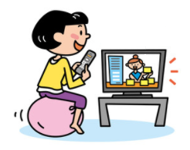
Implementation Requirements for Merchants
--Online Merchant QRC
Acquirer shall update Merchant end to facilitate QRC payment transactions.
Merchant end includes but not limited to:
Online e-commerce website, TV e-commerce system, Multi-media terminals etc.
Online E-commerce Website
TV E-commerce System

