Slide 1
Ontology Tutorial
March 23, 2020
W3C Automotive Working Group Virtual Workshop
Megan Katsumi (katsumi@mie.utoronto.ca)
Mark Fox (msf@mie.utoronto.ca)

Slide 2
Who we are:
The Enterprise Integration Lab (EIL)
20+ years
Investigates the use of IT to create a infrastructure enabling
  dissemination of information
  coordination of decisions
  management of actions
Ontologies for Enterprise Modelling, Agent Architectures and Coordination and Constraint-Directed Scheduling,…
Current focus on Smart Cities
More on https://eil.mie.utoronto.ca

Slide 3
Who we are:
School of Cities
Trans-disciplinary spanning all of UofT’s faculties
  Over 750 faculty do urban-related research
Pillars
  Research: Urban challenges addressed by trans-disciplinary teams
  Education: Undergraduate, Graduate, professional courses for civil servants
  Engagement and Partnership: supporting and working with communities and municipalities
A convener of important conversations
International Satellites
  School of Cities India (sponsored by Tata Trusts)

Slide 4
Purpose
The goal of this session is to provide a brief introduction / primer on the topic of ontologies*
Provide a foundation for future discussions
  Transportation Ontology
Why?
  The development of a transportation ontology
  Cataloguing relevant ontologies
  The idea: this workshop (and future work) will be more effective if we are all talking about the same thing

Slide 5
Disclaimer*
These slides present our position on the subject of ontologies
They are not intended to impose absolute definitions
They are intended to provide a common foundation for our discussion moving forward
  To make sure we are talking about the same things

Slide 6
Outline
What is an ontology?
Ontologies vs vocabularies
The Ontology Spectrum
Ontology components & applications

Slide 7
Ontologies 101: What is an Ontology?
Answers the questions:
  What are the core concepts and properties that span the domain’s data?
    To what extent can we generalize them in a useful way?
  What are the key distinctions?
    Can we formally define necessary and/or sufficient conditions (using properties) for something to be an example (member) of a concept?
More than a reference model (vocabulary) for a domain:
A precise, formal (logical language) representation that is machine-interpretable and supports:
  Reuse
  Semantic integration
  Automated deduction

Slide 8
Example: City Resident
Toronto: “you are identified as a resident if you reside in, own property, or own or operate a business in Toronto” (311 Toronto).
Beijing: “all individuals holding the nationality of the People’s Republic of China who [have] a domicile in Beijing and nowhere else. If the individual maintains a regular dwelling somewhere else, the more regular dwelling is considered their place of residence” (Li, 1991).
New York: “the place which an individual intends to be his permanent home – the place to which he intends to return. It is the home with range of sentiment, feeling and permanent association. One must be domiciled in New York and maintain a home in New York, the time spent in the State is irrelevant” (McGladrey, 2009).
Germany: “a resident of Germany generally refers to an individual who has a domicile in Germany or spends more than six consecutive months in Germany (habitual place of abode)” (Seidel, 2011).

Slide 9
Different Views of a Concept
Toronto
Resident
Beijing
Resident
Mumbai
Resident
Defined in terms of more fundamental properties and concepts
residesIn
ownsProperty
operates
hasAddress
inCity
citizenOf
Resident
Address
Business

Slide 10
Ontologies: Logical Languages
Logical languages for knowledge representation
  First-order logic (FOL)
  OWL(2) – Web Ontology Language
    Description Logic (DL)
  Resource Description Framework (Schema) (RDF(S))

Slide 11
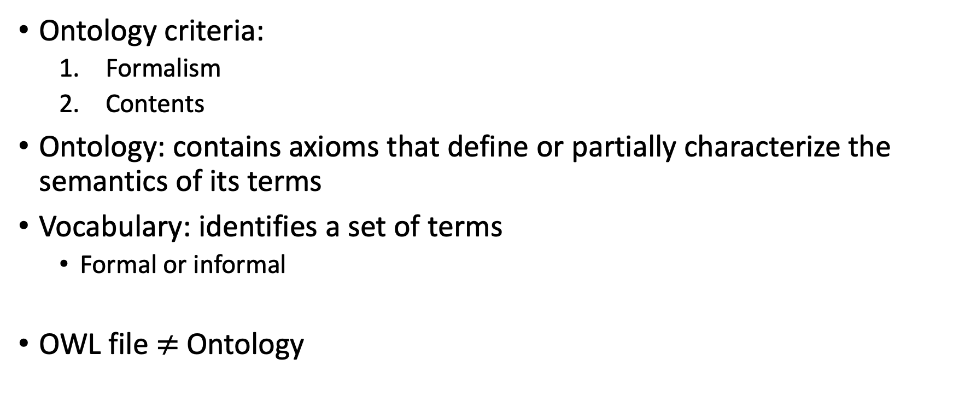
Ontologies vs Vocabularies
Ontology criteria:
  Formalism
  Contents
Ontology: contains axioms that define or partially characterize the semantics of its terms
Vocabulary: identifies a set of terms
  Formal or informal
OWL file $≠$ Ontology

Slide 12
The Ontology Spectrum
ad hoc Hierarchies
(Yahoo!)
XML
Schema
Description Logics
(OWL)
structured
Glossaries
formal
Taxonomies
Terms
XML DTDs
Thesauri
‘ordinary’
Glossaries
Principled, informal hierarchies
Data Models
(UML, STEP)
Data
Dictionaries
(EDI)
First-Order
Logic
RDF, RDFS
DB
Schema
Glossaries & Data Dictionaries
Thesauri, Taxonomies
MetaData,
XML Schemas, & Data Models
Formal Ontologies & Inference
Originally developed by: Gruninger, M., Lehmann, F., McGuinness, D., Uschold, M., & Welty, C. (1999). Association for the advancement of artificial intelligence (aaai) ontologies panel.
Notes:
*lots* of other versions of this “ontology spectrum”

Slide 13
Lots of variations on this diagram, same idea…

Slide 14
Ontology Levels
There may be several levels to a formal ontology:
  The ”knowledge graph” terminology and possibly instances
  Extended definitions
  Specialized ”micro-theories”

Slide 15
Ontology Levels
Supports:
data collection
data access
integration
Resident
Micro-Theory
Axioms/Rules – sometimes in another language
Deduction – answering questions
Definitions and Constraints
Class Definitions (in Logic)
Automated classification
“Knowledge Graph”
Classes and Properties
Taxonomy and Inheritance
Deduction – answering questions
subClassOf
Toronto Resident
ownsPropertyIn
operates
residesIn
Toronto
Business
hasAddress
Households
Transportation Network
Vehicles
inCity
Address
“you are identified as a resident if you reside in, own property, or own or operate a business in Toronto”

Slide 16
Ontology Levels
Supports:
data validation
inference
Micro-Theory
Axioms/Rules – sometimes in another language
Deduction – answering questions
Definitions and Constraints
Class Definitions (in Logic)
Automated classification
“Knowledge Graph”
Classes and Properties
Taxonomy and Inheritance
Deduction – answering questions
“you are identified as a resident if you reside in, own property, or own or operate a business in Toronto”
TorontoResident subClassOf Resident
and (residesIn.Toronto
or ownsPropertyIn.Toronto
or operates.(Business
and hasAddress.(Address and inCity.Toronto)))
Resident
Toronto Resident
Household

Slide 17
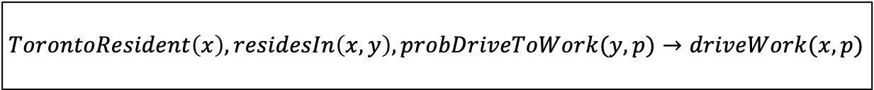
Ontology Levels
Supports:
automated reasoning
Micro-Theory
Axioms/Rules – sometimes in another language
Deduction – answering questions
Definitions and Constraints
Class Definitions (in Logic)
Automated classification
“Knowledge Graph”
Classes and Properties
Taxonomy and Inheritance
A Toronto Resident living in a given zone has a probability P(zone) of driving to work.
$$TorontoResident\left(x\right),residesIn\left(x,y\right),probDriveToWork(y,p)→driveWork(x,p)$$

Slide 18
Questions, comments, discussion?

