Slide 1
Gen2 FOSS Implementation Build and Run
Magnus Gunnarsson
2020-03-23

Slide 2
Introduction
The idea with this presentation is to give a quick introduction on how to test, download and build and run the Gen2 implementation project.
I will go thru
Where to find the code
Different ways to run (and build) the project
How to custimize your builds using golang modules
I wont talk about how to install the tools needed but if you need help let me know!

Slide 3
So where can I find the code
Fetching the code
The main repository is located on github and all development is done in the master branch and can be downloaded using git.
$ git clone https://github.com/MEAE-GOT/W3C_VehicleSignalInterfaceImpl.git
We are following github’s workflow with forks and creating pull requests https://gist.github.com/Chaser324/ce0505fbed06b947d962

Slide 4
puppis.w3.org
Web websocket client: http://puppis.w3.org:7777
websocket server: ws://puppis.w3.org:8080
http server http://puppis.w3.org:8888

Slide 5
Build and run using Docker-compose
Dependencies
Linux, Git, Docker, Docker-Compose
Instructions
Clone the github repository
$ git clone git@github.com:MEAE-GOT/W3C_VehicleSignalInterfaceImpl.git
$ cd W3C_VehicleSignalInterfaceImpl
To build and launch the server use
$ docker-compose up -d
To rebuild use
$ docker-compose up -d --force-recreate –build
And to stop use
$ docker-compose down

Slide 6
Build and run using scripts
Dependencies
Linux, Golang version 1.13 or above, GNU Screen, Git
Instructions
Clone the github repository and move to the folder
$ git clone git@github.com:MEAE-GOT/W3C_VehicleSignalInterfaceImpl.git
$ cd W3C_VehicleSignalInterfaceImpl
To launch the server use
$ ./W3CServer.sh startme
To stop run
$ ./W3CServer.sh stopme

Slide 7
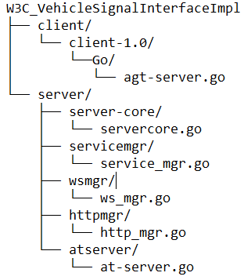
Manual build
Dependencies
Linux, Golang version 1.13 or above, Git
Instructions
Clone the github repository
$ git clone git@github.com:MEAE-GOT/W3C_VehicleSignalInterfaceImpl.git
$ cd W3C_VehicleSignalInterfaceImpl
Move to the folder containing the part you want to build
$ cd W3C_VehicleSignalInterfaceImpl/server/server-core/
And build and run
$ go build -o servercore
$ ./servercore
Note
Above steps needs to be done for all server component starting with servercore

Slide 8
Customizing your build
The project uses golang modules for dependency management
Dependency management clean and update
$ go mod tidy
$ go get -u ./...
Customizing dependencies using the replace directive by editing go.mod
replace example.com/some/dependency => example.com/some/dependency v1.2.3
replace example.com/some/dependency => example.com/your/fork
replace example.com/some/dependency => ./foo/bar

