Slide 1


An Ontology-based Standard for City Data
ISO/JTC 1 WG 11 Smart Cities
Megan Katsumi (katsumi@mie.utoronto.ca), Mark Fox
Enterprise Integration Lab (eil.utoronto.ca)
University of Toronto Transportation Research Institute (uttri.ca)
University of Toronto
W3C Workshop on Data Models for Transportation
September 2019

Slide 2
Who we are
Enterprise Integration Laboratory investigates the use of Information Technology to create business infrastructures that enable:
  dissemination of information
  coordination of decisions
  management of actions
Our basic research has explored topics such as:
  Ontologies for Enterprise Modelling,
  Agent Architectures and Coordindation and
  Constraint-Directed Scheduling,
  and applied them to problems such as Smart Cities, Transportation, Supply Chain Management, Knowledge-Based Design and Enterprise Engineering.

Slide 3
Toronto Virtual Enterprise (TOVE) Ontologies (1991-2010)

Slide 4
ISO 21972
Upper Level Ontology for City Indicators
Defines an ontology for the representation of indicator definitions
  For use in automating the measurement of systems and cities
  Applied to ISO 37120 Sustainable Cities and Communities
Based on our GCI Indicator Ontology

Slide 5
Global City Indicator (GCI) Ontologies (2011-)

Slide 6
The City Data Model
New work item proposal in ISO WG11 Smart Cities
Goal: specify a standard to enable semantic interoperability across city services
  City services: both physical and social
How?
  Provide an ontology-based model of the common concepts required to represent city services’ data
  3-part standard, divided by level of abstraction
Notes:
To motivate the need for a standard city data model, consider the evolution of cities. Cities deliver physical and social services that traditionally have operated as silos. If during the process of becoming smarter, transportation, social services, utilities, etc. were to develop their own data models, then we would have smarter silos. To create truly smart cities data must be shared across these silos which can only be accomplished through the use of a common data model. For example, “Household” is a category of data that is commonly used by city services. Members of Households are the source of transportation, housing, education, and recreation demand. It represents who occupies a home, age, occupations, where they work, abilities, etc. Though each city service may gather and/or use different aspects of a Household, much of the data needs to / should be shared with each other.

Slide 7
City Data Model Overview: 3 Parts
Notes:
The Service Level spans concepts commonly associated with a particular service but still shared with other services, such as Vehicles and Transportation network. The process of development of this standard is to iteratively select a city service and apply the ontology engineering development process to create, extend and/or modify each level of the standard.

Slide 8
Initial City Services
2019 - Transportation Planning:
  Starting point is the iCity Transportation Planning Suite of Ontologies
  Liason with TC204
  Collaboration with Esri Canada to create a knowledge graph that adopts the ontology to merge Esri data with transportation planning data
2020 - Water and Sanitation: Asset Management

Slide 9
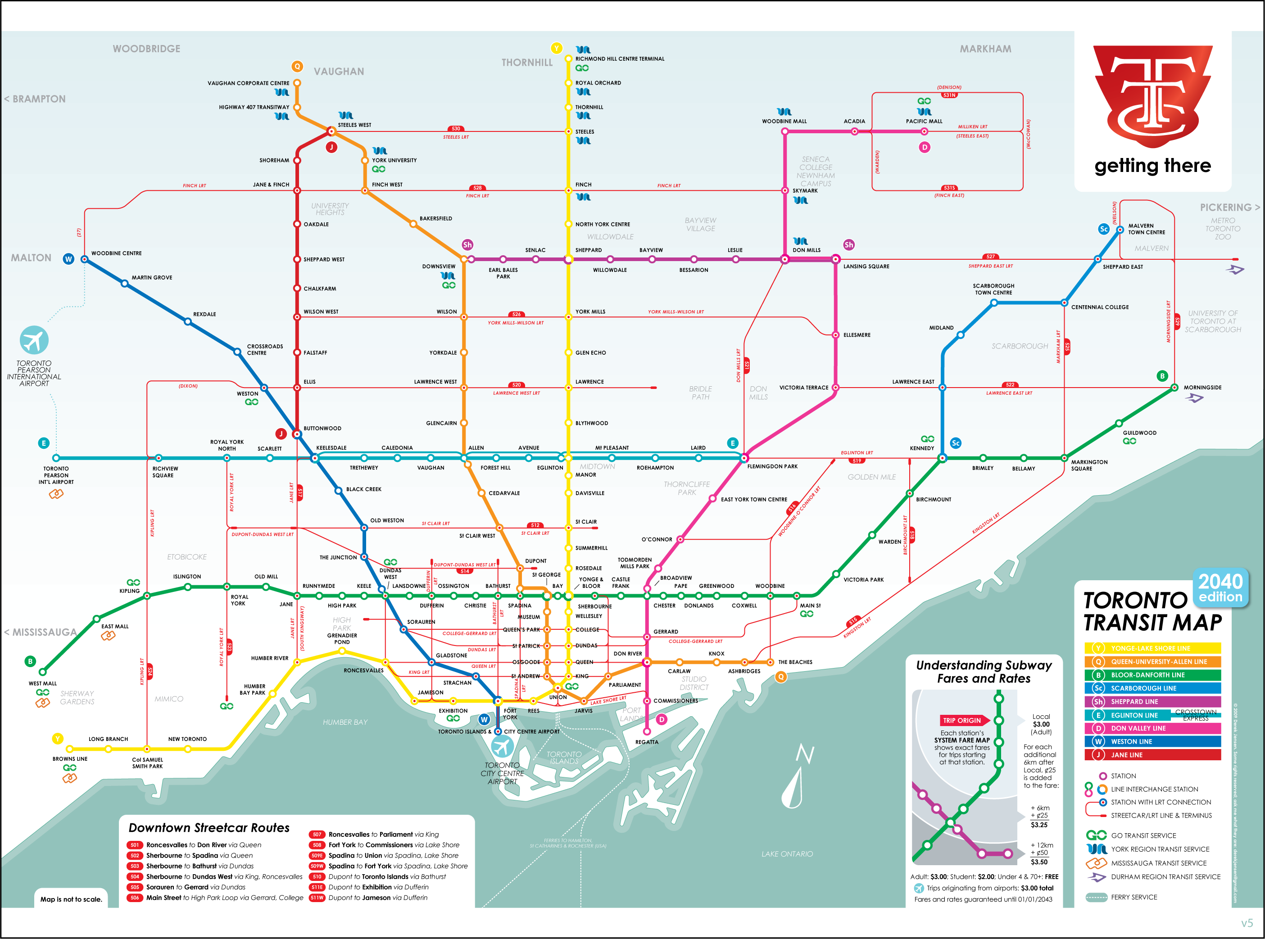
Transportation Planning
Goal: Planning transportation infrastructure over a long horizon
What will demand for public transportation and roads be over the next 30 years?
How do changes in transportation infrastructure affect travelers?
What are the environmental impacts of growth?
…

Slide 10
Transportation Planning
Problem: data silos
  Multitude of transportation planning tools are in use by researchers and cities
  No easy way to compare results as each has their own unique data models
  Collected data is often “single use”, even within research groups
Requirements for integration: a standard data model
  Must work with different tools, representations
  Must have a unique interpretation; incorrect and correct interpretations should be clearly identifiable
  Must be easily extensible: tools and approaches are always changing
Proposed Solution: an ontology for transportation planning

Slide 11
City Data Model for Transportation Planning

Slide 12
Summary
Foundation and city-level concepts are common across many applications in transportation and beyond
The City Data Model will be used and extended to capture city services data, but may not be suitable for all types of transportation data
Some key questions:
  What concepts are shared with other areas of transportation?
  How can we work together to converge on these definitions?

Slide 13
iCity TPSO Ontologies
Accessible as OWL (RDF/XML) files in Protégé Editor or raw text
Basic HTML documentation via web browser
Activity: http://ontology.eil.utoronto.ca/icity/Activity/
Building: http://ontology.eil.utoronto.ca/icity/Building/
Change: http://ontology.eil.utoronto.ca/icity/Change/
Household: http://ontology.eil.utoronto.ca/icity/Household/
Land use: http://ontology.eil.utoronto.ca/icity/LandUse/
Mereology: http://ontology.eil.utoronto.ca/icity/Mereology/
OM: http://ontology.eil.utoronto.ca/icity/OM/
Organization: http://ontology.eil.utoronto.ca/icity/Organization/
Parking: http://ontology.eil.utoronto.ca/icity/Parking/
Person: http://ontology.eil.utoronto.ca/icity/Person/
Public Transit: http://ontology.eil.utoronto.ca/icity/PublicTransit/
Resource: http://ontology.eil.utoronto.ca/icity/Resource/
Spatial Location: http://ontology.eil.utoronto.ca/icity/SpatialLoc/
Time: http://ontology.eil.utoronto.ca/icity/Time/
Transportation System: http://ontology.eil.utoronto.ca/icity/TransportationSystem/
Travel Cost: http://ontology.eil.utoronto.ca/icity/TravelCost/
Trip: http://ontology.eil.utoronto.ca/icity/Trip/
Trip Cost: http://ontology.eil.utoronto.ca/icity/TripCost/
Vehicle: http://ontology.eil.utoronto.ca/icity/Vehicle/
Report working draft: http://ontology.eil.utoronto.ca/icity/iCityOntologyReport_1.2.pdf

