Slide 1
Federal Rail Administration Grade Crossing Behavior Model
Lightning Talk / Robert Rittmuller, PMP CISSP

Slide 2
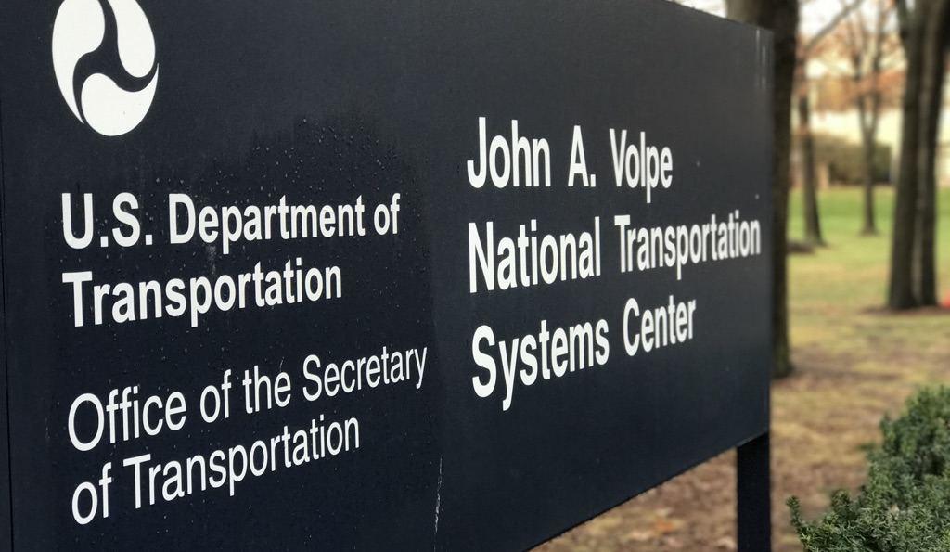
About the Volpe Center
Fee-For-Service federal agency that specializes in:
Operations Research
Transportation Economics
Engineering Psychology
Environmental Science
Software Engineering
IT System Administration
Web & Mobile Development
Data Science
Civil Engineering
Data Analysis
City Planning
Policy Analysis
Statistics
Project Management
Notes:
The John A. Volpe National Transportation Systems Center, founded in 1970 as a fee-for-service federal agency that specializes in a variety of technical areas related to transportation research.

Slide 3
Project Background
FRA wanted to accurately detect pedestrian behavior at rail grade crossings.
Primary goal is to increase safety around grade crossings.
Reduce vehicle / train / pedestrian interactions.
Reduce rail suicides.
Cameras located at each grade crossing capture video 24/7.
Mix of both SD and HD video.
Over a year of pre-recorded data.

Slide 4
Computer Vision Model Architecture
Developed using the S3D-G architecture as described in “Rethinking Spatiotemporal Feature Learning: Speed-Accuracy Trade-offs in Video Classification” - Saining Xie, Chen Sun, Jonathan Huang, Zhuowen Tu, Kevin Murphy
https://arxiv.org/abs/1712.04851
Architecture was chosen to provide classification of temporal features (behavior) while still producing adequate performance.
Noteworthy architectural features include the replacement of some 3d convolutions with 2d convolutions to increase performance without excessive loss in overall accuracy (F1).
Ability to classify grade crossing behavior using single-shot approach.

Slide 5
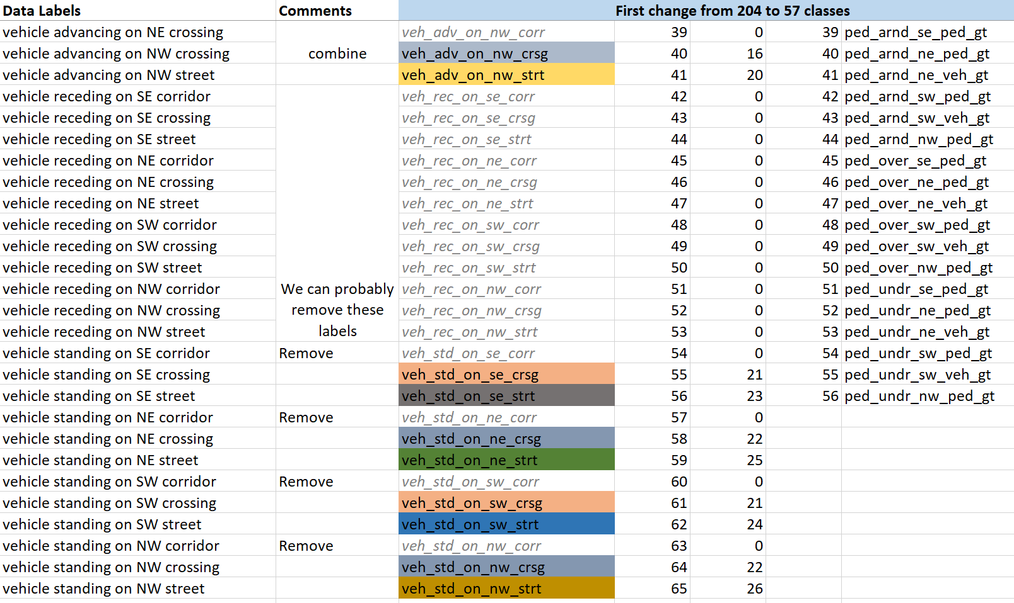
Dynamic Labeling Strategy
204 Initial Labels
96 Final Labels

Slide 6
Visual Example of Labels

Slide 7
Model Performance (Early Metrics)
Training Data | F1 | Precision | Recall
Overall | 0.920 | 0.937 | 0.902
Evaluation Data | F1 | Precision | Recall
Overall | 0.694 | 0.694 | 0.693
Gates | 0.897 | 0.886 | 0.908
Vehicles | 0.797 | 0.771 | 0.824
Trains | 0.555 | 0.594 | 0.520
Pedestrians | 0.386 | 0.401 | 0.372
Ped. (crsg) | 0.419 | 0.453 | 0.386
Ped. (-crsg) | 0.353 | 0.349 | 0.358

Slide 8
Conclusion
This is an actively developed open source Volpe project.
Both model and video data ingestion pipeline will be made available.
GitHub repository will be live by the end of October (or earlier).
Future work may include the deployment of the model to IoT devices at the grade crossings (Nvidia Jetson Nano).
Shout-out to the team; Franklin Abodo, Rithika Netti

