Slide 1
Federal Perspectives on Transportation Data
Robert Rittmuller, PMP CISSP | Volpe Center, Cambridge MA

Slide 2
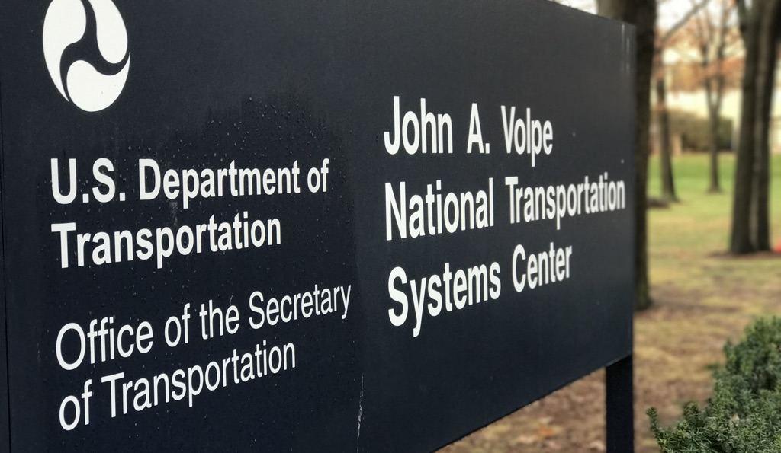
About the Volpe Center
Fee-For-Service federal agency that specializes in:
Operations Research
Transportation Economics
Engineering Psychology
Environmental Science
Software Engineering
IT System Administration
Web & Mobile Development
Data Science
Civil Engineering
Data Analysis
City Planning
Policy Analysis
Statistics
Project Management
Notes:
The John A. Volpe National Transportation Systems Center, founded in 1970 as a fee-for-service federal agency that specializes in a variety of technical areas related to transportation research.

Slide 3
Overview
Data Models for Safety
Data Models for Research
Data Models for Cyber
Conclusion & Future Vison

Slide 4
Data Models for Safety
Top agency priority.
As new technologies are implemented, safety needs to be considered.
Notes:
Important to note that the safety of the general public within today’s transportation systems is a top priority for the agency. Reducing traffic fatalities is a key metric.

Slide 5
Example DOT Data Models Related to Safety
Motor Vehicle Crash Research
Model Minimum Uniform Crash Criteria
Connected Vehicles
Basic Safety Message (BSM)
Autonomous Vehicles
Work Zone Data Exchange for Automated Vehicle Safety
New!
Notes:
Talking points:
MMUCC – Used by NHTSA within the CDAN motor vehicle crash research program to standardize basic vehicle crash variables.
BSM – Standard safety messages used in ongoing connected vehicle pilot project with Wyoming, New York and Tampa.
Work Zone Data Exchange - New effort sponsored by the Intelligent Transportation Systems – Joint Program Office to facilitate data standardization and exchange between automated vehicle vendors starting with work zone data.
This is just the tip of the iceberg, DOT has many safety-related data models / projects.

Slide 6
Work Zone Data Exchange (WZDx)
The Work Zone Data Exchange (WZDx) Specification enables infrastructure owners and operators (IOOs) to make harmonized work zone data available for third party use.
The intent is to make travel on public roads safer and more efficient through ubiquitous access to data on work zone activity.
Specifically, the project aims to get data on work zones into vehicles to help automated driving systems (ADS) and human drivers navigate more safely.
Open source data specification!
https://github.com/usdot-jpo-ode/jpo-wzdx

Slide 7
Transportation Data Models for Research
Supporting transportation research goals:
SHRP2 NDS Video Analytics Phase I,II
FRA Grade Crossing Behavior Analysis
Development of advanced data analysis tools:
Natural Language Processing (NLP) for FAA Cockpit Audio Transcription
NLP for FAA Maintenance Log Classification

Slide 8
SHRP2 NDS Video Analysis
Phase I
Frame-by-frame analysis of SHRP2 Naturalistic Drive Study forward-facing video for the detection of roadway features:
Work/construction zones
Basic work/construction zone components; advanced warning, active work zone, end of work zone
Addition of detected work zone features to the SHRP2 Roadway Information Database.
Phase II
Advanced feature detection within the SHRP2 NDS data set:
Roadway weather
Traffic signal and state detection
Advanced work zone features; advanced warning signs, cones, barrels, jersey barriers, message signs, and arrow boards
Worked closely with VTTI & Oak Ridge National Laboratory
https://github.com/VolpeUSDOT/SNVA

Slide 9
Natural Language Processing for Air Traffic Control Language Recognition
To support FAA research objectives, an NLP audio and language model were built to transcribe cockpit audio
Utilized the ATC0 and ATCOSIM data for training
Language model was tuned to support both ATC and common English linguistic constructs
Developed using open source components combined with custom audio and language model development

Slide 10
Transportation Data Models for Cybersecurity
Adapting to a changing threat landscape
Intelligent Transportation Systems / Joint Program Office – Legacy ITS Research
Automotive IoT
Advanced Driver Assistance Systems Cybersecurity Research
Government Telematics Security Conformance Acceptance (GTSCA) Research

Slide 11
Government Telematics Security Conformance Acceptance (GTSCA) Research
A new technology program, sponsored by DHS, designed to provide the groundwork for an assurance process covering in-vehicle telematics “IoT” devices.
This project is looking at the evolving threat landscape presented by Electronic Logging Devices (ELDs) through the development of a pilot ELD assessment process.
Volpe Center working together with MIT, Underwriters Lab (UL) and Geotab to support our sponsor’s requirements.

Slide 12
Electronic Logging Devices / Telematics
Connected in-vehicle systems present new challenges.
Operational Controller Area Network (CAN) Bus interface to Telematics and ELDs
Data privacy concerns.
Lack of standardized data models.
Types of systems:
Telematics systems.
Electronic Logging Devices (ELDs).
Infotainment Systems.
In-vehicle remote systems diagnostics.
Notes:
There are critical security concerns around the use of any internet connected devices that have access to vehicle systems. ELDs, Telematics dongles, infotainment systems that display vehicle data, all harbor the potential for remote compromise.

Slide 13
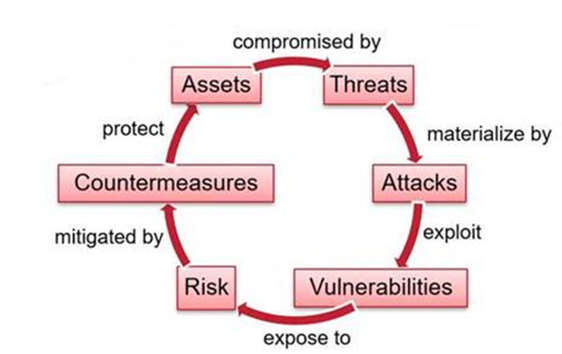
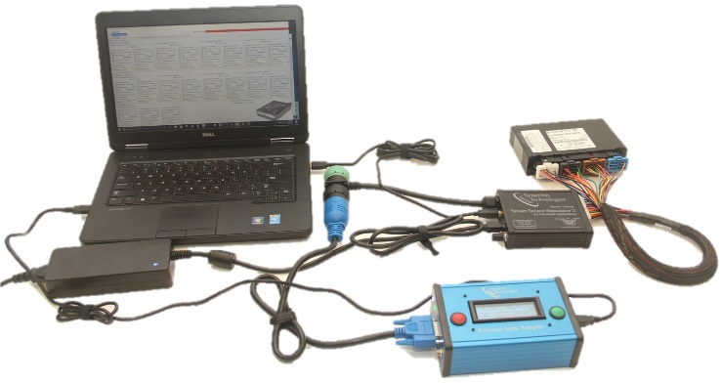
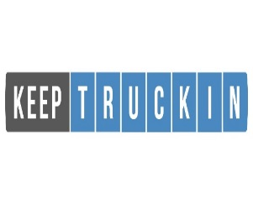
ELD Security Testing Flow
Underwriters Lab (UL) Threat Modeling Process
NMFTA
Telematics Cyber RFP Template
UL Cyber Testing Process
UL Final Report
DHS/DOT-Volpe Telematics Primer
DOT/Volpe Center
Volpe Pen Testing
Volpe Testing Report
GTSCA Concept of Operations (CONOP) Report
Synercon
Truck in a Box

Slide 14
Future Vision
Advanced Driver Assistance Systems
Ability to perform safety evaluations on complex computer vision-based, LIDAR-based, Radar-based ADAS.
We need access to data from ADAS that is standardized across multiple manufacturers.
Automotive IoT Cybersecurity
We need to establish standard baselines for how these devices should be implemented.
We need to develop automotive privacy models that work in the real world.
We do understand that data is valuable!
Develop better cybersecurity standards around autonomous fleet management.

Slide 15
Questions?
Thank You!
Volpe Center Project Team
Robert Rittmuller
Allison Rossetto
Brian Sumner
Andrea Sparko
Federal Sponsors
DHS
FAA
ITS JPO
FHWA
NHTSA
Franklin Abodo
Rithika Neti
Kevin Harnett
Brendan Harris
NMFTA
Graham Watson
Gus Brown

