Slide 1

“Detection & Inclusion of Two-Wheelers
into the
Connected Car Ecosystem”

Slide 2
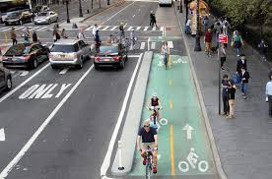
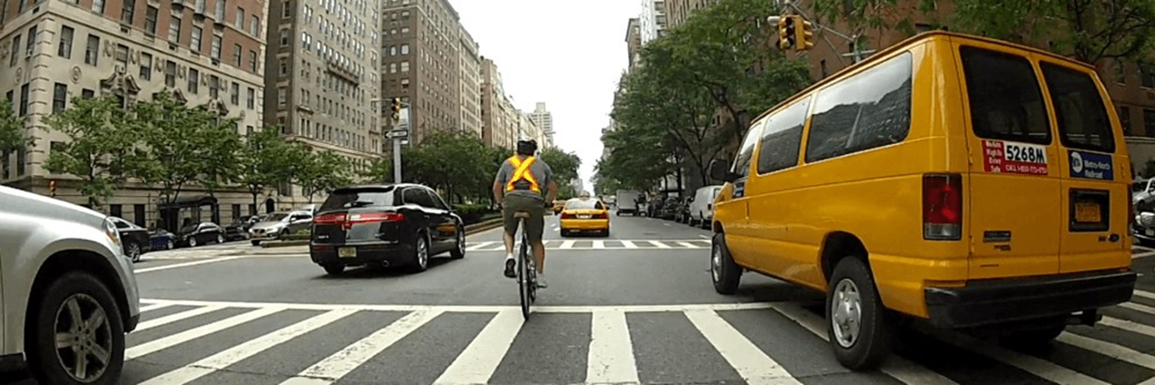

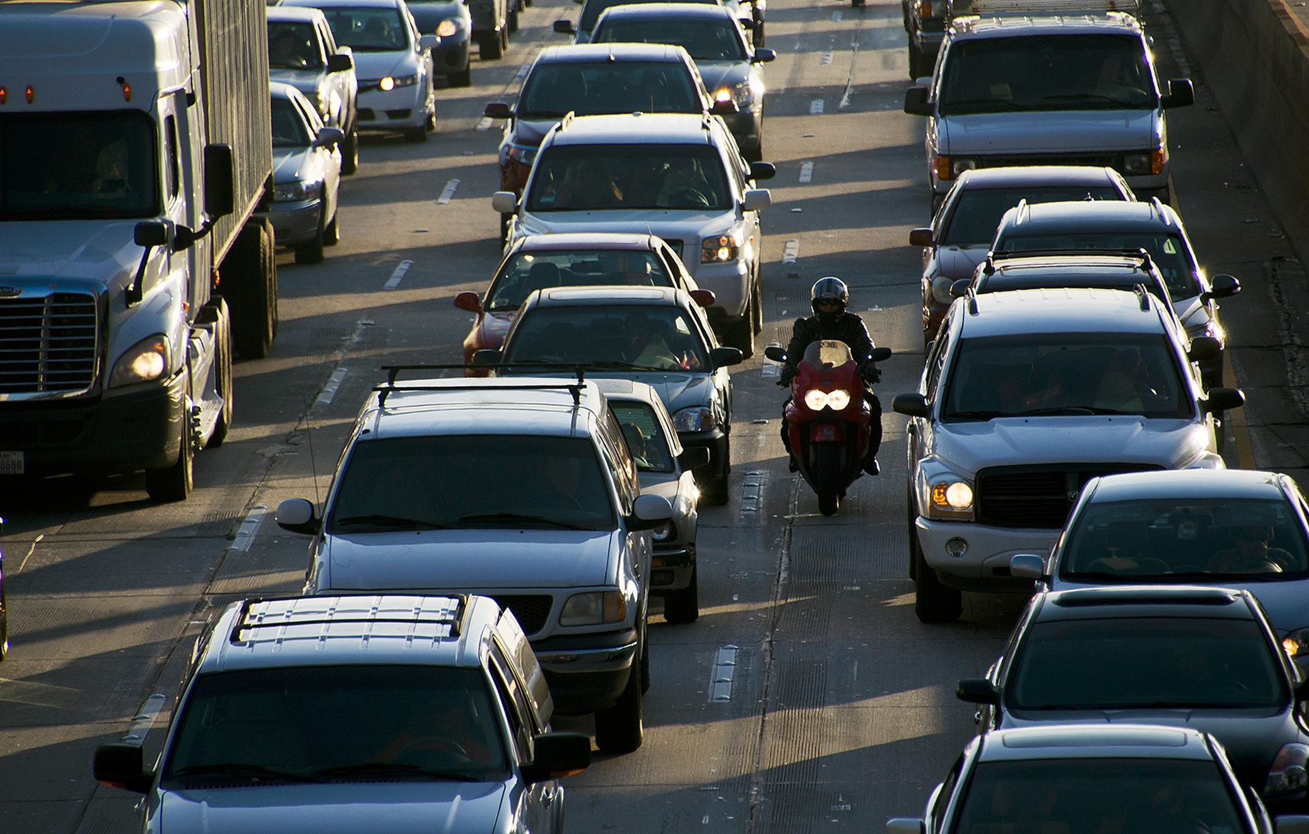
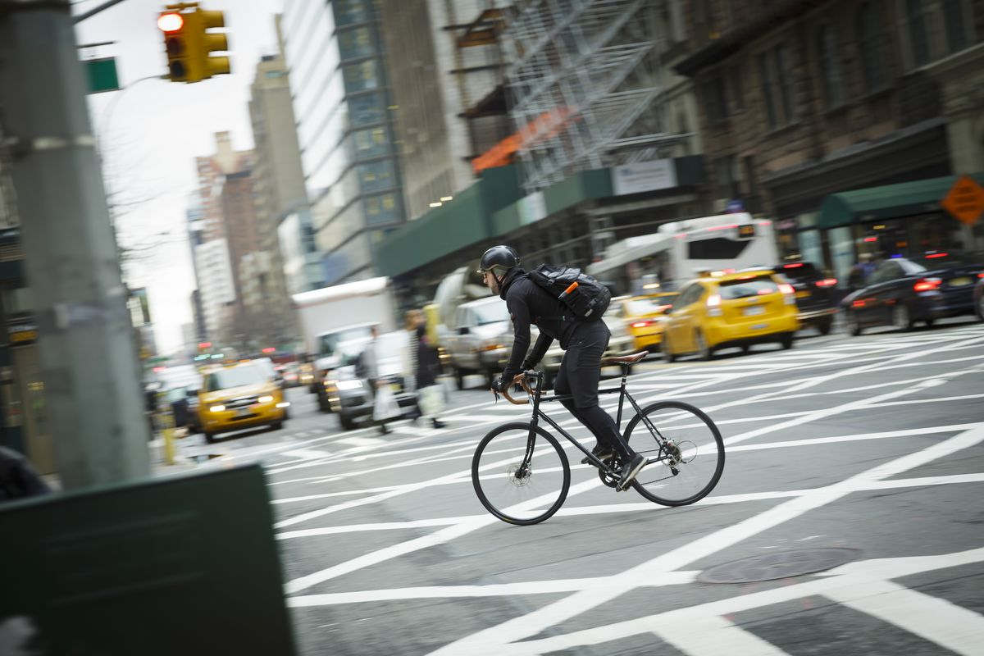
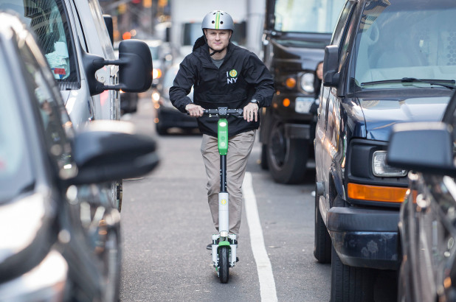
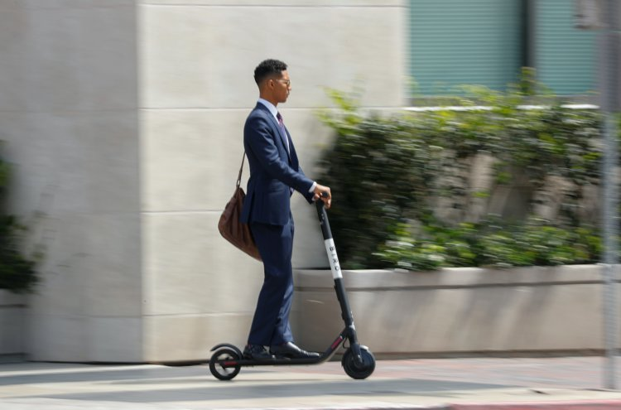
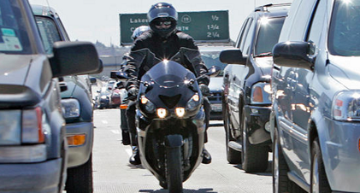
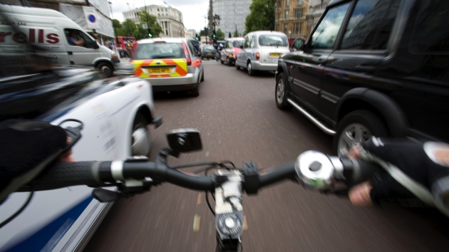

Problem
Riders are not always visible to Drivers…

Slide 3
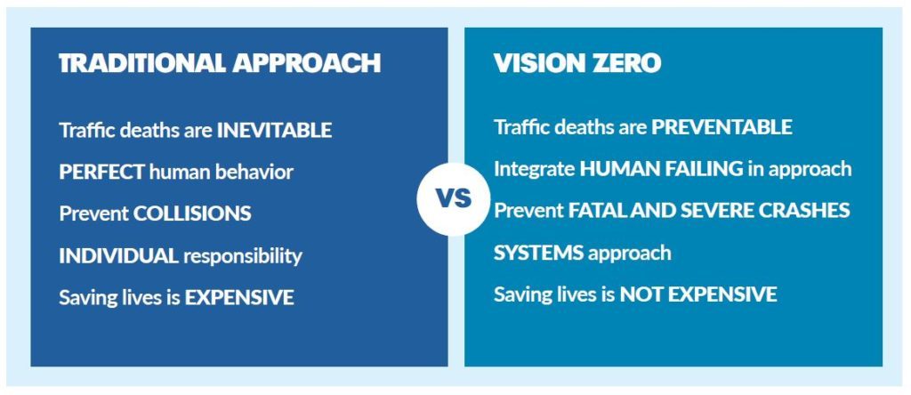
Vision Zero
Efforts
Multiple Stakeholders (Regulators, Legislature, Urban Planners, IoT Companies, Commuters). Others?
Public Inclusion: Outreach & Education
Enforcement of Road-Sharing: Initially teaching opportunities then enforcement. Thoughts?
Adaptation of Infrastructure/Streets to include ALL forms of mobility: How?

Slide 4
Enhanced Vision Zero
Efforts
Ridar Systems
  Passive Safety
  Driver UX to minimize notifications & distraction (verbal, visual, audible)
  Headless unit for two-wheelers
Adoption
  Utilize Metropolitan/City Vehicles/Drivers
    Ability to monitor usage
    Gather notification feedback
    Insurance Discounts
    Near-misses/ # of interactions
    Adjust Notifications/minimize false-positives
  Encourage Cyclists/Clubs to Participate
    Anonymized User Data
    Gamification
    Collect data
      Geofence Intersections of high accident rates
      Near-misses/ # of interactions

Slide 5


Application Solution
“Ridar Systems is a cloud-based, mobile system that uses cellular technology to notify drivers of the proximity of nearby riders”
Safety
Data Science
Innovation
Improves visibility of riders to other vehicle beyond that of normal line-of-sight and sensor- based systems
Collect and analyze real world data on actual vehicle and motorcycle interactions
Accelerates the inclusion of motorcyclists & bicyclists in the innovation of connected car technology

Slide 6




Stand-Alone/V2V
Augmented Technology
Standard near line-of-site ADAS
Range: ~100m
V2V/DSRC
Range: ~300m
Ridar Systems: 5 second rule
Range: ~30m - ~500m (dependent upon speed/direction of both vehicles)
“Ridar Systems can function as a standalone mobile solution using cloud-based cellular technology– a technology which is readily-available to all drivers & riders, no matter their mode of transportation. And, it is available now.”

Slide 7


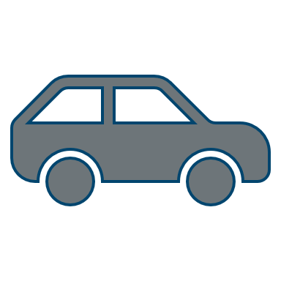
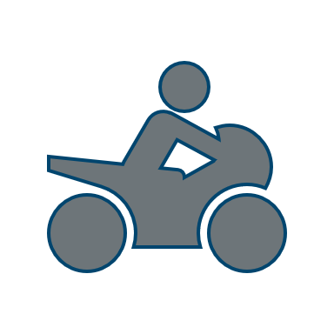

How
It Works
Ridar Systems captures the location, speed, and direction of travel for both drivers and riders using a cellular connection.
This information flows to the cloud where our proprietary software calculates all of this data multiple times per second to determine the likelihood that the two are headed towards the same geographic location which may result in a collision.
When it is determined that there is the potential for an interaction, a distinct voice will indicate to the driver where that rider is approaching (i.e. "Rider left”, “Rider ahead”, etc.). This first notification occurs when it is calculated that the rider is approximately 5 seconds from the driver’s location.

Slide 8
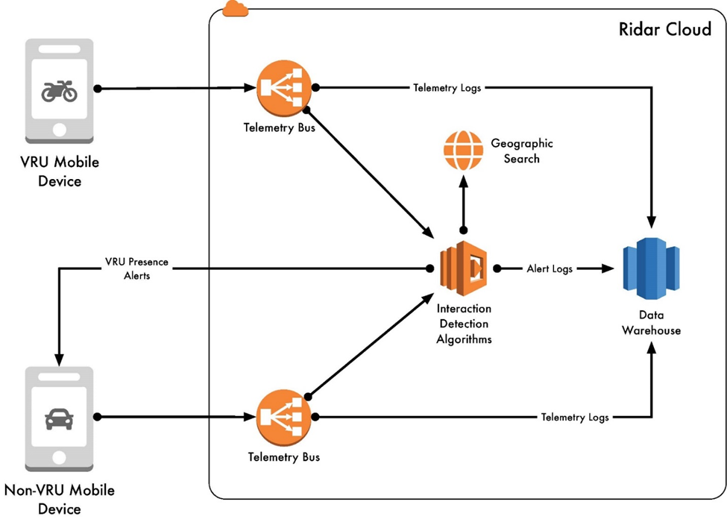
Data
Model

Slide 9
Telemetry
Delivery & Notifications

Slide 10
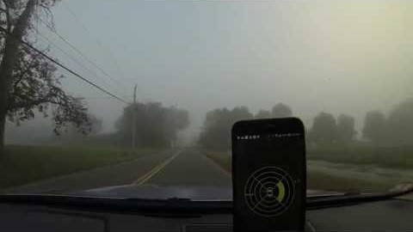
“Will Ride 4 Food”
Cycling Event

Slide 11
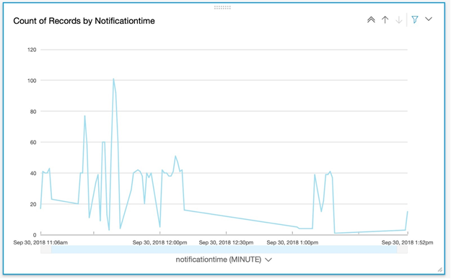
Capture of Data-Graphical Representation
This data represents the number of times these riders sent data to the driver (1 time/second). We do collect a LOT of data through this effort—data that can be collected to alert drivers to the approach of riders.

Slide 12
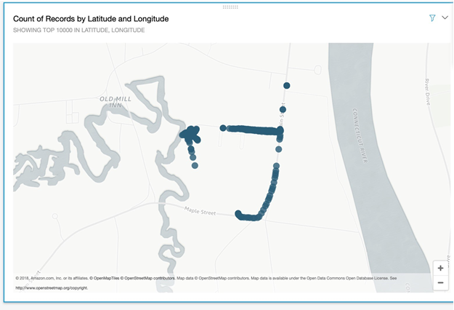
Visual Representation of Data Map
This map represents the numerous times that data is flowing between rider & driver, creating a visual of another segment of the event.

Slide 13
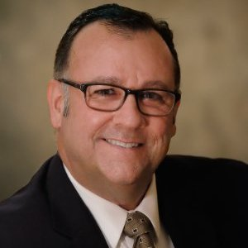

Management Team
Brent Massey
Thadd Selden
Drue Freeman
CEO & Co-Founder
CTO
Strategic Advisor
Successful start-up experience and holder of previous US Patent 4,967,943
Technology background & Visionary behind this technology.
Rider - BMW R1200GS
Visionary technologist with expertise in software management, software architecture, object-oriented design
Rider – Triumph Bonneville
Drue Freeman is a 30-year semiconductor veteran. He advises and consults for
technology companies ranging from early-stage start-ups to multi-billion dollar
corporations and for financial institutions investigating the implications of the
technological disruptions impacting the automotive industry.

Slide 14
Questions?
contact us for more information:
bmassey@ridarsystems.com

