Slide 1


Vehicle Signal Specification
September 12, 2019 | GENIVI and W3C – Enabling the Connected Car through Collaboration
Rudolf J Streif
Invited Expert, ibeeto
This work is licensed under a Creative Commons Attribution-Share Alike 4.0 (CC BY-SA 4.0) GENIVI is a registered trademark of the GENIVI Alliance in the USA and other countries. Copyright © GENIVI Alliance 2018.

Slide 2
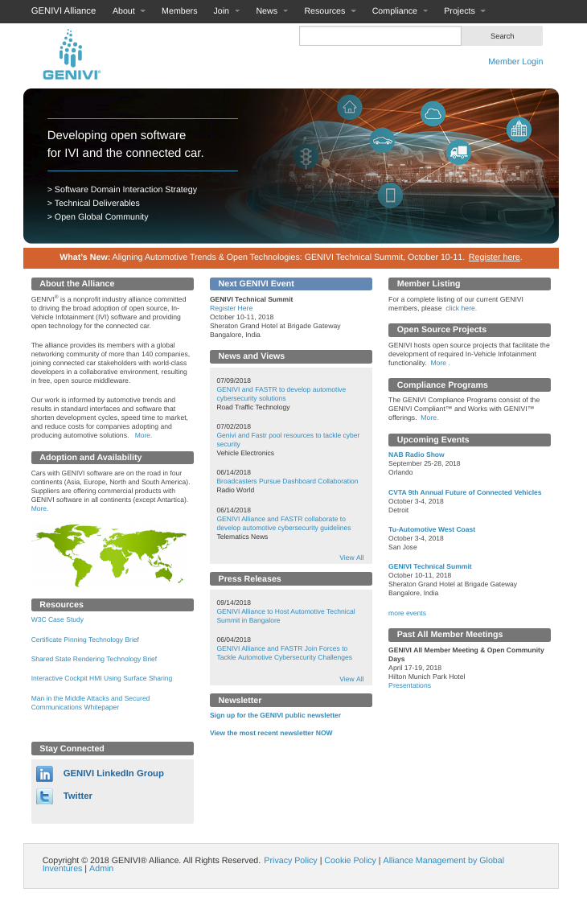
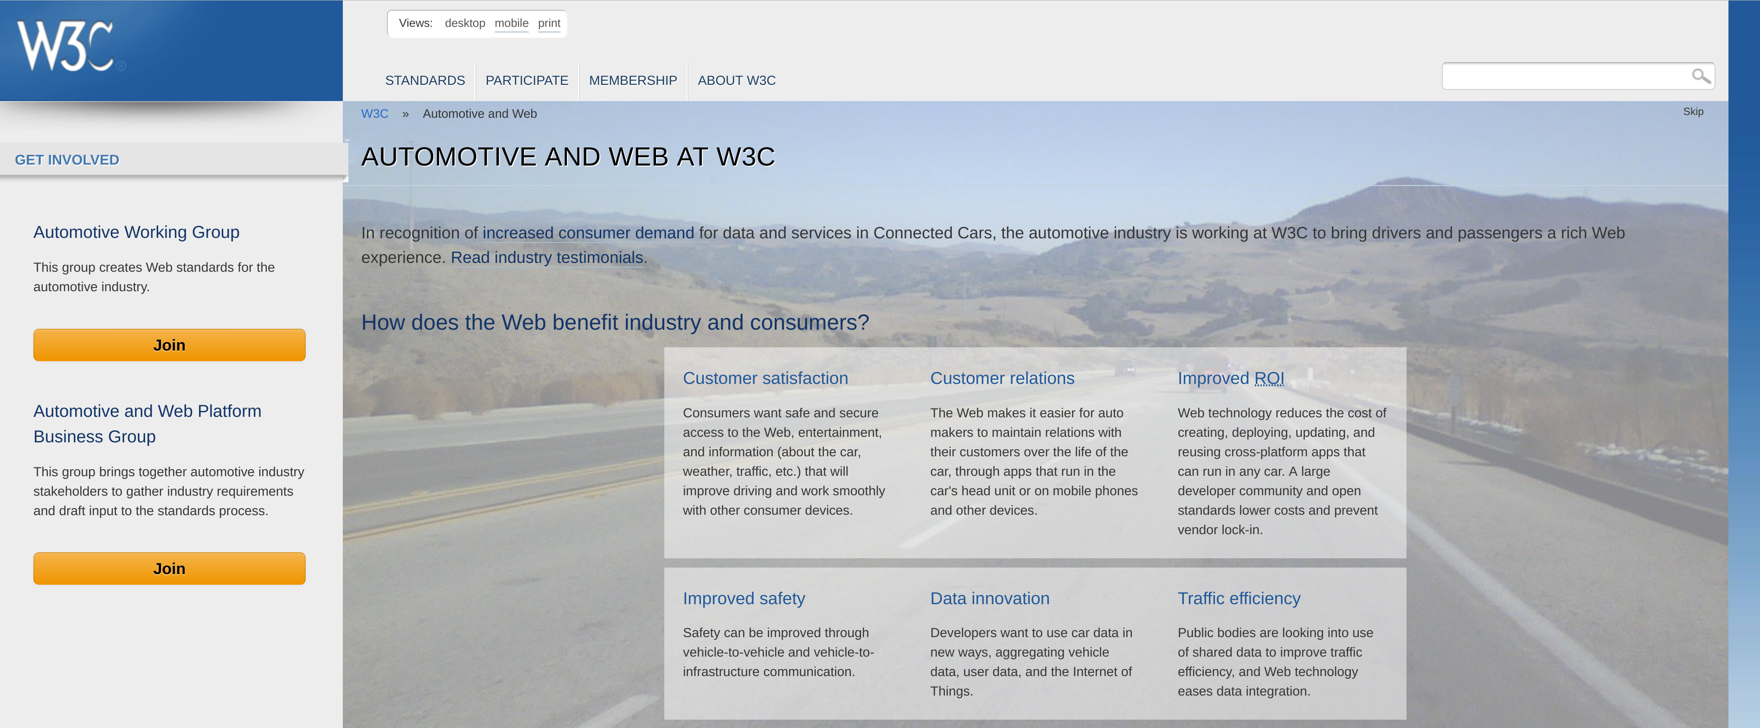
Automotive Leadership meets Web Innovation
www.w3c.org/auto
www.genivi.org

Slide 3
W3C Automotive Working Group
Mission – develop specifications for an open web platform for developers to access vehicle data through IVI systems and vehicle data protocols
74 Participants from Companies and 12 Invited Experts
Participating Companies – 360, Access, Alibaba Group, APTPOD, Audi, Baidu, Caruso GmbH, ETRI, Fraunhofer Gesellschaft, GENIVI Alliance, Geotab, HTML5 Converged Technology Forum, Igalia, IBM, INRIX, Institut Telecom, International Forecourt Standards Forum, Jaguar Land Rover, KDDI, LG Electronics, Mitsubishi Electric, Vinli, Volvo Cars, VW
Status – Vehicle Information Service Specification (VISS) is currently in Candidate Recommendation (CR) state to become an official W3C standard.

Slide 4


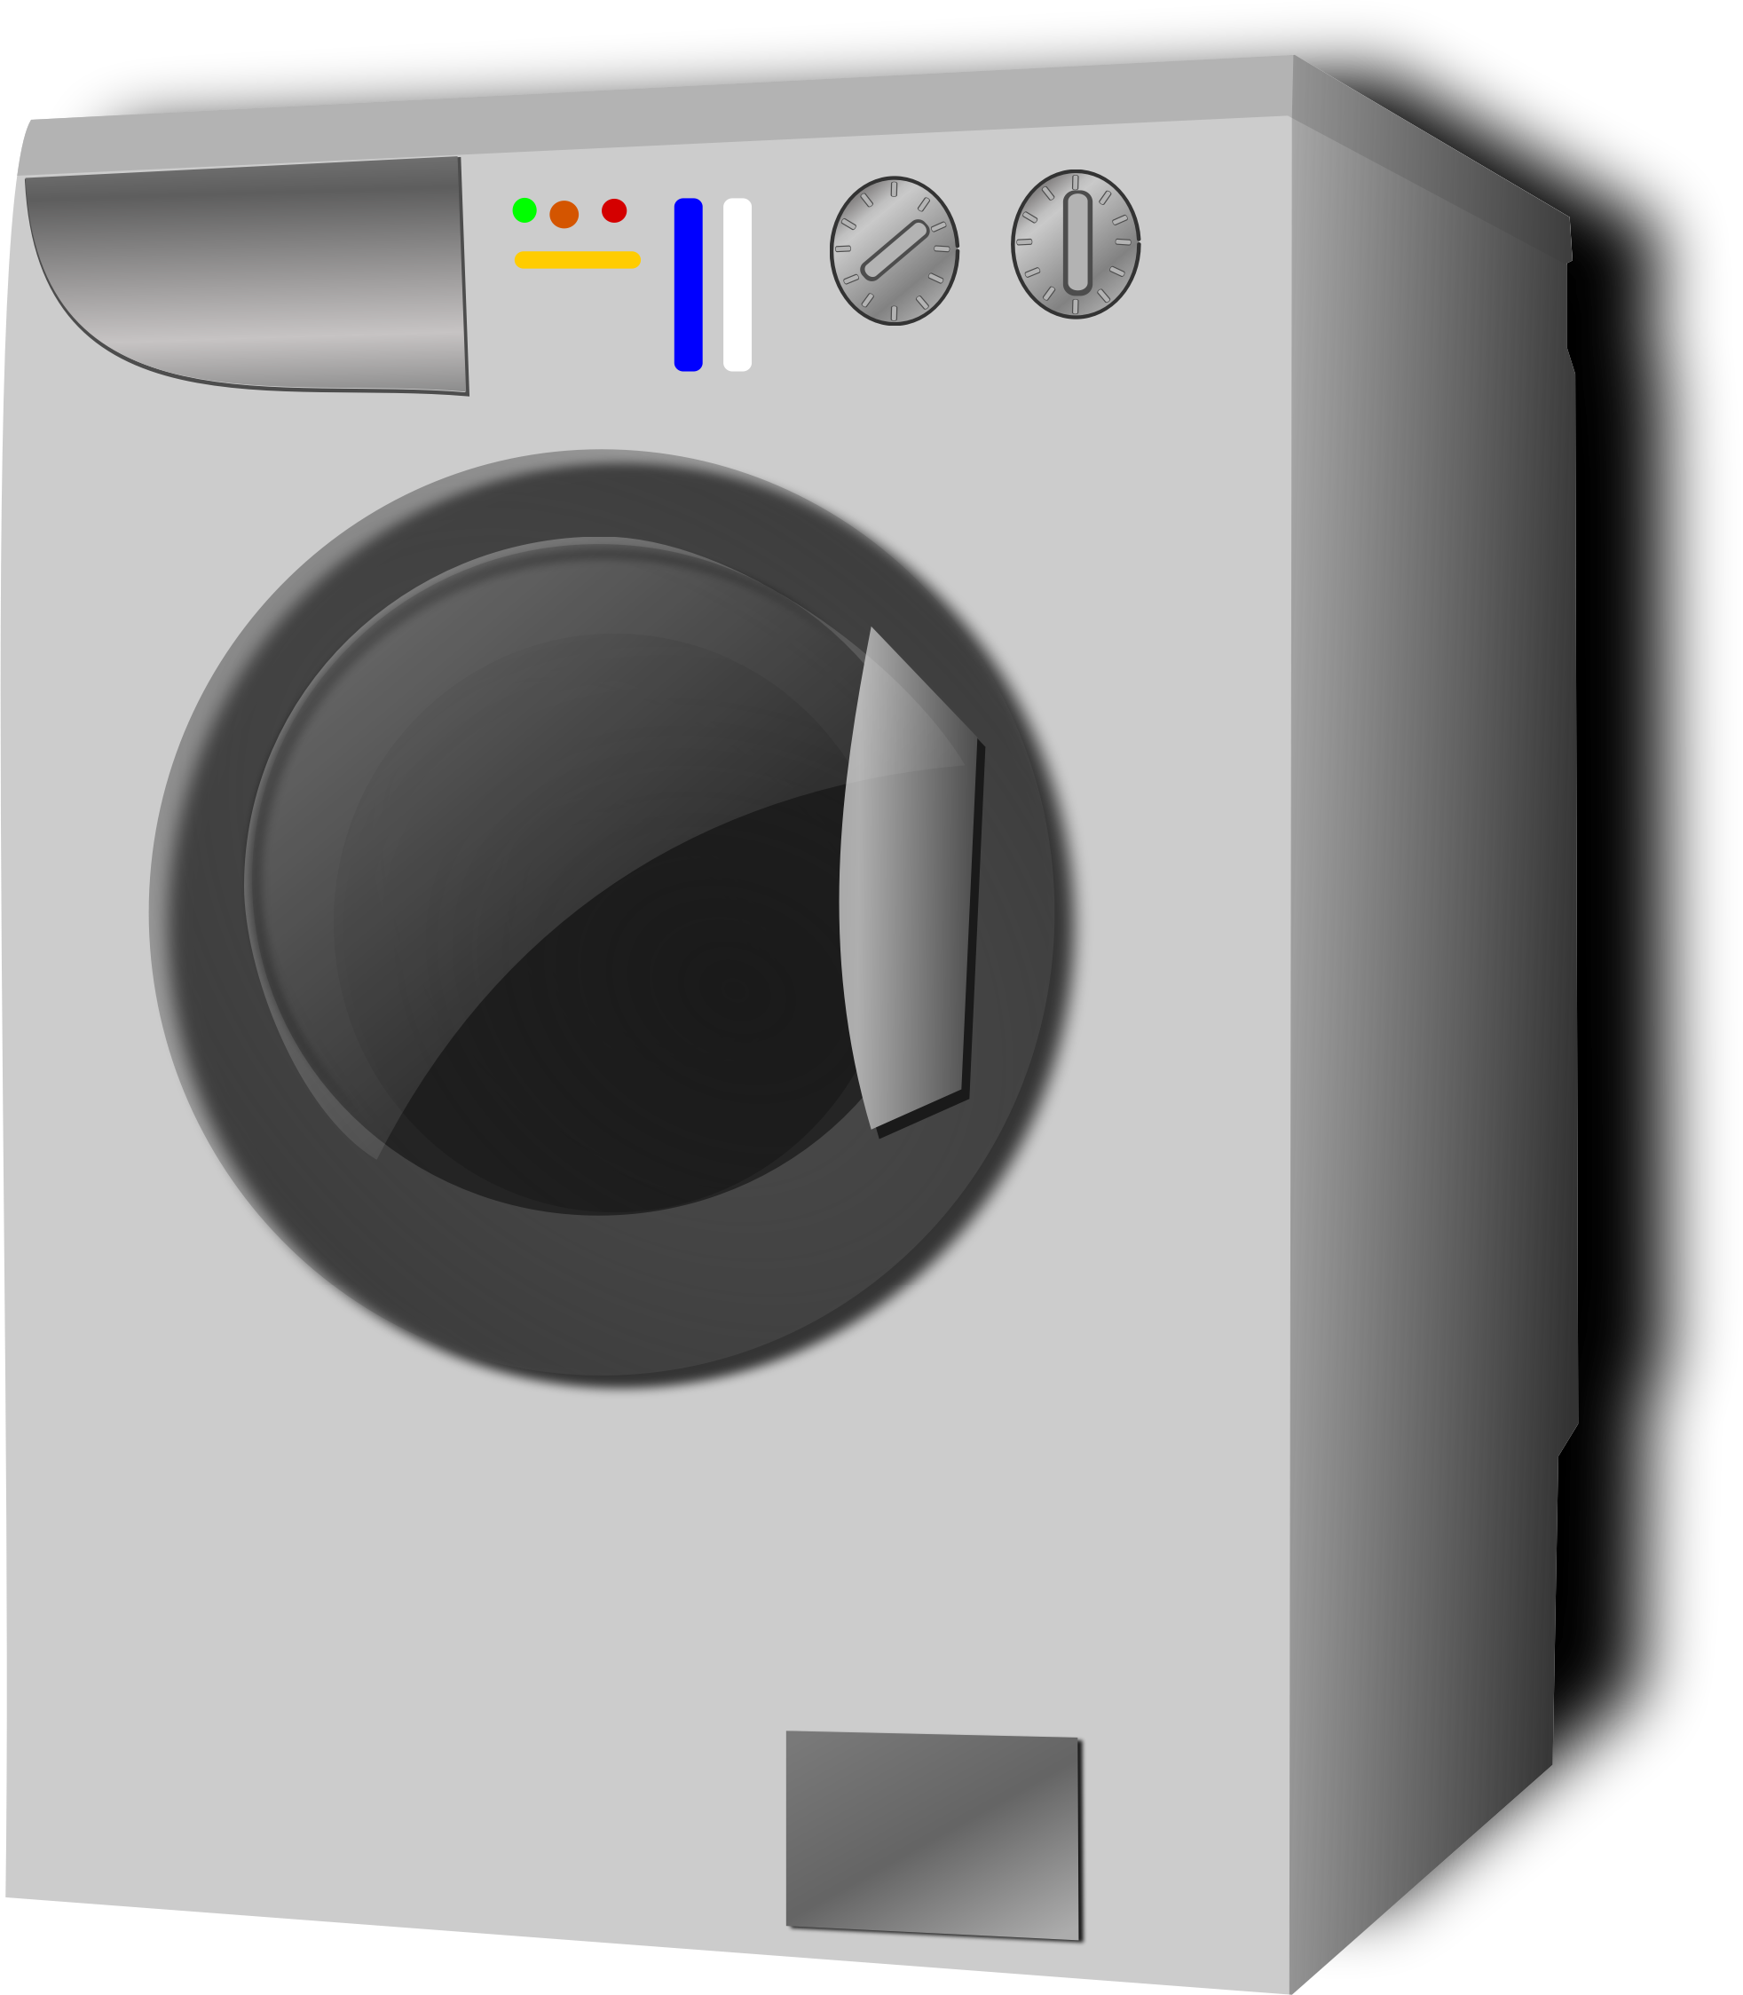



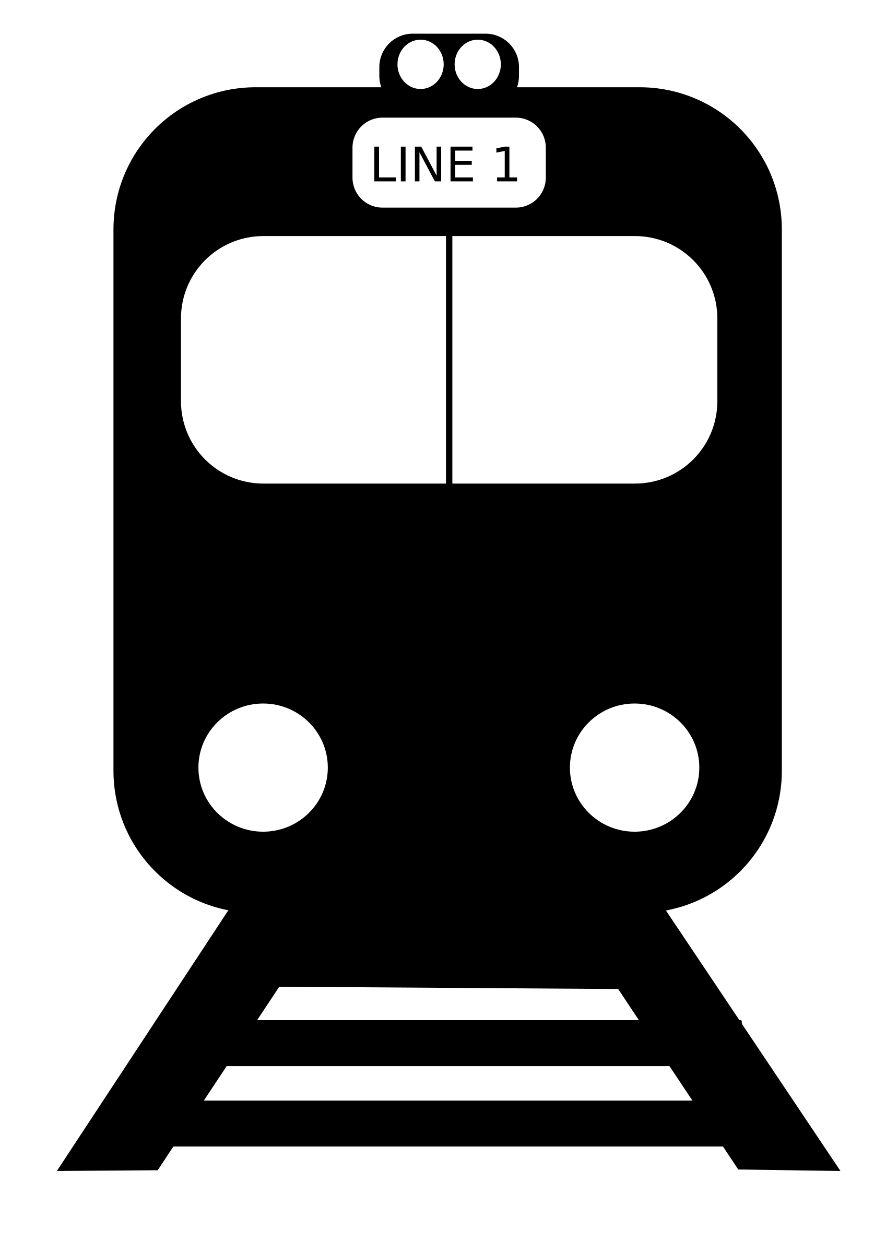


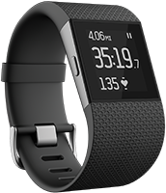



The Problem
Smart City
Smart Home
Connected Devices
Intermodal Transportation
V2I
V2V

Slide 5
The Challenge
Providing access to vehicle status information and data to cloud services, web applications, mobile devices and more.
There is no standard convention for a vehicle data API.
OEMs wish to be able to easily extend a standard API with signals and controls for their purposes.
Security mechanisms are required that provide authentication and authorization to access vehicle signals and control.
Design that decouples signal interface from the electrical architecture of the vehicle.
Application developers and Services Providers would like to have a way to rapidly deploy new applications and services in collaboration with OEMs.

Slide 6
Conventional Approach – “Fat API”
An API for every signal or control:
Issues with this approach:
Addition of new signals and controls requires change of the specification.
Challenges maintaining backwards compatibility.
Complexity in providing per-API authorization and access control.
Single end-point addressing.
var vehicle = navigator.vehicle;
vehicle.vehicleSpeed.get().then(function (vehicleSpeed) {
console.log("Vehicle speed: " + vehicleSpeed.speed);
}, function (error) {
console.log("There was an error"); });
var vehicleSpeedSub = vehicle.vehicleSpeed.subscribe(function (vehicleSpeed) {
console.log("Vehicle speed changed to: " + vehicleSpeed.speed);
vehicle.vehicleSpeed.unsubscribe(vehicleSpeedSub);
});

Slide 7
New Approach – Services with Signal Tree
Vehicle Signal Specification (VSS)
Incepted at Jaguar Land Rover’s Global Digital Development Center in Portland, OR.
Published as open-source through the GENIVI Alliance.
Contributors: Volvo Cars, BMW, and others
The core services get, set, subscribe, unsubscribe, getVSS and authorize are provided by a network server
The services get, set, subscribe and unsubscribe provide access to vehicle signals and controls.
The service getVSS allows clients to query the server for available signals.
Using the authorize service, the client presents a security token to the server for authentication and authorization.
Vehicle Signals and Controls are identified as nodes of a vehicle signal tree
A fully qualified signal name addresses a single signal node.
Wildcards for branches and node names provide for addressing of signal groups.

Slide 8
Vehicle Signal Tree Vehicle Signal Specification

Slide 9
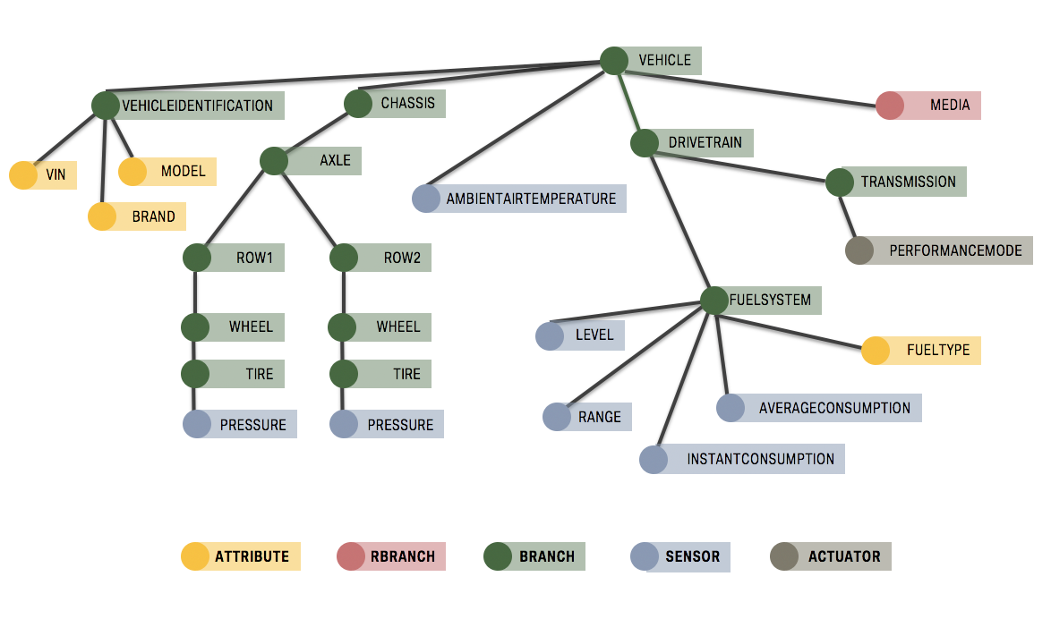
Vehicle Signal Tree
Tree structure provides for hierarchical access to signals and attributes.
Branches group signals and attributes into entities that logically belong together.
Wildcards allow access to entire sets of signals.
Notes:
9

Slide 10
Addressing
Vehicle.Chassis.Axle.Row1.Wheel.Tire.Pressure
Vehicle.Drivetrain.FuelSystem.Level
Vehicle.VehicleIdentification.VIN
Vehicle.AmbientTemperature
Dot-notation for name path. All components within the path are called nodes.
Last path component, called leaf, represents attribute, sensor or actuator.
Leading path components represent the branches.
Wildcards can be used to address multiple signals and/or branches.

Slide 11
Specification Format
Vehicle.Drivetrain.Transmission: type: branch description: Drivetrain data for…
Vehicle.Drivetrain.Transmission.Speed: datatype: Int32 type: sensor min: -250 max: 250 unit: m/s description: Current vehicle speed, sensed by gearbox
Formatted as YAML lists
Simple conversion into other formats such as JSON, France IDL, CSV, and more
# denotes a comment or a directive

Slide 12
Format Transformation
Franca IDL Generator
Franca IDL
Specification
vss.vspec
JSON Generator
JSON
Specification
attribute.vspec
VSS
Parser
signal.vspec
CSV Generator
CSV
Specification
oem.vspec
VSI Generator
VSI
Generator
Tools written in Python transform VSS YAML (vspec) format into other formats.
Standard Python library parses VSS YAML into a data structure.
Output generators use the data structure to write their specific format.
Output generators for Franca IDL, JSON, CSV and VSI are currently available. Other generators can easily be added.
The VSI generator creates an alphabetically sorted list of the fully qualified signal and attribute names and assigns an index value to them.

Slide 13
Contribution and Releases
Repository on Github under the GENIVI organization: https://github.com/GENIVI/vehicle_signal_specification
GENIVI Github Repo
V1
V2
V3
V4
master
develop
Contributor Fork
develop
PR #1
PR #2
PR #3
PR #4
PR #5
ML
ML
ML
ML
ML
Contributor forks GENIVI VSS repo.
Contributor makes changes and submits pull-request against develop branch.
Contributor e-mails genivi-projects mailing list pull-request info (hypertext link).
Maintainer and contributors discuss and approve. Maintainer merges pull request.
Releases are created by merging the develop branch into the master branch and tagging the master branch.

Slide 14
Architecture

Slide 15
Vehicle Data Interfaces Architecture
IVI / Headunit
Managed Runtime
Web Runtime
Web Browser
JS Library
JS Library
REST Interface
NiFi Processor
Ingestion
TCU
WebSocket Server (WSS)
Vehicle Bus Interface
Cloud Bridge
Cloud Bridge
Vehicle Bus

Slide 16
Vehicle Information Service Specification (VISS) Version 1 – Current W3C Automotive WG Specification

Slide 17
Overview
Internet Web Server
Vehicle
A web socket server (NodeJS etc.) provides access to vehicle signals.
Web clients such as applications running inside a web runtime or a web browser communicate with the web socket server using a JavaScript library which implements the web socket server protocol and exposes an object API.
Native clients can directly use the web socket server protocol.
Clients can be agents with no UI or applications with UI.
IVI / Headunit
Internal Web Server
Managed Runtime
Web Runtime
Web Browser
JS Library
JS Library
TCU
WebSocket Server (WSS)

Slide 18
Service Messages
Service Messages
authorize | Enables client to pass security tokens for Security Principals to the server to support access-control.
getVSS | Allows the client to request metadata describing signals and data attributes that are potentially accessible.
get | Enables the client to get a value once.
set | Enables the client to set a value once.
subscribe | Enables the client to receive a notification containing a JSON data structure with values for one or more vehicle signals and/or data attributes. The client requests that it is notified when the signal changes on the server.
unsubscribe | Allows the client to notify the server that it should no longer receive notifications based on that subscription.
unsubsribeAll | Allows the client to notify the server that it should no longer receive notifications for any active subscription.

Slide 19
Vehicle Information Service Specification (VISS) Version 2 – Proposal

Slide 20
Overview
Internet Web Server
Vehicle
IVI / Headunit
RSE
In addition to Version 1 ECUs can provide an optional micro service implementation for RESTful access.
In particular useful for media resources.
Internal Web Server
Managed Runtime
Web Runtime
Web Browser
Web Browser
JS Library
JS Library
TCU
WebSocket Server (WSS)
Micro Service
(REST Server)

Slide 21
HTTP/REST Addressing
Vehicle.Chassis.Axle.Row1.Wheel.Tire.Pressure
becomes
https://<server>/Vehicle/Chassis/Axle/Row1/Wheel/Tire/Pressure
using the standard HTTP GET/PUT/POST for reading, writing and modifying resources (if applicable; sensors would be read-only while actuators can be written).
To avoid long paths resulting from a deeply nested tree the path can be collapsed using a computed UUID:
https://<server>/df35a3d8-2cc3-5ce6-84f5-f6db49dc344f/Pressure
(Version 5 UUID from “Vehicle.Chassis.Axle.Row1.Wheel.Tire” within namespace “00000000-0000-0000-0000-000000000000”)

Slide 22
Repository and Specification
https://github.com/w3c/automotive
https://w3c.github.io/w3c/automotive

Slide 23
Thank you!
Visit GENIVI at http://www.genivi.org or http://projects.genivi.org
Contact us: help@genivi.org
Visit W3C Automotive at http://www.w3c.org/auto
https://www.w3.org/auto/wg / https://www.w3.org/community/autowebplatform
Contact Ted Guild: ted@w3c.org
This work is licensed under a Creative Commons Attribution-Share Alike 4.0 (CC BY-SA 4.0) GENIVI is a registered trademark of the GENIVI Alliance in the USA and other countries. Copyright © GENIVI Alliance 2018.

Slide 24
Backup Slides

Slide 25
Vehicle Signal Specification (VSS) Vehicle Signal Tree Definition

Slide 26
Specification Format – Branch Description
Vehicle.Drivetrain.Transmission: type: branch description: Transmission-specific data
Fields
type – set to branch for a branch, and rbranch for a resource branch
description – informative text describing the branch

Slide 27
Specification Format – Signal Description
Vehicle.Drivetrain.Transmission.Speed: datatype: Int32 type: sensor min: -250 max: 250 unit: m/s description: Current vehicle speed, sensed by gearbox
Fields
datatype – data type expressed as France IDL data type
type – signal type: sensor, actuator, attribute, stream
unit – SI unit unless the type is Boolean
min, max – unless the type is Boolean or enumeration
enum – enumeration values for enumeration
description – informative text describing the signal

Slide 28
Specification Format – Resource Branch Description
Vehicle.Media.Items: type: rbranch description: The media item object… child-type: mediaItemObject child-properties: 3 prop-name: [“id”, “name”, “uri”] prop-description: [“item id”, “item-name”, “object uri”] prop-type: [“string”, “string”, “string”] prop-format: [“uuid”, “”, “uri”]
prop-unit: [“”, “”, “”]
prop-value: [“”, “”, “”]
Resource branches can only host element nodes (leaves).
Element nodes of resource branches can be created dynamically, for instance the media files stored on a media, a playlist, etc.
The rbranch fields describe the element nodes.

Slide 29
Aggregate File Inclusion
attribute.vspec
vss.vspec
# top level vspec
#include attribute.vspec
#include signal.vspec
#include oem.vspec
vss.vspec
signal.vspec
oem.vspec
Vehicle signal specification files (vspec) can include other vspec file using the #include directive.
Content of the included file is inserted into the including file at the position of the #include directive.
Facilitates collaboration and minimizes editorial conflicts.

Slide 30
Reuse File Inclusion
Vehicle
door.vspec
# door signals
Open: type: Boolean description: Door is open
Locked: type: Boolean description: Door is locked
Cabin
Door
Row1
Row2
Left
Right
Left
Right
cabin.vspec
# doors
#include door.vspec Signal.Cabin.Door.Row1.Left
#include door.vspec Signal.Cabin.Door.Row1.Right
#include door.vspec Signal.Cabin.Door.Row2.Left
#include door.vspec Signal.Cabin.Door.Row2.Right
Open
Open
Open
Open
Locked
Locked
Locked
Locked
Specification fragments are included at a specific position of the signal tree.
Specification fragments can be reused and an update is automatically reflected everywhere where the fragment is used.

Slide 31
Private OEM Extensions
Attribute
Signal
oem_x.vspec
Private
# Include standard vspec
#include vss.spec
# Add proprietary signals
Private.OEM_X.Teleporter.Mode: …
Private.OEM_X.WarpDrive: …
Body
Cabin
Body
Chassis
OEM_X
Body Type
Refuel Position
Trunk
Teleporter
WarpDrive
Door
Open
Locked
Mode
…
Power
…
Count
vss.vspec
oem_x.vspec
OEMs can use GENIVI vspec as a starting point and add proprietary signals.
Use cases for
Reserved use by OEM and chosen vendors;
Public use by 3rd party application developers.
Mature private extensions intended for public use can be submitted for VSS inclusion.

Slide 32
Attribute Declaration and Definition
Vehicle
Vehicle
oem_x.vspec
# Include standard vspec
#include vss.spec
# Override/define attributes
Vehicle.Body.BodyType: value: Sedan
Vehicle.Cabin.Door.Count: value: 4
Body
Cabin
Body
Cabin
Body Type
RefuelPos
Door
Body Type
value: Sedan
Refuelos
value: rearleft
Door
Count
Count
value: 4
vss.vspec
oem_x.vspec
Standard VSS either
Only declares an attribute or
Declares and attribute and assigns a default value.
Declaration is overridden by definition in an OEM- or model-specific VSS file with the correct value.

Slide 33
Overriding Signal Definitions
vss.vspec
Vehicle
Vehicle
# Default signal definitions
Signal.Drivetrain.GearChangeMode: enum: [“auto”, “manual” ]
Drivetrain
Drivetrain
GearChangeMode
enum: [ “auto”, “manual” ]
GearChangeMode
enum: [ “auto”, “manual”, “semi-auto” ]
oem_x.vspec
# Include standard vspec
#include vss.spec
# Override/define signal definitions
Signal.Drivetrain.GearChangeMode: enum: [“auto”, “manual”, “semi-auto” ]
vss.vspec
oem_x.vspec
Standard vspec lacks setting or has incorrect setting for a OEM/model etc.
OEM/model-specific vspec can override the setting.

Slide 34
Vehicle Information Service Specification (VISS)
Authorization and Access Model

Slide 35
Authorization – Security Principles
Security Principal | Token Name | Description
User | Authorization | The user that the client is making requests on behalf of. This may be a person e.g. driver or passenger, it may be an organisation e.g. Emergency Services or may be any other legal entity.
Device | www-vehicle-device | The originating device that is making the request to the server. This may be an ECU in the vehicle that is hosting the WebSocket Server or may be a device that is connected to the vehicle via a WiFi hotspot or may be any other device.

Slide 36
Authorization – Example
if(userTokenOnly){
// Pass user token only
vehicle.send('{ "action": "authorize",
"tokens": { "authorization": "<user_token_value>" },
"requestId": "<some_unique_value>" }');
} else if (deviceTokenOnly) {
// Pass vehicle/device token only
vehicle.send('{ "action": "authorize",
"tokens": { "www-vehicle-device": "<device_token_value>" },
"requestId": "<some_unique_value>" }');
} else if (userAndDeviceToken) {
// Pass tokens for user and device
vehicle.send('{ "action": "authorize",
"tokens": { "authorization": "<user_token_value>",
"www-vehicle-device": "<device_token_value>" },
"requestId": "<some_unique_value>" }');
}

Slide 37
Authorization – Security Token
Element | Description
Path | The signal path the token authorizes. The path may be a branch name or contain wildcards to authorize entire branches.
Actions | List of actions that the token authorizes for the path. The list contains at least one of the actions getVSS, get, set, subscribe and unsubscribe.
Valid From | Timestamp in UTC indicating the date and time from which on the token is valid.
Valid Until | Tmestamp in UTC indicating the date and time until which the token is valid.

Slide 38
Introspection – getVSS
interface vssRequest {
attribute Action action;
attribute string? path;
};
interface vssSuccessResponse {
attribute Action action;
attribute string path;
attribute object vss;
};
interface vssErrorResponse {
attribute Action action;
attribute string path;
attribute Error error;
};
WebIDL
client -> {
"action": "getVSS",
"path": "Signal.Body"
}
receive <- {
"action": "getVSS",
"path": "Signal.Body",
"vss": { }
}
Message

Slide 39
Get Signal Value – get
interface getRequest {
attribute Action action;
attribute DOMString path;
};
interface getSuccessResponse {
attribute Action action;
attribute DOMString path;
attribute any value;
attribute DOMTimeStamp timestamp;
};
interface getErrorResponse {
attribute Action action;
attribute DOMString path;
attribute Error error;
attribute DOMTimeStamp timestamp;
};
WebIDL
client -> {
"action": "get",
"path": "Signal.Drivetrain.Speed",
}
receive <- {
"action": "get",
"path": "Signal.Drivetrain.Speed",
"value": 55,
“timestamp": <DOMTimeStamp>
}
Message

Slide 40

Set Signal Value – set
interface getRequest {
attribute Action action;
attribute DOMString path;
attribute any value;
};
interface setSuccessResponse {
attribute Action action;
attribute DOMString path;
attribute any value;
attribute DOMTimeStamp timestamp;
};
interface setErrorResponse {
attribute Action action;
attribute DOMString path;
attribute Error error;
attribute DOMTimeStamp timestamp;
};
WebIDL
client -> {
"action": "set",
"path": "Signal.Cabin.Door.*.IsLocked",
"value":{ [ {"Row1.Right.IsLocked" : true },
{"Row1.Left.IsLocked" : true },
{"Row2.Right.IsLocked" : true },
{"Row2.Left.IsLocked" : true } ] }
}
receive <- {
"action": "set",
"path": "Signal.Cabin.Door.*.IsLocked",
"value":{ [
{"Signal.Cabin.Door.Row1.Right.IsLocked" : true }, {"Signal.Cabin.Door.Row1.Left.IsLocked" : true },
{"Signal.Cabin.Door.Row2.Right.IsLocked" : true },
{"Signal.Cabin.Door.Row2.Left.IsLocked" : true } ] },
"timestamp": <DOMTimeStamp>
}
Message

Slide 41
Subscription Request – subscribe
interface subscribeRequest {
attribute Action action;
attribute DOMString path;
attribute object? filters;
attribute string requested;
};
interface subscribeSuccessResponse {
attribute Action action;
attribute string requestId;
attribute string subscriptionId;
attribute DOMTimeStamp timestamp;
};
interface subscribeErrorResponse {
attribute DOMString path;
attribute string requestId;
attribute Error error;
attribute DOMTimeStamp timestamp;
};
WebIDL
interface subscriptionNotification {
attribute string subscriptionId;
attribute DOMString path;
attribute any value;
attribute DOMTimeStamp timestamp;
};
interface subscriptionNotificationError {
attribute string subscriptionId;
attribute DOMString path;
attribute object filters;
attribute Error error;
attribute DOMTimeStamp timestamp;
};

Slide 42
Subscription Request – subscribe
client -> {
"action": “subscribe",
"path": "Signal.Drivetrain.Transmission.TripMeter",
“requestId": 1004 }
}
receive <- {
"action": “subscribe",
"reqestId": 1004,
“subscriptionId": 35472,
"timestamp": <DOMTimeStamp>
}
Message

Slide 43
Unsubscription Request – unsubscribe
interface unsubscribeRequest {
attribute Action action;
attribute string subscriptionId;
attribute string requestId;
};
interface unsubscribeSuccessResponse {
attribute Action action;
attribute string? subscriptionId;
attribute string requestId;
attribute DOMTimeStamp timestamp;
};
interface unsubscribeErrorResponse {
attribute Action action;
attribute string subscriptionId;
attribute Error error;
attribute string requestId;
attribute DOMTimeStamp timestamp;
};
WebIDL
client -> {
"action": “unsubscribe",
"subscriptionId": 102,
"requestId": 5273
}
receive <- {
"action": “unsubscribe",
"subscriptionId": 102,
"requestId": 5273
"timestamp": <DOMTimeStamp>
}
Message

Slide 44
Server-side Filtering
// client receives data every 100ms
{ "action": "subscribe",
"path": "<any_path>",
"filters": { "interval": 100 },
"requestId": "<some_unique_value>" }
// client receives data when the value is
// between 100 and 200 (inclusive)
{ "action": "subscribe",
"path": "<any_path>",
"filters": {
"range":{ "above": 100, "below": 200 }
},
"requestId": "<some_unique_value>" }
// client receives data when the value is below
// 100 (inclusive)
{ "action": "subscribe",
"path": "<any_path>",
"filters": { "range": { "below": 100 } },
"requestId": "<some_unique_value>" }
Message
For signal subscriptions filters can be provided to throttle messages on the server side.
Filters only apply to nodes of the VSS tree and not to branches.
Filter tags include:
Interval
Range
Minimum Change

