Slide 1
Open Telematics API
Lightning Talk @ W3C Workshop

Slide 2
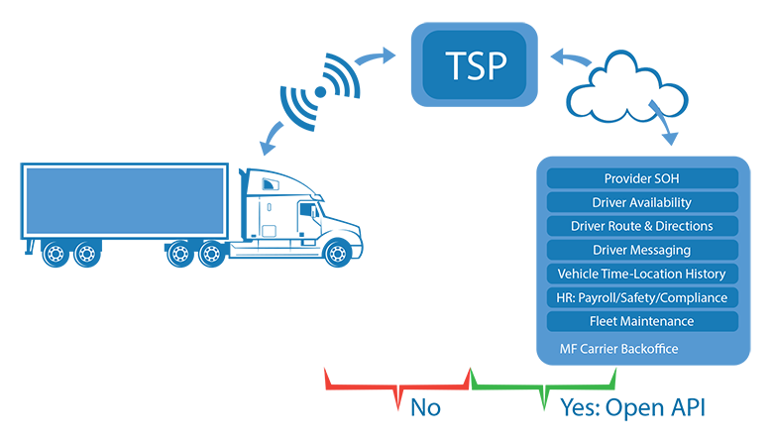
What We’ve Done
Collaborated to create:
Machine-readable REST API specification for how LTL motor freight carriers can integrate with TSPs

Slide 3
OTAPI Release
github/nmfta-repo/nmfta-opentelematics-api
Source of specification
Offline HTML documentation
opentelematicsapi.docs.apiary.io
Interactive HTML documentation
apimatic.io/apidocs/nmfta-opentelematics-api
Client libraries
github/nmfta-repo/nmfta-opentelematics-prototype
Prototype server implementation

Slide 4
The Data Model
Vehicle
Fleet
Driver
Log Event (‘ELD’ events)
Vehicle Performance Event (idle time summaries etc.)
Vehicle Fault Code Event (e.g. DTCs)
Vehicle Status Event (e.g. battery V)
Accessible via use-case focused streaming APIs

Slide 5
Security-First
Security Manifest of OTAPI Design Decisions
Mandatory Fine-grained Access Controls
Mandatory Client-Side Security Requirements
Mandatory Sever-Side Security Requirements
Published prototype satisfies server-sider security requirements

Slide 6
Contributors
Fleet Managers | Telematics Providers | Independents
Bill Brown, SEFL | Samsara Networks, Inc. | Altaz Valani, Security Compass
Penske Truck Leasing | Geotab | Andrew Smith, ISE Inc.
Old Dominion Freight Lines | Omnitracs | Dr. Jeremy Daily, UTulsa
 | Derek Held, Zonar Systems
Many revisions in many pull requests
A couple face to face sessions
Several unnamed contributors
Many conference calls ☺

Slide 7
Future Work
Find a home for future revisions of OTAPI
Adding support for on-boarding and off-boarding of devices/vehicles (common when vehicles come from truck leasing companies)

Slide 8
Thank You!
github/nmfta-repo/nmfta-opentelematics-api
Ben Gardiner
ben.gardiner@nmfta.org (no, I don’t know why this needs to be clickable in a presentation either)
www.nmfta.org

