Slide 1
Towards A Common Data Model
Ken Vaughn
ISO/TC 204/WG 1 Convenor
A presentation for W3C
12-13 Sept 2019

Slide 2
ITS Data Model Structure
Long-term integration requires top-down
Subject
Area Model
Conceptual Data Model
Logical Data Model
Overall structure
Vocabulary based on formal ontology
Platform-generic data model
Component Logical Data Model
 |  |  |  |  |  |  |  | (Optional) |  |  |  |  |  |  |  | (Optional) |  |  |  |  |  |  |  | (Optional)
Platform-generic component model
Physical Data Model
Interface standard data model
Business pressures dictate bottom-up
Notes:
The logical data model is developed from three primary inputs
Existing standards that represent industry consensus on what data is needed and how it is formatted
The Conceptual data model that provides a structure to the data and standardised definitions of entities
A reference systems engineering architecture, such as HARTS, that identifies the services and information exchanges that are needed and thereby provide a meaningful context in which to view the massive data model

Slide 3
ITS Data Model Development Approach
Reference Architecture
Information View
(Under Development)
Functional View
Physical View
Communication View
SAM Class Diagram
CDM Class Diagram (ISO 14812)
LDM Class Dia (Info flow focus)
LDM Class Diagram (Class focus)
Processes
Physical Object
CLDM Class Dia (Info flow)
PDM->LDM Traceability Dia
Data Flow
Information Transfers
ITS Interface Standards
PDM Class Diagram (Info Flow)
Notes:
We’ll now take a look at some examples of what each item looks like starting from the bottom of our figure

Slide 4
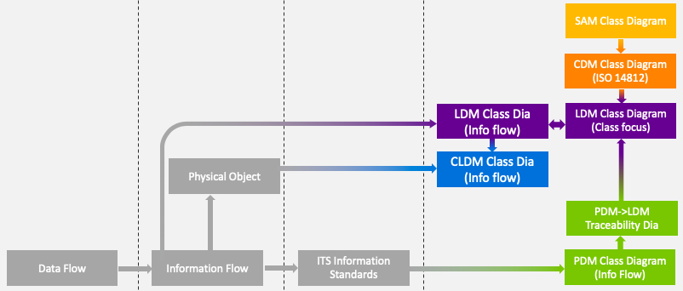
ITS Reference Architecture
ARC-IT (http://arc-it.org)
Currently being updated to add international content from HARTS (http://htg7.org)
Over 140 service packages
Over 800 information flows
Over 1700 information transfers (a.k.a., information flow triples)
Most flows have different solutions in different regions of the world (~200 data standards)
Architecture actively maintained and expanded
Maint and Constr
Field Personnel
Driver
Simplified service package for Worker Safety
personal input
personal updates
driver updates
Roadside Equipment
personal location
Personal Information Device
personal location
Vehicle OBE
personal safety
warning
vehicle location
and motion
Personal Work
Zone Safety
work zone safety warning
+ proxied personal location
RSE Work Zone Safety
vehicle location and motion
Vehicle Work Zone Warning

Slide 5
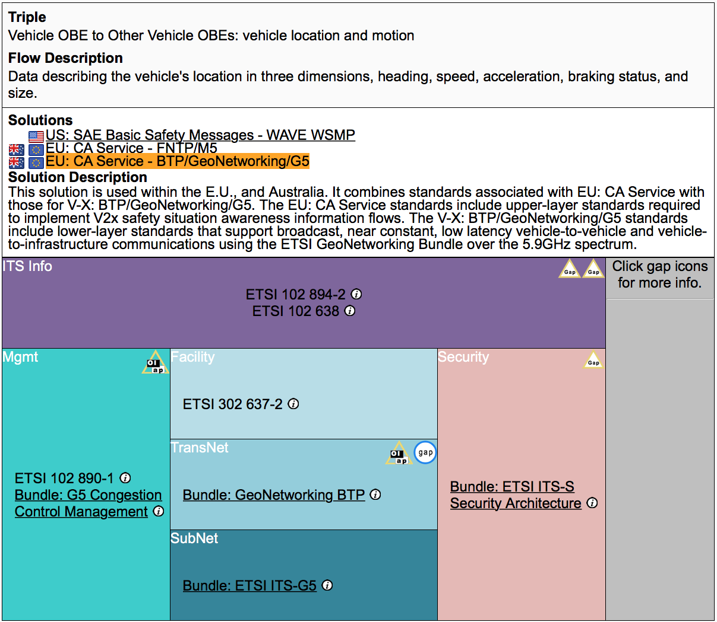
Comm View
Vehicle Location and Motion
Notes:
Once you click on a specific triple, the Communications View provides a detailed description of the information flow along with a series of potential solutions for implementing the flow. The regions to which the flows are most applicable are shown next to each solution. The lower portion of the display shows the various standards needed to implement the information flow per the selected solution.
From this information we can begin producing the relevant data views. If data standards already exist (e.g., in this case, defined by the Basic Safety Message and the CA Service), we can derive our model directly from the approved standards. When the data standards do not exist, we can still produce a sample logical model from the text in the flow description.

Slide 6
Content of Standard
ETSI 102 894-2 defines structure to report the position of a vehicle
ReferencePosition ::= SEQUENCE {
latitude Latitude,
longitude Longitude,
positionConfidenceEllipse PosConfidenceEllipse ,
altitude Altitude
}
Notes:
The information standards will define a data model, but often this is done in code rather than in a graphical model

Slide 7
Info View
Physical Data Model: CAM
Notes:
This structure can be readily converted into a graphical UML class diagram to concisely depict the physical data model for the CAM message; the highlighted section of this diagram shows the portion of the diagram that displays the structure shown on the previous slide.

Slide 8
Information View
https://github.com/k-vaughn/its-reference-model
Logical Data Model
Info Flow Focus for Vehicle Location and Motion
Notes:
As we map all of the data defined in Physical Data models into the Logical Data Model, the logical data model begins to take shape. Whereas the Physical Data Model organises the data according to the structural relationships defined by the message structures, the Logical Data Model organises the data according to semantic relationships. In other words, every attribute directly describes the class of which it is a member; thus, the attribute Vehicle.length defines the length of the Vehicle.
The mapping process follows several distinct rules that help resolve debates about how this model should look.
Generalisation of classes should be used to promote reuse of data elements for all instances where the data applies (e.g., geolocation is associated with a PhysicalEntity since any PhysicalEntity will logically have a geolocation – this ensures that this information is expressed the same way regardless if you are defining a vehicle, roadside device, an origin, etc.)
Data structures should follow the rules for second and third normal form (i.e., data elements related to each other should be grouped into their own class; for example, rather than defining speed and speedAccuracy as direct attributes of Vehicle, define them as a part of a Speed class that has an association with a Vehicle)
Datatypes should be logically defined as integers expressed in SI-based units with decimal shifting to allow for desired resolution (e.g., cm/s)
This rule can be broken when mutually agreed by the industry, e.g., to use degrees rather than radians

Slide 9
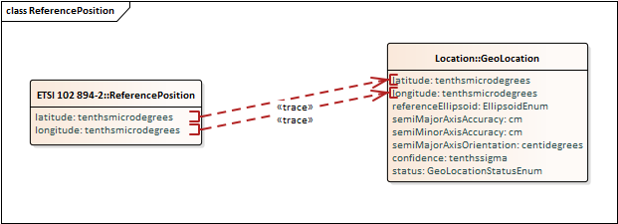
Information View
Physical Model
Traceability Focus
Notes:
UML also allows us to graphically depict traceability. On the left, we see one of the structures defined by the CAM message while the right shows the corresponding information from the Logical Data Model.
In this instance, we notice that the trace lines are marked in red, indicating that there is an associated issue that has been identified with the trace. The specific issue is that the two standard implementations (CAM and BSM) disagree on the exact location of the reference point. Within CAM, the reference point is defined to be the front-center of the rectangle that outlines the extents of the vehicle as projected onto the roadway. The BSM defines the same rectangle, but identifies its reference point as the middle-center of the rectangle. Thus, if an application needs to merge these two data sources, it will need to adjust for this difference in definition.

Slide 10
An Expansive Coordination Effort just for Transport
ANSI X.12
APTA
CEN TC 278
ETSI ITS TC
GTFS
IEEE 1609 WG
IEC SyC Smart Cities
IIC
ISO TC22
ISO TC 204
ISO TC 268
ISO/IEC JTC1 SC41
ISO/IEC JTC1 SC42
ISO/IEC JTC1 WG11
ITE
Local
National
NTCIP
OASIS
OneM2M
SAE
SENSORIS
W3C
WZDx

Slide 11
Towards a Consistent Model
Can’t delay current development efforts
Move towards a consistent model for all stakeholders (i.e., layered approach)
Readily accessible by all interested parties (i.e., no pay wall)
Common sense of ownership (i.e., easy to provide input)
Notifications when relevant changes are proposed (modularity)
Version controlled, with ready access to older versions
Need to define:
Data Modeling Framework (e.g., how do layers relate to one another)
Modeling Rules (e.g., a UML profile)
Governance (e.g., who contributes, comments, approves)
Defining common rules will allow:
Easier understanding, tracing, and integration among independent efforts
Common toolsets
Work towards a common goal

Slide 12
Possible Framework?
IoT Model
Industry Models
Subject
Area Model
Industry Conceptual Data Model
Industry Logical Data Model
IoT Conceptual Data Model
IoT Logical Data Model
Subject
Area Model
Subject
Area Model
Industry Conceptual Data Model
Industry Logical Data Model
Subject
Area Model
Industry Conceptual Data Model
Industry Logical Data Model
Categories
Shared entities
Common attributes
 |  |  |  |  |  |  |  | (Optional) |  |  |  |  |  |  |  | (Optional) |  |  |  |  |  |  |  | (Optional)
 |  |  |  |  |  |  |  | (Optional) |  |  |  |  |  |  |  | (Optional) |  |  |  |  |  |  |  | (Optional)
 |  |  |  |  |  |  |  | (Optional) |  |  |  |  |  |  |  | (Optional) |  |  |  |  |  |  |  | (Optional)
Notes:
The logical data model is developed from three primary inputs
Existing standards that represent industry consensus on what data is needed and how it is formatted
The Conceptual data model that provides a structure to the data and standardised definitions of entities
A reference systems engineering architecture, such as HARTS, that identifies the services and information exchanges that are needed and thereby provide a meaningful context in which to view the massive data model

Slide 13
Discussion
Do we agree on the need to collaborate?
What specific topics are worthy of collaboration?
Defining framework
Rules for modelling and documentation
Rules for governance
Specifying common data
Security issues
Broader architecture issues
Thoughts on approach discussed

Slide 14
Thank You.
Ken Vaughn
+1-571-331-5670
kvaughn@trevilon.com
www.trevilon.com

