Slide 1
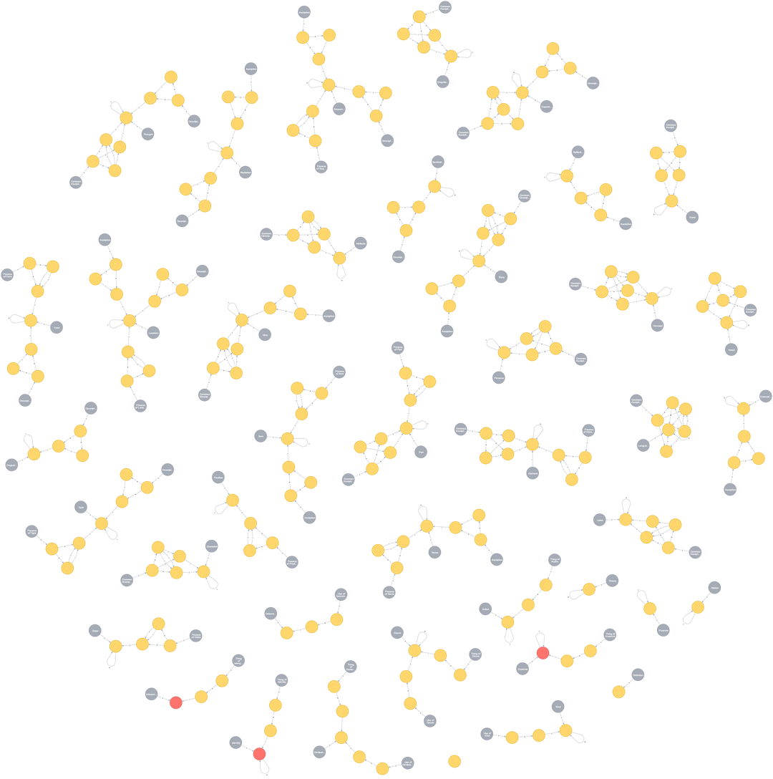
ADEPT – a Limited Iterative Ontological Notation
Gregory E Sharp MD
www.salveretec.com

Slide 2
I came to ADEPT through the challenge of Interoperability in Healthcare
Transportation faces the same challenges as Healthcare:
  An assortment of proprietary solutions with a historical lack of industry incentives to unify data silos
  A variety of data capture and serialization formats in regular use
  A lack of data standardization or shared metrics
  Good ontology work that struggles to find implementation
  We have data but lack the means to harvest insights and apply them
  Security and Privacy are essential but they often receive attention only as an afterthought to the achievement of technical requirements
  AI/automation are happening but we feel inadequately prepared to anticipate or shape their consequences

Slide 3
ADEPT is pattern before language
The problem is that information is primarily understood as language.
Language begins and ends with the arbitrary assignment and manipulation of symbols (semiotics and linguistics).
There exist common relational patterns within all information that are not symbolic or arbitrary.
ADEPT understands information through a limited (and therefore computable) set of relational patterns and subsequently derives language.
ADEPT therefore becomes a single method to represent any language and any data expressed by that language.
One relational logic to express any content in every context.

Slide 4
ADEPT key features
ADEPT Isolates all informational content from all informational context to expose relational patterns and utilizes these to represent all ontology, schema, application/serialization format and data regardless of domain.
ADEPT is based upon a three value logic that represents ambiguity, uncertainty and error as a normal (and manageable) part of any system.
Because ADEPT is a logical system based upon a limited set of constraints and a finite set of patterns that result in a fixed schema, it can be automatically indexed and remain performant as it scales (I think).
ADEPT distinguishes data schema from its implementation but represents them in a common instance.
The actual data model lives within its instances in ADEPT.
Any instance of ADEPT can accommodate and reconcile multiple data models.

Slide 5
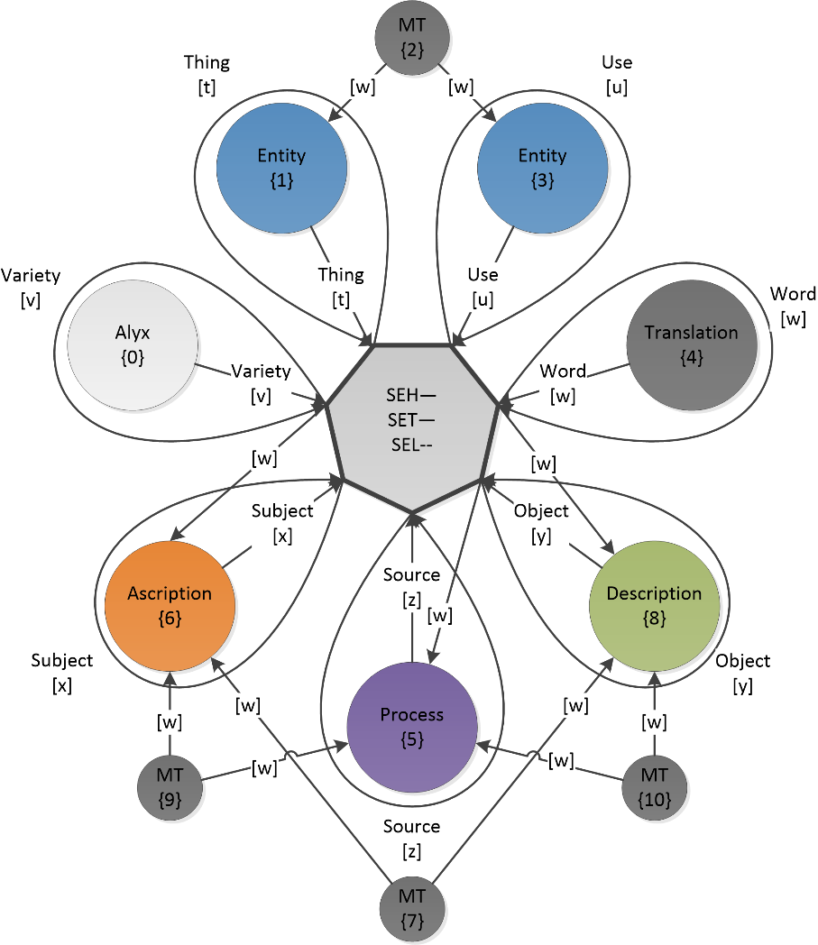
A Limited Iterative Ontological Notation built upon 7 relationships that define 40 building blocks to express information’s structure and content
the “sense” of each ADEPT channel:
Thing = Intrinsic sense
Use = Extrinsic sense
Variety = Representative sense
Word = Meaningful sense
Subject = Individual sense
Object = Collective sense
Source = Contextual sense

Slide 6
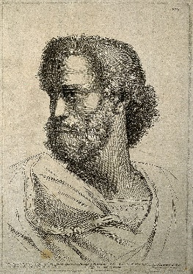
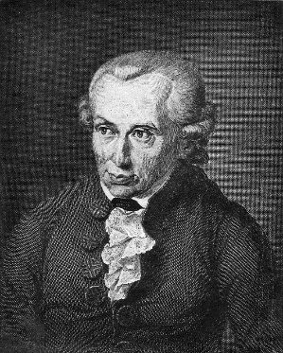
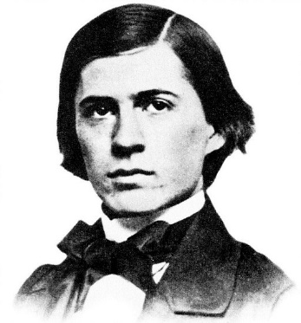
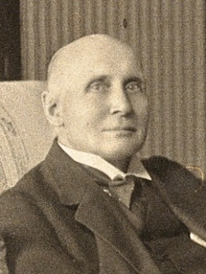
ADEPT brings the work of history’s great thinkers into the computing age.
Aristotle
Kant
Pierce
Whitehead

Slide 7
Any ADEPT instance is its own little universe of information integrating schema, language, ontology and data into one consistent model.
Tables → spreadsheets, databases
Graphs → social networks, the semantic web
Hierarchies → organizational trees, genealogy
Geometries → measurements, coordinates, extension, space
Cycles → processes, time, change
Transaction → economics, commerce
Language → alphabets, words, grammar, syntax

Slide 8
ADEPT is a different approach
This may be exactly what is needed in healthcare and transportation.
I am looking for projects in which ADEPT can be applied, tested and deployed.
If interested in discussing ADEPT further:
  www.salveretec.com
  gs@salveretec.com
  Greg Sharp MD

