Slide 1
Assistive Technologies for XR Extend AT, New AT, or is AT embedded in the XR?
Markku (Mark) Hakkinen, Educational Testing Service (moderator)
Léonie Watson, W3C/Tetralogical
Jason White, Educational Testing Service
Meredith Ringel Morris, Microsoft

Slide 2
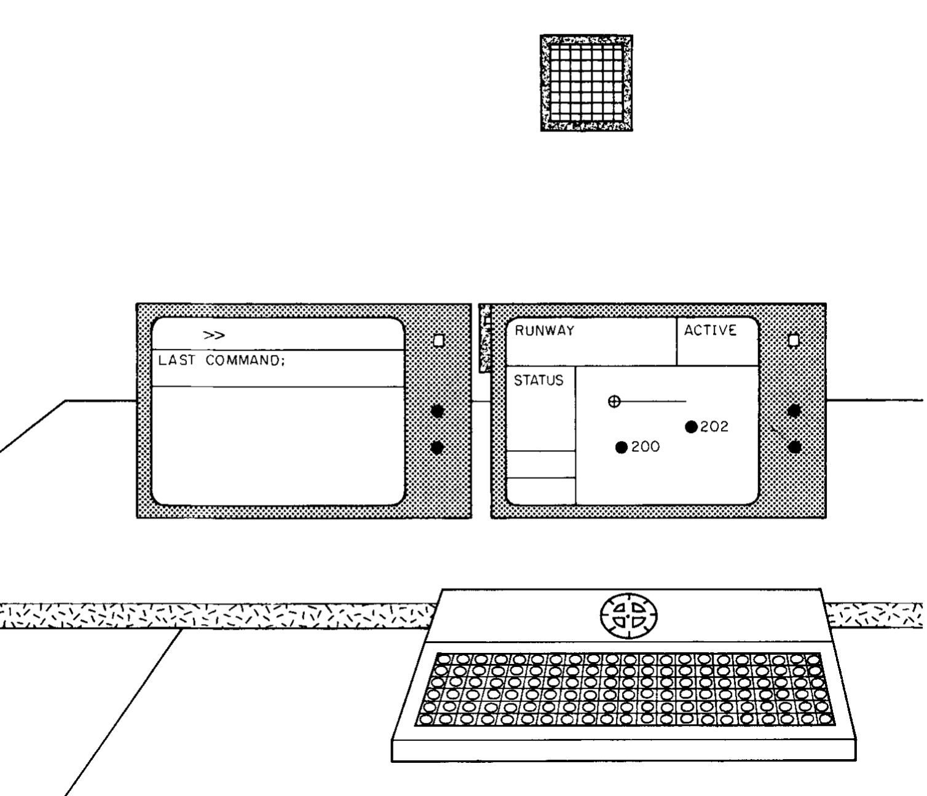
What’s taking so long?
Lindquist, T. E., Fainter, R. G., & Hakkinen, M. T. (1985). GENIE: a modifiable computer-based task for experiments in human-computer interaction. International journal of man-machine studies, 23(4), 391-406.
Inclusive VR circa 1998
http://mindknit.org//index.php?page=american-psychiatric-association-institute---vr-and-autism

Slide 3
Some basic questions?
Can the existing AT model evolve to effectively support XR, or do we need rethink it?
Screen readers, for example, are a based on a legacy of 2D GUI interactions, and we continue to extend that model with WAI-ARIA, for better or for worse.
Is the accessibility API model of today too constraining to support XR?

Slide 4
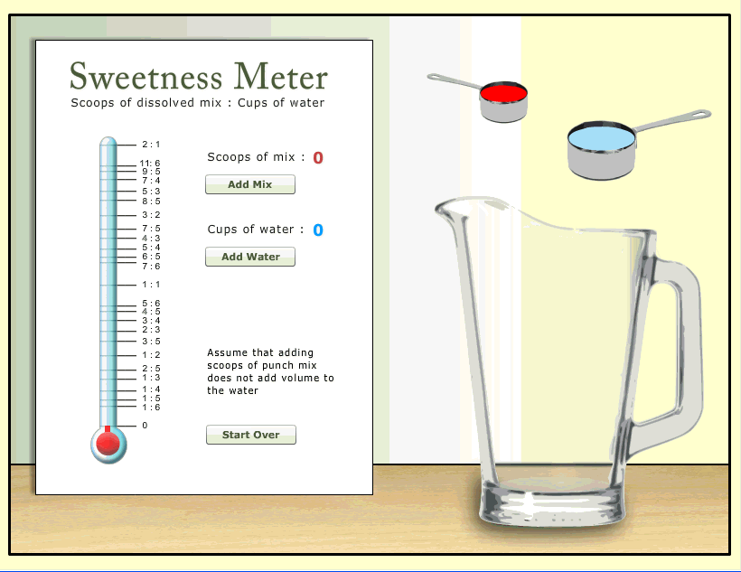
Describing Objects
Cayton-Hodges, G. A., Marquez, E., Keehner, M., Laitusis, C., van Rijn, P., Zapata-Rivera, D., & Hakkinen, M. T. (2012). Technology enhanced assessments in mathematics and beyond: Strengths, challenges, and future directions. Princeton, NJ: Educational Testing Service.
This Photo by Unknown Author is licensed under CC BY-SA-NC

Slide 5
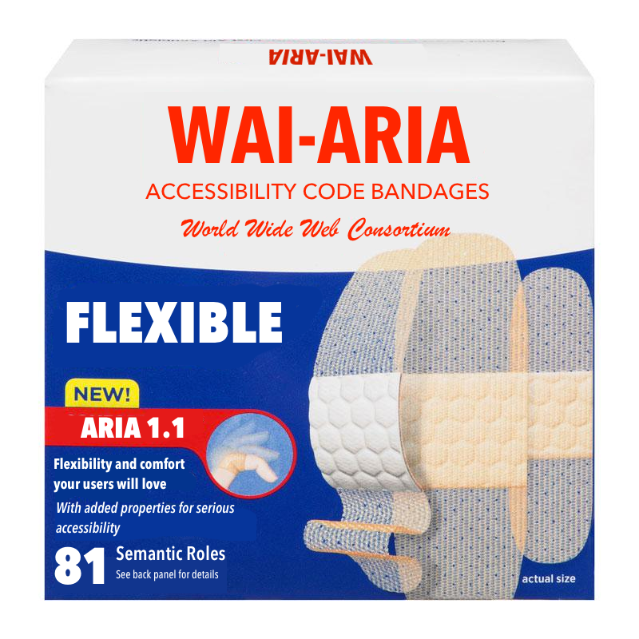

Slide 6
WAI-ARIA
WAI-ARIA can be used to add semantics and states to interactions
Constrained to the common GUI widgets
ARIA 1.1 added aria-roledescription to allow authors to provide an alternate name for common interactive roles
A first step, but really suggested we also needed custom states
The question arises, can WAI-ARIA become extensible to support novel interactions?
And more importantly, will current AT be able to support it?

Slide 7
PhET Accessible Simulations
https://phet.colorado.edu/sims/html/john-travoltage/latest/john-travoltage_en.html

Slide 8
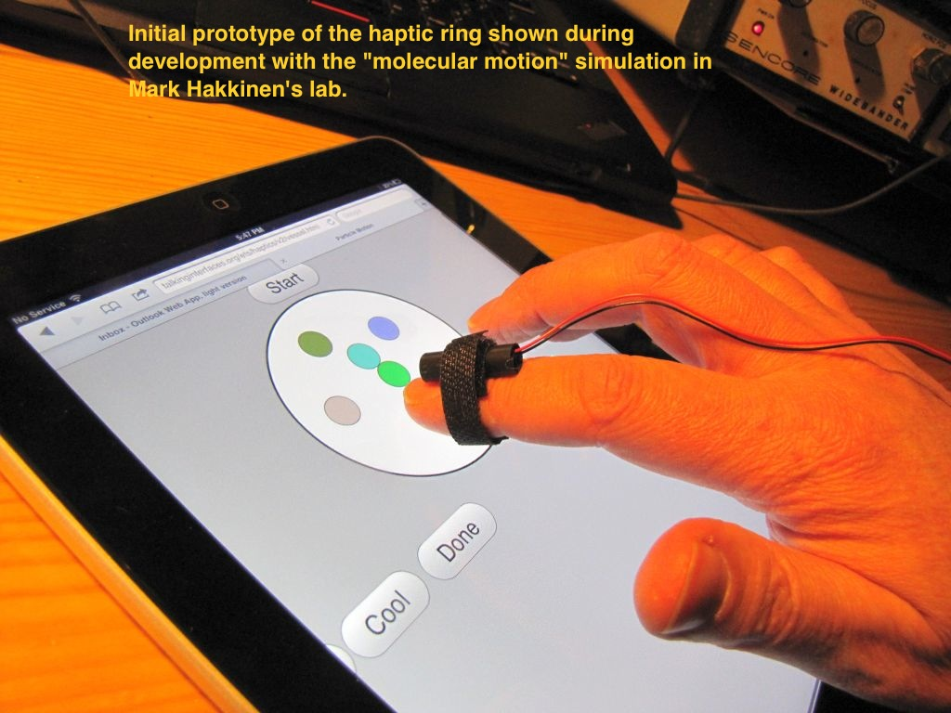
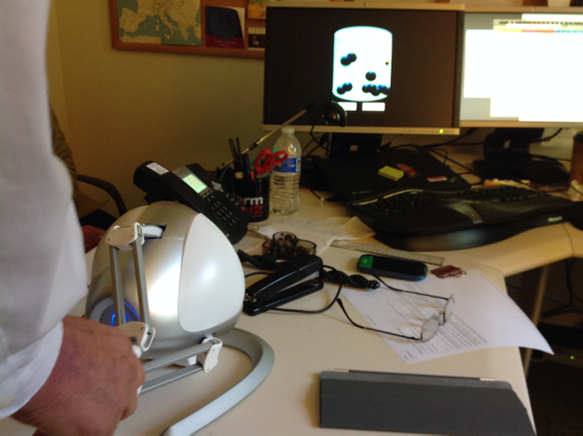
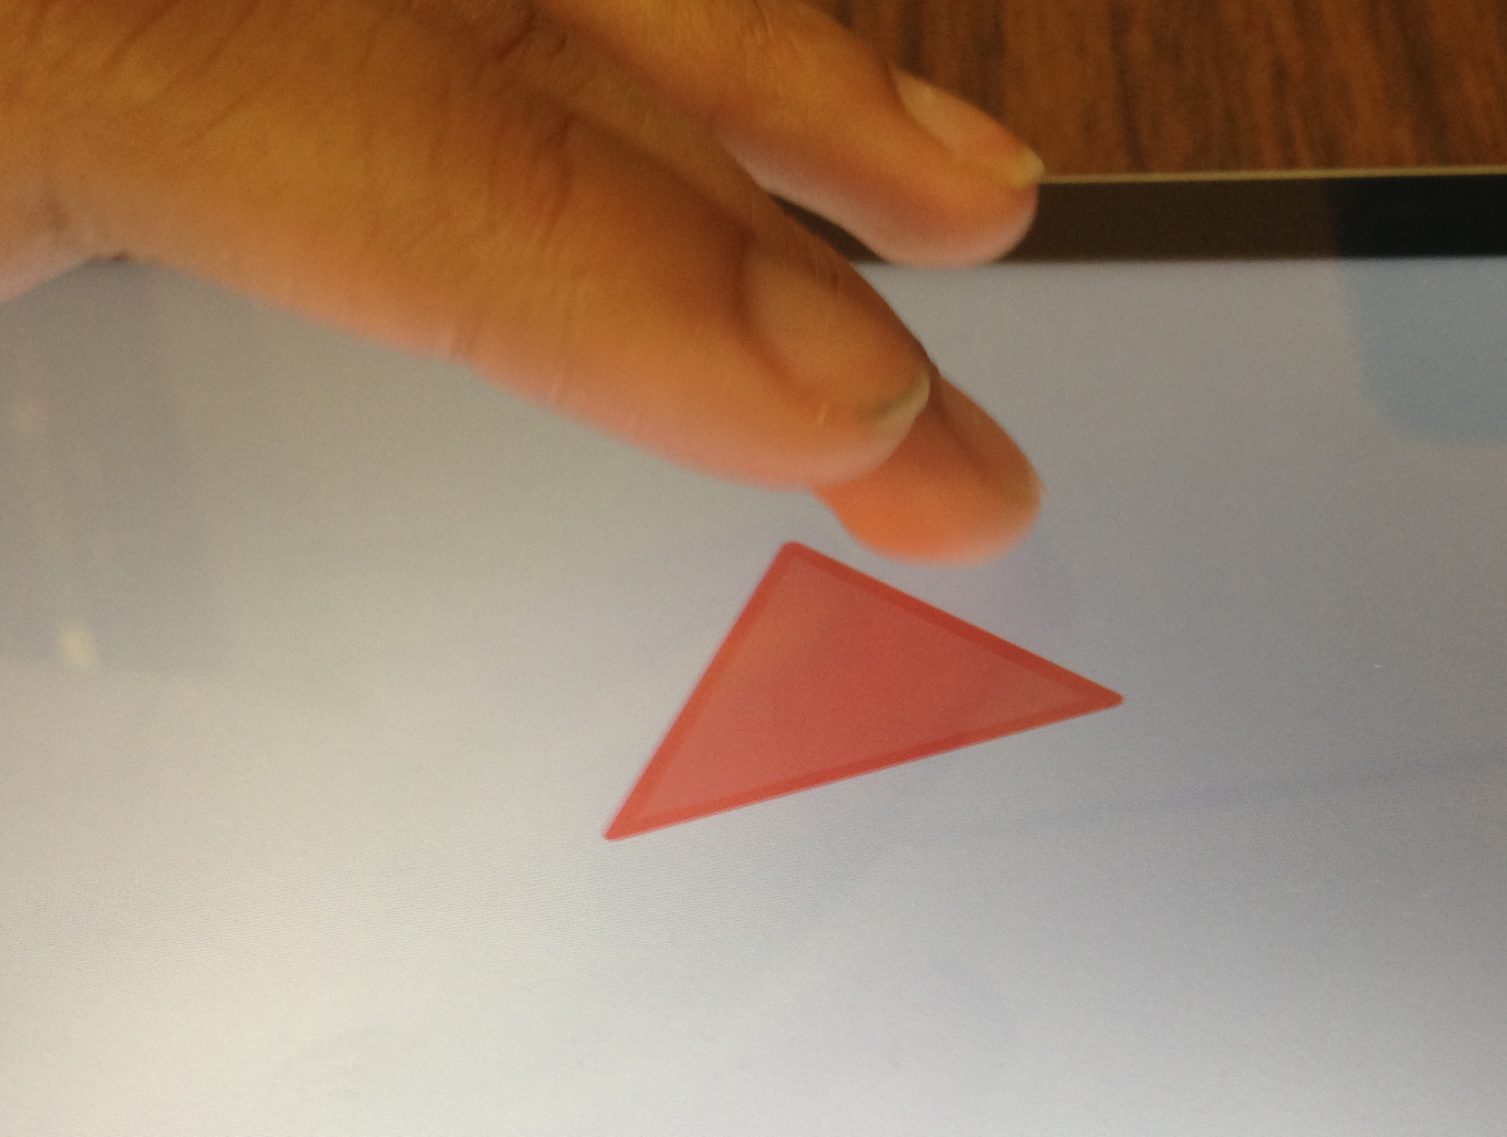
Adding other properties: Haptics and Sound

Slide 10
So this leads for our first question
Is WAI-ARIA the right model for informing AT about XR scenes, objects, their properties and interactions or are we asking ARIA to do something it was never designed to do?

Slide 11
If not ARIA….
If the need for richer and flexible semantics puts ARIA out of the picture, what is the alternative?

Slide 12
Can current AT Adapt?
Given the 2D nature of Screen Reader and Magnification, for example, can they adapt to support usable interaction with immersive environments?

Slide 13
What would the ideal AT look like?
Existing model of user preferred AT interfacing to XR
Hybrid of existing AT and XR?
Built-in AT that exposes yet to be defined interfaces for user devices
All of the above
None of the above

Slide 14
Audience Questions?

