Slide 1
Enabling the
thrilling applications that will drive
usage of 5G networks
Jeff Jaffe, W3C CEO

Slide 2
What are some 5G applications?
Supercharged WebRTC
Next gen TV. HDR, 360
VR , AR
IoT
Connected car
Driverless car
Internet of Things

Slide 3
What needs to be done for enablement
7
APPLICATION LAYER
Layering implies that when you have a new capability at the physical layer, no changes are required at upper layers
This never turns out to be true
Additional APIs for cross-layer optimizations
Performance issues
New applications on the top of the stack create new requirements throughout the stack
6
PRESENTATION LAYER
5
SESSION LAYER
4
TRANSPORT LAYER
3
NETWORK LAYER
2
DATA LINK LAYER
Bandwidth; latency characteristics - this is "5G"
1
PHYSICAL LAYER

Slide 4
The Internet / Web as the driving higher level infrastructure
Reasons to expect that these applications will choose to run on the web stack :
Interop
Multiple platform support
# of programmers who can program in Web
They are all >1 party applications
Lower maintenance costs
Availability of open source to reduce development and testing costs
Largest possible addressable market
WebRTC stack
Web RTC Application
WebRTC
Signalling
WebRTC Performance Management
Web RTC
Network Integration
Even if application prototypes on 5G don't need the web, 5G won't get scaling and mass rollout without the Web.
Network Access

Slide 5
Innovation might start on a proprietary architecture, but it ends up on the Internet/Web stack
01
Telephony
VoIP
Reasons that innovation starts proprietary and then moves :
Proprietary can start faster --> but interop always wins long-term and catches up
Proprietary may take short cuts (e.g. performance) --> but standard fixes that sooner or later
02
TV
WebTV
03
Flash
HTML5 video
04
ApplePay
Payment Request API
05
Skype
WebRTC

Slide 6
What types of problems need to be solved
Having concluded that future apps enabled by 5G will migrate to the Internet/Web stack - what problems need to be solved?
Performance
Integration of the Network Protocol Layer

Slide 7
Performance
Protocols improvements:
HTTP2
WebRTC
QUIC
Web Packaging
Client-side improvements:
Service Worker
Web Performance APIs
Challenge:
Network management in an all encrypted world

Slide 8
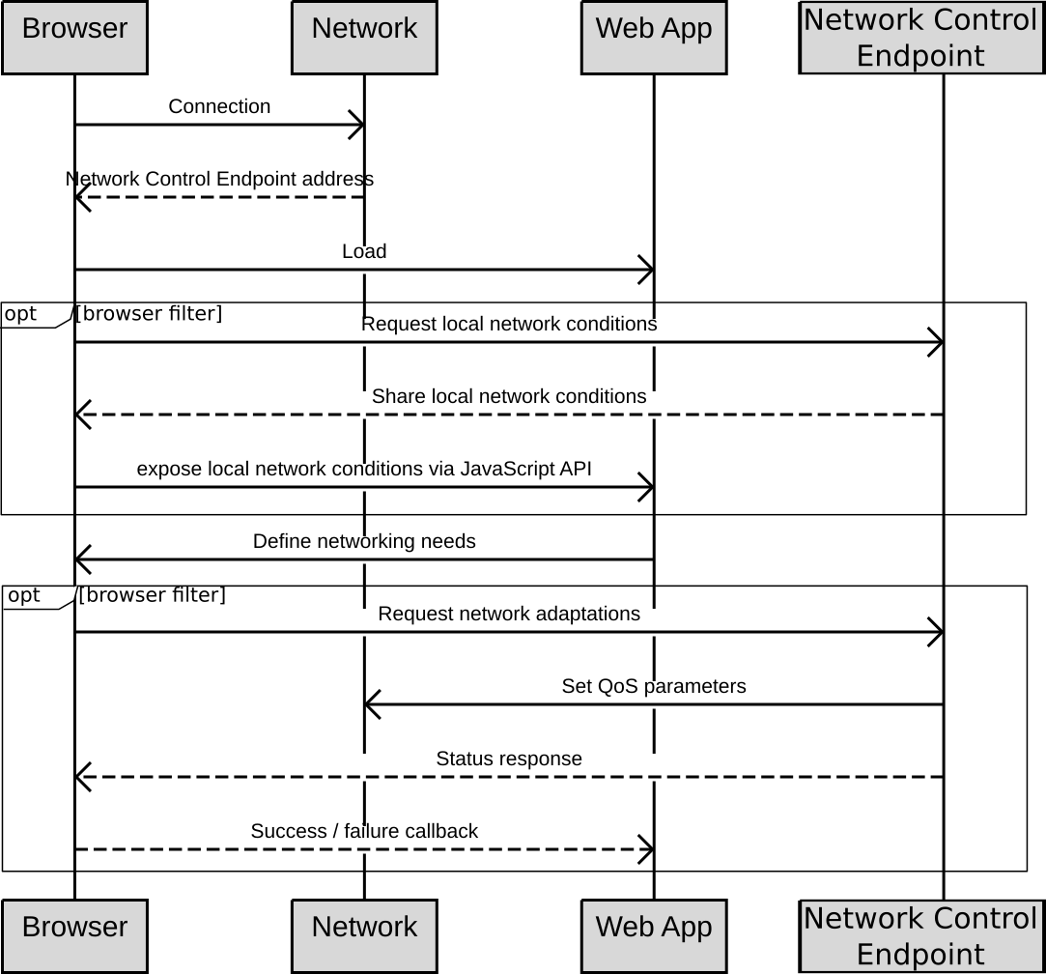
Integration of the Network Protocol Layer
Control of network layer:
Network slicing on-demand
Application-managed network performances (via Multi-access edge computing MEC)
Exploiting network-provided computing resources (MEC)
Discovery :
How to enable Web apps to adapt to their network context?
How to enable network to advertise their additional capabilities to long tail application developers?

Slide 9
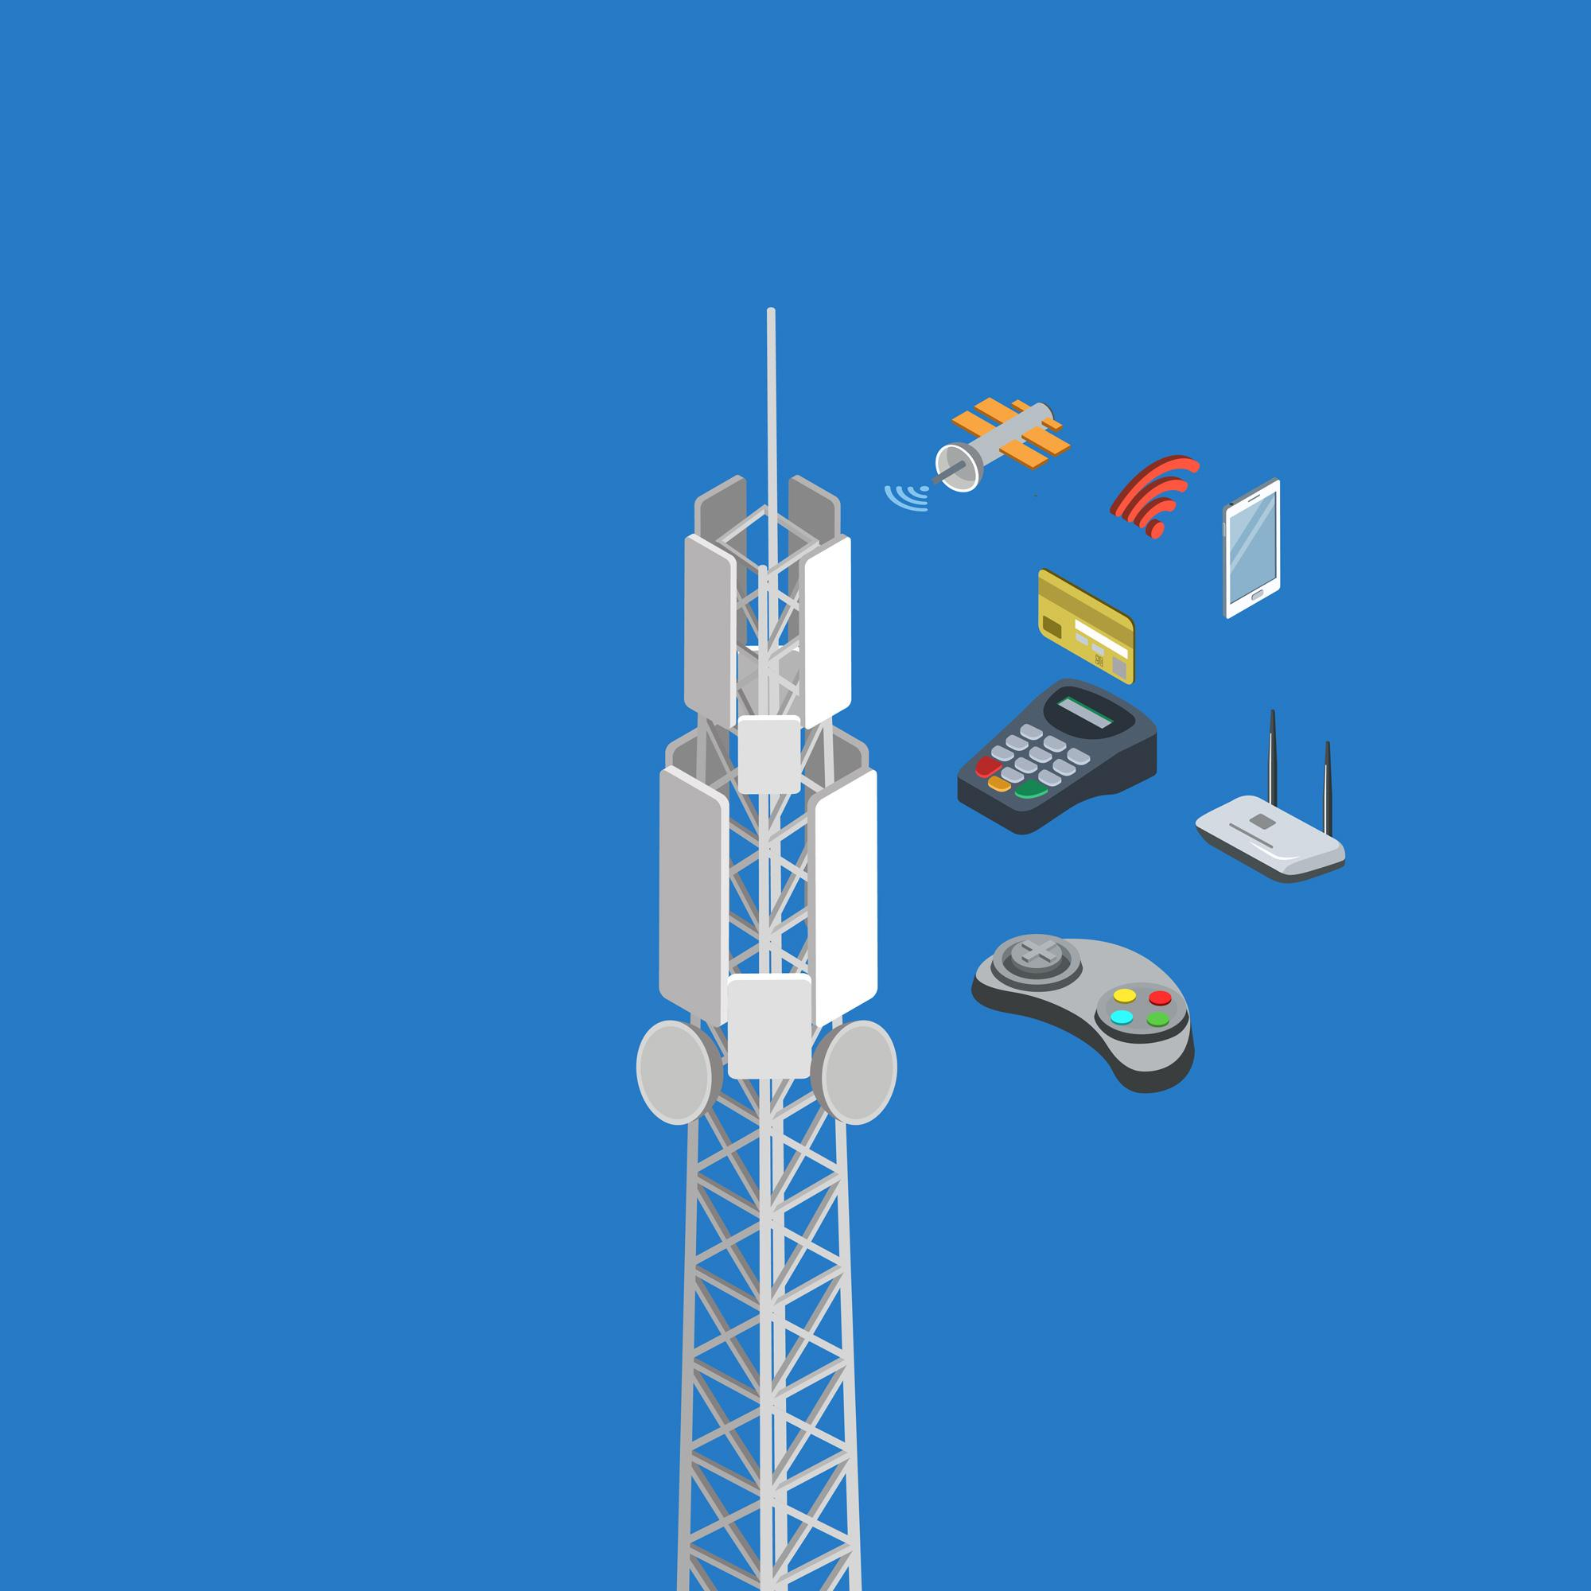
Pragmatic Steps
Hear all of the workshop input.
There is enough there for at least one; perhaps several CGs.
Need to determine how to have the conversation moving forward
about priorities and timeframes (used to be Web and Mobile IG).

Slide 10
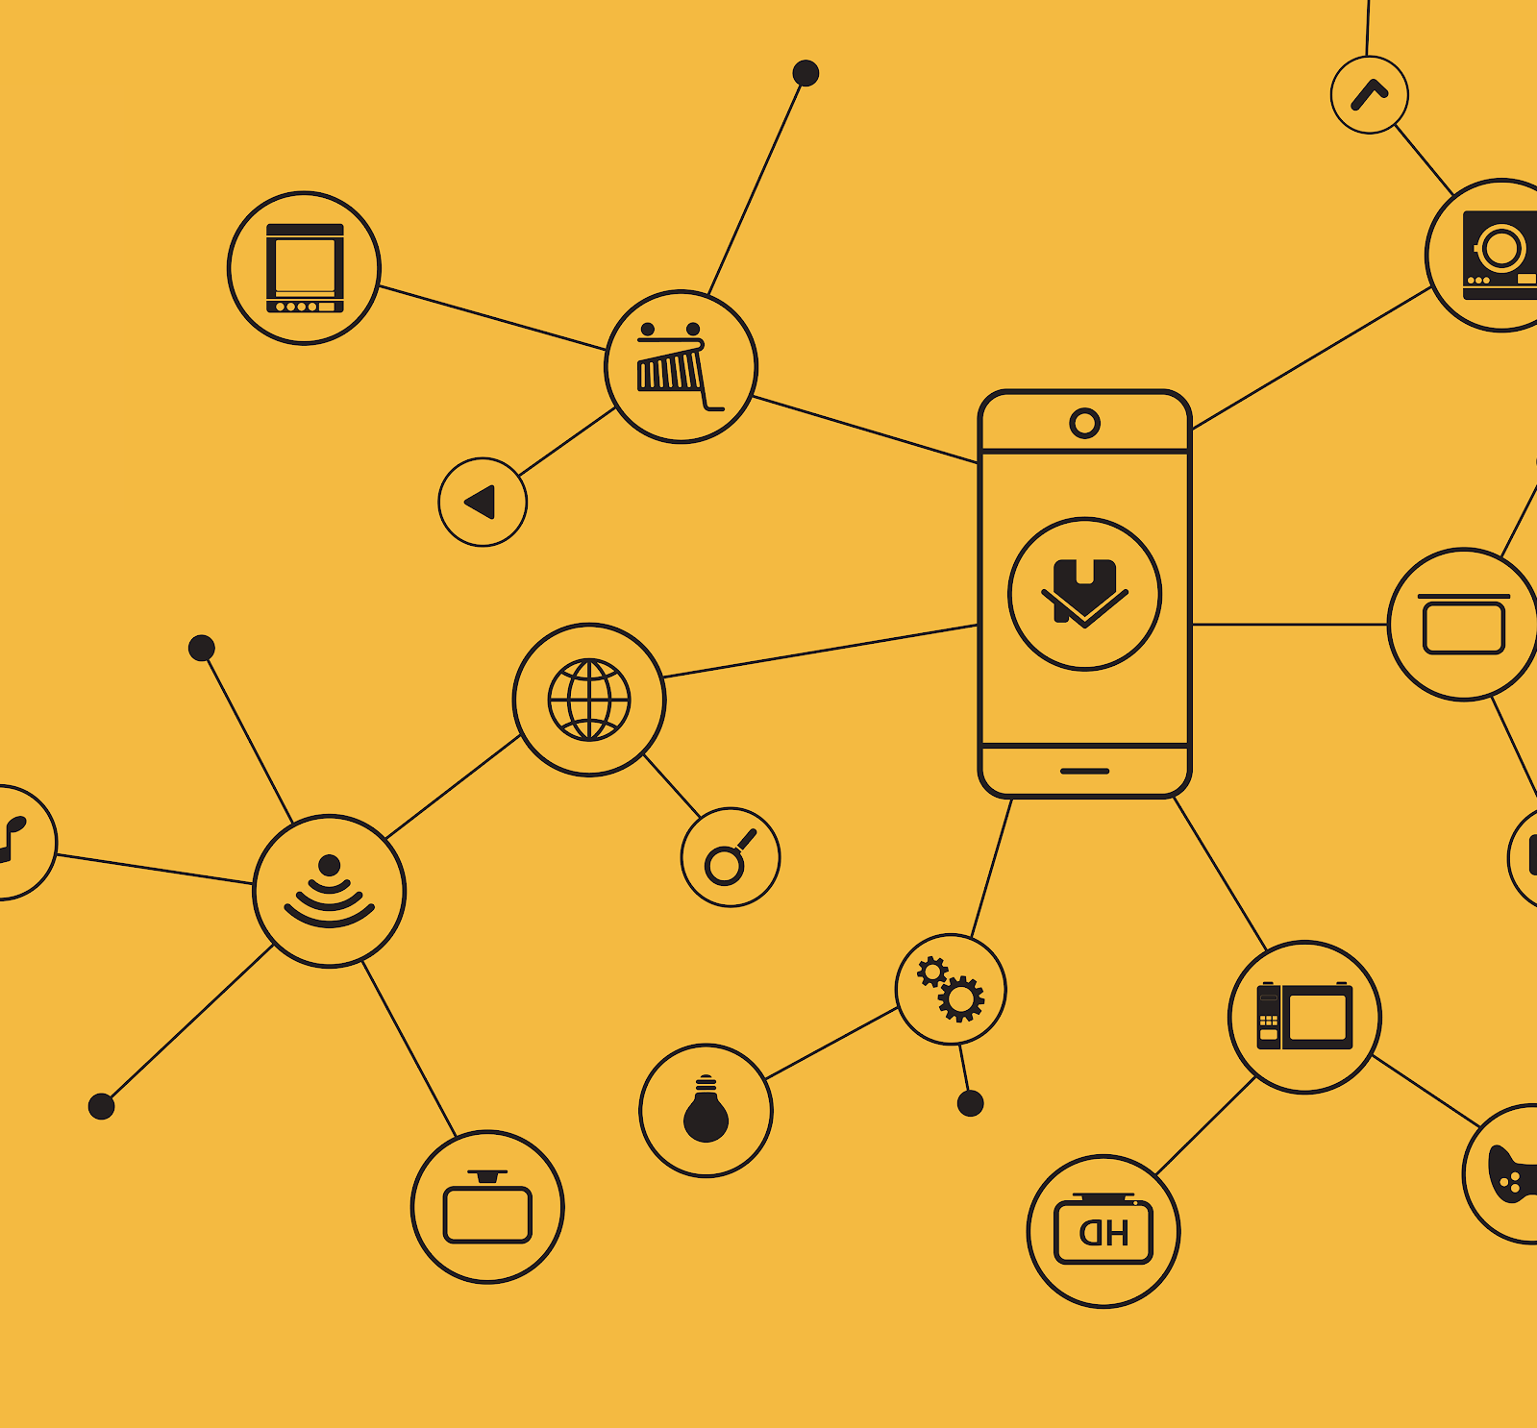
Recap
Between application possibilities and what the network can provide there is an enormous opportunity to again re-make the landscape of our connected world.
As engineers we need to focus on end-to-end solution and recognize that we are most likely to be slowed down by the middleware, if we don't get started on it.

