Slide 1
ISO 20022 and APIs

Slide 2
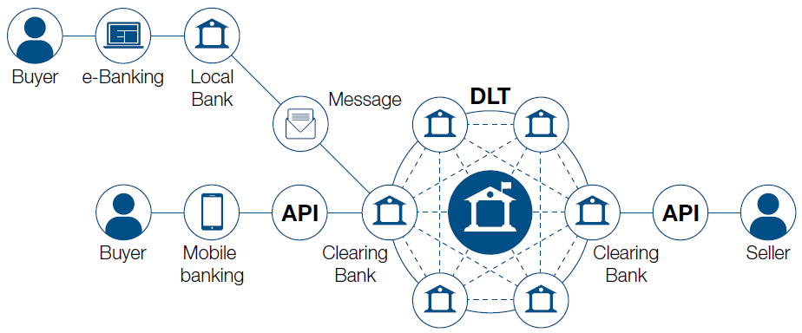
Extreme fragmented payments landscape, but the business standards remain the same…

Slide 3
PayLater standard

Slide 4
Who’s involved
Standards bodies
ISO 20022, Berlin Group…
Banks
Citibank, Lloyds, Nordea…
Merchants
Electrolux, booking.com, Amazon…
Service Providers
Google, SWIFT,…

Slide 5
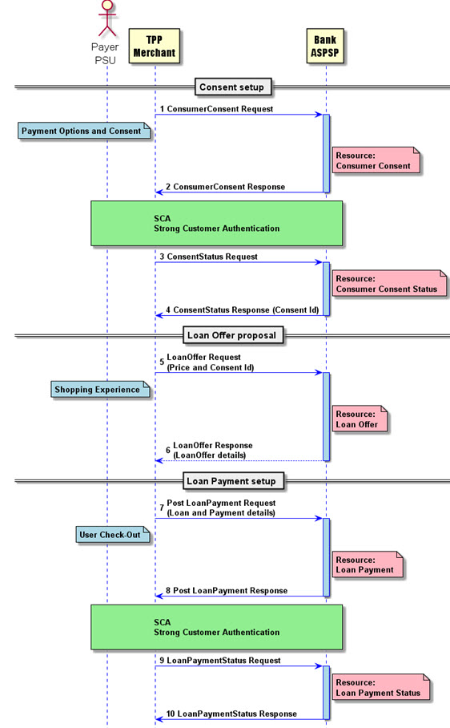
Define the Paylater Flows

Slide 6
Define the Resource data model endpoints (and methods)
Uniquely identifies the Account resource
Id:ResourceId
Name: Max35Text
…
consumer_consent
Methods that can be applied in this Resource/endpoint
Read
The path to an endpoint
Id:ResourceId
Name: Max35Text
…
consent_status
Id:ResourceId
…
loan_offer
Id:ResourceId
…
Id:ResourceId
…
payment_status
loan_payment
Read
Read
Read
Read
…and SWIFT has a POC that allows you to do this

Slide 7
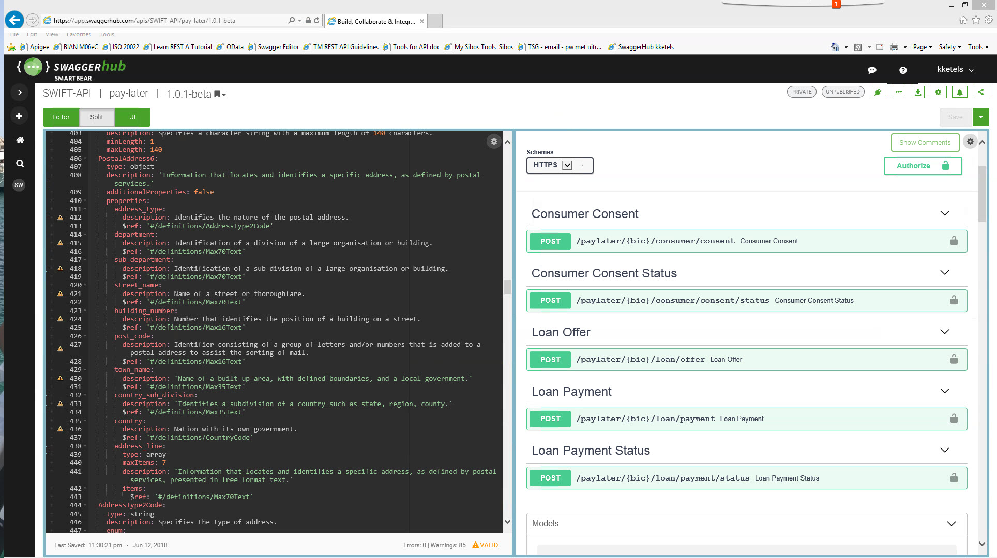
Push to an API design tool (such as Swagger)

Slide 8
Thank you

