Slide 1
Security and Privacy Questionnaire
Document update progress
TPAC 2018
Lyon, France
Lukasz Olejnik
@lukOlejnik

Slide 2
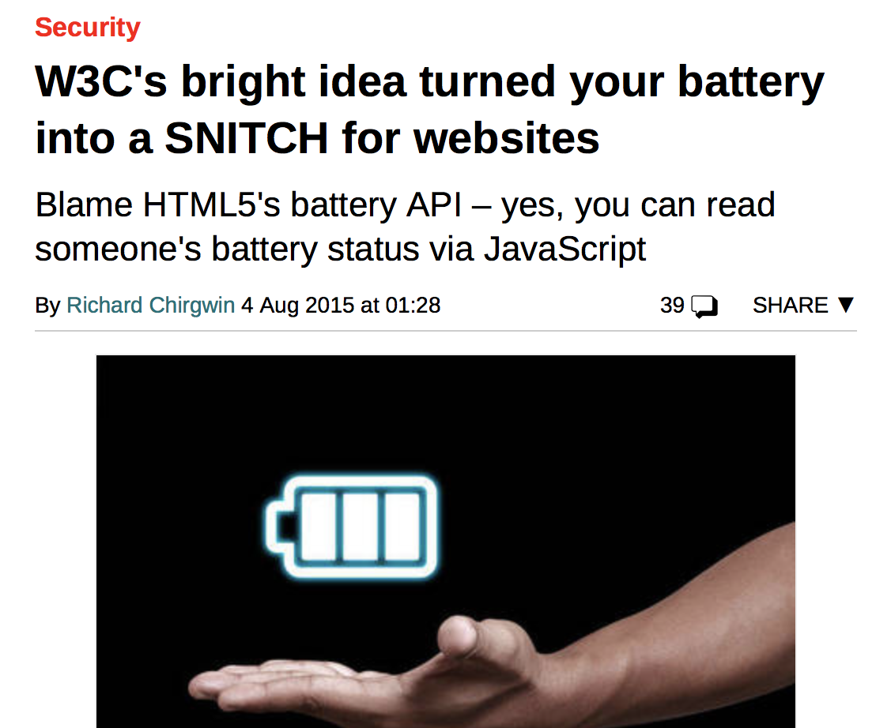
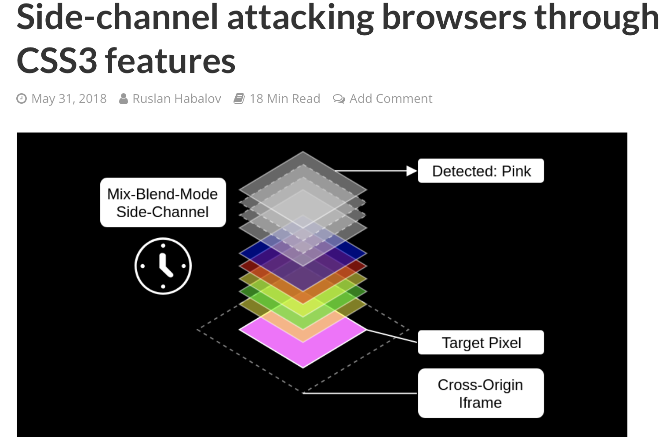
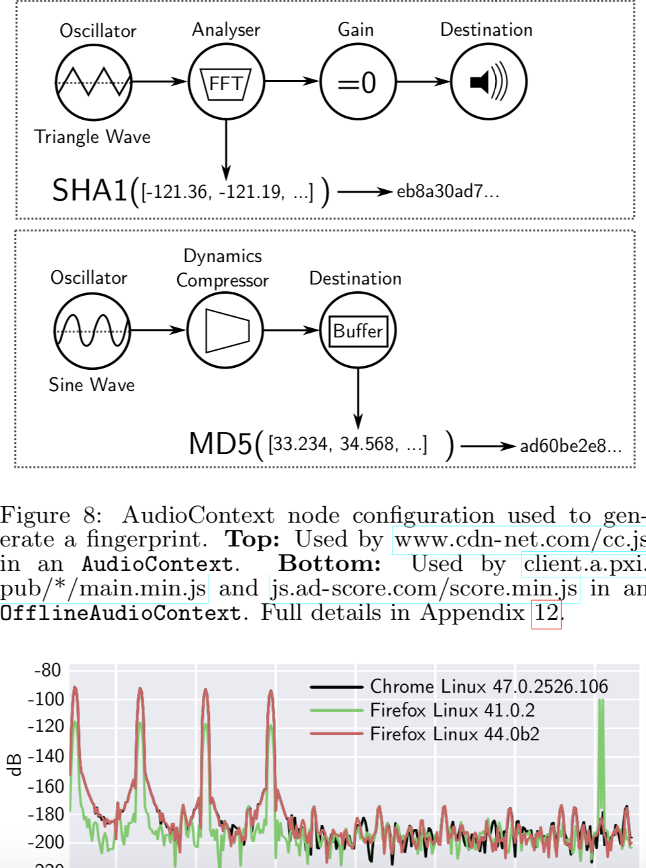
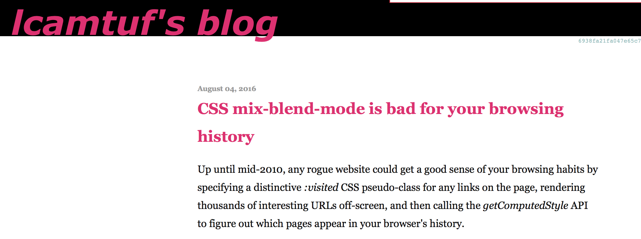
Successful track of privacy record

Slide 3
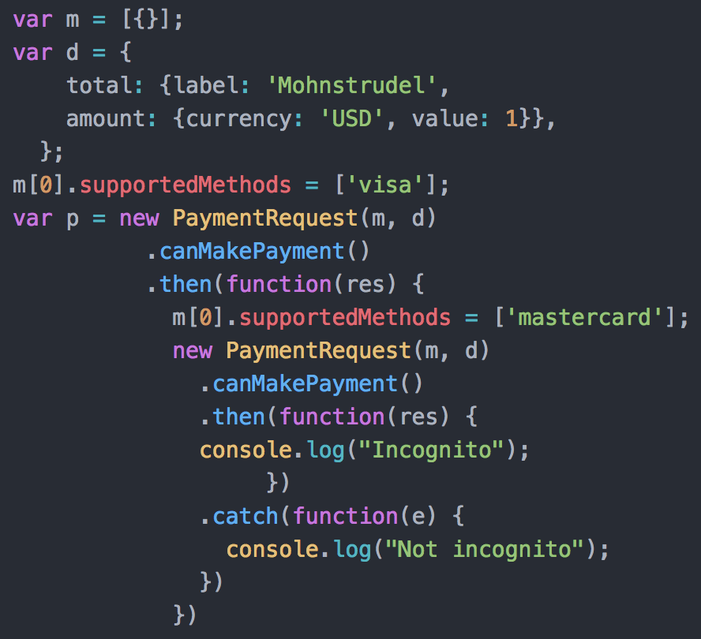

Precision matters?
Incognito detection With Web Payment API
Chrome enforces 30 minute per-origin quota on canMakePayment()
  Can’t test for visa and subsequently for mastercard
    NotAllowedError: Not allowed to check whether can make payment”.
Quota not enforced on Incognito
  Means: NotAllowedError not triggered!
  Can test for any card we like and no exception is returned
Deterministic test for Incognito mode

Slide 4
We have found the right solution
More Paper Work

Slide 5
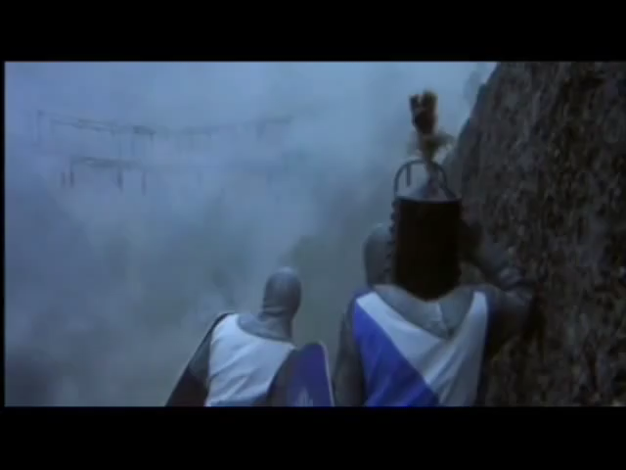
We carefully analysed multiple models
Including non-traditional

Slide 6
Remaking S&P Q
An update for more civilised times.
Mike West is out (thanks for the work!).
Lukasz (moi) took the ownership [January 2018].
New editors [October 2018].
    Lukasz Olejnik (independent / TAG).
    Jason Novak (Apple / PING).

Slide 7
The new process?
Privacy by Design.
  I’d love to explain more what this means.
  Today: Think of security and privacy on early phases.
Fill in the review prior to asking for a TAG review.
  Feel free to ask for external support, i.e. PING or so.

Slide 8
High-level design recommendations for new features
In 5 seconds
Drop the feature.
Don’t assume things are fine. They might not.
Sanitize the data handled in the feature.
Making a privacy impact assessment.

Slide 9
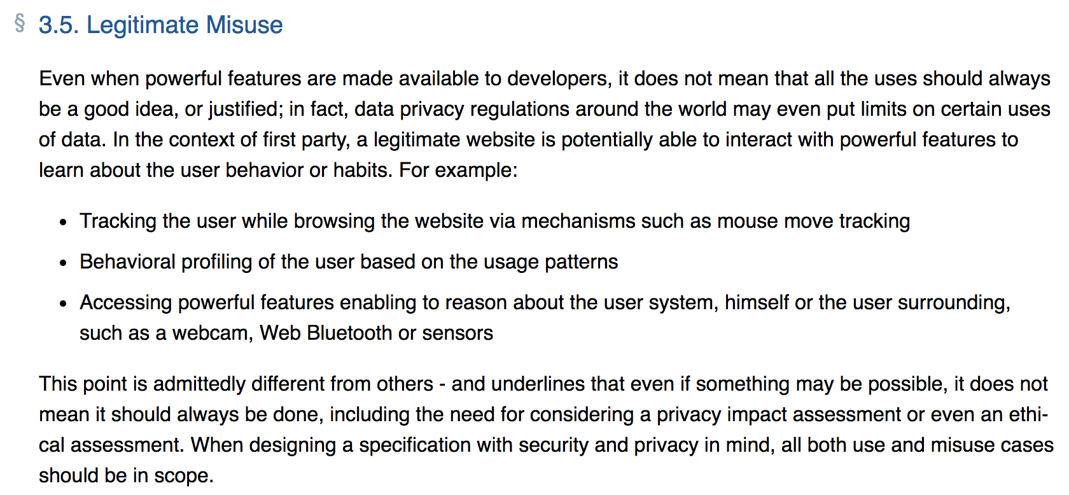
We also have this

Slide 10
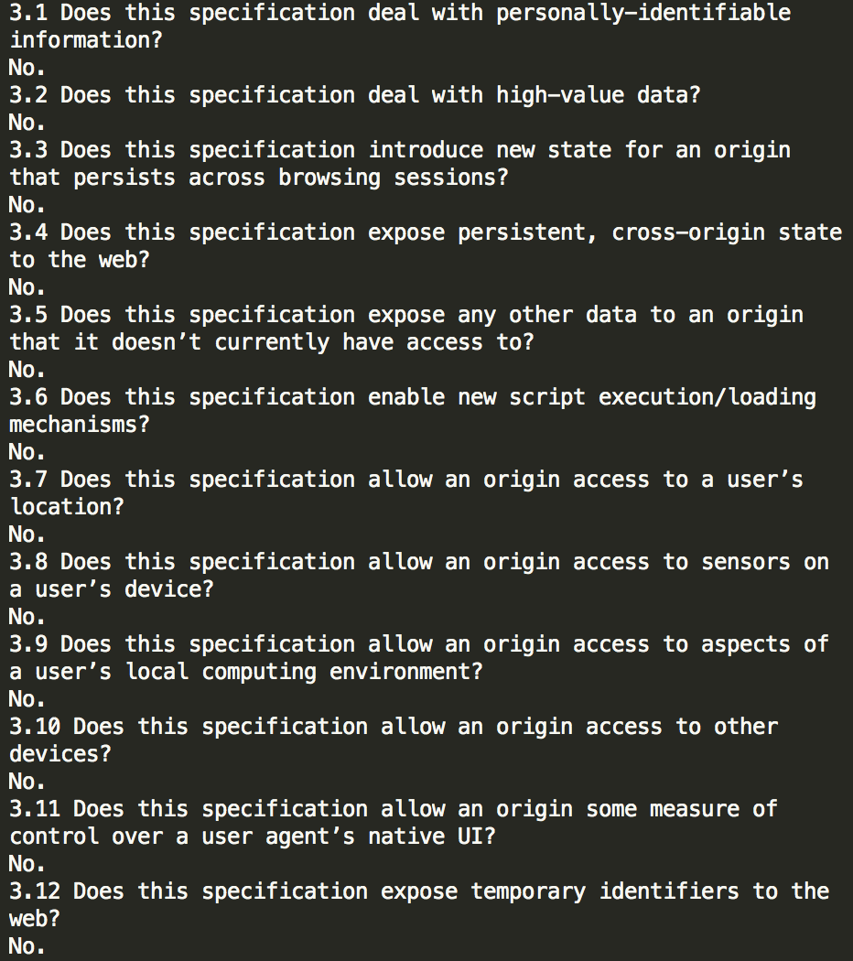
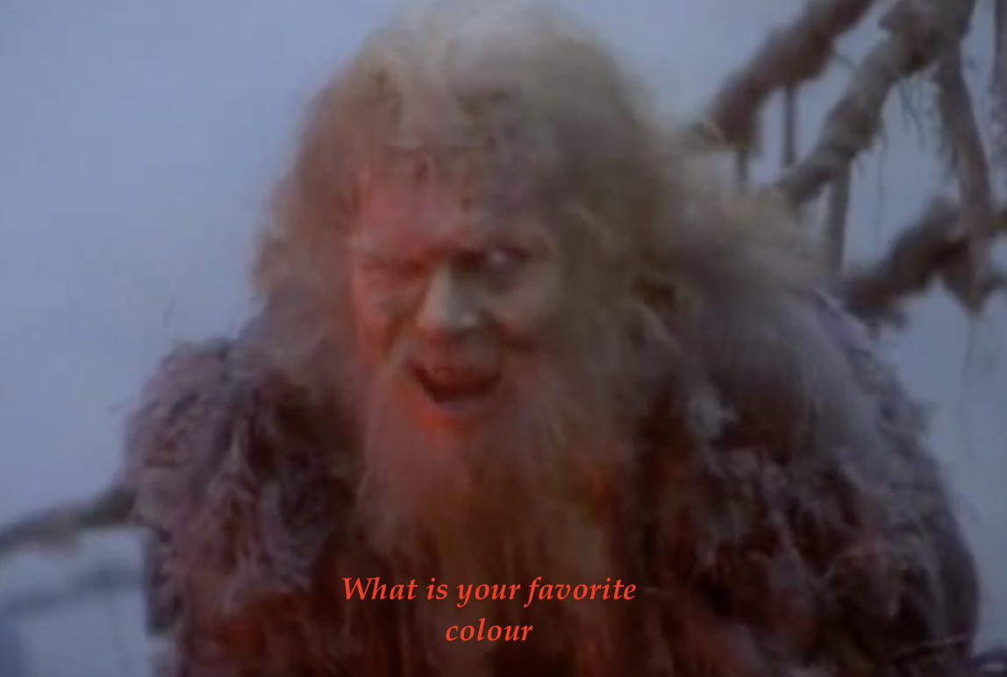
NOT A CHECK BOX
Should not be used as a “check box" exercise
  Not helping improve privacy or security.
  Makes Lukasz sad
Each question needs to be considered
  Describe concerns, along with a possible mitigation strategy (if you have it).
One-word answers not good (“yes” / “no”).
  Include an explanatory description.
“Why” and “how”, rather than “if”.

Slide 11
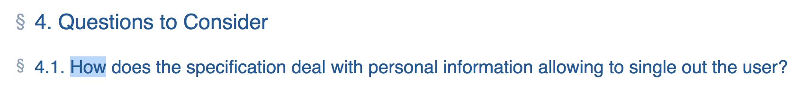
Example new question
“Does the specification deal with personal information allowing to single out the user?”
  Not Really useful answers: No, Yes, Blue
“How does the specification deal with personal information allowing to single out the user?”
  Not Really useful answers: Anyhow, It does not, Get lost
“What information might this feature expose and why”?
  Maybe in this way?

Slide 12

Main takeaway
Security and Privacy is Important
We’re doing Something
Provide more context to feature authors
Ask for more context
Make filling the questionnaire mandatory
Aim for final somewhere in 2019
me@lukaszolejnik.com
lukaszolejnik.com
@lukOlejnik

