Slide 1
Privacy Language Requirements

Slide 2
Lessons Learned from LPL
Layered Privacy Language (LPL)
Policy-Structure
Policy -> Purposes -> Data
Separation between Data-Source and Data-Recipient
Free Specification of Content for Elements
P3P had limited set of values for e.g. purposes
Human-Readability and Machine-Readability
Transfer of Data is considered
Sticky Policy
Layers of Policies (can be discussed)
Implementation agnostic formalization (XML, JSON, Semantic?, …)
Personalization of Privacy Policy
Defintion of
De-Identification rules (anonymization, pseudonymization, privacy models) realistic?

Slide 3
Layered Privacy Language (LPL)
On May 25 2018 the General Data Protection Regulation (GDPR) will be enforced
Legal View:
Privacy Policy Structure
Data Subject Rights
Consent
Human-Readability
Technical View:
Access Control
Anonymization Method
Privacy Model
Provenance
LPL is a language combining the Legal and Technical View on Privacy

Slide 4
Topics to Consider
Topics (Policy Language Content)
What does the policy model? Holistic approach or Domain-specific approach?
Consider specific legal framework
GDPR (different national interpretation)?
HIPAA?
Privacy in Asia?
Purpose of the Policy Language
Inform Users?
Enable Negotiation?
Data Trading?
Enforcement of Policies (Purpose-based Access Control)?

Slide 5
Topics to Consider
Topics (Policy Integration)
How to integrate the privacy policy into/onto existing technologies?
Internet of Things
Edge Computing has limited resources?
Cloud Computing might be too late?
Big Data
How to process policies from different sources?
What is the overhead (storage, processing time)?
Mobility
Differentiation between drivers?
Communication between smart cars and smart cities?
„Default“ Applications? Integration in Databases? Privacy Patterns?

Slide 6
Topics to Consider
Topics (User Interface)
Inform Users on the processing of personal data
Legal Validity should be assumed; Focus on Purposes of Processing
Purposes which are „unusual“
Purposes which can be modified (opt-in; opt-out)
What is Privacy by Default? Provide different pre-defined settings of privacy?
Privacy Icons to give fast overview
Not standardized yet; domain-specific?
How to capture consent?
Guideline for Policy Content (Text) Creation?

Slide 7
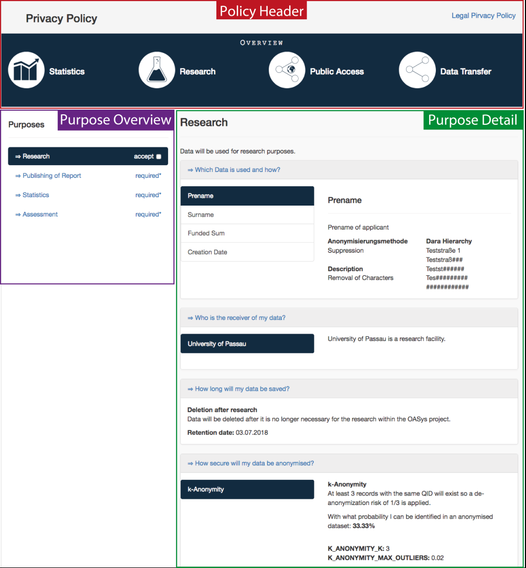
User Interface
LPL Personalized Privacy Policy UI
VISM Approach
Overview with Privacy Icons
Consent/Dissent to Purposes
Proof-of-Concept for Web-Applications
Future Work
More Personalization (DataRecipient, Data, etc.)
V2 coming soon (JSF-TagLibrary)

Slide 8
Topics to Consider
Topics (User Experience)
Consider Different User Groups
„Normal“ User; Children; Elderly; Disabilities (Blind,…)
Personalized Automatic Policy Negotiation
Personal Privacy Preferences Language (e.g. P3P and APPEL)
(College will begin his PhD thesis on this with LPL)
Tracing of Agreed/Consented Policies
Browser Plugin to browse accepted policies
„Remember“ decisions to apply them again
Give the user the feeling that a service is privacy-conform (e.g. icon in url-line?)

Slide 9
Topics to Consider
Topics
Security and Privacy
Will the policy contain personal information? Privacy-Inferences?
Do we need Encryption? Signatures?
How to establish Trust? (System like SSL?)
Avoid Tampering with Policies?
Policy Validation (P3P didnt check for conflicts)
Protocol (Centralized?; Dezentraliced?)
How to communicate the policy between machines?
How to handle different Versions of the policy (V1.0, V1.5, V2.0)
How are changes communicted within the „policy-network“ (my work)
Accountability?

Slide 10
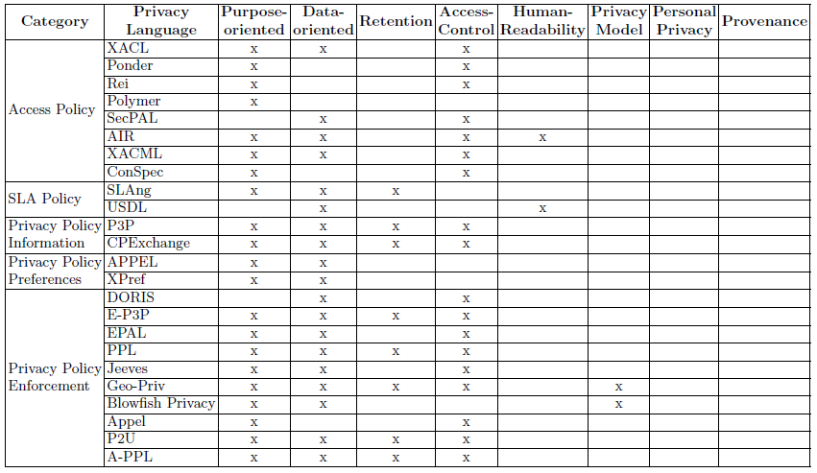
State-of-the-Art Analysis

Slide 11
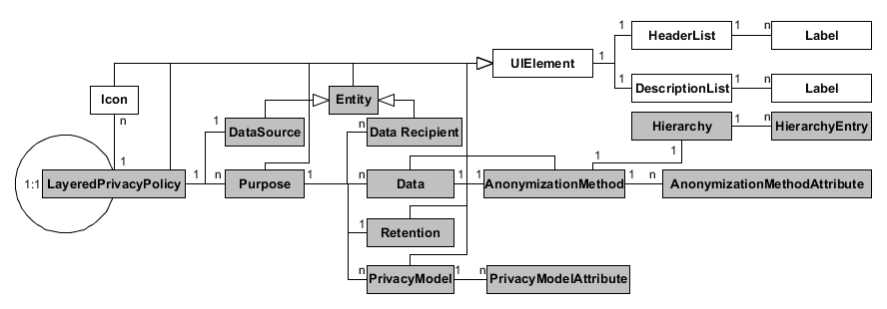
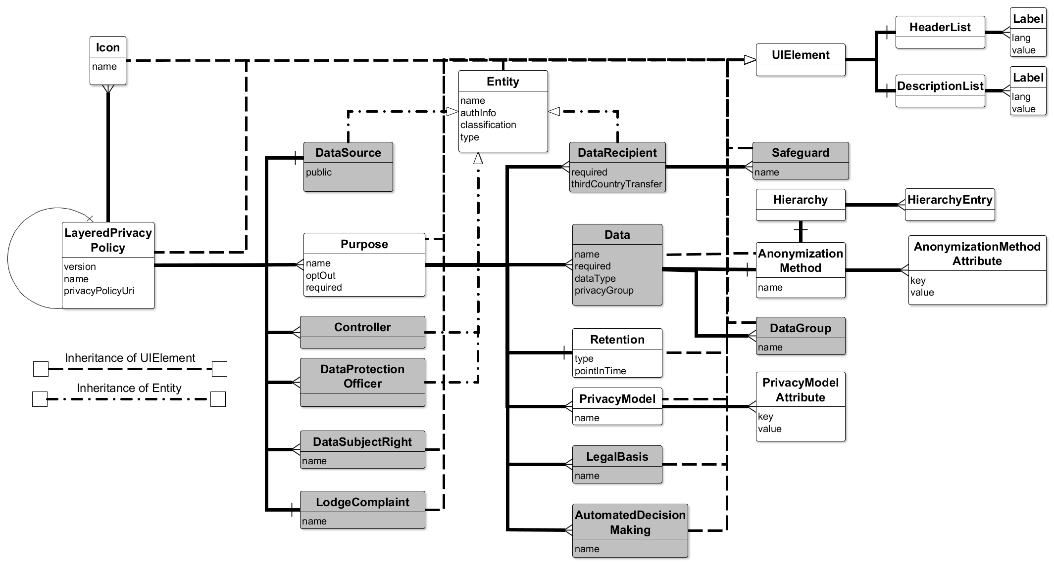
LPL Evolution
Layered Privacy Language:
LPL UI Extension:
LPL Art. 12-14 Extension:

Slide 12
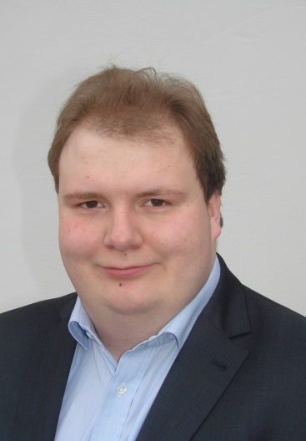
HELLO! BONJOUR! SERVUS!
Contact
2nd Year Cotutelle PhD Student
Mail: Armin.Gerl@uni-passau.de
Thesis: Modelling of a Privacy Language and Efficient Query-based Anonymization
Supervisors: Prof. Harald Kosch, Prof. Lionel Brunie
Co-Supervisor: Dr. Nadia Bennani

