Slide 1
What is the Spatial Data on the Web Interest group up to?
108th OGC Technical Committee
Stuttgart, Germany
Linda van den Brink, Jeremy Tandy
10 September 2018

Slide 2
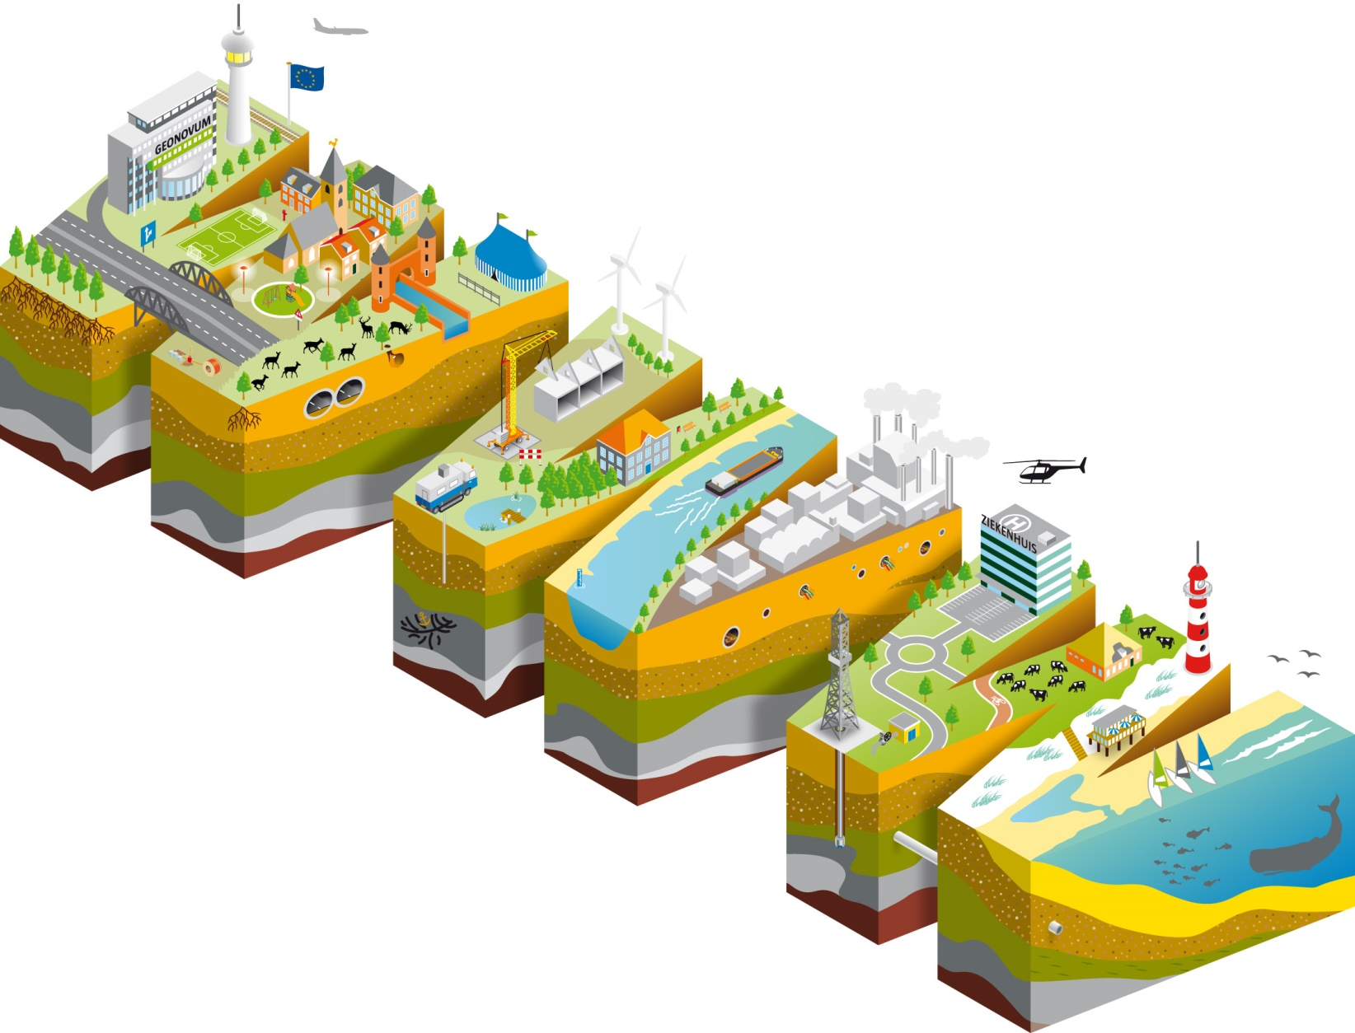
Spatial Web data: findable by search engines, usable by web developers
Notes:
What we are about again

Slide 3
The transition
Spatial Data on the Web…
working group > interest group
What the working group (2015-2017) did:
Integration of spatial information with other data on the Web;
Gather best practices for publishing spatial data on the web;
Complete the standardization of informal technologies already in widespread use: OWL Time, Sensor Network Ontology
Work on web coverages ‘n stuff
Notes:
Highlighting that SDWIG is the successor to SDWWG and that the process has been pretty much seamless: most of the same participants, evolution of work created by SDWWG is being performed or directed by SDWIG.

Slide 4
Ongoing work (currently)
What the Interest Group (Oct 2017 – Dec 2019) is doing:
Statistical Data on the Web Best Practice
Spatial Data on the Web Best Practice: Implementation & adoption
SSN + OWL Time: Errata
Sheparding new ideas for standards
Website: https://www.w3.org/2017/sdwig/
Notes:
Evolution of work created by SDWWG is being performed or directed by SDWIG.

Slide 5
SDWIG: how we operate
“Interest group” (W3C speak) = similar to a DWG and we’re also pretty similar to OGC/ISOTC211 JAG
Difference with SDWWG: we cannot create standards!
This is okay because we are doing cool stuff: Identifying, evaluating & incubating work for standardization related to spatial web data
Reminder: we are operating mostly using W3C processes and tools but we are a joint W3C/OGC group and ANYONE WHO IS AN OGC member can join!
Deze foto van Onbekende auteur is gelicentieerd onder CC BY-SA
Notes:
Note that there is an important difference between the previous group and the current one: the WG per W3C rules could actually create standards and had a finite life span. OGC flexed its process a bit to allow the group to generate standards-level output despite not being a formal SWG. The IG is like a very-well organized DWG: it evaluates requirements and identifies work for standardization, but any real standards work would have to be pushed to an OGC SWG and a W3C WG. Many of the rules for SDWIG are based on a proven model of cooperation in the JAG with ISO / TC 211.

Slide 6
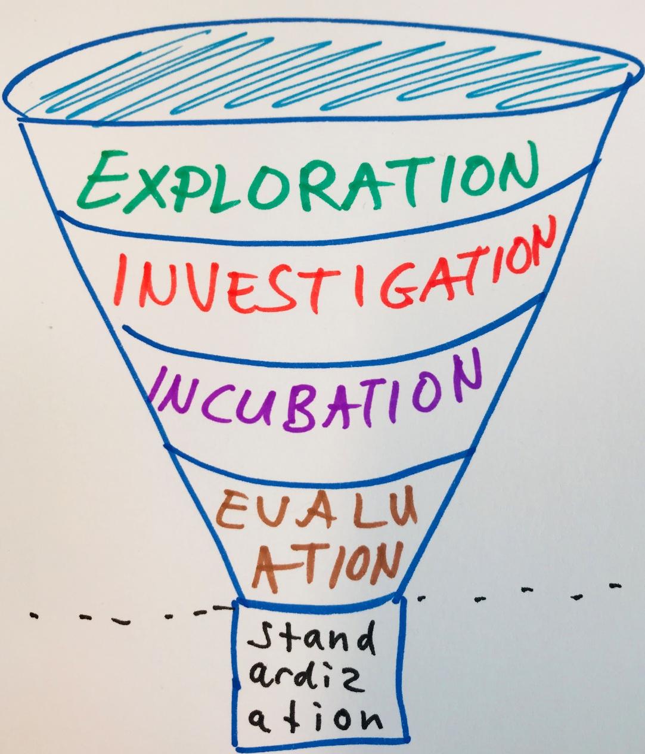
Work method: “The Strategy Funnel”
Advancing ideas towards standardization
From newbie ideas…to concrete SWG proposals
Notes - discussion papers, best practices…
We do not operate below this line!
Notes:
A really exciting work method occurring in SDWIG is the use of a funnel to identify candidate ideas and draft specifications that might be suitable for standardization. This is a formal process to assess maturity that works somewhat like the use of Best Practices and Discussion Papers in DWGs to advance prototypical standards. The difference from OGC DWGs (and an idea that perhaps some DWGs should adopt) is that the funnel activity is very structured and intersection points with other groups in the OGC and W3C are identified early. A few examples (including WebVMT) would be useful - these examples can be the meat of the presentation.

Slide 7
Strategy funnel
Find it here: https://github.com/w3c/strategy/projects/2 (filter on ‘geospatial’)
Scope: Geospatial + Web
Evaluation of new possible standardization items
Viability
Leadership
Support, community
Maturity
Should [item] be developed at OGC or W3C or in a joint group?
Notes:
Go to strategy funnel… look at WebVMT and its traversal through the Funnel.

Slide 8
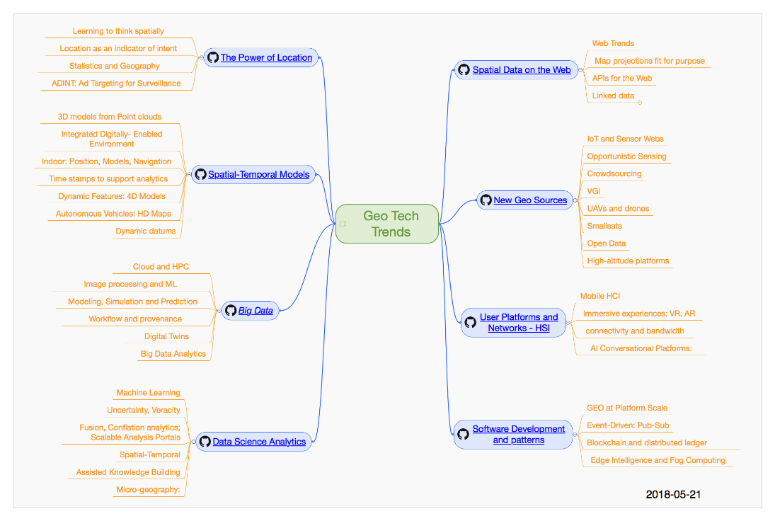
Coordination with OGC
OAB is informed when an item moves forward
Working groups to be formed through proper procedure
Regular coordination with OGC Technology Trends

Slide 9
Through the Strategy Funnel… and then?
If something is ready for standardization, a new SWG will be established to advance the work
SDWIG will guide the harmonization of JOINT working groups
Standards Working Group (SWG)
and/or
Working Group (WG)
Notes:
Again: SDWIG is not a SWG. If some work is thought to be ready for standardization, a new SWG will be established to advance that work and it will all occur per both OGC and W3C processes, harmonized as best as is possible. That harmonization will guided just as rigorously as happens with ISO / TC 211.

Slide 10
Questions? Ask us! SDWIG chairs: Linda van den Brink l.vandenbrink@geonovum.nl @brinkwoman Jeremy Tandy j.tandy@metoffice.co.uk
Notes:
I hope everything is clear!

