Slide 1
The merging of Web and Mobile APP
Introduction of Weex open source project
Dapeng(Max) Liu
Alibaba

Slide 2
Content
Challenge in Mobile Web
Proposed Direction
What is Weex?
2

Slide 3
Challenge in Mobile Web
W3C DOM and related standards are originally designed for PC browsers
Mismatch between DOM and mobile development
The latest features on mobile platform are usually hard to be exposed by current Web APIs
3

Slide 4
Challenge in Mobile Web
Cross-Platform
Development Efficiency
Function & Performance
Requirement:
Flexible platform API
High performance
Fast Iteration
Run in browser
Hybrid
Compared with Native
Different HTML5 capability
Limited access of platform API
UI interaction needs improve
Different HTML5 capability
Low performance
Performance ! !
4

Slide 5
Content
Challenge in Mobile Web
Proposed Direction
What is Weex?
5

Slide 6
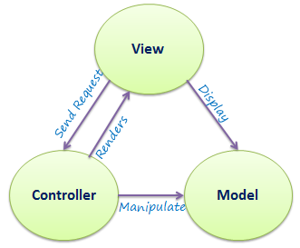
Proposed Direction
DOM for Mobile
Abstract the features of mobile platform
Support the cross-platform of mobile development
Possible items
Use DOM for mobile to describe the similar concepts as in Native, like MVC (Model, View, Controller)
Describe the application life circle management suitable for Mobile
6

Slide 7
Content
Challenge in Mobile Web
Proposed Direction
What is Weex?
7

Slide 8
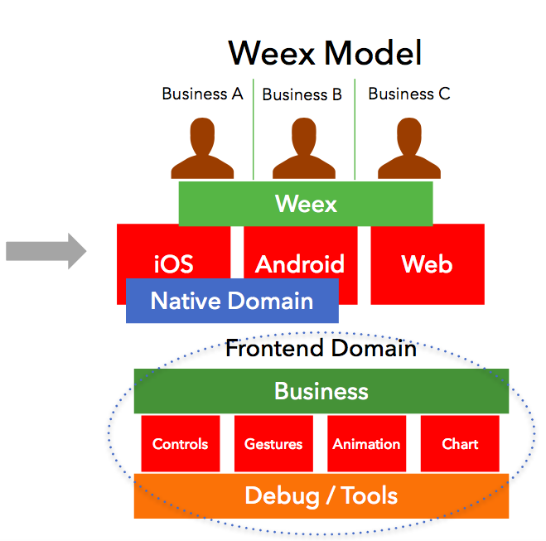
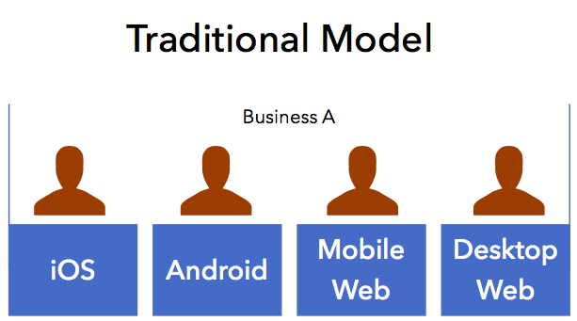
What is weex？
A web development framework can run on cross-platform of mobile.
8

Slide 9
Weex ecosystem
Developer community
Development efficiency
Performance & Experience
Implementation
15K+ developers
Open source components library and tools
The development time can be reduced by 50%
For loading time, the performance gap with Native is about 100-200ms
100+ applications
https://weex.apache.org/cn/
9

Slide 10
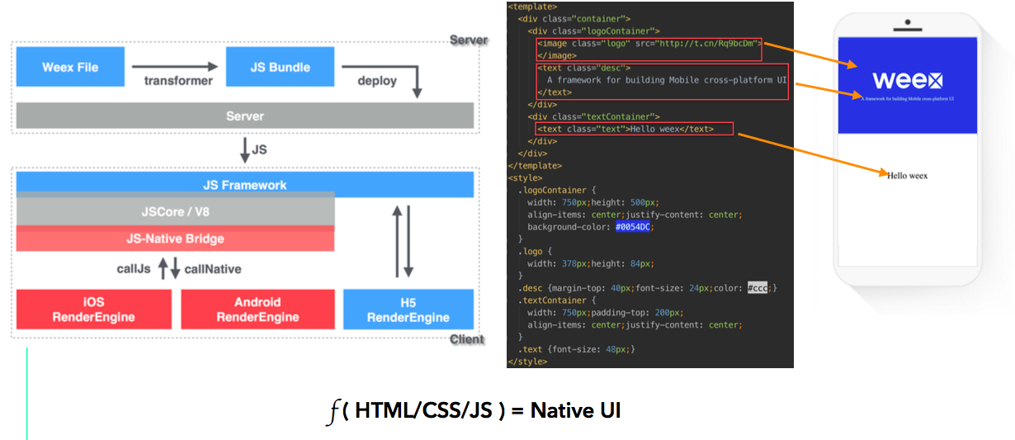
Framework & Architecture

Slide 11
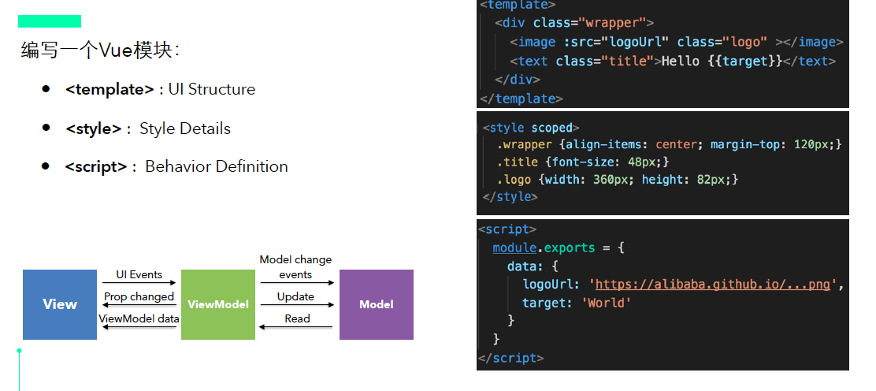

Slide 12
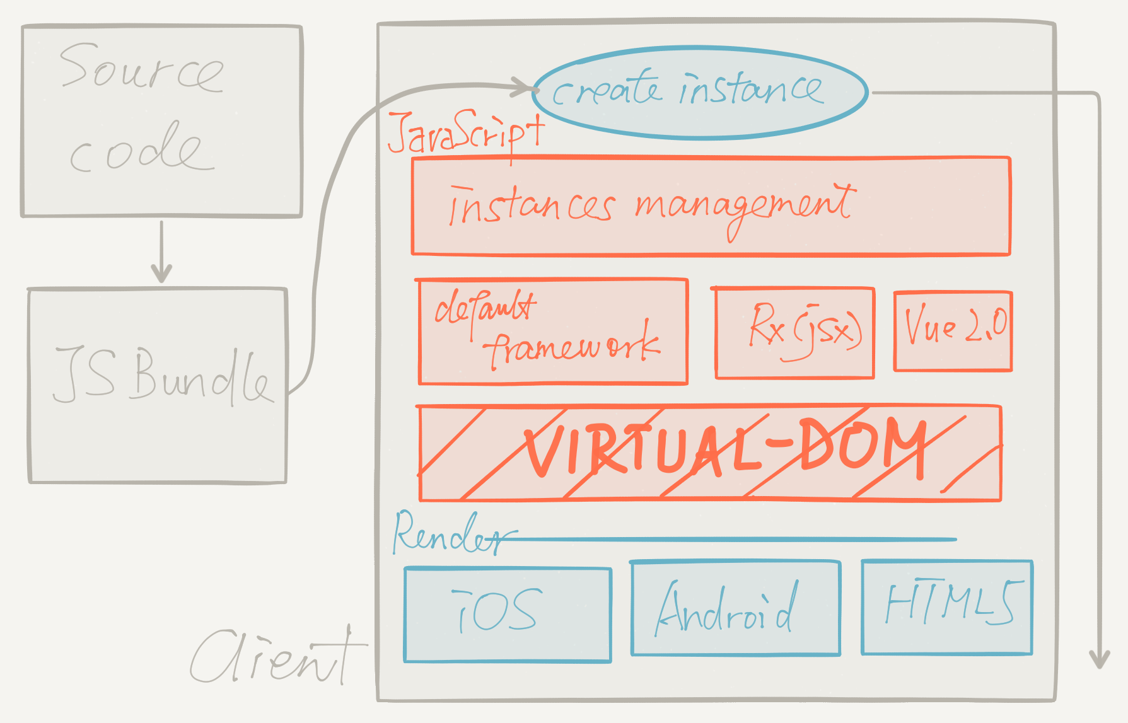
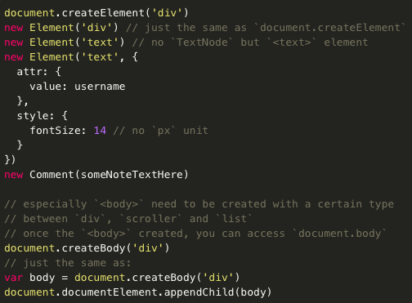
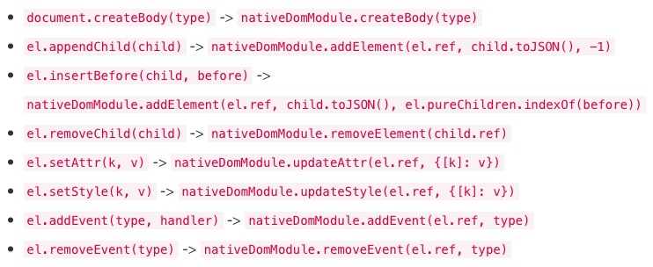
Weex virtual-DOM API
Weex can use JS control the view layer of native by weex virtural-DOM
Weex virtural-DOM API is a more neutral norms between Web and native
Native code corresponding to DOM code in weex virtural-DOM API
1
2
3
12

Slide 13
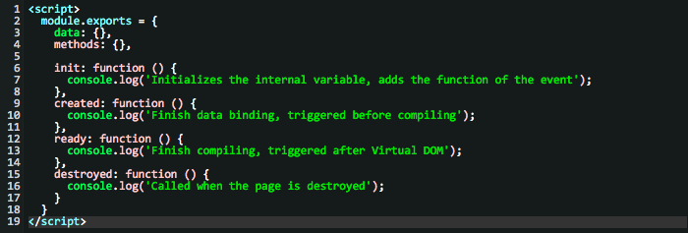
Weex life circle
13

Slide 14
Advantage
 | WEEX | Native | H5 | Hybrid APP
Development efficiency | High, JS/Html | Low, Android/OC | High, JS/Html | High, JS/Html
Performance experience | Good | Great | Not well | Ordinary
Component ecology | Good | Ordinary | Great | Great
Iteration speed | 1min | 2~3 weeks finish 70% | 1min | 1min
Learning threshold | Low, easy to learn | High, too many different language | Low, easy to learn | Low, easy to learn
Multi terminal cost | 1 version | 3 version | 1 version | 1 version
14

Slide 15
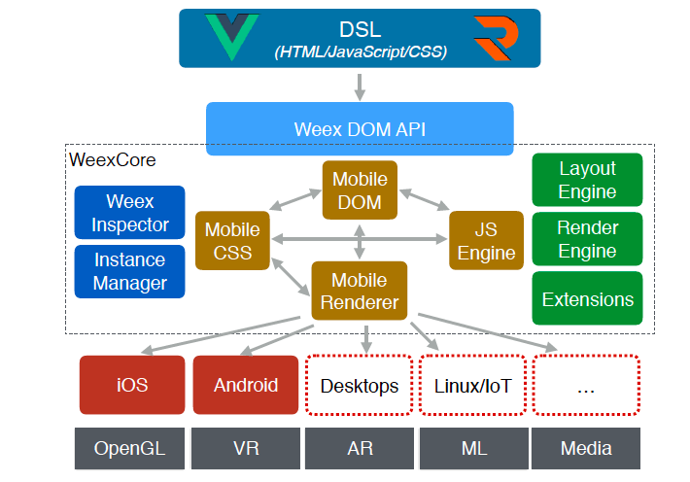

Slide 16
Proposed CG
https://www.w3.org/community/groups/proposed/

Slide 17
Thanks！

