Slide 1

PUBLISHING @ W3C

Slide 2

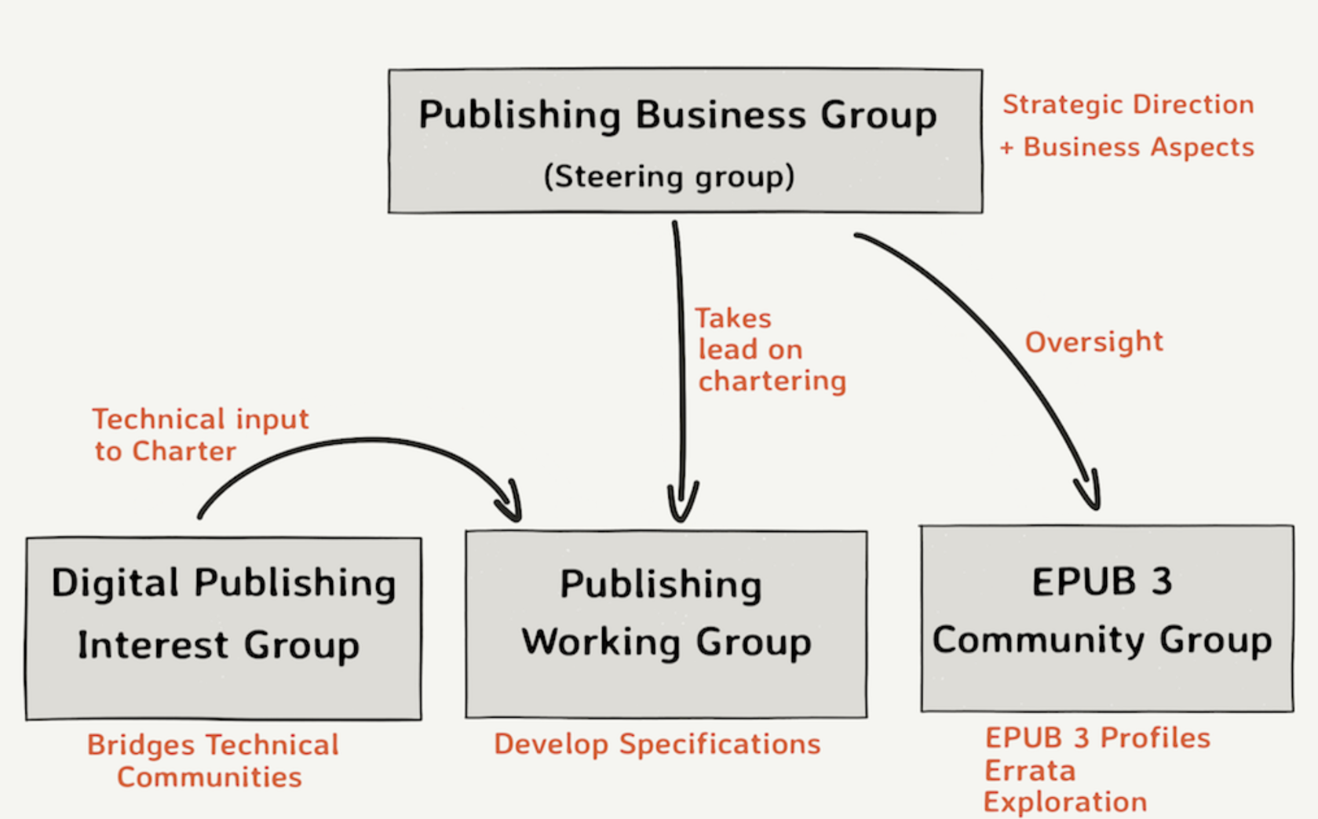
Publishing@W3C &
The Changing Face of Documents

Slide 3
Who Am I?
Rick Johnson
We are a (happy!) customer of what the W3C has produced!
We deliver web and native applications:
On 7 different platforms (also the platform behind Follett, Chegg, and Barnes & Noble Education)
With WCAG 2.0 AA accessibility (and a 100% score on the fundamental accessibility EPUB tests)
Supporting EPUB and PDF, with online or download/offline use
Delivering more than 25 million titles a year into the education market
To more than 15 million students at 7,000 institutions
One of the founders of VitalSource in 1994
AC rep for VitalSource | Ingram Content Group
Board member of the IDPF
Co-chair of the Publishing Business Group
Co-chair of the Steering Committee of Publishing@W3C
Board member of IMS Global
Chair of BISG’s EPUB Working Group
Passionate Accessibility Advocate
23 years in the ’eTextbook’ industry
12 years at Apple Computer as a National Consulting Engineer
Co-author of the LTI2 open source sample code
Co-inventor of 3 international patents around ebook distribution

Slide 4
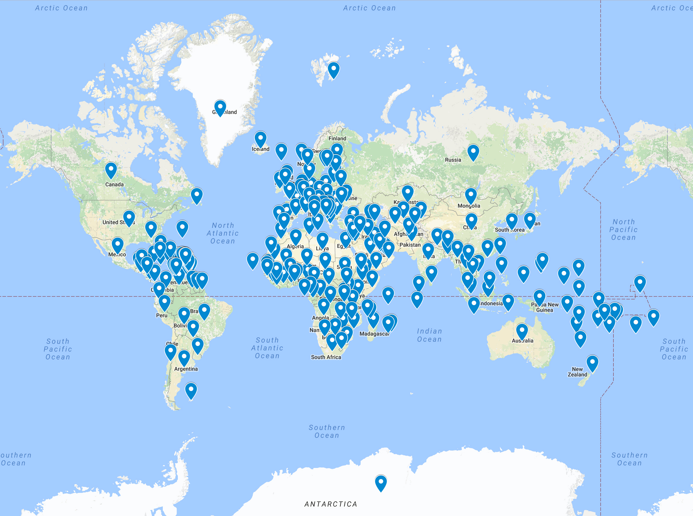
Arabic
Bulgarian
Catalan
Chinese-Simplified
Chinese-Traditional
Czech
Danish
Dutch
English-UK
English-US
Finnish
French
French-Canada
German
Greek
Hebrew
Hindi
Icelandic
Irish Gaelic
Italian
Japanese
Korean
Magyar (Hungarian)
Norwegian
Polish
Portuguese
Portuguese-Brazilian
Romanian
Russian
Spanish-Mexico
Spanish-Spain
Swedish
Tagalog (Filipino)
Thai
Tiếng Việt (Vietnamese)
Turkish
Welsh
Localized in 37 languages,
with users in 241 countries and territories

Slide 5
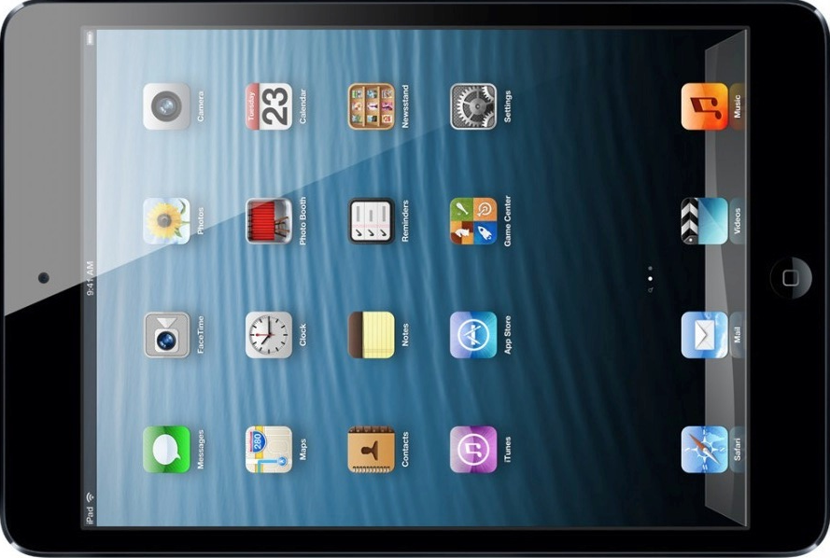


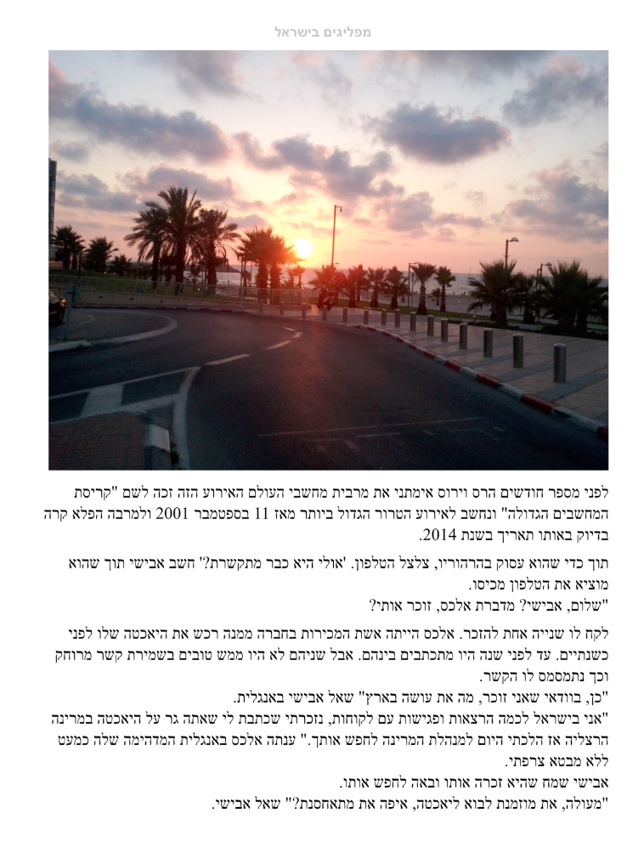
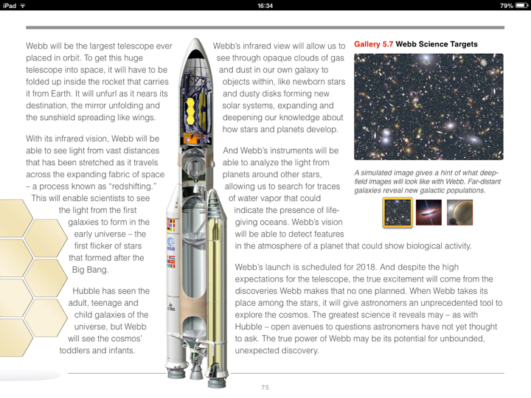
Not another one of those talks…

Slide 6

The
Act
of
Reading
HTML
DOM
CSS
SVG
JavaScript
…
OWP

Slide 7

Delivering the Web's original concept of a gigantic library of… publications

Slide 8

The
Act
of
Learning

Slide 9
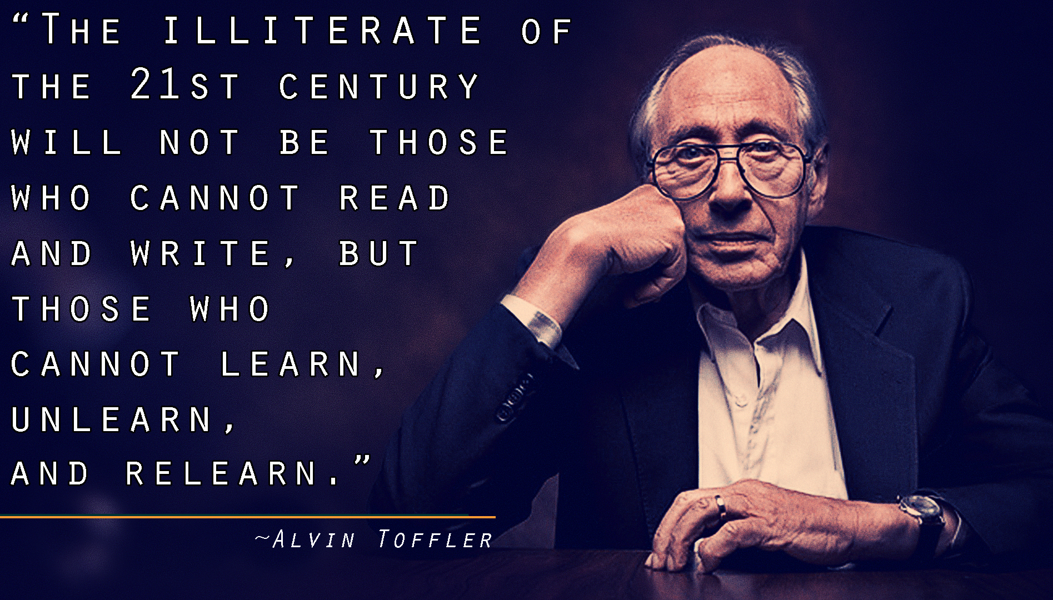

Slide 10
HTML
DOM
CSS
SVG
JavaScript
…
Interactive
Engaging
Compelling
Content
OWP

Slide 11
Demo Time!

Slide 12
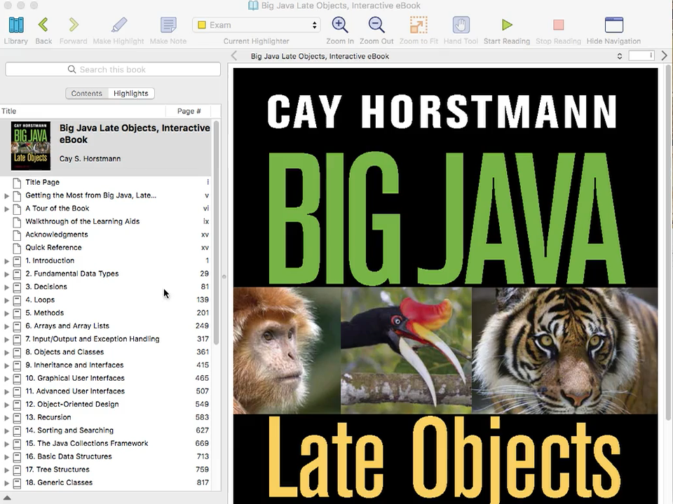
EPUB 3
with
Interactivity
Downloaded &
Offline

Slide 13
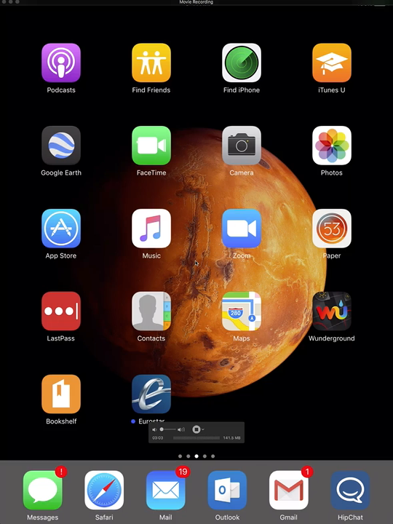
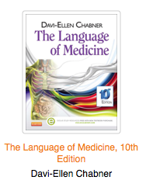
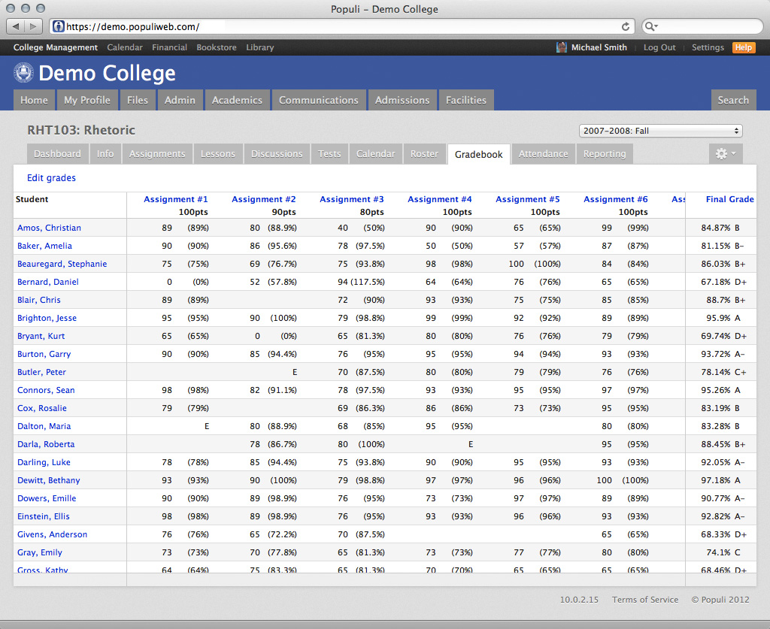
Online Course Environment
Todays Assignment
Deep link from a course
Returns an outcome

Slide 14

Live Demos!
The Hebrides, Opus 26 “Fingal’s Cave” by Mendelssohn
Timbre: The Color of Sound

Slide 15

Learning content is changing…
…new requirements need new approaches

Slide 16

Learning content is changing…
In Education
30.9
Global Education Market Revenue by Geography, 2013-19 ($Billions)
26.2

Slide 17
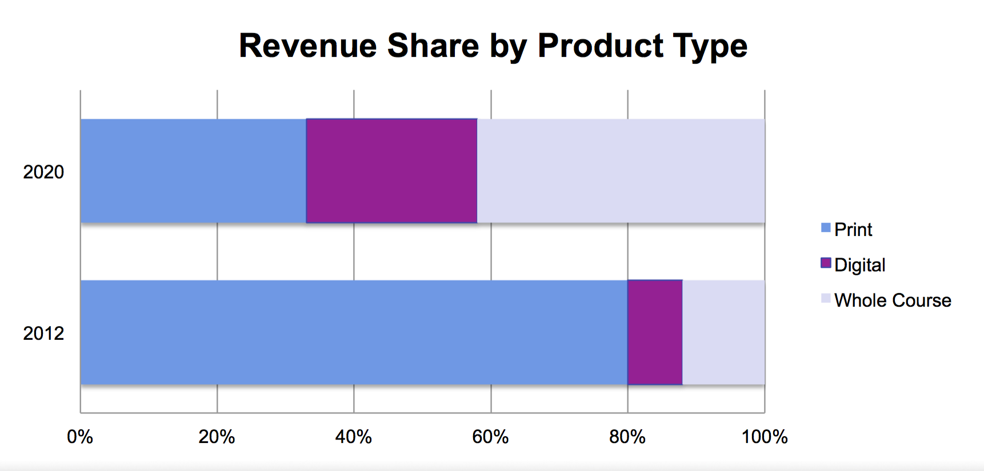
Learning content is changing…
￼
In Education

Slide 18
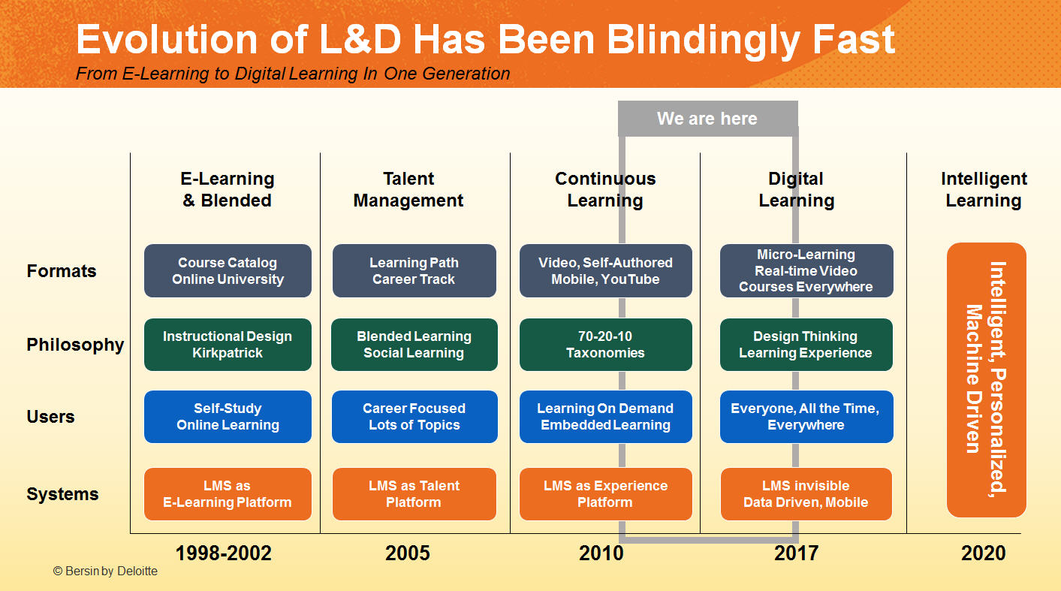
Learning content is changing…
In Corporate Learning

Slide 19
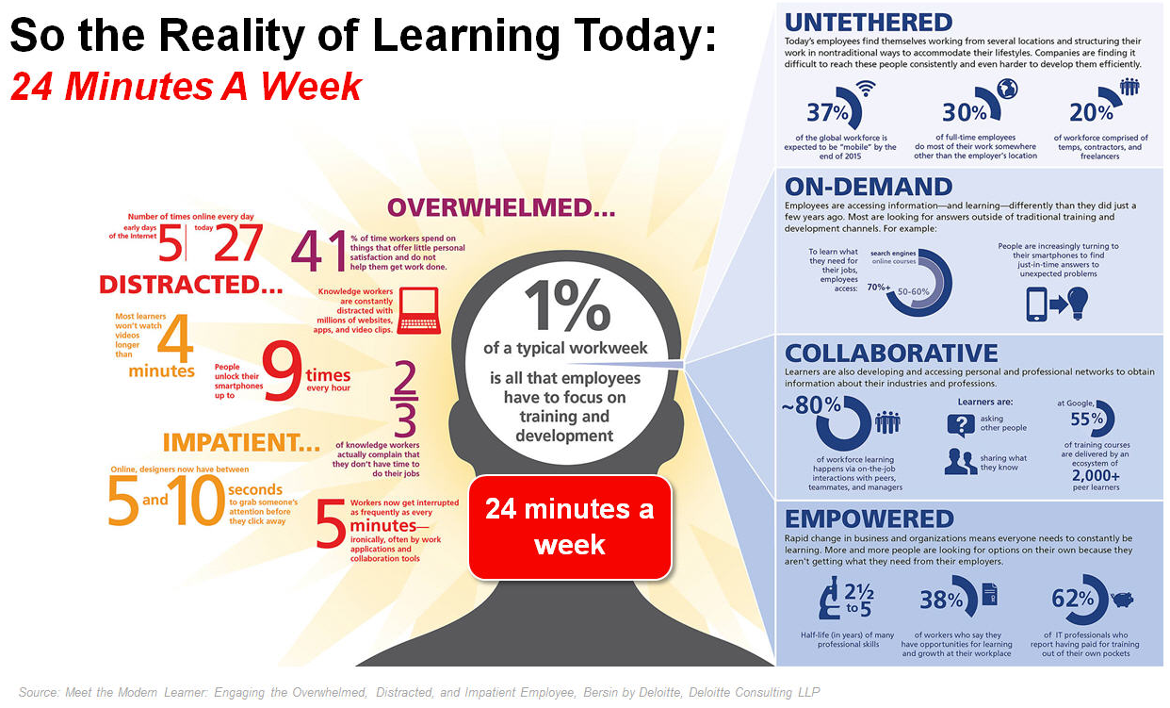

Slide 20

Reading & Learning need a balanced approach to deliver the richness of the OWP
The Web
of
Documents
The Web
of
Applications

Slide 21
This is what
publishing@w3c
is all about!

Slide 22
It is the goal of the Publishing Working Group to provide, in concert with other W3C Groups, the necessary technologies on the Open Web Platform to make the combination of traditional publishing and the Web complete in terms of the readers’ needs, portability, distribution, archiving, offline access, or reliable cross referencing.

Slide 23
In short, all publications—with all their specificities and traditions—should become first-class entities on the Web.

Slide 24
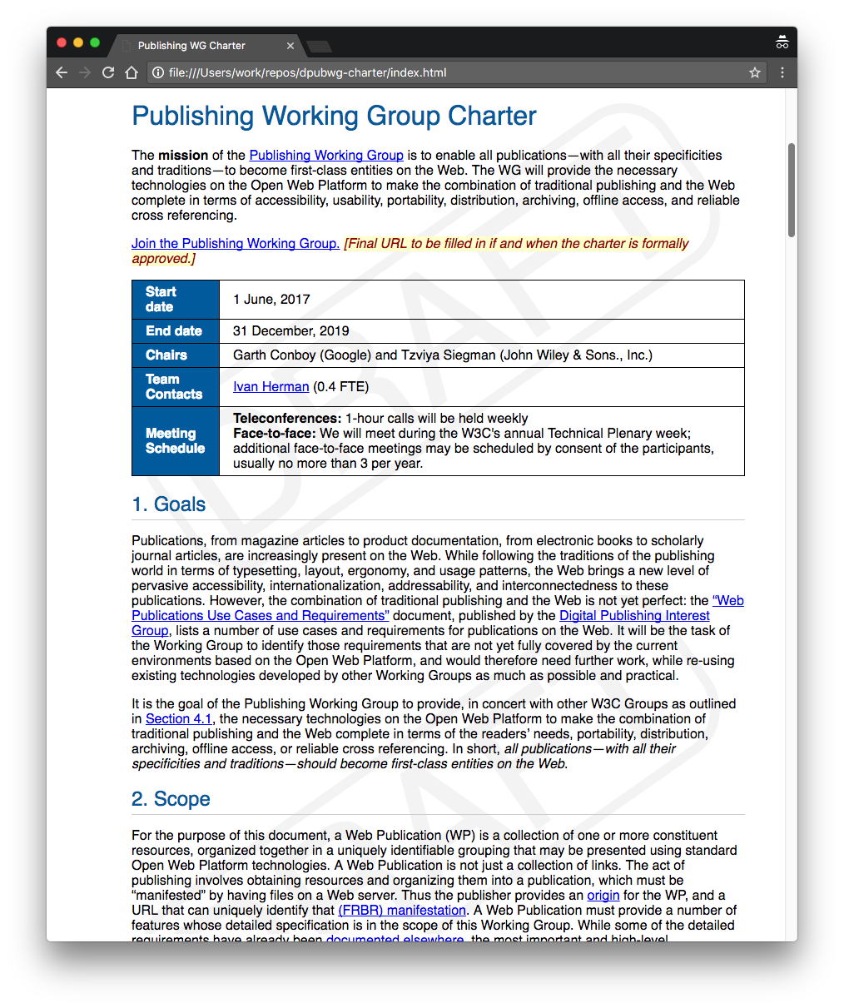
￼
The charter is available to read…
Please vote!

Slide 25
￼
Work is
underway…
Get involved in one (or more!) of the groups!
Let your organizations know about the Publishing@W3C Summit event on November 9-10 (co-located with TPAC)

Slide 26
Thank you for listening!

