Slide 1
Ivan Herman
W3C/CWI, ivan@w3.org
EdTech Conference 2017
16 November, 2017
Madrid, Spain

Slide 2
Advance the Open Web platform for publishing. Ultimately realizing an ambitious vision for fully Web-native Publications: publications—with all their specificities and traditions—should become first class entities on the Web.

Slide 3
Broad W3C membership
Some W3C Members that may become, or are already, active in this work

Slide 4
Some history
W3C and IDPF has a history of cooperation since 2013.
The “Digital Publishing Interest Group” was established at that time.
W3C was also part of the IDPF/IMS “EDUPUB” initiative.
W3C and IDPF “merged” in February 2017 to give a completely new life to this cooperation leading to the Publishing@W3C activity.
All the groups that we are talking about have been created a few months ago.

Slide 5
Publishing@W3C Groups
Publishing Business Group
strategic and business directions
EPUB 3 Community Group
EPUB 3.1 checker, errata management, new features
“EPUB in Education” (a.k.a. EDUPUB) adaptation to EPUB 3.1
Publishing Working Group
towards a W3C Standard on Publishing: Web Publications and Packaged Web Publications

Slide 6
There is actually more
The groups above are the strictly speaking “publishing” groups.
However, there are number of issues that
are very relevant to publishing, but not only;
whose technical solution is to be worked on by other Working Groups, e.g.:
pagination and general page control — CSS WG;
accessibility issues — ARIA WG and Accessibility Guidelines WG;
offline access — Web Platform WG and Service Workers WG.
All Publishing@W3C groups have active relationships with such W3C groups.

Slide 7
The Publishing Working Group

Slide 8
“Web Publications”: what is the goal?
Publications—with all their specificities and traditions—should become first class entities on the Web.
This means:
it should be possible to load the publication content into a browser or a specialized reader, whatever the user prefers;
it should be possible to read the book either offline or online, whatever the circumstances dictate;
contents could be authored regardless of where they are used.

Slide 9
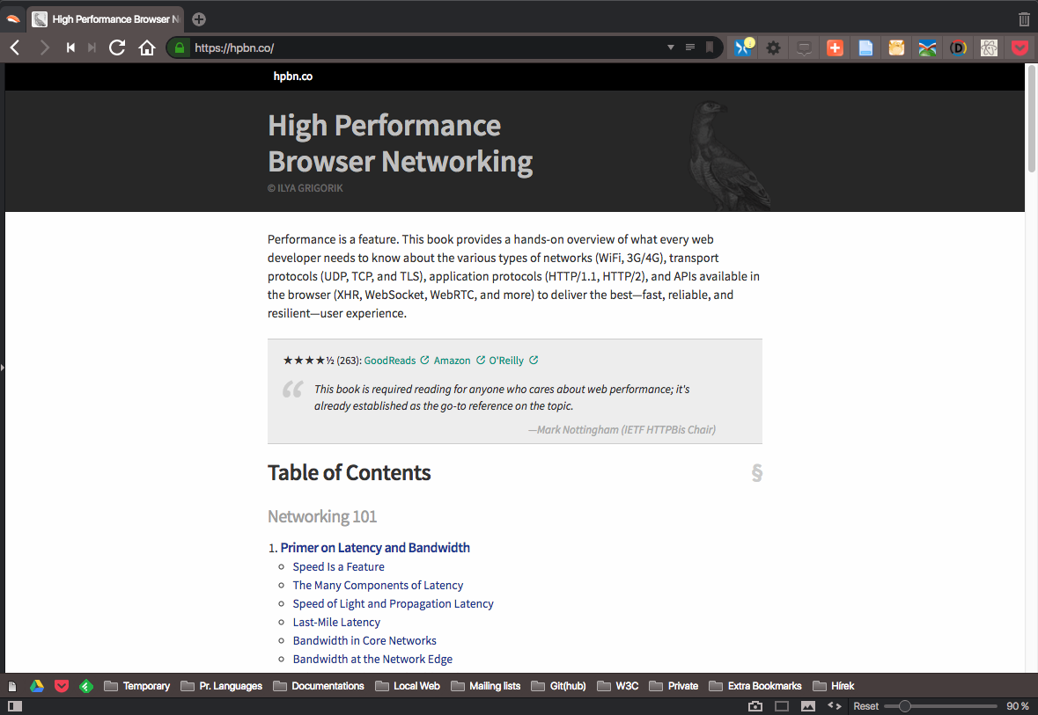
Example: book through a Web browser, visible offline and online

Slide 10
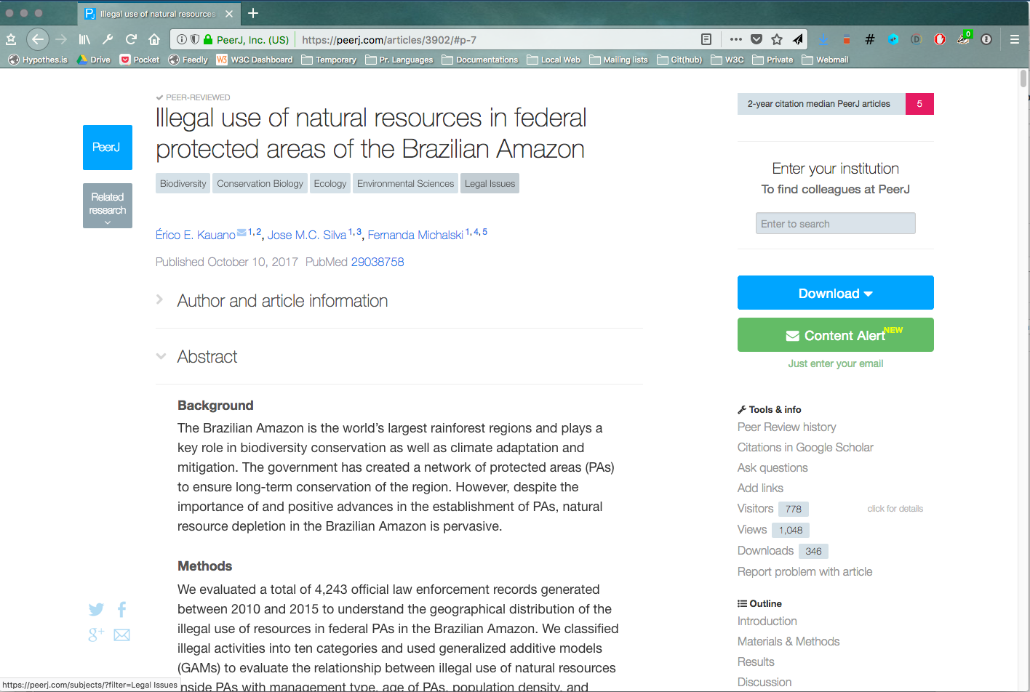
Example: scientific article on the Web

Slide 11
These are still not perfect…
To achieve this, these publications:
use newest browser technologies (Web Workers, Service Workers, …);
many aspects are handcrafted in specialized scripts;
or not yet done, e.g., downloading the scholarly article means PDF, i.e., a different format.
To achieve a general approach:
lots of details remain to be clarified;
there should be an alignments with the technologies used in Web browsers, by Web developers, …
But: they indicate the direction!

Slide 12
Use Cases
Collected by the (now defunct) Digital Publishing Interest Group:
articles (scholarly journals, news agency reports, business publications);
educational materials (text books, exercise collections, etc.);
magazines;
product documentations;
governmental and legal publications;
and, of course, books of any kind.
All these use cases raise a number of technical requirements.

Slide 13
An example for an architectural challenge: many resources under the hood…

Slide 14
Need the concept of “publication” over many resources on the Web
A publication may consist of many resources (text, images, videos, etc).
On the Web, these are linked together, but they keep their complete “independence”.
For publishing the abstract “work” should be a single, conceptual unit on the Web: a Web Publication (WP).

Slide 15
Why do we need the WP concept?
The publication has to be checked for integrity as a whole (e.g., in a legal publication).
Value counters (counters, section numbering, footnotes, endnotes, etc.) should be consistent across the publication.
Any search, text analysis, etc., facility for a book should have access to the full publication.
User preferences should apply to the “work” rather than to a single Web page.
Publishing and library business models are based on the concept of “work”.

Slide 16
How does that translate to the Web?
The current Web builds on the notion of a single resource:
HTML source, metadata, CSS style sheet, etc.;
each has its own URL.
Rendering is based on the interoperation of many such resources.
URL of the content
blockquote.quote {
<section>
<h1>Introduction</h1>
<p>We dream of a world where books, and indeed all kinds of publications, are first-class citizens of the web. </p>
…
“metadata” : {
“dc:title”: “WP”,
“dc:creator”: [
“Markus Gylling”,
“Tzviya Siegman”,
“Dave Cramer”,
…
URL of the metadata
URL of the image

Slide 17
How does that translate to the Web?
A WP is a collection of Web resources, considered as a single Web resource
there is a unique Web address for the collection;
metadata is for the publication as a whole.
Web Publications are part of the Web!
URL of the Publication
blockquote.quote {
<section>
<h1>Introduction</h1>
<p>We dream of a world where books, and indeed all kinds of publications, are first-class citizens of the web. </p>
…
“metadata” : {
“dc:title”: “WP”,
“dc:creator”: [
“Markus Gylling”,
“Tzviya Siegman”,
“Dave Cramer”,
…

Slide 18
A number of technical issues are being discussed
Definition of the “WP Infoset”, i.e., a collection of information that characterizes a WP
title, constituent Web resources and their reading order, identifiers, default natural language,…
Specific security/privacy considerations.
Are there specific accessibility issues to consider?
What information are necessary for, e.g., unified search?
How to achieve offline access to publications?
…

Slide 19
Beyond Web Publications
Packaged Web Publication:
the Web Publication may have to be stored and distributed in a separate file (“package”)
what packaging format should be used?
EPUB 4:
a profile of PWP, with additional requirements (e.g., on accessibility);
achieve functional round-tripping with EPUB 3.

Slide 20
Publishing@W3C: combine traditions with modernity…

Slide 21
One more thing before we finish…

Slide 22
This is not how development works at W3C…

Slide 23
…it is more like that!

Slide 24
W3C members move things forward!

Slide 25
Some Useful Links
“Home” of Publishing@W3C:
http://www.w3.org/publishing/
Publishing Business Group:
https://www.w3.org/publishing/groups/publ-bg/
Publishing Working Group:
https://www.w3.org/publishing/groups/publ-wg/
EPUB 3 Community Group:
https://www.w3.org/publishing/groups/epub3-cg/
Web Publication (WG Editors’ draft)
https://w3c.github.io/wpub/
Web Publications Use Cases and Requirements (Interest Group Note):
https://www.w3.org/TR/pwp-ucr/
Web Publication (Interest Group Note):
https://www.w3.org/TR/pwp/

Slide 26
Slides are available at:
https://www.w3.org/2017/Talks/Madrid-IH/
©W3C

Slide 27
Thank you for your attention!

