Slide 1
Humility and the IoT
…or what the Physical Web taught me about ecosystems
@scottjenson
scottj@google.com

Slide 2
???

Slide 3
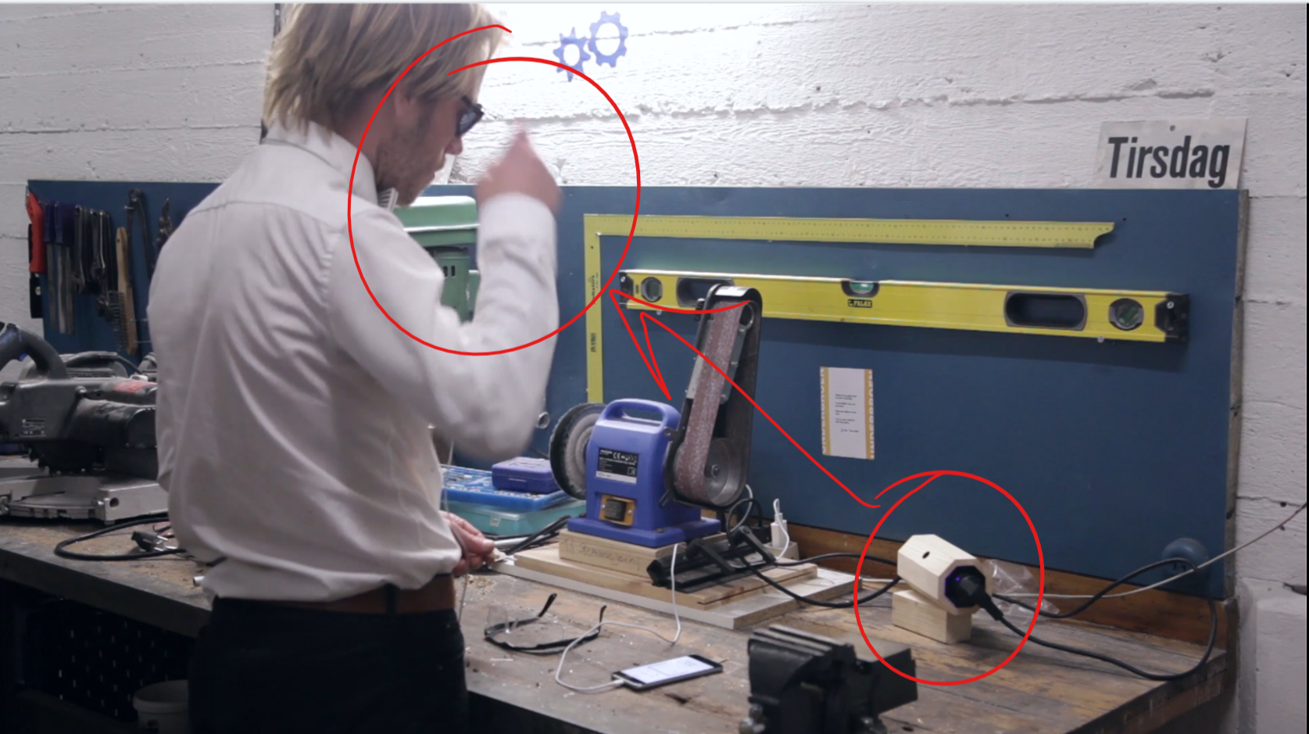

Slide 4
Emergent directions
Flexible platform?
Initial Value

Slide 5
Jeff Jaffe April 2016

Slide 6
App Store APIs

Slide 7
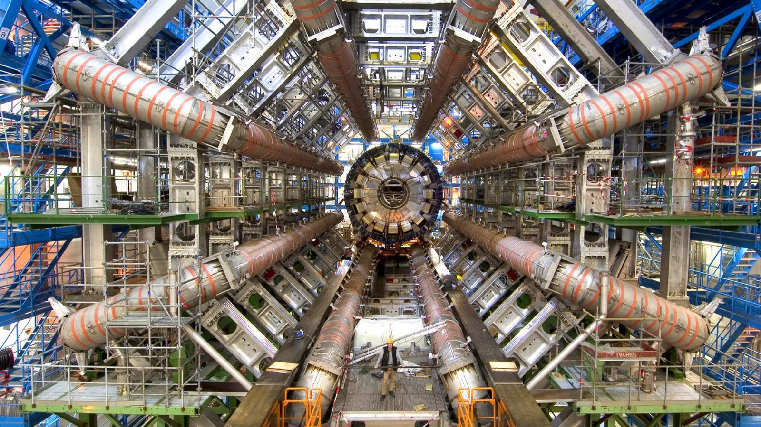

Slide 8
HTML
“An index”

Slide 9
HTML
“An index”

Slide 10
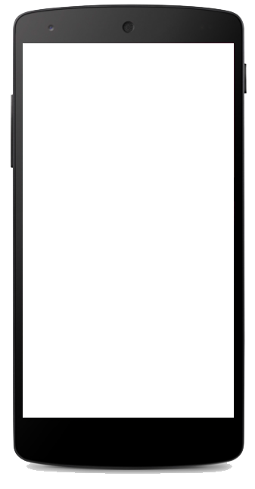
It all started as a UX observation…

Slide 15
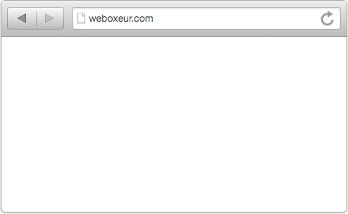
Magic goes here
Notes:
The web, and it’s standards bodies, usually focuses on the DOM, the white rectangle where all of the content goes. This rectangle is amazing, and getting better all the time.

Slide 16
C:\>
But this place is BORING...
Notes:
But what about that address bar at the top? Has it really changed all that much in the list 25 years? We’ve done a bit with auto complete but we are still asking users to type to go anywhere. What’s wrong with this picture? We have taken the most amazing rendering engine on the planet and strapped a command line UI on top of it! Every other mobile app today is taking advantage of the sensors in mobile phones, why can’t the browser do that as well?

Slide 17
The Web needs a discovery service
Obey your thirst!
Buy a Coke with just a tap, no coins, no fumbling around
https://coke.com/m23454
SFMuni Bus
Bus 17 arriving in 3 minutes
https://sfmuni.com/bs3245
PayIT Parking
Only $4/hour during the day, get alerts when your time is up
https://payit.com/meter432
1. Discovery
2. Fetch/Rank
3. Interact

Slide 18
Notes:
But by being built on the web, we just get better as the web gets better (ServiceWorker)

Slide 19
Problem

Slide 20
Initial Value
URL

Slide 21
Emergent Behaviors

Slide 22
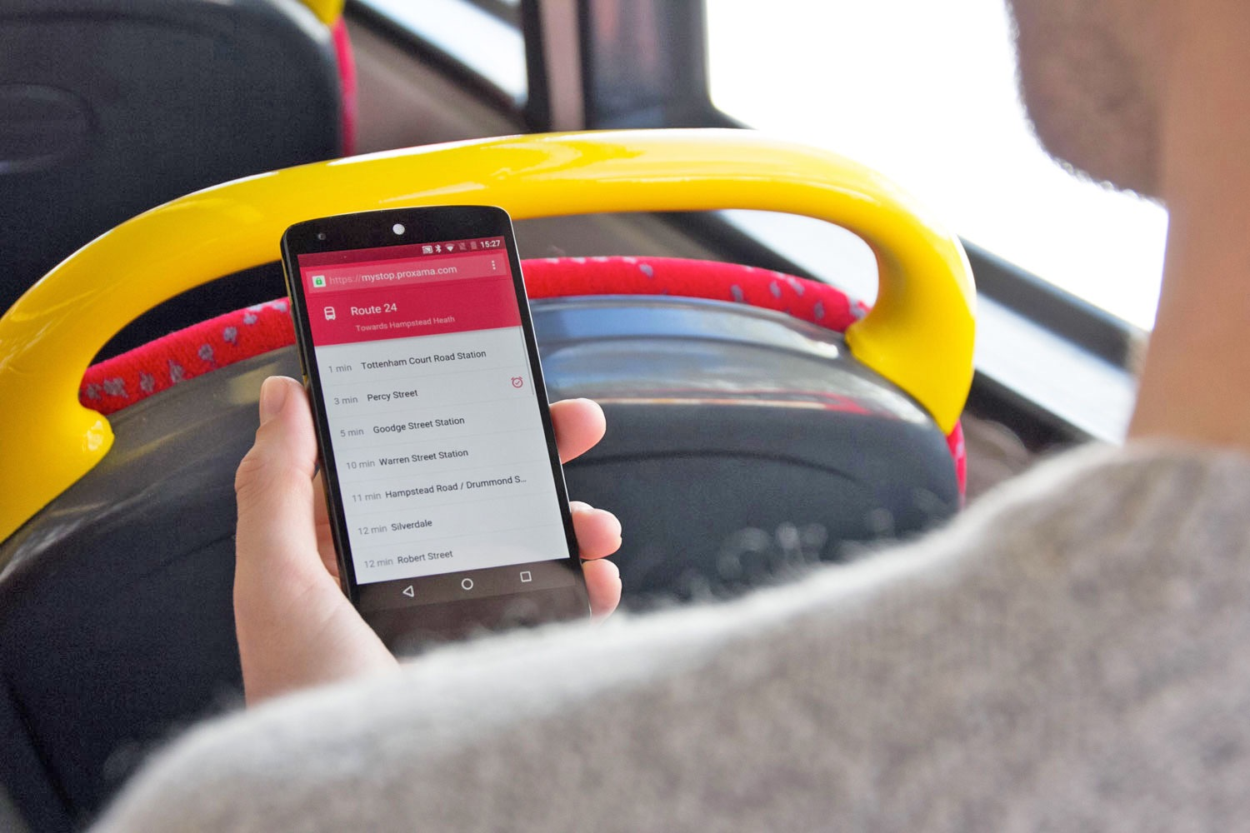

Slide 23
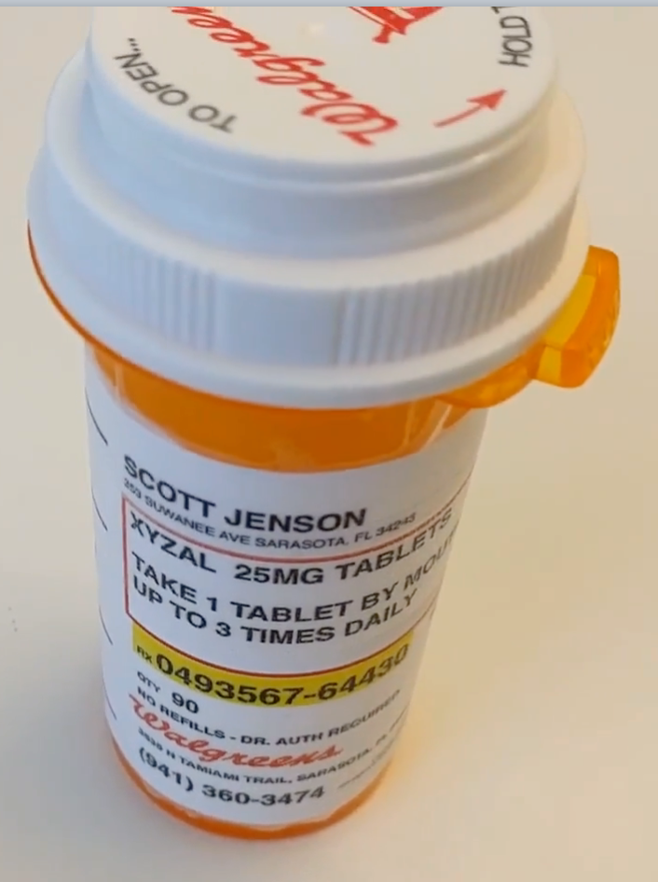

Slide 25
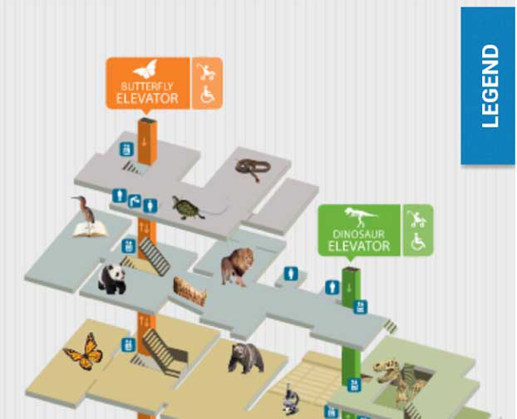

Slide 27
Emergent directions
URL + Web
Initial Value

Slide 28
What about the IoT?

Slide 29
Flexible platform?

Slide 30
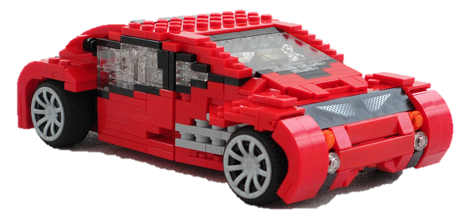
Building a Lexus out of Legos
IEEE Computer February 2017
Smart setup
Semantic Map
Standard Descriptions
Centralized Data

Slide 31
JSON + HTTP + JS + …
???

Slide 32
Thanks

