Slide 1
PSD2 and W3C
Impact for account and payment processing

Slide 2
Open Payment Services
PSD2 mandates as from 2018
  Payment roles
    Payment Service Users (PSU)
    Account Servicing Payment Service Providers (ASPSP)
    Payment Initiation Service Providers (PISP)
    Account Information Service Providers (AISP)
  Strong authentication requirements
    Authentication of PSU by the ASPSP
    Can be executed through PISP or AISP “channels”

Slide 3
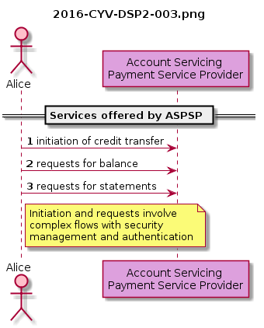
Account Servicing PSP

Slide 4
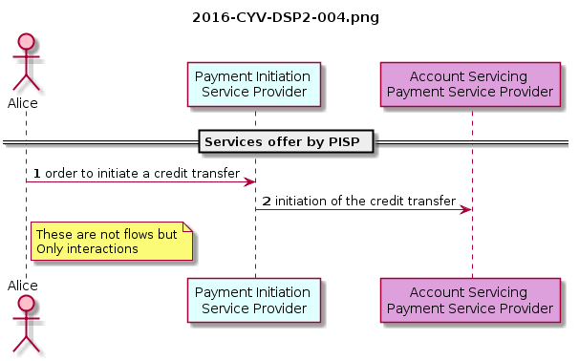
Payment Initiation Service Provider
Notes:
Obviously those interactions bring some issues:
What is the nature of the Authentication between the client and the PISP
How the previous Authentication between client and ASPSP should evolve with the presence of the PISP?
What is the nature of the Authentication between the ASPSP and the PISP?
How to interconnect those 3 authentication process in order to have a secure “3 actors” system
Furthermore the PSD2 asks:
for a strong authentication (2 means on 3) of the client, with possible exceptions to be determined
for a strong authentication with dynamic link to amount and beneficiary in case of a payment
for prior reimbursement by the bank if the client claims the transaction to be unauthorised, then the bank asks the PISP
no obligation from a PISP towards an ASPSP

Slide 5
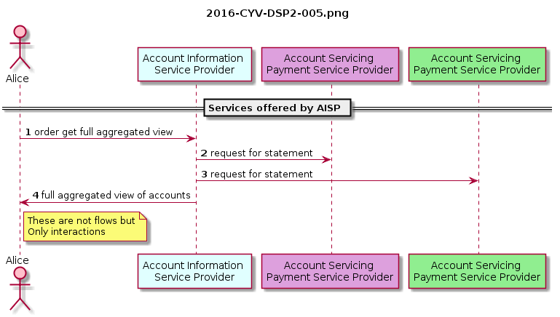
Account Information Service Provider
Notes:
Obviously those interactions bring same type of issues:
What is the nature of the Authentication between the client and the?
How the previous Authentication between client and ASPSP evolves with the presence of the AISP?
What is the nature of the Authentication between the ASPSP and the AISP?
How to interconnect those 3 authentication process in order to have a secure “3 actors” system
Furthermore the PSD2 asks:
for a strong authentication (2 means on 3) of the client with possible exceptions. Even if the PSD2 do not detailed the first time and recurrent connection, for a user perspective it is admitted that:
the authentication for the first time (when the client asks the AIPS to aggregate) should be strong
then, the recurrent connection of the AISP to ASPPSP do not involved the client for systematic strong authentication
without any contractual obligation from a AISP towards an ASPSP.

Slide 6
Impact on W3C Use Cases
Terminology
  Add “PSD2” roles PSU, ASPSP, AISP and PISP
Payment Phases
  Negotiation of Payment Terms
  Negotiation of Payment Instruments
  Payment Processing
  Delivery of Product/Receipt and Refunds
Strong Authentication requirements
  No more support for Password Auth (6.2.3)

Slide 7
3. An Overview of Payment Phases
The decriptions below only discuss the interactions between the payer and payee
  These are Payment Service Users in PSD2 terminology
  PISP and AISP interact between the Payment Service User and the Payment Service Providers
We do not expose the low-level exchanges between banks, card associations or other back-end “payment clearing” parties in a transaction
  These are outside the PSD2 requirements

Slide 8
3.1 Negotiation of Payment Terms
In the first phase of the payment process, the payer and the payee negotiate the terms of the payment.
Discovery of Offer. The payer discovers the payee's offer (e.g., by browsing a Web page or from a native application).
Agreement on Terms. The payer and the payee agree to what will be purchased, for how much, in what currency, which payment schemes or loyalty programs are acceptable, etc. The payee may require the payer to authenticate themselves. The payee may generate an invoice for the payer.
Application of Marketing Elements. The payer discovers and applies any loyalty programs, coupons, and other special offers to the payment terms.
Agreement on terms
The payment schemes available may be depending on the Payment Initiation Service Provider used by the payer or payee

Slide 9
3.2 Negotiation of Payment Instruments
In the second phase of the payment process, payer and payee determine which payment instruments the payer will use to transfer funds to the payee.
Discovery of Accepted Schemes. The payer discovers the payment instruments that are accepted by the payee.
Selection of Payment Instruments. The payer selects one or more payment instruments that are available to the payer and are accepted by the payee.
Authentication to Access Instruments. The payer's access to the payment instrument is authenticated. The payer consents to pay. Note: This authentication with the payment processor is distinct from any authentication required by the payee (such as when a merchant requires a customer to have an account and log in to the merchant's Web site).
Discovery of accepted Schemes
In this phase, a selection of the Payment Initiation Service Provider can be added. Selection could be done by the payer as well as the payee
The PISP can influence the payment instruments which are supported by it
Authentication to Access Instruments
Authentication for access to the payment instrument remains between the Payment Service User (payer) and the Account Servicing Payment Service Provider

Slide 10
3.3 Payment Processing
The third phase of the payment process is used to initiate the transfer of funds. Depending on the payment instrument, the transfer of funds may be verified immediately or only after several days.
Initiation of Processing. Depending on the payment instrument, the payer (e.g., when using PayPal or Yandex Money), the payee(e.g., when using a credit card), or other party (e.g., bank) initiates processing.
Verification of Available Funds. The payer may need to provide a proof of funds or a proof of hold to the payee before finalizing payment and delivery of the product.
Authorization of Transfer. The payee receives proof that the transfer of funds has been authorized.
Completion of Transfer. The payment scheme determines the details of payment clearing and settlement. Transfer times may vary from near-realtime to multiple days. The payee, the payer, and/or third parties (such as regulatory bodies) may be notified as each stage of the clearing and settlement process is completed.
Initiation of Processing
When a PISP is used, it will initiatie the processing on the payer or payee’s behalf
Verification of Available Funds
This function may be executed by an Account Information Service Provider on the payers or payee’s behalf
Authorization of Transfer
The PISP may receive the authorization of the payment on the payee’s behalf
Completion of Transfer
Depending on the payment protocol, the PISP may determine the details of clearing and settlement. The PISP however does not hold the funds, otherwise it would be an Account Servicing Payment Service Provider

Slide 11
PSD2 - Article 97 Authentication
1. Member States shall ensure that a payment service provider applies strong customer authentication where the payer:
(a) accesses its payment account online;
(b) initiates an electronic payment transaction;
(c) carries out any action through a remote channel which may imply a risk of payment fraud or other abuses.
2. With regard to the initiation of electronic payment transactions as referred to in point (b) of paragraph 1, Member States shall ensure that, for electronic remote payment transactions, payment service providers apply strong customer authentication that includes elements which dynamically link the transaction to a specific amount and a specific payee.
3. With regard to paragraph 1, Member States shall ensure that payment service providers have in place adequate security measures to protect the confidentiality and integrity of payment service users’ personalised security credentials.
4. Paragraphs 2 and 3 shall also apply where payments are initiated through a payment initiation service provider. Paragraphs 1 and 3 shall also apply when the information is requested through an account information service provider.
5. Member States shall ensure that the account servicing payment service provider allows the payment initiation service provider and the account information service provider to rely on the authentication procedures provided by the account servicing payment service provider to the payment service user in accordance with paragraphs 1 and 3 and, where the payment initiation service provider is involved, in accordance with paragraphs 1, 2 and 3.

