Slide 1
ISO 20022 harmonisation TF

Slide 2
What is our mission?
Align WPWG flows with ISO20022 components, and collaborate on any required changes or additions to ISO20022.

Slide 3
Who are we?
Kris Ketels <kris.ketels@swift.com> (ISO 20022 Registration Authority) (lead)
David Ezell <david_e3@verifone.com> (National Association of Convenience Stores (NACS))
Patrick Adler <patrick.adler@chi.frb.org> (Federal Reserve Bank of Minneapolis)
Vincent Kuntz <Vincent.Kuntz@swift.com> (ISO 20022 Registration Authority)
Frédéric Meignien <frederic.meignien@cantonconsulting.fr> (CANTON CONSULTING)
Claudia S. Swendseid (Claudia.swendseid@mpls.frb.org)
Contact us if you want to join

Slide 4
Deliverables
A document specifying the differences between a WG-produced deliverable and the ISO2022 repository.
This WG-produced deliverable specifies the web payments messaging requirements/flows.
Work to incorporate web payment flows into the ISO 20022 repository

Slide 5
WG-produced deliverable
What are the Web Payment requirements
Define the “Web Payments Business Process(es)”
Scopes the project for ISO 20022
Analyse WP use cases, terminology, workflows, roles
< WP Workflow TF
Define the detailed content of the flows
What is the correct level of detail?
What is the common denominator between e.g. js api vs http rest call?
< WPWG?

Slide 6
ISO 20022 perspective (1)
Business Process
Define a new process “web payments”, derived from the Cards business process
Link Web Payment specific roles to ISO 20022 Business Roles
Identify any missing roles (PISP, PSP, AISP, ...)
Align or identify gaps in terminology (identify synonyms) and definitions

Slide 7
Example of Payment Initiation (overall process overview)

Slide 8
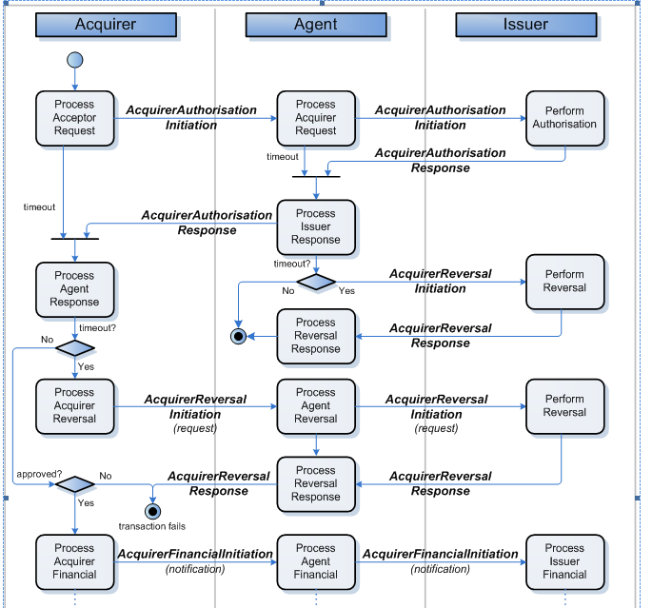
Example of Card Payment Initiation
Notes:
Acceptor = Merchant

Slide 9
ISO 20022 perspective (2)
Business Transactions
Align Web Payments workflows with ISO 20022 BusinessTransactions
Define extensions to existing flows (e.g. in Payment Initiation)
Define new flows
Align or identify gaps in terminology (identify synonyms) and definitions
Results of the Flows TF work

Slide 10
ISO 20022 Payment Initiation Flow

Slide 11
ISO 20022 perspective (3)
Logical Models
Align the detailed Web Payments flows with ISO 20022 MessageDefinitions
Define extensions to existing MessageDefinitions
Define new MessageDefinitions
Define common, reusable ISO 20022 components
Align or identify gaps in terminology (identify synonyms) and definitions

Slide 12
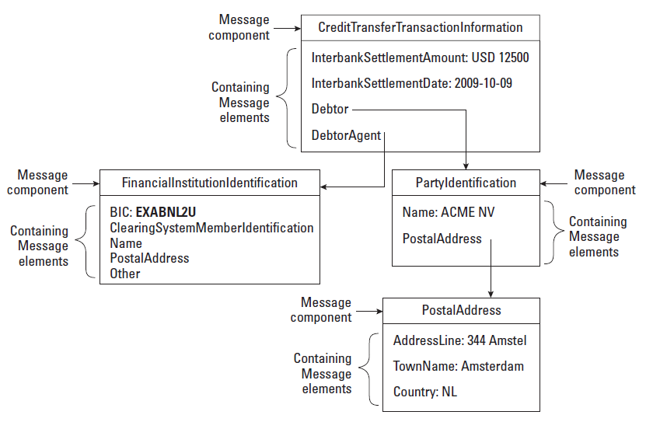
ISO 20022 Logical Model
Elements refer to the Business / Conceptual layer for the definitions

Slide 13
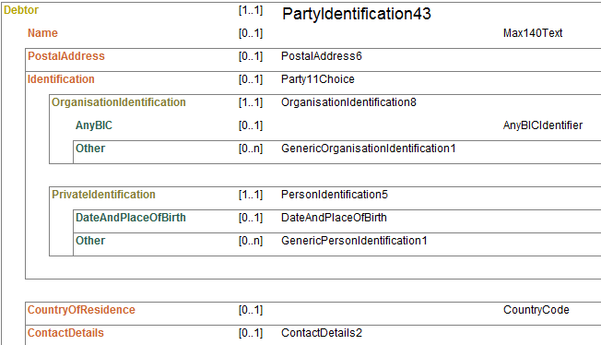
ISO 20022 Logical Model

Slide 14
Deliverables
Define the ISO 20022 Business Case
Who are the users/sponsors
Estimated usage of messages
Timeline
Submit newly defined BusinessProcesses, BusinessRoles, BusinessTransactions... to ISO 20022
Submit changes to existing ISO 20022 repository components.
http://www.iso20022.org/documents/general/ISO20022RegistrationProcedures.pdf

Slide 15
questions
Difference between a ‘browser api’ and the ‘message api’. Is there a need for alignment?
Timeline?

