Slide 1
Ad Fraud: An Overview
Ash Kalb, Co-Founder

Slide 2
Ad fraud is (at least) a $6billion per year problem.

Slide 3
Not all of that money goes to the bad guys.

Slide 4
But advertisers probably shouldn’t be sending a billion dollars a year to organized criminals.

Slide 5
And they don’t want to be.

Slide 6
This is the reason real people’s computers are being broken into.

Slide 7
Today, ad fraud is the most effective and profitable way to monetize a botnet.

Slide 8
It’s not a solved problem, and not part of the noise or priced in.

Slide 9
BOT FRAUD IS NOT EVENLY DISTRIBUTED
52%
INCREASE
BOT TRAFFIC
BOTS
WHAT WE FOUND
23%
17%
DECREASE
EFFICACY
11%
DISPLAY
PROGRAMMATIC
INVENTORY
SOURCED
TRAFFIC
VIDEO
The Bot Baseline: Fraud in Digital Advertising. White Ops and ANA, 2014.

Slide 10
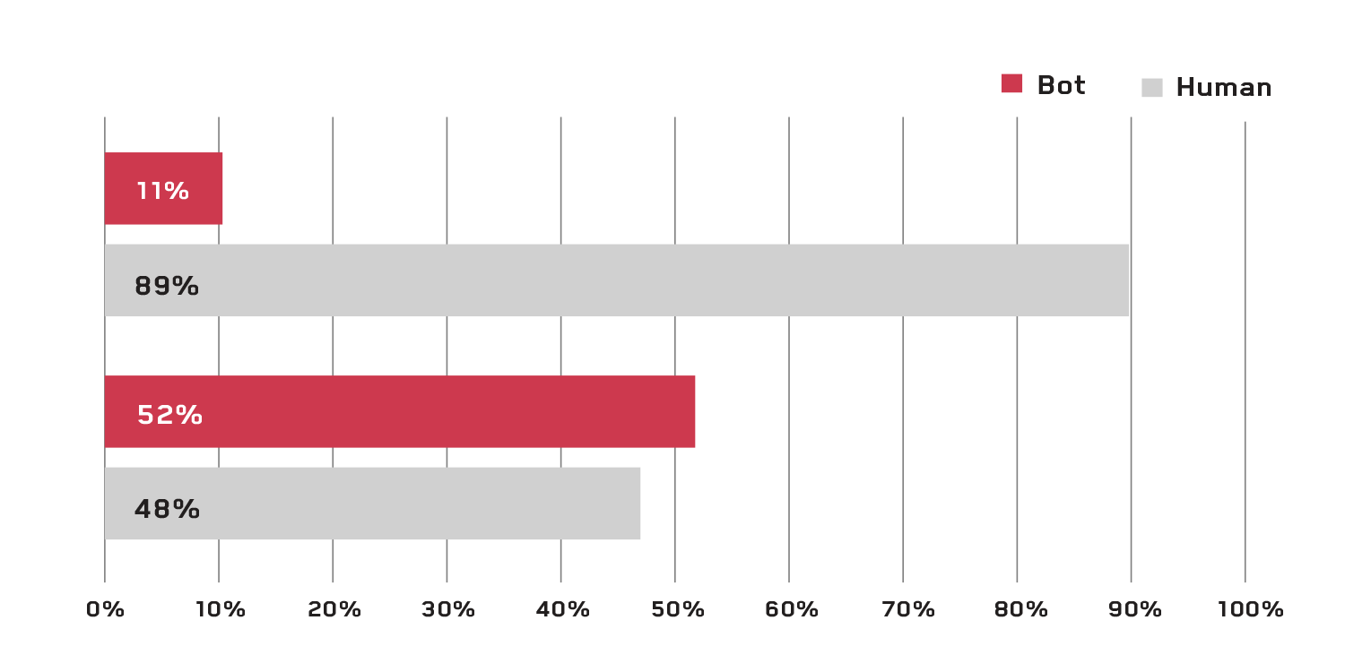
“SOURCED TRAFFIC” IS MORE BOT THAN HUMAN
WHAT WE FOUND
AVERAGE BOT PERCENTAGE
The Bot Baseline: Fraud in Digital Advertising. White Ops and ANA, 2014.

Slide 11
Wait; what’s sourced traffic?

Slide 12
Let’s put on our black hats and look at
how the bad guys make money
Notes:
Surprisingly, the most common question: “How do the bad guys make money?”
1) Fake sites
2) Real sites that need a little more traffic
Fake sites
Objectively and measurably awful content
Scraped or copied from other sites wholesale
Doesn’t matter, nobody human goes there anyway
Sites host ads, ads generate revenue
75% of bot traffic went to non-premium, mostly fake sites
Definitely a dominant paradigm…
…but does this mean the real sites are cleaner?
…are there real sites?

Slide 13
There are two ways
the black hat hackers get paid
Notes:
Surprisingly, the most common question: “How do the bad guys make money?”
1) Fake sites
2) Real sites that need a little more traffic
Fake sites
Objectively and measurably awful content
Scraped or copied from other sites wholesale
Doesn’t matter, nobody human goes there anyway
Sites host ads, ads generate revenue
75% of bot traffic went to non-premium, mostly fake sites
Definitely a dominant paradigm…
…but does this mean the real sites are cleaner?
…are there real sites?

Slide 14
…with fake sites.
Notes:
Fake sites
Objectively and measurably awful content
Scraped or copied from other sites wholesale
Doesn’t matter, nobody human goes there anyway
Sites host ads, ads generate revenue

Slide 15


…when real sites need more traffic.
…with fake sites.
&

Slide 16

Sourced Traffic
$
One site paying another to send more traffic
Notes:
We are able to detect traffic sourcing – when a site pays another site to “send it traffic”
The majority of sourced traffic that we witnessed was obviously botty, even/especially for premium publishers
Actually our single strongest predictor of bottiness

Slide 17

Sourced Traffic
$
especially
Sourced traffic is usually botty traffic (even for premium sites)

Slide 18
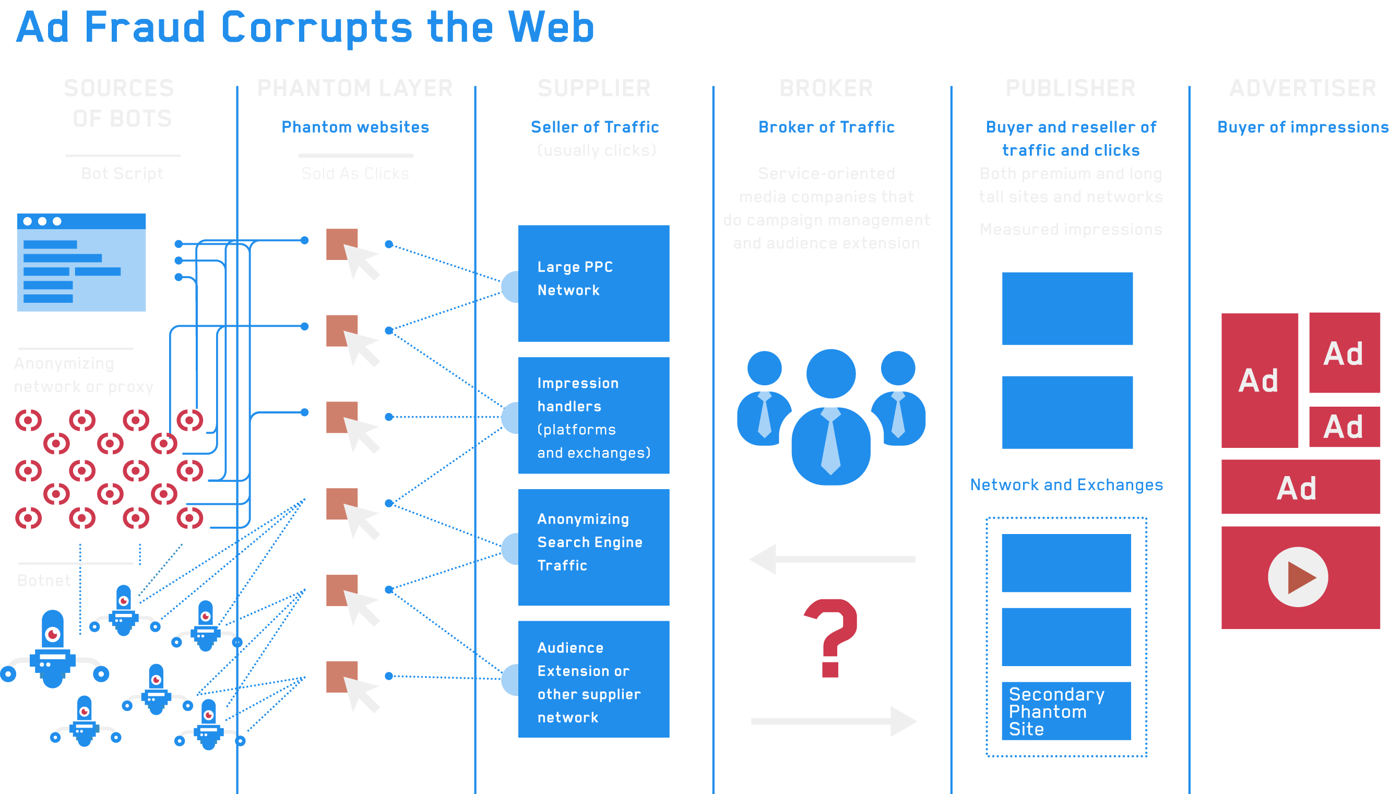
Notes:
Difficulties: It’s a huge ecosystem, and everyone profits from bigger numbers but you

Slide 19


PREMIUM PUBLISHERS ARE UNDER TREMENDOUS PRESSURE TO:
Hit revenue targets
Deliver eCPM growth
Maintain comScore audience growth
Notes:
Premium publishers – the same publishers many agency executives have long standing relationships with – are under tremendous pressure to:
Hit revenue targets
Deliver eCPM growth
Maintain comScore audience growth

Slide 20
WHEN SECURING AN IO FOR A BUY, PUBLISHERS RARELY GO BACK TO THE AGENCY AND SAY “SORRY, I CAN’T FILL YOUR WHOLE ORDER.”

Slide 21
INSTEAD, THE PUBLISHER AGREES TO THE IO, THEN TURNS TO 3RD PARTY TRAFFIC SUPPLIERS TO BUY TRAFFIC.

Slide 22
THESE PUBLISHERS DO NOT KNOW THEY ARE BUYING FAKE TRAFFIC; THEY ARE DOING SO INADVERTENTLY.

Slide 23
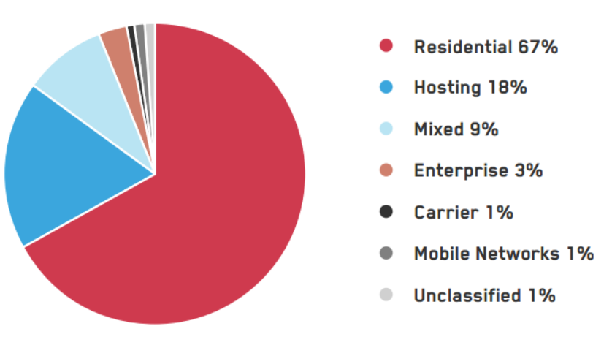
BOTS DISGUISE THEMSELVES AS REAL PEOPLE
Bot source by IP Address
WHAT WE FOUND
The Bot Baseline: Fraud in Digital Advertising. White Ops and ANA, 2014.

Slide 24
WHAT WE HEAR A LOT…
?

Slide 25
1. “But I only buy direct via premium publisher relationships; they don’t have bots”

Slide 26
2. “The bots are priced in and get optimized out like any other waste gets optimized out”

Slide 27
3. “But I only buy on actions via attribution. Bots can’t fake attribution.”

Slide 28
4. “But I’m already protected from bots – we’re running ACME Audience Verification”

Slide 29

OLD DEFENSES ARE NOT SOLVING THE FRAUD PROBLEM
Predictive defenses do not catch the newest bots
Statistical, big data analytics do not catch the most sophisticated bots
Auditing and spot checks do not expose evasive tactics
Making assumptions about traffic quality leads to preventable losses

Slide 30
New attacks easily defeat traditional defenses
NEW ATTACKS EASILY DEFEAT TRADITIONAL DEFENSES
Evolving Threats
Bot-cloaking mechanics
Advertising malware
Ad injection
Ongoing 0-day attacks
Old Defenses
Prediction
Statistics-based analytics
Auditing
Assumptions
Cyber security agnostic approaches

Slide 31
EVOLVING ATTACKS THREATEN THE DIGITAL AD ECOSYSTEM
Cloaked bots use incentivized traffic to fool stakeholders
Malicious Toolbars consume inventory behind the scene
Injected Ads harm everyday computer users and publishers
Browser 0-Day Attacks cause unanticipated fraud in campaigns

Slide 32
3 REALLY IMPORTANT THINGS TO REMEMBER
Bot fraud is the #1 monetization engine of botnets worldwide
Bot fraud is the most scalable form of ad fraud, ever, and always will be
Not all bot detection is created equal

