Slide 1

Jarrett Wold
Director of Technology and Platforms

Slide 2
Ad-ID
Ad-ID - Industry standard for identifying advertising assets across all media platforms
  Joint venture of
    American Association of Advertising Agencies (4A’s)
    Association of National Advertisers (ANA)

Slide 3
Advertising is no longer about
Giving Marketers
  what they want
  when they want it
  and at the lowest price possible

Slide 4
Marketers are looking for innovation
If you can point to things that
  simplify multi platform campaigns
  Improve cross platform measurement
  Reduce cost
  Enable Interactivity
  Underpin addressability
You earn a spot as a valued partner

Slide 5
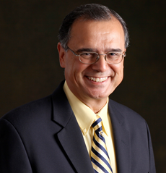
Bob Liodice – ANA President & CEO
“Universal acceptance of Ad-ID by all marketers, media and agencies will unleash $1‐2 billion in productivity enhancement across the supply chain.
Common coding will substantially enrich measurement for all syndicated suppliers.”

Slide 6
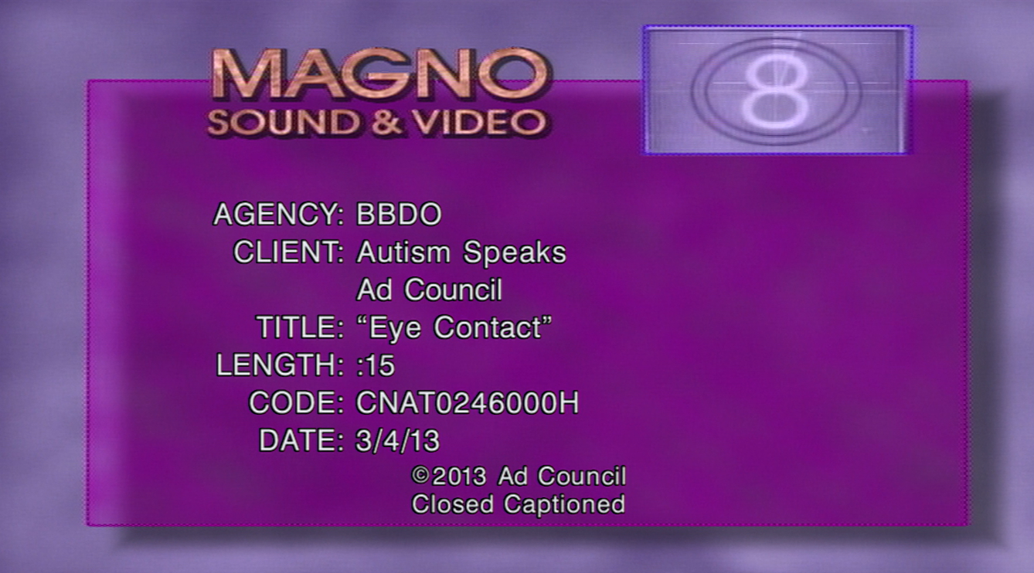
Today’s Analog Commercial Slate
We’ve outgrown the Analog slate
It is cut off before air
  Either by commercial distributor
  Or media outlet
We need to move to a Digital slate

Slide 7
Moving to a digital “Ad Slate”
Ad-ID is at the center of the industry transition to digital
Ad slates
  Metadata embedded into files (like iTunes)
XMP Ad-ID Schema developed with Interactive Advertising Bureau & Adobe
  Radio, Online Video, Banners, and Magazines
MXF developed with
the Advanced Media Workflow Association / Society of Motion Picture & Television Engineers
  For Broadcast TV

Slide 8
AD-Id is Advertising Metadata

Slide 9
Standards referencing Ad-ID
SMPTE RP 2092-1 Representation of Ad-ID®
SMPTE RP 2092-2 MXF Ad-ID® Digital Ad Slate
AMWA AS-12 MXF Commercial Delivery
Interactive Advertising Bureau – Video Ad Serving Template (VAST 4.0)
SCTE 130 Digital Program Insertion – Advertising Systems Interfaces
SMPTE RP 2021-5 Using Ad-ID and EIDR as Alternate Identifiers in SMPTE BXF and ATSC PMCP
Ad-ID Digital Ad Slate for XMP Version 1.0

Slide 10
What Is Ad-ID?
Company Prefix
User-Provided (letters, numbers)
High-Def or 3D
ABCD XXXXXXX H or D
Advertising Metadata
Marketer related
Parent Company
Advertiser
Brand
Product
Product Categories
Agency Name
Commercial related
Media Type
Medium
Commercial Title
Definition (HD, SD, 3D)
Length
Language

Slide 11
Some Ad-ID Adoption Facts
Advertisers using Ad-ID represent
  84 % of Network Dollars
  70 % of Cable Dollars
  43 % of Spot TV Dollars
  66 % of All TV Dollars
Used by over 600 Agencies
Nearly 1.7 Million ads registered since 2003

Slide 12
Share by Advertiser size
 | 2014 |  |  |  | 2013
Advertiser Size | No | Yes | Total | Share % | Yes | Share %
$ 500 Mllion + | 5 | 33 | 38 | 87% | 32 | 84%
Large ($100-$499 Million) | 46 | 120 | 166 | 72% | 104 | 63%
Medium ($ 26 Million - $ 99 Million) | 201 | 233 | 434 | 54% | 162 | 37%
Sub Total | 252 | 386 | 638 | 61% | 298 | 47%
Small (less than $ 25 Million) | 324,802 | 1,248 | 325,892 | 0% | 649 | 0%
Grand Total | 325,054 | 1,634 | 326,530 | 1% | 947 | 0%

Slide 13
Video Adoption is significant
 |  | 2012 |  | 2013 |  | 2014
Media | Universe | Ad-ID Count | Share | Ad-ID Count | Share | Ad-ID Count | Share
Video | 334,000 | 160,812 | 48% | 186,343 | 56% | 264,085 | 79%
Audio | 285,000 | 32,415 | 11% | 33,909 | 12% | 43,629 | 15%
Print | 170,000 | 11,584 | 7% | 11,591 | 7% | 11,407 | 7%
Internet Display | 800,000 | 4,078 | 1% | 4,765 | 1% | 6,209 | 1%
Out of Home Display | 50,000 | 2460 | 5% | 2,007 | 4% | 2,663 | 5%
Other | 50,000 | 2,252 | 5% | 4,758 | 10% | 6,544 | 13%
Grand Total | 1,689,000 | 213,601 | 13% | 243,373 | 14% | 334,537 | 20%

Slide 15
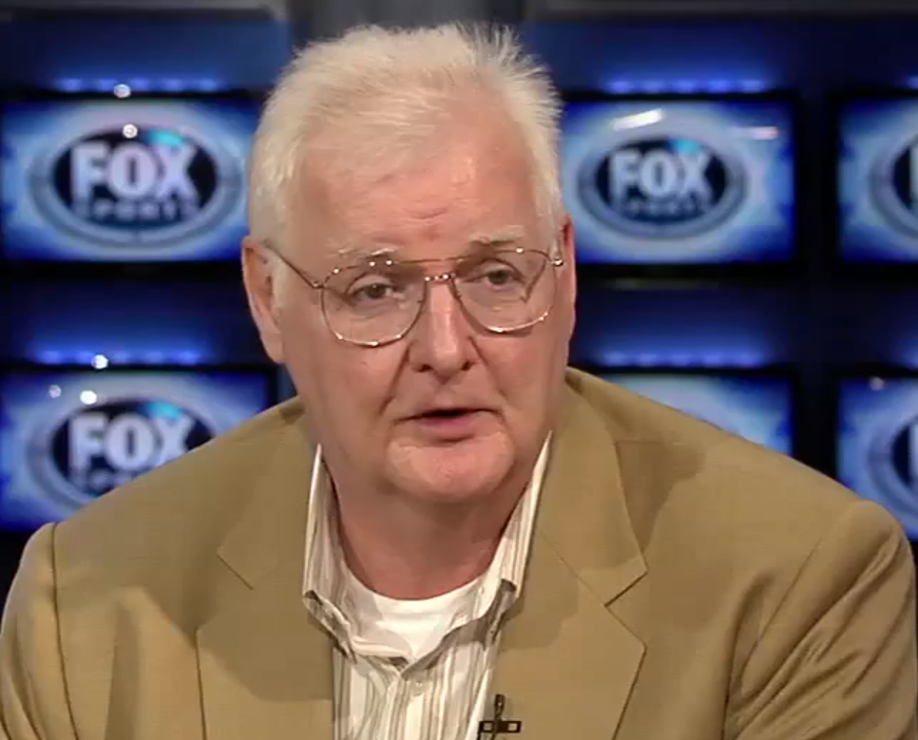
CLYDE SMITH - SVP NEW TECHNOLOGY - FOX
“If you can’t identify it, you can’t operationalize or measure it;
if you can't measure it you can't monetize it.”
Notes:
Clyde Smith of Fox who is associated with the efforts of The society of Motion picture and television engineers and Advanced Media Workflow Association puts it best:
“If you can’t identify it, you can’t operationalize or measure it; if you can’t measure it, you can’t monetize it. Identity is a key enabler for operational orchestration and measurement as well as management.”

Slide 16
Media Interoperability

Slide 17

SAG-AFTRA Contract requirement
As of April 1, 2014
  All commercials produced for television, radio and digital platforms featuring SAG-AFTRA union members, must use Ad-ID as the sole standard commercial identifier.

Slide 18


















Vendor Integrations
Commercial Distribution
Systems Vendors

Slide 19
SMPTE / CIMM OpenID
The Coalition for Innovative Media Measurement (CIMM) and the Society of Motion Picture and Television Engineers (SMPTE) have partnered for the Open Binding of IDs (OBID) initiative. This will define an open method of directly associating industry standard content identifiers
(Ad-ID for ads, and Entertainment Identifier Registry Association (EIDR) for programming) with the audiovisual content itself for a variety of purposes, including audience measurement.
How Is This Different?
Open ID takes a different approach
Detect identifier of what is airing and then do with it what you like.
It’s an open standard
How it’s used is up to the industry
Coexistence
Since Open ID uses Audio watermarking
Some Other Requirements
Carry either Ad-ID or EIDR
Survive across all common distribution platforms
Survive recording and playback
Detect change in ID within a second
Retrieve EIDR within five seconds, Ad-ID within three seconds
Be able to replace an ID
Insertion and detection at various points
Do not degrade perceptible quality
Insertion in linear or non-linear
Don’t degrade performance of consumer devices
Timeframe
RFP issued: April 3, 2015
RFP closed: May 4
Meeting in NY for review of submissions: May 20/21
Potential Revisions to Test Plan based on responses: May 28
Self Testing: Aug / Sept 2015
Lab Testing: October 2015
SMPTE Publication: June 2016
inserted at the broadcast facility. that it not interfere with…
Nielsen
Anti piracy watermarks
It’s critical
New Advanced Television Systems Com- mittee (ATSC) 3.0 standard watermark
How Do You Develop This?
Initially came out of CIMM TAXI
Formed Study Group in SMPTE to look at what’s possible
Now in Drafting Group to get input from those willing to offer technology, and actu- ally draft standards docs.

Slide 20
Questions?

