Slide 1
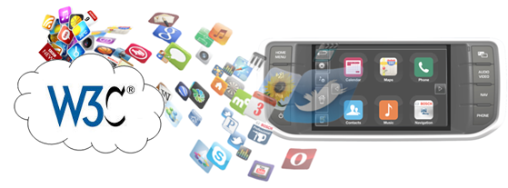
W3C Automotive and Web Platform Working Group
Web Payments – Selected Automotive Use Cases

Slide 2
Document Summary
Purpose: Prepared for W3C Web Payments Group: Introduce Automotive Web Platform Group and provide some selected, indicative use cases defining how web payments can be applied in automotive scenarios.
Audience: W3C Web Payments Group, W3C Automotive Web Platform Group,
JLR Management, JLR Teams working on Connected Infotainment,
Connected Car, Connected Services etc.
Status: Draft v1.0 23rd October 2015
Author: Dr. Kevin Gavigan, Software Architect, Connected Infotainment,
Electrical, Electronic and Software Engineering Product Development (EESE),
Jaguar Land Rover

Slide 3

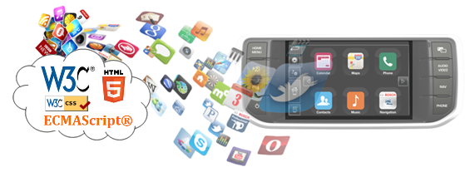
Contents
Introduction to Automotive Web Platform Business & Working Groups
Initial Automotive Web Payment Use Cases
Definitions and References

Slide 4


W3C Automotive and Web Platform
Business & Working Groups
Goals
  Accelerate the adoption of Web technologies in automotive industry.
    Create specifications, starting with the Vehicle Data API Specification.
    Create conformance tests to cover new specifications that get defined.
    Provide use cases and other reports to identify additional needed standards
Activities
  First Working Draft of Vehicle Information API and Vehicle Data API has been published
  Working Group is progressing Vehicle API specifications.
  Business Group is looking at other opportunities for standardization
    e.g. Media Tuner, Location Based Services / Navigation
  Security and Privacy Task Force
    Develop and share Automotive Security and Privacy Use Cases
Participants
  133 participants, ~25 attend each bi-annual Face to Face meeting

Slide 5
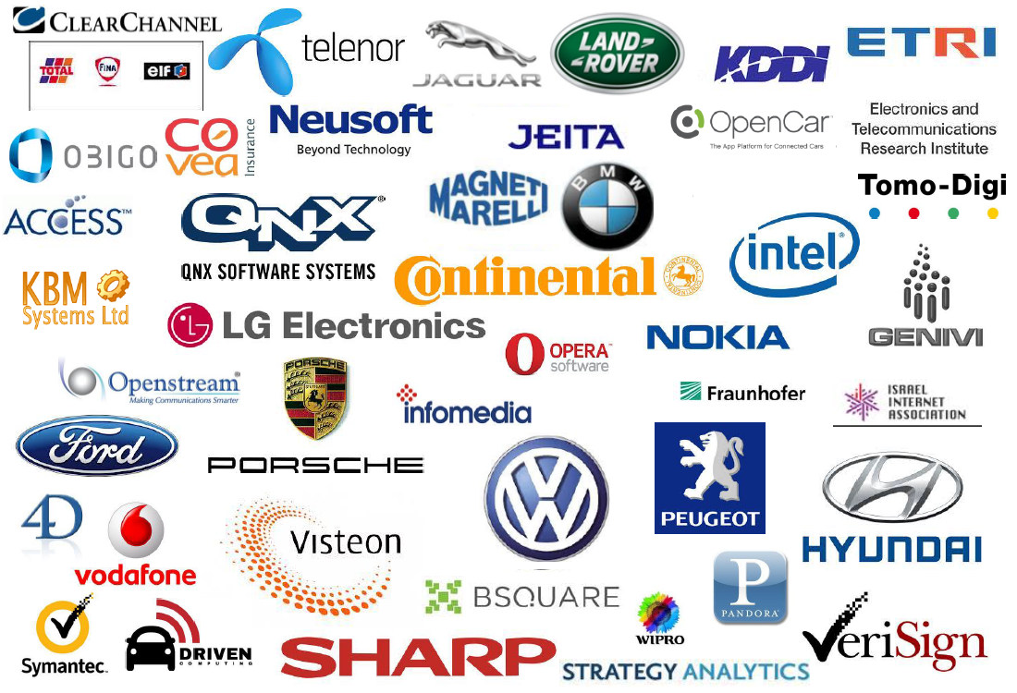
W3C Automotive & Web BG – Participants (partial list)

Slide 6
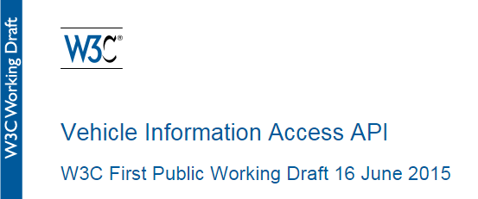
W3C Automotive & Web Working Group
Vehicle Information API
  Defines open standard for HTML5/JavaScript Application developers
  Enables web connectivity through vehicle data access protocols
      In Vehicle Infotainment systems (IVI)
      HTML5/JS Apps running on mobile devices
  Data can come from numerous sources
      OBD-II, CAN, LIN
      Bluetooth, WiFi, Cloud Connections
  Goal
    Create an API enabling App Development in consistent manner across all automotive manufacturers
  Status
    Working Group created to progress → Open Standard (Recommendation)
    First Public Working Draft published Q2 2015
    See http://www.w3.org/TR/vehicle-information-api/

Slide 7
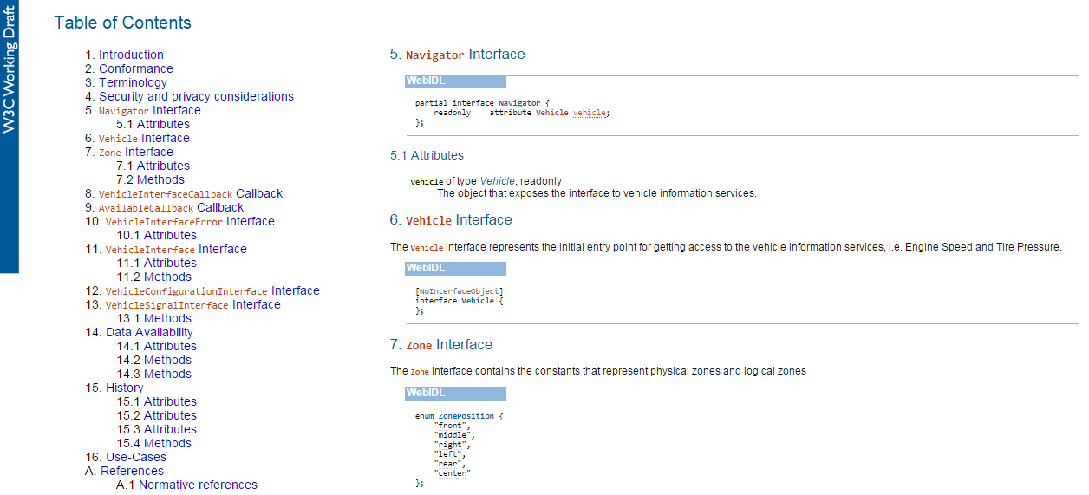
W3C Automotive & Web WG – Vehicle Information API

Slide 8
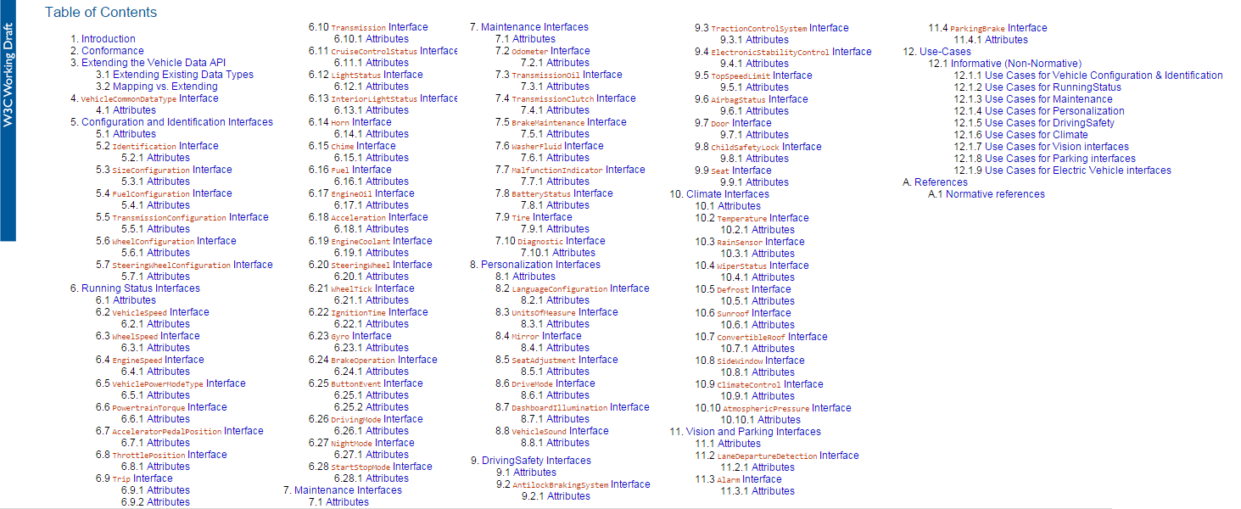
W3C Automotive & Web WG – Vehicle Data API

Slide 9


Use Case #1: Car pays parking charge
Vehicle leaving car park uses Web Payment
to pay parking fee
Primary Actor
Owner/driver of vehicle that wants to make a Web Payment using the vehicle.
Level: Summary Level
Stakeholders and Interests
Vehicle Payment System: On-board system that makes payment.
Car Park Charging System: System that communicates with Web Payment facility on vehicle to request payment.
Preconditions
Driver or owner of vehicle has created a Digital Wallet and registered at least one Digital Payment Instrument.
Vehicle can communicate with Car Park Charging System and supports making Web Payment’s using Digital Wallet.
Driver or owner of vehicle has sufficient funds to make the payment.
Type of Web Payment Digital Payment instrument is recognized and accepted by the Car Park Charging System.
Car Park issues a ticket or uses Automatic Number Plate Recognition (ANPR) to determine when vehicle arrives.

Slide 10
Use Case #1: Car pays parking charge
Vehicle leaving car park uses Web Payment to pay parking fee (cont.)
Main Success Scenario
Vehicle approaches Car Park barrier. Driver takes a ticket or vehicle is identified using ANPR.
Vehicle Web Payment system and Car Park Charging System create secure connection.
Car Park Charging System makes a request for payment (Payment Initiation Request). Amount is based on how long vehicle has been parked. Request includes Terms and list of acceptable Digital Payment Schemes.
On-board Vehicle Web Payment System looks up the Digital Payment Instrument(s) that it has in it's Digital Wallet and selects one that is acceptable to the Car Park Charging System (as indicated in Payment Initiation Request).
Vehicle Web Payment system displays the terms and asks driver of vehicle to confirm payment (e.g. via Head Unit)
Vehicle Web Payment system makes (executes) the payment.
Proof of payment is generated and payment is completed.
Car Park barrier is opened and vehicle continues on its journey.

Slide 11


Use Case #2: Car pays toll fee
Car at toll booth uses Web Payment to pay fee
Primary Actor
Owner/driver of vehicle that wants to make a Web Payment using the vehicle.
Level
Summary Level
Stakeholders and Interests
Vehicle Payment System: Onboard system that makes Web Payment on behalf of owner or driver of vehicle.
Toll Charging System: System that communicates with Web Payment facility on vehicle to request payment.
Preconditions
Driver or owner of vehicle has created a Digital Wallet and registered at least one Digital Payment Instrument.
Vehicle can communicate with Toll Charging System and supports making Web Payment’s using Digital Wallet.
Driver or owner of vehicle has sufficient funds to make the payment.
Type of Web Payment Digital Payment instrument is recognized and accepted by the Toll Charging System.

Slide 12

Use Case #2: Car pays toll fee
Car at toll booth uses Web Payment to pay fee
Main Success Scenario
Vehicle approaches Toll Booth Charging Point for road, bridge, tunnel etc.
Type of vehicle is identified (e.g. from Registration Number).
Vehicle Web Payment system & Toll Charging System create secure connection.
Toll Charging System makes a Payment Initiation Request (which includes Terms and list of acceptable Digital Payment Schemes).
On-board Vehicle Web Payment System looks up (discovers) the Digital Payment Instrument(s) that it has in it's Digital Wallet and selects one that is acceptable to the Toll Charging System (as indicated in Payment Initiation Request).
Vehicle Web Payment system displays terms and asks driver of vehicle to confirm payment for the vehicle type.
Vehicle Web Payment system makes (executes) the payment.
Proof of payment is generated and payment is completed.
Toll Booth barrier is opened and vehicle continues on its journey.

Slide 13

Use Case #3: Car pays for fuel
Vehicle uses Web Payment to pay for fuel
Primary Actor
Owner/driver of vehicle that wants to make a Web Payment
using the vehicle.
Level
Summary Level
Stakeholders and Interests
Vehicle Payment System: On-board system that makes Web Payment on behalf of owner or driver of vehicle.
Gas Station Charging System: System that communicates with Web Payment facility on vehicle to request payment.
Preconditions
Driver or owner of vehicle has created a Digital Wallet and registered at least one Digital Payment Instrument.
Vehicle can communicate with Gas Station Charging System & supports making Web Payment’s using Digital Wallet.
Driver or owner of vehicle has sufficient funds to make the payment.
Type of Web Payment Digital Payment instrument is recognized and accepted by the Gas Station Charging System.

Slide 14
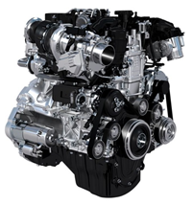


Use Case #3: Car pays for fuel
Car uses Web Payment to pay for fuel (cont.)
Main Success Scenario
Vehicle parks at gas station pump.
Driver indicates that wishes to pay at pump using Web Payment.
Vehicle Payment System and Gas Station Charging System create secure connection.
Driver Purchases up to pre-agreed limit is approved by Gas Station Charging System
Driver adds fuel to vehicle up to pre-agreed limit
Gas Station Charging System makes a Payment Initiation Request (which includes Terms & Payment Schemes).
On-board Vehicle Web Payment System looks up (discovers) the Digital Payment Instrument(s) that it has in it's Digital Wallet and selects one that is acceptable to the Charging System.
Vehicle displays terms and asks driver of vehicle to confirm payment.
Vehicle Web Payment system makes (executes) the payment.
Proof of payment is generated and payment is completed.

Slide 15
Definition of Terms
Term | Definition | Reference
CAN | Controller Area Network: A multi-master serial bus based standard for communication between Electronic Control Unit (ECU) nodes on a vehicle. | https://en.wikipedia.org/wiki/CAN_bus
Digital Payment Scheme | A payment scheme is a set of rules and technical standards for the execution of payment transactions that are followed by adhering entities (payment processors, payers and payees). A digital payment scheme is one where transactions take place over digital networks (such as the Web). Some digital payment schemes make use internally of payment instruments from other payment schemes. How they register and communicate with internal payment instruments is beyond the scope of this charter. | http://www.w3.org/2015/06/payments-wg-charter.html#digital-payment-instrument
Digital Payment Instrument | A payment instrument is an account, token or other means of conducting a transaction according to a payment scheme. A digital payment instrument is one that is associated with a digital payment scheme. | http://www.w3.org/2015/06/payments-wg-charter.html#digital-payment-instrument
Digital Wallet | A wallet is a container for payment instruments that affords access to them. A digital wallet holds digital payment instruments. | http://www.w3.org/2015/06/payments-wg-charter.html#digital-wallet
LIN | Local Interconnect Network: Serial network protocol used for communication between components in automotive vehicle | https://en.wikipedia.org/wiki/Local_Interconnect_Network
OBD-II | On-board diagnostics version 2 – gives vehicle technician access to the status of vehicle subsystems. | https://en.wikipedia.org/wiki/On-board_diagnostics#OBD-II

Slide 16
References
Reference | URL / Publisher
W3C Automotive Web Platform Main Page | http://www.w3.org/community/autowebplatform/wiki/Main_Page
W3C Automotive Web Platform Group | https://www.w3.org/community/autowebplatform/
W3C Automotive Web Platform Group Charter | http://www.w3.org/2014/automotive/charter
W3C Automotive Working Group | http://www.w3.org/auto/wg/
W3C Web Payments Community Group | https://www.w3.org/community/webpayments/
W3C Web Payments Working Group Charter | http://www.w3.org/2015/10/payments-wg-charter.html
Web Payments at W3C | http://www.w3.org/Payments/
Vehicle Information Access API – W3C First Public Working Draft | http://www.w3.org/TR/vehicle-information-api/
Vehicle Data API – W3C First Public Working Draft | http://www.w3.org/TR/vehicle-data/
Jaguar F-Pace Guinness World Record 360 Loop | https://www.youtube.com/watch?v=y64JhPtpicA&feature=youtu.be

Slide 17
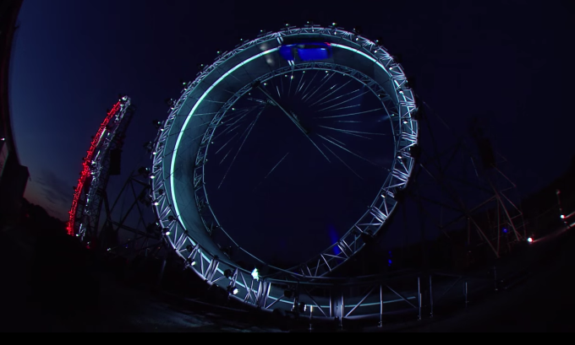
Any Questions?
https://www.youtube.com/watch?v=y64JhPtpicA&feature=youtu.be

