Slide 1
Secure Elements and W3C
L. Castillo
06/16/15

Slide 2
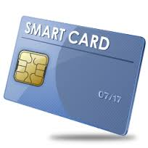
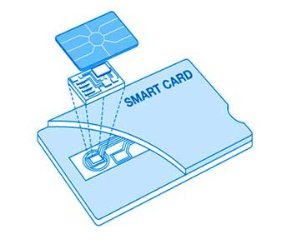
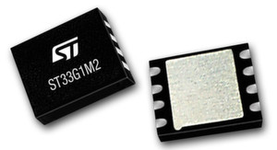
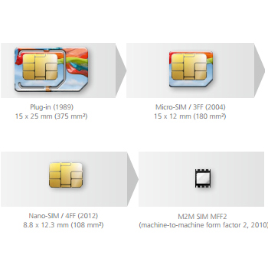
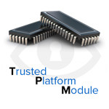
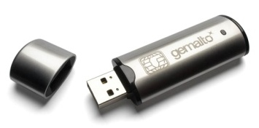
Secure Elements at a glance
Secure microprocessor, secure memory, crypto engine

Slide 3
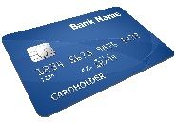
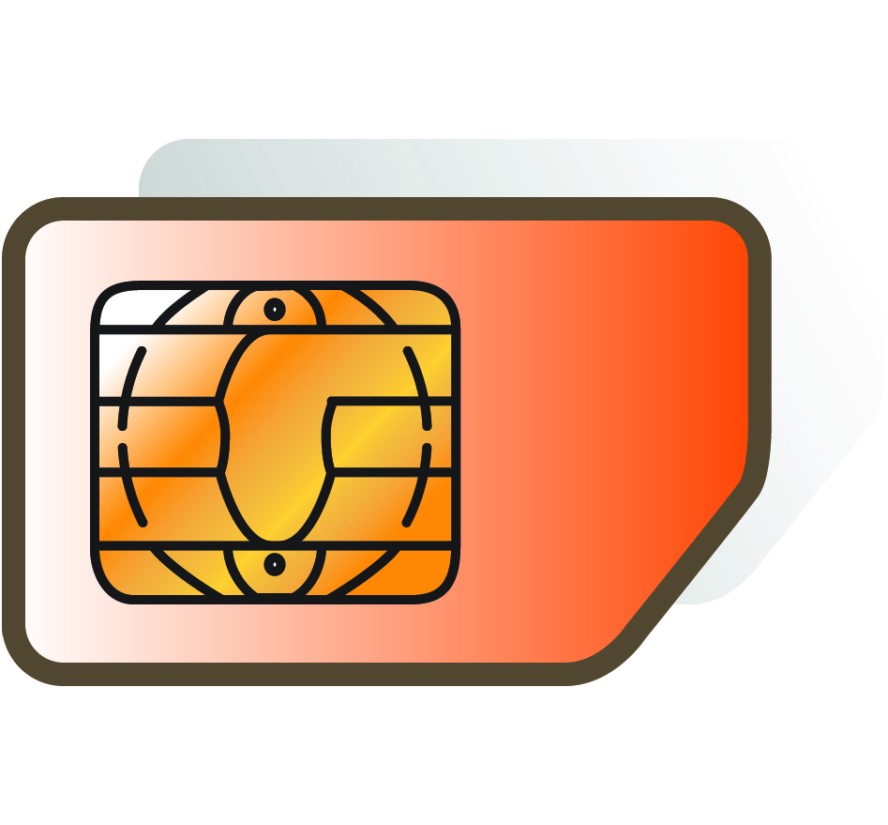
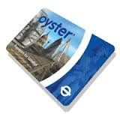
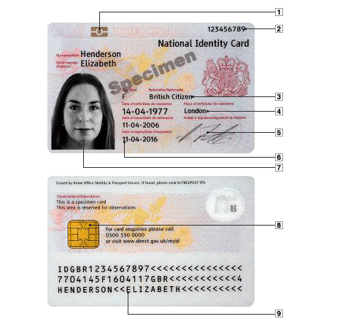
Many applications
Banking
Telecoms
ID
Transport
Caveats
Small memory, Low power, Low processing
Secure Elements don’t have a 6 weeks release cycle

Slide 4
A common set of standards
CC EAL
FIPS
EMVCo
3GPP
ETSI
GSMA
PIV
IAS ECC
eIDAS
OATH
Business
Applications
ISO/IEC 7816 5-12
Java Card
GlobalPlatform
OS & Application
Management
ISO/IEC 7816 1-4
ISO/IEC 14443
Communication
Security
Features

Slide 5
W3C and Secure Elements
Use cases to provide access to secure elements in web applications presented in SysApp WG
Two factor authentication in web application
“Chip present” mCommerce
Reload transport card
Mobile ID
Reduce middleware burden on users
Multiple efforts to provide access at various abstraction levels
SE API in W3C SysApp WG at Communication level
WebCrypto API support for SE at Cryptographic services level
Past efforts stalled or stopped, one main issue
Security policy & Access control to secure elements
Notes:
Middleware = driver burden
Drivers => plug n’ play
FIDO
SE API based on OMAPI (SIM Alliance)

Slide 6
Security Model Issue
Web two security models
Permissions: for local, user controlled resources (GPS, storage, etc…)
Same Origin Policy: for remote, domain-bound resources / entities
SEs Security model
Physical binding to a user’s device (for user control)
Contained applications are owned and managed by remote entities
Remote entity authentication doesn’t rely on web domains
Support for SEs requires either compromise or a new model
Using User Permissions - might open security hole for SE apps NOT using strong remote authentication
Using SOP – requires binding SE apps to web domains and changing 6 bn+ SEs on a three year cycle
Using a new Web App security model – Trust and Permission CG efforts stalled
Notes:
Permissions are specified in W3C, great
Permission API, W3C Trust and Permission CG
https://www.w3.org/community/trustperms/
GP SEAC

Slide 7
Web Payments: touch points with SEs
Credentials for authentication and/or payments
Proximity payment infrastructure
EMV Card-based payment processing
Tokenization
World-wide EMV transition
TEE

Slide 8
Next steps
Ongoing efforts: collecting requirements to address SEs services through the web
Global Platform Web APIs group
W3C Working Group coming soon
Many actions around Security / Credentials in W3C
Web Security
…
Recruiting participants for the coming W3C Working Group
Contact Virginie Galindo: virginie.galindo@gemalto.com
Notes:
* Name to be defined

