Slide 1
Workshop on Chinese layout Requirements
On Mongolian Network Layout
Nasun-urt
那顺乌日图
mgnasun@imu.edu.cn
School of Mongolian Studies, Inner Mongolia University
2014.09.11

Slide 2
One, Mongolian language
There are about 8 million Mongolian people in the world, they mainly live in China, Mongolia, Russia (there are also some Mongolian descendants in Afghanistan, India and central Asia) and other countries, scattered all over the world.
At present, there are 9 kinds of Mongolian languages in the Mongolian language group. They also has many dialects and idioms among Mongolian.

Slide 3
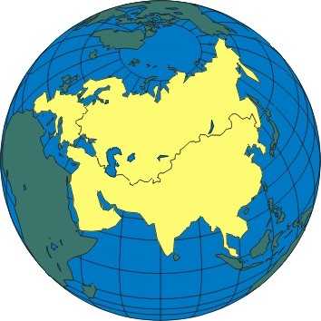
The territory of Mongol empire
The picture can be enough to explain the influence of Mongolian language and culture on the world.

Slide 4
1, the Characteristics of Mongolian Language
there are 5 kinds of Mongolian characters in the world(the Traditional Mongolian, the Todo Mongolian , Cyrillic Mongolian, Buryat Cyrillic Mongolian and Kalmyk Cyrillic Mongolian).
Mongolian have used more than ten kinds of characters including the characters have used in the history(e.g. Phags-pa script，Soyombo script，Vagindara script. etc.).
It is the people to one of the most use of the existing text in the world.

Slide 5
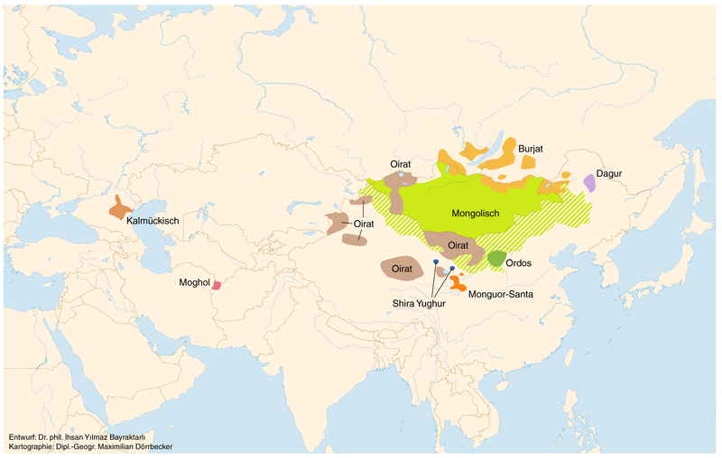
Distribution of the Mongolian language

Slide 6
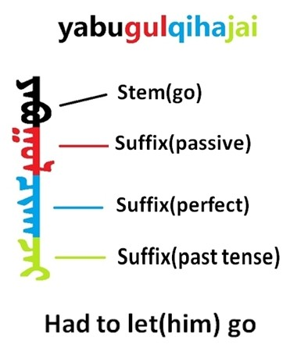
The Mongolian, belonging to Mongolian group of the Altaic language family, is a typical agglutinative language. Its grammatical form is rich and complex , and indicate the grammatical meanings with adding some suffixes to the stem.
It Brings a lot of difficult problem to the words judgment of the language information processing.

Slide 7
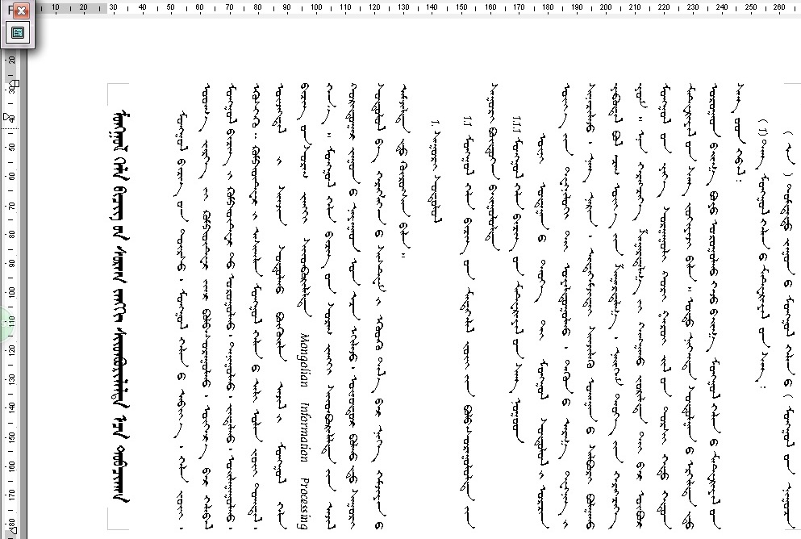

Slide 8
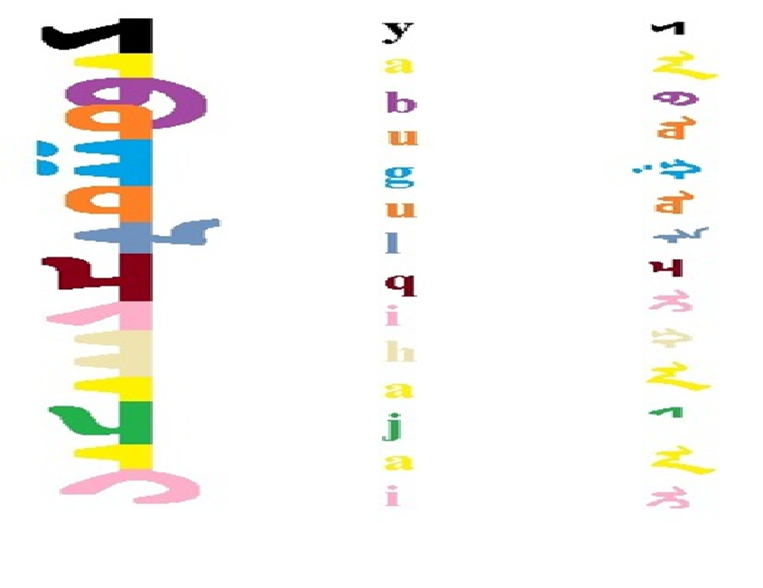
Latin transformational form（the pronunciation of the letter）
Each letter in UNICODE encoding shape（Nominal character）
Words(the variant form）

Slide 9
Two, the Coding Standard of Mongolian
Mongolian has entered the ISO/IEC 10646-2000；GB13000\18030.
Mongolian code can be divided into “nominal characters” and “presentation forms” two parts.

Slide 10
1, the support for the traditional Mongolian display is not perfect
Three, the Existential Problems
The methods of the existing browser supporting for vertical display is not unified. Different browser takes different properties to display the vertical texts. such as：writing-mode: tb-lr; -moz-writing-mode: vertical-lr.etc.
There isn’t some functions to supporting vertical display on some browsers such as Firefox.
Therefore, we need to set the following format properties in order to showing traditional Mongolian script.

Slide 11
2, Support for display of traditional Mongolian is inadequate
-moz-writing-mode: vertical-lr; -webkit-writing-mode: vertical-lr; -o-writing-mode: vertical-lr; -ms-writing-mode: tb-lr; writing-mode: tb-lr;
For a browser that not support the vertical display, we can use rotating the canvas to solve the problem, but this method is not easy to use.

Slide 12
3, The Problem of Mongolian Font
At present, there isn’t Mongolian default font (except Window7,8) in the operating system .Its browser must be use embedded fonts to display the Mongolian;
Because of the production units of Mongolian font become more and more, there are some differences between them, and bringing some obstacles on the transmission of the script;
Although the technology for the embedded font also has a variety of formats and methods, it is difficult to know well. This is resulting in some technical barriers on the development of Mongolian website.

Slide 13
4, The International Standard on Mongolian encoding engine is not standardized.
Although the international standard code on Mongolian has developed for many years, but its encoding engine of many manufacturers is not uniform, and resulting in the incompatible systems.
Some other operating system does not yet include the international encoding engine of Mongolian such as the mobile phone , and resulting in the Mongolian does not display properly.
Some of the browser has built-in encoding engine, and does not use the engine of its operating system. To an extent, this was affect the unified processing on the international standards of Mongolian;

Slide 14
Chrome 37
IE 11

Slide 15
5, Some operational issues such as moving cursor
There was some problems in general on moving the cursor after the vertical type was set up from left to right. In other words, when you move the cursor key leftwards, the cursor is move upwards.
Currently the display of cursor in some browser is not enough beautiful , and become a point on some browser, even deviate from the centerline of text sometimes .

Slide 16
6, A support for the prohibiting rules of Mongolian is not enough.
Some of the Mongolian punctuation can not appear in beginning or end of the row, but the existing browser does not correctly deal with the problem;
For the alignment of the paragraph in Mongolian, which requires an uniformity on showing Mongolian text that display smoothly all of the beginning and end of the row.

Slide 18
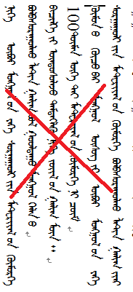
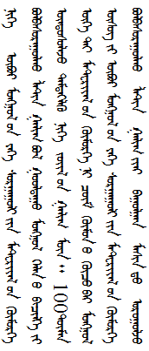

Slide 19
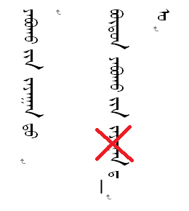
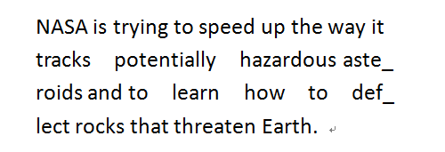
Mongolian is different from English. It is use the "-" to indicate a word is not finished at the end of one line in English. However, the Mongolian is an adhesive language, it can not use the symbol "–" . In Mongolian, if adding the symbol “–”,there will be occur some errors on the variant characters, for example:

Slide 20
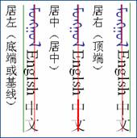
7, The alignment of characters within a line
The default alignment of Mongolian text within a line should be a central line that a middle or a central line -aligned alignment of the character pattern. It was more important for the mixing appearance on Spanish and Chinese characters.

Slide 21
8, The lack of various controls
Because of the special features of the Mongolian, when it showing on the Web page, it needs some vertical controls such as ComboBox、ListBox、CheckBox、Label that corresponding the horizontal controls on the text.

Slide 22
1, Add the displaying properties of Mongolian
Four, Solution
Support Mongolian vertical displaying features by adding writing-mode: traditional-Mongolian.
When using the property of “Body”, we will rotate the entire page to 90 degrees with counterclockwise, and properly display other modules including text displaying, controls according to the Mongolian characteristics.

Slide 23
2, Add default font
Embed default font in all browsers. The font is installed automatically when installing the browser.
Or to provide some unified free fonts on the Internet server that can be used all over Mongolian websites.

Slide 24
3, Unify the coding engine of the international standard on Mongolian
Provide an unified Mongolian coding engine for all browser makers ( We can provide the algorithm).

Slide 25
4, Support the prohibiting rules of Mongolian
Some line breaking rules including Mongolian symbols and additional components of the case must be added to the browser-related algorithms (We can provide the related rules).

Slide 26
5, Support the Mongolian Controls
Add Mongolian specified controls of Mongolian, such as:
MongolianEditor、MongolianCheckBox、 MongolianComboBox、MongolianListBox、MongolianCheckBox、MongolianLabel

Slide 27
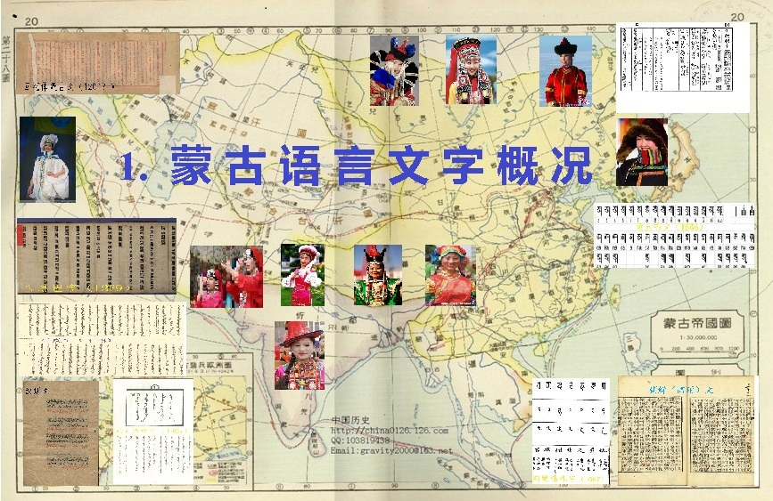

Slide 28
thank you!
 

