Slide 1
Building
Social Applications
with the
Linked Data Platform
Sandro Hawke - Overview
sandro@w3.org, twitter: sandhawke
Joe Presbrey - Demo & Details
Andrei Sambra - Demo & Details
(MIT CSAIL)
11 March 2014, Cambridge Semantic Web Gathering
Slides at http://www.w3.org/2014/Talks/0311-sandro/

Slide 2
Overview
The Social Lock-In Problem
The “Crosscloud” Solution
The Linked Data Platform
An Example
Research Questions
(then)
Joe’s Demo
Andrei’s Demo

Slide 3
Individual User Lock-In
User does some work in some program
Work is saved in proprietary format
User is stuck using only that program until:
willing to lose that work
someone reverse-engineers the format (usually lossy)
export then import (usually lossy)
Ongoing drag on innovation, productivity
“TCO should include exit costs”
Solutions: open source software, standard formats

Slide 4
Group Lock-In
Economics, “The Network Effect”: more users = more value
If I want to share my photos, with access control, on flickr
then all my friends have to use flickr
If Facebook is the only system everyone is using, then the only way to reach everyone is Facebook
Thus Facebook’s 1.8e+11 USD market cap?
If something better came along, could you get your high school friends and cousins to move it?
Open Source and Standard Formats don’t help here
Also: not everyone uses Facebook, or … anything modern.
Postal service, Telephone, E-Mail

Slide 5
Developer Lock-Out
If users are locked into a system, developers are unable to attract them elsewhere
Imagine a better Facebook, but you’re the only one there….
You can build on the major platforms
But only subject to their terms
And subject to the limitations of their platform
And you still only get the users who want to use that platform
Is there a better way?

Slide 6
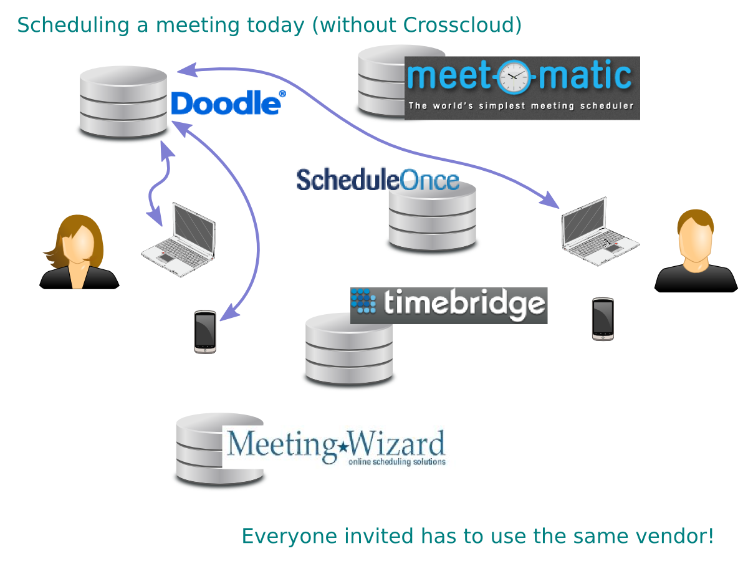

Slide 7
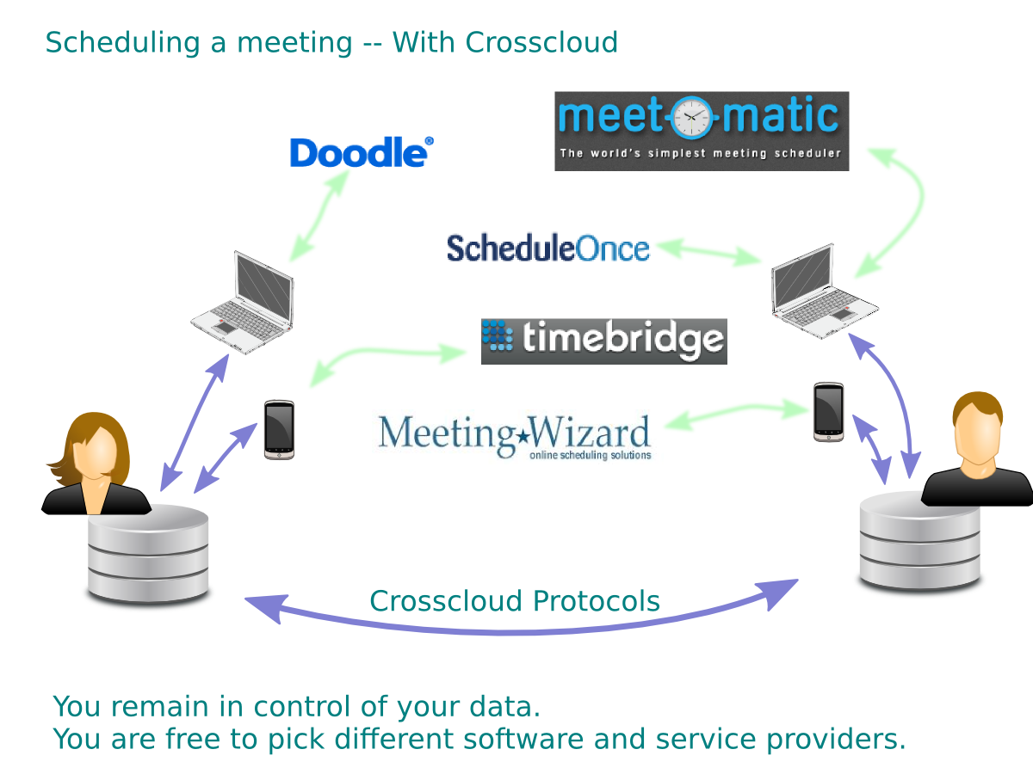

Slide 8
Crosscloud Vision
User’s data remains on a general-purpose server, responsible to the user
Users can expose it to any application they like
Users can switch providers
Applications (ideally) provide the same functionality, but with external data
Data is in RDF (open standard format)
Data is accessed via HTTP (open standard protocol)

Slide 9
Linked Data Platform
Start with Linked Data ...
Use working HTTP IRIs to name things, provide data about things, provide links
… and make it into a full data storage/access system
W3C Submission Feb 2012
From: IBM, DERI, EMC, Oracle, Red Hat, SemanticWeb.com, and Tasktop
LDP Working Group - Second Last Call published Today
http://www.w3.org/TR/ldp
Very basic starting point

Slide 10
Linked Data Platform 1.0 Provides
Containers
POST to create new Resource
GET provides triples linking to each member
Paging (not in today’s draft)
rel=first, last, next, prev
flow control
just the interesting stuff, if sorted

Slide 11
Extensibility
HTTP
HTTP Link headers (with defined relations)
HTTP Prefer / Preference-Applied headers (with defined preferences)
Can’t really use media type extensibility, since RDF already uses that
RDF
define new properties and classes, as usual

Slide 12
Extensions used in today’s demos
WebID -- Use IRIs to identify people, properties/classes in what you get back
Workspaces -- Link from WebID to Containers of stuff
Change Propagation -- Real-time notify client of changed data
Access control -- server grants read/write access based on user’s WebID (using client certificates)

Slide 13
Example: To-Do List WebApp
User logs in with their WebID
App can read RDF triples describing to-do list items
App can modify/delete RDF triples describing to-do list items
It’s just doing HTTP GET, POST, DELETE, PUT with small Turtle documents

Slide 14
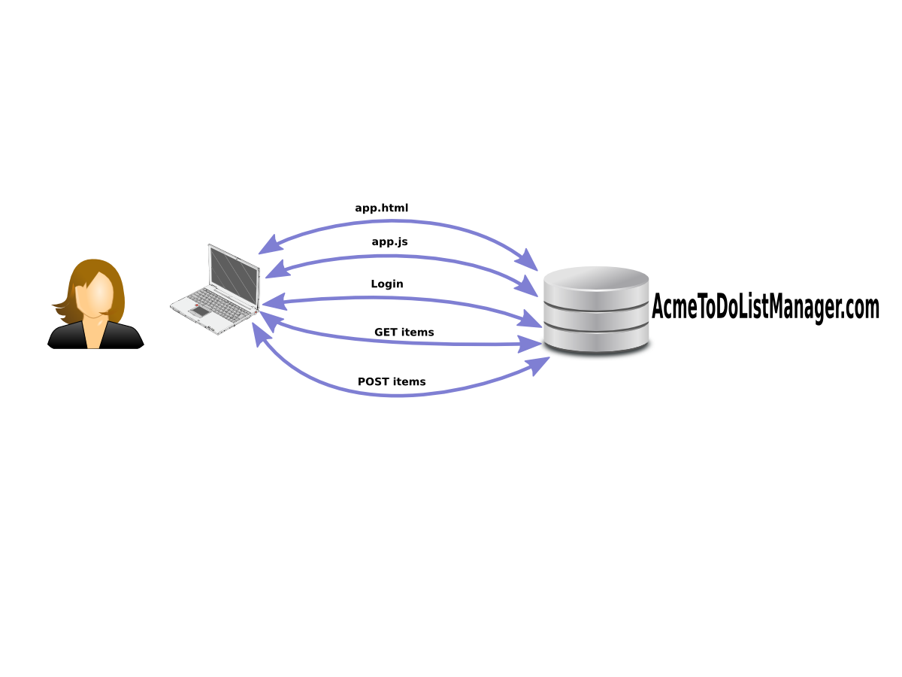
Pre-Crosscloud WebApp

Slide 15
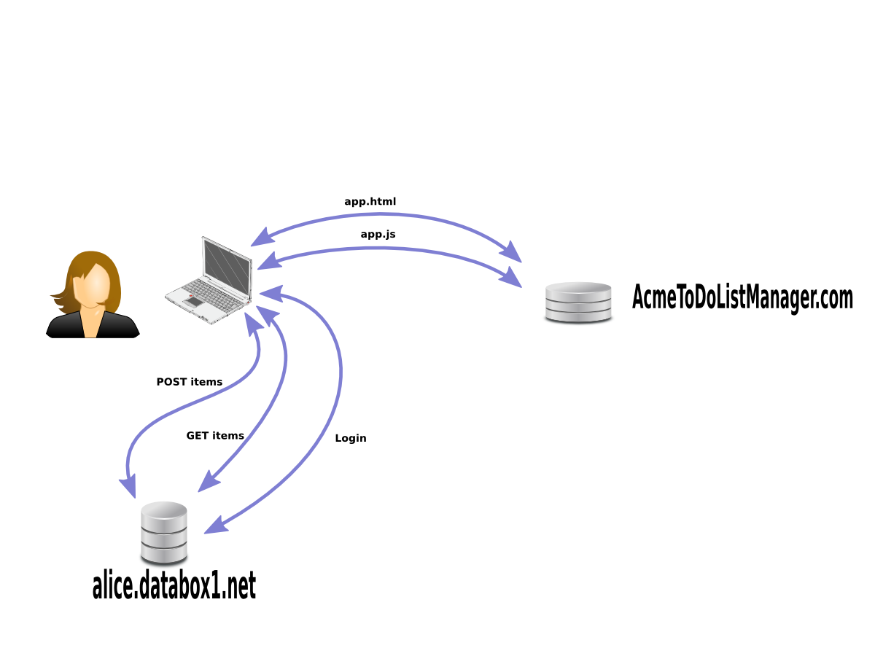
Move the Data to Alice’s Server

Slide 16
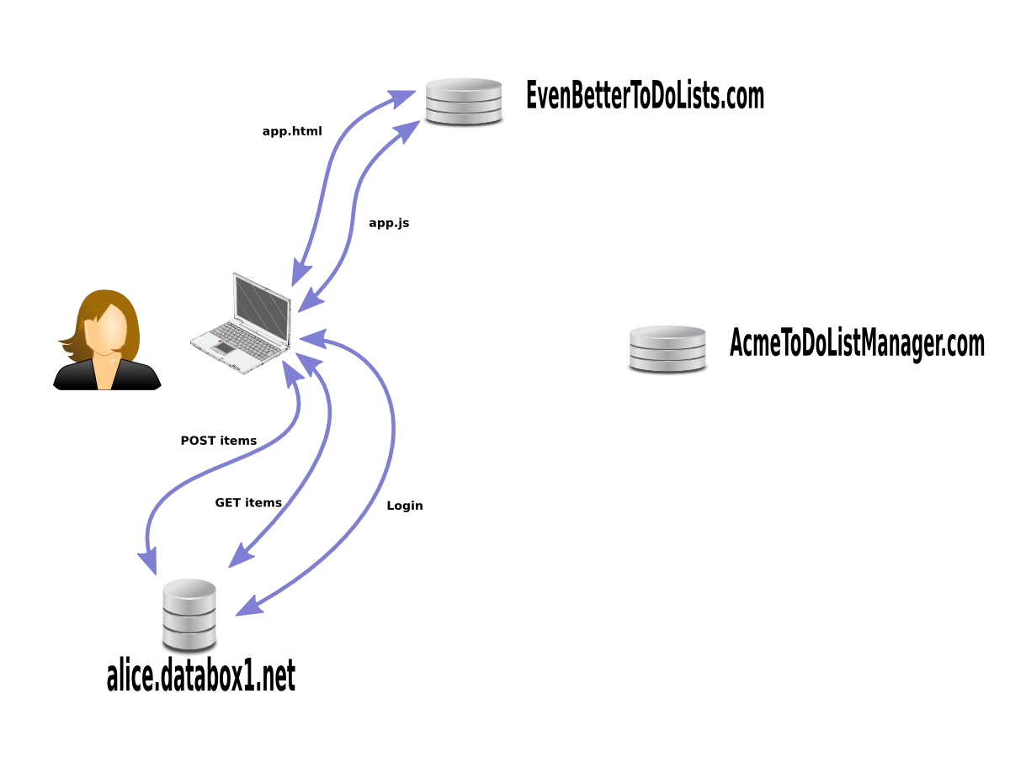
Switch WebApps

Slide 17
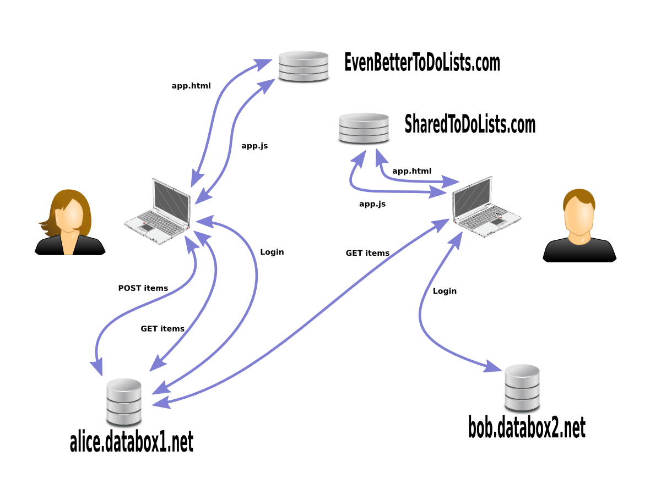
Unlocked Social

Slide 18
Why is that so great?
Same shared state, but...
Open Standard Protocols: anyone can build another UI (“EvenBetterToDoLists”)
UI can be forked, improved, with the same user base
We’ve escaped group lock-in
Standard, commodity backend service (like web hosting)
User control, optional additional privacy
No Password Proliferation

Slide 19
Other Applications
Microblogging (cimba) [twitter, facebook]
Office Apps
Media Sharing
Product Reviews/Feedback
Gaming
...

Slide 20
Lots of Research To Do
This work is supported by and in collaboration with QCRI (which is hiring)
Related work in our group supported by NSF & Knight Foundation
The “Social WebArch” Group
Tim Berners-Lee, PI (MIT)
Ashraf Aboulnaga, Co-PI (QCRI)
Essam Mansour, Ahmed El-Roby (QCRI)
Sandro Hawke, Andrei Sambra, Joe Presbrey (MIT)
Lalana Kagal, Project Lead PI (MIT)

Slide 21
Efficient Change Propagation
Fast (notify, patch)
(while running as a WebApp)
Inbound (following 1000s of people)
Outbound (1000s of followers)
Massive scale (Obama Campaign has 40M followers, follows 0.65M)

Slide 22
Access Control
Who can see my data? (read access)
Individuals, Groups, Logical Groups
Who can write to my space? (write access)
Who do I pay attention to, when they write to their own space? (notify access)
Semi-Trusted Software (like current OAuth WebApps)
give them access to some of your data
limit the harm they can do by writing
be able to identify and undo any harm they do

Slide 23
Designing for Reliability
Where can we build redundancy/failover into the protocols?
A smarter client allows much simpler server architecture
Load balancing

Slide 24
Vocabulary Translation
Interoperability Requires using the same Vocabulary, or Translation
Multiple vocabularies for one domain, at some point in time
Multiple vocabularies over time (migration)
Conversion Rules are more data (indexed, trusted, crowdsourced, purchased)
Conversion via OWL? N3? RIF? JavaScript? Java? Something New?

Slide 25
Technology Adoption
This can and should be research, too
What do developers need?
Quick results, simple model, open source, open standards
What do end-users need?
Quick results, great apps
What do business users need?
Stability, proven utility, trained workforce
What does the industry need (for standardization) ?
consensus among a critical mass

Slide 26
Next Steps
W3C Participation
WebID Community Group
Federated Social Web Community Group
Linked Data Platform Working Group
Open Source Contributions
Academic Collaboration
Business Collaboration

