Slide 1
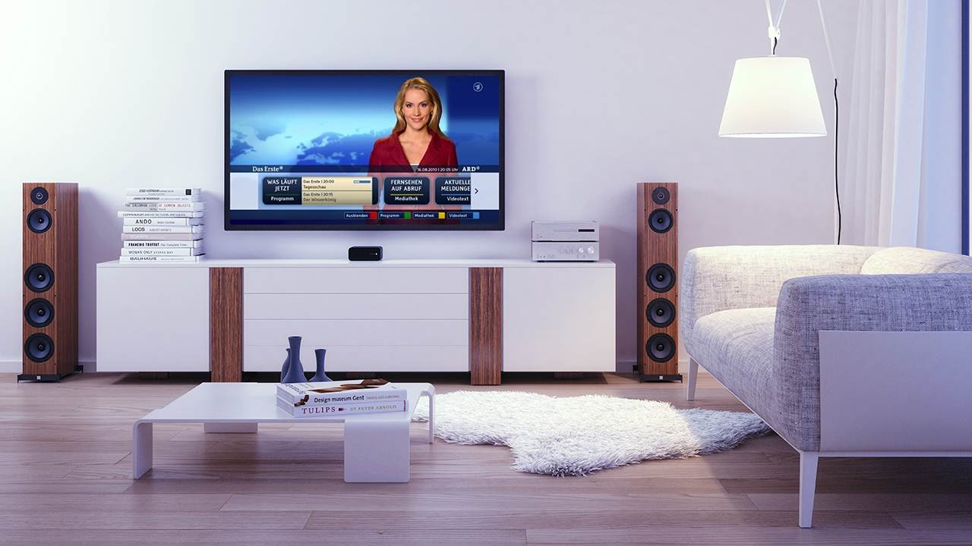

Web & TV IG Overview
Giuseppe Pascale, Opera Software
Notes:
1

Slide 2
Goals (from the Web and TV IG charter)
Identification of requirements for tighter support of media-centric applications on the Web Platform
Identification of gaps in the Web Platform that do not allow the identified requirements to be met
Review of deliverables under development by other W3C groups that are relevant to the IG scope and report bugs as appropriate
Liaison with other organizations in the media industry that are using the Web Platform for their technical specifications and/or their services to foster alignment and interoperability on a global scale

Slide 3
Web and TV IG
IG != WG
  No technical specification developed
  Focus on requirements and input for existing and/or new WGs
Resources
  Wiki: http://www.w3.org/2011/webtv/wiki/Main_Page
  Home Page: http://www.w3.org/2011/webtv/
Organization
  Discussion on the list is preferred and is encouraged
  Specific topics can (a) create Task Force (TF) and/or (b) create a Community Group (CG).

Slide 4

Web and TV Interest Group Work Flow
Web & TV IG (Task Force)
Bug reports
WG
Use cases
current
spec
Standards &
trade orgs.
Requirements
New API
WG
new
spec
Members
Gap analysis
New
API
CG
WG
draft
spec
new
spec

Slide 5
IG work overview
Closed
  Home Network TF (HNTF):http://www.w3.org/2011/webtv/wiki/HNTF
  Media Pipeline TF (MPTF):http://www.w3.org/2011/webtv/wiki/MPTF
  Testing TF (TestingTF): https://www.w3.org/2011/webtv/wiki/Testing
  Timed Text TF (TTTF):https://www.w3.org/2011/webtv/wiki/Tt
Active
  Media APIs: https://www.w3.org/2011/webtv/wiki/Media_APIs

Slide 6
Home Network TF (closed)
Web & TV IG
DAP WG
Requirements for Home Networking
Scenarios
Network
Service
Discovery
Members
New
API
Goal: Identify gaps to enable discovery and control of devices and services in the local area IP network
Outcome:
  Use cases and requirements for potential specifications
  Network Service Discovery API (Working Draft)
  Spec reviewed by implementers and by Privacy IG (PING), some security/privacy concerns raised
  A new update to address such concerns submitted to the group for review.

Slide 7
Media Pipeline TF (closed)
Web & TV IG
Bug reports
HTML WG
Gap analysis
HTML5
Members
Adaptive Bitrate
Requirements
New API
MSE
Content Protection
Requirements
New API
EME
Goal: Improve HTML5 media pipeline to support media services
Outcome:
  Bug reports toward HTML5 addressed. HTML5 is currently a Candidate Recommendation
  MSE (Media Source Extensions): Candidate Recommendation, early browser support
  EME (Encrypted Media Extensions): Working Draft, early browser support
  IG members form new group: Media Resource In-band Tracks CG

Slide 8
Testing TF (closed)
ATSC, DLNA,
IPTV Forum Japan
OIPF,
SmartTV Alliance
Web & TV IG
Testing Use Cases
Testing group
Testing
Requirements
Planning input
Open Web Platform Testing Plan
Members
Web & TV Testing Survey Results
Goal: Collect Web & TV testing use cases, requirements. Identify gaps in current test tools and test coverage. Liaison with external organizations
Outcome:
  Use cases & requirements completed
  10 external organizations surveyed, 5 returned survey
  Reports delivered to Testing group

Slide 9
Timed Text TF (closed)
Web & TV IG
Timed Text WG
Timed Text Efforts
TTML
DECE, EBU
SMPTE
Timed Text Use Cases
Planning input
Web Media Text Tracks CG
WebVTT
Members
Consensus Input
Goal: Develop recommendations to facilitate the use of TTML and WebVTT content on the Web, including interoperability with other timed text formats.
Outcome & status:
  Document scope and variations of TTML and WebVTT
  Gather Web-based timed text use cases from the TV and Media industry
  Delivered IG Consensus Input to Timed Text WG, Gather Web-based timed text use cases from the TV and Media industry and IG members.
  New charter for TT WG (a) included both TTML and WebVTT (b) added a deliverable to create a mapping doc between TTML and WebVTT.

Slide 10
Media APIs TF (ongoing)
Previous work
  Investigate requirements for discover and control of device capabilities (e.g. tuner control)
  Investigate how to expose TV metadata to web applications
  Investigate mapping between Media Element API and in-band metadata
Current work
  Identify requirements for audio fingerprinting and watermarking
  Media stream synchronization
  Triggered interactive overlay
  Clean audio

Slide 11
Thanks
Giuseppe Pascale, Opera Software
Notes:
11

