Slide 1
Introduction to Linked Open Data
Tutorial
DC-2013 Conference
2nd September, 2013, Lisbon, Portugal
Ivan Herman, W3C

Slide 2
These slides are also available on the Web:
http://www.w3.org/2013/Talks/0902-Lisbon-IH/

Slide 3
Introduction

Slide 4
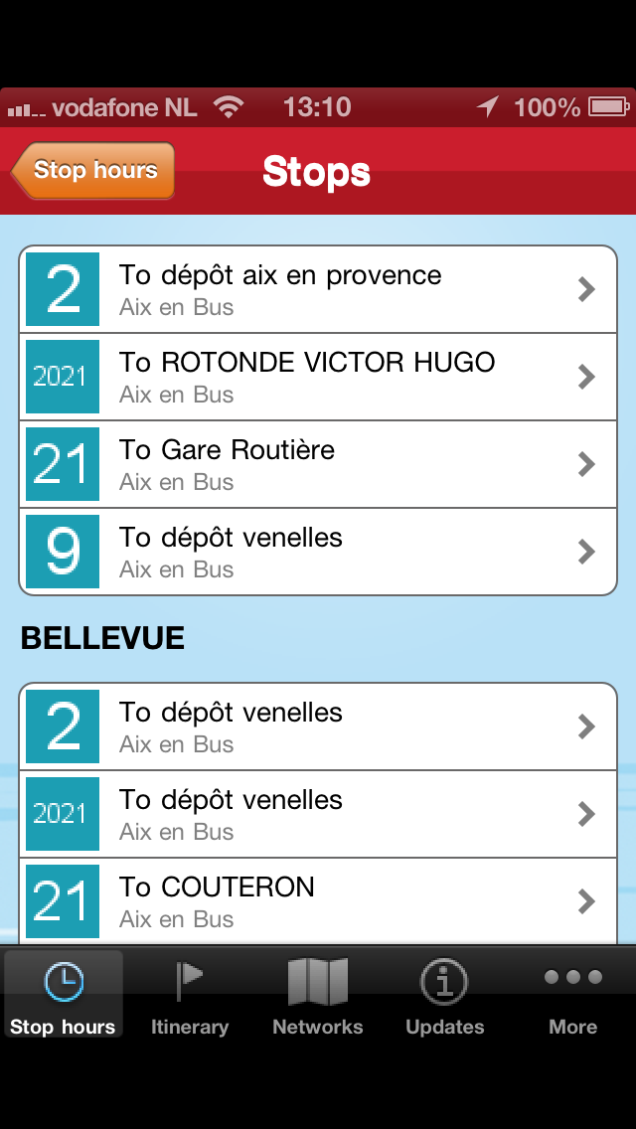
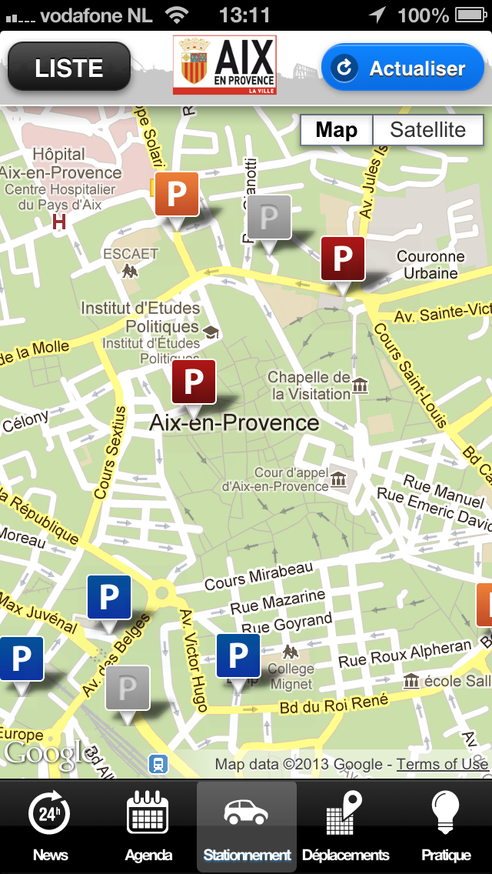
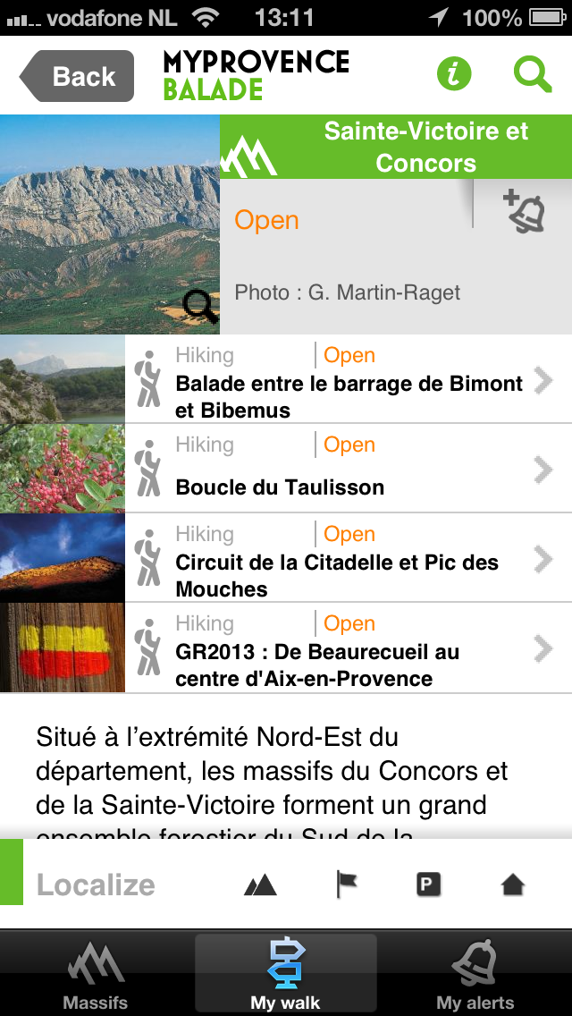
Notes:
Applications relying on various types of data published by the municipality of Aix

Slide 5
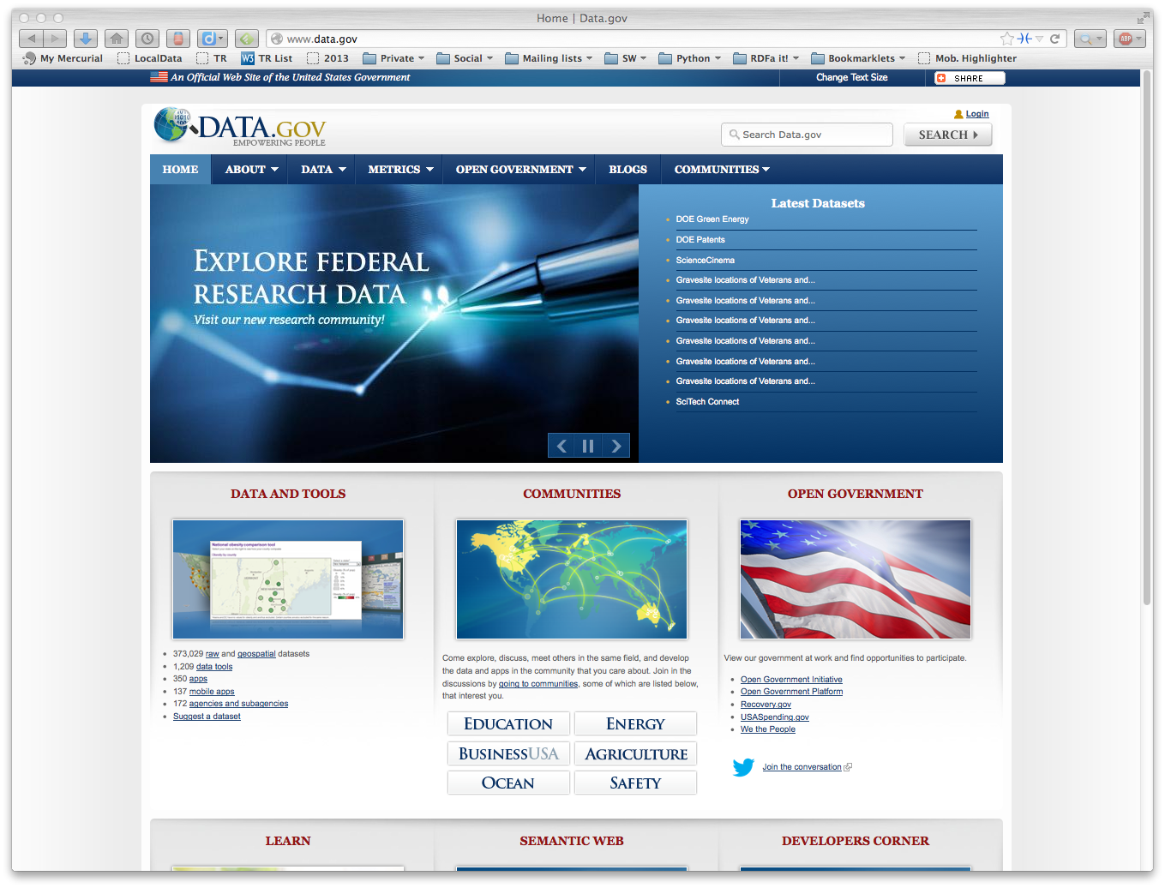

Slide 6
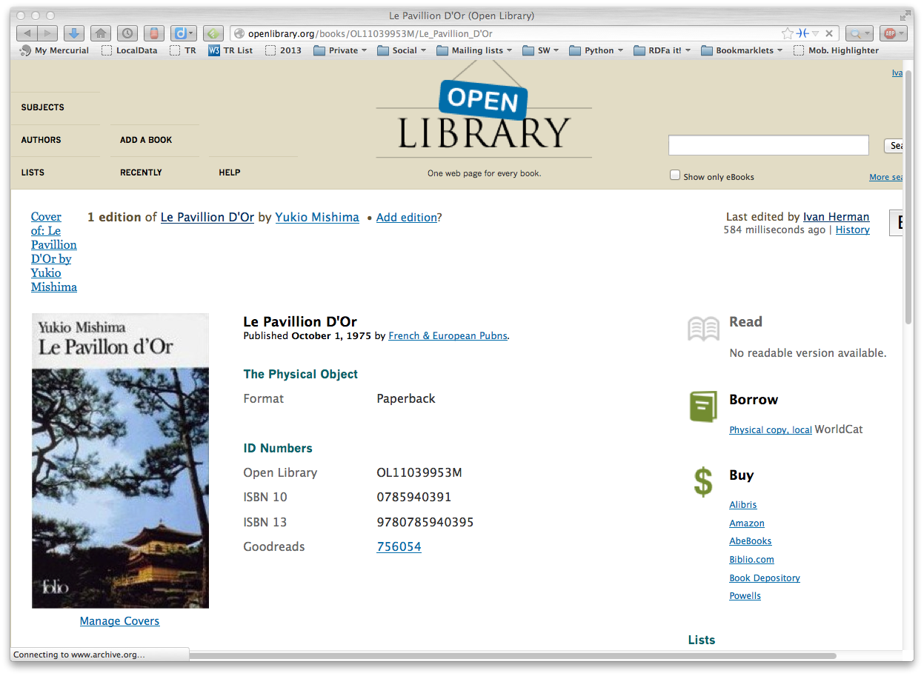

Slide 7
Take a specific example

Slide 8
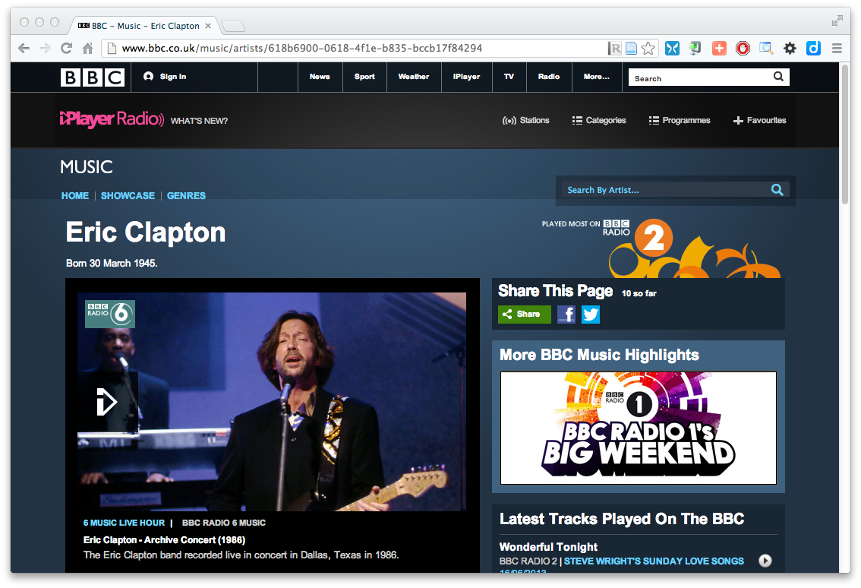
The Music site of the BBC

Slide 9
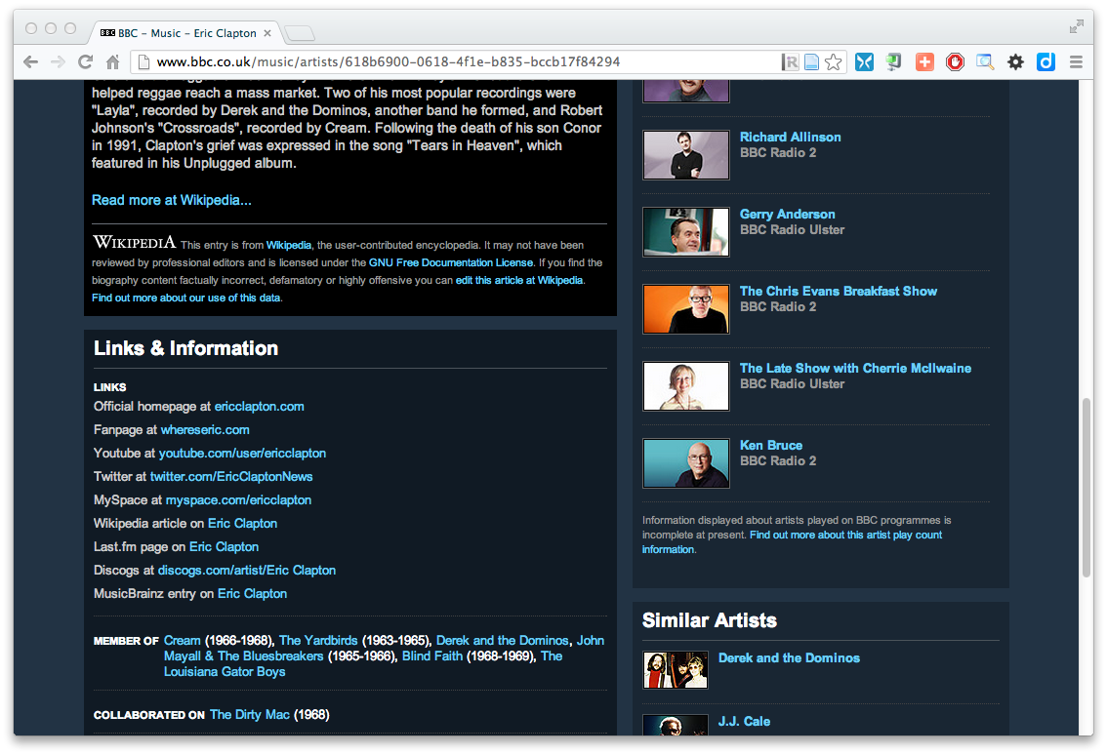
The Music site of the BBC

Slide 10
How to build such a site 1.
Site editors roam the Web for new facts
may discover further links while roaming
They update the site manually
And the site gets soon out-of-date ☹

Slide 11
How to build such a site 2.
Editors roam the Web for new data published on Web sites
“Scrape” the sites with a program to extract the information
Ie, write some code to incorporate the new data
Easily get out of date again… ☹

Slide 12
How to build such a site 3.
Editors roam the Web for new data via API-s
Understand those…
input, output arguments, datatypes used, etc
hope that the necessary portion of the data is released through the API
Write some code to incorporate the new data
Easily get out of date again… ☹

Slide 13
The choice of the BBC
Use external, public datasets
Wikipedia, MusicBrainz, …
They are available as data
not API-s or hidden on a Web site
data can be extracted using, e.g., HTTP requests or standard queries

Slide 14
In short…
Use the Web of Data as a Content Management System
Use the community at large as content editors

Slide 15
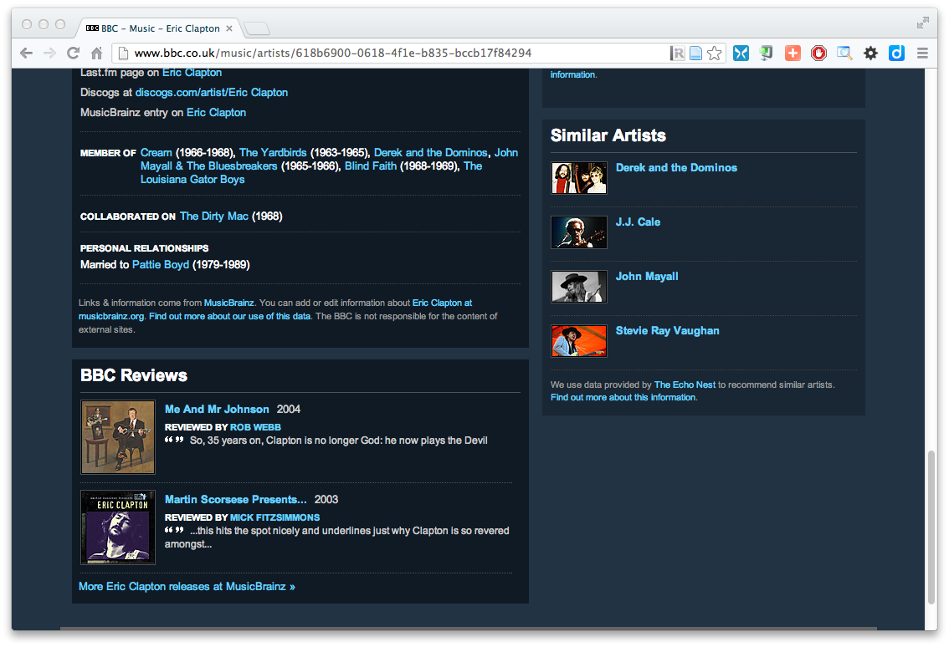
And this is no secret…

Slide 16
And this is no secret…

Slide 17
Data on the Web
There are more an more data on the Web
government data, health related data, general knowledge, company information, flight information, restaurants,…
More and more applications rely on the availability of that data

Slide 18
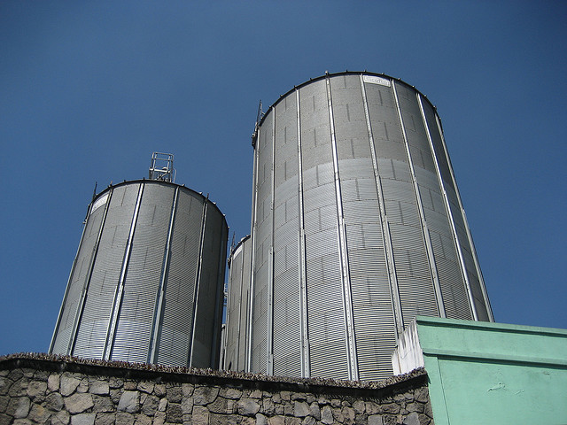
But… data are often in isolation, “silos”
Photo credit “nepatterson”, Flickr

Slide 19
Imagine…
A “Web” where
documents are available for download on the Internet
but there would be no hyperlinks among them

Slide 20
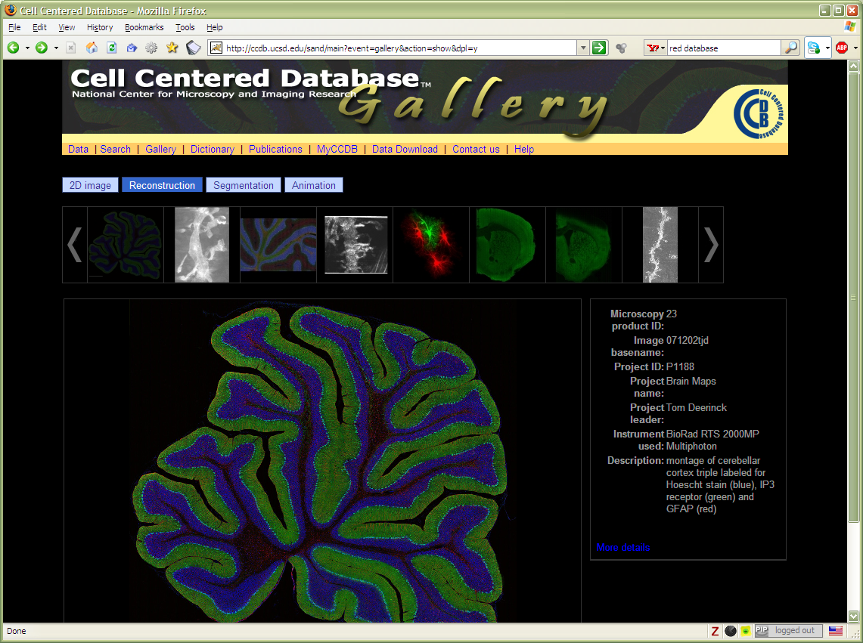
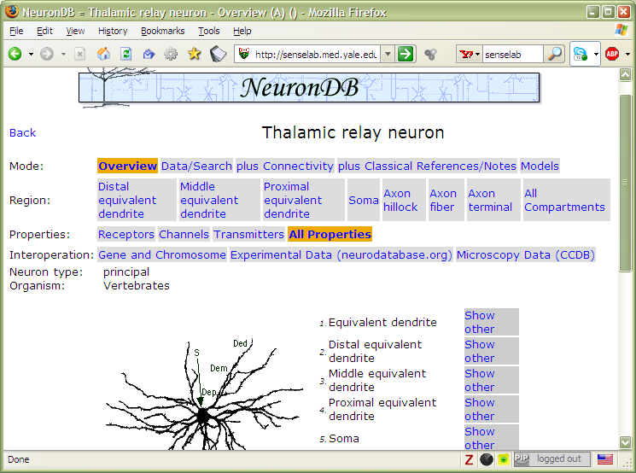
And the problem is real…

Slide 21
Data on the Web is not enough…
We need a proper infrastructure for a real Web of Data
data is available on the Web
accessible via standard Web technologies
data are interlinked over the Web
i.e., data can be integrated over the Web
This is where Linked Data come in

Slide 22
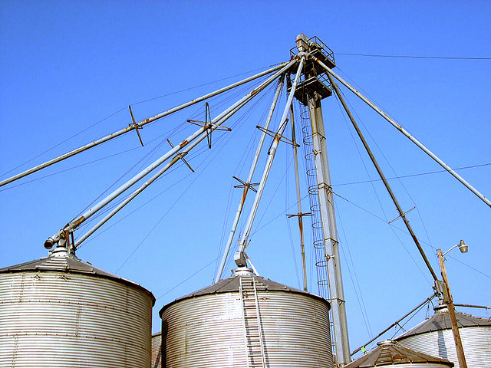
I.e.,… connect the silos
Photo credit “kxlly”, Flickr

Slide 23
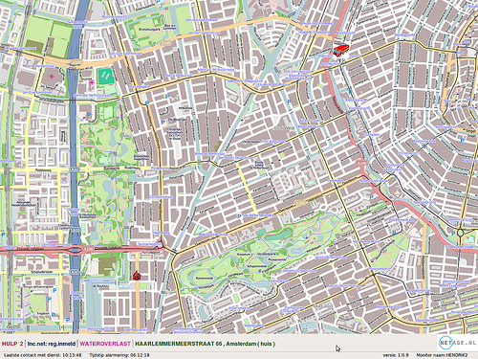
Example: Amsterdam fire brigade routing
Find the best possible route from the station to the fire
e.g., where are the roadblocks?
Use and integrate available city data
Also: republish the structured data for others to use!
Courtesy of Bart van Leeuwen, Amsterdam Fire Service, The Netherlands

Slide 24
In what follows…
We will use a simplistic example to introduce the main technical concepts

Slide 25
The rough structure of data integration
Map the various data onto an abstract data representation
make the data independent of its internal representation…
Merge the resulting representations
Start making, e.g., queries on the whole!
queries not possible on the individual data sets

Slide 26
We start with a book...

Slide 27
A simplified bookstore data (dataset “A”)
ISBN | Author | Title | Publisher | Year
0006511409X | id_xyz | The Glass Palace | id_qpr | 2000
ID | Name | Homepage
id_xyz | Ghosh, Amitav | http://www.amitavghosh.com
ID | Publisher’s name | City
id_qpr | Harper Collins | London

Slide 28
1st: export your data as a set of relations
a:title
The Glass Palace
http://…isbn/000651409X
2000
a:year
a:publisher
London
a:city
a:author
Harper Collins
a:p_name
a:name
a:homepage
Ghosh, Amitav
http://www.amitavghosh.com

Slide 29
Some notes on the exporting the data
Relations form a graph
the nodes refer to the “real” data or contain some literal
how the graph is represented in machine is immaterial for now

Slide 30
Same book in French…

Slide 31
Another bookstore data (dataset “F”)
 | A | B | C | D
1 | ID | Titre | Traducteur | Original
2 | ISBN 2020286682 | Le Palais des Miroirs | $A12$ | ISBN 0-00-6511409-X
3
4
5
6 | ID | Auteur
7 | ISBN 0-00-6511409-X | $A11$
8
9
10 | Nom
11 | Ghosh, Amitav
12 | Besse, Christianne

Slide 32
2nd: export your second set of data
http://…isbn/000651409X
Le palais des miroirs
f:original
f:titre
f:auteur
http://…isbn/2020386682
f:traducteur
f:nom
f:nom
Ghosh, Amitav
Besse, Christianne

Slide 33
3rd: start merging your data
The Glass Palace
a:title
http://…isbn/000651409X
2000
a:year
a:city
a:publisher
London
Harper Collins
a:p_name
a:author
a:name
http://…isbn/000651409X
a:homepage
f:original
Le palais des miroirs
Ghosh, Amitav
http://www.amitavghosh.com
f:titre
f:auteur
http://…isbn/2020386682
f:traducteur
f:nom
Ghosh, Amitav
f:nom
Besse, Christianne

Slide 34
3rd: start merging your data (cont)
The Glass Palace
a:title
http://…isbn/000651409X
2000
a:year
a:publisher
Same URI!
London
a:city
Harper Collins
a:p_name
a:author
a:name
http://…isbn/000651409X
a:homepage
f:original
Le palais des miroirs
Ghosh, Amitav
http://www.amitavghosh.com
f:titre
f:auteur
http://…isbn/2020386682
f:traducteur
f:nom
Ghosh, Amitav
f:nom
Besse, Christianne

Slide 35
3rd: start merging your data
The Glass Palace
a:title
http://…isbn/000651409X
2000
a:year
a:city
a:publisher
London
Harper Collins
a:p_name
a:author
f:original
a:name
f:auteur
a:homepage
Le palais des miroirs
Ghosh, Amitav
http://www.amitavghosh.com
f:titre
http://…isbn/2020386682
f:traducteur
f:nom
Ghosh, Amitav
f:nom
Besse, Christianne

Slide 36
Start making queries…
User of data “F” can now ask queries like:
“give me the title of the original”
well, … « donnes-moi le titre de l’original »
This information is not in the dataset “F”…
…but can be retrieved by merging with dataset “A”!

Slide 37
However, more can be achieved…
We “feel” that a:author and f:auteur should be the same
But an automatic merge doest not know that!
Let us add some extra information to the merged data:
a:author same as f:auteur
both identify a “Person”
a term that a community may have already defined:
a “Person” is uniquely identified by his/her name and, say, homepage
it can be used as a “category” for certain type of resources

Slide 38
3rd revisited: use the extra knowledge
The Glass Palace
a:title
http://…isbn/000651409X
2000
a:year
f:original
Le palais des miroirs
a:publisher
f:titre
London
a:city
Harper Collins
a:p_name
a:author
http://…isbn/2020386682
f:auteur
r:type
f:traducteur
a:name
http://…foaf/Person
r:type
f:nom
a:homepage
f:nom
Besse, Christianne
Ghosh, Amitav
http://www.amitavghosh.com

Slide 39
Start making richer queries!
User of dataset “F” can now query:
“donnes-moi la page d’accueil de l’auteur de l’original”
well… “give me the home page of the original’s ‘auteur’”
The information is not in datasets “F” or “A”…
…but was made available by:
merging datasets “A” and datasets “F”
adding three simple extra statements as an extra “glue”

Slide 40
Combine with different datasets
Using, e.g., the “Person”, the dataset can be combined with other sources
For example, data in Wikipedia can be extracted using dedicated tools
e.g., the “dbpedia” project can extract the “infobox” information from Wikipedia already…

Slide 41
Merge with Wikipedia data
The Glass Palace
a:title
http://…isbn/000651409X
2000
a:year
f:original
Le palais des miroirs
a:publisher
f:titre
London
a:city
Harper Collins
a:p_name
a:author
http://…isbn/2020386682
f:auteur
r:type
f:traducteur
a:name
http://…foaf/Person
r:type
f:nom
a:homepage
r:type
f:nom
Besse, Christianne
Ghosh, Amitav
http://www.amitavghosh.com
foaf:name
w:reference
http://dbpedia.org/../Amitav_Ghosh

Slide 42
Merge with Wikipedia data
The Glass Palace
a:title
http://…isbn/000651409X
2000
a:year
f:original
Le palais des miroirs
a:publisher
f:titre
London
a:city
Harper Collins
a:p_name
a:author
http://…isbn/2020386682
f:auteur
r:type
f:traducteur
a:name
http://…foaf/Person
r:type
f:nom
a:homepage
r:type
f:nom
w:isbn
Besse, Christianne
Ghosh, Amitav
http://www.amitavghosh.com
foaf:name
w:reference
http://dbpedia.org/../The_Glass_Palace
w:author_of
http://dbpedia.org/../Amitav_Ghosh
w:author_of
http://dbpedia.org/../The_Hungry_Tide
w:author_of
http://dbpedia.org/../The_Calcutta_Chromosome

Slide 43
Merge with Wikipedia data
The Glass Palace
a:title
http://…isbn/000651409X
2000
a:year
f:original
Le palais des miroirs
a:publisher
f:titre
London
a:city
Harper Collins
a:p_name
a:author
http://…isbn/2020386682
f:auteur
r:type
f:traducteur
a:name
http://…foaf/Person
r:type
f:nom
a:homepage
r:type
f:nom
w:isbn
Besse, Christianne
Ghosh, Amitav
http://www.amitavghosh.com
foaf:name
w:reference
http://dbpedia.org/../The_Glass_Palace
w:author_of
http://dbpedia.org/../Amitav_Ghosh
w:born_in
w:author_of
http://dbpedia.org/../Kolkata
http://dbpedia.org/../The_Hungry_Tide
w:long
w:lat
w:author_of
http://dbpedia.org/../The_Calcutta_Chromosome

Slide 44
Is that surprising?
It may look like it but, in fact, it should not be…
What happened via automatic means is done every day by Web users!
The difference: a bit of extra rigour so that machines could do this, too

Slide 45
It could become even more powerful
We could add extra knowledge to the merged datasets
e.g., a full classification of various types of library data
geographical information
etc.
This is where vocabularies, extra rules, etc., come in
vocabularies can be relatively simple and small, or huge, or anything in between…
Even more powerful queries can be asked as a result

Slide 46
What did we do?
We identified, uniquely, the pieces of data
We used URI-s to do that
we have the usual Web technologies at our disposal
De-referencing those URIs usually returns useful information
remember the way we could explore the wikipedia/dbpedia data
We abstracted out of the specific data representation; concentrated on the links among data points
We could also deduce, in some cases, new information

Slide 47
So where is the “Linked Data”? So where is the “Semantic Web”?
The Semantic Web provides technologies to make such integration possible
Linked Data is a set of general principles whose realizations are (usually) based on Semantic Web technologies
Hopefully you get a full picture at the end of the tutorial…

Slide 48
The Basis: RDF

Slide 49
RDF triples
Let us begin to formalize what we did!
we “connected” the data…
but a simple connection is not enough… data should be named somehow
hence the RDF Triples: a labelled connection between two resources

Slide 50
RDF triples (cont.)
An RDF Triple (s,p,o) is such that:
“s”, “p” are URI-s, ie, resources on the Web; “o” is a URI or a literal
“s”, “p”, and “o” stand for “subject”, “property”, and “object”
here is the complete triple:
(<http://…isbn…6682>, <http://…/original>, <http://…isbn…409X>)
RDF is a general model for such triples (with machine readable formats like RDF/XML, Turtle, N3, RDFa, Json, …)

Slide 51
RDF triples (cont.)
Resources can use any URI
http://www.example.org/file.html#home
http://www.example.org/form?a=b&c=d
doi:10.3998/3336451.0004.203
RDF triples form a directed, labeled graph (the best way to think about them!)
the abstract concepts are serialized in XML, Turtle, JSON-LD, …

Slide 52
A simple RDF example (in RDF/XML)
http://…isbn/2020386682
f:titre
f:original
http://…isbn/000651409X
Le palais des miroirs
<rdf:Description rdf:about="http://…/isbn/2020386682">
<f:titre xml:lang="fr">Le palais des mirroirs</f:titre>
<f:original rdf:resource="http://…/isbn/000651409X"/>
</rdf:Description>
(Note: namespaces are used to simplify the URI-s)

Slide 53
A simple RDF example (in Turtle)
http://…isbn/2020386682
f:titre
f:original
http://…isbn/000651409X
Le palais des miroirs
<http://…/isbn/2020386682>
f:titre "Le palais des mirroirs"@fr ;
f:original <http://…/isbn/000651409X> .

Slide 54
RDF in programming practice
For example, using Python+RDFLib:
a “Graph” object is created
the RDF file is parsed and results stored in the Graph
the Graph offers methods to retrieve:
triples
(property, object) pairs for a specific subject
(subject, property) pairs for specific object
etc.
the rest is conventional programming…
Similar tools exist in Java, PHP, etc.

Slide 55
Python example using RDFLib
# create a graph from a file
graph = rdflib.Graph()
graph.parse("filename.rdf", format="rdfxml")
# take subject with a known URI
subject = rdflib.URIRef("URI_of_Subject")
# process all properties and objects for this subject
for (s,p,o) in graph.triples((subject,None,None)) :
do_something(p,o)

Slide 56
But programming is not for everyone
Not everyone wants to program
On a higher level of abstraction:
RDF graphs are “stored”
physical triple stores, databases, etc.
simple RDF files loaded by underlying tools
users can query and update the graph
etc.
Data files in different formats and storage are “viewed” as RDF
“bridges”, APIs between RDB and RDF, CSV and RDF

Slide 57
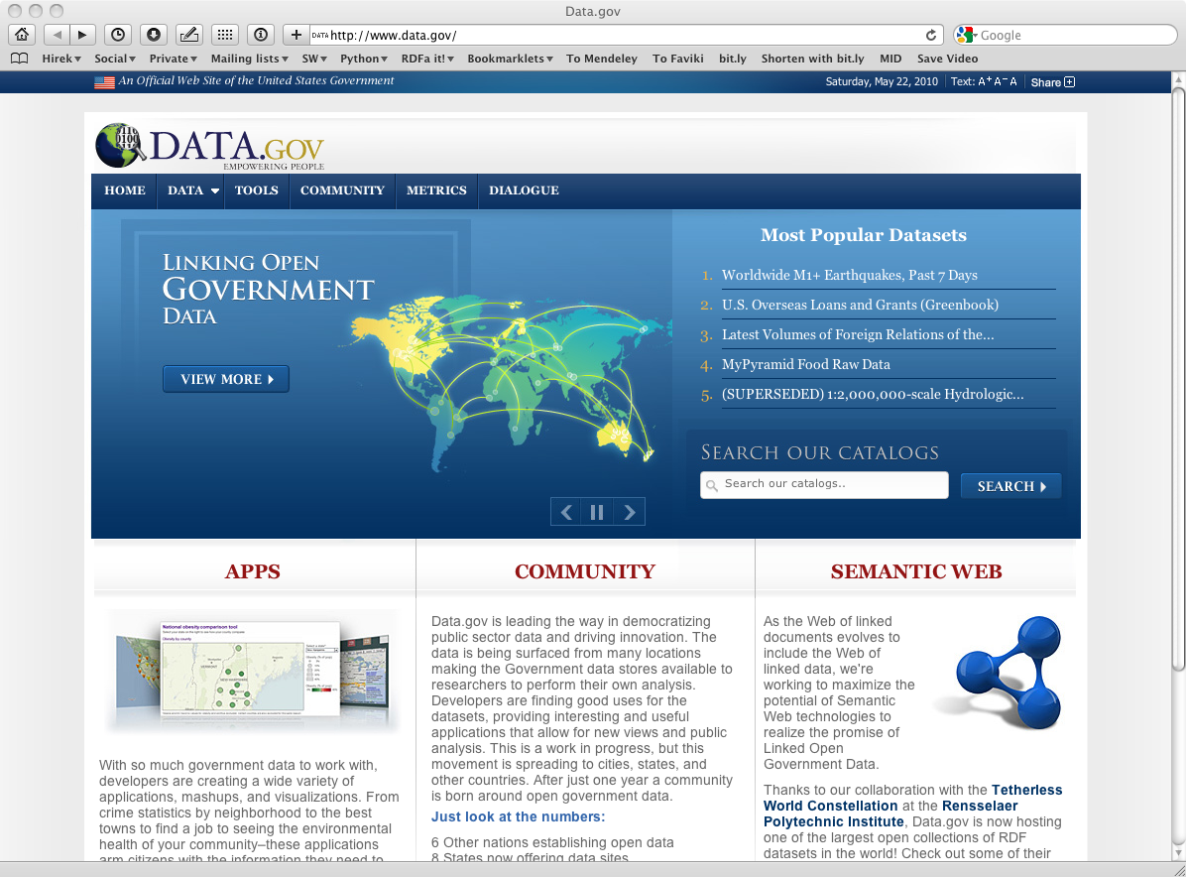
Example: You publish the raw data…

Slide 58
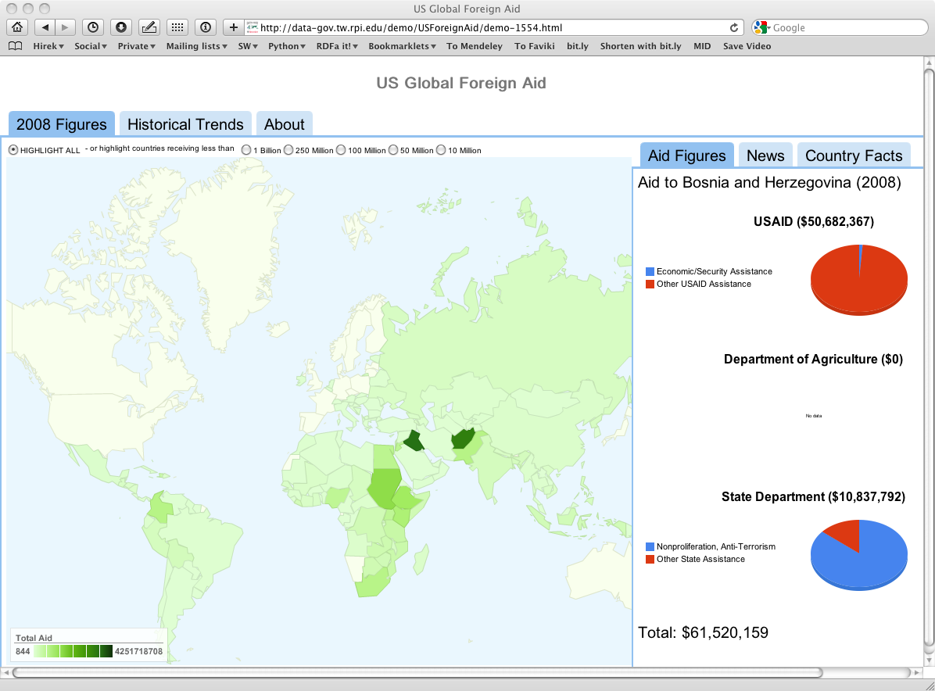
… and others can use it

Slide 59
One level higher up: RDFS, Datatypes
Nexus Simulation Credit Erich Bremmer

Slide 60
Need for RDF schemas
First step towards the “extra knowledge”:
define the terms we can use
what restrictions apply
what extra relationships are there?
Officially: “RDF Vocabulary Description Language”
the term “Schema” is retained for historical reasons…

Slide 61
Classes, resources, …
Think of well known traditional vocabularies:
use the term “novel”
“every novel is a fiction”
“«The Glass Palace» is a novel”
etc.
RDFS defines resources and classes:
everything in RDF is a “resource”
“classes” are also resources, but…
…they are also a collection of possible resources (i.e., “individuals”)
“fiction”, “novel”, …

Slide 62
Classes, resources, … (cont.)
Relationships are defined among resources:
“typing”: an individual belongs to a specific class
“«The Glass Palace» is a novel”
to be more precise: “«http://.../000651409X» is a novel”
“subclassing”: all instances of one are also the instances of the other (“every novel is a fiction”)
RDFS formalizes these notions in RDF

Slide 63
Classes, resources in RDF(S)
rdfs:Class
rdf:type
http://…isbn/000651409X
rdf:type
#Novel
RDFS defines the meaning of these terms
(these are all special URI-s, we just use the namespace abbreviation)

Slide 64
Inferred properties
#Fiction
rdf:type
rdf:subClassOf
http://…isbn/000651409X
rdf:type
#Novel
(<http://…/isbn/000651409X> rdf:type #Fiction)
is not in the original RDF data…
…but can be inferred from the RDFS rules
RDFS environments return that triple, too

Slide 65
Inference: let us be formal…
The RDF Semantics document has a list of entailment rules:
“if such and such triples are in the graph, add this and this”
do that recursively until the graph does not change
The relevant rule for our example:
If:
uuu rdfs:subClassOf xxx .
vvv rdf:type uuu .
Then add:
vvv rdf:type xxx .

Slide 66
Properties
Property is a special class (rdf:Property)
properties are also resources identified by URI-s
There is also a possibility for a “sub-property”
all resources bound by the “sub” are also bound by the other
Range and domain of properties can be specified
i.e., what type of resources serve as object and subject

Slide 67
What does this mean?
Again, new relations can be deduced. Indeed, if
:title
rdf:type rdf:Property;
rdfs:domain :Fiction;
rdfs:range rdfs:Literal.
<http://…/isbn/000651409X> :title "The Glass Palace" .
then the system can infer that:
<http://…/isbn/000651409X> rdf:type :Fiction .

Slide 68
Literals
Literals may have a data type
floats, integers, Booleans, etc., defined in XML Schemas
full XML fragments
(Natural) language can also be specified

Slide 69
Examples for datatypes
<http://…/isbn/000651409X>
:page_number "543"^^xsd:integer ;
:publ_date "2000"^^xsd:gYear ;
:price "6.99"^^xsd:float .

Slide 70
Vocabularies
Photo credit “Indy Reading Coalition”, Wordpress.com

Slide 71
Vocabularies
Data integration needs agreements on
terms
“translator”, “author”
categories used
“Person”, “literature”
relationships among those
“an author is also a Person…”, “historical fiction is a narrower term than fiction”
ie, new relationships can be deduced

Slide 72
Vocabularies
There is a need for “languages” to define such vocabularies
to define those vocabularies
to assign clear “semantics” on how new relationships can be deduced

Slide 73
But what about RDFS?
Indeed RDFS is such framework:
there is typing, subtyping
properties can be put in a hierarchy
datatypes can be defined
RDFS is enough for many vocabularies

Slide 74
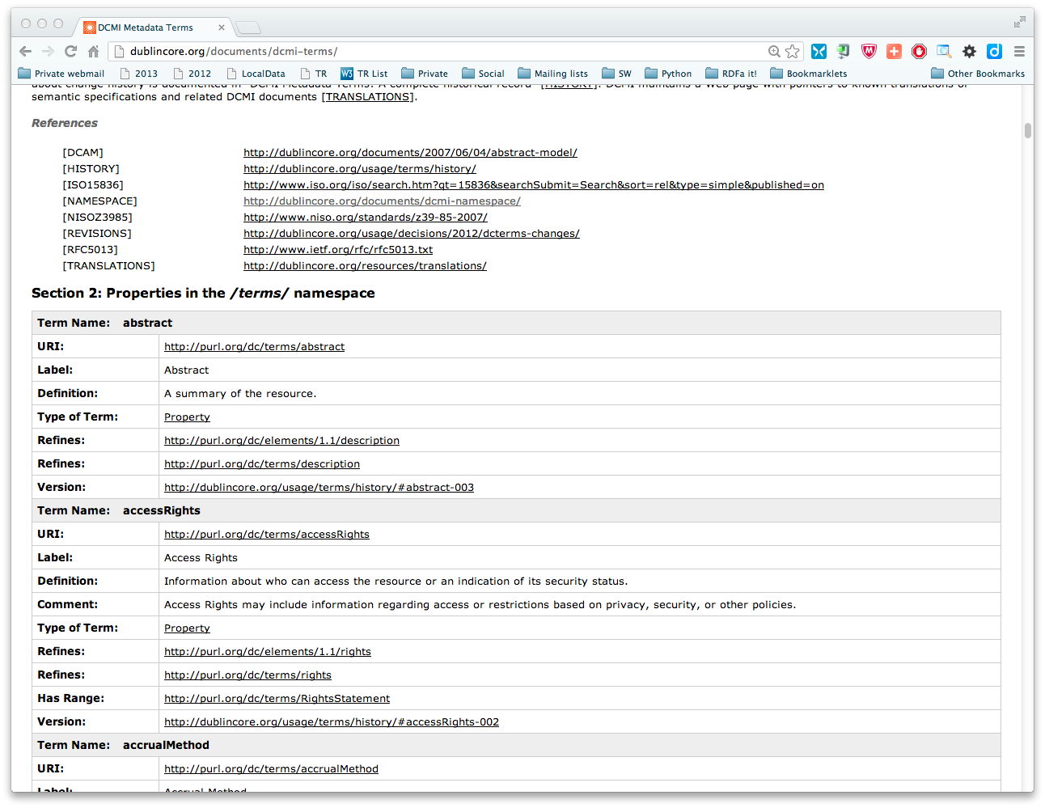

Slide 75
DCTERMS is an RDFS vocabulary
Each term is an RDFS Property or Class identified by a URI
Many property terms have range and domain definitions
Sub-property relationships are also used
dcterms:accessRights
dcterms:issued "2003-02-15"^^xsl:date ;
a rdf:Property ;
rdfs:range dcterms:RightsStatement ;
rdfs:subPropertyOf dcterms:rights ;
…
from http://dublincore.org/2012/06/14/dcterms.ttl

Slide 77
A bit of RDFS can take you far…
Remember the power of merge?
We could have used, in our example:
f:auteur is a sub-property of a:author and vice versa (although we will see other ways to do that…)
Of course, in some cases, more complex knowledge is necessary (see later…)

Slide 78
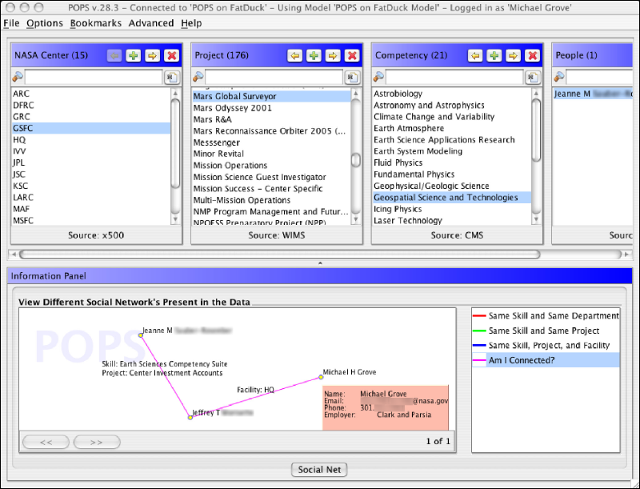
Example: Find the right experts at NASA
Expertise locater for nearly 70,000 NASA civil servants, using RDF integration techniques over 6 or 7 geographically distributed databases, data sources, and web services…
Michael Grove, Clark & Parsia, LLC, and Andrew Schain, NASA, (SWEO Case Study)
Notes:
The use internal ontologies/vocabularies to describe the knowledge areas, and a combination of the RDF data and that ontology to search through the (integrated) databases for a specific knowledge expertise. The dump is from a faceted browser developed by the company to view result data.

Slide 79
Linked Data

Slide 80
“Linking Open Data” Project
Goal: “expose” open datasets in RDF
Set RDF links among the data items from different datasets
Notes:
The important point here is that (1) the data becomes available to the World via a unified format (ie, RDF), regardless on how it is stored inside and (2) the various datasets are interlinked together, ie, they are not independent islands. Dbpedia is probably the most important 'hub' in the project.

Slide 81
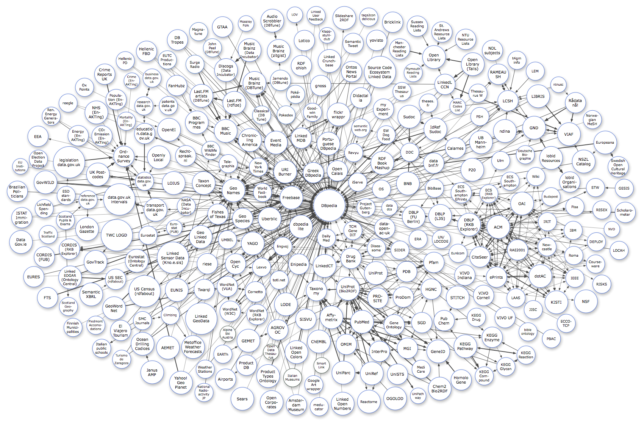
The LOD “cloud”

Slide 82
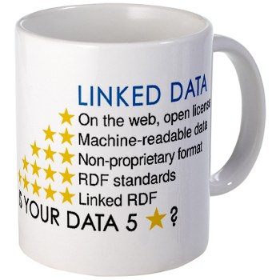
Linked Data Principles a.k.a. is your data 5 Star?
Available on the Web in some format (i.e., use URI to access the data)
Available as machine-readable structured data (e.g., excel instead of an image scan)
As before, but using a non-proprietary format (e.g., CSV instead of excel)
All the above, plus use open standards (RDF & Co.) to identify things, so that people could point at your stuff
All the above, plus link your data to other people’s data to provide context

Slide 83
Linked Data ≈ 5 Star Data (or a collection of 5 Star Data)
Linked Open Data ≈ Linked Data without access restrictions
Notes:
The devil is in the details, but it is o.k. as an approximation!

Slide 84
An important distinction
Linked Data is based on RDF, but
in pure RDF, URI-s are used “simply” as unique identifiers
it is o.k. to use non-referenceable URI-s like ISBN URN-s, or DOI URN-s
in Linked Data URI-s should really really be de-referenceable

Slide 85
Example data source: DBpedia
DBpedia is a community effort to
extract structured (“infobox”) information from Wikipedia
provide a query endpoint to the dataset
interlink the DBpedia dataset with other datasets on the Web

Slide 86
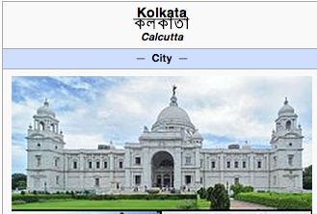
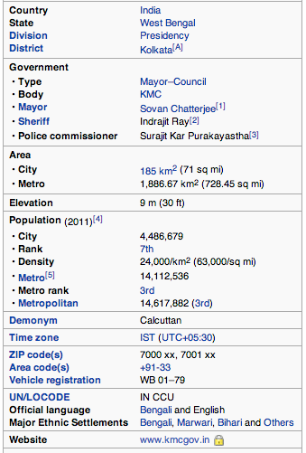
Extracting structured data from Wikipedia
@prefix dbpedia <http://dbpedia.org/resource/>.
@prefix dbterm <http://dbpedia.org/property/>.
dbpedia:Kolkata dbpprop:officialName "Kolkata" ; dbpprop:longd "88" ;
dbpprop:longm "22" ;
dbpprop:longew "E" ;
foaf:homage <http://www.kmcgov.in> ;
dbpedia-owl:populationTotal "4486679" ;
dbpprop:areaTotalKm "185" ;
...
dbpedia:Amitav_Ghosh
dbbedia-owl:birthPlace dbpedia:Kolkata ;
...
Notes:
The right hand portion of the wiki side is what is referred to as 'infobox'. The left side is the dbpedia content as made available.

Slide 87
Links among open datasets
<http://dbpedia.org/resource/Kolkata> owl:sameAs freebase:Kolkata ;
owl:sameAs <http://sws.geonames.org/1275004> ;
owl:sameAs <http://ru.dbpedia.org/resources/Калькутта> ;
...
<http://sws.geonames.org/1275004>
rdfs:seeAlso <http://dbpedia.org/resource/Kolkata>
wgs84_pos:lat "22.56263" ;
wgs84_pos:long "88.36304";
gn:parentCountry <http://sws.geonames.org/1269750> ;
...
Processors can switch automatically from one to the other…
Notes:
This is the important point: this is why this is Linking open data. What the community does (and this is a community project) is to make agreements on how the different datasets can be linked and then the linkage is done automatically by the 'bridges' that map the public datasets into RDF. Eg, geonames is a public dataset by geonames.org and dbpedia is, well... wikipedia:-)

Slide 88
The importance of Linked Data
It provides a core set of data that applications can build on
stable references for “things”,
e.g., http://dbpedia.org/resource/Kolkata/
many many relationships that applications may reuse
e.g., the BBC application!
a “nucleus” for a larger, semantically enabled Web!

Slide 89
Back to the BBC…

Slide 90
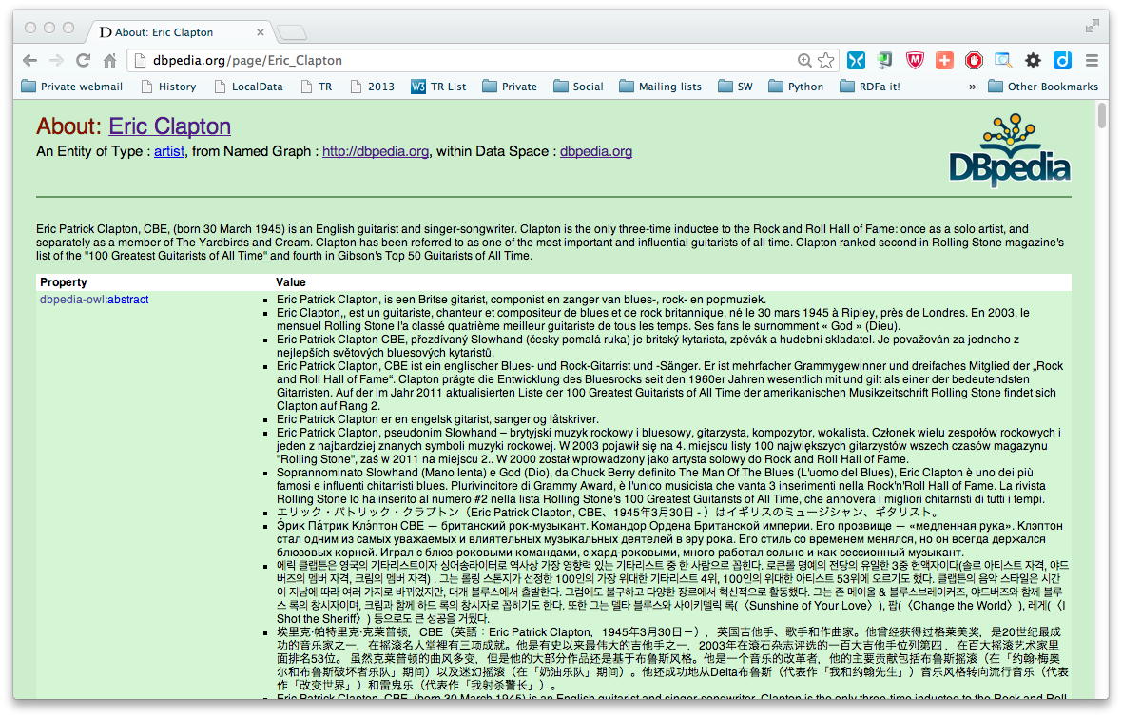
Back to the BBC…

Slide 91
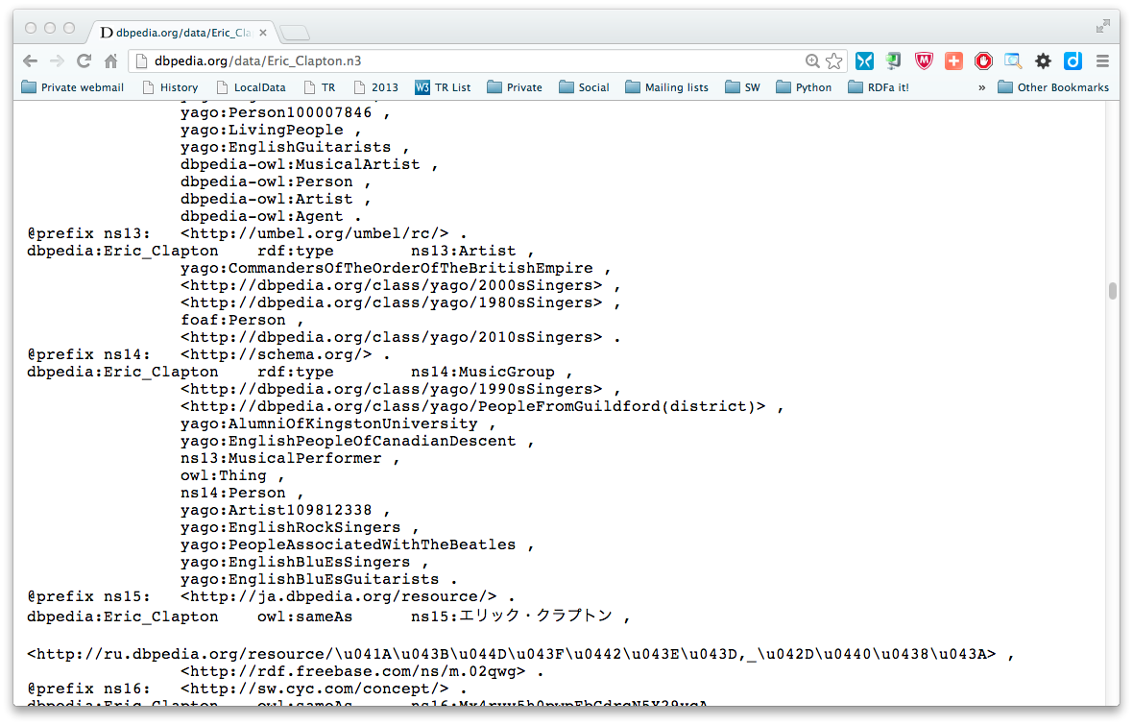
Back to the BBC…

Slide 92
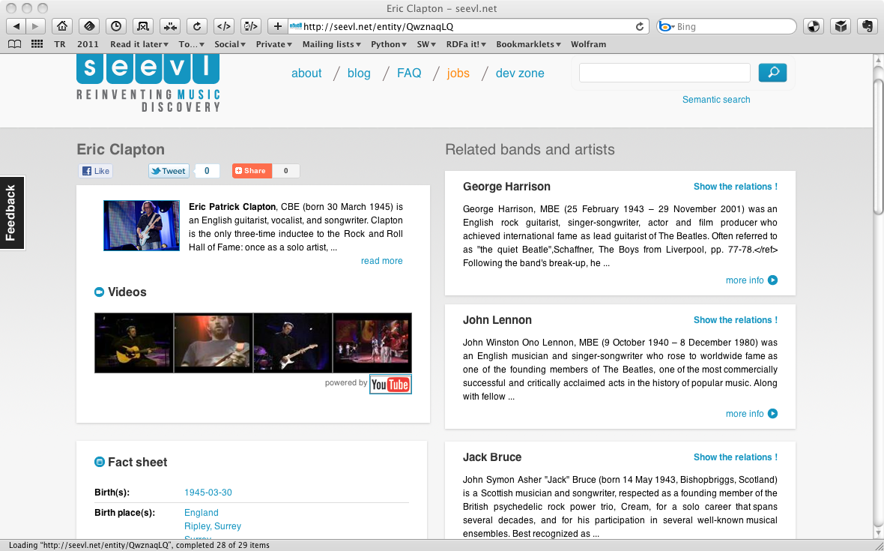
Same dataset, another site

Slide 93
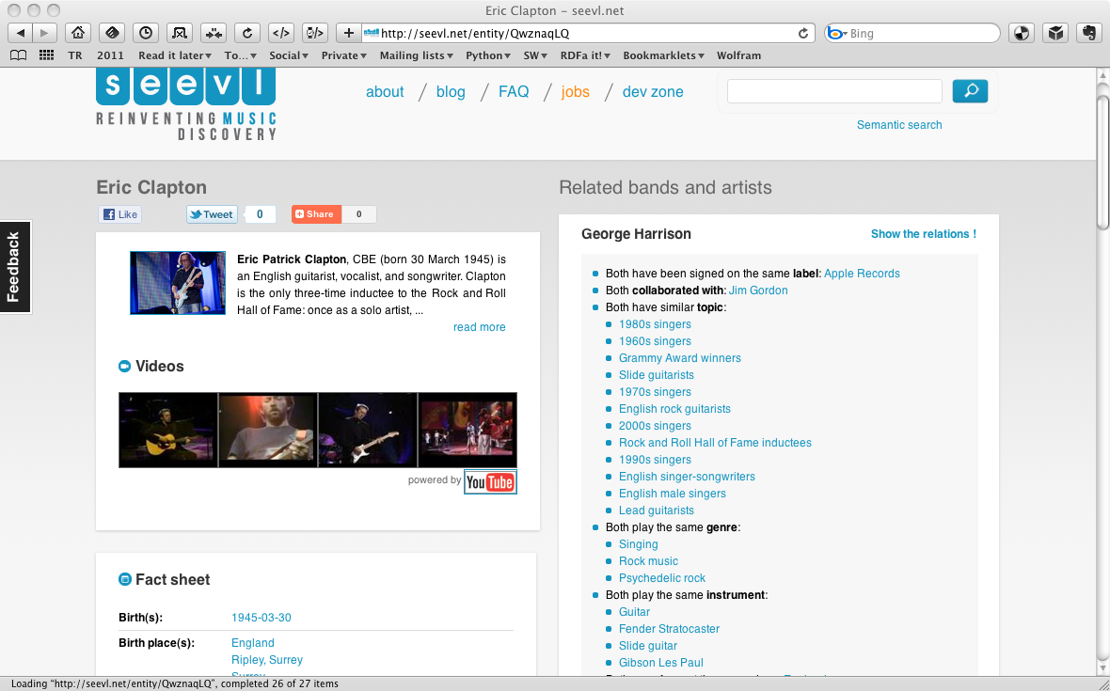
Same dataset, another site

Slide 94
Simplest way to use Linked Data
Use Web technologies! E.g., use HTTP…
extract the data via HTTP GET
interpret the (hopefully RDF) content to, e.g., extract new relationships and resources
Tools are available to do that
although, truth must be said, it is still an evolving world

Slide 95
Example: Simple Application Integration via Linked Data
Application #1
Application #2
HTTP GET, HEAD
Linked Data
on Server #1
Linked Data
on Server #2

Slide 96
Example: Simple Application Integration via Linked Data
Public Library
Bookshop
HTTP GET, HEAD
Catalogue
in Library of Congress
Catalogue
in the Centre Pompidou

Slide 97
Read only vs. Read/Write
Currently, Linked Data is dominated by publishing data for read-only usage
creating/updating the data is done “out of band”
The future to read and write Linked Data

Slide 98
Example: Simple Application Integration via Linked Data
Application #1
Application #2
HTTP GET, HEAD
HTTP PUT, DELETE
Linked Data
on Server #1
Linked Data
on Server #2

Slide 99
Example: Simple Application Integration via Linked Data
Private Email Client
Corporate Email Client
HTTP GET, HEAD
HTTP PUT, DELETE
Private Address Data
Corporate Contact Data

Slide 100
Linked Data Platform (LDP)
Define an HTTP/RESTful based infrastructure to publish, read, write, or modify linked data
typical usage: data intensive application in a browser, application integration using shared data…
The infrastructure should be easy to implement and install
provides an “entry point” for Linked Data applications!
The work is still ongoing at W3C…

Slide 101
How to Publish RDF?
Credit Andrea Wiggins (anikarenina) on Flickr

Slide 102
Technically: the simple approach
Write RDF/XML, Turtle, etc. “manually”
in some cases that is necessary, but it really does not scale…

Slide 103
Access to Relational Databases
Photo credit “mayhem”, Flickr

Slide 104
Relational Databases and RDF
Many of the data on the Web is, in fact, in RDB-s
Proven technology, huge systems, many vendors…
Data integration on the Web must provide access to RDB-s
RDB data should be “exported” into, e.g., RDF

Slide 105
What is “export”?
“Export” does not necessarily mean physical conversion
for very large databases a “duplication” would not be an option
systems may provide “bridges” to make RDF queries on the fly
result of export is a “logical” view of the RDB content

Slide 106
Simple export: RDF Direct Mapping
A standard RDF “view” of RDB tables
Valid for all RDB-s, independently of the RDB schema
Fundamental approach:
each row is turned into a series of triples with a common subject (subject URI based on primary key value)
column names provide the predicate names
cell contents are the objects as literals
cross-referenced tables are expressed through URI subjects

Slide 107
What DM processor does
An DM processor has access to:
an RDB schema
a database governed by the schema
… and produces an RDF graph using a standard mapping
RDB Schema
DM Processing
Tables

Slide 108
Result of the Direct Mapping
What do we get?
we have an RDF “view” of the RDB tables
a query against the RDF view may be transformed into an SQL query against the original tables

Slide 109
Direct mapping of the bookshop tables
ISBN | Author | Title | Publisher | Year
0006511409X | id_xyz | The Glass Palace | id_qpr | 2000
ID | Name | Homepage
id_xyz | Ghosh, Amitav | http://www.amitavghosh.com
0006511409X
<Book#ISBN>
<Book#Author>
id_xyz
The Glass Palace
<Book#Title>
<Book/ISBN-0006511409>
2000
<Book#Year>
<Book#ref-Author>
id_xyz
<Person/ID-id_xyz>
<Person#ID>
<Person#Name>
<Person#Homepage>
Ghosh, Amitav
http://www.amitavghosh.com

Slide 110
Result of the Direct Mapping
What do we miss?
an RDF view that is close to our application; a more “natural” view of the data
i.e., the result of the Direct Mapping must be transformed, somehow, into an RDF that an application may use

Slide 111
Direct graph must be transformed
0006511409X
<Book#ISBN>
<Book#Author>
id_xyz
The Glass Palace
<Book#Title>
<Book/ISBN-0006511409>
2000
<Book#Year>
<Book#ref-Author>
id_xyz
<Person/ID-id_xyz>
<Person#ID>
<Person#Name>
<Person#Homepage>
Ghosh, Amitav
http://www.amitavghosh.com
Property names should be mapped
URI-s should be minted
Literals should be replaced by URI-s
The Glass Palace
a:title
http://…isbn/000651409X
2000
a:year
a:author
a:name
a:homepage
Ghosh, Amitav
http://www.amitavghosh.com

Slide 112
Enters R2RML
Separate vocabulary for a finer control of the mapping
gets to the final RDF graph with one processing step
Fundamentals are similar:
each row is turned into a series of triples with a common subject
cross-referenced tables linked via URI-s

Slide 113
Enters R2RML
There is a finer control over the structure of the result graph
the format of the (common) subject URI can be controlled
objects might be URI-s generated on the fly via templates from column names
datatypes can be assigned to literal objects
“virtual” tables can be generated through SQL before processing them through R2RML
R2RML can generate the final RDF ready to be used by an application

Slide 114
What R2RML processor does
An R2RML processor has access to:
an RDB schema
an R2RML instance
a database governed by the schema
… and produces an RDF graph
RDB Schema
R2RML Processing
Tables
R2RML Instance

Slide 115
CSV Data
CSV (“Comma Separated Value”) may be the single most widespread format of datasets published on the Web
There is no standard RDF mapping yet, but…
… the structure is very close to a relational table
W3C plans to start a group that will (also) standardize that mapping
pretty much along the lines of the Direct Mapping

Slide 116
Structured data in HTML:
RDFa & microdata
Photo credit “shetladd”, Flickr

Slide 117
RDF with HTML
By adding some “meta” information, the same source can be reused
typical example: your personal information, like address, should be readable for humans and processable by machines
Some solutions have emerged:
add extra statements in microdata or RDFa that can be converted to RDF
microdata can be used for a (useful) subset of RDF
RDFa is, essentially, a complete serialization of RDF

Slide 118
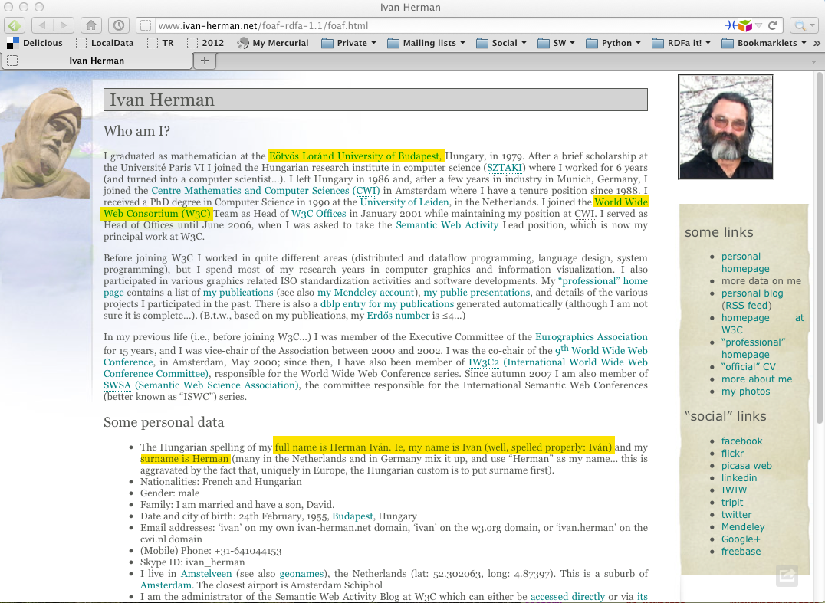

Slide 119
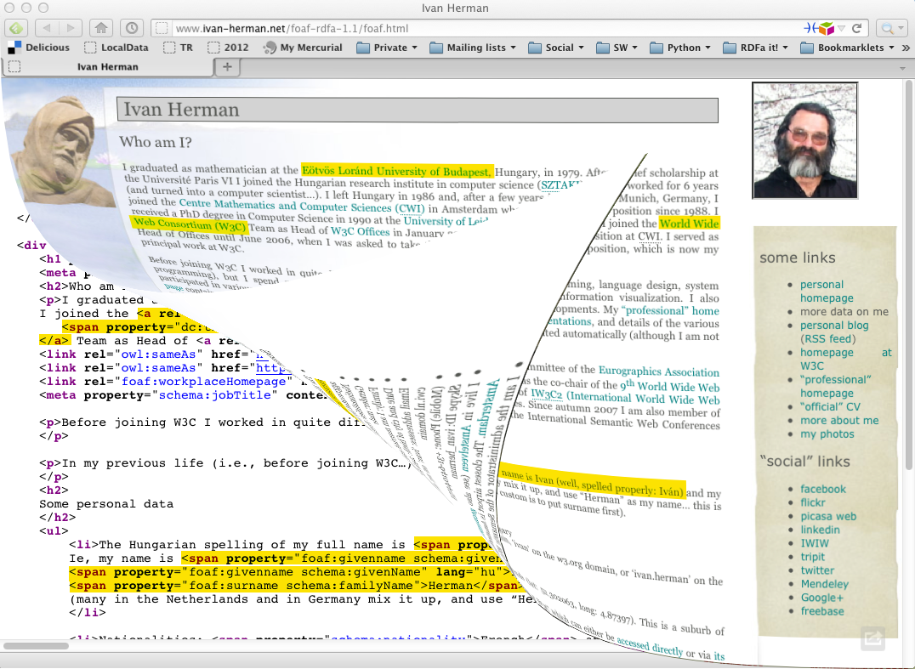

Slide 120
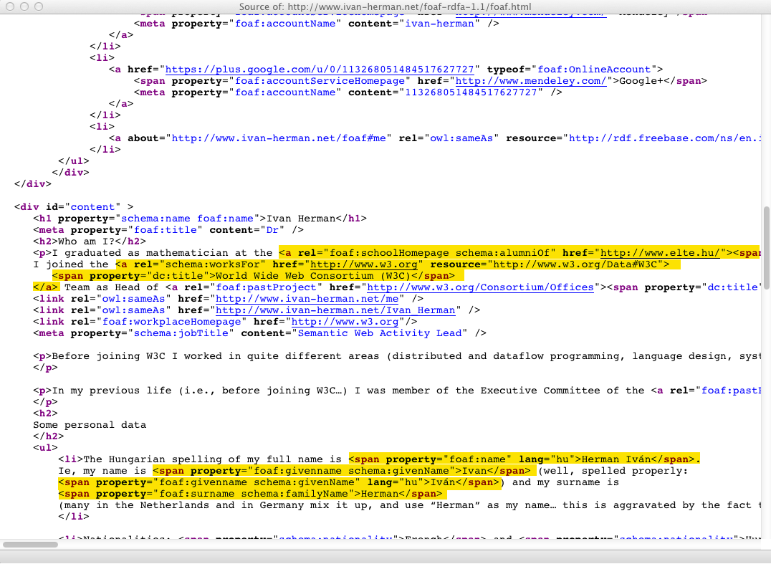

Slide 121
Yielding…
<http://www.ivan-herman.net/foaf#me>
schema:alumniOf <http://www.elte.hu> ;
foaf:schoolHomePage <http://www.elte.hu> ;
schema:worksFor <http://www.w3.org/W3C#data> ;
…
<http://www.elte.hu>
dc:title "Eötvös Loránd University of Budapest" .
…
<http://www.w3.org/W3C#data>
dc:title "World Wide Web Consortium (W3C)”
…

Slide 122
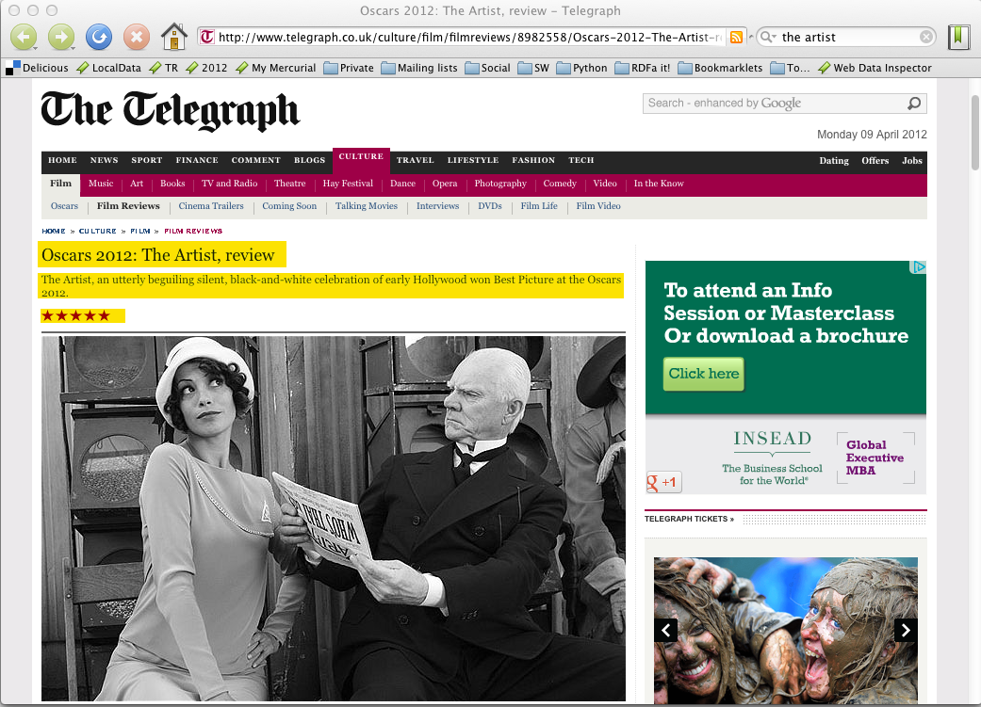

Slide 124
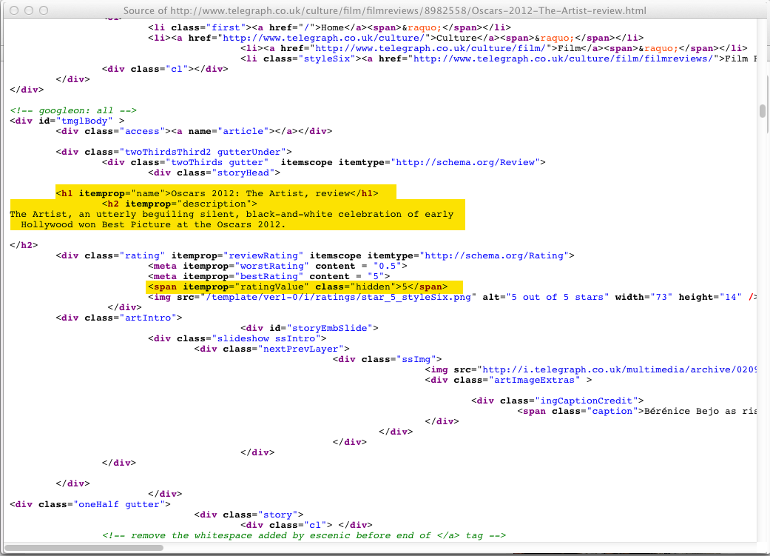

Slide 125
Yielding…
[ rdf:type schema:Review ;
schema:name "Oscars 2012: The Artist, review" ;
schema:description "The Artist, an utterly beguiling…" ;
schema:ratingValue "5" ;
…
]

Slide 126
schema.org
Schema.org is a cooperation of search engines (Bing, Google, Yahoo!, and Yandex)
It is a large vocabulary that they all understand
The terms are extracted from HTML5+microdata or HTML5+RDFa
the various partners use it for different purposes
it can be used by anyone outside of the search world!

Slide 127
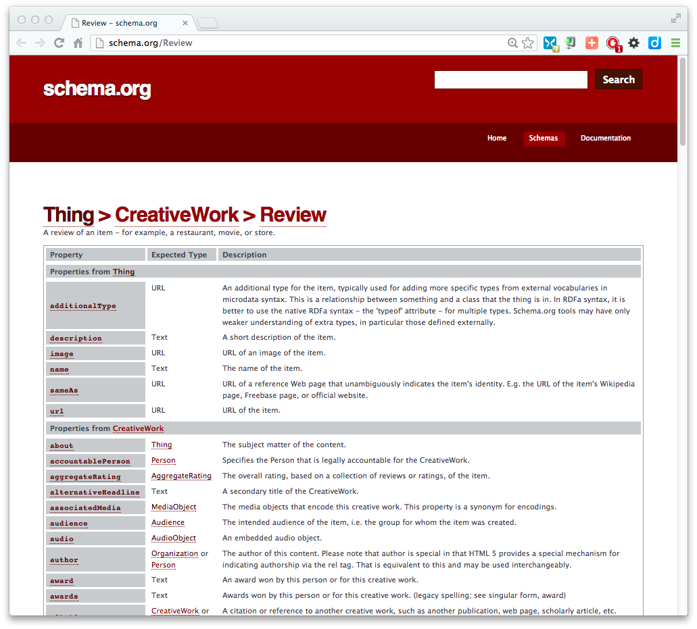

Slide 128
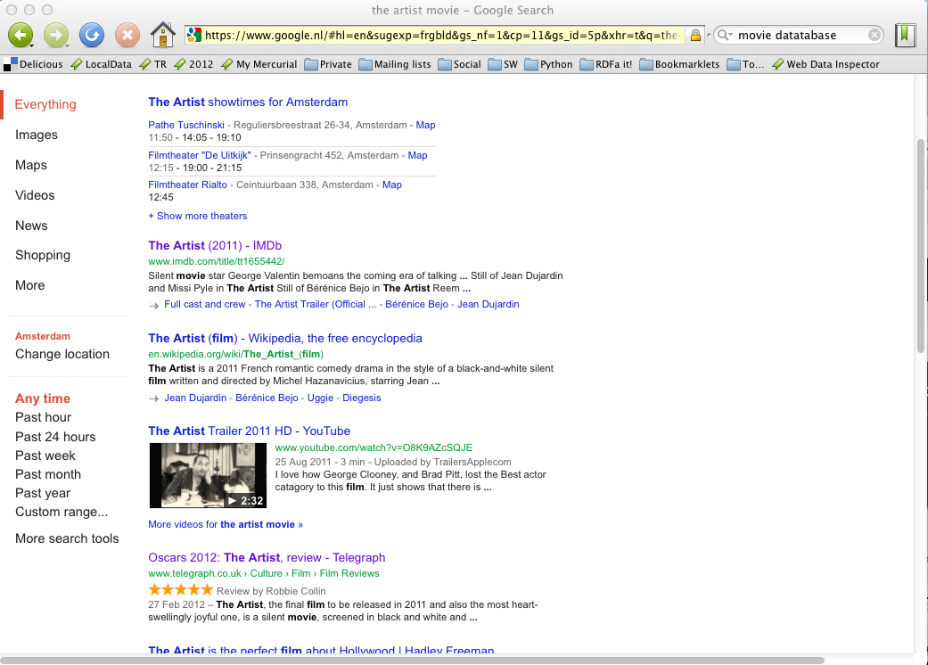

Slide 129
HTML+* can also be generated
CMS systems may generate such data automatically
e.g., Drupal 7 generates pages with RDFa included
There are a number of plugins to blogging systems
generate HTML+RDFa or HTML+microdata

Slide 130
How to Publish Data?
Credit Andrea Wiggins (anikarenina) on Flickr

Slide 131
Some things to remember if you publish data
Publish your data first, care about sexy user interfaces later!
the “raw data” can become useful on its own right and others may use it
you can add your added value later by providing nice user access
If possible, publish your data in RDF but if you cannot, others may help you in conversions
trust the community…
Add links to other data. “Just” publishing isn’t enough…

Slide 132
Some things to remember if you publish data
Think about persistence and versioning
others may depend on the data you publish…
Be careful about URIs you choose
avoid being very domain dependent; e.g., your institution’s name may change at some point
use some consistent URI structure
e.g. http://publications.europa.edu/{type}/{subtype}
etc.
Avoid reinventing the wheel when choosing vocabularies

Slide 133
Some things to remember if you publish data
Document your data, i.e., provide metadata
there are vocabularies to do this
Data Catalog Vocabulary (DCAT)
Vocabulary of Interlinked Datasets (VoID)
DCTERMS (of course ☺)
vocabularies for licensing (Open Data Commons, government licenses)
this area is still very much in development…
A new group on Best Practices will start at W3C soon

Slide 134
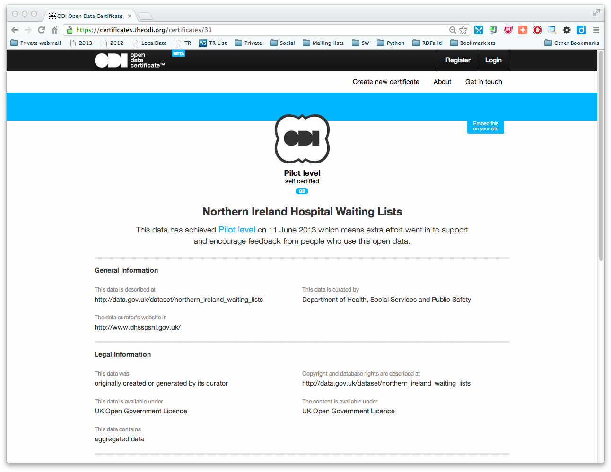

Slide 135
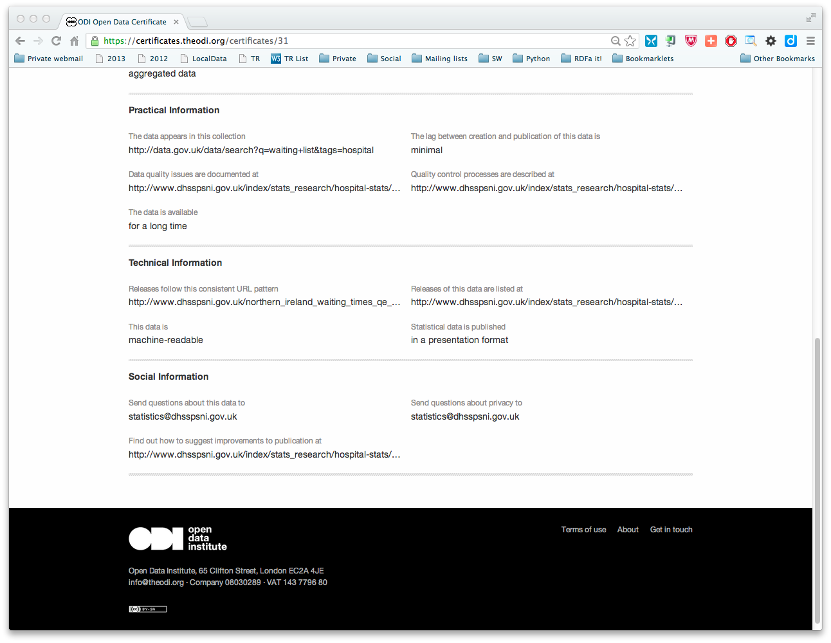

Slide 136
Query and Update RDF: (SPARQL)
Photo credit “reedster”, Flickr

Slide 137
RDF data access
The LDP approach is great to build up simple applications
But as data grows, complexity of relationships grows
more sophisticated query possibilities are necessary
triples are stored in (possibly very large) databases (“triple stores”)
How do I query the RDF data?

Slide 138
Querying RDF graphs
Remember the Python+RDFLib idiom:
for (s,p,o) in graph.triples((subject,None,None)) :
do_something(p,o)

Slide 139
Querying RDF graphs
In practice, more complex queries into the RDF data are necessary
something like: “give me the (a, b) pair of resources, for which there is an x such that (x parent a) and (b brother x) holds” (i.e., return the uncles)
these rules may become quite complex
The goal of SPARQL (Query Language for RDF)

Slide 140
Analyze the Python+RDFLib example
for (s,p,o) in graph.triples((subject,None,None)) :
do_something(p,o)
?p
?o
?p
?o
subject
?p
?o
?p
?o

Slide 141
General: graph patterns
The fundamental idea: use graph patterns
the pattern contains unbound symbols
by binding the symbols, subgraphs of the RDF graph are selected
if there is such a selection, the query returns the bound resources

Slide 142
Our Python example in SPARQL
SELECT ?p ?o
WHERE {subject ?p ?o}
The triples in WHERE define the graph pattern, with ?p and ?o “unbound” symbols
The query returns all p, o pairs
?p
?o
?p
?o
subject
?p
?o
?p
?o

Slide 143
Simple SPARQL example
SELECT ?isbn ?price ?currency # note: not ?x!
WHERE {?isbn a:price ?x. ?x rdf:value ?price. ?x p:currency ?currency.}
a:name
Ghosh, Amitav
a:author
a:author
http://…isbn/000651409X
http://…isbn/2020386682
a:price
a:price
a:price
a:price
rdf:value
p:currency
rdf:value
p:currency
rdf:value
p:currency
rdf:value
p:currency
33
:£
50
:€
60
:€
78
:$

Slide 144
Simple SPARQL example
SELECT ?isbn ?price ?currency # note: not ?x!
WHERE {?isbn a:price ?x. ?x rdf:value ?price. ?x p:currency ?currency.}
Returns: [<…409X>,33,:£]
a:name
Ghosh, Amitav
a:author
a:author
http://…isbn/000651409X
http://…isbn/2020386682
a:price
a:price
a:price
a:price
rdf:value
p:currency
rdf:value
p:currency
rdf:value
p:currency
rdf:value
p:currency
33
:£
50
:€
60
:€
78
:$

Slide 145
Simple SPARQL example
SELECT ?isbn ?price ?currency # note: not ?x!
WHERE {?isbn a:price ?x. ?x rdf:value ?price. ?x p:currency ?currency.}
Returns: [<…409X>,33,:£], [<…409X>,50,:€]
a:name
Ghosh, Amitav
a:author
a:author
http://…isbn/000651409X
http://…isbn/2020386682
a:price
a:price
a:price
a:price
rdf:value
p:currency
rdf:value
p:currency
rdf:value
p:currency
rdf:value
p:currency
33
:£
50
:€
60
:€
78
:$

Slide 146
Simple SPARQL example
SELECT ?isbn ?price ?currency # note: not ?x!
WHERE {?isbn a:price ?x. ?x rdf:value ?price. ?x p:currency ?currency.}
Returns: [<…409X>,33,:£], [<…409X>,50,:€],
[<…6682>,60,:€]
a:name
Ghosh, Amitav
a:author
a:author
http://…isbn/000651409X
http://…isbn/2020386682
a:price
a:price
a:price
a:price
rdf:value
p:currency
rdf:value
p:currency
rdf:value
p:currency
rdf:value
p:currency
33
:£
50
:€
60
:€
78
:$

Slide 147
Simple SPARQL example
SELECT ?isbn ?price ?currency # note: not ?x!
WHERE {?isbn a:price ?x. ?x rdf:value ?price. ?x p:currency ?currency.}
Returns: [<…409X>,33,:£], [<…409X>,50,:€],
[<…6682>,60,:€], [<…6682>,78,:$]
a:name
Ghosh, Amitav
a:author
a:author
http://…isbn/000651409X
http://…isbn/2020386682
a:price
a:price
a:price
a:price
rdf:value
p:currency
rdf:value
p:currency
rdf:value
p:currency
rdf:value
p:currency
33
:£
50
:€
60
:€
78
:$

Slide 148
Pattern constraints
SELECT ?isbn ?price ?currency # note: not ?x!
WHERE { ?isbn a:price ?x. ?x rdf:value ?price. ?x p:currency ?currency.
FILTER(?currency == :€) }
Returns: [<…409X>,50,:€], [<…6682>,60,:€]
a:name
Ghosh, Amitav
a:author
a:author
http://…isbn/000651409X
http://…isbn/2020386682
a:price
a:price
a:price
a:price
rdf:value
p:currency
rdf:value
p:currency
rdf:value
p:currency
rdf:value
p:currency
33
:£
50
:€
60
:€
78
:$

Slide 149
Other SPARQL features
Limit the number of returned results; remove duplicates, sort them, …
Optional patterns
CONSTRUCT new graphs, not only return data
Use datatypes and/or language tags when matching a pattern
Aggregation of the results (min, max, average, etc.)
Path expressions (a bit like regular expressions)

Slide 150
SPARQL usage in practice
SPARQL is usually used over the network
HTTP request is sent to a SPARQL endpoint
return is the result of the SELECT, the CONSTRUCT,…
Separate documents define the protocol and the result format
SPARQL Protocol for RDF with HTTP and SOAP bindings
SPARQL results in XML or JSON formats
Many big datasets usually offer “SPARQL endpoints” using this protocol

Slide 151
SPARQL Update
SPARQL CONSTRUCT returns a new, modified graph
the original data remains unchanged!
SPARQL Update modifies the original dataset!

Slide 152
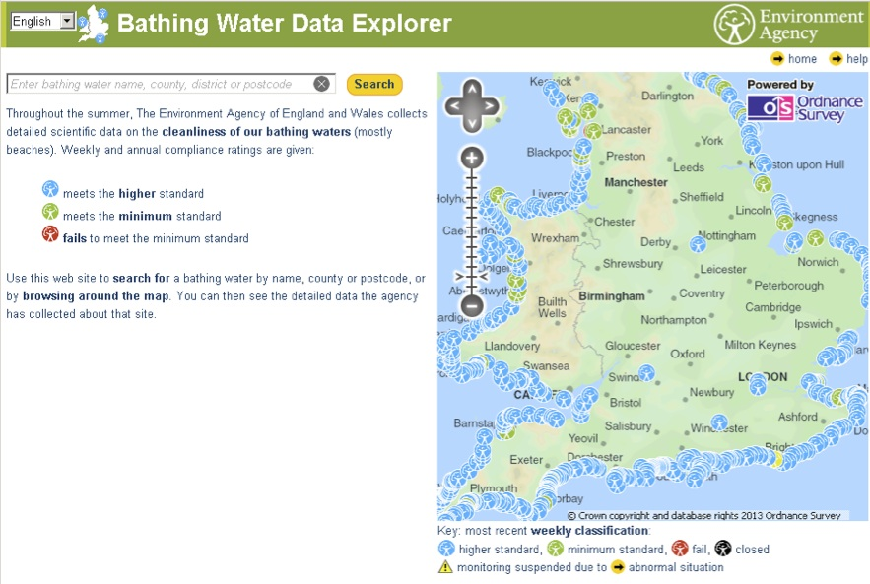
Bathing Water Data Explorer
Notes:
UK Dept. of Environment, Food and Rural Affairs publishes many different datasets (geospatial, flood maps, climate records, etc. Not all, but many are published now as linked datasets, like bathing water quality or water reservoir. Data is available through a SPARQL endpoint, but interactive applications can also be built on top

Slide 153
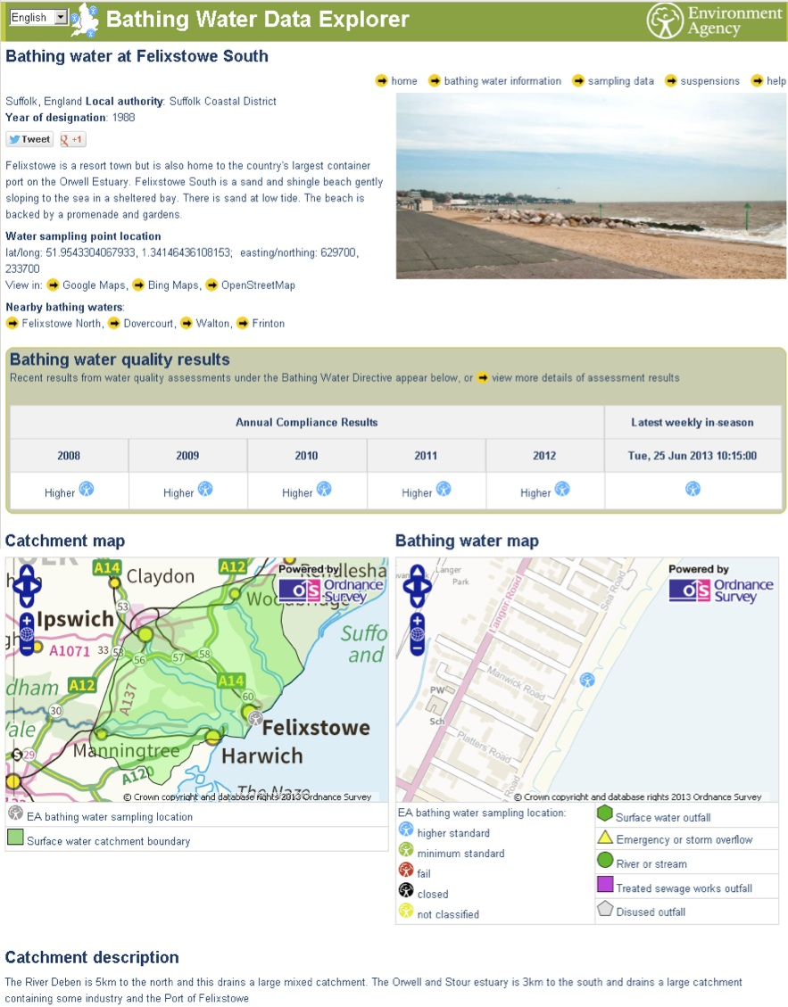
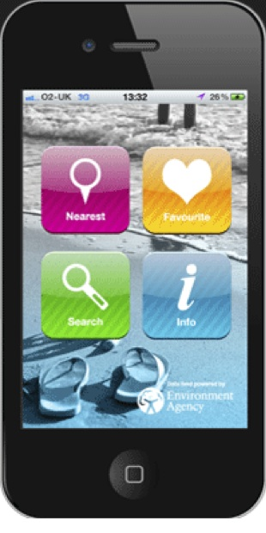
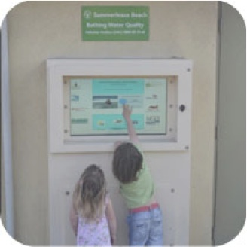
Bathing Water Data Explorer
Notes:
UK Dept. of Environment, Food and Rural Affairs publishes many different datasets (geospatial, flood maps, climate records, etc. Not all, but many are published now as linked datasets, like bathing water quality or water reservoir. Data is available through a SPARQL endpoint, but interactive applications can also be built on top

Slide 154
Vocabularies
Photo credit “Indy Reading Coalition”, Wordpress.com

Slide 155
But what about RDFS?
RDFS is enough for many vocabularies
But not for all!

Slide 156
Some technologies have emerged
To re-use thesauri, glossaries, etc: SKOS
To define more complex vocabularies with a strong logical underpinning: OWL

Slide 157
Thesauri, glossaries (SKOS)
Photo credit “scarletgreen”, Flickr

Slide 158
SKOS
Represent and share classifications, glossaries, thesauri, etc
for example:
Dewey Decimal Classification, Art and Architecture Thesaurus, ACM classification of keywords and terms…
classification/formalization of Web 2.0 type tags
Define classes and properties to add those structures to an RDF universe
allow for a quick port of this traditional data, combine it with other data

Slide 159
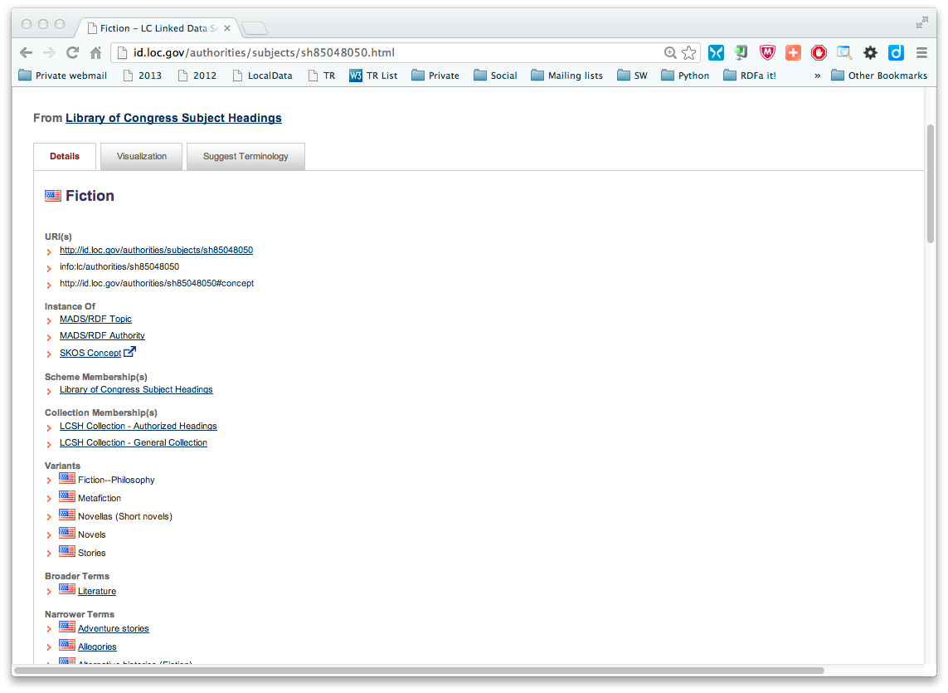
The term “Fiction”, as defined by the Library of Congress

Slide 160
Thesauri have identical structures…
The structure of the LOC page is fairly typical
label, variants/alternate label, narrower, broader, …
there is even an ISO standard for these
SKOS provides a basic structure to create an RDF representation of these

Slide 161
LOC’s “Fiction” in SKOS/RDF
Literature
skos:Concept
Fiction
skos:prefLabel
rdf:type
skos:prefLabel
skos:broader
http://id.loc.gov/…#concept
skos:altLabel
skos:narrower
Metafiction
skos:altLabel
skos:narrower
skos:prefLabel
Novels
Allegories
Adventure stories
skos:prefLabel

Slide 162
Usage of the LOC graph
Fiction
skos:Concept
Historical Fiction
skos:prefLabel
skos:prefLabel
rdf:type
skos:broader
dc:subject
dc:title
http:.//…/isbn/…
The Glass Palace

Slide 163
Importance of SKOS
SKOS provides a simple bridge between the “print world” and the (Semantic) Web
Thesauri, glossaries, etc., from the library community can be made available
LOC is a good example
SKOS can also be used to organize, e.g., tags, annotate other vocabularies, …

Slide 164
Importance of SKOS
Anybody in the World can refer to common concepts
they mean the same for everybody
Applications may exploit the relationships among concepts
e.g., I can make SPARQL searches for, say, works that are categorized as “Fiction”, albeit indirectly only

Slide 165
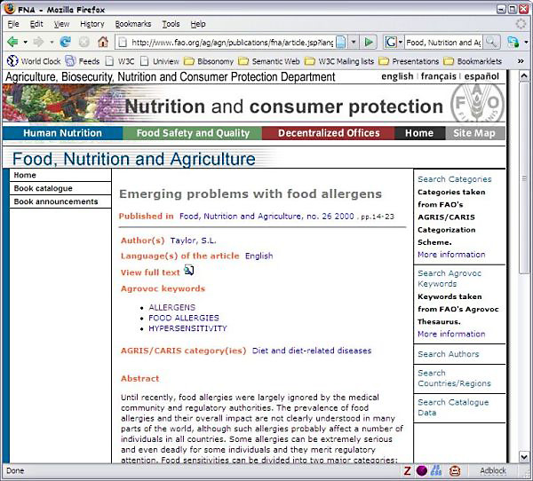
Example: FAO Journal portal
Improved search on journal content based on an agricultural ontology and thesaurus (AGROVOC)
Courtesy of Gauri Salokhe, Margherita Sini, and Johannes Keizer, FAO, (SWEO Case Study)
Notes:
The articles in the Food, Nutrition and Agriculture (FNA) Journal cover topics such as community nutrition, food quality and safety, nutrition assessment, nutrient requirements, food security and rural development. The full-text articles may be in English, French or Spanish.
Metadata about each article in the FNA Journal was available in different formats. Work has been undertaken to combine the metadata and to convert it to a single RDF(S) format, using some ontologies developed internally. A search application was created on top of the ontology and the instance data. A user is guided through the navigation of data by following the links that connect the different metadata elements, such as articles within a specific issue, authors, languages, or keyword.

Slide 166
Ontologies (OWL)
Photo credit “Rickydavid”, Flickr

Slide 167
SKOS is not enough…
SKOS may be used to provide simple vocabularies
But it is not a complete solution
it concentrates on the concepts only
no characterization of properties in general
simple from a logical perspective
i.e., only a few inferences are possible

Slide 168
Application may want more…
Complex applications may want more possibilities:
characterization of properties
identification of objects with different URI-s
disjointness or equivalence of classes
construct classes, not only name them
more complex classification schemes
can a program reason about some terms? E.g.:
“if «Person» resources «A» and «B» have the same «foaf:email» property, then «A» and «B» are identical”
etc.

Slide 169
Web Ontology Language = OWL
OWL is an extra layer, a bit like RDF Schemas
own namespace, own terms
it relies on RDF Schemas
It is a separate recommendation

Slide 170
OWL is complex…
OWL is a large set of additional terms
We will not cover the whole thing here…

Slide 171
Term equivalences
For classes:
owl:equivalentClass: two classes have the same individuals
owl:disjointWith: no individuals in common
For properties:
owl:equivalentProperty
remember the a:author vs. f:auteur?
owl:propertyDisjointWith

Slide 172
Term equivalences
For individuals:
owl:sameAs: two URIs refer to the same concept (“individual”)
owl:differentFrom: negation of owl:sameAs

Slide 173
Connecting to French
a:author
owl:equivalentProperty
f:auteur
a:Novel
owl:equivalentClass
f:Roman

Slide 174
Typical usage of owl:sameAs
Linking our example of Kolkata from one data set (DBpedia) to the other (Geonames):
<http://dbpedia.org/resource/Kolkata> owl:sameAs <http://sws.geonames.org/1275004>;
This is a major mechanism of “Linking” in the Linked Open Data project

Slide 175
Property characterization
In OWL, one can characterize the behavior of properties (symmetric, transitive, functional, inverse functional, reflexive, irreflexive, …)
OWL also separates data and object properties
“datatype property” means that its range are typed literals

Slide 176
What this means is…
If the following holds in our triples:
:email rdf:type owl:InverseFunctionalProperty.

Slide 177
What this means is…
If the following holds in our triples:
:email rdf:type owl:InverseFunctionalProperty.
<A> :email "mailto:a@b.c".
<B> :email "mailto:a@b.c".

Slide 178
What this means is…
If the following holds in our triples:
:email rdf:type owl:InverseFunctionalProperty.
<A> :email "mailto:a@b.c".
<B> :email "mailto:a@b.c".
then, processed through OWL, the following holds, too:
<A> owl:sameAs <B>.

Slide 179
Classes in OWL
In RDFS, you can subclass existing classes… that’s all
In OWL, you can construct classes from existing ones:
enumerate its content
through intersection, union, complement
etc.

Slide 180
Enumerate class content
:Currency
rdf:type owl:Class;
owl:oneOf (:€ :£ :$).
I.e., the class consists of exactly of those individuals and nothing else

Slide 181
Union of classes
:Novel rdf:type owl:Class.
:Short_Story rdf:type owl:Class.
:Poetry rdf:type owl:Class.
:Literature rdf:type owl:Class;
owl:unionOf (:Novel :Short_Story :Poetry).
Other possibilities: complementOf, intersectionOf, …

Slide 182
For example…
If:
:Novel rdf:type owl:Class.
:Short_Story rdf:type owl:Class.
:Poetry rdf:type owl:Class.
:Literature rdf:type owl:Class;
owl:unionOf (:Novel :Short_Story :Poetry).
<myWork> rdf:type :Novel .
then the following holds, too:
<myWork> rdf:type :Literature .

Slide 183
It can be a bit more complicated…
If:
:Novel rdf:type owl:Class.
:Short_Story rdf:type owl:Class.
:Poetry rdf:type owl:Class.
:Literature rdf:type owlClass;
owl:unionOf (:Novel :Short_Story :Poetry).
fr:Roman owl:equivalentClass :Novel .
<myWork> rdf:type fr:Roman .
then, through the combination of different terms, the following still holds:
<myWork> rdf:type :Literature .

Slide 184
What we have so far…
The OWL features listed so far are already fairly powerful
e.g., various databases can be linked via owl:sameAs, functional or inverse functional properties, etc.
Many inferred relationship can be found using a traditional rule engine

Slide 185
However… that may not be enough
Very large vocabularies might require even more complex features
typical usage example: definition of all concepts in a health care environment
some major issues
the way classes (i.e., “concepts”) are defined
handling of datatypes
OWL includes those extra features but… the inference engines become (much) more complex ☹

Slide 186
Example: Organ Failure Risk Detection
System by IO Informatics and UBC:
data integrated from experimental data, clinical endpoints, public ontologies, LOD, etc.
statistical analysis is performed on the data
SPARQL is used to query the results
a visual interface is provided
for clinicians, a simple web-based alerting of “hits” is provided with statistical scores
Courtesy of Robert Stanley, et al, IO Informatics, USA, and UBC, Canada, (SWEO Case Study)

Slide 187
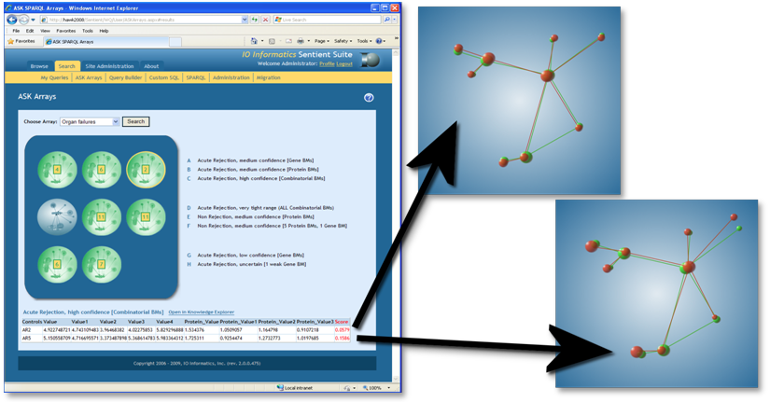
Example: Organ Failure Risk Detection
Courtesy of Robert Stanley, et al, IO Informatics, USA, and UBC, Canada, (SWEO Case Study)

Slide 188
What have we achieved? (putting all together)

Slide 189
Remember the integration example?
Web of Data Applications
Stand Alone Applications
Browser Applications
Query and Update
Common “Graph” Format &
Common Vocabularies
Inferencing
“Bridges”
Data on the Web

Slide 190
The same with what we learned
Linked Data and Semantic Web Applications
Stand Alone Applications
Browser Applications
SPARQL, RDF
RDF Graph with vocabularies in RDFS, SKOS, OWL, …
Inferencing
RDFa, μData,
R2RML, DM …
Data on the Web

Slide 191
Available documents, resources
Photo credit “Abizern”, Flickr

Slide 192
Available specifications: Primers, Guides
The “RDF Primer” and the “OWL Guide” give a formal introduction to RDF(S) and OWL
SKOS has its separate “SKOS Primer”
GRDDL Primer and RDFa Primer have been published
The W3C Semantic Web Activity Wiki has links to all the specifications

Slide 193
“Core” vocabularies
There are also a number “core vocabularies”
Dublin Core
FOAF: about people and their organizations
DOAP: on the descriptions of software projects
SIOC: Semantically-Interlinked Online Communities
vCard in RDF
…

Slide 194
Some books
D. Wood, M. Zaidman, and L. Ruth: Linked Data, 2013
G. Antoniu, P. Groth, F. van Harmelen, and R. Hoekstra: Semantic Web Primer, 3rd edition, 2012
T. Heath and C. Bizer: Linked Data: Evolving the Web into a Global Data Space, 2011
D. Allemang and J. Hendler: Semantic Web for the Working Ontologist 2nd edition, 2011
M. Watson: Practical Semantic Web and Linked data Applications, 2010
P. Hitzler, R. Sebastian, and M. Krötzsch: Foundation of Semantic Web Technologies, 2009
…
See the separate Wiki page collecting book references

Slide 195
Further information
Planet RDF aggregates a number of SW blogs:
http://planetrdf.com/
Semantic Web Interest Group
a forum developers with a publicly archived mailing list, and a constant IRC presence on freenode.net#swig
anybody can sign up on the list
http://www.w3.org/2001/sw/interest/
Linked Data mailing list
a forum concentrating on linked data with a public archive
anybody can sign up on the list
http://lists.w3.org/Archives/Public/public-lod/

Slide 196
Lots of Tools (not an exhaustive list!)
Some names:
Jena, AllegroGraph, Mulgara, Sesame, flickurl, 4Store, …
TopBraid Suite, Virtuoso environment, Falcon, Drupal 7, Redland, Pellet, …
Disco, Oracle 11g, RacerPro, IODT, Ontobroker, OWLIM, Talis Platform, …
RDF Gateway, RDFLib, Open Anzo, DartGrid, Zitgist, Ontotext, Protégé, …
Thetus publisher, SemanticWorks, SWI-Prolog, RDFStore…
…
Categories:
Triple Stores
Inference engines
Converters
Search engines
Middleware
CMS
Semantic Web browsers
Development environments
Semantic Wikis
…
More on http://www.w3.org/2001/sw/wiki/Tools

Slide 197
Conclusions

Slide 198
Linked Data, the Semantic Web, and related technologies are there to integrate data on the Web
The goal is the creation of a Web of Data

Slide 199
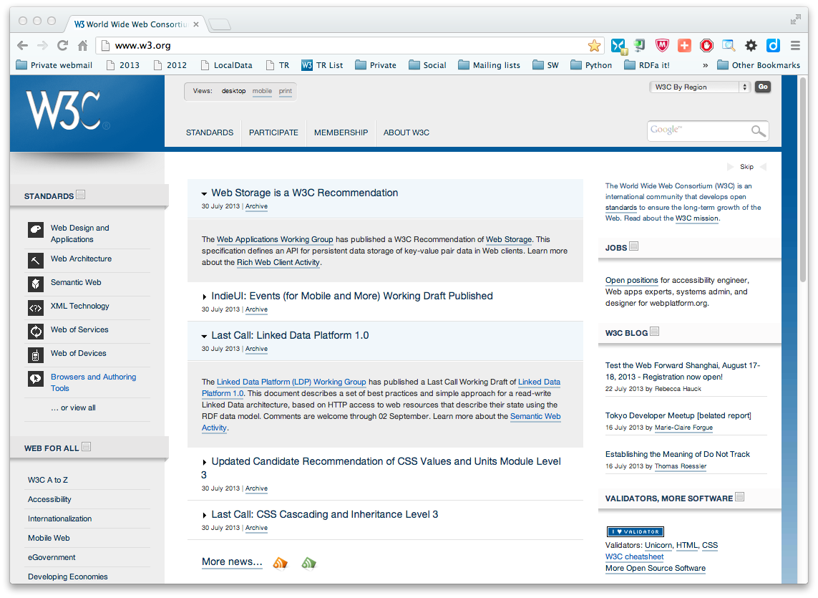
Lot remain to be done…
Lots of issues to be solved
But… W3C needs experts!
consider joining W3C, as well as the work done there!

Slide 200
Enjoy the Conference!

Slide 201
Thank you for your attention
These slides are also available on the Web:
http://www.w3.org/2013/Talks/0902-Lisbon-IH/

