Slide 1
Linked Data Applications:
There is no One-Size-Fits-All Formula
Asunción Gómez-Pérez
Facultad de Informática, Universidad Politécnica de Madrid
Campus de Montegancedo sn, 28660 Boadilla del Monte, Madrid
http://www.oeg-upm.net
asun@fi.upm.es
Acknowledgements:
O.Corcho, D. Garijo, D. Vila, L.Vilches, B. Villazón
Work distributed under the license Creative Commons Attribution-Noncommercial-Share Alike 3.0

Slide 2
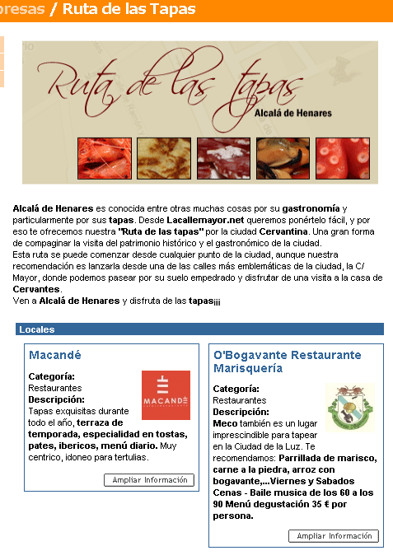
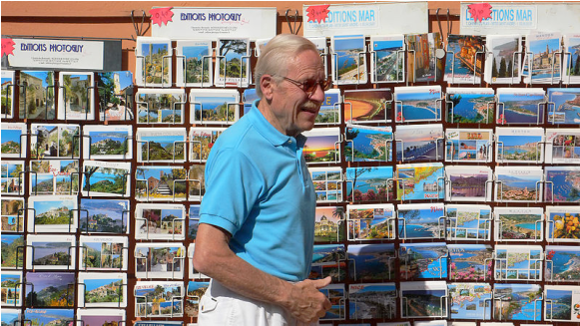
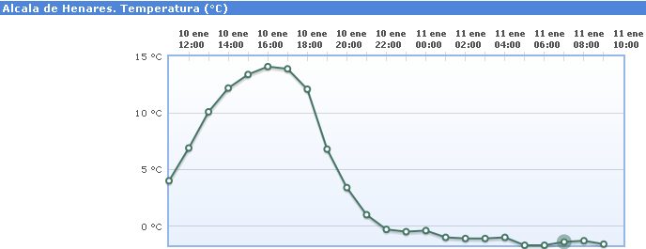

Complex queries using data from heterogeneous Web pages
http://www.bne.es/
http://elviajero.elpais.com/
Cervantes enthusiast from Germany visiting Madrid and willing to know more about Cervantes’ work and life
http://www.viaf.org/
http://www.aemet
*Picture attribution: http://commons.wikimedia.org/wiki/User:Gugerell

Slide 3


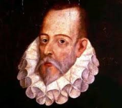
Data Integration
BD BNE
BD VIAF
BD
AEMET
BD IGN
BD Prisa
BD DBpedia
BNE
Ubicado en
Alcalá de Henares
1605
El Quijote
Año de
Publicación
Same as
Autor
birthPlace
M. Cervantes
M. Cervantes
Alcalá de Henares
M. Cervantes
creator
Year of
publication
Don Quixote
1960
Alcalá de Henares
Alcalá de Henares
Translated
into
located
guía
Temperatura
Hebrew
20º
Tapas Siglo de Oro
VIAF

Slide 4
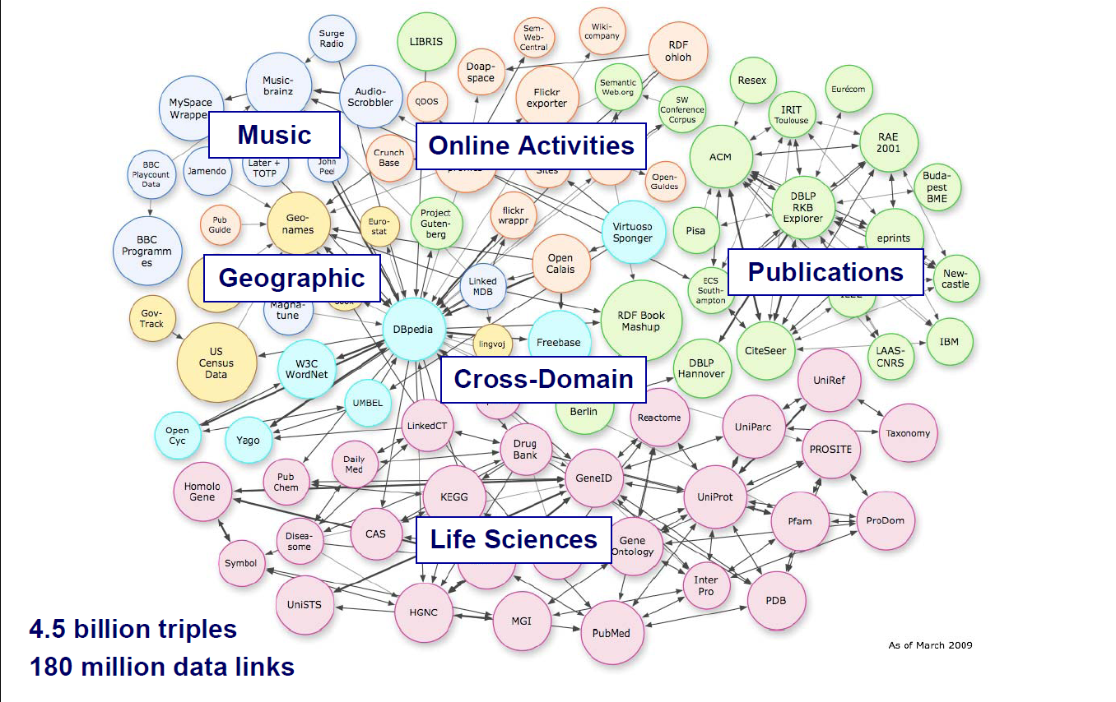
LOD clouds

Slide 5

Foundations
RDF(S) models
Unique identifiers: URI
identify or name a resource
Equivalence links to other datasets
Same As
Data navigation
http://iflastandards.info/ns/fr/frbr/frbrer/C1005
http://iflastandards.info/ns/fr/frbr/frbrer/C1001
Is creator of
Person
Cer
Work
Is a
Is a
Is creator of
Cervantes
Cer
El Quijote
http://datos.bne.es/resource/XX1718747
http://datos.bne.es/resource/XX3383563
Same As
Same As
Cervantes
http://viaf.org/viaf/17220427
Cervantes
http://dbpedia.org/resource/Miguel_de_Cervantes

Slide 6
Foundations
Aligning Models with Owl EquivalentClass
Person
http://schema.org/Person
http://iflastandards.info/ns/fr/frbr/frbrer/C1005
EquivalentClass
Person
Person
http://xmlns.com/foaf/0.1/Person
birthPlace
Municipality
EquivalentClass
Municipio
http://dbpedia.org/resource/Municipalities_of_Spain
http://geo.linkeddata.es/ontology/Municipio
Is a
Is a
Alcalá de Henares
Same As
Alcalá de Henares
http://dbpedia.org/page/Alcal%C3%A1_de_Henares
http://geo.linkeddata.es/resource/Alcalá de Henares
Lessons learnt
Reuse existing models
Align the data and the concepts.

Slide 7
The model (Ontology) and the data for people
Idiom
translation
Is creator of
birthPlace
Ontology
Year
Work
Person
Place
Publication date
Located at
Has subject
Library
Catalán
translation
Is creator of
birthPlace
1960
El Quijote
Cervantes
Alcalá de Henares
Publication date
Has subject
Located in
Data
Vida de Cervantes
BNE

Slide 8
The ontology and the data for the machine
Language
Ontology
http://iflastandards.info/ns/fr/frbr/frbrer/C1002
translation
Is creator of
work
Person
Año
http://iflastandards.info/ns/fr/frbr/frbrer/C1001
http://iflastandards.info/ns/fr/frbr/frbrer/C1005
Publication date
birthPlace
Has subject
http://geo.linkeddata.es/ontology/Municipio
Located in
Biblioteca
http://xmlns.com/foaf/0.1/Organization
Catalán
http://datos.bne.es/resource/XX1924295
translation
http://geo.linkeddata.es/resource/Alcalá de Henares
Don Quijote de la Mancha
Cervantes Saavedra, Miguel de
1960
http://datos.bne.es/resource/XX3383563
Es autor
birthPlace
http://datos.bne.es/resource/XX1718747
Publication date
Has subject
Located in
http://datos.bne.es/resource/bimo0002045496
BNE
Vida de Miguel de Cervantes Saavedra
Data
http://datos.bne.es/#

Slide 9
Datos.bne.es

Slide 10
datos.bne.es

Slide 11
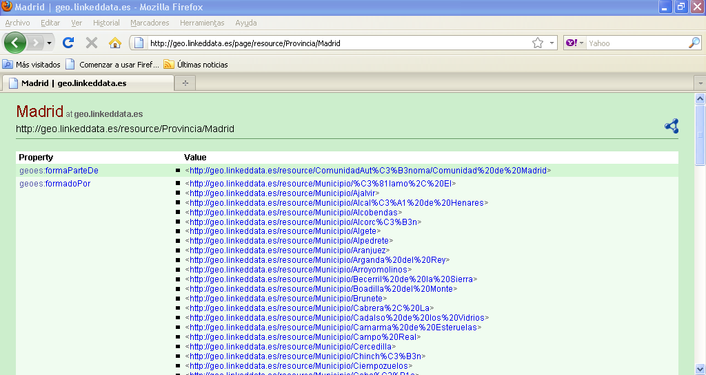
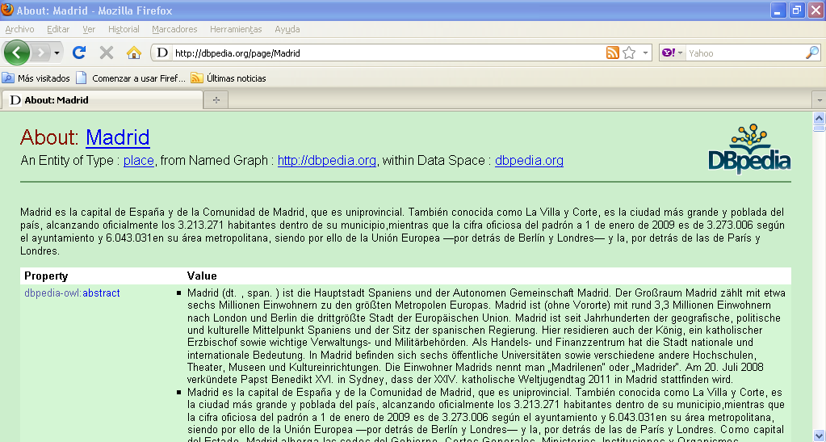
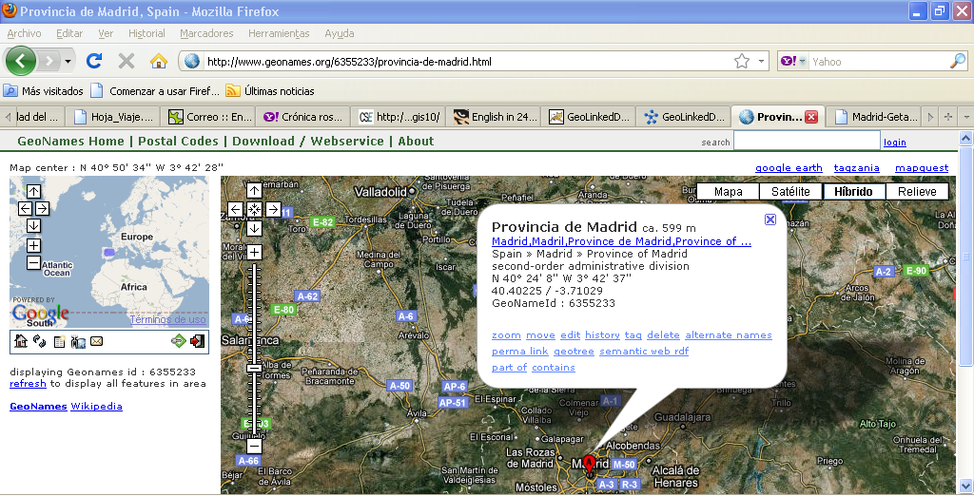
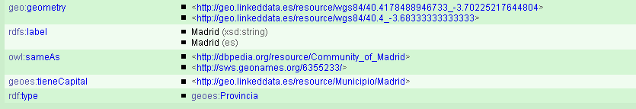
http://geo.linkeddata.es

Slide 12
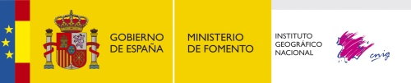


geo.linkeddata.es

Slide 13
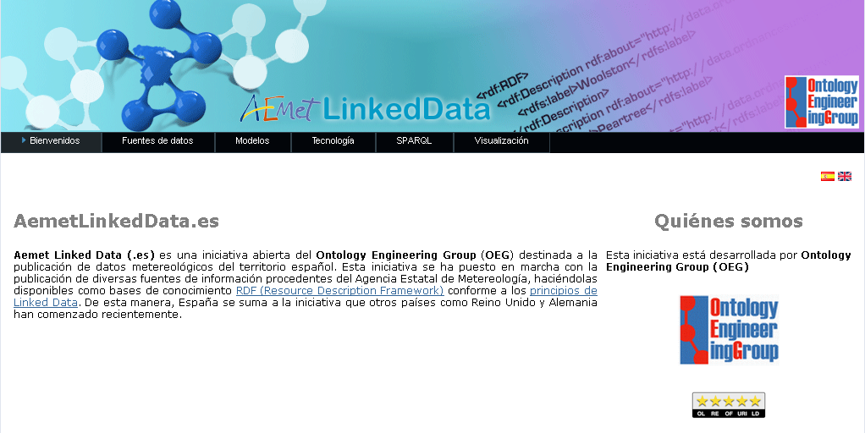

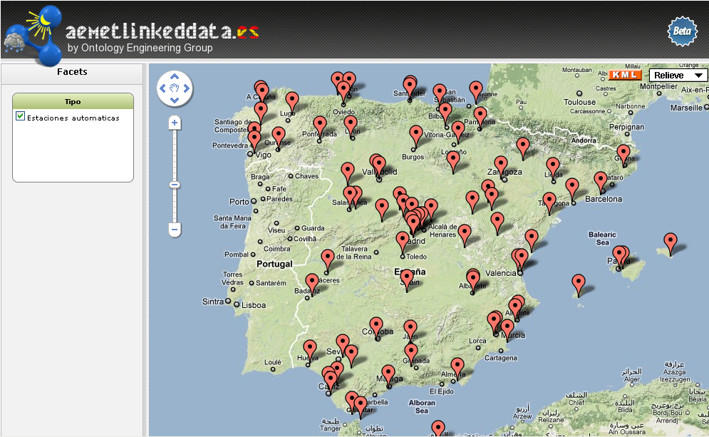
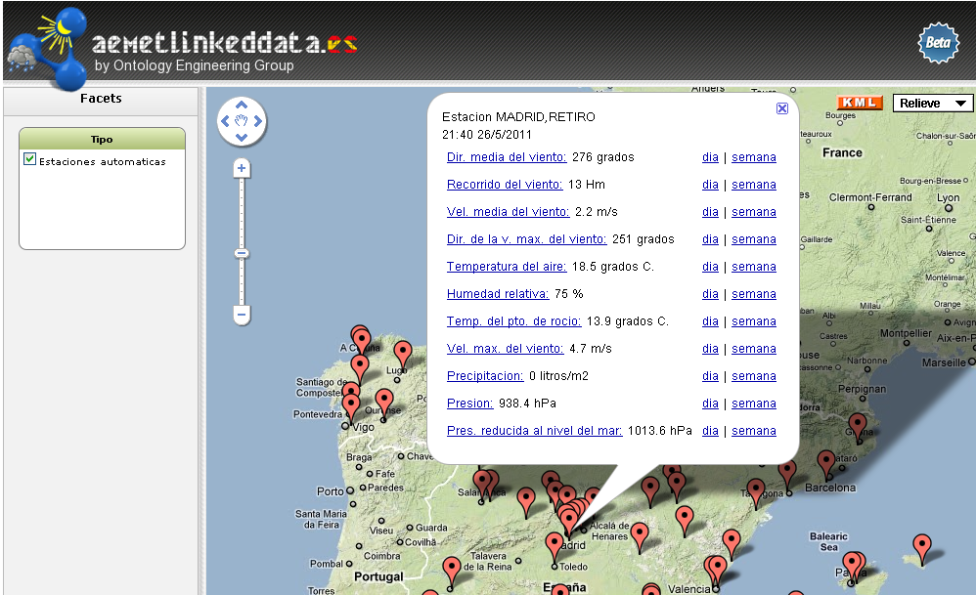
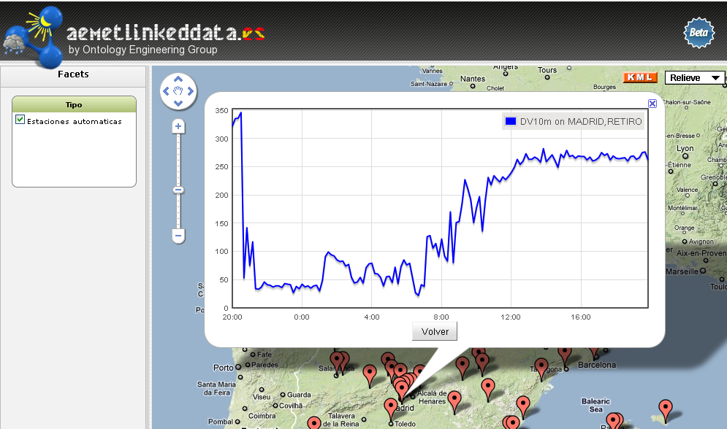
aemet.linkeddata.es

Slide 14
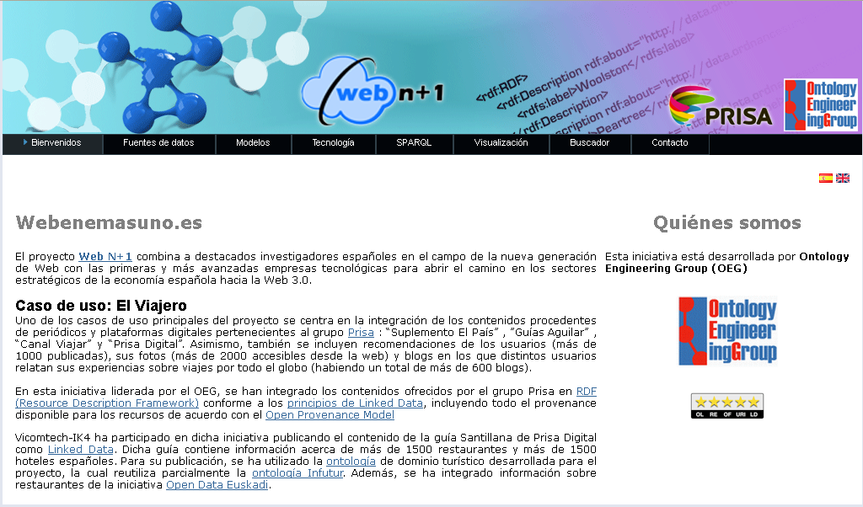

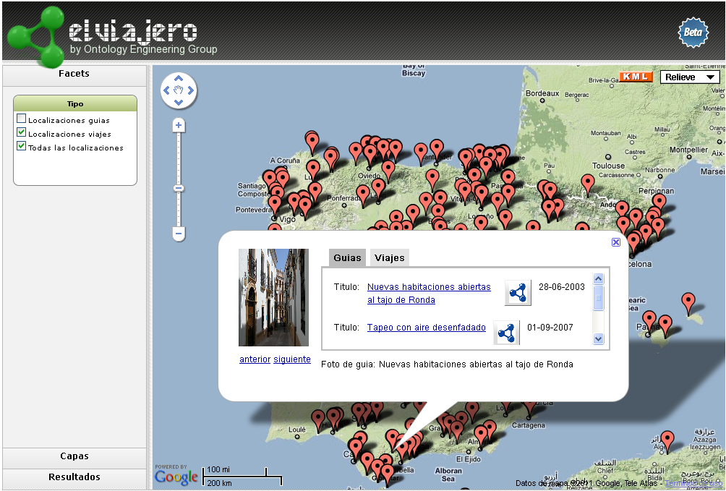
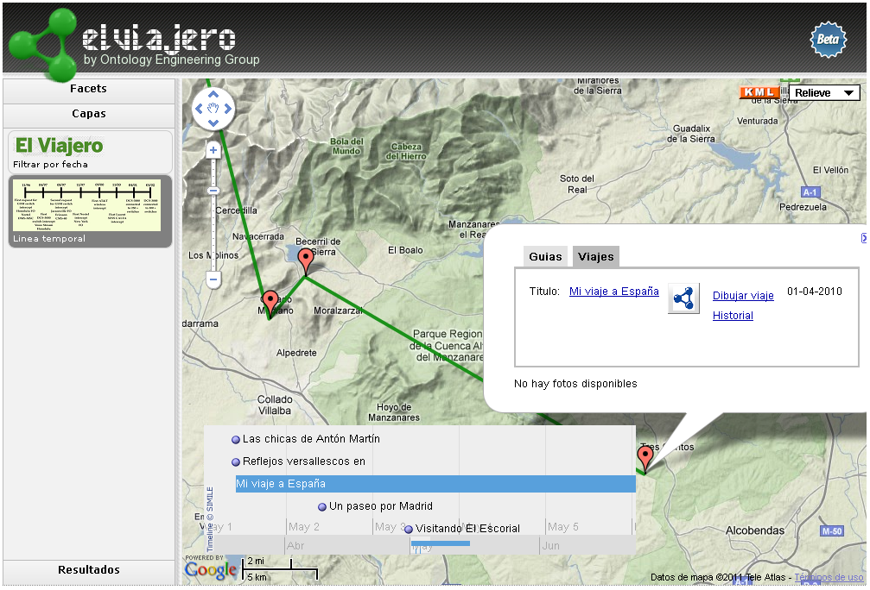
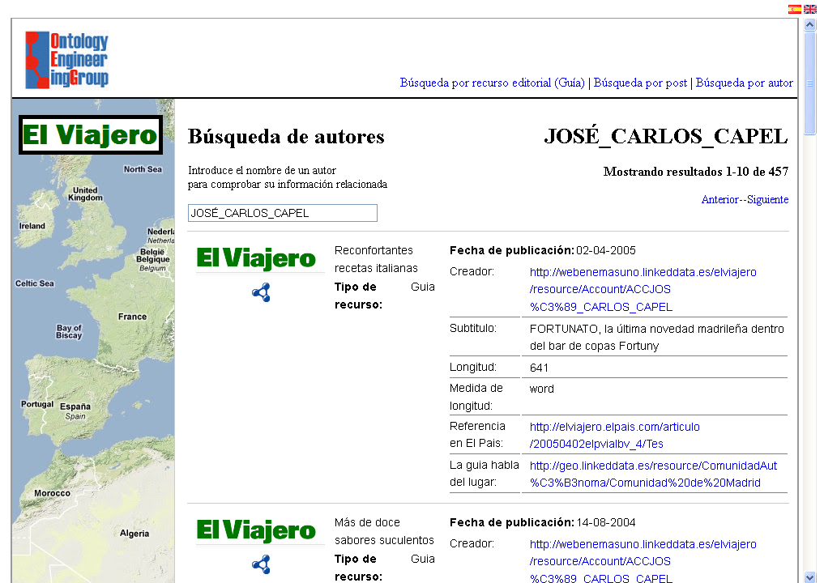
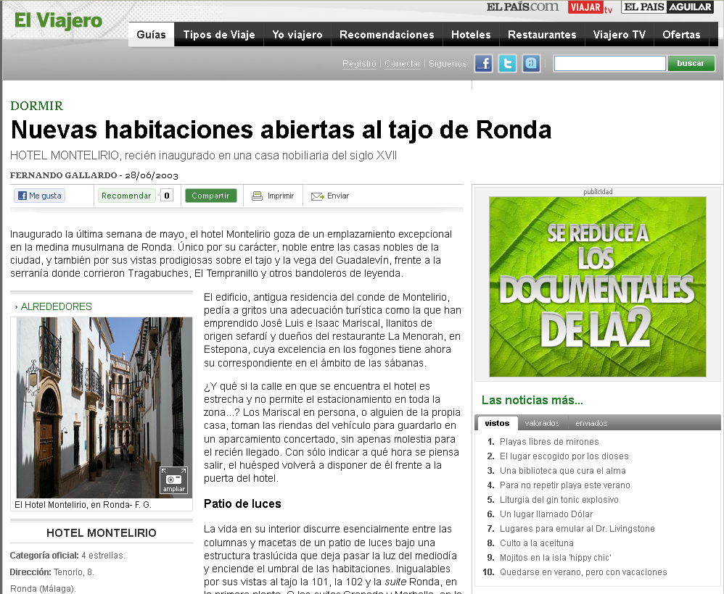
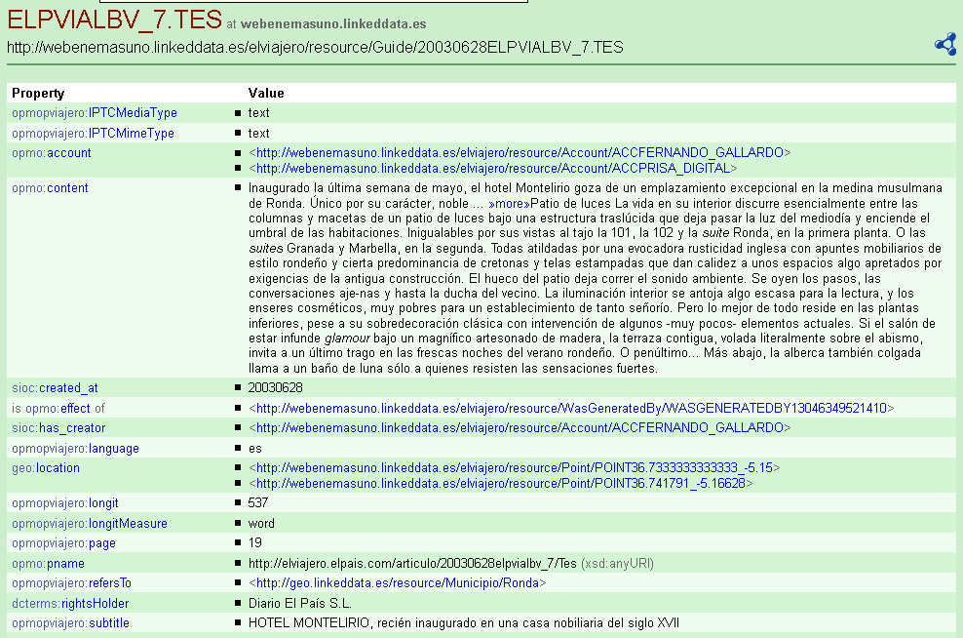
webenemasuno.linkeddata.es/

Slide 15
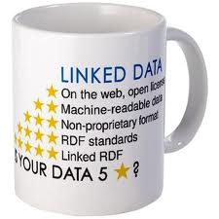
Results
http://datos.bne.es
    http://webenemasuno.linkeddata.es/
Total number of authority records: 4.100.000
Total number of bibliographic records: 2.390.140
Total number of RDF triples: 58.053.215
Links (15% authority): 587.520
Linked sources:
  VIAF
  SUDOC (Sistema Universitario de Documentación) FR
  GND (Auth German National Library) GER
  LIBRIS Sweden
  DBPedia
Total number of guides: 27.876
Total number of posts: 32.502
Total number of locations: 6.838
Total number of RDF triples: 9.462.339
Linked sources: 12.750
  DBPedia (6024 links)
  GeoLinkedData (6726 links)
http://geo.linkeddata.es/
Number of geo type phenomenon: 95 (Rivers, mountains, etc.)
Number of geo entities: 155.000
Total number of RDF triples: 21.564.199
Links: 1002 (outlinks) y 6782 (coming)
Linked sources: DBpedia y GeoNames (outlinks)
AEMET y El Viajero (entry)

Slide 16
Linked Data Applications:
There is no One-Size-Fits-All Formula
Asunción Gómez-Pérez
Facultad de Informática, Universidad Politécnica de Madrid
Campus de Montegancedo sn, 28660 Boadilla del Monte, Madrid
http://www.oeg-upm.net
asun@fi.upm.es
Acknowledgements:
O.Corcho, D. Garijo, D. Vila, L.Vilches, B. Villazón
Work distributed under the license Creative Commons Attribution-Noncommercial-Share Alike 3.0

