Slide 1
GGIE - The Glass to Glass Internet Ecosystem
Glass of Creation to Glass of Consumption
~and everything in between~
March 2014

Slide 2
The Internet has changed our relationship with Content

Slide 3
30+ years of Internet development
In the ~30+ year history of the Internet – Internet Engineers have focused on reliably delivering packets from device to device
The Internet groups reflect this historical focus on connectivity:
IETF, ISOC, ICANN, W3C – each plays an important role in the puzzle
It has given us a very reliable & scalable Internet
The End-End Content Workflow has largely been excluded as “out of scope” – Yet it’s highly dependent on work in each group

Slide 4
Engaging the Community on Content
GGIE is a place to engage on End-End Digital Content Issues at all levels: Social – Prosumer - Professional
GGIE is not another SDO – It’s goal to help SDOs
Bring together technical experts across 5 focus areas:
Scalability, Metadata, Content Identification, User Identity, Privacy
Digital Content Use Cases & GAP analysis to document new requirements to feed into Internet SDO workgroups

Slide 5
GGIE Core Features
GGIE will not write standards
Standards development to be done in existing SDOs
Use Cases & GAP studies will be free for groups to use and modify
GGIE will be open and allow easy participation
GGIE will not create or accept IP contributions

Slide 6
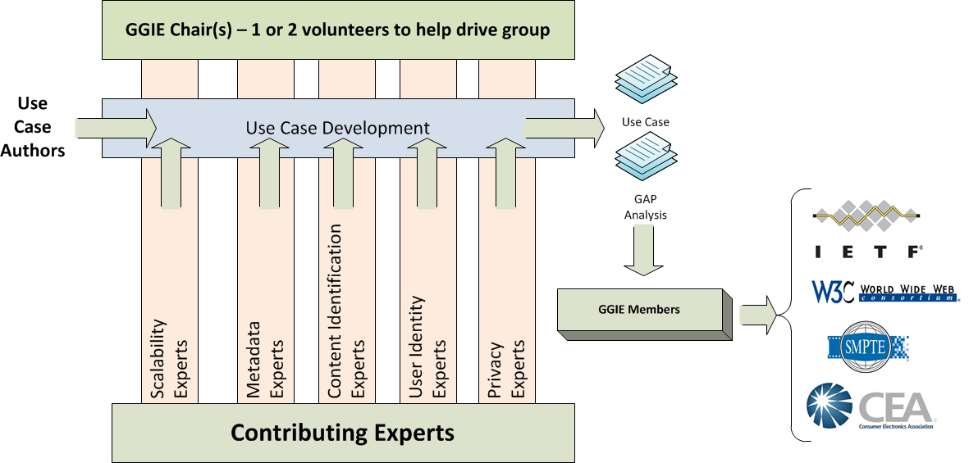
GGIE Work Flow
+ Collaboration with SDOs

Slide 7
More Info on GGIE
Contact: Glenn Deen – glenn.deen@nbcuni.com

