Slide 1
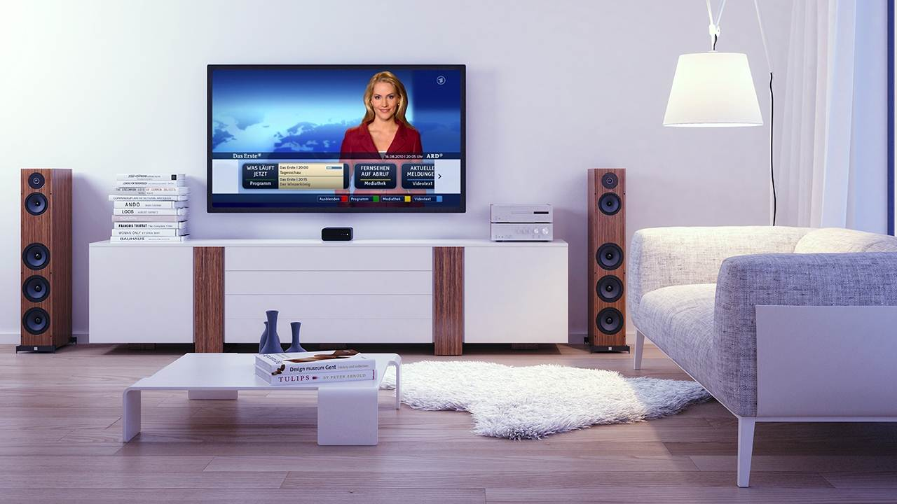
Web & TV IG Overview
Giuseppe Pascale, Opera Software
Notes:
1

Slide 2
Goals (from the Web and TV IG charter)
Identification of requirements for tighter support of media-centric applications on the Web Platform
Identification of gaps in the Web Platform that do not allow the identified requirements to be met
Review of deliverables under development by other W3C groups that are relevant to the IG scope and report bugs as appropriate
Liaison with other organizations in the media industry that are using the Web Platform for their technical specifications and/or their services to foster alignment and interoperability on a global scale

Slide 3
Web and TV IG
IG != WG
No technical specification developed
Focus on requirements and input for existing and/or new WGs
Resources
Wiki: http://www.w3.org/2011/webtv/wiki/Main_Page
Home Page: http://www.w3.org/2011/webtv/
Organization
Discussion on the list is preferred and encouraged
Task Forces (TFs) for specific topics (may hold dedicated calls)

Slide 4
Web and TV Interest Group Work Flow
Web & TV IG (Task Force)
Bug reports
WG
Use cases
current
spec
Standards &
trade orgs.
Requirements
New API
WG
new
spec
Members
Gap analysis
New
API
CG
WG
draft
spec
new
spec

Slide 5
TFs work overview
Past
Home Network TF (HNTF):http://www.w3.org/2011/webtv/wiki/HNTF
Media Pipeline TF (MPTF):http://www.w3.org/2011/webtv/wiki/MPTF
Testing TF (TestingTF): https://www.w3.org/2011/webtv/wiki/Testing
Timed Text TF (TTTF):https://www.w3.org/2011/webtv/wiki/Tt
Ongoing
Media APIs TF: https://www.w3.org/2011/webtv/wiki/Media_APIs

Slide 6
Home Network TF (closed)
Web & TV IG
DAP WG
Requirements for Home Networking
Scenarios
Network
Service
Discovery
Members
New
API
Goal: Identify gaps to enable discovery and control of devices and services in the local area IP network
Outcome:
Use cases and requirements for potential specifications
Network Service Discovery API (Working Draft)
Spec reviewed by implementers and by Privacy IG (PING), some security/privacy concerns raised
A new update trying to address such concerns recently submitted to the group for review.

Slide 7
Media Pipeline TF (closed)
Web & TV IG
Bug reports
HTML WG
Gap analysis
HTML5
Members
Adaptive Bitrate
Requirements
New API
MSE
Content Protection
Requirements
New API
EME
Goal: Improve HTML5 media pipeline to support media services
Outcome:
Bug reports toward HTML5 addressed. HTML5 is currently a Candidate Recommendation
MSE (Media Source Extensions): Candidate Recommendation, early browser support
EME (Encrypted Media Extensions): Working Draft, early browser support
IG members form new group: Media Resource In-band Tracks CG

Slide 8
Testing TF (closed)
ATSC, DLNA,
IPTV Forum Japan
OIPF,
SmartTV Alliance
Web & TV IG
Testing Use Cases
Testing group
Testing
Requirements
Planning input
Open Web Platform Testing Plan
Members
Web & TV Testing Survey Results
Goal: Collect Web & TV testing use cases, requirements. Identify gaps in current test tools and test coverage. Liaison with external organizations
Outcome:
Use cases & requirements completed
10 external organizations surveyed, 5 returned survey
Reports delivered to Testing group

Slide 9
Timed Text TF (closed)
Web & TV IG
Timed Text WG
Timed Text Efforts
TTML
DECE, EBU
SMPTE
Timed Text Use Cases
Planning input
Web Media Text Tracks CG
WebVTT
Members
Consensus Input
Goal: Develop recommendations to facilitate the use of TTML and WebVTT content on the Web, including interoperability with other timed text formats.
Outcome & status:
Document scope and variations of TTML and WebVTT
Gather Web-based timed text use cases from the TV and Media industry
Delivered IG Consensus Input to Timed Text WG, Gather Web-based timed text use cases from the TV and Media industry and IG members.
New charter for TT WG is under review. Attempt to coordinate WebVTT and TTML work under the same group

Slide 10
Media APIs TF (ongoing)
Goal
Identify requirements for recording and downloading media
Investigate requirements for discover and control of device capabilities (e.g. tuner control)
Investigate how to expose TV metadata to web applications
Investigate mapping between Media Element API and in-band metadata
Synchronization of broadcast content and web applications up to frame accurate

Slide 11
Media APIs TF (ongoing)
Status
Finalizing requirement document (latest draft here)
“Tuner Control” requirement which may be addressed by a Community Group. Discussing scope and definition.
Other requirements are already partially addressed by existing specs, and need to be followed-up with existing WGs/CGs
Device APIs WG – NSD
HTML WG – HTML5, HTML5.1, MSE
WebApps WG – Manifest, Push, Service Worker, Web Storage
Web Crypto WG – Web Crypto API
WebRTC WG – WebRTC
Group ready to start with a new iteration of work

Slide 12
Thanks
Giuseppe Pascale, Opera Software
Notes:
12

Slide 13
Task Forces
Self-organized sub groups to discuss specific topics
Most TFs follow the following working process
Phase 1: define use cases the TF member want to focus on
Phase 2: extract requirements that specification(s) should met to cover the identified use cases
Phase 3: gaps analysis of the existing Web Platform
Is it possible to use existing web standards to accomplish this? If not, what could be standardized?
Phase 4: identify which WG/CG/BG (existing or new) is suitable for the follow-up
Once they have achieved their goals, TFs are closed

Slide 14
Home Network TF
Goal:
identify gaps to enable discovery and control of devices and services in the local area IP network
Output
Use cases and requirements for potential specifications
http://www.w3.org/TR/hnreq/
Follow-up
In DAP WG
Spec status
Network Service Discovery API (Working Draft)
Implementers have raised some security concerns
DAP is currently discussing how to address them

Slide 15
Service Discovery
An API to discovery and communicate with services on the network (proposed by Opera, CableLabs)
https://dvcs.w3.org/hg/dap/raw-file/tip/discovery-api/Overview.html
Use Case:
Allow Web Applications to discover services on the local network and communicate with them
Design Goals:
Reuse of existing communication API (XHR, Web Sockets, etc)
Support legacy devices & discovery protocols (UPnP, Bonjour…)
Minimize requirements on the UA for communication protocols
Keep discovery as part of the UA for security reasons.

Slide 16
Service Discovery
Promise getNetworkServices(type);
interface NetworkService
id, name, type, url, config, online;
onavailable, onunavailable, onnotify;

