Slide 1
Inter-Device Media Synchronization in Multi-Screen Environment
Geun-Hyung Kim, Dong-Eui University
Sunghan Kim,
Electronic and Telecommunications Research Institute

Slide 2
Contents
Introduction
media synchronization and multi-screen environment
multi-screen service migration
use cases in multi-screen service migration
overall architecture
issues and conclusion

Slide 3
Introduction (media synchronization)
media synchronization
important issue to guarantee the QoE (Quality of Experience) of any media session in convergence service
inter-media synchronization on a single device has been investigated intensively
media (or contents) delivered along a single delivery path
e.g., (digital) broadcasting, OTT
media (or contents) delivered along different delivery paths
e.g., hybrid broadcast or hybridcasting
inter-media synchronization on several devices is discussing lately.

Slide 4
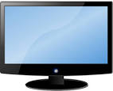
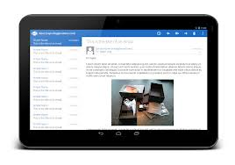
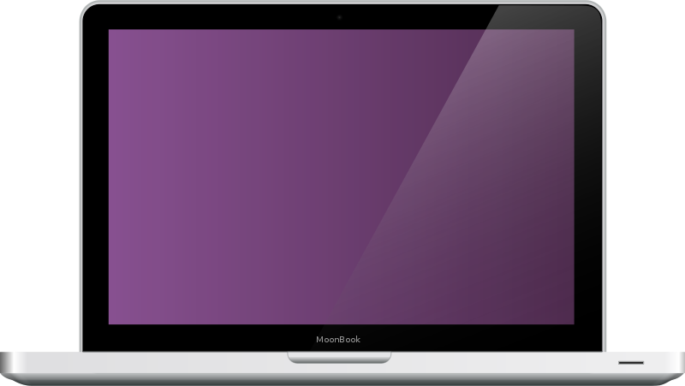
Introduction (multi-screen environment)
users own multiple devices
that have a connection to the Internet.
that are connected each other
that have different computational capacity and different screen size
examples of web-based convergence services
public (broadcasting content etc.) + personal services (internet poll, supplement information, personal advertisement etc.)

Slide 5
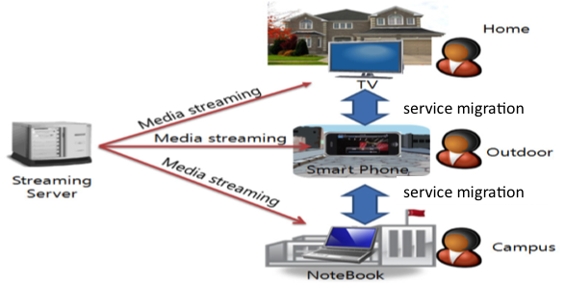
Service migration
basic example of seamless service migration
watching a movie through smart TV
at home
keep watching the movie with his
smart phone on the way to the campus
watching the movie with notebook to
utilize bigger screen that smart phone

Slide 6
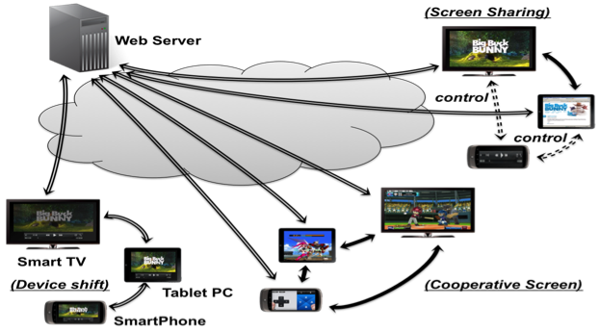
Multi-Screen Service Migration

Slide 7
Multi-Screen Service Migration
Device shift
simple service (content) migration pattern
whole content will be migrated from one screen to other screens seamlessly
users can enjoy the same content on their various devices
service session information should be synchronized to continue service experience seamlessly
Cooperative screen
partial service (component or content) will be migrated to other screen
content migration to overcome the limitation of a single screen size (virtual screen)
multiple screens interact each other to provide rich service experience after migration occurs
e.g., game control and display area (or component) expansion
Screen Sharing
partial service (supplemental information) will be migrated to other screen
an example of supplemental information: the information about actor, actress, or player

Slide 8
requirements
Synchronized media presentation on each individual screen in the multi-screen environment
it is necessary to have a coherent orchestration of multiple devices’ content presentation experience
Synchronously seamless migration of whole content (or partial content) that runs on one screen (browser) initially to other screen (browser)
Synchronously seamless replication of whole content that runs on one screen (browser) initially to other screen (browser)
synchronously seamless migration of partial content that runs on one screen (browser) initially to other screen (browser)
Synchronization between TV content and web-based supplemental contents. that can be migrated to other screen

Slide 9
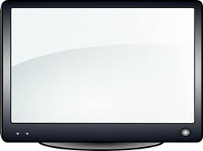
example of service migration procedure
1
5
2
4
3

Slide 10
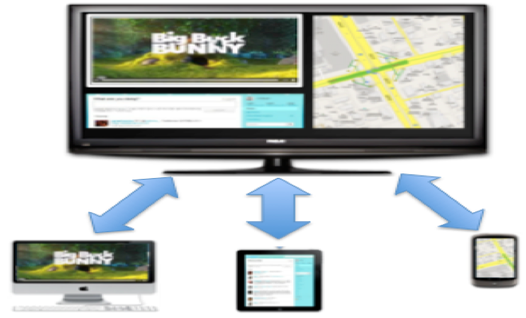
example of service migration
web content sharing

Slide 11
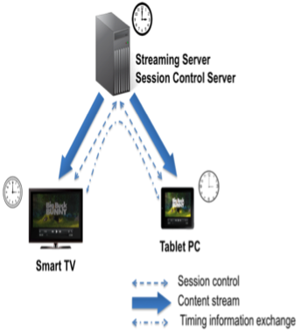
Simple Architecture
inter-device media synchronization
exchanging playback timing information periodically between devices via IP networks

Slide 12
issues
direct or indirectly network device discovery (cross-browser)
direct communication or indirect communication for exchanging timing information (cross-browser)
signaling information to migrate service component seamlessly
component-based web application authoring mechanism to migrate specific component to other screen

Slide 13
Conclusion
investigate the multi-screen service migration pattern
investigate the issues on inter-device media synchronization and seamless service migration in multi-screen environment

Slide 14
Thanks for your listening.

