Slide 1
Enabling Second Display Use Cases on the Web
4th W3C Web & TV Workshop
Presenter: Louay Bassbouss, Fraunhofer FOKUS
Dominik Röttsches, Intel OTC Finland, @abrax5

Slide 2
Introducing the Second Screen Presenation CG
http://www.w3.org/community/webscreens/
(Links to Presentation API Proposal, Demo, Charter, Wiki, ML, etc.)
Intel Initiative, Group founded end of 2013, chaired by Dominik Röttsches, Intel
36 Participants: Browser Vendors, Researchers, Silicon Manufacturers, Operators
Bringing Second Display Use Cases to the Web
Bridging the gap to native: Second display use cases can be implemented on iOS and Android and PC already, now the web needs them

Slide 3
Current Status
CG discusses third iteration of Presenation API proposal on mailing list and Wiki
http://www.w3.org/community/webscreens/wiki/API_Discussion
http://lists.w3.org/Archives/Public/public-webscreens/
Approaching a good common understanding of use cases and requirments
Community group welcomes new participants
Browsers:
  Presentation API part of Google`s Chrome agenda 2014:
  https://groups.google.com/a/chromium.org/d/msg/blink-dev/Z5OzwYh3Wfk/IWooaY5FZowJ
  Commitment from Mozilla to experimentally implement API

Slide 4
Second Display for the Web?
Enabling the User Agent to show web content full screen on nearby displays, such as TVs, projectors etc.

Slide 5
“Second Display” Clarification
Second Display in this context means presenting on nearby displays from a UA on your primary device (laptop, handheld) to the display
Different compared to Web & TV context, where "Second Screen" is often used to mean an application on a tablet, phone or other device associated with a program simultaneously broadcast on a TV.

Slide 6
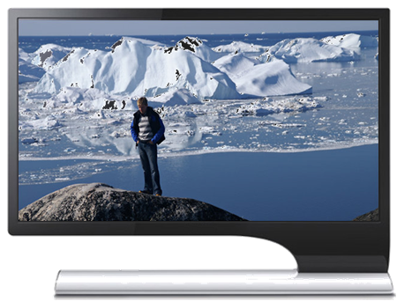
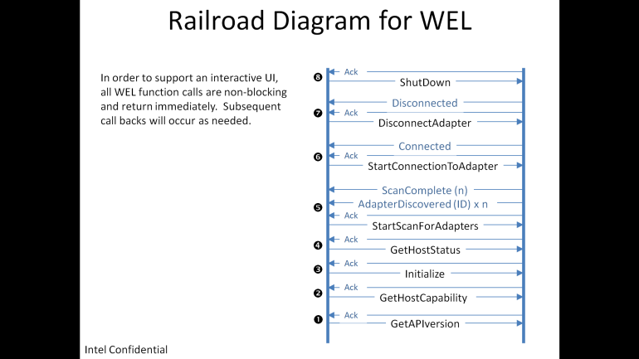
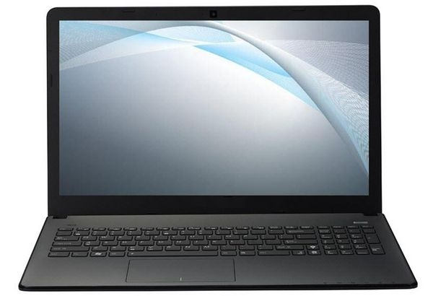
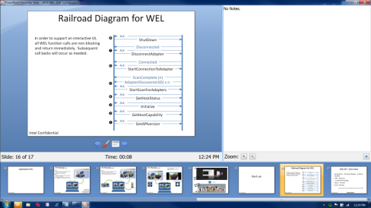
Use Case: Presentation
❷
❶
(Slide material courtesy of Steve Barile, PCCG)

Slide 7


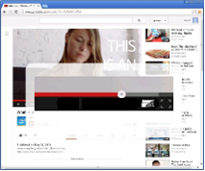
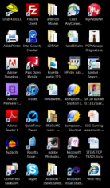
Use Case:
Video Sharing &
Media Flinging
❷
❶

Slide 8
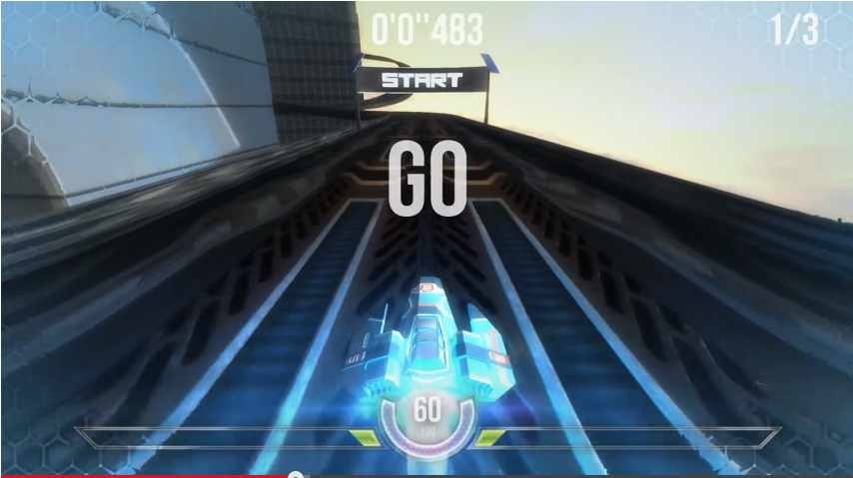
Use Case: Gaming
e.g. Game Controls/
Inventory/
Map
❷
❶

Slide 9
Remote Display Technologies
Miracast & Intel Wireless Display
  On Windows 8 & 8.1
  On Android
Airplay
  On iOS & OS X – multi-monitor support in OS X Mavericks
DLNA-based
  Xbox, Windows Media, PS3, TVs
Chromecast
  Partially web-based, two user agents connecting

Slide 10
OS APIs for Second Displays
Desktop OS
  “Invisible Monitor cable”
  Wireless displays are transparent to applications
  API-wise appear just like any other monitor, Display Enumeration & Info
  Allows Mirror/Clone Mode, Extended Mode
Mobile OS
  Special APIs to access secondary displays
  Mirroring and second-screen mode
  Compatible with Widget/Views architecture of the OS

Slide 11
Situation on the Web – Why we need Presentation API
Popup Blocking (using secondary windows is frowned upon)
Fullscreen API established
Network Service Discovery API (covering DLNA, Zeroconf, DIAL)
Alternative Sinks for Video Elements
  Microsoft’s PlayTo extensions for the video element
  Apple’s Airplay support for media elements
  Sink enumeration for Video and Audio Elements proposal http://lists.w3.org/Archives/Public/public-html/2013Aug/0101.html
Chromecast
  Integration in Android, Chrome browser

Slide 12
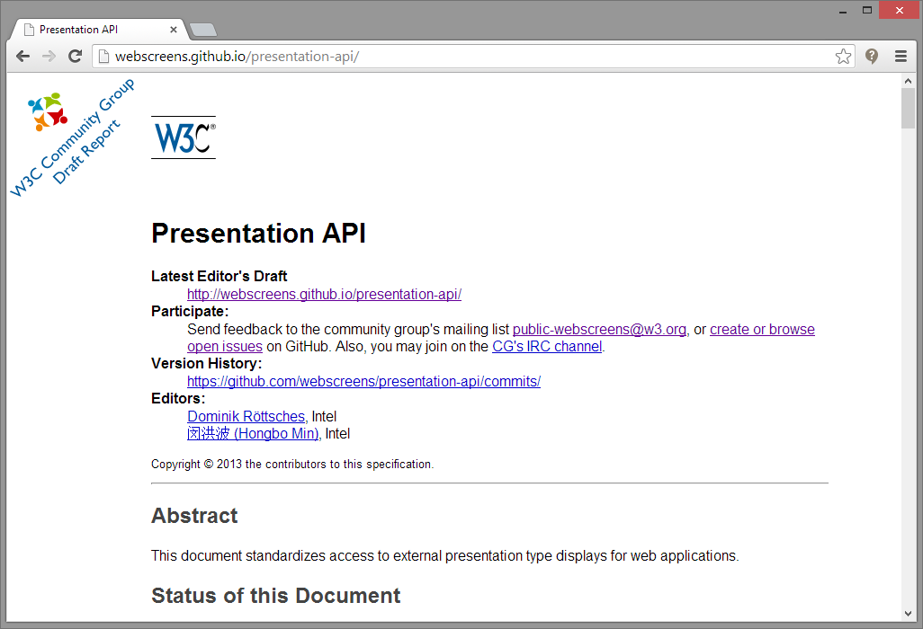
Presentation API Proposal
http://webscreens.github.io/presentation-api/ &
new proposal:
http://www.w3.org/community/webscreens/wiki/API_Discussion
Abstracts away physical display connection technologies
Simple, unobtrusive API which enables a wide variety of use cases

Slide 13
API Preview
IDL
interface NavigatorPresentation : EventTarget {
PresentationSession requestSession(DOMString url);
attribute EventHandler onavailablechange;
attribute EventHandler onpresent;
};
partial interface Navigator {
readonly attribute NavigatorPresentation presentation;
};

Slide 14
Presentation API Example
TV / Second Screen
<video>
<script>
navigator.presentation.onpresent = function(e) {
// Communicate with opener page.
e.session.postMessage(/*...*/);
e.session.onmessage = function() {/*...*/};
</script>
Phone / Laptop
<script>
var session =
presentation.requestSession('http://example.org/');
session.onstatechange = function() {
switch (session.state) {
case 'connected':
session.postMessage(/*...*/);
session.onmessage = function() { /*...*/ };
break;
case 'disconnected':
console.log('Disconnected.');
break;
}
};
</script>
Communicating commands
Like “Play/Pause Video”

Slide 15
Presentation API Key Features
Presentation API
  requestSession will create a presentation window on the secondary display for the given URL
  Returns PresentationSession object on success
  Presentation window always frameless, full screen window – common denominator between mobile and desktop scenarios
  onavailablechange event indicates if there is at least one available secondary display
  Web Messaging-like communication between opener and second screen
Security: Fingerprinting risk mitigated by not leaking a display enumeration footprint

Slide 16
Presentation API Demo
http://webscreens.github.io/presentation-api/demo/
Proof of Concept demo implementation based on Chromium
Simulates initial version of API

Slide 17
Participate
Second Screen Presentation Community Group
http://www.w3.org/community/webscreens/
Review the API proposal and charter
Join the mailing list http://lists.w3.org/Archives/Public/public-webscreens/
Discuss on #webscreens W3C IRC
Find more information on the Wiki
http://www.w3.org/community/webscreens/wiki/Main_Page
Notes:
Feedback on API & Use Cases?
Implement?
Share your experiences with regards to second screen usage

Slide 18
http://www.w3.org/community/webscreens/
Copyright © 2013 Intel Corporation. All rights reserved
Intel, the Intel logo, Ultrabook are trademarks of Intel Corporation in the U.S. and/or other countries.
*Other names and brands may be claimed as the property of others.

