Slide 1

MULTISCREEN SERVICE
IN SHANGHAI
Oriental Cable Network
Mingmin Wang
March 12th 2014

Slide 2
Agenda
Overview of OCN
Multiscreen Service Deployment
Multiscreen Service Development

Slide 3
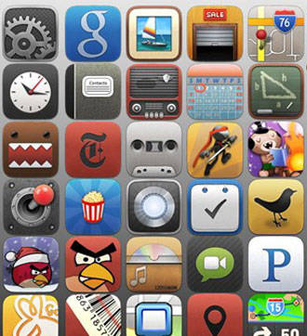
Multiscreen Service
Overview of OCN
Overview
Network Architecture
Interactive TV Service

Slide 4
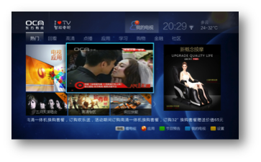
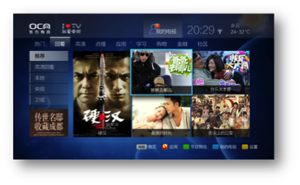
6M home-pass and digital subs, the largest metro cable network worldwide, single head-ended. Started triple play convergence field trial since 1999
Over 1M HDTV subscribers and 1.3M digital Pay TV users, own a comprehensive city-wide VOD platform supporting millions subscribers.
Deployed broadband data service from 2000, 320k HSD subscribers.
Start NGB (next generation broadcasting) network upgrading in Shanghai since 2008.building up the backbone with 1Tbps bandwidth, and providing end-user 30Mbps access bandwidth.

Slide 5
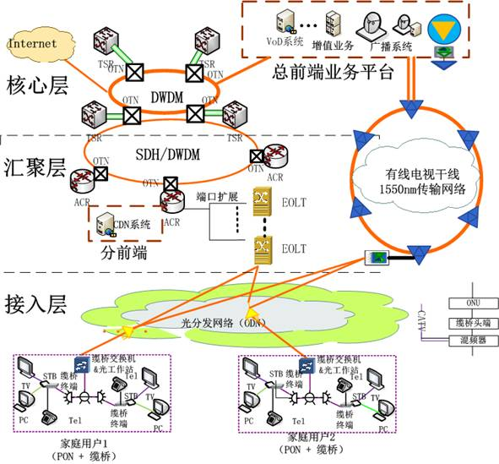
NGB——network architecture
Core network speed: Terabit
Into building speed: Gigabit
Home pass speed : 100 Mbps(Fast Ethernet)

Slide 6
NGB——home access network

Slide 7
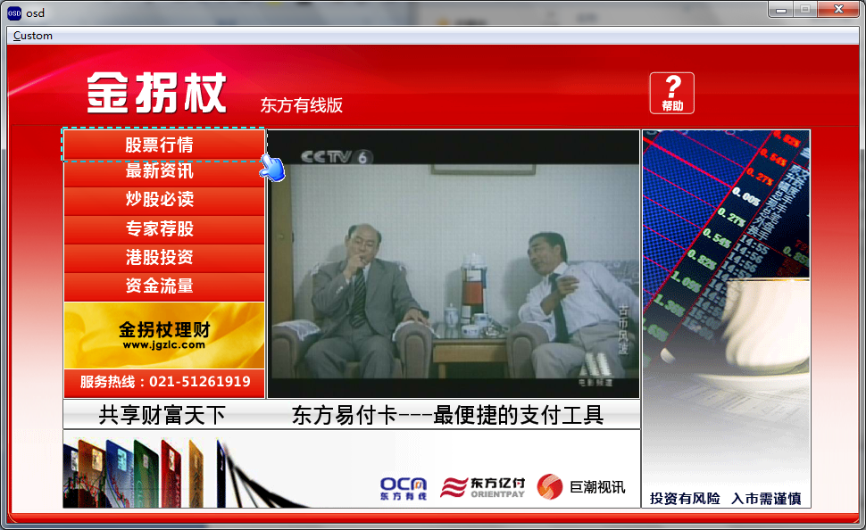
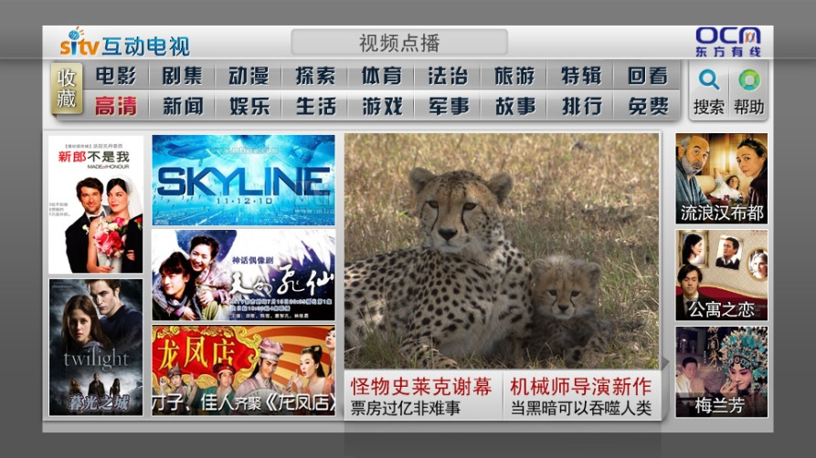
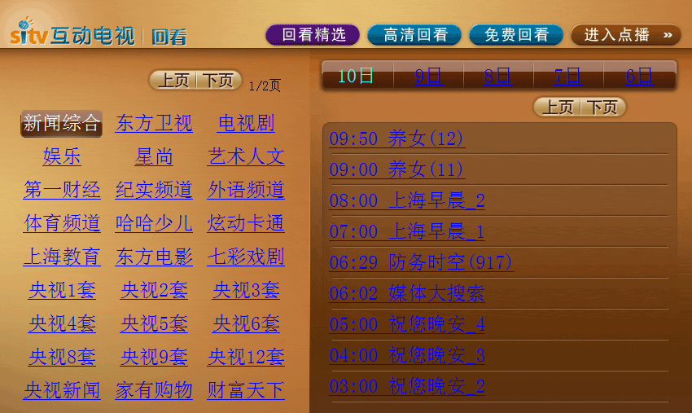
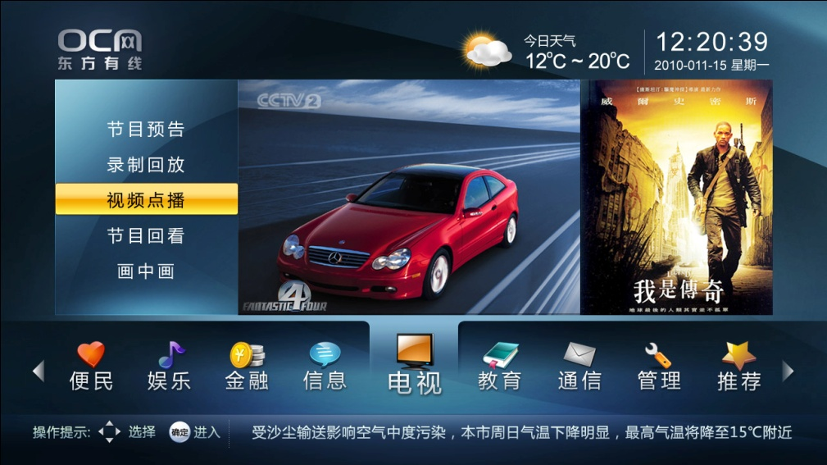
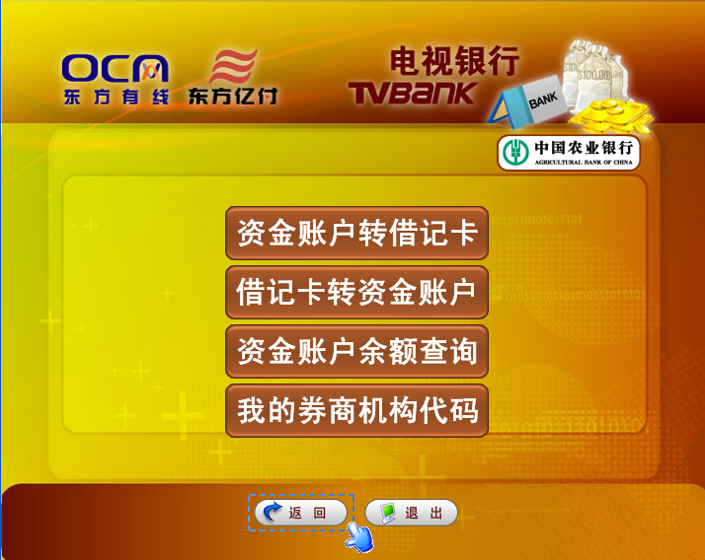
Intercactive TV service
160 SD broadcasting channels and about 10M digital stbs.
30 HD broadcasting channels, including paytv channel and 3dtv channel;
HD vod and catchup TV service, 1M subscribers and support 5M current streams；
TV Shopping, TV education, Gaming, Music, TV albums and Karok …

Slide 8
Multiscreen Service
Multiscreen Service Deployment
Architecture
Typical user case

Slide 9


Multiscreen Service Deployment
Multiple-screen experience involves a variety of service types and related technologies, it provides the content sharing, companion devices, and unified communication to end-users who are using multiple smart devices connected on different networks operated by TV MSO.
broadcasting
vod
NGB
network
NGB service platform
Catchup tv
Tv messaging
application

Slide 10
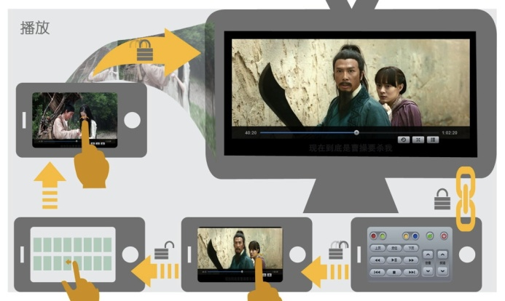
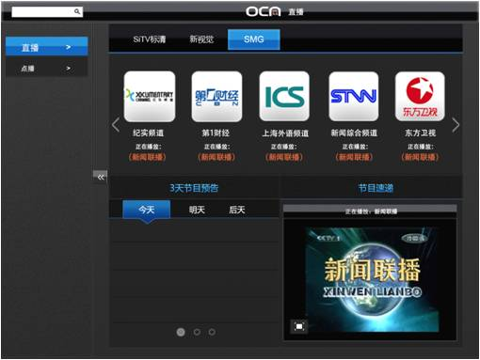
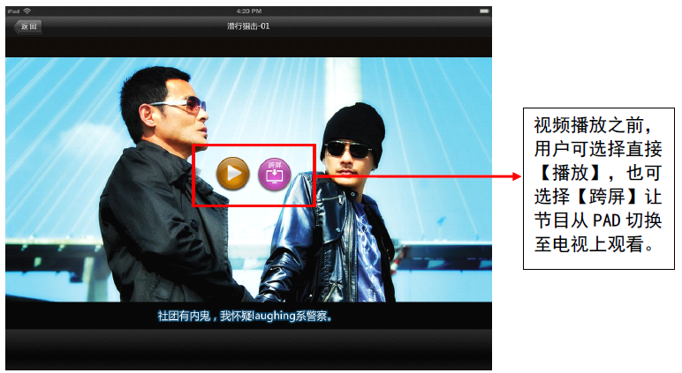
Multiscreen Service Deployment
60 SD live streaming channel and 10 HD live streaming channel, 10k hours VOD content, support iOS/Android pad and phone;

Slide 11
Multiple screen service or application
Device management
system
Service coordination support system
Unique content management
Smart search
engine
plugins
Device config
Unique customer management
Unique session management
Device status
report
Unique resource management
Unified message system (XMPP)
Current
video
service infrastructure
DVB
VOD
SDV
OTT

Slide 12
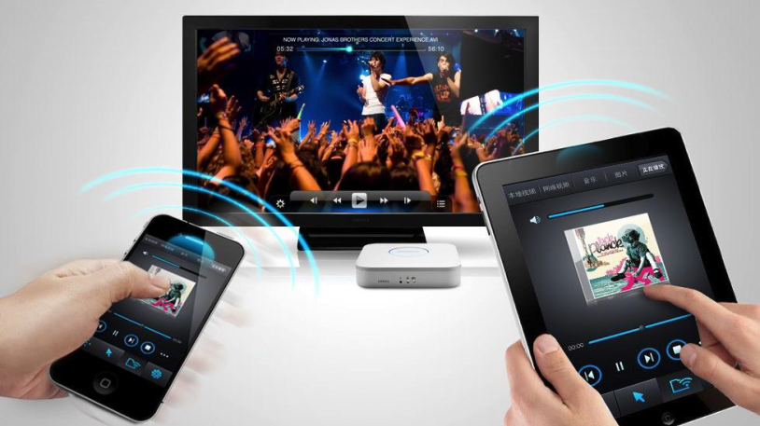
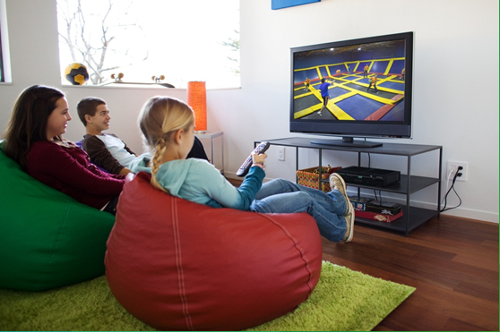


Multiscreen Service Deployment
■Typical user case
Supported by a video-cloud deployed at cable head-end, allows users to view the same content on different devices.
NGB HD STB
MOBILE
PHONE
Typical applications
SMART-TV
PAD/PC
SMART HOMEGATEWAY
CROSSSCREEN-APP
OTT
APP
VIDEO MESSAGING

Slide 13
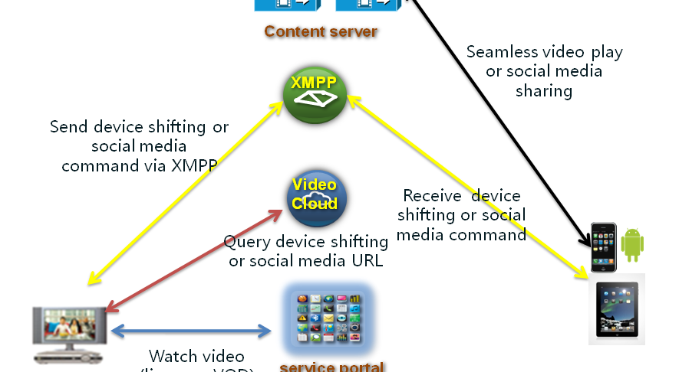
Multiscreen Service Deployment
Support companion devices multi-screen interactive service ,such as content sharing and social networking , realtime video chat and use as remote control.

Slide 14
Multiscreen Service
Multiscreen Service Development
Typical application
Smart home gateway

Slide 15
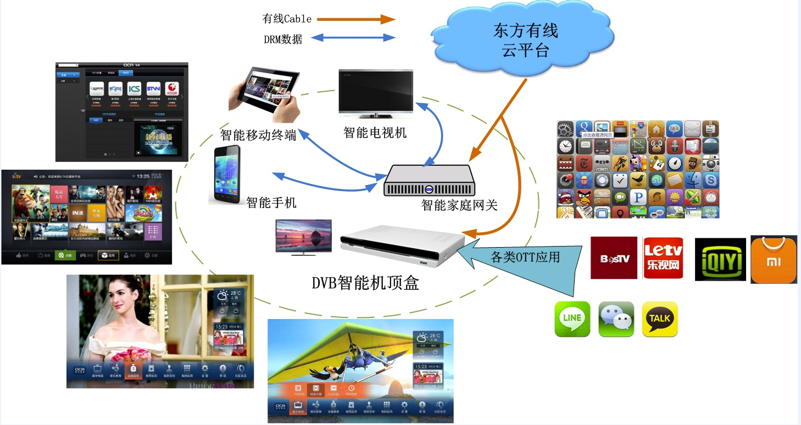
Multiscreen Service Development
—Typical application(1)-DVB+OTT+APP

Slide 16
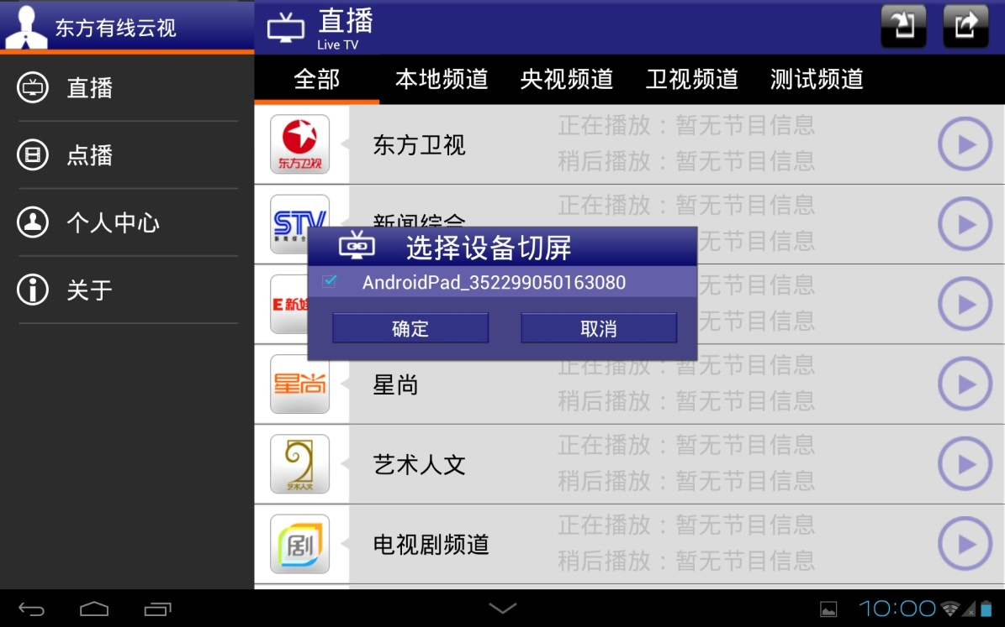
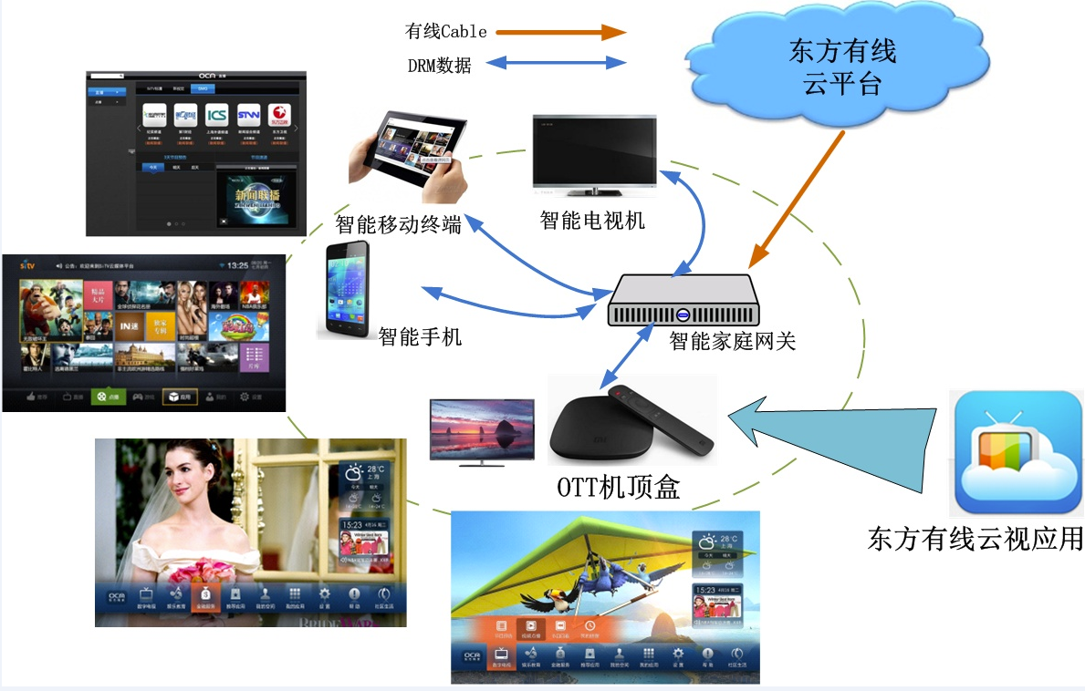
Multiscreen Service Development
--Typical application(2) OTT+DVB+APP

Slide 17
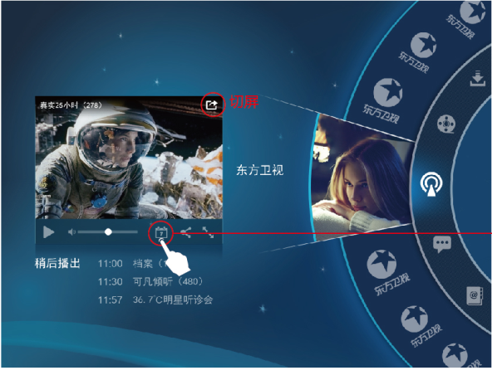
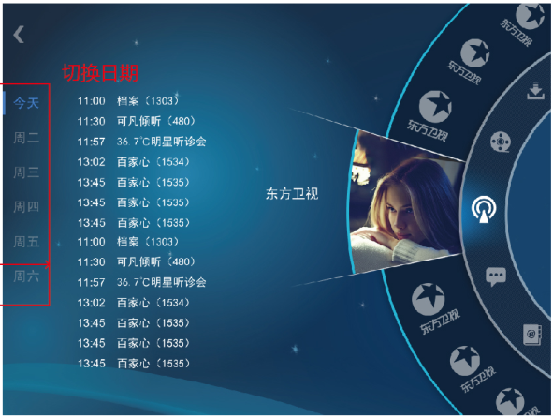
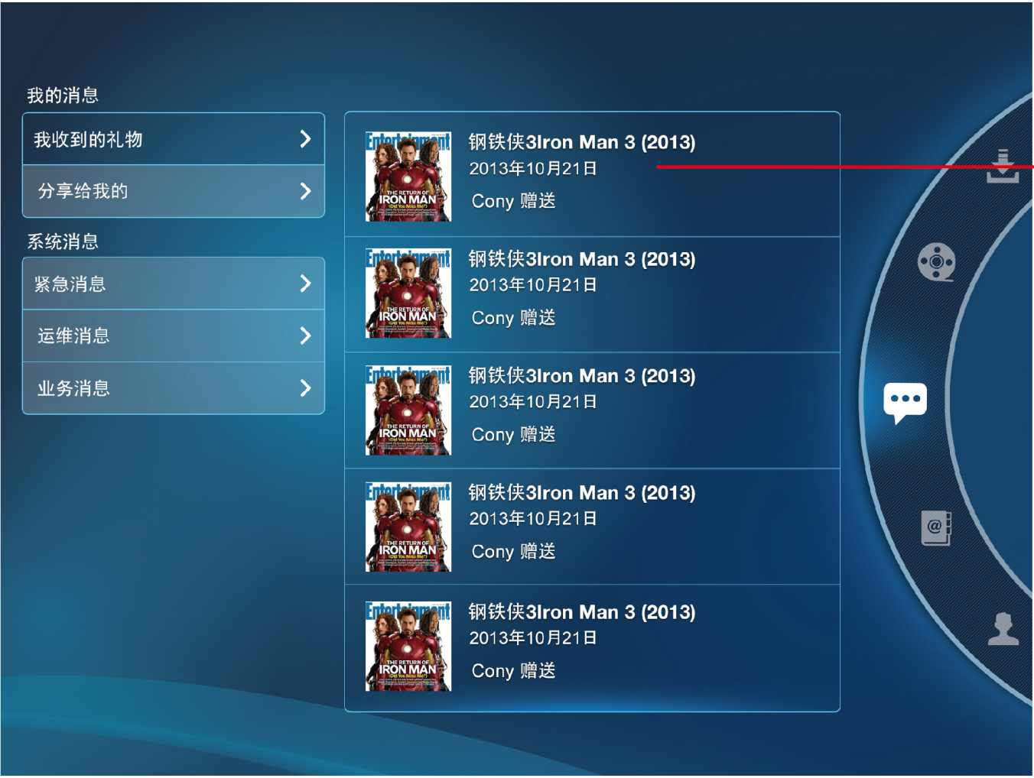
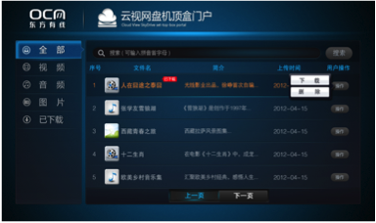
Multiscreen Service Development
TV video messaging , content sharing and networking app.

Slide 18

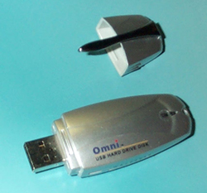
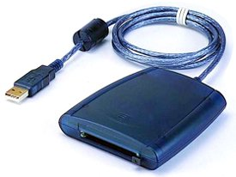

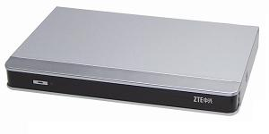

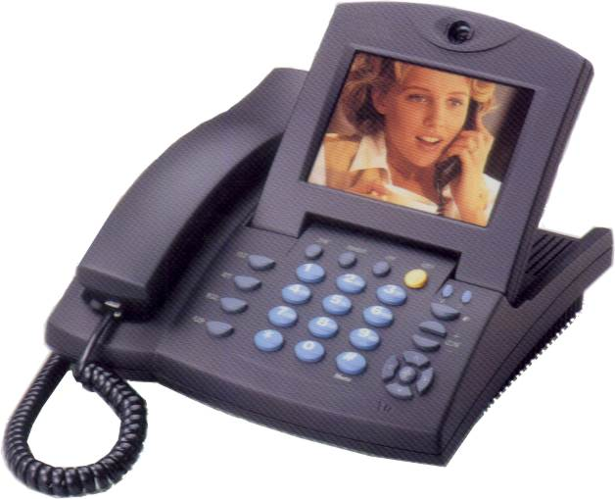





Multiscreen Service Development
—Smart Home gateway
数据、语音、视频和未来各种服务
NMS
打印机
TV
机顶盒
USB
Softswitch
LAN
Stereos
NGB
Ethernet
EOC
Cable
家庭网关
CARDBUS
FXS
IPTV
WLAN
FXS
BT
Video Phone
GSM/CDMA
FXA
PC
Ethernet
POTS Phone
or VoIP
Bluetooth
ZigBee
（M2M）
Bluetooth Enabled
GSM Phone

Slide 19

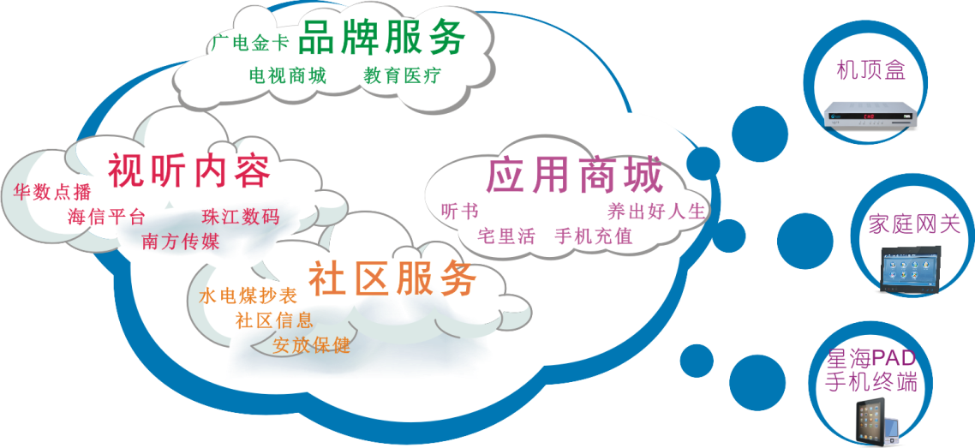

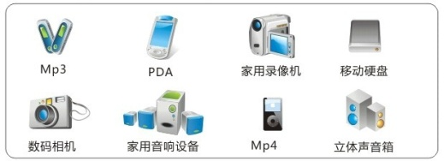

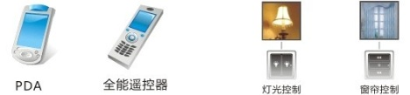


Multiscreen Service Development
NGB cable network+4G wireless network
家庭安防
智能网关
视听娱乐
家庭网络
智慧生活
多屏应用
丰富多彩的内容及服务

Slide 20
Suggestions
Multiple screen services can be implemented by different solution and specifications. Which one is suitable for OCN?
Use XMPP protocol to build message infrastructure, so all interactive commands can be easily translated and connect with local operators’ system to share the contents and information.
Use HTML5 as a middleware specification to be communicated among different types of devices, and try to add some specific definition for better video experience.
Metadata specification for video is fragmentally . Currently cable operators follow CableLbs’ ADI metadata standard system, but Internet video service providers use their own metadata format.
OCN has followed our enterprise technical specifications for XMPP/HTML5/METADATA to develop and deploy multiple screen services.

Slide 21
Thank You!
A BETTER TOMORROW.

