Slide 1

Fraunhofer Institute FOKUS
Future Applications and Media

Slide 2
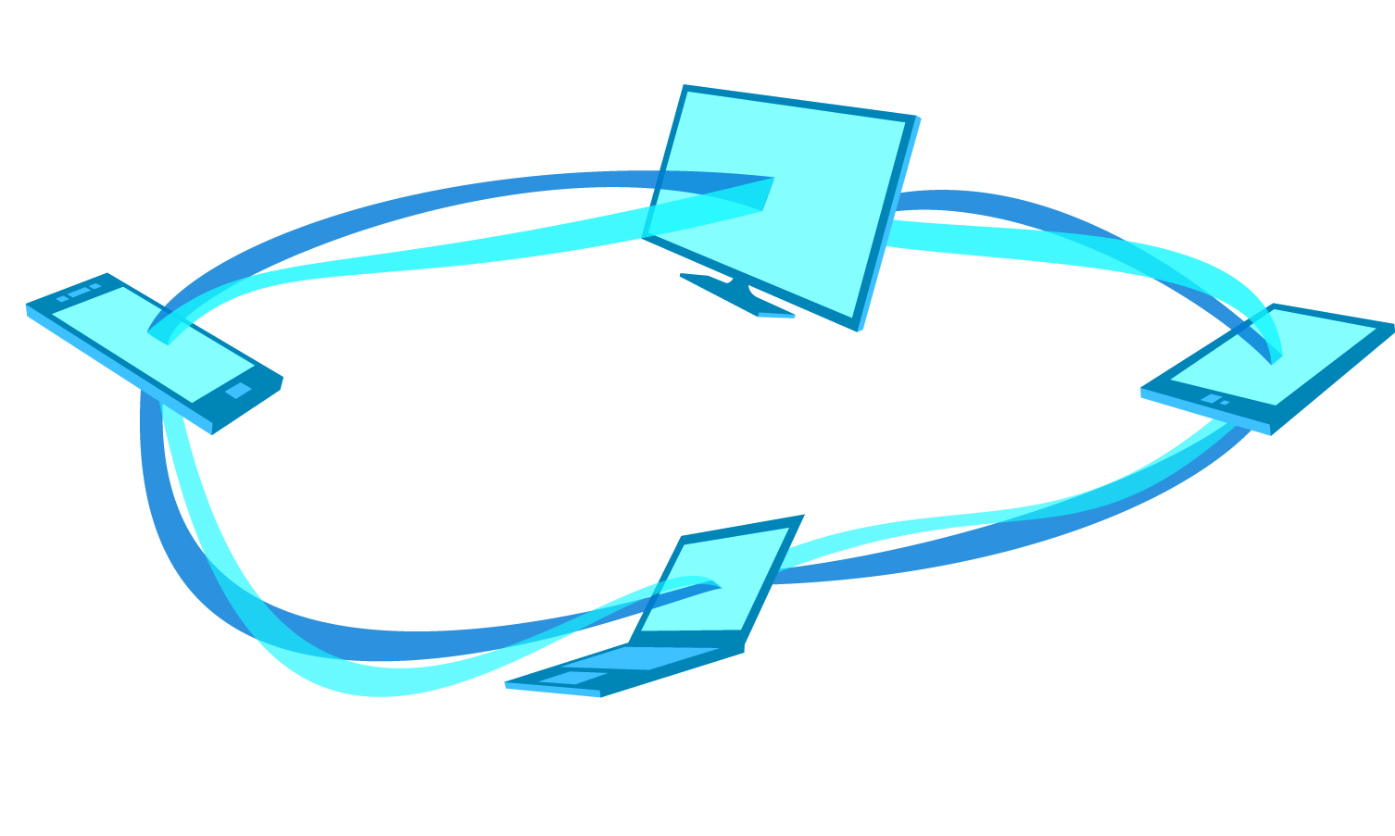

Challenges for enabling targeted multi-screen advertisement for interactive TV services
Louay Bassbouss, louay.bassbouss@fokus.fraunhofer.de,
Dr. Stephan Steglich, stephan.steglich@fokus.fraunhofer.de
The Fourth W3C Web and TV Workshop, 12–13 March 2014, Munich, Germany

Slide 3
Outline
Use Case: Multi-Screen Advertisement in Multi-View Scenarios
Opportunities and Challenges for Developing interactive TV services
Multi-Screen for the Web
DASH and DRM

Slide 4
Use Case
Multi-Screen Advertisement in Multi-View Scenarios

Slide 5
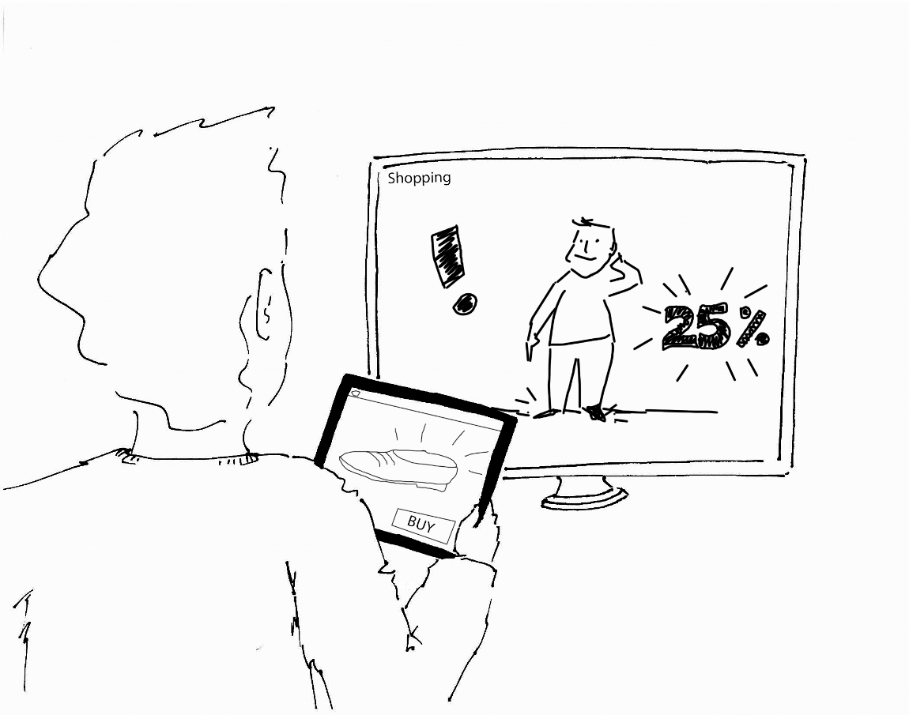
Use Case
Multi-Screen Advertisement in Multi-View Scenarios
Main camera perspective on TV (e.g. Formula 1 race camera)
Other camera perspectives on companion devices (e.g. Formula 1 cockpit camera perspective)
Interaction: user can select his favorite driver or team and request to display additional information on TV or CS
During commercial breaks, the companion device displays interactive companion App related to the Ad on the TV
http://www.w3.org/2011/webtv/wiki/Media_APIs/Use_Cases#12._.22Use_Case_Twelve_.E2.80.93_Multiscreen_Advertisement.22

Slide 6
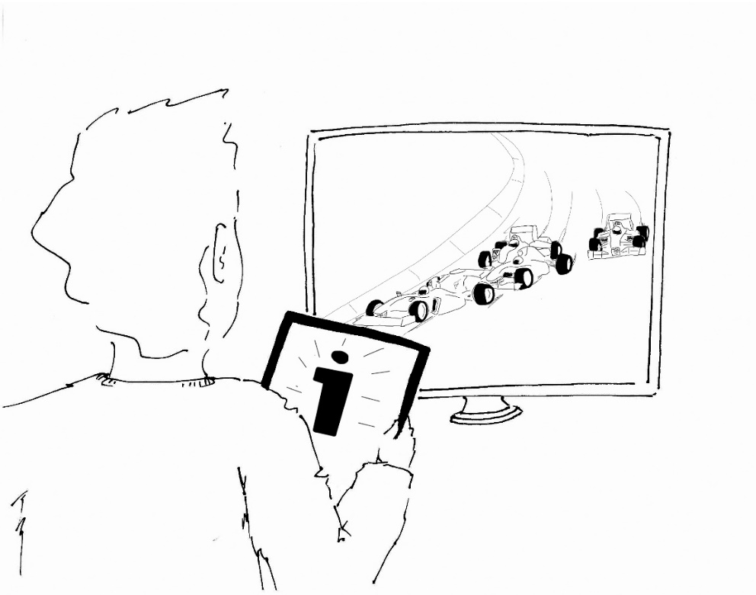
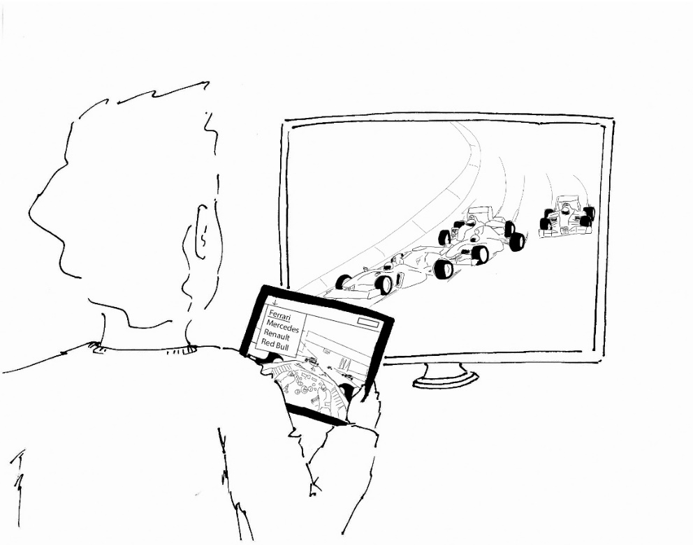

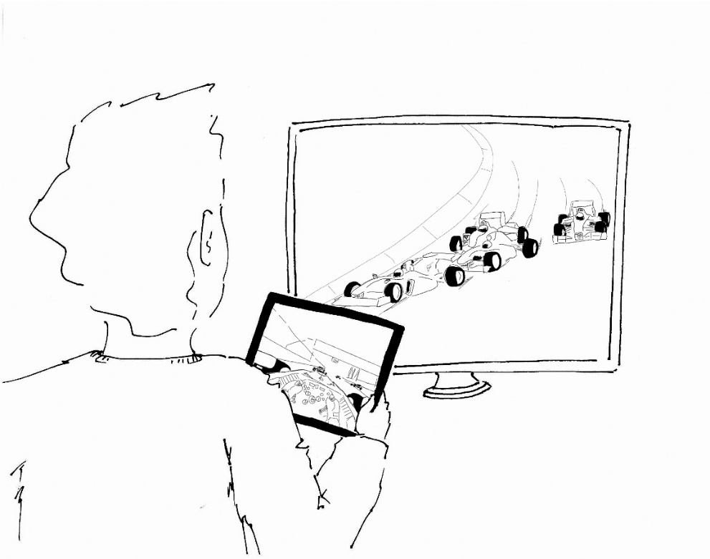
1
2
3
4

Slide 7


Slide 8
Opportunities and Challenges for Developing interactive TV services

Slide 9
Opportunities and Challenges for Developing interactive TV services
Our experiences in designing and developing TV services result in 10 suggestions for general TV development and a differentiation of general in-app logic and technology dependent code
Some web elements would benefit even more from a common standard dictating just one way of implementation especially audio/video elements
The implementation of audio/video elements differs when using standardized web technologies on different platforms (e.g. HTML-Object-Tag vs. HTML5-Video-Object vs. proprietary solutions)
Using only one object for all platforms offering access to all needed functions, parameters as well as sync and stream events, via standardized APIs would leverage the current TV application development a lot.
These APIs must make it possible to handle broadcast, broadband and local audio/video content.

Slide 10
Multi-Screen for the Web

Slide 11



Multi-Screen for the Web
Main Multi-Screen requirements identified from the Use Case
Notification and App Launch: There SHALL be a mechanism that allows a TV service to send a push notification to a companion device (or many companion devices) containing all information necessary to launch a specific application
App2App communication: There SHALL be a mechanism that allows the TV service and companion applications to exchange content in both directions.
Notification
Launch
Communication

Slide 12
Relevant Standards and gaps
Notification and App Launch
Existing W3C APIs that address Notifications:
  The W3C Web Notifications specification provides an API to display notifications to alert users outside the context of a web page [http://www.w3.org/TR/notifications].
  The Web Notifications API is relevant for local but not for remote notifications: notifications are displayed on the same device where the UA is running
Ideas for new API that addresses Notification and App Launch at same time:
  The TV application get notified when a companion device is connected or disconnected.
    Abstracts from discovery and pairing mechanisms used behind
  When the TV application receives a device connection event, it should be able to send a launch request to the connected companion device
  The companion device displays a notification similar to Web Notifications
  If the user clicks on the notification, the requested application will be launched and a connection between TV and companion device will be established

Slide 13
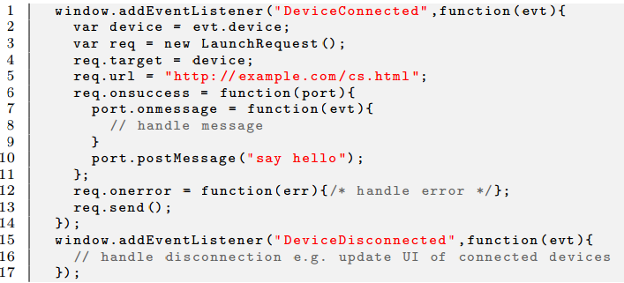
Possible technical specification
Notification and App Launch
TV Application part

Slide 14
Relevant Standards
App2App communication
There are many W3C standards relevant for the communication between web pages running in the same UA (Web Messaging API), between web pages running on different devices (WebRTC) or between web pages running in a user agent and remote server (XMLHTTPRequest, WebSockets)
  The Web Messaging specifies a simple API and can be adopted as a simple messaging mechanism between the TV and companion Apps, because it abstracts from the communication protocol used behind.
Upgrade to other mechanisms if needed as following:
  WebRTC: Use the Web Messaging channel to exchange connection meta data such as RTC offer, RTC answer, etc.
  WebSockets (or XMLHTTPRequest): Use the Web Messaging channel to exchange e.g. a session ID. Both apps (TV and companion Apps) join the same session on the server using WebSockets or XMLHTTPRequest

Slide 15
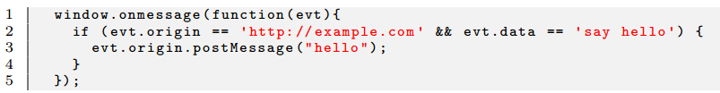
Possible technical specification
App2App communication
TV Application part
Companion Application part

Slide 16
DASH and DRM

Slide 17
Dash.js
„A reference client implementation for the playback of MPEG DASH via Javascript and compliant browsers“
https://github.com/Dash-Industry-Forum/dash.js
Uses W3C MSE & EME
Only supported in Chrome and IE11
Some of the features that can be easily integrated into dash.js:
  ad-insertion
  multi-screen media synchronization
  improved adaptive switching algorithms
  MPEG DASH live playback from broadcast sources
  interoperable content protection

Slide 18

FAMIUM DASH/DRM
Feature Architecture
Live Transcoder
VoD Transcoder
FAMIUM Server
FOKUS
Ad Server
FOKUS
Content Server
Azure
Akamai
FOKUS
License Server
PlayReady
FOKUS
sync
ad insertion
live
DRM
dash.js

Slide 19
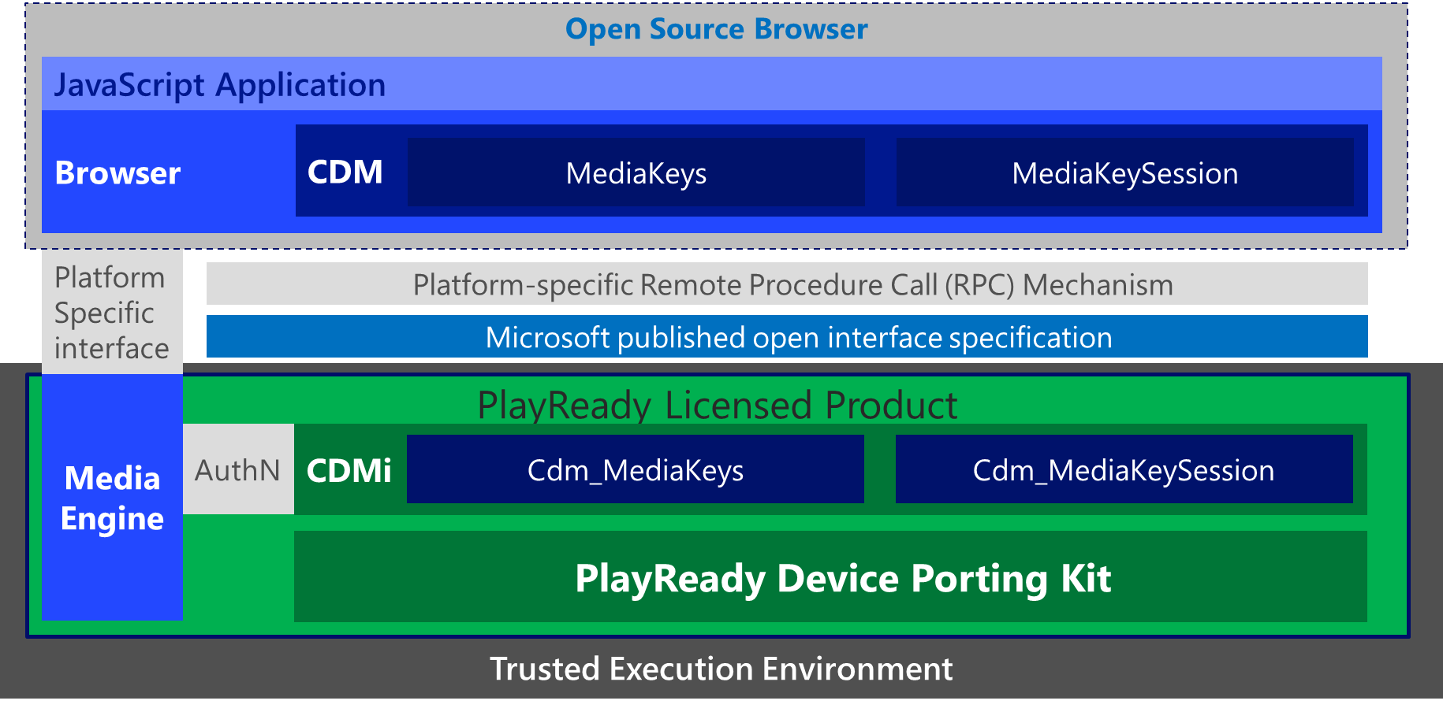
Microsoft CDMi
Microsoft has developed a generalized interface enabling open source browsers to support Encrypted Media Extensions – the Content Decryption Module interface (CDMi).
The CDMi is an open interface for accessing a platform DRM Content Decryption Module (CDM) which may be used by a User-agent to expose CDM functionality as specified by the W3C HTML Encrypted Media Extensions.

Slide 20
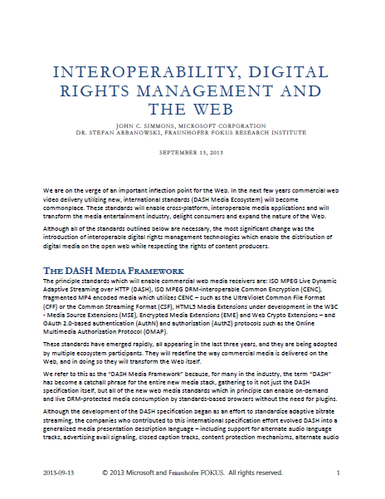
White Paper describes use of:
Common Encryption (CENC)
Encrypted Media Extensions
Content Decryption Module interface
to solve DRM interoperability in a browser.
www.Microsoft.com/playready

Slide 21
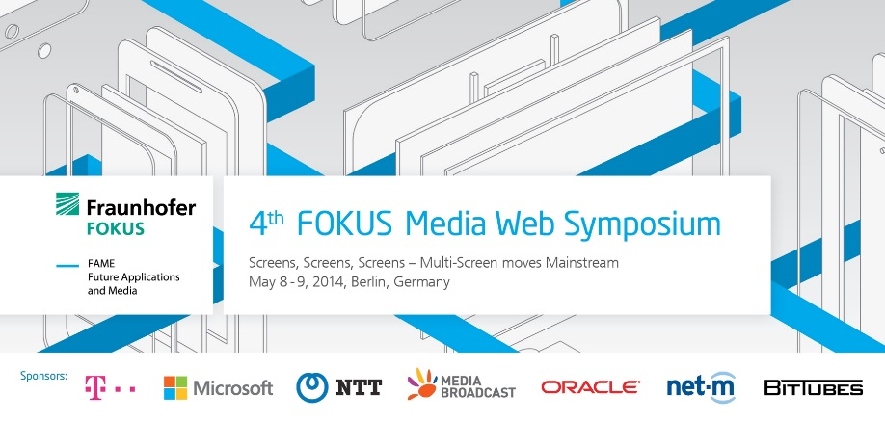
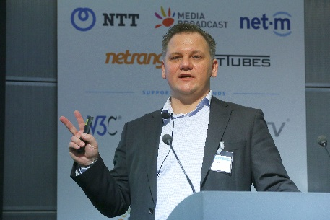
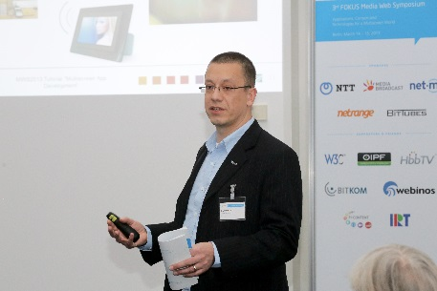
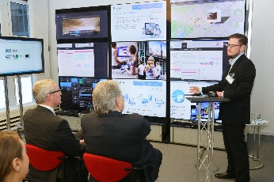
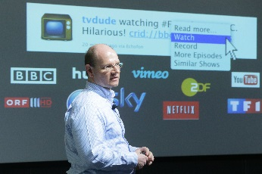

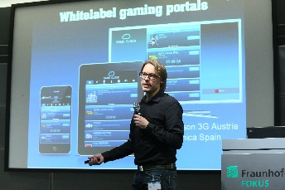
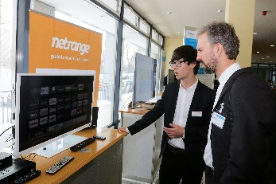
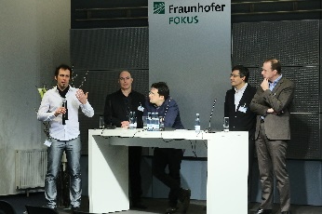
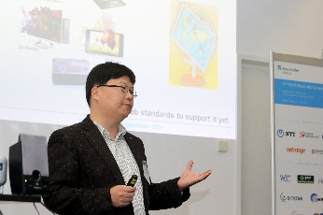
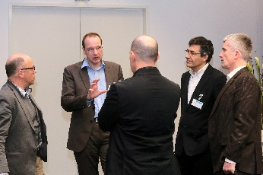
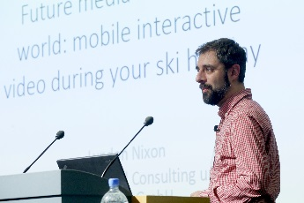
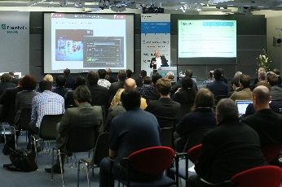

Media Web Symposium – May 8-9, 2014
www.fokus.fraunhofer.de/go/mws

Slide 22
