Slide 1
MURATA Makoto
Co-chair of the IDPF Advanced/Hybrid Layouts WG
I18N sub-group lead of the IDPF EPUB WG
Traitor of the XML Schema WG and a co-inventor of RELAX NG
Then member of the W3C XML WG

Slide 2
Web and Electronic books/magazines: similarities and differences

Slide 3
WWW
academic papers
Absolutely everything

Slide 4
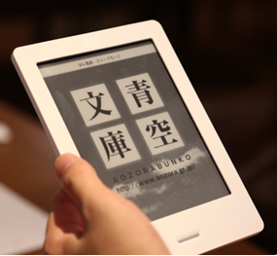
Ebook
Notes:
But electronic books (including EPUB) are based on web technologies.

Slide 5
Synergy
Ebooks (including EPUB) are based on web technologies
Self publishing: blog first, ebook second

Slide 6
Differences (1): Packaging
IDPF
EPUB publications are distributable packages of web contents.
IETF and W3C
MHTML (mainly for e-mail)
W3C widget packaging (mainly for widgets)

Slide 7
Differences (2): Key players
W3C
Browser vendors
IT guys
IDPF
Google, Apple
B&N, Kobo, Sony, ...
Traditional publishers

Slide 8
Differences (3): Priorities
IDPF
Longevity
Traditional typography
Vertical writing
Ruby
Javascript in EPUB is not recommended.
W3C
Web-based application programs

Slide 9
Going forward
Awareness
Information exchange
AHL and SVG
AHL and media fragments
EPUB and CSS

Slide 10
Advanced Hybrid Layouts WG

Slide 11
Rendition selection
ZIP
Reflowable rendition
Fixed layout rendition for a tablet
Fixed layout rendition for a mobile phone

Slide 12
Automatically or interactively choose one rendition (package document) from multiple renditions in a ZIP file
Japanese rendition and English rendition
High resolution rendition and Low resolution rendition
Imaged-based rendition and reflowable rendition
“Content negotiation” within a package

Slide 13
Rendition mapping
ZIP
Reflowable rendition
Fixed-layout rendition
Regions

Slide 14
Multi-directional mapping among multiple renditions within a ZIP file
Multi-directional links not embedded in HTML or SVG
Based on regions in images

Slide 15
Intra-rendition navigation
Fixed-layout rendition

Slide 16
Panel-based navigation for comics on mobile phones
Different navigation for different screen sizes
“Table of contents” in image-based magazines

Slide 17
Representing regions
Two possibilities
Media fragments of W3C
SVG elements or views
Issues
Non-rectangular?
Neither views nor renderable elements, but rather hints for reading systems?

Slide 18
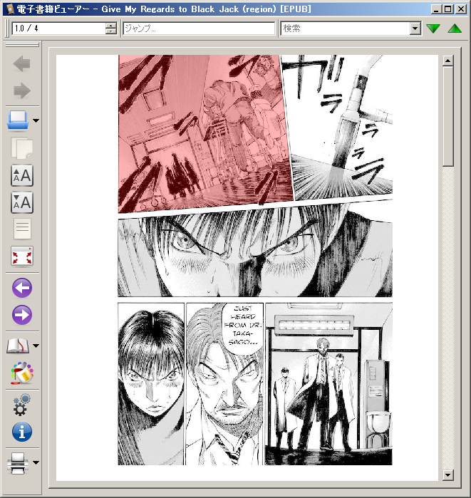

Slide 19
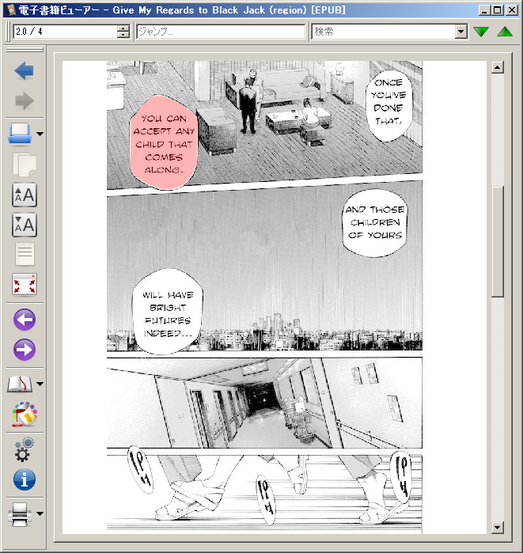

Slide 20
Report of the AHL session of the SVG WG meeting
Liaison statement from AHL to SVG
AHL Participation in the F2F of the SVG WG yesterday
Very productive and friendly atmosphere
SVG WG even mentioned the idea of finishing non-rectangular views in a timely manner
Liaison statement back from SVG is being written.

