Slide 1
eBooks Workshop Discussion Topics
Metadata, Language and Characters.
NTT Network Innovation Laboratory
KAWABATA, Taichi

Slide 2
Topics
Ruby and Ateji in Metadata
Unencoded Characters in Metadata
Multiple Language/Script Specification in ePUB Contents

Slide 3
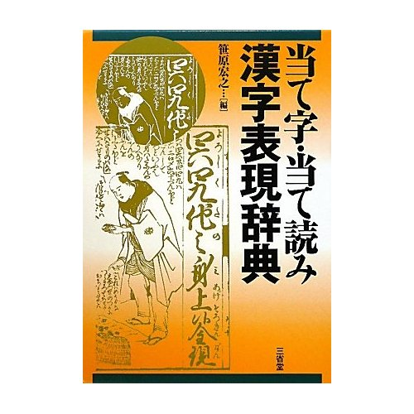
Ruby and Ateji in Metadata
Ateji （宛字） … In modern Japanese, ateji (当て字, 宛字 or あてじ, literally "assigned characters") primarily refers to kanji used phonetically to represent native or borrowed words, without regard to the meaning of the underlying characters.
Ruby （宛字） … Ruby characters (ルビ?) are small, annotative glosses that can be placed above or to the right of a Chinese character when writing languages with logographic characters such as Chinese or Japanese to show the pronunciation. (excerpts from http://en.wikipedia.org)
“当て字・当て読み 漢字表現辞典” is a comprehensive dictionary of Ateji appeared in Japanese Literature.

Slide 4




Ruby and Ateji in Metadata
Background
  Recently, books with Ateji titles has become popular, especially among Japanese “light novels”.

Slide 5
Ruby and Ateji in Metadata
“Metadata” of ePUB3
  Metadata encapsulates Publication meta information of ePUB3 books.
  It provides title, author, publisher, publication date, etc. data of the books.
  They are used for searching and indexing, etc. of ePUB data.
Problems
  Current ePUB3 Metadata does not provide “Ruby” functionality.

Slide 6
Ruby and Ateji in Metadata
Ruby/Ateji Solution for metadata really necessary?
  Currently, many websites or eBook shops just ignore Ateji or, use 《・・・》 / 〈・・・〉 brackets for Ruby/Ateji.
  e.g. 「とある科学の超電磁砲《レールガン》」
If Ruby/Ateji is necessary, what should be considered?
  Compatibility
  No ambiguities
Any Solutions?
  Use INTERLINER ANNOTATION CHARACTERS
  Ⓐ超電磁砲ⓈレールガンⓉ
  New metadata properties?
  Any smart solutions?
Ⓐ | U+FFF9 | INTERLINEAR ANNOTATION ANCHOR
Ⓢ | U+FFFA | INTERLINEAR ANNOTATION SEPARATOR
Ⓣ | U+FFFB | INTERLINEAR ANNOTATION TERMINATOR

Slide 7
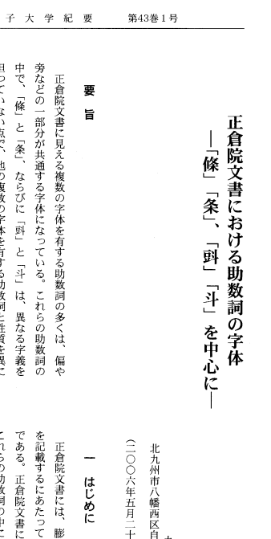
Unencoded Characters in Metadata
Background
  Unencoded or non-JIS characters sometimes appear on titles of books or papers.
Problem
  ePUB3 metadata does not provide the way to display unencoded/non-standard characters.
  For example, CiNii (Japan’s Paper Repository Service) uses wildcard character “〓” (GETA Character) for unencoded characters.
  「東洋学文献類目検索」has a large number of papers with unencoded characters.
  Encoded in UCS does not guarantee that it can be displayed by the Readers.

Slide 8
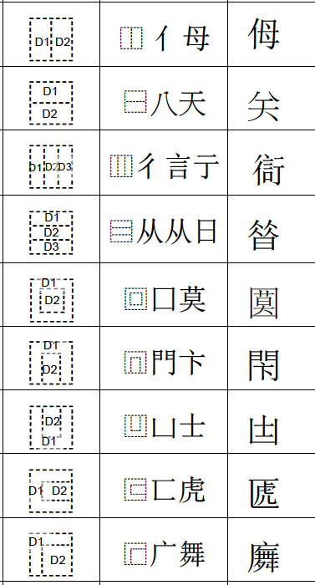

Unencoded Characters in Metadata
Solutions needed?
  Just use “〓” is enough for metadata is enough?
Possible Solutions?
  Provides a way to specify Font for displaying Metadata.
  (Possible for bookshelf tools?)
  IDS (Ideographic Description Characters) for unencoded ideographs.
  IVS (Ideographic Variation Sequence) for database-registered Variants
⿰豆斗

Slide 9
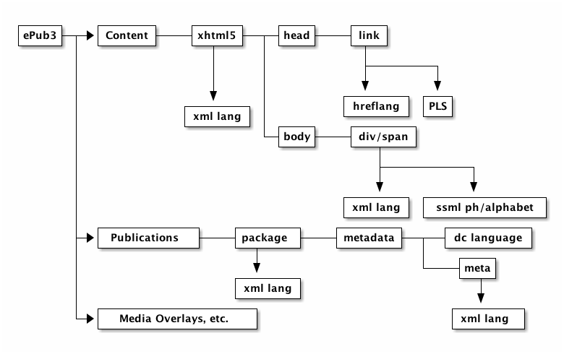
Multi-Language Specifications
ePUB spec. has several methods for Language specifications.
  XHTML xml:lang attributes && SSML ssml:ph, ssml:alphabet attributes.
However, there may be multiple layer of language specification.

Slide 10
Multi-Language Specifications
What can be used for script/language specification?
  Font Selection
  “Hello”, 「今日は」 and 「你好」
  Text Layout Rules
  JLREQ, etc.
  Pronunciation
  I saw a movie called “la vie en rose.”
xml:lang specification
Amgibuities?
Conflict and
Amgibuities?
xml:lang and/or
ssml:ph specification

