Slide 1




Use Case and Requirement for Future Work
2013. 11. 15.
Sangrae Cho
Authentication Research Team

Slide 2


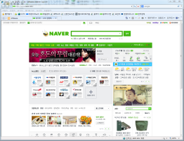


Korean banking use case
2. Issue certificate
Web Browser
caserver.com
Public key pair is
generated in the browser.
4. Verify
certificate
3. use certificate (digital signature)
bank.com

Slide 3
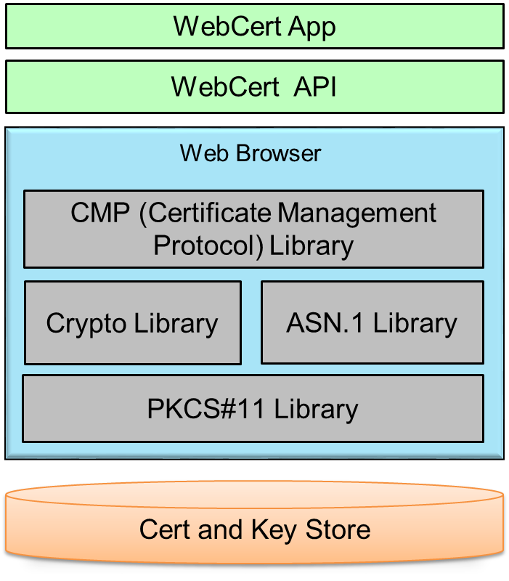
Prototype Architecture
Client Side
Server Side
WebCert
Gateway
CA Server
Issuing/Updating/Revoking

Slide 4
CMP in Browser
WebCert App
HTML/JavaScript
WebCert API
Firefox Web Browser
CMP (Certificate Management Protocol) Library
ETRI Imp.
Crypto Library
ASN.1 Library
Open Source
PKCS#11 Library
NSS Library
Cert and Key Store
Firefox Cert/Key DB

Slide 5
CMP operation flow in Browser
Certificate issuing request
CMP operation flow
in the case of certificate issuing
CMP message handling
Crypto operation
Key generation and Encryption
CMP ASN.1 encoding
HTTP request
HTTP response
Certificate issuing response
CMP ASN.1 decoding
Crypto operation
Digital Signature Verification
CMP message handling
Storage operation
Store private key and cert to DB

Slide 6
Requirement for future work
Private key
  Private key should be wrapped and unwrapped using a password
  Private key should be wrapped when not in use
  Password policy is required for strong password
Digital signature and encryption API
  API that support PKCS#7 or JOSE for digital signature and encryption
    CertStorage API
  API that can access a key and certificate DB in a browser
  Without this API, a certificate can not be used
    External secure device support
  Strong requirement that a private key should be stored in secure element such as Smart Card or USIM in Korea
  Need to support for PKCS11 compatible devices
    UI for certificate management & usage
  Guideline to suggest UI for better user experience in cert management & usage

Slide 7
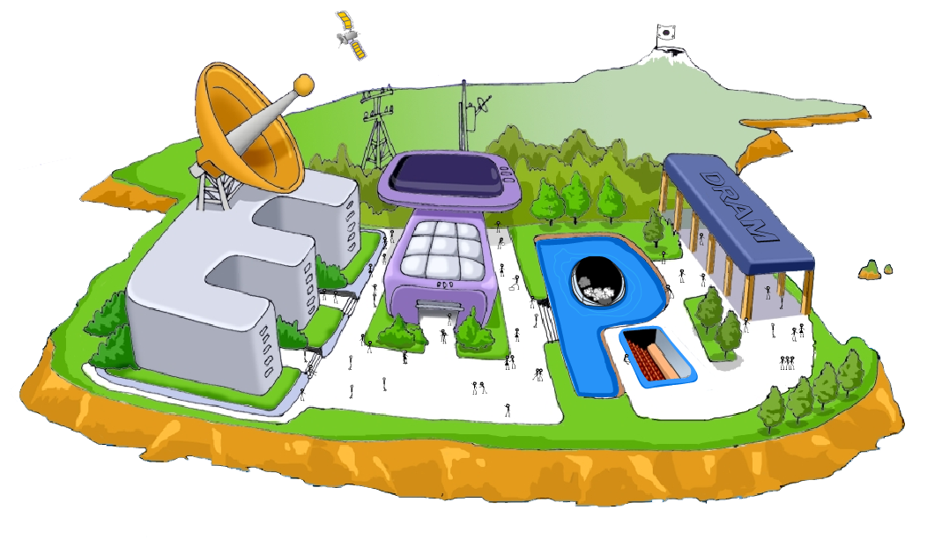
Thank You

