Slide 1
A short introduction to Semantic Web technologies
Ivan Herman, W3C
June 6th, 2012
Presentation by Oracle

Slide 2
What are we talking about when referring to the Semantic Web?

Slide 3
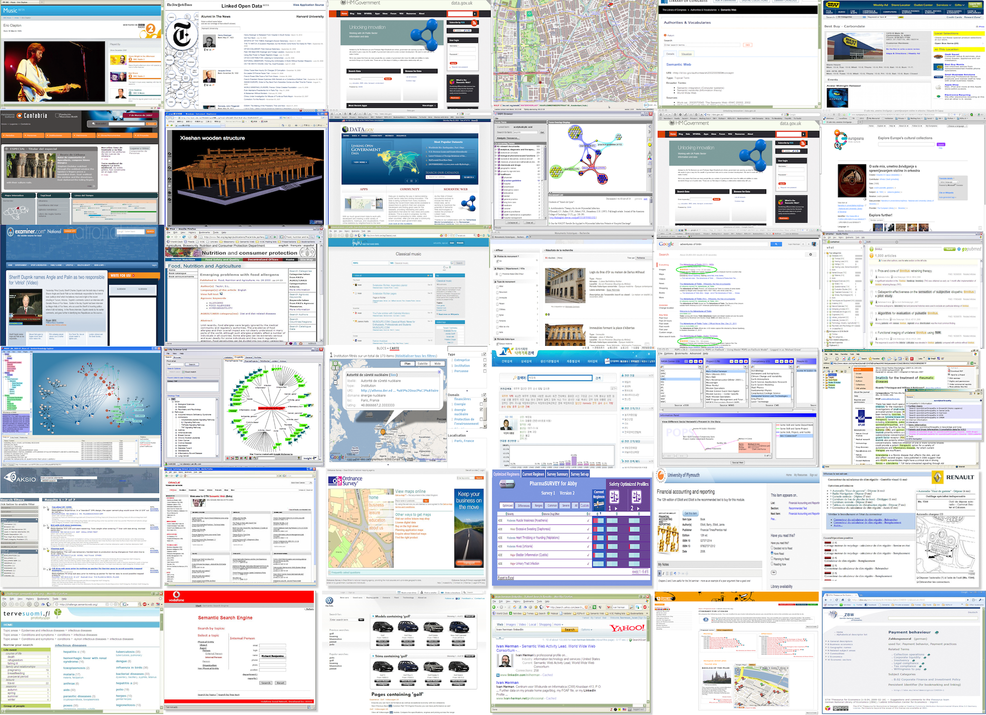

Slide 4
For some people, Semantic (Web) is…
A system manipulating and analyzing knowledge
e.g., via big ontologies, vocabularies
Google’s Knowledge Graph?
Improve search by adding structure to embedded data
A means to integrate many different pieces of data
Integrate data-oriented applications
And a mixture of all these…
Notes:
For the second bullet: in some cases graph based databases simply work better

Slide 5
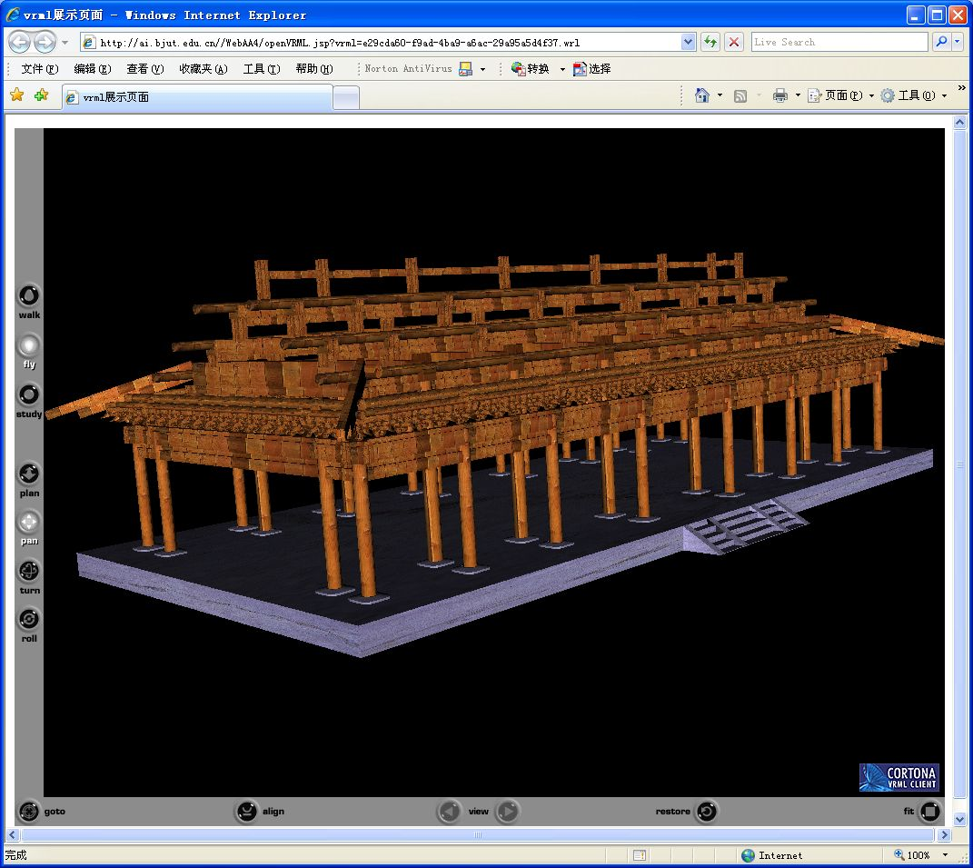
Xieshan wooden structure
Courtesy of Songmao Zhang, Academy of Mathematics and System Sciences, China
Notes:
All the knowledge about the wooden structures is encoded in OWL plus also SWRL rules, which then drives an external program to generate animation

Slide 6
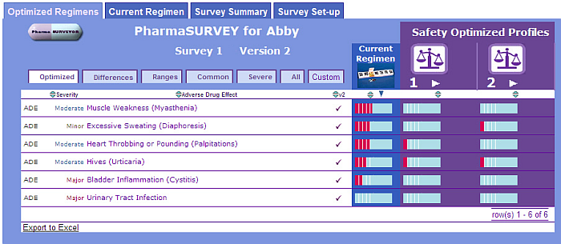
Courtesy of Erick Von Schweber, PharmaSURVEYOR Inc., (SWEO Use Case)
Notes:
Tool to find the best drug usage adapted to an individual patient. The navigator tool combines various databases, ontologies to provide a better tool.
The flexibility of the interface is important: the structure of the underlying data (e.g., databases, regulation) change often, but by localizing the change on the database-to-RDF mapping, the rest of the system is protected against change; one of the main reasons why this approach was chosen

Slide 7
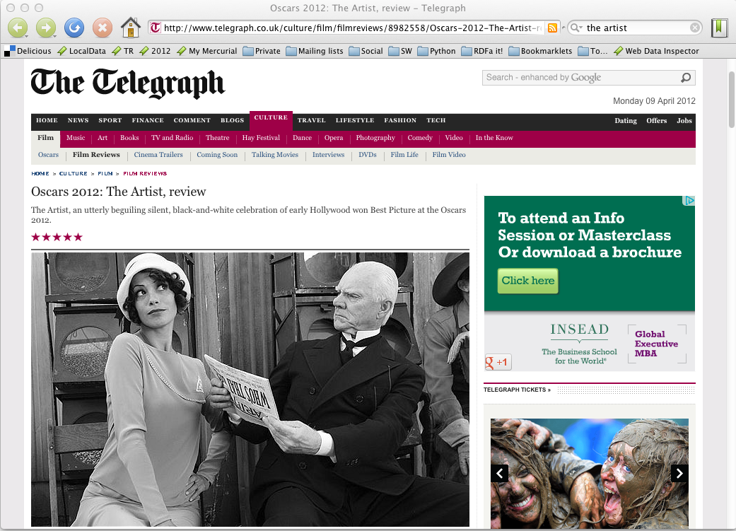

Slide 8
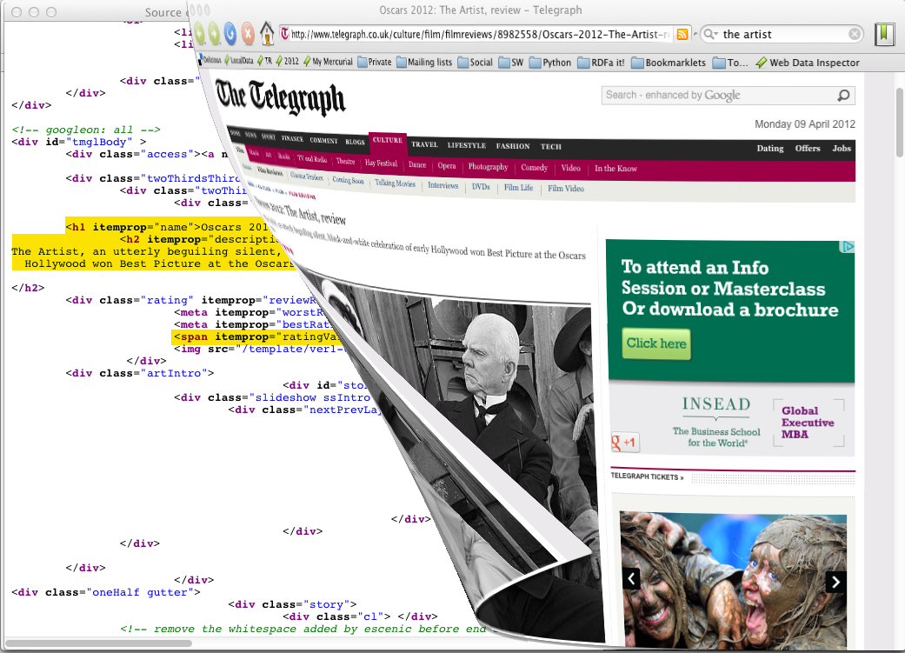

Slide 9
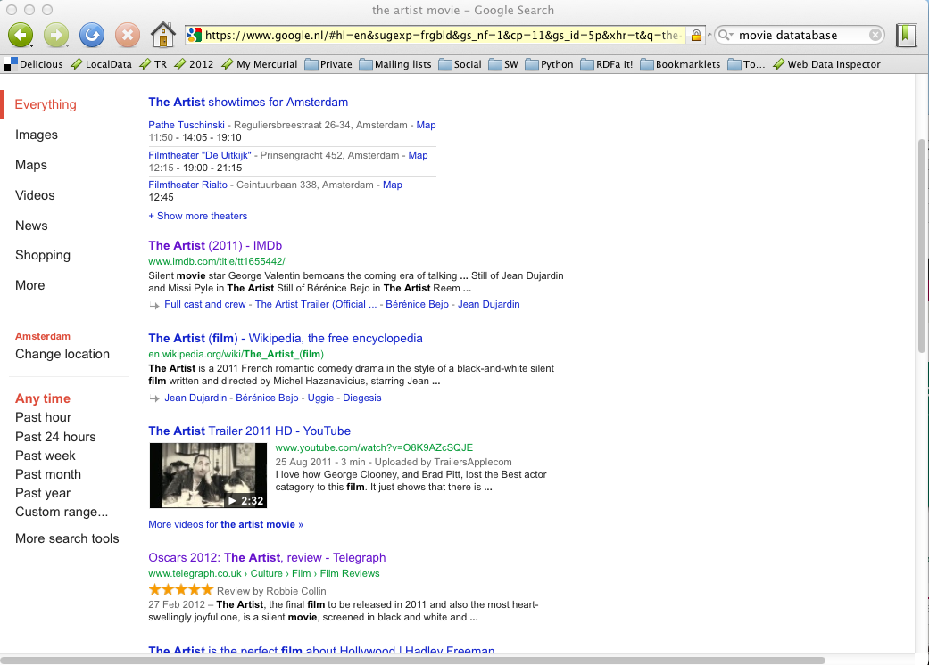

Slide 10
A major trend: Data on the Web
There are more an more data on the Web
government data, health related data, general knowledge, company information, flight information, restaurants,…
More and more applications rely on the availability of that data

Slide 11
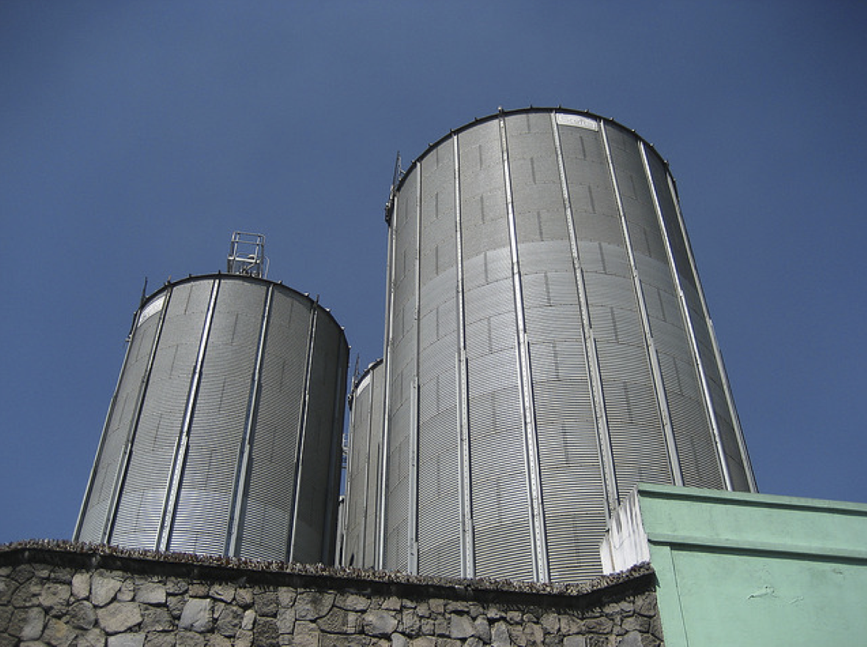
But: we do not want that!
Photo credit “nepatterson”, Flickr

Slide 12
Imagine…
A “Web” where
documents are available for download on the Internet
but there would be no hyperlinks among them

Slide 13
Data on the Web is not enough…
We need a proper infrastructure for a real Web of Data
data is available on the Web
accessible via standard Web technologies
data are interlinked over the Web
ie, data can be integrated over the Web
This is where Semantic Web technologies come in

Slide 14
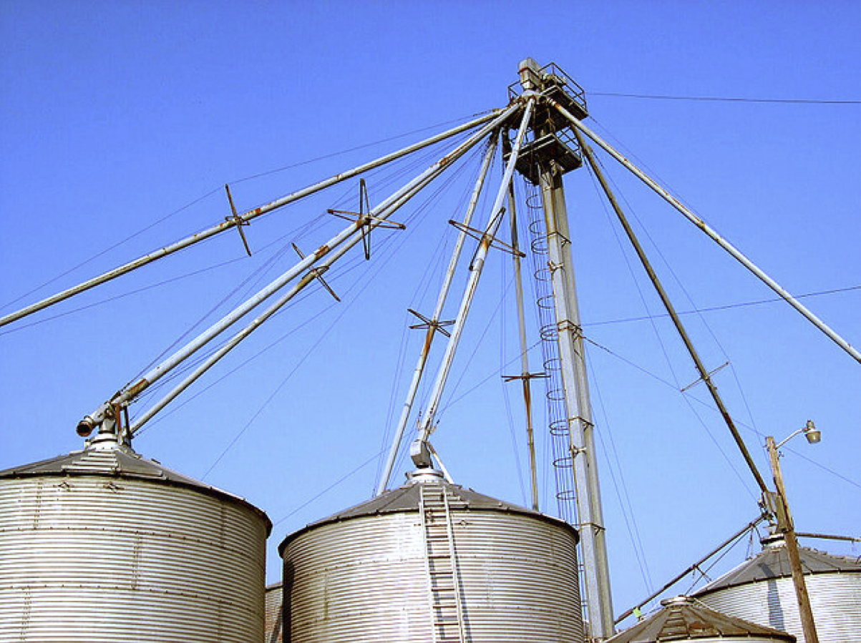
This is what we want!
Photo credit “kxlly”, Flickr

Slide 15
In what follows…
We will use a simplistic example to introduce the main Semantic Web concepts for the data integration case

Slide 16
The rough structure of data integration
Map the various data onto an abstract data representation
make the data independent of its internal representation…
Merge the resulting representations
Start making queries on the whole!
queries not possible on the individual data sets

Slide 17


Slide 18
A simplified bookstore data (dataset “A”)
ISBN | Author | Title | Publisher | Year
0006511409X | id_xyz | The Glass Palace | id_qpr | 2000
ID | Name | Homepage
id_xyz | Ghosh, Amitav | http://www.amitavghosh.com
ID | Publisher’s name | City
id_qpr | Harper Collins | London

Slide 19
1st: export your data as a set of relations
a:title
The Glass Palace
http://…isbn/000651409X
2000
a:year
a:publisher
London
a:city
a:author
Harper Collins
a:p_name
a:name
a:homepage
Ghosh, Amitav
http://www.amitavghosh.com

Slide 20
Some notes on the exporting the data
Relations form a graph
the nodes refer to the “real” data or contain some literal
how the graph is represented in machine is immaterial for now

Slide 21


Slide 22
Another bookstore data (dataset “F”)
 | A | B | C | D
1 | ID | Titre | Traducteur | Original
2 | ISBN 2020286682 | Le Palais des Miroirs | $A12$ | ISBN 0-00-6511409-X
3
4
5
6 | ID | Auteur
7 | ISBN 0-00-6511409-X | $A11$
8
9
10 | Nom
11 | Ghosh, Amitav
12 | Besse, Christianne

Slide 23
2nd: export your second set of data
http://…isbn/000651409X
Le palais des miroirs
f:original
f:titre
f:auteur
http://…isbn/2020386682
f:traducteur
f:nom
f:nom
Ghosh, Amitav
Besse, Christianne

Slide 24
3rd: start merging your data
The Glass Palace
a:title
http://…isbn/000651409X
2000
a:year
a:city
a:publisher
London
Harper Collins
a:p_name
a:author
a:name
http://…isbn/000651409X
a:homepage
f:original
Le palais des miroirs
Ghosh, Amitav
http://www.amitavghosh.com
f:titre
f:auteur
http://…isbn/2020386682
f:traducteur
f:nom
Ghosh, Amitav
f:nom
Besse, Christianne

Slide 25
3rd: start merging your data (cont)
The Glass Palace
a:title
http://…isbn/000651409X
2000
a:year
a:publisher
Same URI!
London
a:city
Harper Collins
a:p_name
a:author
a:name
http://…isbn/000651409X
a:homepage
f:original
Le palais des miroirs
Ghosh, Amitav
http://www.amitavghosh.com
f:titre
f:auteur
http://…isbn/2020386682
f:traducteur
f:nom
Ghosh, Amitav
f:nom
Besse, Christianne

Slide 26
3rd: start merging your data
The Glass Palace
a:title
http://…isbn/000651409X
2000
a:year
a:city
a:publisher
London
Harper Collins
a:p_name
a:author
f:original
a:name
f:auteur
a:homepage
Le palais des miroirs
Ghosh, Amitav
http://www.amitavghosh.com
f:titre
http://…isbn/2020386682
f:traducteur
f:nom
Ghosh, Amitav
f:nom
Besse, Christianne

Slide 27
Start making queries…
User of data “F” can now ask queries like:
“give me the title of the original”
well, … « donnes-moi le titre de l’original »
This information is not in the dataset “F”…
…but can be retrieved by merging with dataset “A”!

Slide 28
However, more can be achieved…
We “feel” that a:author and f:auteur should be the same
But an automatic merge doest not know that!
Let us add some extra information to the merged data:
a:author same as f:auteur
both identify a “Person”
a term that a community may have already defined:
a “Person” is uniquely identified by his/her name and, say, homepage
it can be used as a “category” for certain type of resources

Slide 29
3rd revisited: use the extra knowledge
The Glass Palace
a:title
http://…isbn/000651409X
2000
a:year
f:original
Le palais des miroirs
a:publisher
f:titre
London
a:city
Harper Collins
a:p_name
a:author
http://…isbn/2020386682
f:auteur
r:type
f:traducteur
a:name
http://…foaf/Person
r:type
f:nom
a:homepage
f:nom
Besse, Christianne
Ghosh, Amitav
http://www.amitavghosh.com

Slide 30
Start making richer queries!
User of dataset “F” can now query:
“donnes-moi la page d’accueil de l’auteur de l’original”
well… “give me the home page of the original’s ‘auteur’”
The information is not in datasets “F” or “A”…
…but was made available by:
merging datasets “A” and datasets “F”
adding three simple extra statements as an extra “glue”

Slide 31
Combine with different datasets
Using, e.g., the “Person”, the dataset can be combined with other sources
For example, data in Wikipedia can be extracted using dedicated tools
e.g., the “dbpedia” project can extract the “infobox” information from Wikipedia already…

Slide 32
Merge with Wikipedia data
The Glass Palace
a:title
http://…isbn/000651409X
2000
a:year
f:original
Le palais des miroirs
a:publisher
f:titre
London
a:city
Harper Collins
a:p_name
a:author
http://…isbn/2020386682
f:auteur
r:type
f:traducteur
a:name
http://…foaf/Person
r:type
f:nom
a:homepage
r:type
f:nom
Besse, Christianne
Ghosh, Amitav
http://www.amitavghosh.com
foaf:name
w:reference
http://dbpedia.org/../Amitav_Ghosh

Slide 33
Merge with Wikipedia data
The Glass Palace
a:title
http://…isbn/000651409X
2000
a:year
f:original
Le palais des miroirs
a:publisher
f:titre
London
a:city
Harper Collins
a:p_name
a:author
http://…isbn/2020386682
f:auteur
r:type
f:traducteur
a:name
http://…foaf/Person
r:type
f:nom
a:homepage
r:type
f:nom
w:isbn
Besse, Christianne
Ghosh, Amitav
http://www.amitavghosh.com
foaf:name
w:reference
http://dbpedia.org/../The_Glass_Palace
w:author_of
http://dbpedia.org/../Amitav_Ghosh
w:author_of
http://dbpedia.org/../The_Hungry_Tide
w:author_of
http://dbpedia.org/../The_Calcutta_Chromosome

Slide 34

Merge with Wikipedia data
The Glass Palace
a:title
http://…isbn/000651409X
2000
a:year
f:original
Le palais des miroirs
a:publisher
f:titre
London
a:city
Harper Collins
a:p_name
a:author
http://…isbn/2020386682
f:auteur
r:type
f:traducteur
a:name
http://…foaf/Person
r:type
f:nom
a:homepage
r:type
f:nom
w:isbn
Besse, Christianne
Ghosh, Amitav
http://www.amitavghosh.com
foaf:name
w:reference
http://dbpedia.org/../The_Glass_Palace
w:author_of
http://dbpedia.org/../Amitav_Ghosh
w:born_in
w:author_of
http://dbpedia.org/../Kolkata
http://dbpedia.org/../The_Hungry_Tide
w:long
w:lat
w:author_of
http://dbpedia.org/../The_Calcutta_Chromosome

Slide 35
It could become even more powerful
We could add extra knowledge to the merged datasets
e.g., a full classification of various types of library data
geographical information
etc.
This is where ontologies, extra rules, etc, come in
ontologies/rule sets can be relatively simple and small, or huge, or anything in between…
Even more powerful queries can be asked as a result

Slide 36
So where is the Semantic Web?
The Semantic Web provides technologies to make such integration possible!
Hopefully you get a full picture at the end of the tutorial…

Slide 37
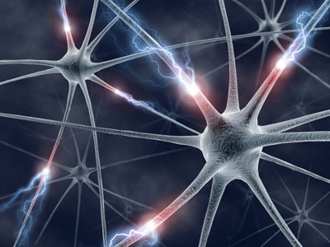
The Basis: RDF

Slide 38
RDF triples
Let us begin to formalize what we did!
we “connected” the data…
but a simple connection is not enough… data should be named somehow
hence the RDF Triples: a labelled connection between two resources

Slide 39
RDF triples (cont.)
An RDF Triple (s,p,o) is such that:
“s”, “p” are URI-s, ie, resources on the Web; “o” is a URI or a literal
“s”, “p”, and “o” stand for “subject”, “property”, and “object”
here is the complete triple:
(<http://…isbn…6682>, <http://…/original>, <http://…isbn…409X>)
RDF is a general model for such triples (with machine readable formats like RDF/XML, Turtle, N3, RDFa, JSon, …)

Slide 40
RDF triples (cont.)
RDF triples are also referred to as “triplets”, or “statements”
The “p” is sometimes referred to as “predicate”

Slide 41
RDF triples (cont.)
Resources can use any URI
http://www.example.org/file.html#home
http://www.example.org/f.xml#xpath(//q[@a=b])
http://www.example.org/form?a=b&c=d
RDF triples form a directed, labeled graph (the best way to think about them!)

Slide 42
A simple RDF example (in Turtle)
http://…isbn/2020386682
f:titre
f:original
Le palais des miroirs
http://…isbn/000651409X
<http://…/isbn/2020386682>
f:titre "Le palais des mirroirs"@fr ;
f:original <http://…/isbn/000651409X> .

Slide 43
URI-s play a fundamental role
URIs made the merge possible
URIs ground RDF into the Web
information can be retrieved using existing tools
this makes the “Semantic Web”, well… “Semantic Web”

Slide 44
RDF in programming practice
For example, using Python+RDFLib:
a “Graph” object is created
the RDF file is parsed and results stored in the Graph
the Graph offers methods to retrieve (or add):
triples
(property,object) pairs for a specific subject
(subject,property) pairs for specific object
etc.
the rest is conventional programming…
storage of the Graphs are either in-memory, or attached to some back-end database
Similar tools exist in Java, PHP, etc.

Slide 45
Python example using RDFLib
# create a graph from a file
graph = rdflib.Graph()
graph.parse("filename.rdf", format="rdfxml")
# take subject with a known URI
subject = rdflib.URIRef("URI_of_Subject")
# process all properties and objects for this subject
for (s,p,o) in graph.triples((subject,None,None)) :
do_something(p,o)

Slide 46
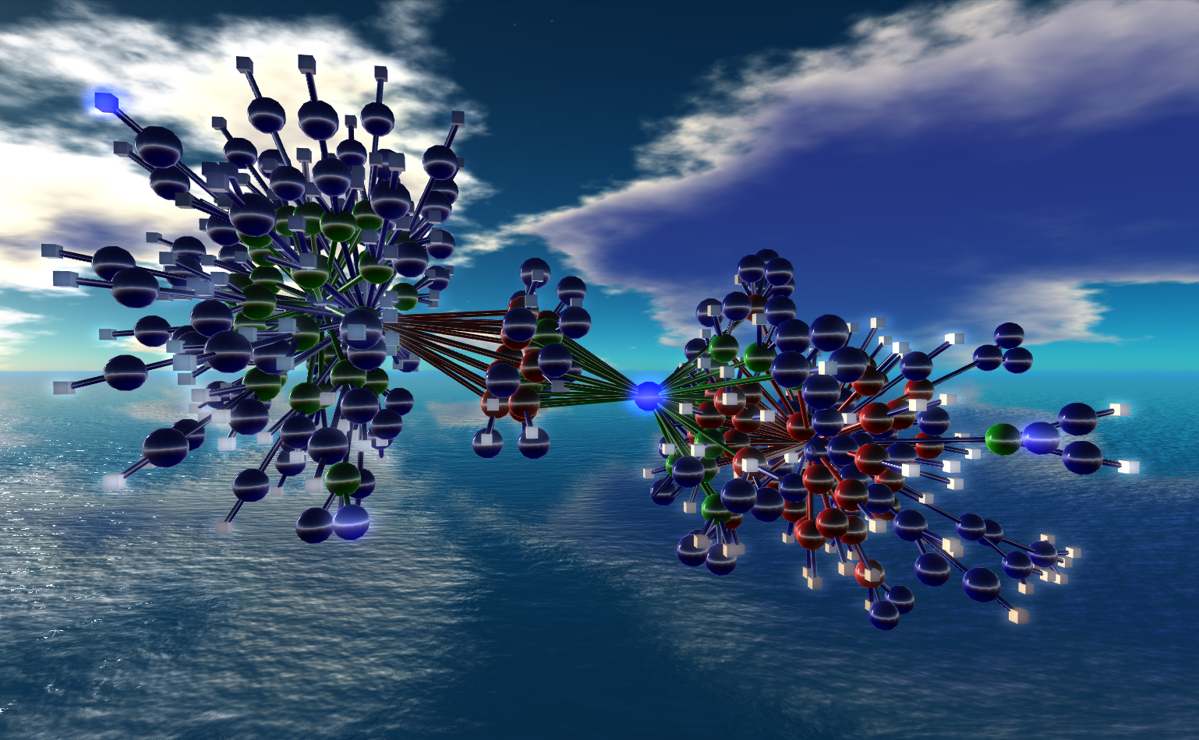
One level higher up: RDFS, Datatypes
Nexus Simulation Credit Erich Bremmer

Slide 47
Need for RDF schemas
First step towards the “extra knowledge”:
define the terms we can use
what restrictions apply
what extra relationships are there?
Officially: “RDF Vocabulary Description Language”
the term “Schema” is retained for historical reasons…

Slide 48
Classes, resources, …
Think of well known traditional vocabularies:
use the term “novel”
“every novel is a fiction”
“«The Glass Palace» is a novel”
etc.
RDFS defines resources and classes:
everything in RDF is a “resource”
“classes” are also resources, but…
…they are also a collection of possible resources (i.e., “individuals”)
“fiction”, “novel”, …

Slide 49
Classes, resources, … (cont.)
Relationships are defined among resources:
“typing”: an individual belongs to a specific class
“«The Glass Palace» is a novel”
to be more precise: “«http://.../000651409X» is a novel”
“subclassing”: all instances of one are also the instances of the other (“every novel is a fiction”)
RDFS formalizes these notions in RDF

Slide 50
Classes, resources in RDF(S)
rdfs:Class
rdf:type
http://…isbn/000651409X
rdf:type
#Novel
RDFS defines the meaning of these terms
(these are all special URI-s, we just use the namespace abbreviation)

Slide 51
Inferred properties
#Fiction
rdf:type
rdf:subClassOf
http://…isbn/000651409X
rdf:type
#Novel
(<http://…/isbn/000651409X> rdf:type #Fiction)
is not in the original RDF data…
…but can be inferred from the RDFS rules
RDFS environments return that triple, too

Slide 52
Inference: let us be formal…
The RDF Semantics document has a list of (33) entailment rules:
“if such and such triples are in the graph, add this and this”
do that recursively until the graph does not change
The relevant rule for our example:
If:
uuu rdfs:subClassOf xxx .
vvv rdf:type uuu .
Then add:
vvv rdf:type xxx .

Slide 53
Properties
Property is a special class (rdf:Property)
properties are also resources identified by URI-s
There is also a possibility for a “sub-property”
all resources bound by the “sub” are also bound by the other
Range and domain of properties can be specified
i.e., what type of resources serve as object and subject

Slide 54
What does this mean?
Again, new relations can be deduced. Indeed, if
:title
rdf:type rdf:Property;
rdfs:domain :Fiction;
rdfs:range rdfs:Literal.
<http://…/isbn/000651409X> :title "The Glass Palace" .
then the system can infer that:
<http://…/isbn/000651409X> rdf:type :Fiction .

Slide 55
Literals
Literals may have a data type
floats, integers, booleans, etc., defined in XML Schemas
full XML fragments
(Natural) language can also be specified

Slide 56
A bit of RDFS can take you far…
Remember the power of merge?
We could have used, in our example:
f:auteur is a subproperty of a:author and vice versa (although we will see other ways to do that…)
Of course, in some cases, more complex knowledge is necessary (see later…)

Slide 57
Vocabularies
RDFS makes it possible to define vocabularies:
collection of properties and classes
relationships among those and to terms in other vocabularies
Some examples:
Dublin Core terms: creator, date, …
FOAF terms: characterization of persons
Good Relations: eCommerce terms
Creative Commons: copyright classes, license relations, …
schema.org terms: events, organizations, places, reviews, …
…

Slide 58
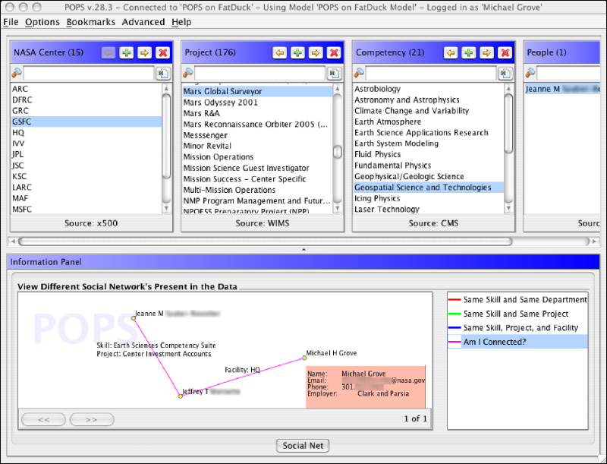
Michael Grove, Clark & Parsia, LLC, and Andrew Schain, NASA, (SWEO Case Study)
Notes:
Expertise locater for nearly 70,000 NASA civil servants, using RDF integration techniques over 6 or 7 geographically distributed databases, data sources, and web services…
The use internal ontologies/vocabularies to describe the knowledge areas, and a combination of the RDF data and that ontology to search through the (integrated) databases for a specific knowledge expertise. The dump is from a faceted browser developed by the company to view result data.

Slide 59
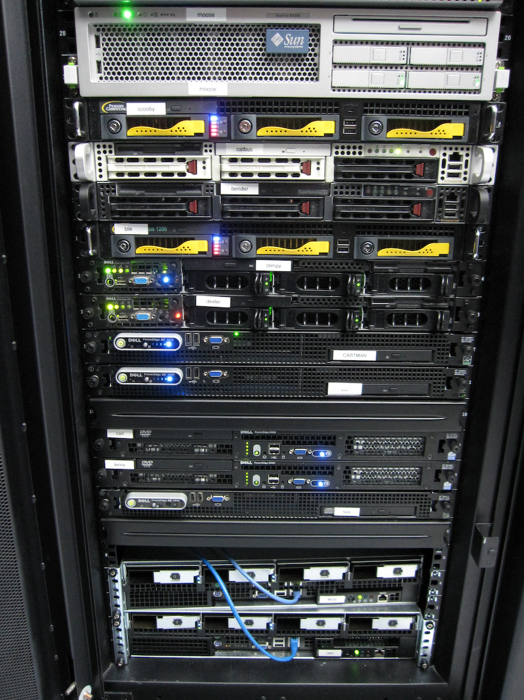
Access to Relational Databases (Direct Mapping, R2RML)
Photo credit “mayhem”, Flickr

Slide 60
Relational Databases and RDF
Most of the data on the Web is, in fact, in RDB-s
Data integration on the Web must provide access to RDB-s

Slide 61
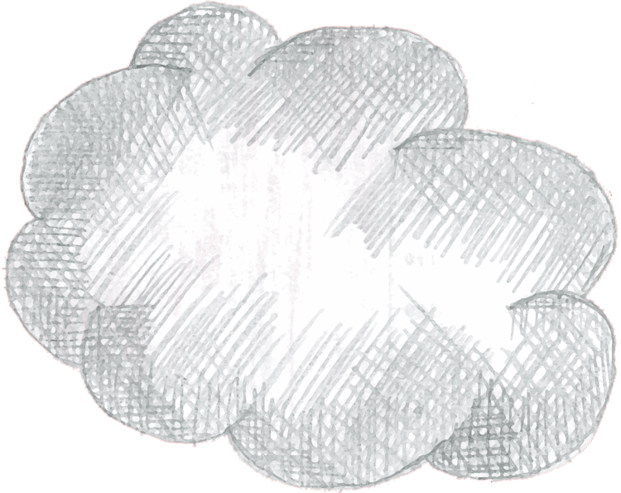
RDF provides a common “view”
Common “view”
in
RDF
export
export
query
query
query
export

Slide 62
What is “export”?
“Export” does not necessarily mean physical conversion
for very large databases a “duplication” would not be an option
systems may provide SQL “bridges” to make queries on the fly
Result of export is a “logical” view of the RDB content

Slide 63
What is “export”?
“Export” does not necessarily mean physical conversion
for very large databases a “duplication” would not be an option
systems may provide SQL “bridges” to make queries on the fly
Result of export is a “logical” view of the RDB content

Slide 64
Simple export: Direct Mapping
A canonical RDF “view” of RDB tables
Only needs the information in the RDB Schema

Slide 65
Fundamental approach
Each column name provides a predicate
ISBN | Author | Title | Publisher | Year
0006511409X | id_xyz | The Glass Palace | id_qpr | 2000
Each row is a subject
Table references are URI objects
Cells are Literal objects
ID | Name | Homepage
id_xyz | Ghosh, Amitav | http://www.amitavghosh.com

Slide 66
Fundamental approach
ISBN | Author | Title | Publisher | Year
0006511409X | id_xyz | The Glass Palace | id_qpr | 2000
0006511409X
<Book#ISBN>
<Book#Author>
id_xyz
The Glass Palace
<Book#Title>
<Book/ISBN-0006511409>
2000
<Book#Year>
<Book#ref-Author>
id_xyz
ID | Name | Homepage
id_xyz | Ghosh, Amitav | http://www.amitavghosh.com
<Person/ID-id_xyz>
<Person#ID>
<Person#Name>
<Person#Homepage>
Ghosh, Amitav
http://www.amitavghosh.com

Slide 67


Tables
RDB Schema
Direct Mapping
“Direct Graph”

Slide 68
Pros and cons of Direct Mapping
Pros:
Direct Mapping is simple, does not require any other concepts
know the Schema ⇒ know the RDF graph structure
know the RDF graph structure ⇒ good idea of the Schema(!)
Cons:
the resulting graph is not what the application really wants

Slide 69
But: direct graph must be transformed
0006511409X
<Book#ISBN>
<Book#Author>
id_xyz
The Glass Palace
<Book#Title>
<Book/ISBN-0006511409>
2000
<Book#Year>
<Book#ref-Author>
id_xyz
<Person/ID-id_xyz>
<Person#ID>
<Person#Name>
<Person#Homepage>
Ghosh, Amitav
http://www.amitavghosh.com
Property names should be mapped
URI-s should be minted
Literals should be replaced by URI-s
The Glass Palace
a:title
http://…isbn/000651409X
2000
a:year
a:author
a:name
a:homepage
Ghosh, Amitav
http://www.amitavghosh.com

Slide 70
Tables
RDB Schema
Direct Mapping
“Direct Graph”
Graph Processing
Final, Application Graph

Slide 71
Beyond Direct Mapping: R2RML
Separate vocabulary to control the details of the mapping, e.g.:
finer control over the choice of the subject
creation of URI references from cells
predicates may be chosen from a vocabulary
datatypes may be assigned
etc.
Gets to the final RDF graph with one processing step

Slide 72
Back to the bookshop example
ISBN | Author | Title | Publisher | Year
0006511409X | id_xyz | The Glass Palace | id_qpr | 2000
ID | Name | Homepage
id_xyz | Ghosh, Amitav | http://www.amitavghosh.com
The Glass Palace
a:title
http://…isbn/000651409X
2000
a:year
a:author
a:name
a:homepage
Ghosh, Amitav
http://www.amitavghosh.com

Slide 73
R2RML Instance
Tables
RDB Schema
R2RML
Mapping
Final, Application Graph

Slide 74
Extract of an R2RML Instance
ISBN | Author | Title | Publisher | Year
0006511409X | id_xyz | The Glass Palace | id_qpr | 2000
ID | Name | Homepage
id_xyz | Ghosh, Amitav | http://www.amitavghosh.com
<Person>
rr:tableName "Person_Table" ;
rr:subjectMap [
rr:termtype rr:BlankNode ;
] ;
rr:predicateObjectMap [
rr:predicate a:name
rr:objectMap [
rr:column "Name"
]
] ;
rr:predicateObjectMap [
rr:predicate a:homepage ;
rr:objectMap [
rr:column "Homepage" ;
rr:termtype "IRI"
]
] ;
The Glass Palace
a:title
http://…isbn/000651409X
2000
a:year
a:author
a:name
a:homepage
Ghosh, Amitav
http://www.amitavghosh.com

Slide 75
Relationships to the Direct Mapping
Fundamentals are similar:
each row is turned into a series of triples with a common subject
Direct mapping is a “default” R2RML mapping
Usage depends on the availability of tools, personal background and experience, …

Slide 76
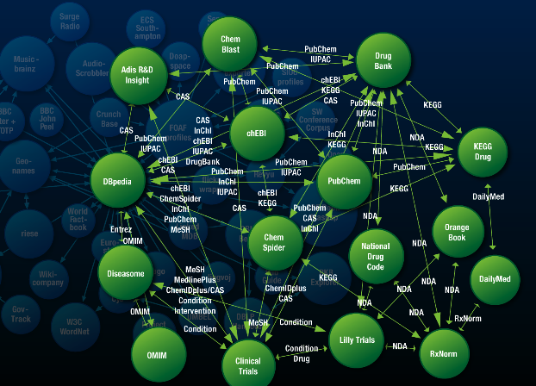
Linked Data

Slide 77
Linked Data “Movement”
Goal: “expose” whole datasets on the Web
remember the importance of data!
Set links among the data items from different datasets
we want to avoid the silo effects
Use open standards to access data
Notes:
The important point here is that (1) the data becomes available to the World via a unified format (ie, RDF), regardless on how it is stored inside and (2) the various datasets are interlinked together, ie, they are not independent islands. Dbpedia is probably the most important 'hub' in the project.

Slide 78
Linked Data makes it possible to develop complex mashup applications easily

Slide 79


Example data source: DBpedia
DBpedia is a community effort to
extract structured (“infobox”) information from Wikipedia
provide a query endpoint to the dataset
interlink the DBpedia dataset with other datasets on the Web

Slide 80
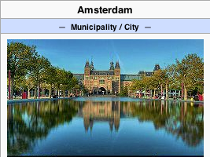
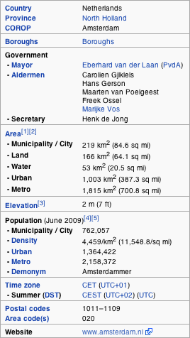
Extracting structured data from Wikipedia
@prefix dbpedia <http://dbpedia.org/resource/>.
@prefix dbterm <http://dbpedia.org/property/>.
dbpedia:Amsterdam dbterm:officialName "Amsterdam" ; dbterm:longd "4" ;
dbterm:longm "53" ;
dbterm:longs "32" ;
dbterm:website <http://www.amsterdam.nl> ;
dbterm:populationUrban "1364422" ;
dbterm:areaTotalKm "219" ;
...
dbpedia:ABN_AMRO
dbterm:location dbpedia:Amsterdam ;
...
Notes:
The right hand portion of the wiki side is what is referred to as 'infobox'. The left side is the dbpedia content as made available.

Slide 81
Automatic links among open datasets
<http://dbpedia.org/resource/Amsterdam> owl:sameAs <http://rdf.freebase.com/ns/...> ;
owl:sameAs <http://sws.geonames.org/2759793> ;
...
<http://sws.geonames.org/2759793>
owl:sameAs <http://dbpedia.org/resource/Amsterdam>
wgs84_pos:lat "52.3666667" ;
wgs84_pos:long "4.8833333";
geo:inCountry <http://www.geonames.org/countries/#NL> ;
...
Processors can switch automatically from one to the other…
Notes:
This is the important point: this is why this is Linking open data. What the community does (and this is a community project) is to make agreements on how the different datasets can be linked and then the linkage is done automatically by the 'bridges' that map the public datasets into RDF. Eg, geonames is a public dataset by geonames.org and dbpedia is, well... wikipedia:-)

Slide 82
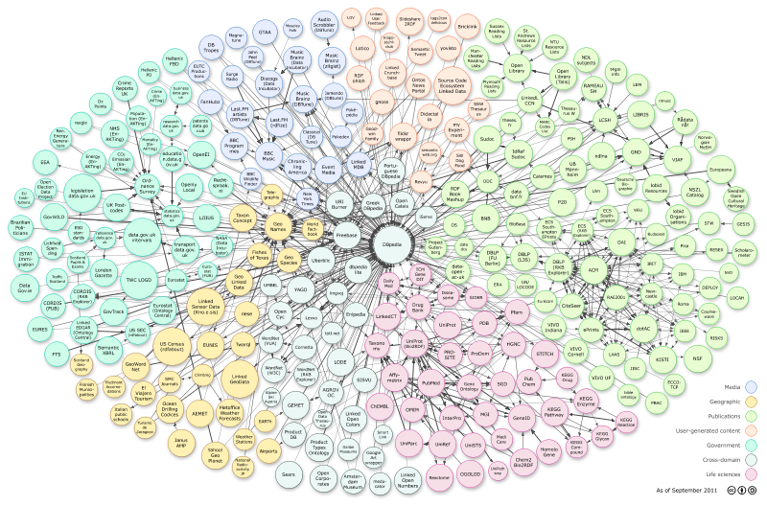
The LOD “cloud”, September 2011
Courtesy of Richard Cyganiak and Anja Jentzsch

Slide 83
The importance of Linked Data
It provides a core set of data that Semantic Web applications can build on
stable references for “things”,
e.g., http://dbpedia.org/resource/Amsterdam
many relationships that applications may reuse
a “nucleus” for a larger, semantically enabled Web!
For many, publishing data may be the first step into the world of Semantic Web

Slide 84
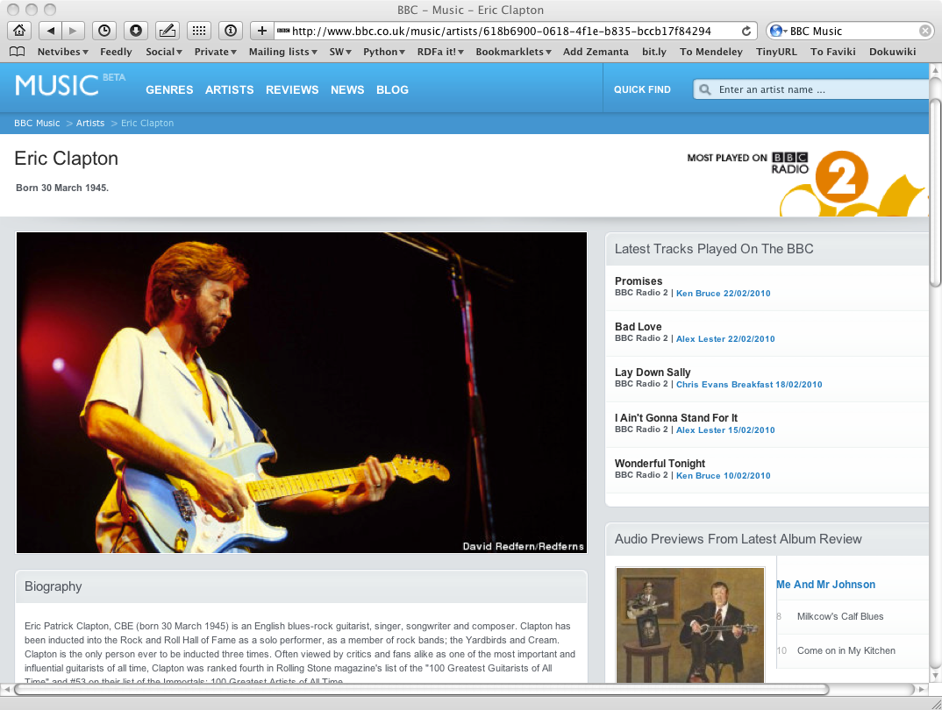

Slide 85
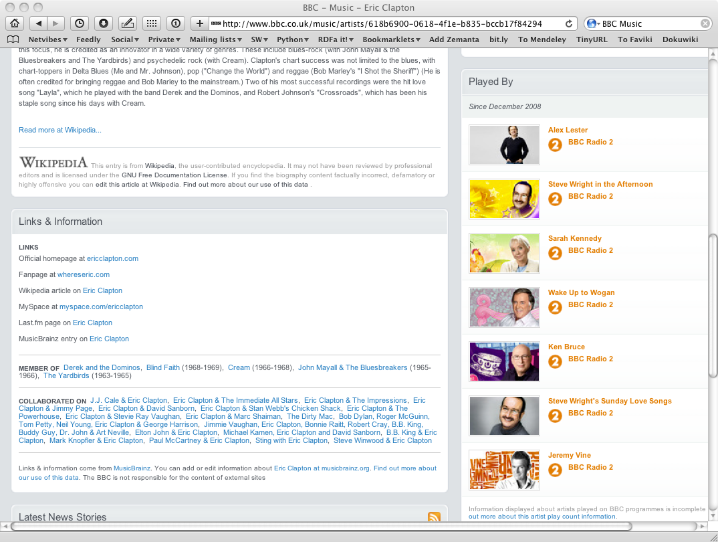

Slide 86
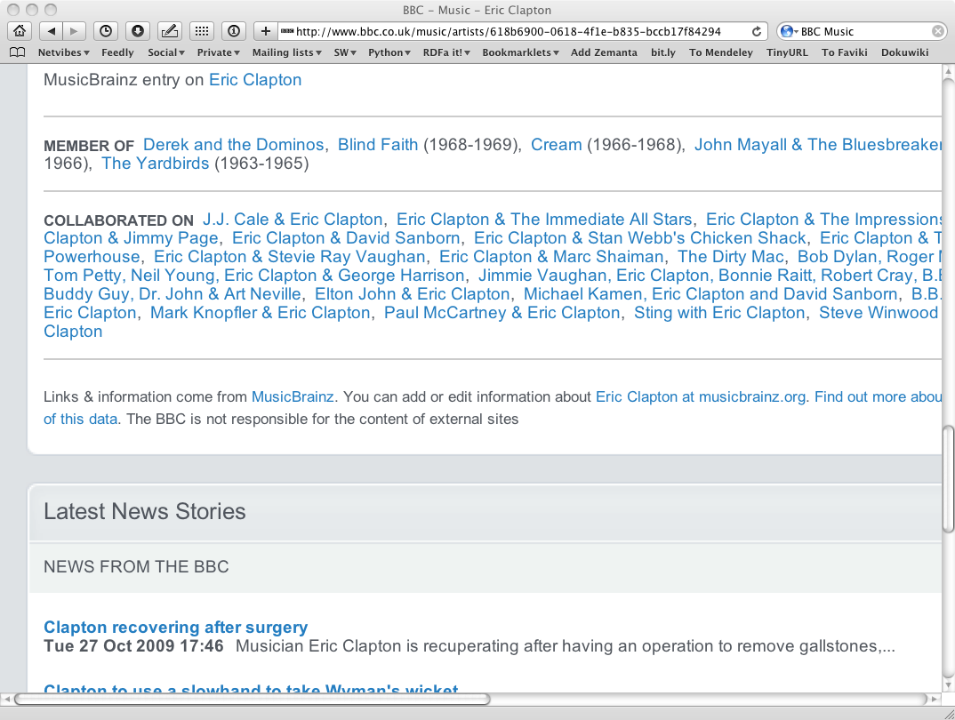
And this is no secret…

Slide 87
Some characteristics of Linked Data and its Applications
The datasets are essentially read-only
they are curated “out of band”: regularly extracted from other databases, changed manually by data owners, etc
The dominating paradigm is to extract data via a specialized query engine (see later)
Applications use (very) large datasets via (RDF based) integration

Slide 88
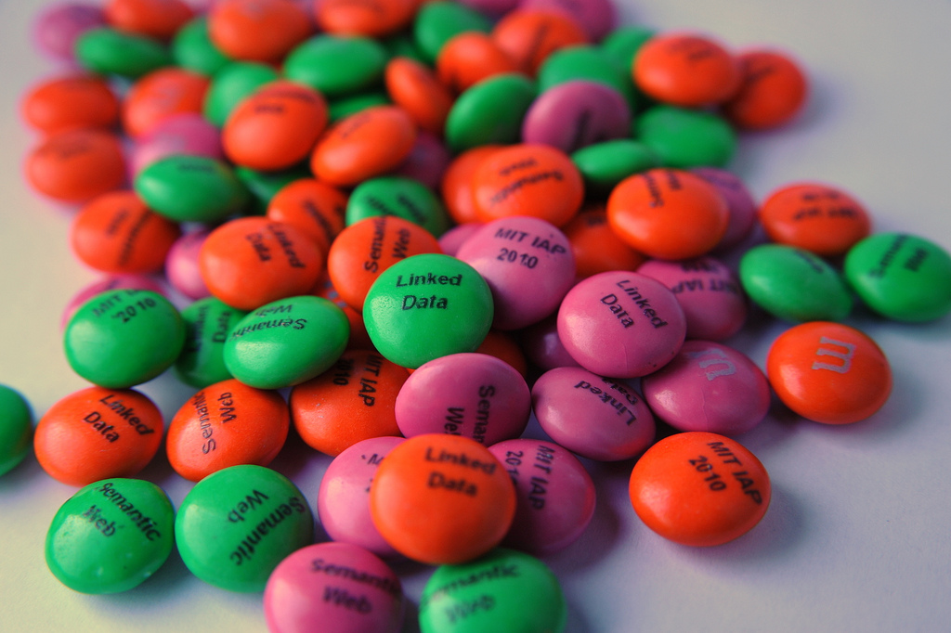
Query RDF: (SPARQL)
Photo credit “reedster”, Flickr

Slide 89
Querying RDF graphs
In practice, complex queries into the RDF data are necessary
something like: “give me the (a,b) pair of resources, for which there is an x such that (x parent a) and (b brother x) holds” (i.e., return the uncles)
these rules may become quite complex
The goal of SPARQL (Query Language for RDF)

Slide 90
General: graph patterns
The fundamental idea: use graph patterns
the pattern contains unbound symbols
by binding the symbols, subgraphs of the RDF graph are selected
if there is such a selection, the query returns the bound resources

Slide 91
A simple example in SPARQL
SELECT ?p ?o
WHERE {subject ?p ?o}
The triples in WHERE define the graph pattern, with ?p and ?o “unbound” symbols
The query returns all p,o pairs
?p
?o
?p
?o
subject
?p
?o
?p
?o

Slide 92
Simple SPARQL example
SELECT ?isbn ?price ?currency # note: not ?x!
WHERE {?isbn a:price ?x. ?x rdf:value ?price. ?x p:currency ?currency.}
a:name
Ghosh, Amitav
a:author
a:author
http://…isbn/000651409X
http://…isbn/2020386682
a:price
a:price
a:price
a:price
rdf:value
p:currency
rdf:value
p:currency
rdf:value
p:currency
rdf:value
p:currency
33
:£
50
:€
60
:€
78
:$

Slide 93
Simple SPARQL example
SELECT ?isbn ?price ?currency # note: not ?x!
WHERE {?isbn a:price ?x. ?x rdf:value ?price. ?x p:currency ?currency.}
Returns: [<…409X>,33,:£]
a:name
Ghosh, Amitav
a:author
a:author
http://…isbn/000651409X
http://…isbn/2020386682
a:price
a:price
a:price
a:price
rdf:value
p:currency
rdf:value
p:currency
rdf:value
p:currency
rdf:value
p:currency
33
:£
50
:€
60
:€
78
:$

Slide 94
Simple SPARQL example
SELECT ?isbn ?price ?currency # note: not ?x!
WHERE {?isbn a:price ?x. ?x rdf:value ?price. ?x p:currency ?currency.}
Returns: [<…409X>,33,:£], [<…409X>,50,:€]
a:name
Ghosh, Amitav
a:author
a:author
http://…isbn/000651409X
http://…isbn/2020386682
a:price
a:price
a:price
a:price
rdf:value
p:currency
rdf:value
p:currency
rdf:value
p:currency
rdf:value
p:currency
33
:£
50
:€
60
:€
78
:$

Slide 95
Simple SPARQL example
SELECT ?isbn ?price ?currency # note: not ?x!
WHERE {?isbn a:price ?x. ?x rdf:value ?price. ?x p:currency ?currency.}
Returns: [<…409X>,33,:£], [<…409X>,50,:€],
[<…6682>,60,:€]
a:name
Ghosh, Amitav
a:author
a:author
http://…isbn/000651409X
http://…isbn/2020386682
a:price
a:price
a:price
a:price
rdf:value
p:currency
rdf:value
p:currency
rdf:value
p:currency
rdf:value
p:currency
33
:£
50
:€
60
:€
78
:$

Slide 96
Simple SPARQL example
SELECT ?isbn ?price ?currency # note: not ?x!
WHERE {?isbn a:price ?x. ?x rdf:value ?price. ?x p:currency ?currency.}
Returns: [<…409X>,33,:£], [<…409X>,50,:€],
[<…6682>,60,:€], [<…6682>,78,:$]
a:name
Ghosh, Amitav
a:author
a:author
http://…isbn/000651409X
http://…isbn/2020386682
a:price
a:price
a:price
a:price
rdf:value
p:currency
rdf:value
p:currency
rdf:value
p:currency
rdf:value
p:currency
33
:£
50
:€
60
:€
78
:$

Slide 97
Pattern constraints
SELECT ?isbn ?price ?currency # note: not ?x!
WHERE { ?isbn a:price ?x. ?x rdf:value ?price. ?x p:currency ?currency.
FILTER(?currency == :€) }
Returns: [<…409X>,50,:€], [<…6682>,60,:€]
a:name
Ghosh, Amitav
a:author
a:author
http://…isbn/000651409X
http://…isbn/2020386682
a:price
a:price
a:price
a:price
rdf:value
p:currency
rdf:value
p:currency
rdf:value
p:currency
rdf:value
p:currency
33
:£
50
:€
60
:€
78
:$

Slide 98
Update: insert
INSERT {?isbn rdf:type frbr:Work}
WHERE {?isbn a:price ?x. ?x rdf:value ?price. ?x p:currency ?currency.}
a:name
Ghosh, Amitav
a:author
a:author
http://…isbn/000651409X
http://…isbn/2020386682
a:price
a:price
a:price
a:price
rdf:value
p:currency
rdf:value
p:currency
rdf:value
p:currency
rdf:value
p:currency
33
:£
50
:€
60
:€
78
:$

Slide 99
Update: insert
INSERT {?isbn rdf:type frbr:Work}
WHERE {?isbn a:price ?x. ?x rdf:value ?price. ?x p:currency ?currency.}
frbr:Work
rdf:type
rdf:type
a:name
Ghosh, Amitav
a:author
a:author
http://…isbn/000651409X
http://…isbn/2020386682
a:price
a:price
a:price
a:price
rdf:value
p:currency
rdf:value
p:currency
rdf:value
p:currency
rdf:value
p:currency
33
:£
50
:€
60
:€
78
:$

Slide 100
Other SPARQL features
Limit the number of returned results; remove duplicates, sort them, …
Construct a graph combining a separate pattern and the query results
Use datatypes and/or language tags when matching a pattern
Aggregation of the results (min, max, average, etc.)
Path expressions (a bit like regular expressions)

Slide 101
Remember this?
Tables
RDB Schema
Direct Mapping
“Direct Graph”
Graph Processing
Final, Application Graph

Slide 102
Remember this?
Tables
RDB Schema
Direct Mapping
“Direct Graph”
SPARQL CONSTRUCT
Final, Application Graph

Slide 103
SPARQL usage in practice
SPARQL is usually used over the network
HTTP request is sent to a SPARQL endpoint
result is the result of the SELECT, the CONSTRUCT,…
Separate documents define the protocol and the result format
SPARQL Protocol for RDF with HTTP and SOAP bindings
SPARQL results in XML or JSON formats
Big datasets usually offer “SPARQL endpoints” using this protocol

Slide 104
SPARQL as a unifying point
Application
SPARQL Endpoint
SPARQL Endpoint
SPARQL Construct
SPARQL Construct
Triple store
SPARQL Update
SPARQL Processor
SPARQL Update
Database
RDFa
NLP Techniques
GRDDL, RDFa
SQL⬄RDF
RDF Graph
Relational
Database
HTML
Unstructured Text
XML/XHTML

Slide 105
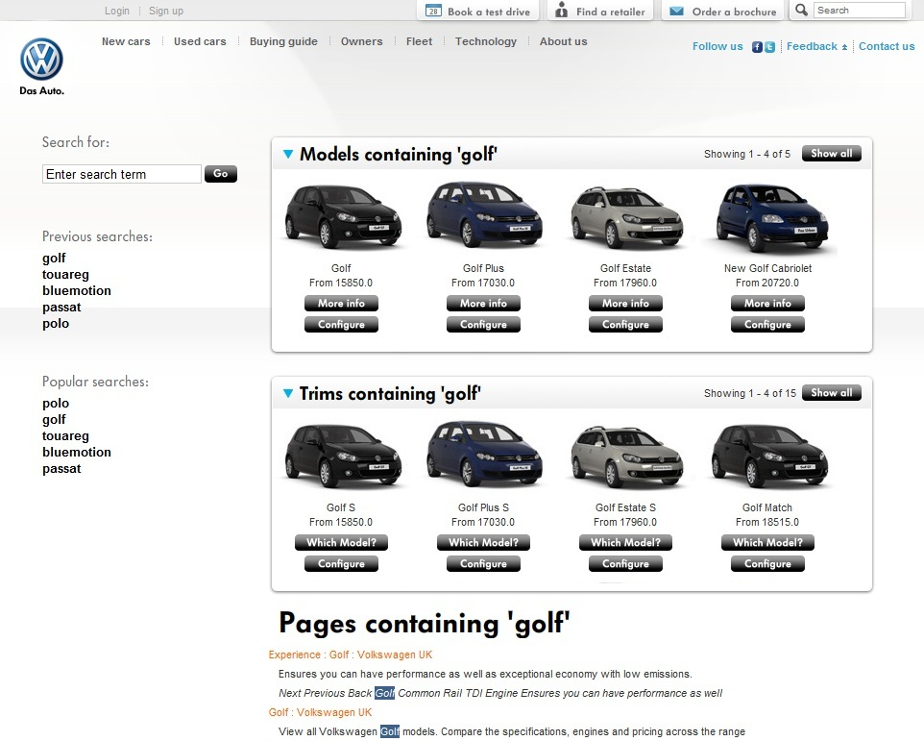
Notes:
Typical example:
- using public and private vocabularies
content collected from various internal pages, merged with product data
some reasoning happens on the merged data
sparql is used to search the data
get some user interface to drive all this

Slide 106

Vocabularies
Photo credit “Indy Reading Coalition”, Wordpress.com

Slide 107
Vocabularies
Data integration needs agreements on
terms
“translator”, “author”
categories used
“Person”, “literature”
relationships among those
“an author is also a Person…”, “historical fiction is a narrower term than fiction”
i.e., new relationships can be deduced

Slide 108
Vocabularies
There is a need for “languages” to define such vocabularies
to define those vocabularies
to assign clear “semantics” on how new relationships can be deduced

Slide 109
But what about RDFS?
Indeed RDFS is such framework:
there is typing, subtyping
properties can be put in a hierarchy
datatypes can be defined
RDFS is enough for many vocabularies
we have seen some of those…
But not for all!

Slide 110
Three technologies have emerged
To re-use thesauri, glossaries, etc: SKOS
To define more complex vocabularies with a strong logical underpinning: OWL
Generic framework to define rules on terms and data: RIF

Slide 111
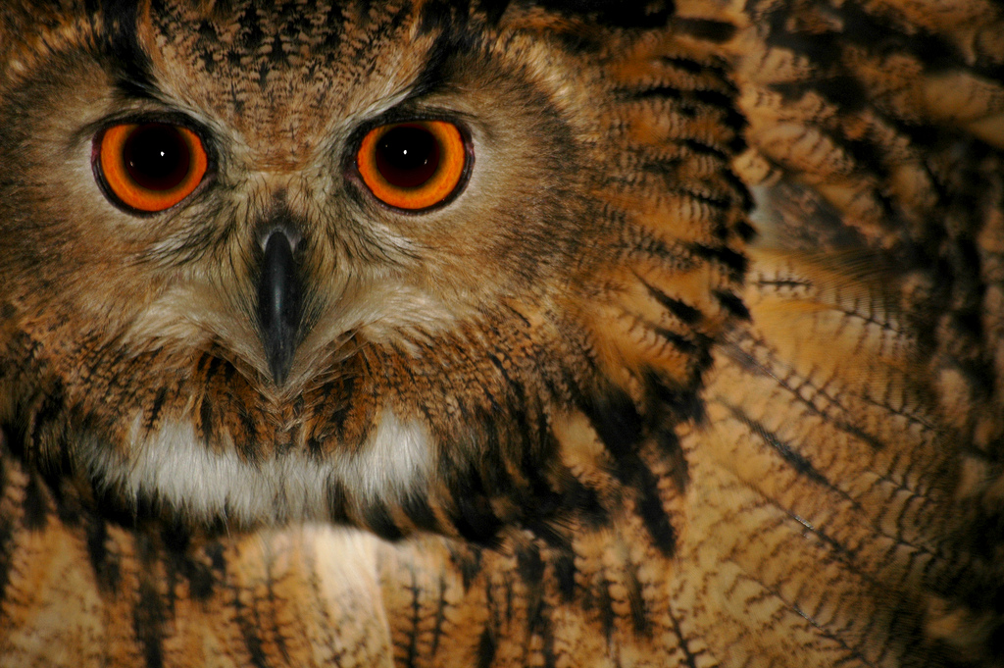
Ontologies (OWL)
Photo credit “Rickydavid”, Flickr

Slide 112
Application may want more than RDFS…
Complex applications may want more possibilities:
characterization of properties
identification of objects with different URI-s
disjointness or equivalence of classes
construct classes, not only name them
more complex classification schemes
can a program reason about some terms? E.g.:
“if «Person» resources «A» and «B» have the same «foaf:email» property, then «A» and «B» are identical”
etc.

Slide 113
Web Ontology Language = OWL
OWL is an extra layer, a bit like RDF Schemas
own namespace, own terms
it relies on RDF Schemas
It is a separate recommendation

Slide 114
OWL is complex…
OWL is a large set of additional terms
We will not cover the whole thing here…

Slide 115
Term equivalences
For classes:
owl:equivalentClass: two classes have the same individuals
owl:disjointWith: no individuals in common
For properties:
owl:equivalentProperty
remember the a:author vs. f:auteur?
owl:propertyDisjointWith

Slide 116
Term equivalences
For individuals:
owl:sameAs: two URIs refer to the same concept (“individual”)
owl:differentFrom: negation of owl:sameAs

Slide 117
Other example: connecting to French
a:author
owl:equivalentProperty
f:auteur
a:Novel
owl:equivalentClass
f:Roman

Slide 118
Typical usage of owl:sameAs
Linking our example of Amsterdam from one data set (DBpedia) to the other (Geonames):
<http://dbpedia.org/resource/Amsterdam> owl:sameAs <http://sws.geonames.org/2759793>;
This is the main mechanism of “Linking” in the Linked Open Data project

Slide 119
Property characterization
In OWL, one can characterize the behavior of properties (symmetric, transitive, functional, inverse functional, reflexive, irreflexive, …)

Slide 120
What this means is…
If the following holds in our triples:
:email rdf:type owl:InverseFunctionalProperty.

Slide 121
What this means is…
If the following holds in our triples:
:email rdf:type owl:InverseFunctionalProperty.
<A> :email "mailto:a@b.c".
<B> :email "mailto:a@b.c".

Slide 122
What this means is…
If the following holds in our triples:
:email rdf:type owl:InverseFunctionalProperty.
<A> :email "mailto:a@b.c".
<B> :email "mailto:a@b.c".
then, processed through OWL, the following holds, too:
<A> owl:sameAs <B>.

Slide 123
Classes in OWL
In RDFS, you can subclass existing classes… that’s all
In OWL, you can construct classes from existing ones:
enumerate its content
through intersection, union, complement
etc

Slide 124
Enumerate class content
:Currency
rdf:type owl:Class;
owl:oneOf (:€ :£ :$).
I.e., the class consists of exactly of those individuals and nothing else

Slide 125
Union of classes
:Novel rdf:type owl:Class.
:Short_Story rdf:type owl:Class.
:Poetry rdf:type owl:Class.
:Literature rdf:type owl:Class;
owl:unionOf (:Novel :Short_Story :Poetry).
Other possibilities: complementOf, intersectionOf, …

Slide 126
For example…
If:
:Novel rdf:type owl:Class.
:Short_Story rdf:type owl:Class.
:Poetry rdf:type owl:Class.
:Literature rdf:type owl:Class;
owl:unionOf (:Novel :Short_Story :Poetry).
<myWork> rdf:type :Novel .
then the following holds, too:
<myWork> rdf:type :Literature .

Slide 127
What we have so far…
The OWL features listed so far are already fairly powerful
E.g., various databases can be linked via owl:sameAs, functional or inverse functional properties, etc.
Many inferred relationship can be found using a traditional rule engine

Slide 128
However… that may not be enough
Very large vocabularies might require even more complex features
typical usage example: definition of all concepts in a health care environment
some major issues
the way classes (i.e., “concepts”) are defined
handling of datatypes
OWL includes those extra features but… the inference engines become (much) more complex ☹

Slide 129
But: OWL is hard!
The combination of class constructions with various restrictions is extremely powerful
What we have so far follows the same logic as before
extend the basic RDF and RDFS possibilities with new features
define their semantics, ie, what they “mean” in terms of relationships
expect to infer new relationships based on those
However… a full inference procedure is hard ☹
not implementable with simple rule engines, for example

Slide 130
OWL “species” or profiles
OWL species comes to the fore:
restricting which terms can be used and under what circumstances (restrictions)
if one abides to those restrictions, then simpler inference engines can be used
They reflect compromises: expressiveness vs. implementability

Slide 131
OWL Species
OWL Full
OWL DL
OWL EL
OWL RL
OWL QL

Slide 132
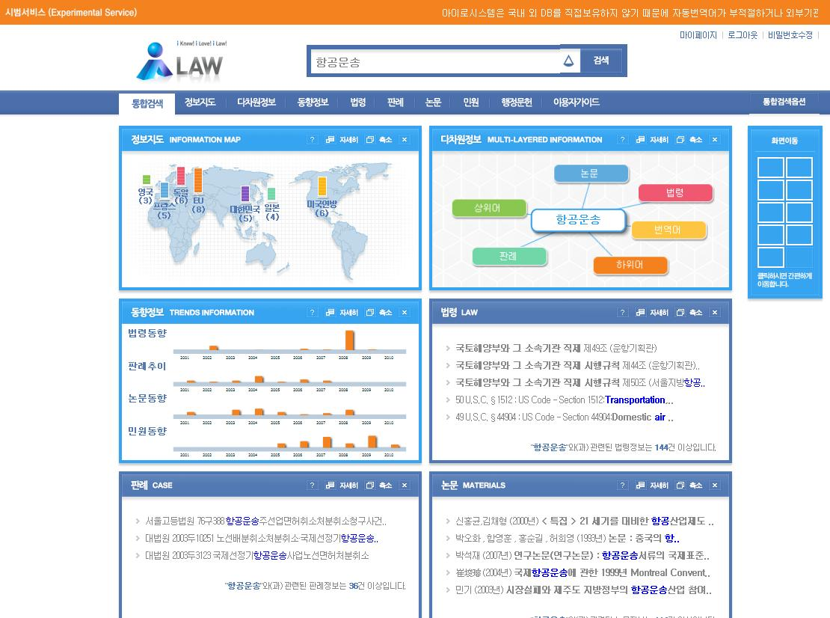

Courtesy of Hanming Jung, et al, KISTI and MOJ Korea, (SWEO Case Study)
Notes:
iLaw
Legal services are to government departments, enabling them:
compare to similar legislation home and abroad, eg:
compare terms with those around
trends, academic papers, civil complaints
Based on:
integration of legal cases from US, Japan, and the EU countries, plus legal articles and academic papers in an RDF store
usage of own ontology, OWL and Rules reasoning

Slide 133
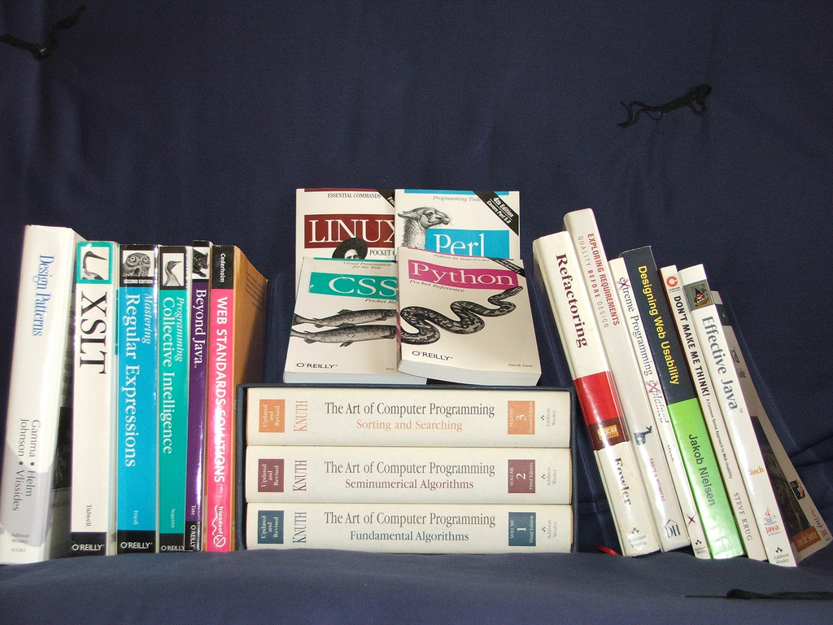
Available documents, resources
Photo credit “Abizern”, Flickr

Slide 134
Some books
T. Heath and C. Bizer: Linked Data: Evolving the Web into a Global Data Space, 2011
M. Watson: Practical Semantic Web and Linked data Applications, 2010
P. Hitzler, R. Sebastian, and M. Krötzsch: Foundation of Semantic Web Technologies, 2009
G. Antoniu and F. van Harmelen: Semantic Web Primer, 2nd edition, 2008
D. Allemang and J. Hendler: Semantic Web for the Working Ontologist, 2008
…
See the separate Wiki page collecting book references

Slide 135
Further information
Planet RDF aggregates a number of SW blogs:
http://planetrdf.com/
Semantic Web Interest Group
a forum developers with a publicly archived mailing list, and a constant IRC presence on freenode.net#swig
anybody can sign up on the list
http://www.w3.org/2001/sw/interest/
Linked Data mailing list
a forum concentrating on linked data with a public archive
anybody can sign up on the list
http://lists.w3.org/Archives/Public/public-lod/

Slide 136
Lots of Tools (not an exhaustive list!)
Some names:
Jena, AllegroGraph, Mulgara, Sesame, flickurl, 4Store, Stardog, …
TopBraid Suite, Virtuoso environment, Falcon, Drupal 7, Redland, Pellet, …
Disco, Oracle 11g, RacerPro, IODT, Ontobroker, OWLIM, Talis Platform, …
RDF Gateway, RDFLib, Open Anzo, DartGrid, Zitgist, Ontotext, Protégé, …
Thetus publisher, SemanticWorks, SWI-Prolog, RDFStore…
…
Categories:
Triple Stores
Inference engines
Converters
Search engines
Middleware
CMS
Semantic Web browsers
Development environments
Semantic Wikis
…
More on http://www.w3.org/2001/sw/wiki/Tools

Slide 137

Conclusions

Slide 138
To remember…
Data on the Web is a major challenge
technologies are needed to use them, to interact with them, to integrate them
Semantic Web technologies, Linked Data principles and practices, etc., should play a major role in publishing and using Data on the Web

Slide 139

Thank you for your attention
These slides are also available on the Web:
http://www.w3.org/2012/Talks/0608-Oracle-IH/

