Slide 1


Semantic Web Activities @ W3C
Ivan Herman, W3C
Semantic Technology & Business Conference
6th June, 2012
San Francisco, CA, USA

Slide 2
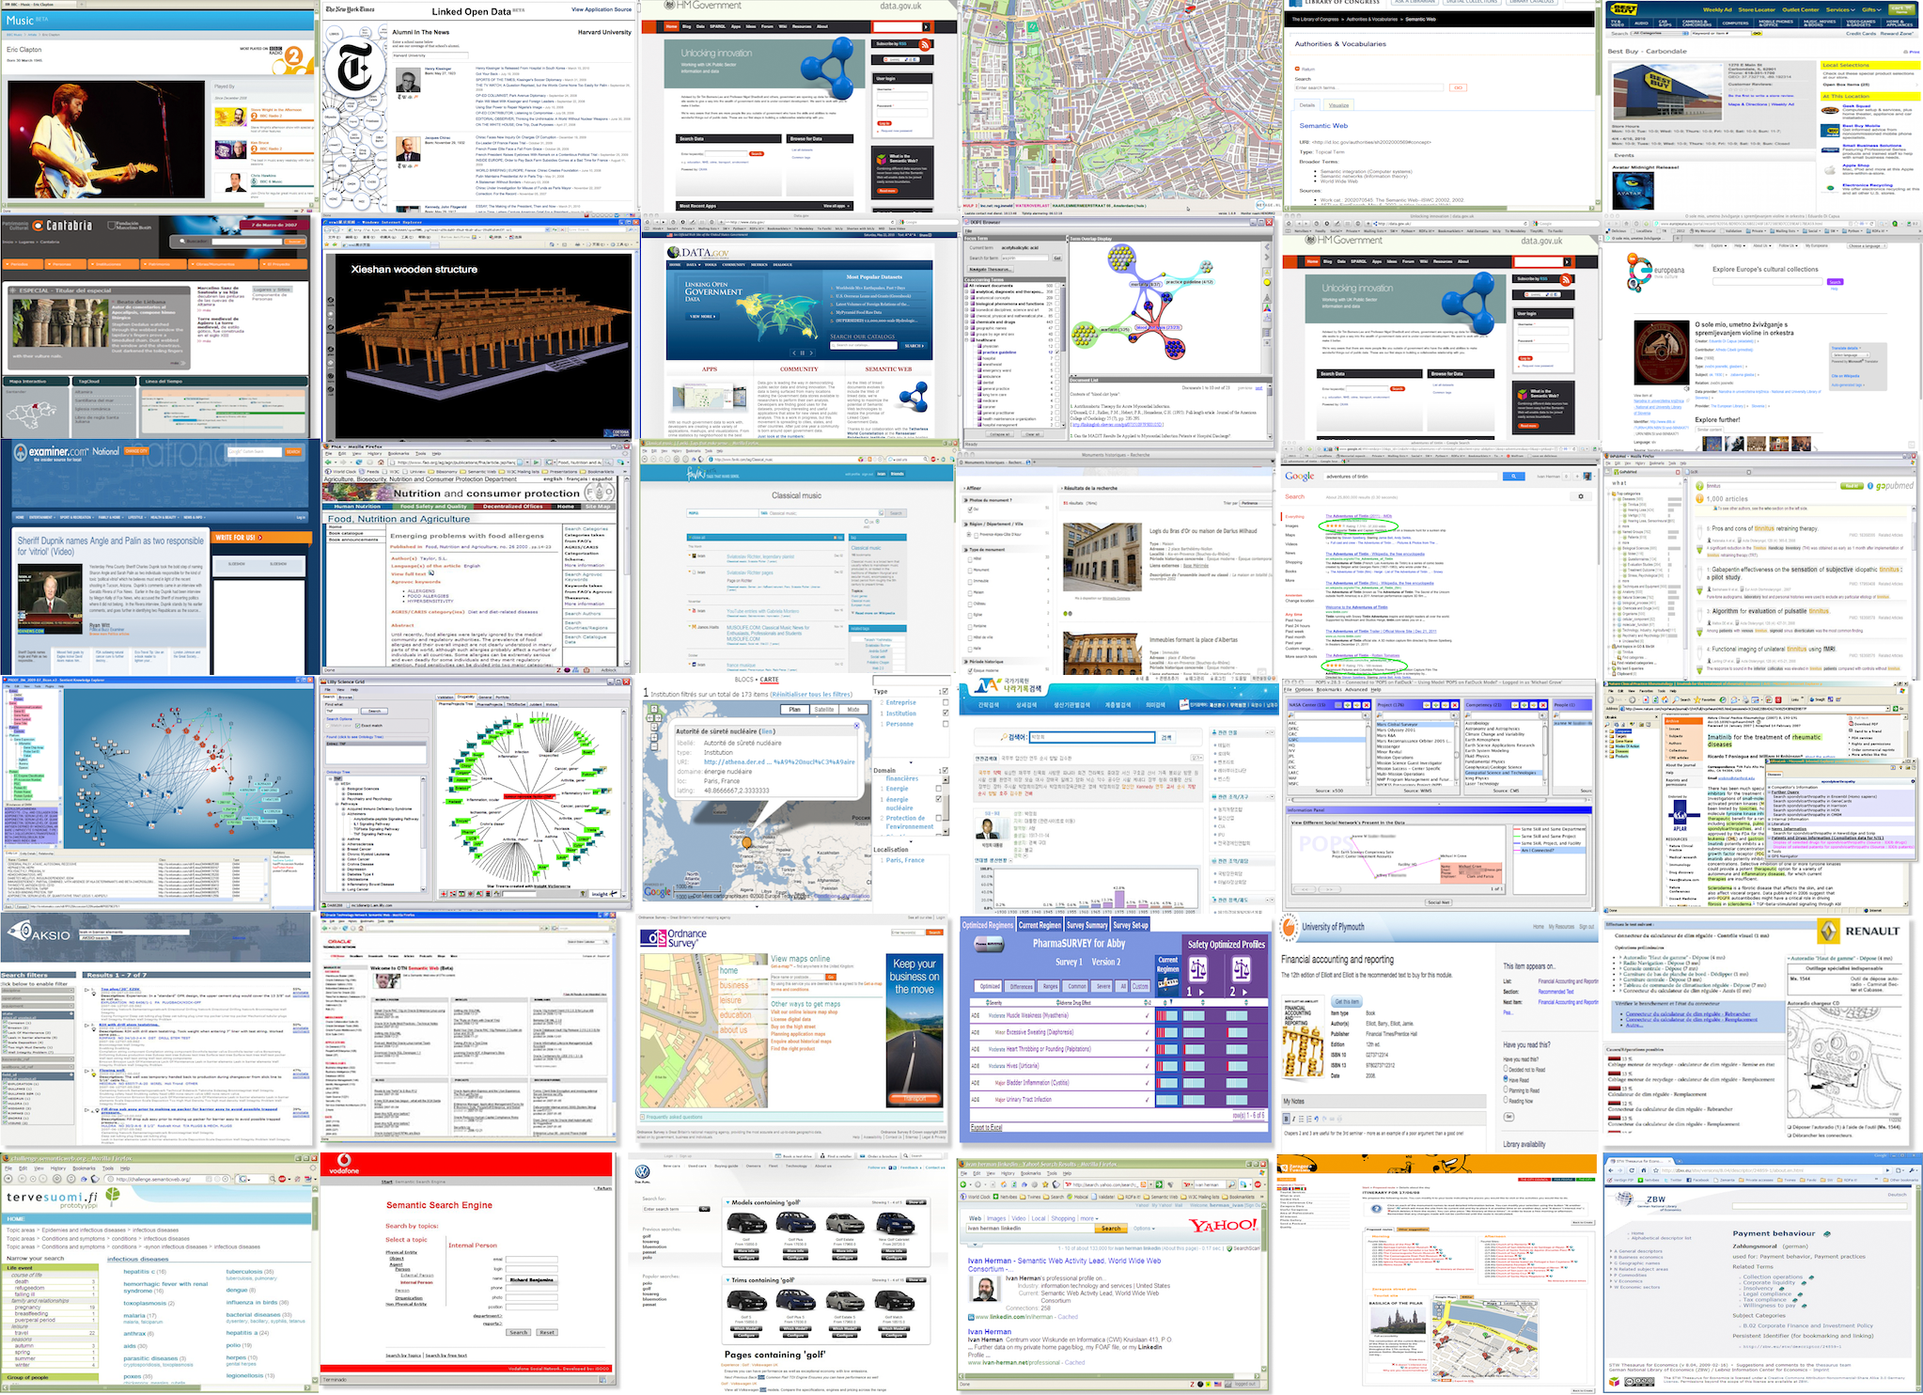

Slide 3
For some people, Semantic (Web) is…
A system manipulating and analyzing knowledge
  e.g., via big ontologies, vocabularies
  Google’s Knowledge Graph?
Improve search by adding structure to embedded data
A means to integrate many different pieces of data
Integrate data-oriented applications
And a mixture of all these…
Notes:
For the second bullet: in some cases graph based databases simply work better

Slide 4
And that is all right!

Slide 5
We have to acknowledge that the field has grown and has become multi-faceted
All different “views” have their success stories
There are also no clear and water-proof boundaries between the different views

Slide 6
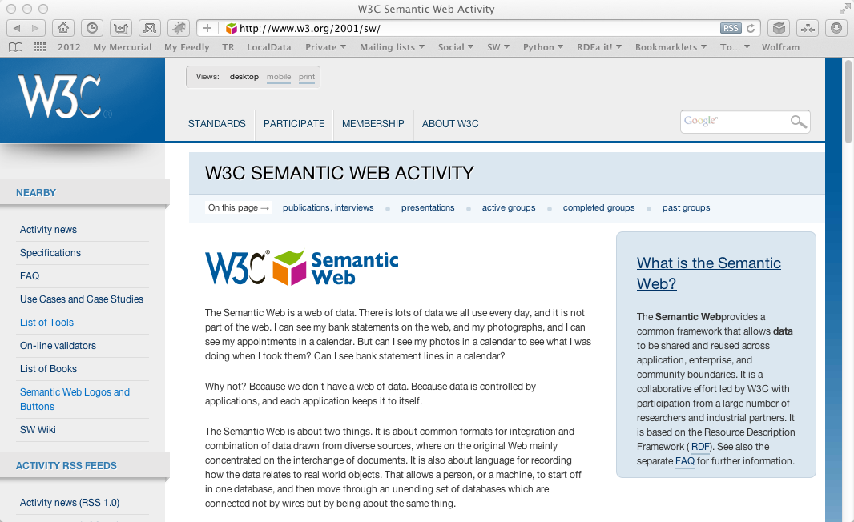
So… what is happening at W3C?

Slide 7
The (almost) past
Some technologies are, essentially, done:
  Ontology for Media Resources
  Media Fragments URI
  SPARQL 1.1 (SPARQL Protocol and RDF Query Language)
  RDB2RDF (Relational Databases to RDF)
  RDFa 1.1 (RDF in attributes)

Slide 8
The present
Some areas are subject of work
  Update of RDF
  Provenance
  Linked Data Platform

Slide 9
The future
We are discussing new works, new areas, e.g.,
  Access Control issues
  Constraint checking on Semantic Web data
  …

Slide 10
Link to specialized communities
Various communities have different emphasis on which part of the Semantic Web they want to use
W3C has contacts with some of those
  health care and life sciences (a separate IG is up and running)
  libraries, publishing
  financials
  the oil, gas, and chemicals community
  governments
… but there are many more!

Slide 11
These community links are not one-way streets!
The communities often contribute technologies that can be used in general
For example:
  New vocabularies may come to the fore: SKOS or FRBR (from libraries), annotations (originally form the HCLS work), Person vocabularies (from the eGov work)
  Health Care had a major influence on the Provenance work
  etc.

Slide 12
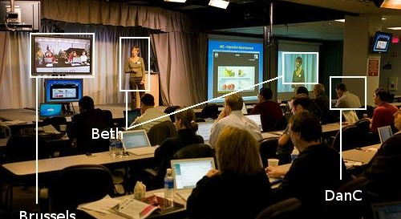
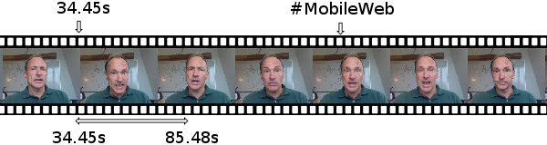
Audio, Video, and Semantics
Photo credit Robert Freund

Slide 13
Audio and Video are now first class entities on the Web

Slide 14
But… video and audio on the Web is not only what you see and hear
— it is also what you can search, discover, distribute, and manage!

Slide 15
Ontologies for Media Resources
The “usual” Semantic Web problem: what vocabularies to use?
The problem is not that there aren’t any… but that there are too many!
  EXIF, MPEG7, XMP, MRSS, …
  none of these cover all aspects
The Ontology for Media Resources document
  defines a core vocabulary
  defines a set of mappings to other formats

Slide 16
Media Fragment URIs
Questions:
  what is the standard URI for, say, a temporal fragment of a video?
  what should be the behavior of the user agents for these URIs?
These are covered by the Media Fragments URI document, e.g.
  http://www.example.com/video.ogv#t=10,20
  http://www.example.com/video.ogv#track=audio
  http://www.example.com/video.ogv#xywh=160,120,320,240

Slide 17
Media Work Status
Ontologies for Media Resources: published as a Recommendation in February 2012
Media Fragments URI: should be published as a Recommendation very soon

Slide 18

Query RDF: SPARQL 1.1
Photo credit “reedster”, Flickr

Slide 19
SPARQL 1.1: adding missing features to SPARQL
Nested queries (i.e., SELECT within a WHERE clause)
Negation (MINUS, and a NOT EXIST filter)
Aggregate function on search results (SUM, MIN,…)
Property path expression (?x foaf:knows+ ?y)
SPARQL UPDATE facilities (INSERT, DELETE, CREATE)
Combination with entailment regimes
Return format definition in JSON and in CSV

Slide 20
SPARQL 1.1 as a unifying point
Application
SPARQL Endpoint
SPARQL Endpoint
SPARQL Construct
SPARQL Construct
Triple store
SPARQL Update
SPARQL Processor
SPARQL Update
Database
Inferencing
RDFa, Microdata
NLP Techniques
GRDDL, RDFa
SQL⬄RDF
RDF Graph
Relational
Database
Inferencing
HTML
Unstructured Text
XML/XHTML

Slide 21
SPARQL 1.1 Status
Technology has been finalized
Goes to “Proposed Recommendation” soon
Should be published as a standard by this fall

Slide 22
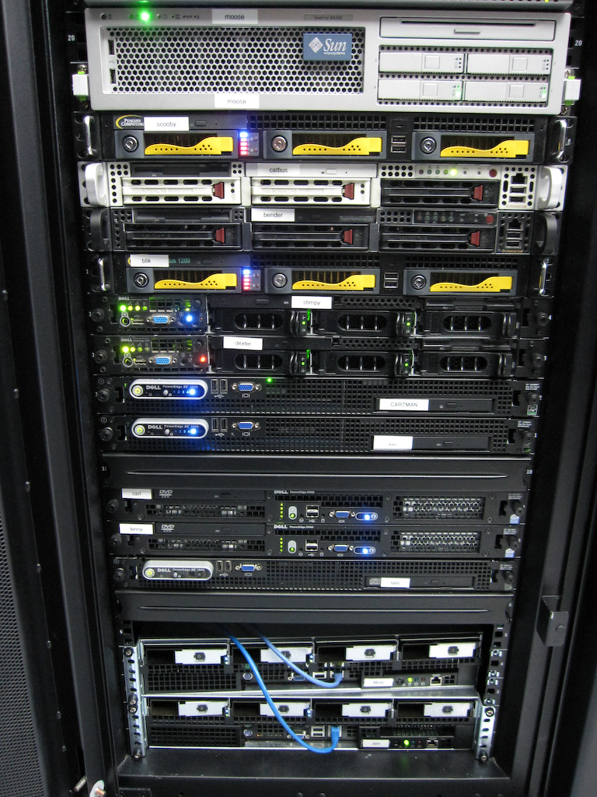
Access to Relational Databases
Photo credit “mayhem”, Flickr

Slide 23
Many RDB systems can handle RDF
Relational database vendors realize the importance of the Semantic Web market
Many systems have a “hybrid” view:
  traditional, relational storage, usually coupled with SQL
  RDF storage, usually coupled with SPARQL
  examples: Oracle 3g, IBM’s DB2, OpenLink Virtuoso,…

Slide 24
What is “export”?
“Export” does not necessarily mean physical conversion
  for very large databases a “duplication” would not be an option
  systems may provide SPARQL⇔SQL “bridges” to make queries on the fly
Result of export is a “logical” view of the RDB content

Slide 25
Simple export: Direct Mapping
A canonical RDF “view” of RDB tables
Only needs the information in the RDB Schema

Slide 26
Fundamental approach
Each column name provides a predicate
ISBN | Author | Title | Publisher | Year
0006511409X | id_xyz | The Glass Palace | id_qpr | 2000
0007179871 | id_xyz | The Hungry Tide | id_qpr | 2004
Each row is a subject
Table references are URI objects
Cells are Literal objects
ID | Name | Homepage
id_xyz | Ghosh, Amitav | http://www.amitavghosh.com

Slide 27


Tables
RDB Schema
Direct Mapping
“Direct Graph”

Slide 28
Pros and cons of Direct Mapping
Pros:
  Direct Mapping is simple, does not require any other concepts
  know the Schema ⇒ know the RDF graph structure
  know the RDF graph structure ⇒ good idea of the Schema(!)
Cons:
  the resulting graph is not what the application really wants

Slide 29
Tables
RDB Schema
Direct Mapping
“Direct Graph”
Graph Processing
(Rules, SPARQL, …)
Final, Application Graph

Slide 30
Beyond Direct Mapping: R2RML
Separate vocabulary to control the details of the mapping, e.g.:
  finer control over the choice of the subject
  creation of URI references from cells
  predicates may be chosen from a vocabulary
  datatypes may be assigned
  etc.
Gets to the final RDF graph with one processing step

Slide 31
R2RML Instance
Tables
RDB Schema
R2RML
Mapping
Final, Application Graph

Slide 32
Relationships to the Direct Mapping
Fundamentals are similar:
  each row is turned into a series of triples with a common subject
Direct mapping is a “default” R2RML mapping
Which of the two approaches is used depend on local tools, personal experiences and background,…
  e.g., user can begin with a “default” R2RML, and gradually refine it

Slide 33
R2RML and Direct Mapping Status
Technology has been finalized
Implementations revealed some minor issues to fold into the specification
Should be finished this summer

Slide 34
At the conference…
“Implementations of R2RML”, Wednesday, 8:45am
  Souripriya Das (Oracle), Jans Aasman (Franz Inc.), Juan Sequeda (Capsenta), and Tony Vachino (Spry, Inc.)

Slide 35
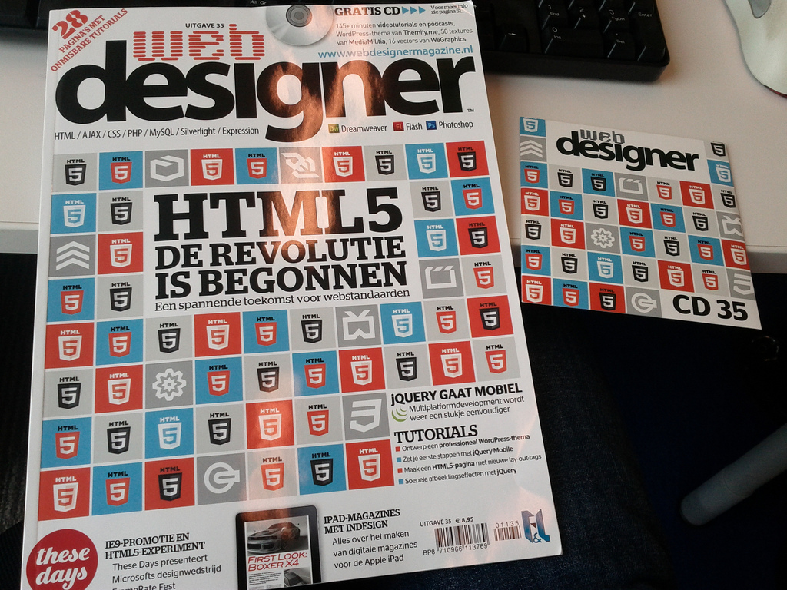
Structured data in HTML:
RDFa & microdata
Photo credit “shetladd”, Flickr

Slide 36
HTML pages are a huge source of structured data
Not necessarily large amount of data per page, but lots of them…
Have become very valuable to search engines
  Google, Bing, Yahoo!, or Yandex (i.e., schema.org) all committed to use such data
Two syntaxes have emerged at W3C:
  microdata with HTML5
  RDFa with HTML5, XHTML, and with XML languages in general

Slide 37
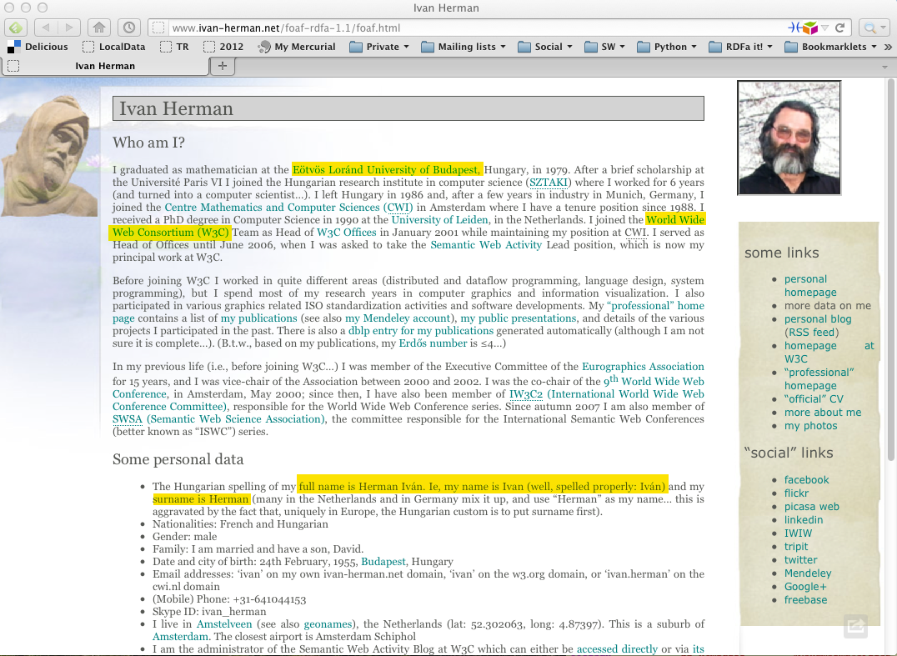

Slide 38
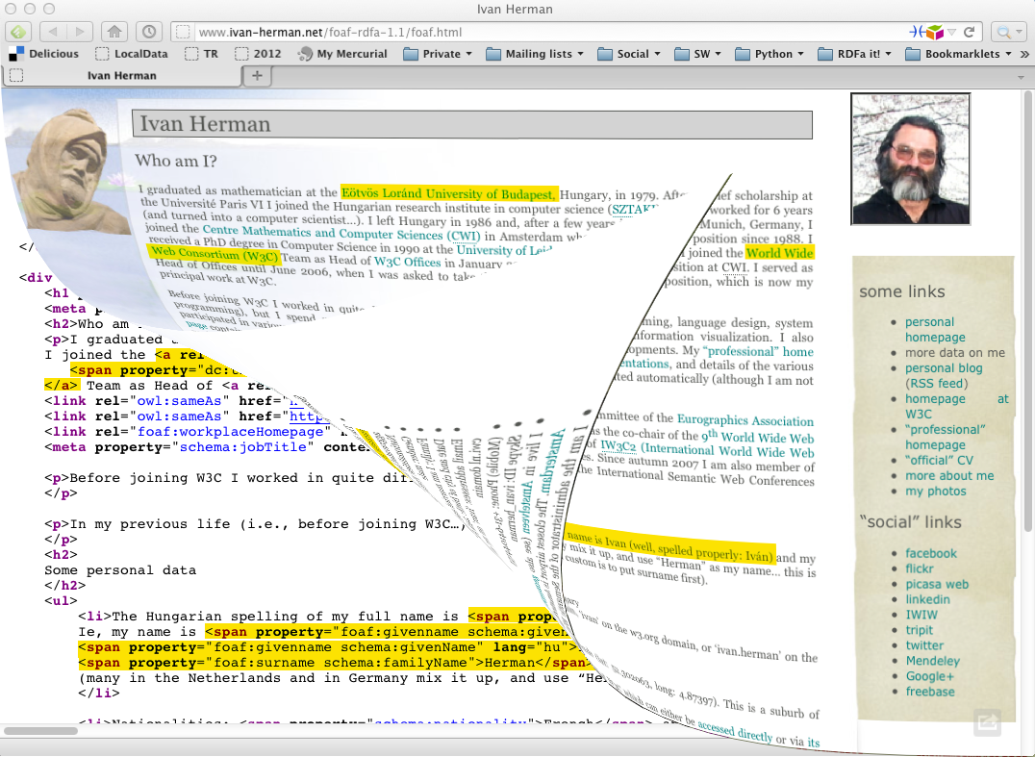

Slide 39
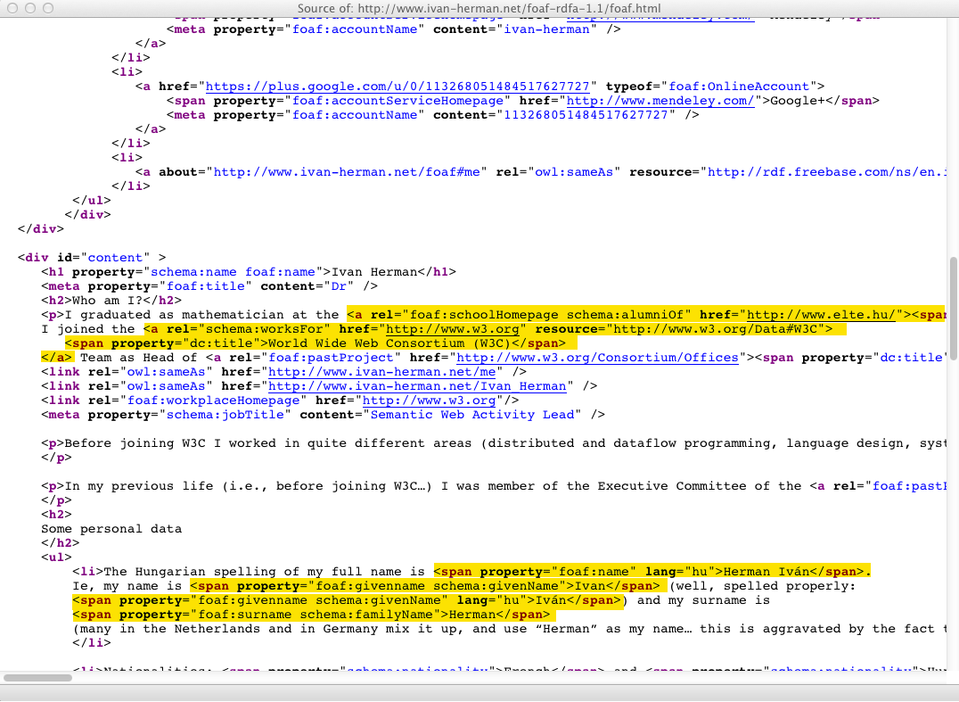

Slide 40
Yielding…
<http://www.ivan-herman.net/foaf#me>
schema:alumniOf <http://www.elte.hu> ;
foaf:schoolHomePage <http://www.elte.hu> ;
schema:worksFor <http://www.w3.org/W3C#data> ;
…
<http://www.elte.hu>
dc:title "Eötvös Loránd University of Budapest" .
…
<http://www.w3.org/W3C#data>
dc:title "World Wide Web Consortium (W3C)”
…

Slide 41
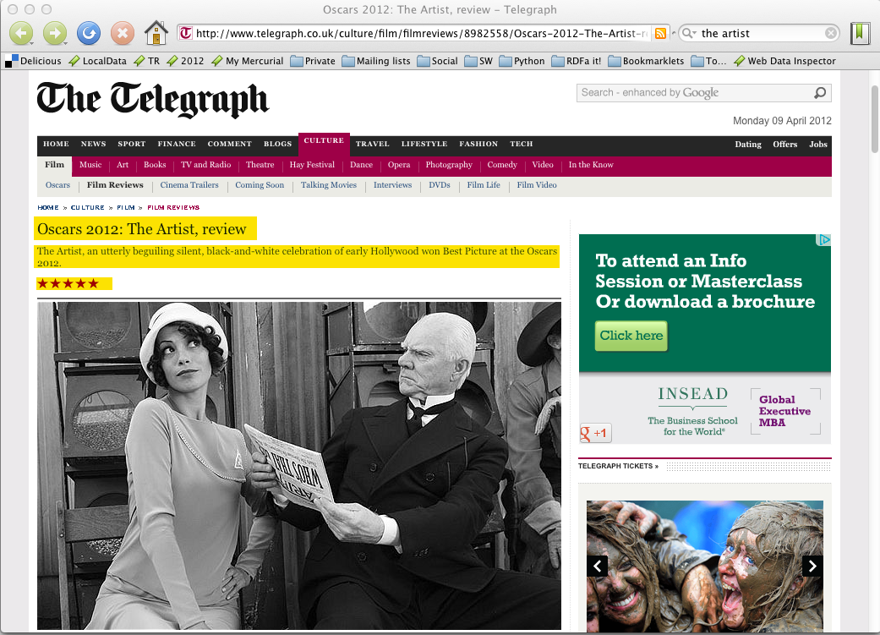

Slide 42
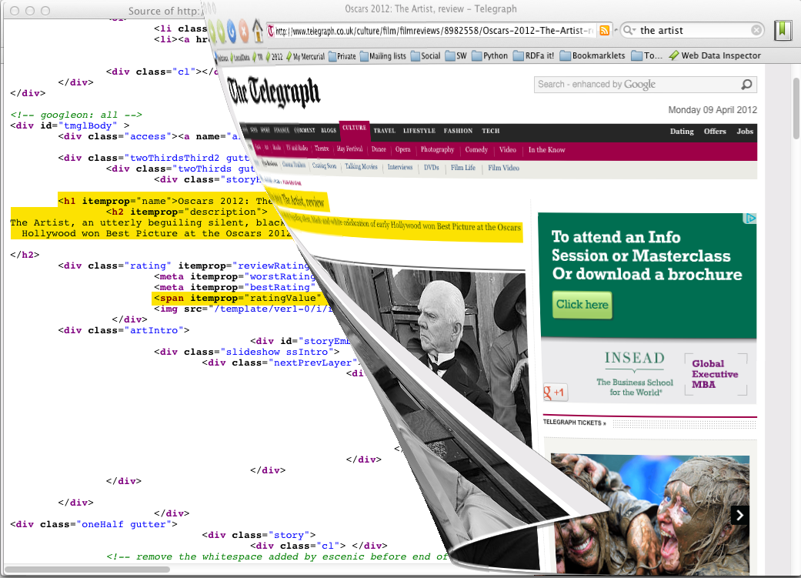

Slide 43
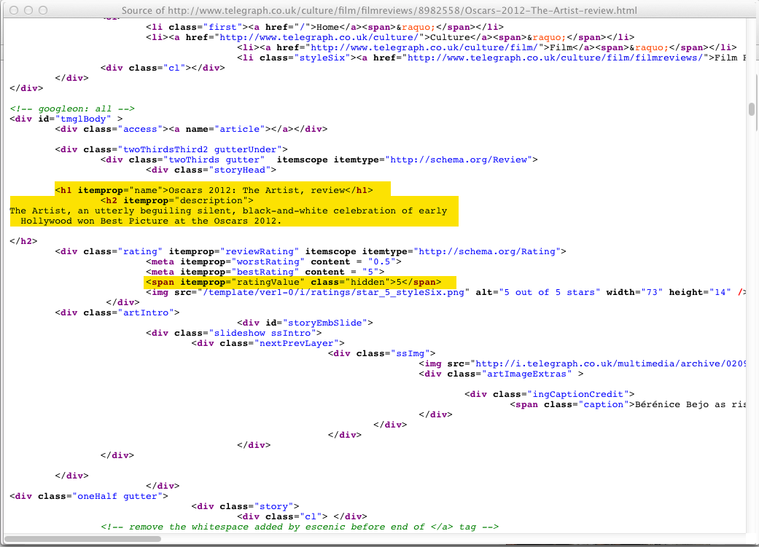

Slide 44
Yielding…
[ rdf:type schema:Review ;
schema:name "Oscars 2012: The Artist, review" ;
schema:description "The Artist, an utterly beguiling…" ;
schema:ratingValue "5" ;
…
]

Slide 45
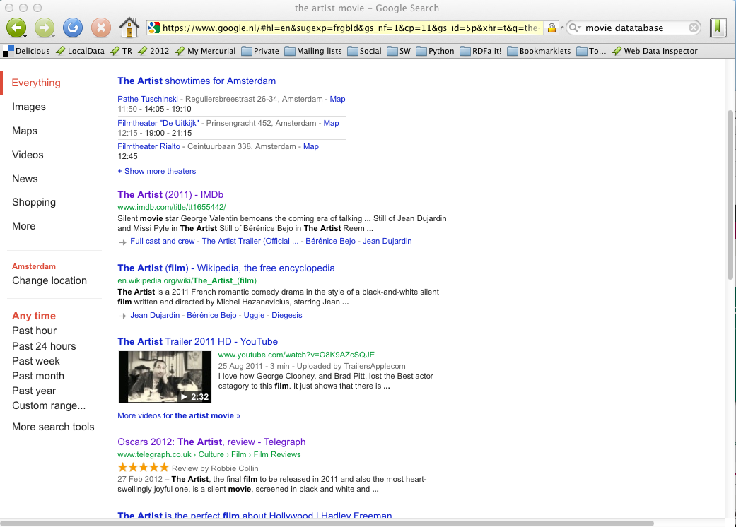

Slide 46
RDFa and microdata: similarities
Both have similar philosophies:
  the structured data is expressed via attributes only (no specialized elements)
  both define some special attributes
    e.g., itemscope for microdata, resource for RDFa
  both reuse some HTML core attributes (e.g., href)
  both reuse the textual content of the HTML source, if needed
RDF data can be extracted from both

Slide 47
RDFa and microdata: differences
Microdata has been optimized for simpler use cases:
  one vocabulary at a time
  tree shaped data
  no datatypes
RDFa provides a full serialization of RDF in XML or HTML
  the price is an extra complexity compared to microdata
RDFa 1.1 Lite is a simplified authoring profile of RDFa, very similar to microdata

Slide 48
Structured data in HTML is mainstream!
… 25% of webpages containing RDFa data […] over 7% of web pages containing microdata.
Mail from Peter Mika, Yahoo!
Based on a crawl evaluation by P. Mika and T. Potter
LDOW2012 Workshop, April 2012, Lyon, France
… web pages that contain structured data has increased from 6% in 2010 to 12% in 2012.
Hannes Mühleisen and Christian Bizer
Web Data Commons—Extracting Structured Data from Two Large Web Corpora,
LDOW2012 Workshop, April 2012, Lyon, France

Slide 49
RDFa 1.1 and microdata status
For RDFa 1.1
  Technology has been finalized
  Is in Proposed Recommendation
  Should be published as a Recommendation any day now
For microdata
  Technology has been finalized
  There is microdata→RDF mapping in a separate Note
  Is part of HTML5, hence its formal advancement depends on other technologies

Slide 50
At the conference…
“Schema.org panel”, Wednesday, 9:45am
  Dan Brickley (schema.org), Ramanathan Guha (Google), Steve Macbeth (Microsoft), Peter Mika (Yahoo!), Jeff Preston (Disney Interactive), Evan Sandhaus (NYT), Alexander Shubin (Yandex); moderator: Ivan Herman (W3C)

Slide 51
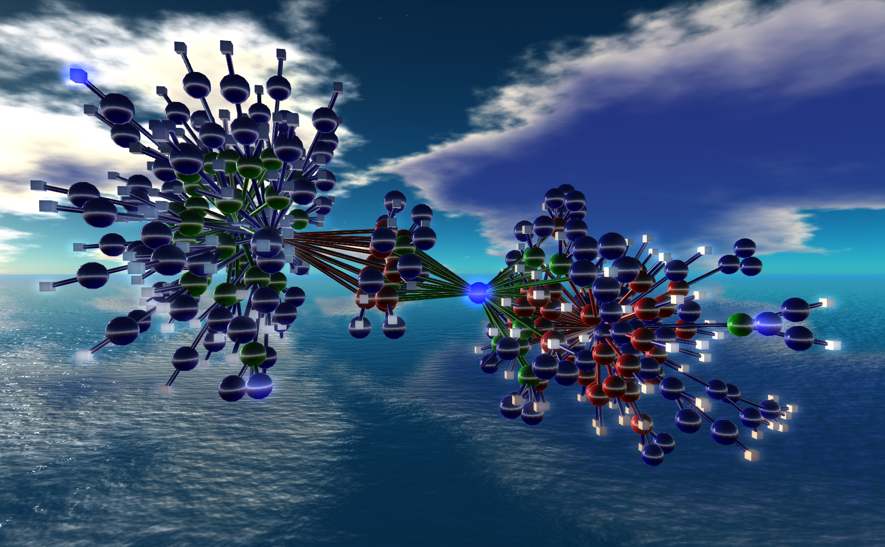
Cleaning up RDF
Nexus Simulation Credit Erich Bremmer

Slide 52
RDF cleanup (a.k.a. RDF1.1)
Many issues have come up since 2004:
  deployment issues
  new functionalities are needed
  underlying technology may have moved on (e.g., datatypes)
The goal of the RDF Working Group is to refresh RDF
NOT a complete reshaping of the standard!

Slide 53
Some new features/plans
Standardize Turtle as a serialization format
Clean up some aspects of datatyping, e.g.:
  plain vs. typed literals
  introduction of an rdf:HTML datatype
  better definition of rdf:XMLLiteral
Proper definition for “named graphs”
  including concepts, semantics, syntax, …
    obviously important for linked data access
    but generates quite some discussions on the details
Standardize a JSON format for linked data (JSON-LD)

Slide 54
Editorial improvements
Cleanup the documents, make them more readable
  maybe a completely new primer
  probably a new structure for the Semantics document

Slide 55
Status
Turtle is almost finalized
Literal cleanup is done
JSON-LD is in a good shape
Lots of discussion currently on named graphs…
A new version of the RDF 1.1 concepts has just been published this morning!
  http://www.w3.org/TR/rdf11-concepts/

Slide 56
At the conference…
“Updates to the Core RDF Standards”, Wednesday, 3:30pm
  David Wood (3 Round Stones, Inc., also co-chair of the W3C RDF WG)
“JSON-LD: JSON for Linked Data”, Thursday, 9:45am
  Gregg Kellogg (Kellogg Associates)

Slide 57
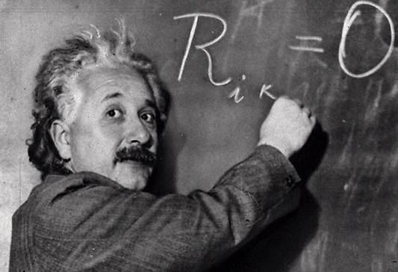
Provenance

Slide 58
The goal is simple…
We should be able to express all sorts of “meta” information on the data
  who played what role in creating the data (author, reviewer, etc.)
  view of the full revision chain of the data
  in case of data integration: which part comes from which original data and under what process
  what vocabularies/ontologies/rules were used to generate some portions of the data
  etc.

Slide 59
…the solution is more complicated
Requires a complete model describing the various constituents (actors, revisions, etc.)
The model should be usable with RDF
Has to find a balance between
  simple provenance: easily usable and editable
  complex provenance: allows for a detailed reporting of origins, versions, etc.
That is the role of the Provenance Working Group (started in 2011)

Slide 60
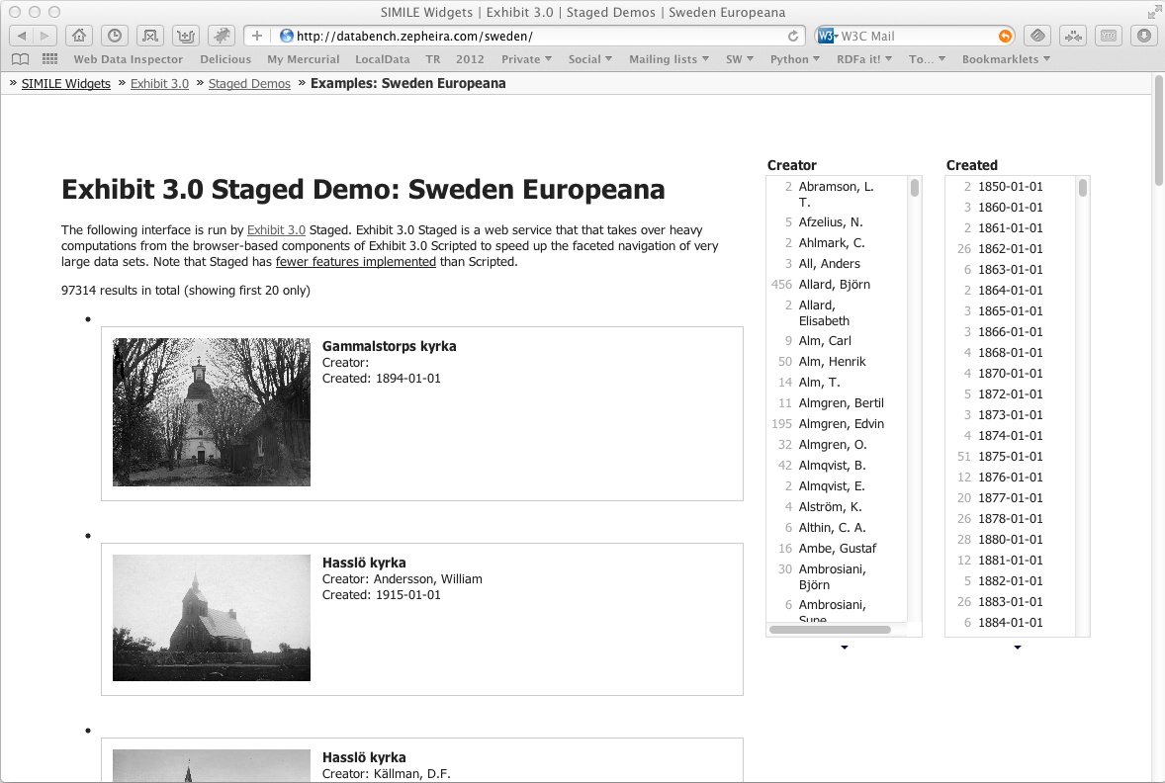
ex:photosDB
ex:facetedView
ex:integratedData
used
ex:metadata
wasGeneratedBy
used
wasGeneratedBy
used
simile:exhibit
ex:integrate
wasAttributedTo
wasAssociatedWith
wasAssociatedWith
foaf:name
foaf:mbox
foaf:mbox
foaf:name
Derek
mailto:derek@ex.com
mailto:betty@ex.com
Betty
Screendump from Zepheira

Slide 61
Status
Drafts have been published
  abstract data model, OWL version
  protocol (where to find provenance data)
  primer
Goal is to finalize the technical design in the fall of 2012

Slide 62
At the conference…
“Benefits and Applications of W3C’s Provenance Standards in Enterprise Semantic Web Applications”, Thursday, 10:45am
  Reza Bfar (Oracle)

Slide 63
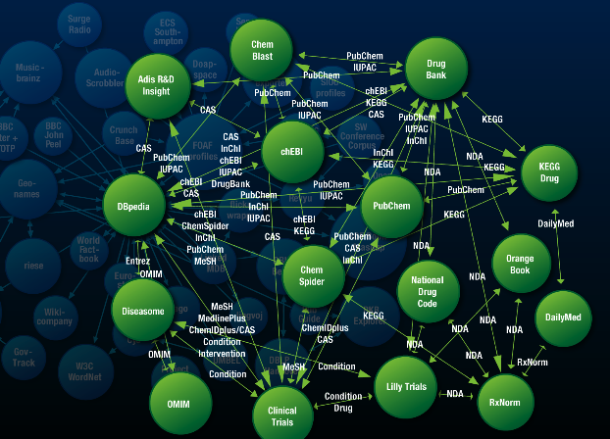
Linked Data Platforms

Slide 64
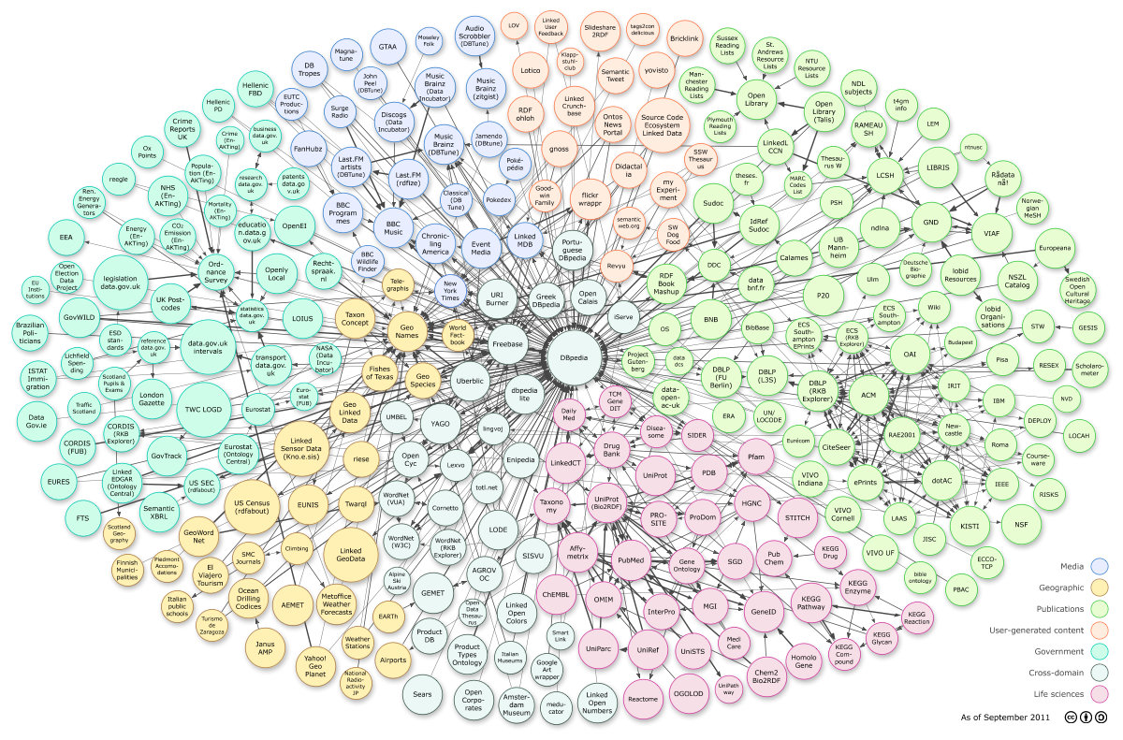
Courtesy of Richard Cyganiak and Anja Jentzsch
Notes:
295 datasets, cca. 31.6B triples

Slide 65
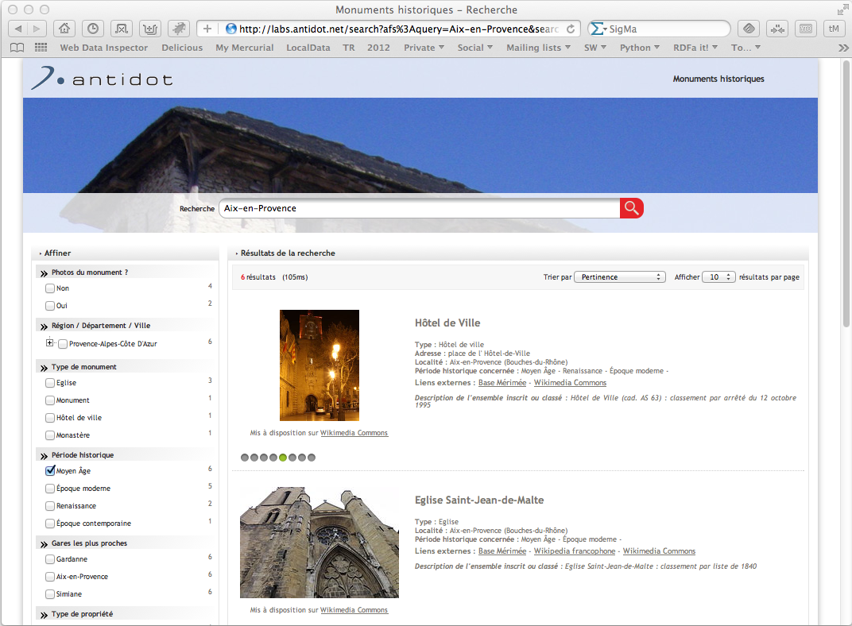
Notes:
Integrated datasets: dbpedia, open street maps, INSEE geographical information, official french list of historical monuments; not all made available in RDF, but integrated in RDF with the available conversion tools; results are merged in an RDF database (over 4.5 million triples) and a company tools is created for the user interface. Done in a few days using available tools

Slide 66
Some characteristics of Linked Data and its Applications
The datasets are essentially read-only
  they are curated “out of band”: regularly extracted from other databases, changed manually by data owners, etc
The dominating paradigm is to extract data via SPARQL queries
Applications use (very) large datasets via (RDF based) integration

Slide 67
However… Linked Data Has Potentials for “Simpler” Applications

Slide 68
Example: Data-intensive application integration
Application Lifecycle Management
  integration of development teams around the globe
  management of bug report, user requirements
  versioning
Distributed access to, and management of Library Catalogue data
Integrated view of corporate and private address book data

Slide 69
There has been approaches in the past
Point-to-point via API
Centralized repository
Central Hub/Bus
Inspired by Arnaud Le Hors, IBM, LDOW2012 Presentation

Slide 70
None of these are really satisfactory ☹
They force to re-invent the wheel on many fronts
  distribution of data around the Internet
  access control issues
  definition and implementation of new API-s, Protocols, data formats
  etc.

Slide 71
Why not make use of an architecture that is…
Distributed at its core
Scalable in terms of users, of data, of hardware and software architecture
Open to anyone
Has a wide variety of available tools
Widely known and deployed
Sounds Familiar? ☺

Slide 72
Linked Data Provides a Better Paradigm: Use the Existing Web Architecture!
Application #1
Application #2
HTTP GET, HEAD
URI+HTTP
HTTP PUT, DELETE
Linked Data
on Server #1
Linked Data
on Server #2

Slide 73
Linked Data Platform WG
Provide a simple, HTTP based infrastructure to publish, read, write, or modify linked data
The infrastructure should be easy to implement and install
  more complex applications may require more sophisticated tools like SPARQL, Provenance, OWL,…
  provides an “entry point” for Linked Data applications!

Slide 74
Linked Data Platform WG
Main Work items:
  define a RESTful way to access/update RDF data via HTTP
    what does HTTP GET/PUT/DELETE/POST/… mean for Linked Data?
  define a “profile” of minimal requirements for applications:
    what RDF datatypes are used
    what serialization syntax(es) must be supported
    how to access reasonable chunks of information (paging)
    how to manage collections of RDF data
    what vocabulary items to use for metadata
    etc.

Slide 75
Status
Has just started a few days ago!

Slide 76
At the conference…
“Linked Enterprise Data Patterns”, Tuesday, 11:30am
  David Wood (3 Round Stones, Inc.), Arnaud Le Hors (IBM), Ashok Malhotra (Oracle)
LDP Working Group BOF: Tuesday, 12:30pm, Franciscan “C”

Slide 77

What else may be on the horizon?

Slide 78
Some challenges raised by Linked Data
Knowledge vs. data ratio is different: very shallow, simple vocabularies for huge sets of data
  the role of reasoning is different (vocabularies, OWL DL, etc., may not be feasible)
Not enough links among datasets
  lots of work on “creating” further links
Scale: billions of triples, increasing every day
  setting a SPARQL endpoint everywhere may not be realistic
Highly distributed
  data may not be in one single database, even within the same organization

Slide 79
Possible future works in the activity
Check on the quality of the published data
Reconsider rule languages for (e.g., for Linked Data applications)
Relationship to JSON
Constraint checking of Data
API-s for client-side Web Application Developers

Slide 80
Possible future works in the activity
Issues around internationalization of Semantic Web technologies
Relationship between Semantic Web technologies and Big Data, Cloud Storage and Computing,…
Specific standard vocabularies (e.g., data annotation, governmental vocabularies)
  some of these may be defined at W3C, some elsewhere

Slide 81
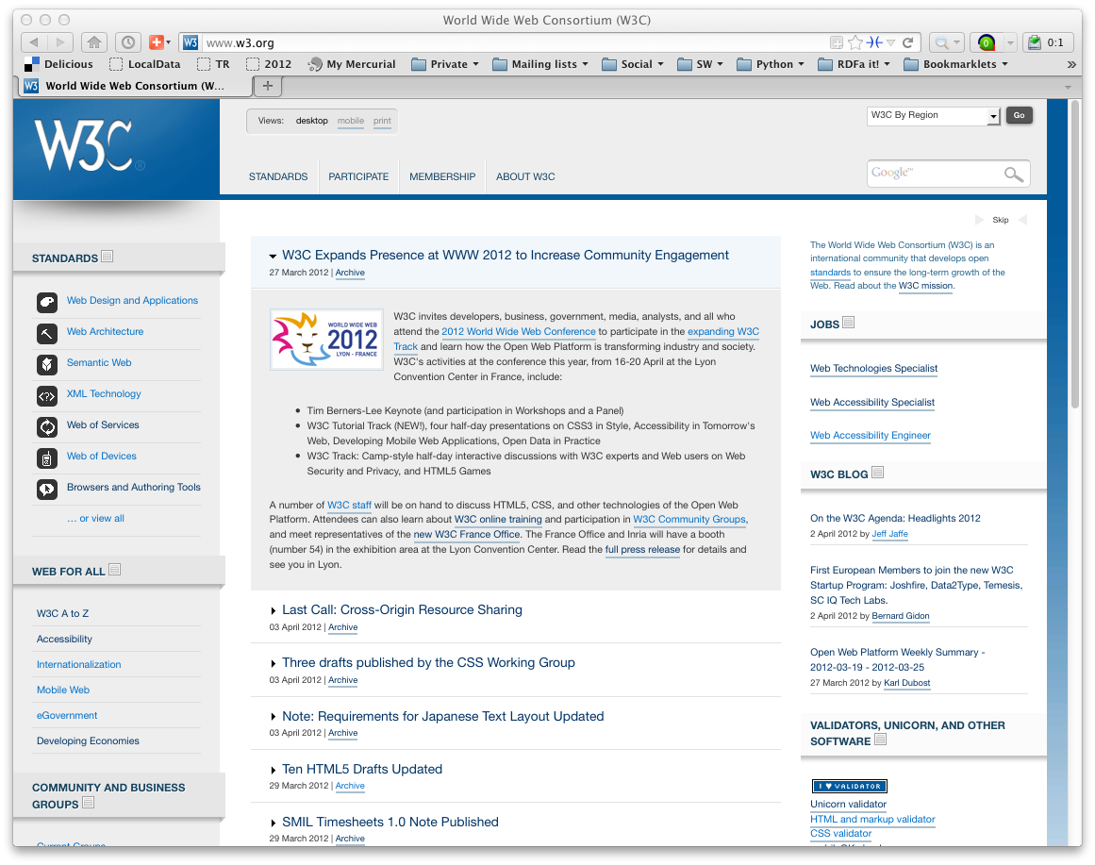
Lot remain to be done…
Lots of issues to be solved
But… W3C needs experts!
  consider joining W3C, as well as the work done there!

Slide 82
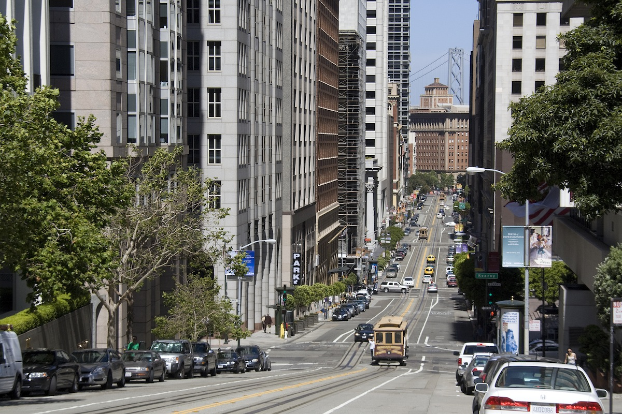
Enjoy The Conference!

Slide 83

Thank you for your attention
These slides are also available on the Web:
http://www.w3.org/2012/Talks/0605-SemTech-IH/

