Slide 1




A new Approach for Publishing Workflows: Abstractions, Standards and Linked Data
Daniel Garijo
Ontology Engineering Group, Departamento de Inteligencia Artificial. Universidad Politécnica de Madrid
Yolanda Gil
Information Sciences and Institute University of Southern California, Marina del Rey
Date: 28/02/2012

Slide 2


Index of contents
Index:
Background
Limitations of existing approaches to workflow publication
Features of our approach
Test use case: the TB-Drugome
Publishing abstract workflows and specific workflows
OPMW Ontology
Linked Data Publication
Workflow querying and Linked Data consumption
Conclusions
1

Slide 3
Background
Typical Published Article
Reproducible Article:
Weaver, GenePattern GRRD, etc.
Text:
Narrative of method,
software packages used
Text:
Narrative of method,
software packages used
Data:
Key datasets and figures/plots
Data:
Key datasets and figures/plots
Workflow:
Workflow/scripts describing
dataflow, codes, and parameters
NOT published,
loosely recorded:
Software:
scripted codes + manual steps +
notes/emails
2

Slide 4
Current issues with existing publication approaches
Only executable workflow is published:
Must have the same codes to re-execute the workflow, but:
Codes become unavailable
Eg: eHits was proprietary and replaced by AutodockVina
Different labs prefer different codes
Eg: R vs Matlab
Eg: viz in Citoscape vs yEd
Must have the same workflow framework to re-execute the workflow
Must have R for Weaver
Must import files to local file system and workflow framework
Must import bundle of workflow/data/code files to reproduce
Reproducible Article:
Weaver, GenePattern GRRD, etc.
Text:
Narrative of method,
software packages used
Data:
Key datasets and figures/plots
Workflow:
Workflow/scripts describing
dataflow, codes, and parameters
3

Slide 5
Key Features of our approach
Publish an abstract workflow in addition to executable workflow
Description of workflow that is independent of the codes executed
Maps to the codes executed (the “executable workflow”)
Publish both abstract and executable workflow using the OPM standard
OPM (Open Provenance Model) is independent of workflow framework and is widely implemented
Other groups can import to their own workflow framework
Publish data and workflows as Linked Data on the Web
All workflows and related files are web-accessible
Simple mechanism to share across local file systems
4

Slide 6
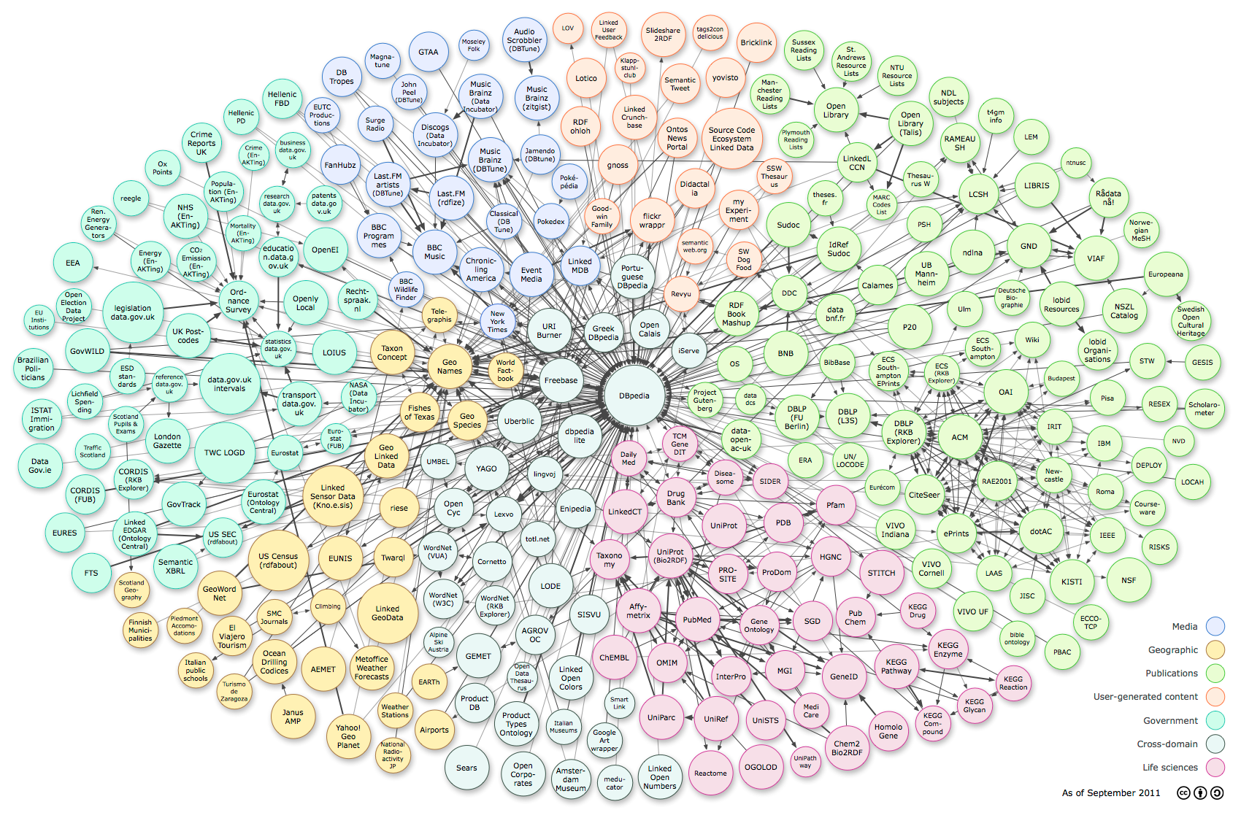
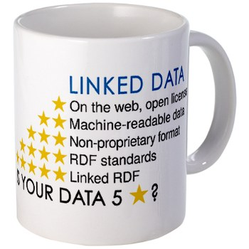
What is Linked Data
1. Use URIs as names for things.
2. Use HTTP URIs so that people can look up those names.
3. When someone looks up a URI, provide useful information.
4. Include links to other URIs.
“Linking Open Data cloud diagram, by Richard Cyganiak and Anja Jentzsch. http://lod-cloud.net/”
5
Notes:
Say that it can be defined as a set of “rules” for publishing content in the web.
Talk about the rules.
Talk about the 5 star dataset publishing
Talk about the diagram, which represent the number of datasets linked with each other. Special mention to reproducibility here.

Slide 7
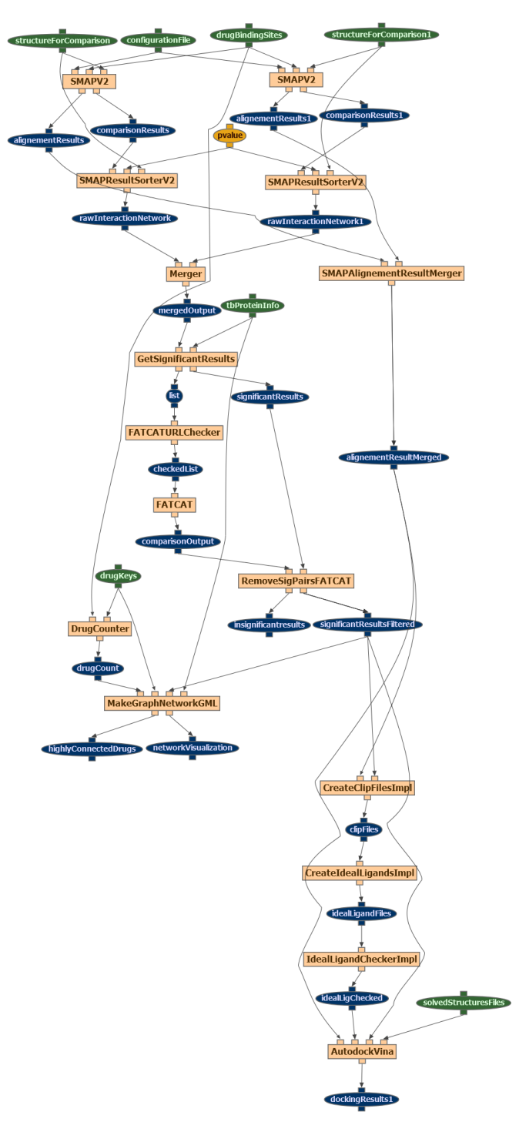
The TB Drugome
Comparison of ligand binding sites using SMAP
5

Slide 8
The TB Drugome (2)
Comparison of dissimilar protein structures using FATCAT
6

Slide 9
The TB Drugome (3)
Graph Network Generation
7

Slide 10
The TB Drugome (4)
Docking using Autodock Vina
8

Slide 11



High level architecture
Other
workflow
environments
WINGS on local laptop
Core
Workflow Template
OPM export
Programatic access (external apps)
Portal
Workflow Instance
Linked Data Publication
WINGS on shared host
Core
Workflow Template
OPM export
Portal
Workflow Instance
Interactive Browsing (Pubby frontend)
WINGS on web server
Core
Workflow Template
OPM export
Users
Portal
Workflow Instance
Wings workflow generation
OPM conversion
Publication
Share
Reuse
9

Slide 12
Abstract workflow and concrete workflow
We export the
abstract workflow
in addition to the
executed workflow
Abstract workflow
has conceptual
steps and is
independent of
execution codes
10

Slide 13
Executed workflow and execution-ready workflow
We export the
abstract workflow
in addition to the
executed workflow
11

Slide 14
High level architecture
Other
workflow
environments
WINGS on local laptop
Core
Workflow Template
OPM export
Programatic access (external apps)
Portal
Workflow Instance
Linked Data Publication
WINGS on shared host
Core
Workflow Template
OPM export
Portal
Workflow Instance
Interactive Browsing (Pubby frontend)
WINGS on web server
Core
Workflow Template
OPM export
Users
Portal
Workflow Instance
Wings workflow generation
OPM conversion
Publication
Share
Reuse
12

Slide 15
OPMW: (I) Representing the Process
13

Slide 16
OPMW: (II) Representing Attribution
14
Notes:
Why is the template useful?
Repurposability of the workflow.

Slide 17
High level architecture
Other
workflow
environments
WINGS on local laptop
Core
Workflow Template
OPM export
Programatic access (external apps)
Portal
Workflow Instance
Linked Data Publication
WINGS on shared host
Core
Workflow Template
OPM export
Portal
Workflow Instance
Interactive Browsing (Pubby frontend)
WINGS on web server
Core
Workflow Template
OPM export
Users
Portal
Workflow Instance
Wings workflow generation
OPM conversion
Publication
Share
Reuse
15

Slide 18
Publication of Workflows as Linked Data
Abstract Workflow
(OPM)
Linked Data publication
RDF Upload Interface
Wings
OPM conversion
OPM conversion
ExecutableWorkflow
(OPM)
Other workflow frameworks
RDF
Triple store
Permanent web-accessible
file store
OPM import
Workflow
Data, Components, etc.
SPARQL Endpoint
Web accessible
Web browser
16

Slide 19
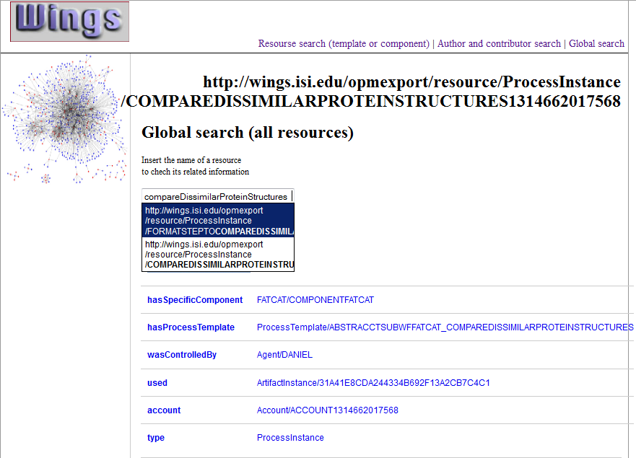
Searching/Browsing Workflows as Linked Data
Types of search
Resource URI (Process instance)
Autocomplete search bar
Specific component for this process instance
Properties
17

Slide 20
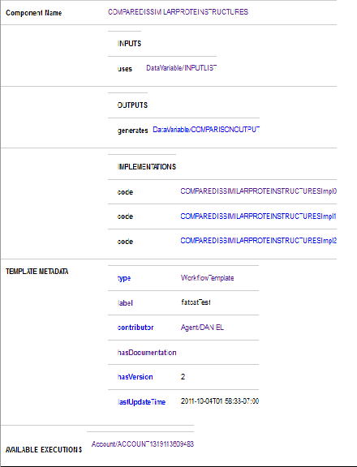
Searching/Browsing Workflows as Linked Data
Component Name
Component Inputs
Component Outputs
Code Implementations
Template additional metadata
Record of the different executions of this workflow
18
Notes:
Explain that this is the application for querying workflow templates that we are currently working on.

Slide 21
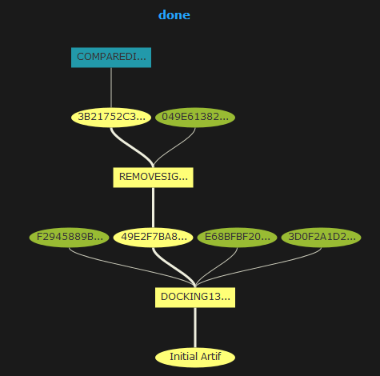
Other possible visualizations
Dynamic visualization of the provenance of resources by queries to the repository
Metadata exploration of the steps of the workflow.
19
Notes:
Explain that this is the application for querying workflow templates that we are currently working on.

Slide 22
Conclusions
Publication of an abstract workflow that represents the computational method in an execution-independent manner.
Publication of the abstract workflow and the executed workflow using the OPM model that is independent of the execution environment used.
Publication of the workflows, components, codes and datasets as Linked Data on the web.
20

Slide 23
Future work
Extensions to abstract workflow publication
Be able to provide abstractions on several steps.
Incomplete provenance.
Create an OPMV/W3C PROV-O profile for common workflow representation.
Increase interoperability with other workflow representation systems.
Workflow reuse in different workflow systems.
Import and execute workflows in other workflow frameworks.
21

Slide 24
References
WINGS workflow system: http://seagull.isi.edu/marbles/
The Open Provenance Model Specification: http://openprovenance.org/
OPMO: http://openprovenance.org/model/opmo
OPMV: http://open-biomed.sourceforge.net/opmv/ns.html
TB Drugome Wiki (Evolution of this work): http://seagull.isi.edu/wings-drugome/index.php/Main_Page
W3C PROV-O current ontology (draft): http://www.w3.org/2011/prov/wiki/PIL_OWL_Ontology
Principles of Linked Data: http://www.w3.org/DesignIssues/LinkedData.html
22

Slide 25



Acknowledgements
UCSD people:
Li Xie
Lei Xie
Sarah Kinnings
Phil Bourne
ISI people:
Varun Ratnakaar
OEG people:
Oscar Corcho
23

Slide 26
A new Approach for Publishing Workflows: Abstractions, Standards and Linked Data
Daniel Garijo
Ontology Engineering Group, Departamento de Inteligencia Artificial. Universidad Politécnica de Madrid
Yolanda Gil
Information Sciences and Institute University of Southern California, Marina del Rey
Date: 28/02/2012

