Slide 1


Introduction to RDFa
2011 Semantic Technologies Conference
7th of June, 2011,
San Francisco, CA, USA
Ivan Herman, W3C

Slide 2
What is RDFa?
For RDF people, it sounds very simple:
  RDFa is a serialization of RDF embedded in XHTML, HTML, or XML in general

Slide 3
So why bother? Why should we care? Why is that of any importance?

Slide 4
RDFa evolves into huge source of RDF triples on the Web

Slide 5
Data for a Web of Data
Apart from relational databases, most of the data on the Web are in… (X)HTML content
New content is generated every day
How would one get structured data from that information?

Slide 6
Authors of the “traditional Web”…
Do not like to generate RDF/XML files separately
  RDF/XML is complex
  it requires a separate storage, generation, etc. mechanism
    that is also valid for, e.g., Turtle
    even when authoring with, say, Emacs, creating an extra file is a load

Slide 7
Solution
Add extra structured content to the (X)HTML pages
Let processors extract those and turn into RDF

Slide 8
Existing approaches
Microformats
  reuses HTML attributes like @class, @title
  separate vocabularies (address, CV, …)
  difficult to mix microformats (no concept of namespaces)
  does not, inherently, define an RDF representation
    possible to transform via, e.g., XSLT + GRDDL, but all transformations are vocabulary dependent

Slide 9
Existing approaches
Microdata
  adds new attributes to HTML5 to express metadata
  can use URI-s, it also fixes some vocabulary mappings (e.g., to Dublin Core elements)
  works well for simpler “single-vocabulary” cases, but…
  …not well suited for mixing vocabularies or for complex vocabularies
  has no notion of datatypes, namespaces
  does defines a generic mapping to RDF

Slide 10
Existing approaches
RDFa
  adds new (X)HTML/XML attributes
  has namespaces and URI-s at its core; i.e., mixing vocabulary is just as easy as in RDF
  complete flexibility for using Literals or URI Resources
  is a complete serialization of RDF

Slide 11
RDFa is a bridge between the Web of Documents and the Web of Data

Slide 12
Therefore…
It is very important for RDF experts and tool providers to
  know RDFa
  parse it alongside Turtle, RDF/XML or other
  when appropriate, generate RDFa pages

Slide 13
What does RDFa look like ?

Slide 14
Main principles of RDFa
RDFa means “RDF in attributes”:
  all RDF contents are defined through XML attributes (no elements)
  the XML/HTML tree structure is used (when appropriate)
  many of the attributes are defined by RDFa
    some attributes (@href, @rel) are also reused
  if possible, the text content is also reused

Slide 15
What does this mean in practice?
The same (X)HTML file:
  is used, unchanged, by browsers
    they ignore attributes they do not know how to present
  can be used by specialized processors (or APIs) to extract RDF triples

Slide 16
Before getting into details…
The current Recommendation is RDFa 1.0
There is an RDFa 1.1 in the making, almost ready
I will talk about RDFa 1.1 and warn when the feature is not available in RDFa1.0

Slide 17
XML, XHTML, HTML (or other)?
XML
XHTML
HTML5
Atom
SVG
…
RDFa Core 1.1
Formally:
  RDFa WG defines Core and XHTML
  HTML WG defines HTML5
  other groups may define others (like Atom)
this tutorial uses XHTML examples

Slide 18
How does it work?

Slide 19
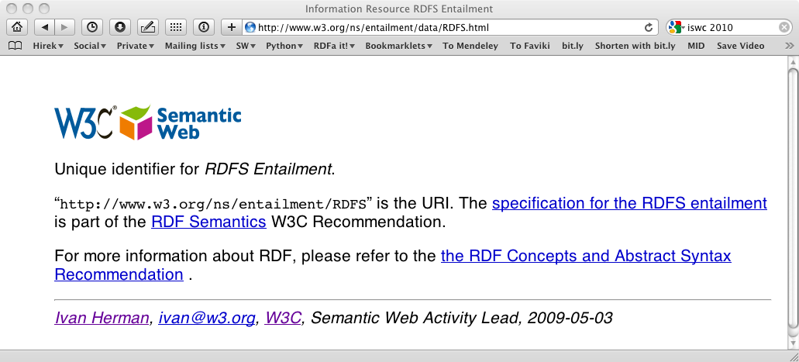

Slide 20
The source and generated RDF…
<p about="http://www.w3.org/ns/entailment/RDFS"
property="http://purl.org/dc/terms/description">
Unique identifier for <em>RDFS Entailment</em>.</p>

Slide 21
The source and generated RDF…
<p about="http://www.w3.org/ns/entailment/RDFS"
property="http://purl.org/dc/terms/description">
Unique identifier for <em>RDFS Entailment</em>.</p>
<http://www.w3.org/ns/entailment/RDFS>
… .

Slide 22
The source and generated RDF…
<p about="http://www.w3.org/ns/entailment/RDFS"
property="http://purl.org/dc/terms/description">
Unique identifier for <em>RDFS Entailment</em>.</p>
<http://www.w3.org/ns/entailment/RDFS>
<http://purl.org/dc/terms/description>
… .

Slide 23
The source and generated RDF…
<p about="http://www.w3.org/ns/entailment/RDFS"
property="http://purl.org/dc/terms/description">
Unique identifier for <em>RDFS Entailment</em>.</p>
<http://www.w3.org/ns/entailment/RDFS>
<http://purl.org/dc/terms/description>
"Unique identifier for RDFS Entailment." .

Slide 25
The source and generated RDF…
<a about="http://www.w3.org/ns/entailment/RDFS"
rel="http://www.w3.org/2000/01/rdf-schema#seeAlso"
href="http://www.w3.org/TR/2004/REC-rdf-mt-20040210/">
RDF Semantics.
</a>

Slide 26
The source and generated RDF…
<a about="http://www.w3.org/ns/entailment/RDFS"
rel="http://www.w3.org/2000/01/rdf-schema#seeAlso"
href="http://www.w3.org/TR/2004/REC-rdf-mt-20040210/">
RDF Semantics.
</a>
<http://www.w3.org/ns/entailment/RDFS>
….

Slide 27
The source and generated RDF…
<a about="http://www.w3.org/ns/entailment/RDFS"
rel="http://www.w3.org/2000/01/rdf-schema#seeAlso"
href="http://www.w3.org/TR/2004/REC-rdf-mt-20040210/">
RDF Semantics.
</a>
<http://www.w3.org/ns/entailment/RDFS>
<http://www.w3.org/2000/01/rdf-schema#seeAlso>
… .

Slide 28
The source and generated RDF…
<a about="http://www.w3.org/ns/entailment/RDFS"
rel="http://www.w3.org/2000/01/rdf-schema#seeAlso"
href="http://www.w3.org/TR/2004/REC-rdf-mt-20040210/">
RDF Semantics.
</a>
<http://www.w3.org/ns/entailment/RDFS>
<http://www.w3.org/2000/01/rdf-schema#seeAlso>
<http://www.w3.org/TR/2004/REC-rdf-mt-20040210/> .

Slide 29
Is that it?

Slide 30
What we have is… NTriples in HTML
The combination of @about with @rel/@property and possibly @href covers most of we need…
But this is too complex for authors

Slide 31
Just compare
<http://www.w3.org/ns/entailment/RDFS>
<http://purl.org/dc/terms/description>
"Unique identifier for RDFS Entailment." .
<http://www.w3.org/ns/entailment/RDFS>
<http://www.w3.org/2000/01/rdf-schema#seeAlso>
<http://www.w3.org/TR/2004/REC-rdf-mt-20040210/> .
with
@prefix rdfs: <http://www.w3.org/2000/01/rdf-schema#> .
@prefix dcterms: <http://purl.org/dc/terms/> .
<http://www.w3.org/ns/entailment/RDFS>
rdfs:seeAlso <http://www.w3.org/TR/2004/REC-rdf-mt-20040210/> ;
dcterms:description "Unique identifier for RDFS Entailment." .

Slide 32
The “Turtle” aspects of RDFa
Use compact URI-s when possible
Make use of the natural structure for
  shared subjects
  shared predicates
  create blank nodes
  …

Slide 33
Compact URIs (“CURIE”s)
Just like in Turtle:
  define a prefix via @prefix
  use prefix:reference to abbreviate a URI

Slide 34
CURIE definition and usage
<html>
…
<p about="http://www.w3.org/ns/entailment/RDFS"
property="http://purl.org/dc/terms/description">
Unique identifier for <em>RDFS Entailment</em>.</p>
…
</html>
can be replaced by:
<html prefix="dcterms: http://purl.org/dc/terms/">
…
<p about="http://www.w3.org/ns/entailment/RDFS"
property="dcterms:description">
Unique identifier for <em>RDFS Entailment</em>.</p>
…
</html>

Slide 35
Some details on @prefix
Can be anywhere in the tree and is valid for the whole sub-tree
  i.e., the html element is not the only place to have it
The same @prefix attribute can hold several definitions:
  prefix="dcterm: http://purl.org… foaf: http://…"

Slide 36
Some details on @prefix
An alternative (deprecated) syntax is
  xmlns:dcterms="http://purl.org/dc/terms/"
CURIEs and “real” URIs can usually be mixed
  if an attribute value can be interpreted as a CURIE, fine
  alternatively, it is considered as a URI
CURIEs cannot be used on @href

Slide 37
RDFa 1.0 Warnings on CURIEs
In RDFa 1.0
  only the xmlns:XXX syntax is usable
  CURIEs on @about can only be used with the extra syntax: about="[pref:ref]"
  Only CURIEs can be used on, e.g., @property or @rel (no fallback on URIs)

Slide 38
Sharing subjects
The basic principle: @about is inherited by children nodes
  i.e., no reason to repeat it

Slide 39
Shared subject example
<html prefix="dcterms: http://purl.org/dc/terms/
rdfs: http://www.w3.org/2000/01/rdf-schema#">
…
<body about="http://www.w3.org/ns/entailment/RDFS">
…
<p property="dcterms:description">
Unique identifier for <em>RDFS Entailment</em>.</p>
<p>…<a rel="rdfs:seeAlso"
href="http://www.w3.org/TR/2004/REC-rdf-mt-20040210">
RDFS Semantics</a>…</p>

Slide 40
… yielding
@prefix rdfs: <http://www.w3.org/2000/01/rdf-schema#> .
@prefix dcterms: <http://purl.org/dc/terms/> .
<http://www.w3.org/ns/entailment/RDFS>
rdfs:seeAlso <http://www.w3.org/TR/2004/REC-rdf-mt-20040210/> ;
dcterms:description "Unique identifier for RDFS Entailment." .

Slide 41
Intricacies of literals

Slide 42
Date examples
<body about=".." prefix="dcterms: http://…"
<address>
<p property="dcterms:date">2010-07-05</p>
</address>
</body>
This leads to:
@prefix dcterms: <http://…> .
<..> dcterm:date "2010-07-05" .

Slide 43
Datatypes
<body about=".." prefix="dcterms: http://… xsd: http://…"
<address>
<p property="dcterms:date" datatype="xsd:date">2010-07-05</p>
</address>
</body>
This leads to:
@prefix dcterms: <http://…> .
@prefix xsd: <http://…> .
<..> dcterms:date "2010-07-05"^^xsd:date .

Slide 44
Controlling the literal content
The basic rule says: the (RDF) Literal is the enclosed text from the HTML content
This is fine in 80% of the cases, but…
…it may not be natural in all cases! E.g.,
  2010-07-05 is the “official” ISO format (for xsd:date)
  but “July 5, 2010” looks much more natural for a human…

Slide 45
Usage of @content
<body about=".." prefix="dcterms: http://… xsd: http://…"
<address>
<p property="dcterms:date" datatype="xsd:date"
content="2010-07-05">July 5, 2010</p>
</address>
</body>
Also leads to:
@prefix dcterms: <http://…> .
@prefix xsd: <http://…> .
<..> dcterms:date "2010-07-05"^^xsd:date .

Slide 46
Subjects, and objects, and subjects again…

Slide 47
The rules until now
What we said is:
  @about sets the subject
  @href sets the object
But that is not always good enough
  we do not always want active links (i.e., the "a" element)
  what about other links in HTML?

Slide 48
We may not always want links…
The RDFa @resource attribute is equivalent to @href
  it sets the object, just like @href
  but it is ignored by a browser, i.e., not a link!
  e.g.,:
<span about="http://www.ivan-herman.net/foaf#me">
<span rel="rdfs:seeAlso"
resource="http://www.w3.org/People/Ivan/">Activity Lead</span>
</span>

Slide 49
“Chaining”
Here is what we would like to have in RDFa
<http://www.w3.org/ns/entailment/RDFS>
dcterms:creator <http://www.ivan-herman.net/foaf#me> .
<http://www.ivan-herman.net/foaf#me>
foaf:mailbox <mailto:ivan@w3.org> ;
foaf:workplaceHomepage <http://www.w3.org> .

Slide 50
“Chaining”
A straightforward way:
<body about="http://www.w3.org/ns/entailment/RDFS">
…
<address>
<span rel="dcterms:creator"
resource="http://www.ivan-herman.net/foaf#me"/>
<span about="http://www.ivan-herman.net/foaf#me">
<a rel="foaf:mailbox"
href="mailto:ivan@w3.org">ivan@w3.org</a>,
<a rel="foaf:workplaceHomepage"
href="http://www.w3.org">W3C</a>
</span>
</address>

Slide 51
“Chaining”
A straightforward way:
<body about="http://www.w3.org/ns/entailment/RDFS">
…
<address>
<span rel="dcterms:creator"
resource="http://www.ivan-herman.net/foaf#me"/>
<span about="http://www.ivan-herman.net/foaf#me">
<a rel="foaf:mailbox"
href="mailto:ivan@w3.org">ivan@w3.org</a>,
<a rel="foaf:workplaceHomepage"
href="http://www.w3.org">W3C</a>
</span>
</address>

Slide 52
“Chaining”: when objects become subjects…
An alternative:
<body about="http://www.w3.org/ns/entailment/RDFS">
…
<address>
<span rel="dcterms:creator"
resource="http://www.ivan-herman.net/foaf#me">
<a rel="foaf:mailbox"
href="mailto:ivan@w3.org">ivan@w3.org</a>,
<a rel="foaf:workplaceHomepage"
href="http://www.w3.org">W3C</a>
</span>
</address>

Slide 53
Chaining means
@resource (or @href) becomes a subject for the sub-tree
This feature is a bit like in RDF/XML

Slide 54
Some extra features

Slide 55
Some extra features
Blank nodes can be created using “_:XX”
Shorthand for RDF types
Helping single-vocabulary cases
Profiles

Slide 56
Typing
Typing can of course be done using @rel="rdf:type"
But that is a widely used combination, so there is a separate @typeof attribute for that

Slide 57
Typing example
<span about="http://www.ivan-herman.net/foaf#me"
typeof="foaf:Person">
<span property="foaf:name">Ivan Herman</span>
</span>,
yields
<http://www.ivan-herman.net/foaf#me> a foaf:Person ;
foaf:name "Ivan Herman" .

Slide 58
Single-vocabulary case
In many cases the content is dominated by one vocabulary (e.g., dcterms, foaf, etc.)
Also: usage of CURIEs and URI-s is intuitive for RDF people…
… but not for average HTML authors!

Slide 59
Usage of vocab and terms
Solution:
  define a vocabulary URI for a sub-tree
  for that sub-tree, simple terms in @rel, @property, etc., are automatically expanded into a full URI using the vocabulary
  RDFa 1.0 warning: this is an RDFa1.1 feature!

Slide 60
@vocab and terms: this…
<div prefix="foaf: http://xmlns.com/foaf/0.1/">
…
<address about="http://www.ivan-herman.net/foaf#me"
typeof="foaf:Person”>
<span property="foaf:name">Ivan Herman</span>,
<a rel="foaf:mailbox"
href="mailto:ivan@w3.org">ivan@w3.org</a>,
<a rel="foaf:workplaceHomepage"
href="http://www.w3.org">W3C</a>
</address>

Slide 61
…becomes
<div vocab="http://xmlns.com/foaf/0.1/">
…
<address about="http://www.ivan-herman.net/foaf#me"
typeof="Person">
<span property="name">Ivan Herman</span>,
<a rel="mailbox"
href="mailto:ivan@w3.org">ivan@w3.org</a>,
<a rel="workplaceHomepage"
href="http://www.w3.org">W3C</a>
</address>

Slide 62
…becomes
<div vocab="http://xmlns.com/foaf/0.1/">
…
<address about="http://www.ivan-herman.net/foaf#me"
typeof="Person">
<span property="name">Ivan Herman</span>,
<a rel="mailbox"
href="mailto:ivan@w3.org">ivan@w3.org</a>,
<a rel="workplaceHomepage"
href="http://www.w3.org">W3C</a>
</address>

Slide 63
…becomes
<div vocab="http://xmlns.com/foaf/0.1/">
…
<address about="http://www.ivan-herman.net/foaf#me"
typeof="Person">
<span property="name">Ivan Herman</span>,
<a rel="mailbox"
href="mailto:ivan@w3.org">ivan@w3.org</a>,
<a rel="workplaceHomepage"
href="http://www.w3.org">W3C</a>
</address>

Slide 64
Profile files
Prefix and term declarations can be collected in a separate file and referred to via a @profile attribute
  the “profile file”
  RDFa 1.0 warning: this is an RDFa1.1 feature!

Slide 65
Profile Example
Say, file “http://ex.org/prof” defines
  prefix mappings:
    "foaf" → "http://xmlns.com/foaf/0.1/"
    "rdfs" → "http://www.w3.org/2000/01/rdf-schema#"
    …
  term mapping:
    "desc" → "http://purl.org/dc/terms/description"
    …

Slide 66
Profile usage example: this…
<html prefix="dcterms: http://purl.org/dc/terms/
rdfs: http://www.w3.org/2000/01/rdf-schema#">
…
<body about="http://www.w3.org/ns/entailment/RDFS">
…
<p property="dcterms:description">
Unique identifier for <em>RDFS Entailment</em>.</p>
<p>…<a rel="rdfs:seeAlso"
href="http://www.w3.org/TR/2004/REC-rdf-mt-20040210">
RDFS Semantics</a>…</p>
…
<address about="http://www.ivan-herman.net/foaf#me">
<span property="foaf:name">Ivan Herman</span>,
…

Slide 67
…becomes
<html profile="http://ex.org/prof">
…
<body about="http://www.w3.org/ns/entailment/RDFS">
…
<p property="desc">
Unique identifier for <em>RDFS Entailment</em>.</p>
<p>…<a rel="rdfs:seeAlso"
href="http://www.w3.org/TR/2004/REC-rdf-mt-20040210">
RDFS Semantics</a>…</p>
…
<address about="http://www.ivan-herman.net/foaf#me">
<span property="foaf:name">Ivan Herman</span>,
…

Slide 68
…becomes
<html profile="http://ex.org/prof">
…
<body about="http://www.w3.org/ns/entailment/RDFS">
…
<p property="desc">
Unique identifier for <em>RDFS Entailment</em>.</p>
<p>…<a rel="rdfs:seeAlso"
href="http://www.w3.org/TR/2004/REC-rdf-mt-20040210">
RDFS Semantics</a>…</p>
…
<address about="http://www.ivan-herman.net/foaf#me">
<span property="foaf:name">Ivan Herman</span>,
…

Slide 69
Default profiles
Even usage of profiles might be “too much” for many HTML authors
  authors will forget to add the @profile declaration
RDFa defines default profiles:
  RDFa clients include these profiles automatically

Slide 70
Default profiles
Default for RDFa in general
  http://www.w3.org/profile/rdfa-1.1
  includes some widely used prefixes (rdf, rdfs, vcard, og, foaf, dc, or dcterms are typical candidates)
  the profile is to be updated regularly by adding new prefixes
Default for (X)HTML
  http://www.w3.org/profile/html-rdfa-1.1
  includes the HTML4 @rel values (next, up, license, …)
  the profile is to be updated regularly by adding @rel values as they evolve in the HTML world
Beware: the exact content of these, and the policy on how to add new prefixes and terms is not yet decided!

Slide 71
So this…
<html profile="http://ex.org/prof">
…
<body about="http://www.w3.org/ns/entailment/RDFS">
…
<p property="dcterms:description">
Unique identifier for <em>RDFS Entailment</em>.</p>
<p>…<a rel="rdfs:seeAlso"
href="http://www.w3.org/TR/2004/REC-rdf-mt-20040210">
RDFS Semantics</a>…</p>

Slide 72
…becomes:
<html>
…
<body about="http://www.w3.org/ns/entailment/RDFS">
…
<p property="dcterms:description">
Unique identifier for <em>RDFS Entailment</em>.</p>
<p>…<a rel="rdfs:seeAlso"
href="http://www.w3.org/TR/2004/REC-rdf-mt-20040210">
RDFS Semantics</a>…</p>

Slide 73
Publishing and consuming RDFa

Slide 74
Authoring RDFa
Some authoring tools already have RDFa facilities:
  e.g., it is possible to add the right DTD to Dreamweaver, Amaya has it at its core, etc.
There are plugins to, e.g., WordPress, to generate RDFa markup
CMS systems (like Drupal 7) may have RDFa built in their publication system
  users generate RDFa whether they know about it or not…

Slide 75
Consuming RDFa
Various search engines begin to consume RDFa
  Google, Yahoo, …
    they may specify which vocabularies they “understand”
    this is still an evolving area
There are libraries, distillers, etc., to extract RDFa information
  may be part of RDF development environments like Redland, RDFLib
  see, for further references, http://rdfa.info/wiki/Consume
Facebook’s “social graph” is based on RDFa

Slide 76
Publishing RDFa
RDFa+HTML file can just be on a server
  the client extracts the RDF content
Content negotiations can be set up on the server side
  the client gets the format he/she asks for
  the RDF content can either be generated on the fly or stored on the server statically

Slide 77
Some deployment examples

Slide 78
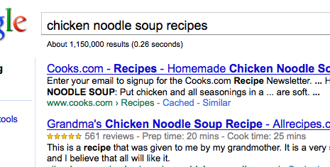
Google’s rich snippets
Embedded metadata (microdata or RDFa) is used to improve search result page
  at the moment only a few vocabularies are recognized, but that will evolve over the years

Slide 79
Effects of, e.g., Google of Facebook
A number of popular sites publish RDFa as part of their normal pages:
  Tesco, BestBuy, Slideshare, The London Gazette, Newsweek, MSNBC, O’Reilly Catalog, the White House…
  Creative Commons snippets are in RDFa (e.g., on Flickr)

Slide 80
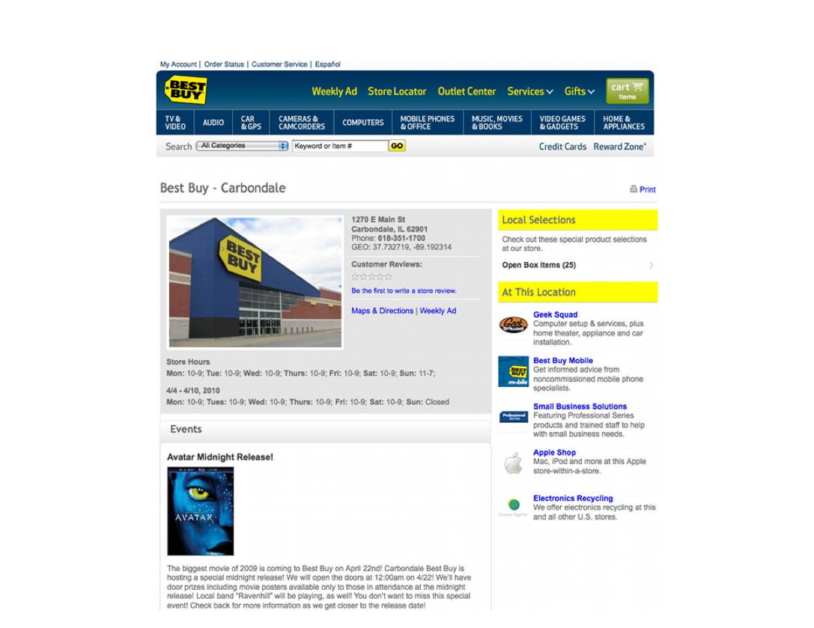
BestBuy Example for RDFa Usage
Courtesy of Jay Myers, BestBuy, SemTech2010 Presentation

Slide 81
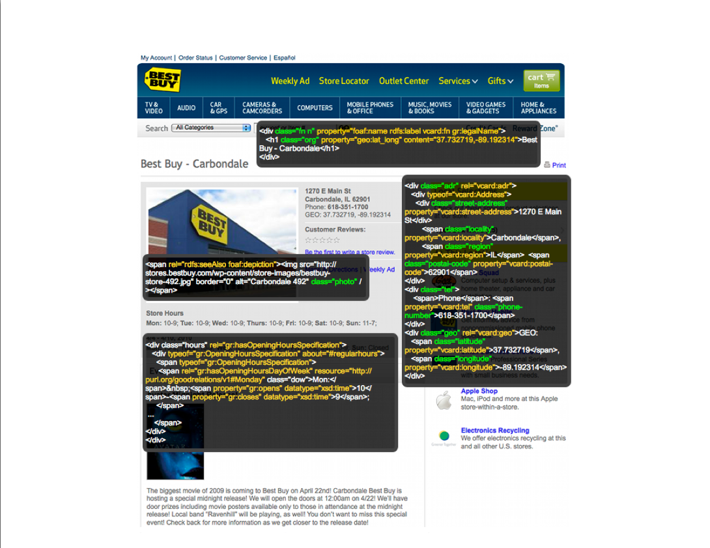
BestBuy Example for RDFa Usage
Courtesy of Jay Myers, BestBuy, SemTech2010 Presentation

Slide 82
Effects on BestBuy
Reported in a BestBuy blog:
  GoodRelations+RDFa improved Google rank tremendously
  30% increase in traffic on BestBuy store pages
  Yahoo observers a 15% increase in click-through rate
  not bad…
Today, BestBuy uses RDFa for much more than just snippets
  eg, to locate shops that have certain products on stock…

Slide 83
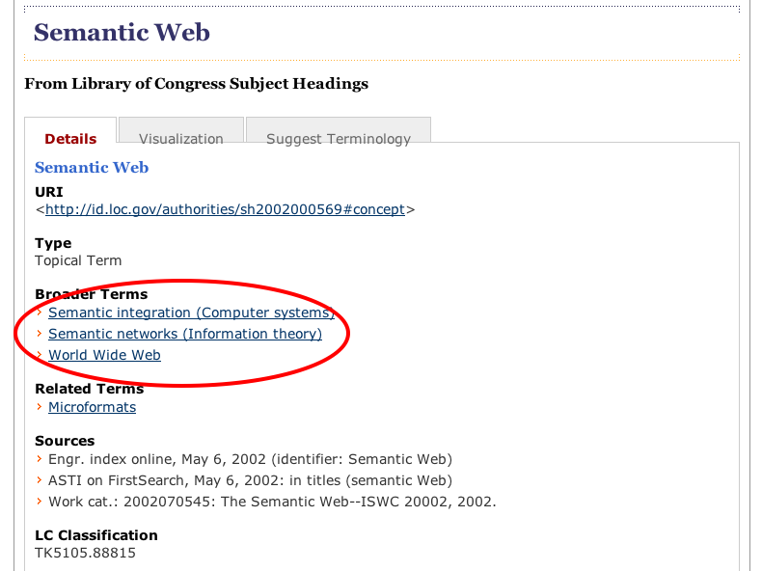
LOC example

Slide 84
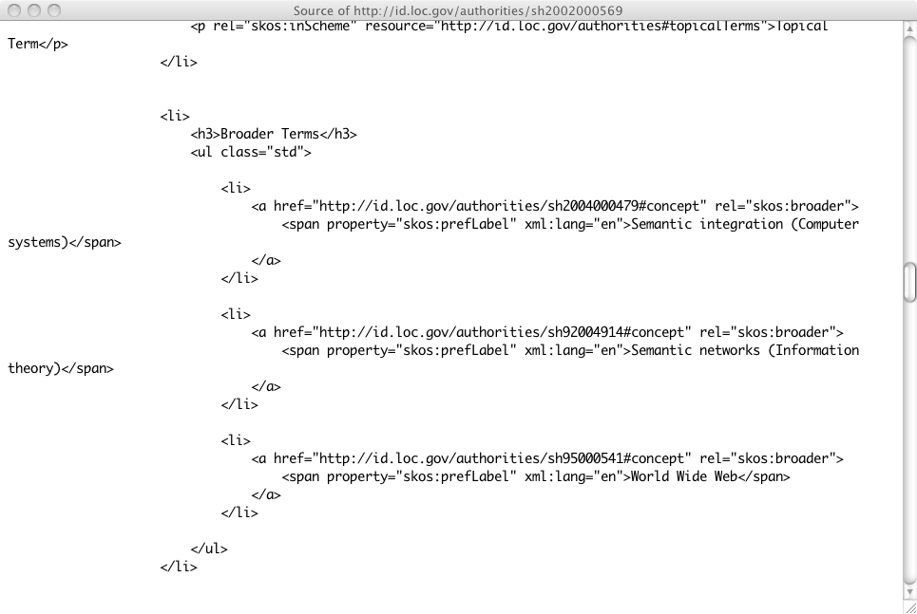
LOC example

Slide 85
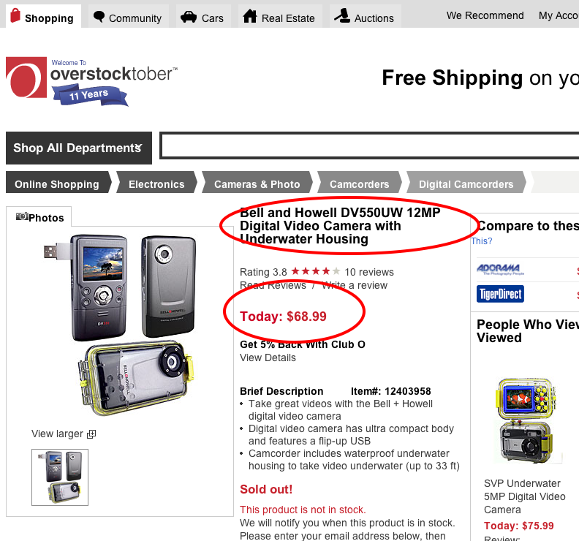
Overstock.com example

Slide 86
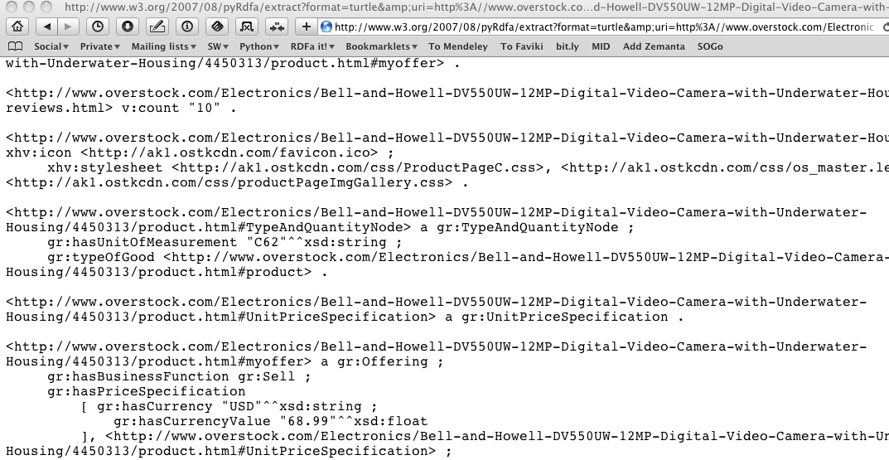
Overstock.com example

Slide 87
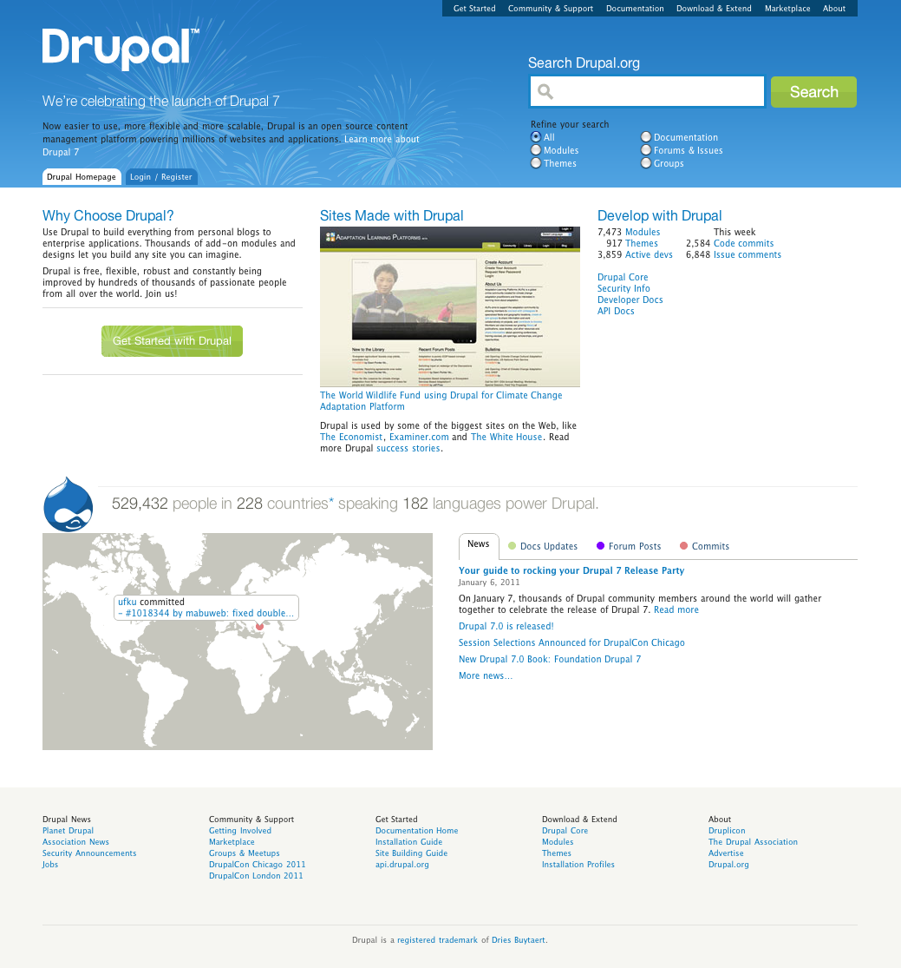
The huge step forward: Drupal 7
Major CMS system
Has RDF at his core, pages contain RDFa
In one step millions of pages of additional RDF data!

Slide 88
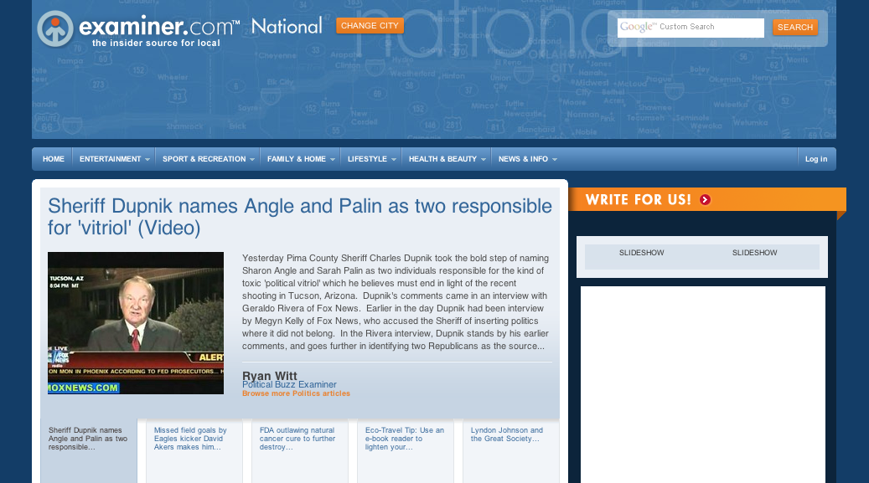
The Examiner.com

Slide 89
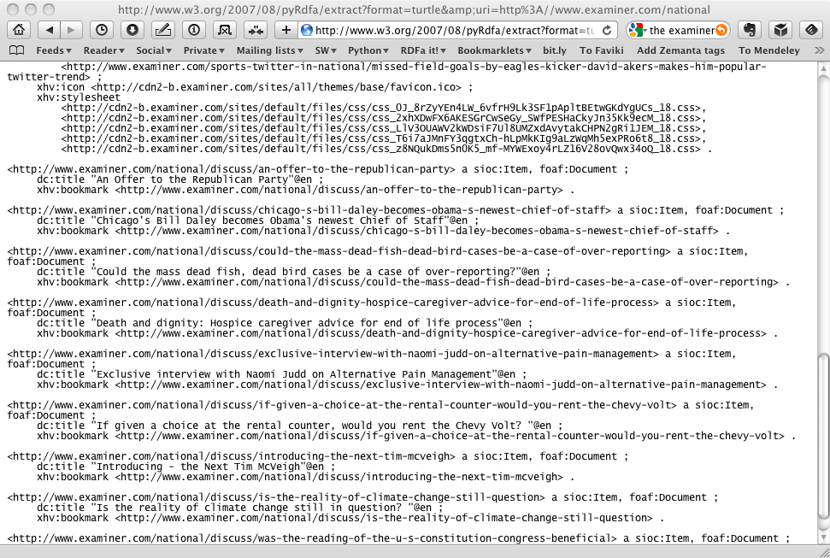
The Examiner.com

Slide 90
What I did not talk about: API
Work is going on to define a Javascript API
It will be possible to extract structured information from within a Web Application
Work is ongoing, let us talk about this at SemTech next year

Slide 91
Conclusions
RDFa is an essential bridge between the Semantic Web and the Web Developers’ communities
Is also an alternative serialization of RDF
Use it!

Slide 92

Thank you for your attention!
These slides are also available on the Web:
http://www.w3.org/2011/Talks/0607-SemTech-RDFa-IH/

