Slide 1
A small overview of W3C
Ivan Herman, W3C

Slide 2

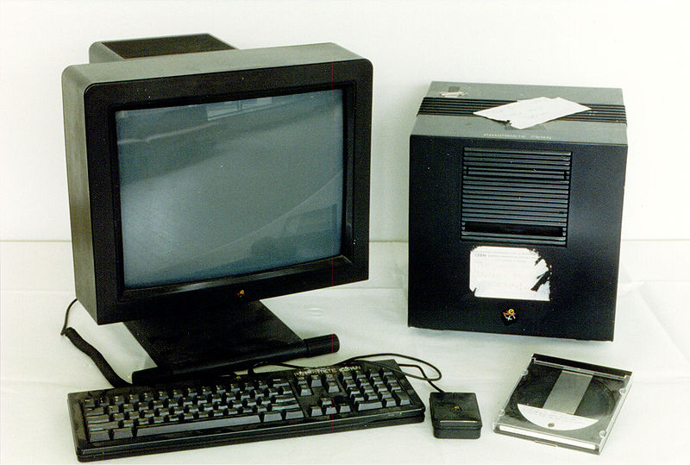
A bit of history…
The Web was created in 1990
Technically, it was a combination of a few concepts:
  a network protocol (HTTP)
  universal naming on the Internet (URI)
  a markup language for documents with hyperlinking (HTML)
Around 1993 it caught up like bushfire…

Slide 3
Why?
Technically, it was the right set of choices
The technology was free for everyone
  does anyone knows what gopher is?
There were vendor neutral standards for each of the technology pieces
  developers could rely on independent specifications, without any vendor lock-in

Slide 4
Free and open standards are important…
The standard text itself should be freely available
  an ISO document may cost many hundred of dollars!
The technology in the standard should be royalty free
  implementers can work without a fear of being sued…

Slide 5
So: development of the Web needs free and open standards
And this is exactly what W3C is all about!
Goal: be the place where international, free and open standards for the World Wide Web are developed

Slide 6
W3C is a membership organization
W3C is a membership organization
  it has members (cca. 340) from all over the globe
    companies, universities, public institutions, …
    standards are developed in cooperation with them
  W3C itself has only a small staff (cca. 60)

Slide 7























Membership from all over the World…

Slide 8
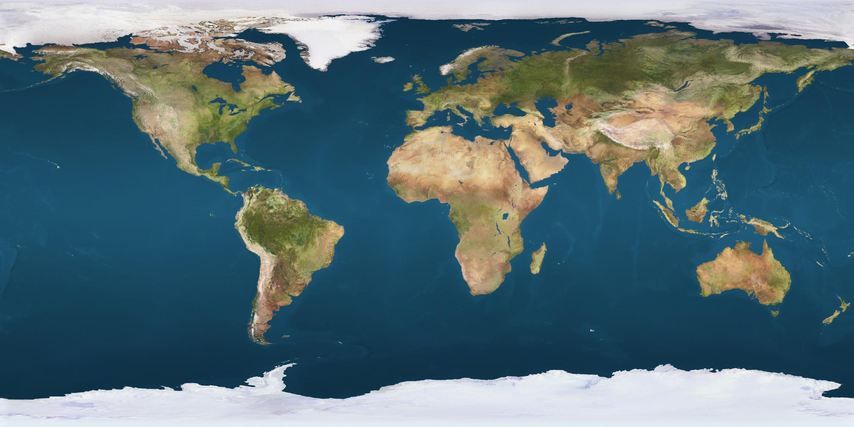
W3C is international
Three “hosts” (in the US, France, and Japan)
16 “offices”

Slide 9























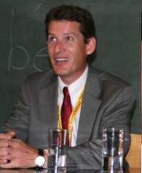









W3C staff is also international…

Slide 10
So what are the technologies at W3C?
In the old days, it was simple
  HTTP + HTML + URI = Web
But the Web has evolved a lot
  graphics, XML documents, multimedia, voice, Web2.0, Semantic Web, Mobile Web, security,…
W3C technologies cover many of these areas

Slide 11
To impress you: the (incomplete) W3C Technology stack
One Web
Web Applications
Ubiquitous Web
Web Services
Semantic Web
Social Web
HTML
MWI
SOAP
OWL
eGovt
XHTML
SMIL
SRGS
MTOM
SKOS
MW4D
CSS
SVG
SSML
PLS
WSDL
GRDDL
P3P
Web Apps
Video
WS-CDL
RDFa
APPEL
XForms
VoiceXML
WS-A
POWDER
XML Sig
XMLHTTPRequest
Geolocation
RIF
XML Enc
MathML
CDF
EMMA
InkML
Life Sciences
XKMS
Web Accessibility / Internationalization / Device Independence / Mobile Access
XML, Namespaces, Schemas, XQuery/XPath, XLink, DOM, XML Base, XPointer, RDF/XML, SPARQL
XML Infoset, RDF(S) Graph
Web Architectural Principles
URI/IRI, HTTP
Internet

Slide 12
Some areas of interest for today…
I will say a few words about
  “Interaction”: HTML, graphics, video.…
  Internationalization
  Mobile Web
  Semantic Web
There are of course more, but we have no time…

Slide 13
HTML5 & Co.

Slide 14
HTML5
(X)HTML has not been updated for a long time
Features are needed to handle new interaction methods:
  inclusion of video and audio
  harmonization with graphics (SVG, Canvas) and maths
  elements for dialogues, navigation, ...
  additional features for forms
  better specifications of corresponding Javascript API-s

Slide 15
HTML5
There are still too many differences among browsers when it comes to rendering
A very precise and detailed processing description is added to HTML5 to reduce these
Caveat: it will still take 1-2 years before this is final…

Slide 16
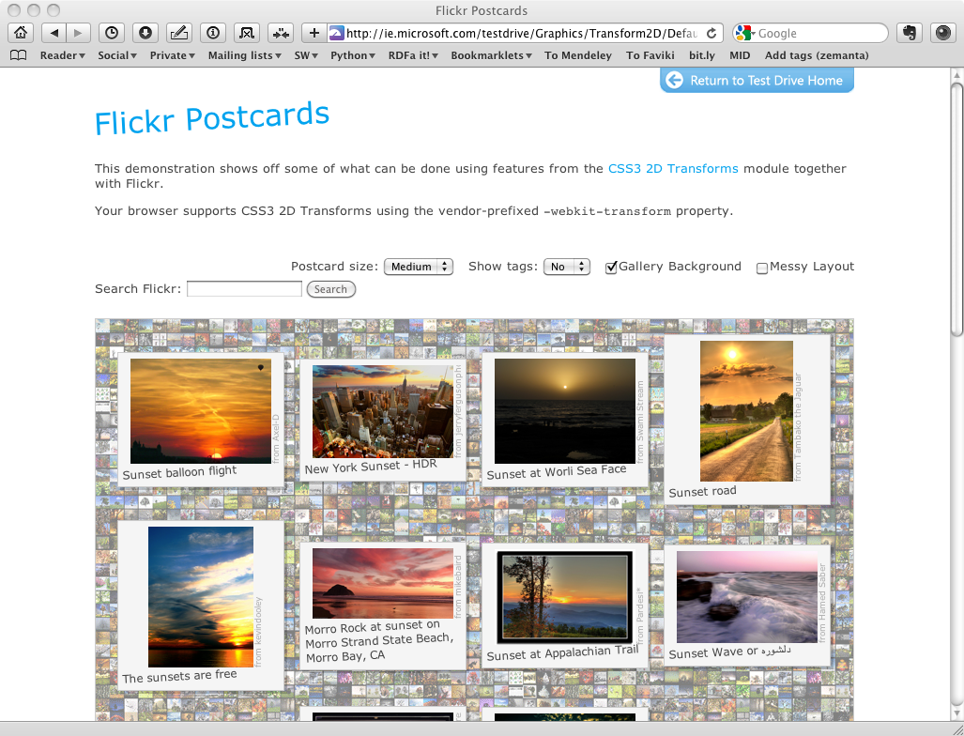
A future HTML5 page

Slide 17
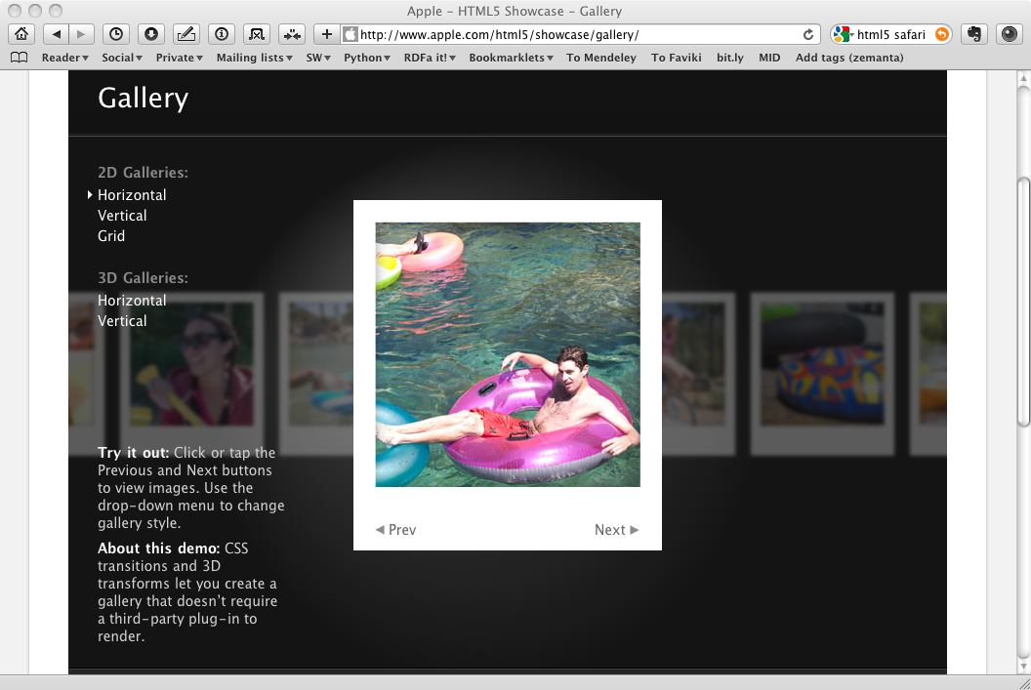
A future HTML5 page

Slide 18
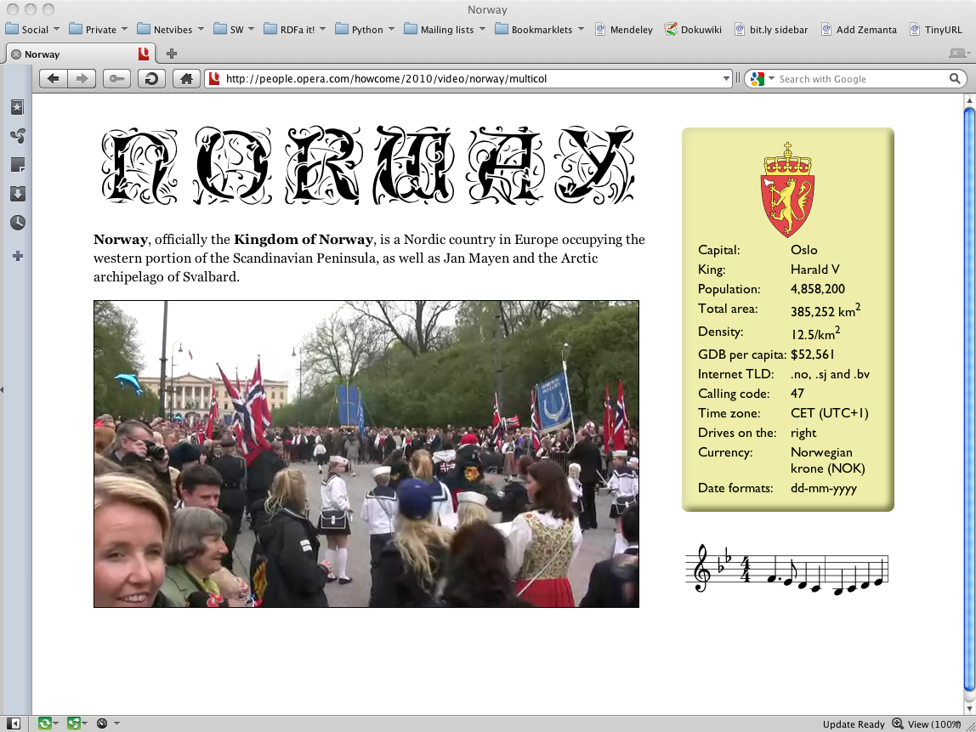
A future HTML5 page

Slide 19
Video on the Web
The Web became a global collaborative communications medium through shared video
In April 2008: 84.4 million videos!
These videos can be on just about anything…

Slide 20
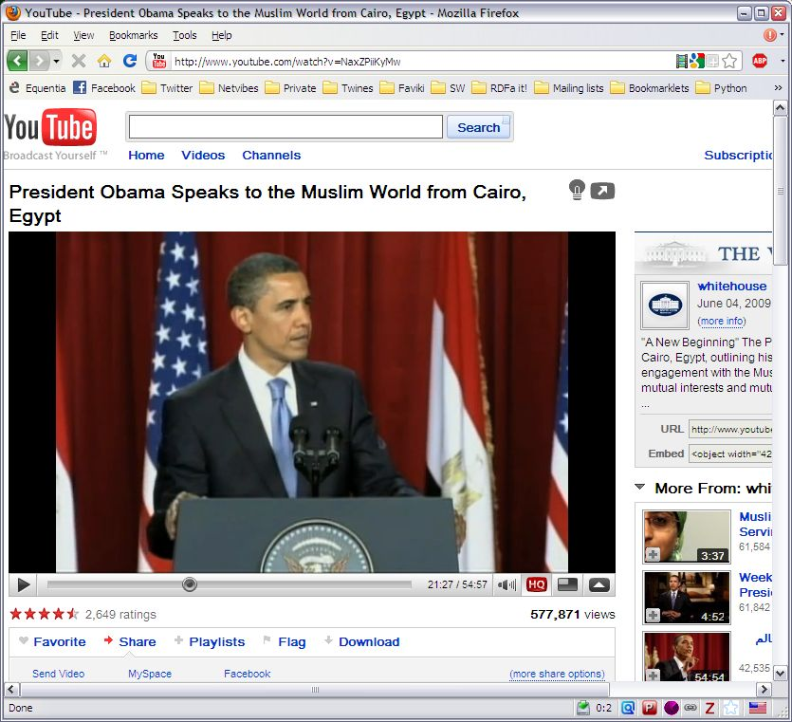
… politics …

Slide 21
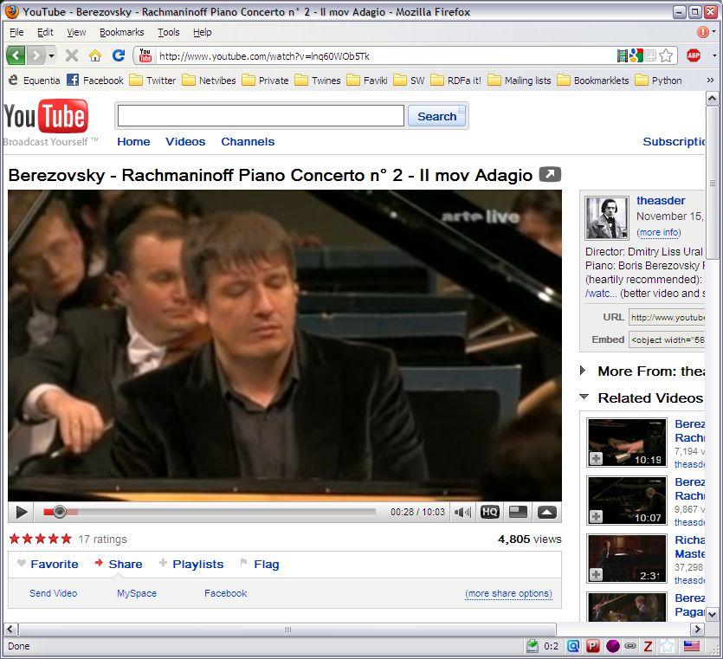
… music …

Slide 22
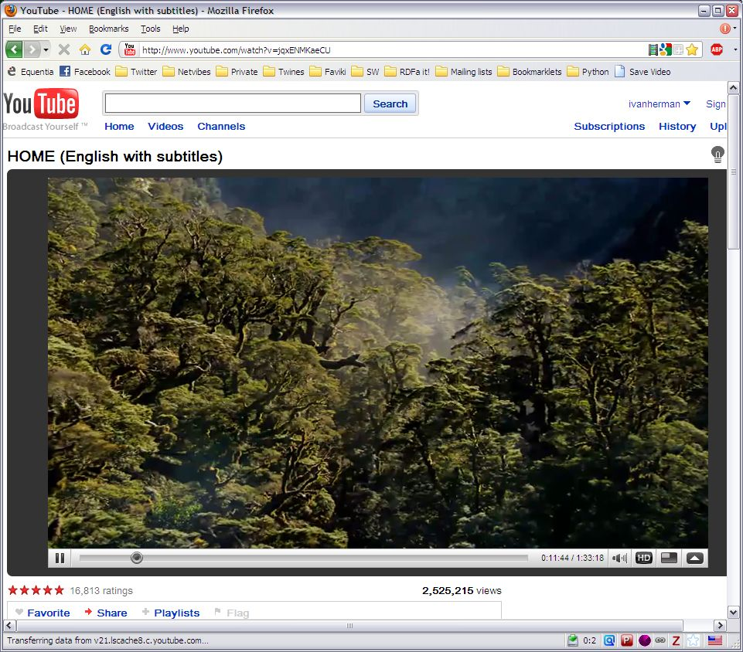
… or even full movies

Slide 23
Video in HTML
Video in HTML4 is complex
  essentially, using <object>, which is complicated
Using the new <video> element in HTML5 should be as simple as using <img>!
  caveat: the encoding format may not always be royalty free
  that is, alas!, outside of control of W3C…
But there are some additional technical issues to handle
  media addressing
  media annotation

Slide 24
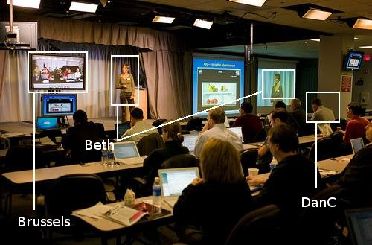
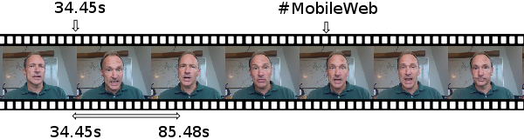
Video and audio addressing
Standard ways should be provided to identify
  spatial fragment
  temporal fragment

Slide 25
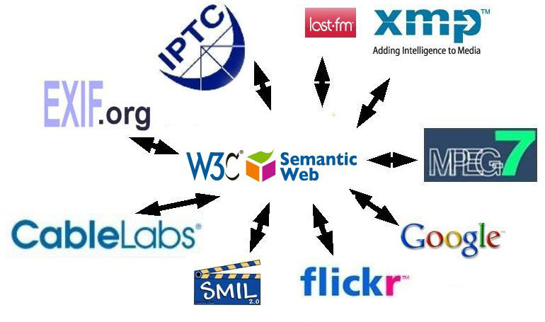
Linking and annotating media content
There are many ways to annotate the content of, say, an image
A standard way should be defined…

Slide 26
“Open Web Platform”
HTML5 + CSS3 are only elements of a general “Open Web Platform”
A number of API-s are also defined to provide a general, Web based application environment
  Web sockets, Web storage, Widgets, …

Slide 27
Internationalization

Slide 28
Internationalization
Web technologies tend to be biased towards “Western” habits
But the Web is International!
That means:
  it should work with all kinds of character sets (Arabic, Chinese, Mongolian, Thai, Japanese, Russian, …)
  one should be able to create document following local customs:
    bulleted lists
    emphasis style
    writing directions
    …

Slide 29
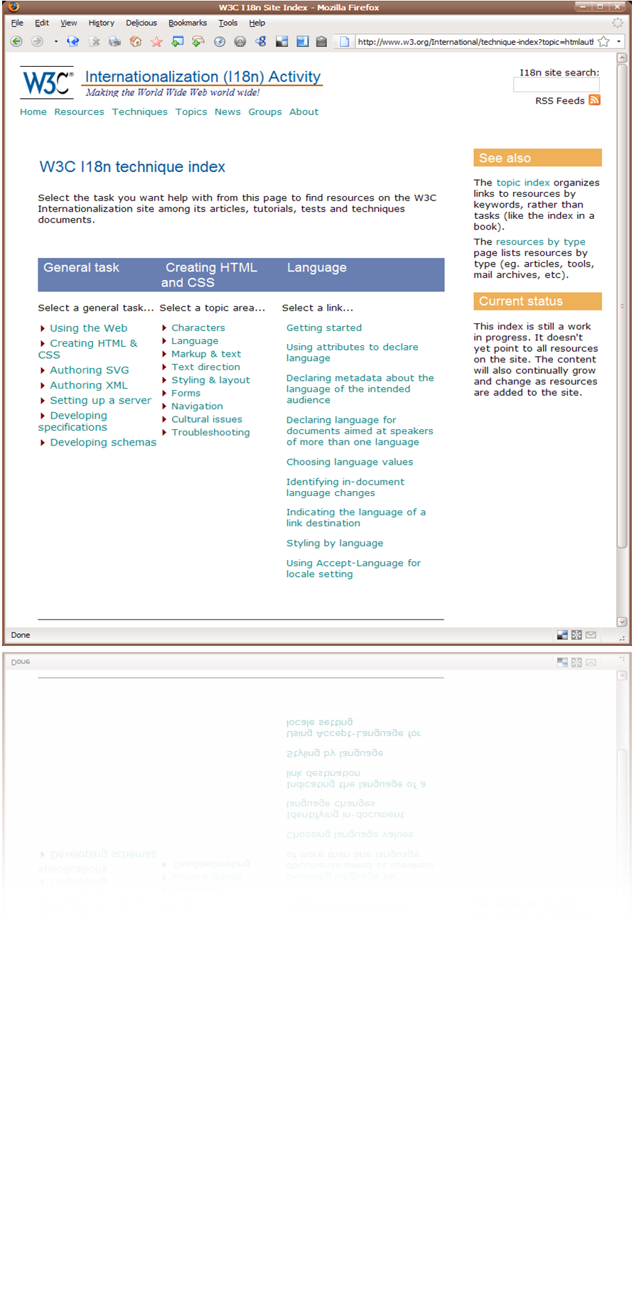
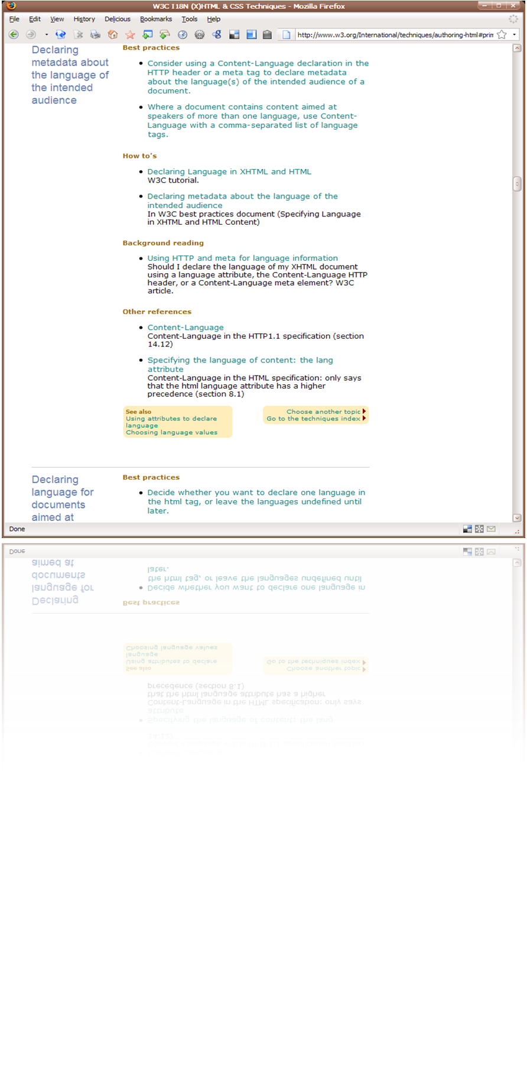
Internationalization at W3C
W3C has a separate “activity” on internationalization (I18N)
  checks and influences all other specifications for possible problems
  provides tutorials, small articles on how to design Web sites properly for this

Slide 30
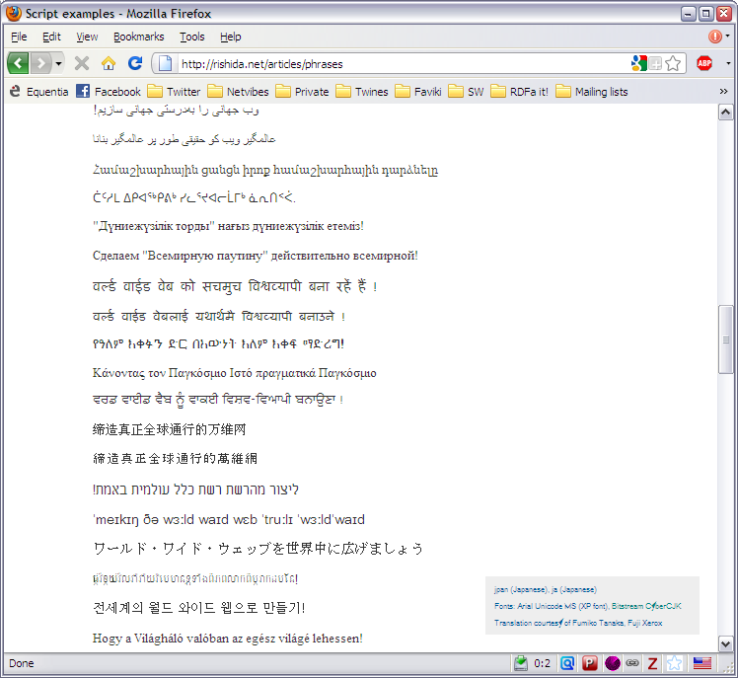
First of all: use Unicode!

Slide 31

Unicode takes care of a lot of things…
Is automatically generated by:
<p>bahrain <span lang="ar" xml:lang="ar" title="Means egypt">مصر</span> kuwait</p>

Slide 32
…but not everything
Need better control for:
  vertical writing and directions
  bidirectional situations
  non-Latin list styling
  ruby
Some of these are already part of HTML4 and CSS2
Some of these are being worked on for HTML5 and CSS3

Slide 33
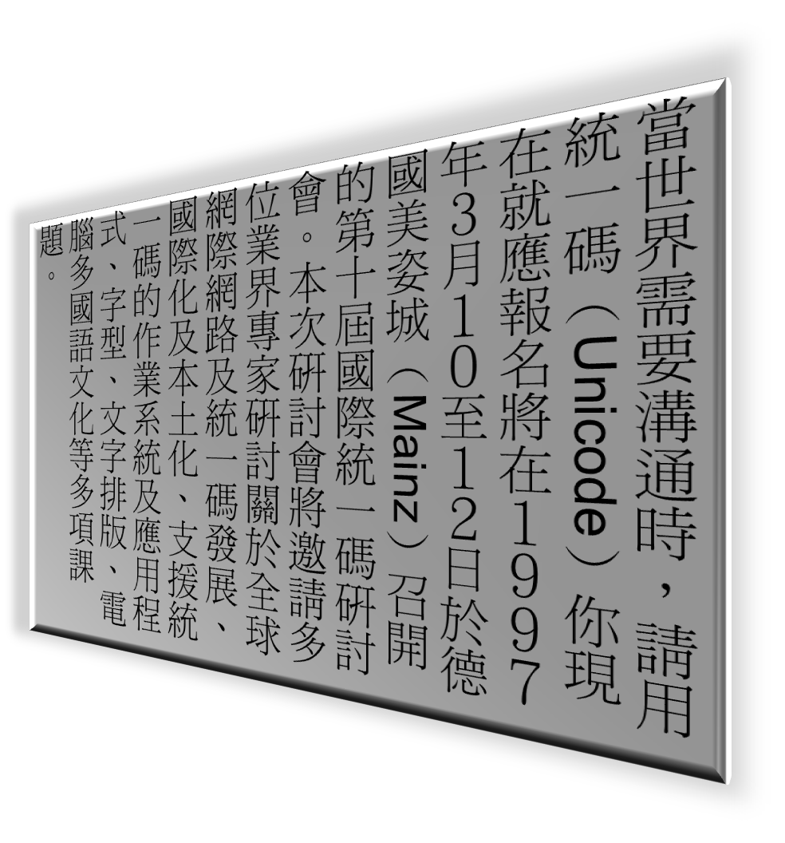

Vertical texts

Slide 34
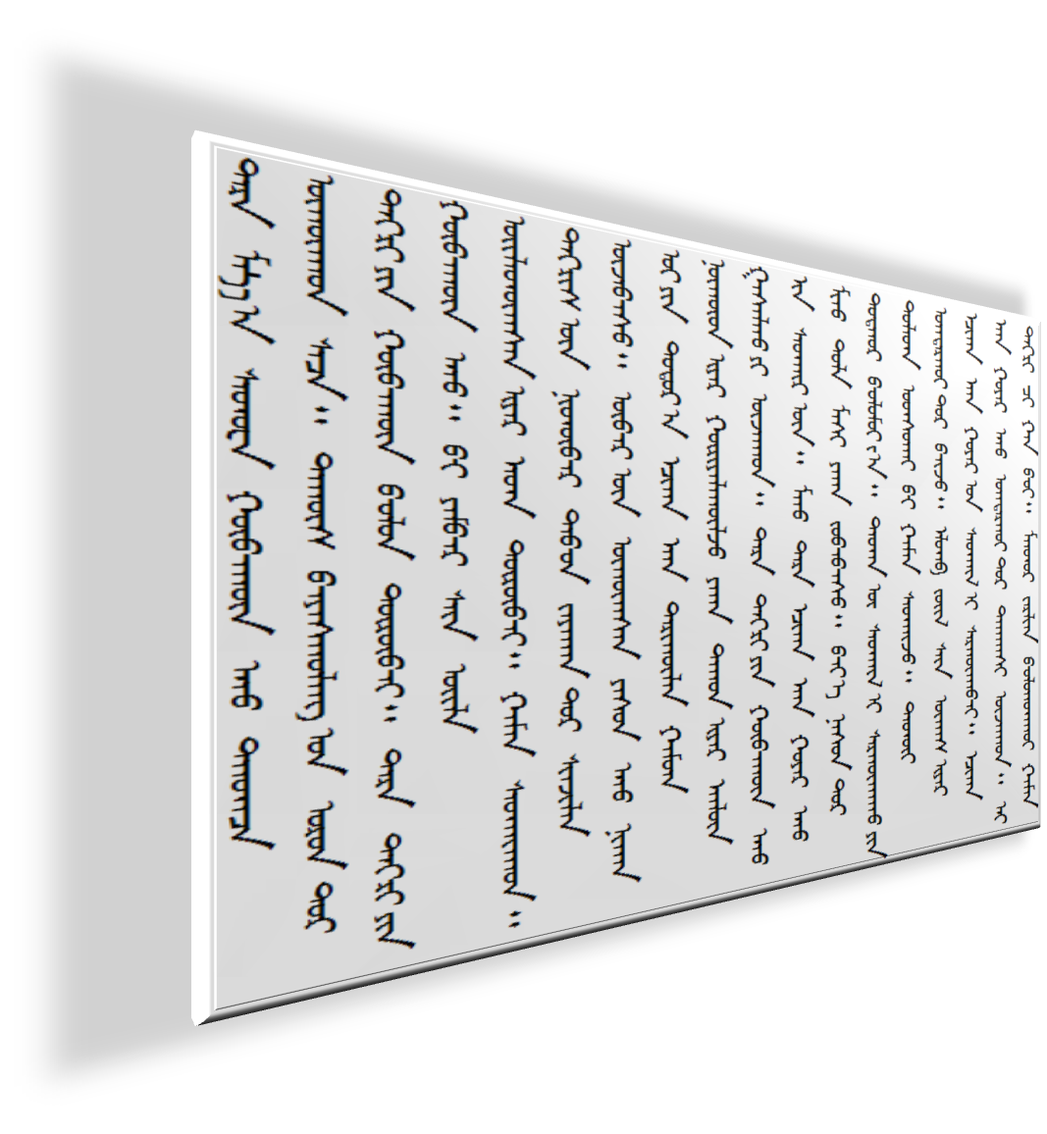

Vertical texts

Slide 35
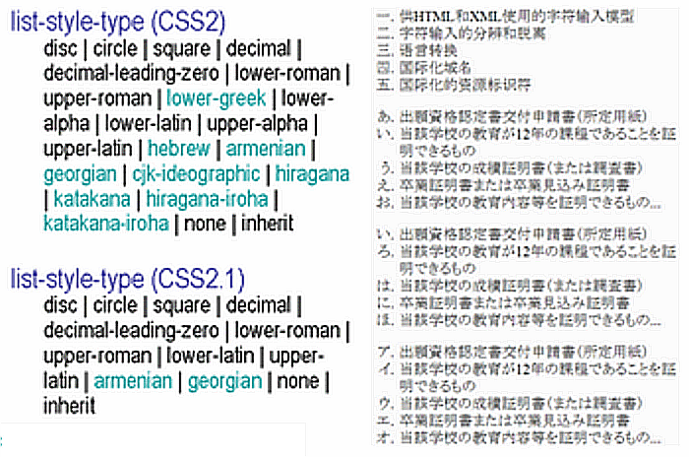
Bullet styles

Slide 36




Ruby (markup and styling)

Slide 37
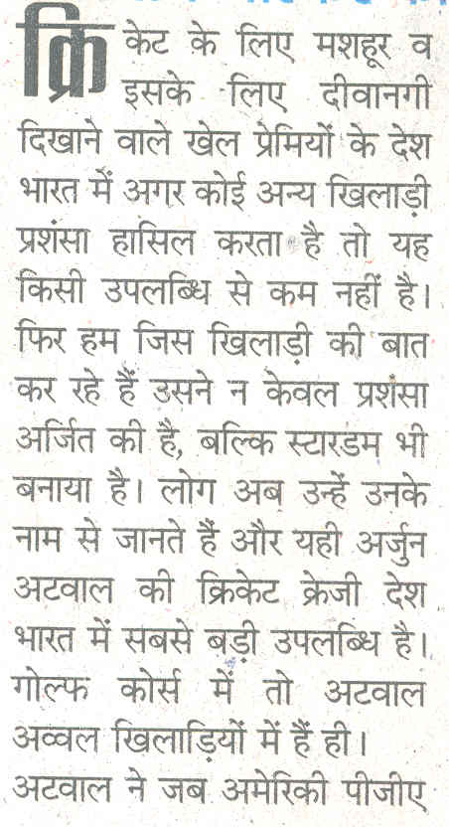

International typography: first letter

Slide 38
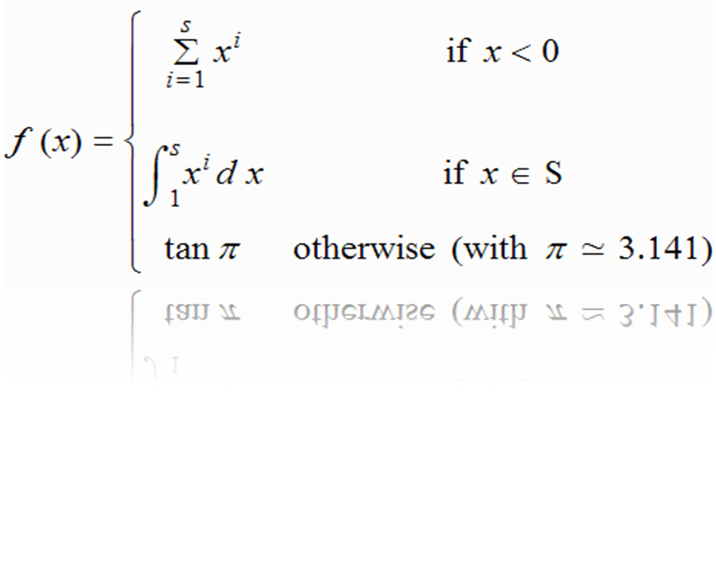
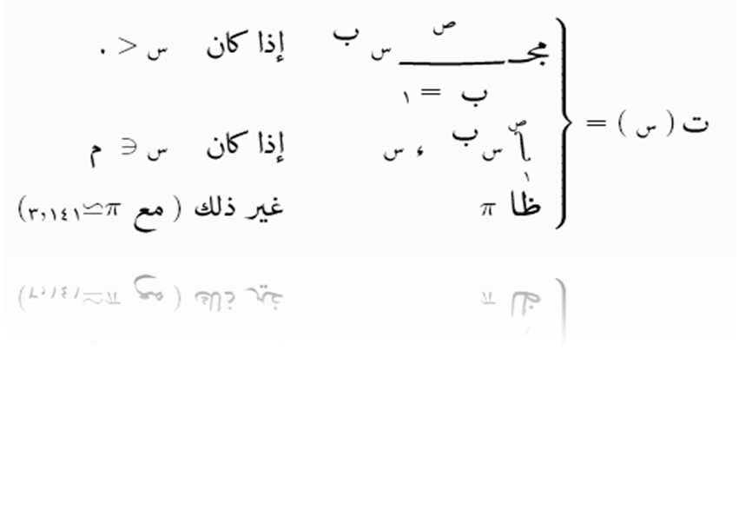
International typography: mathematics

Slide 39
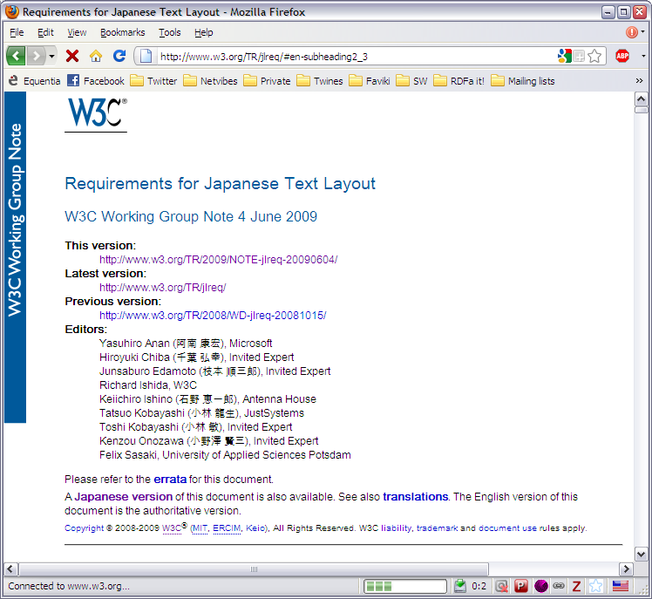
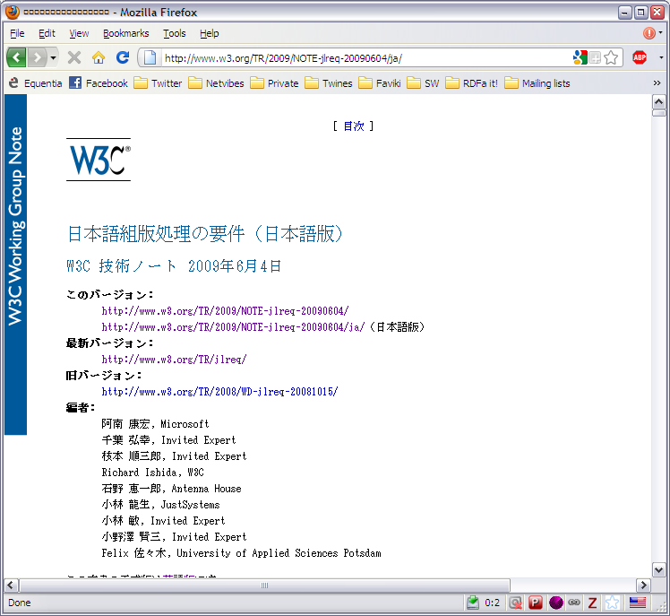
International typography

Slide 40
Mobile Web

Slide 41
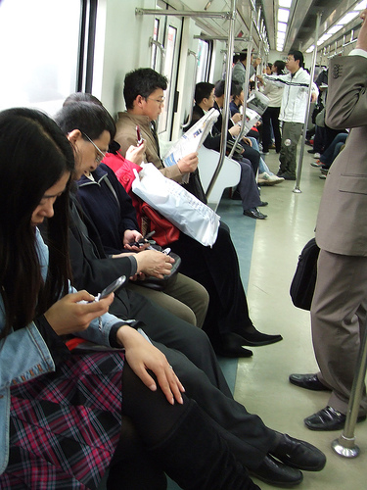
Mobile Web
Everybody talks about it
But… everybody knows it can be frustrating

Slide 42
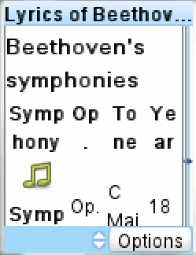
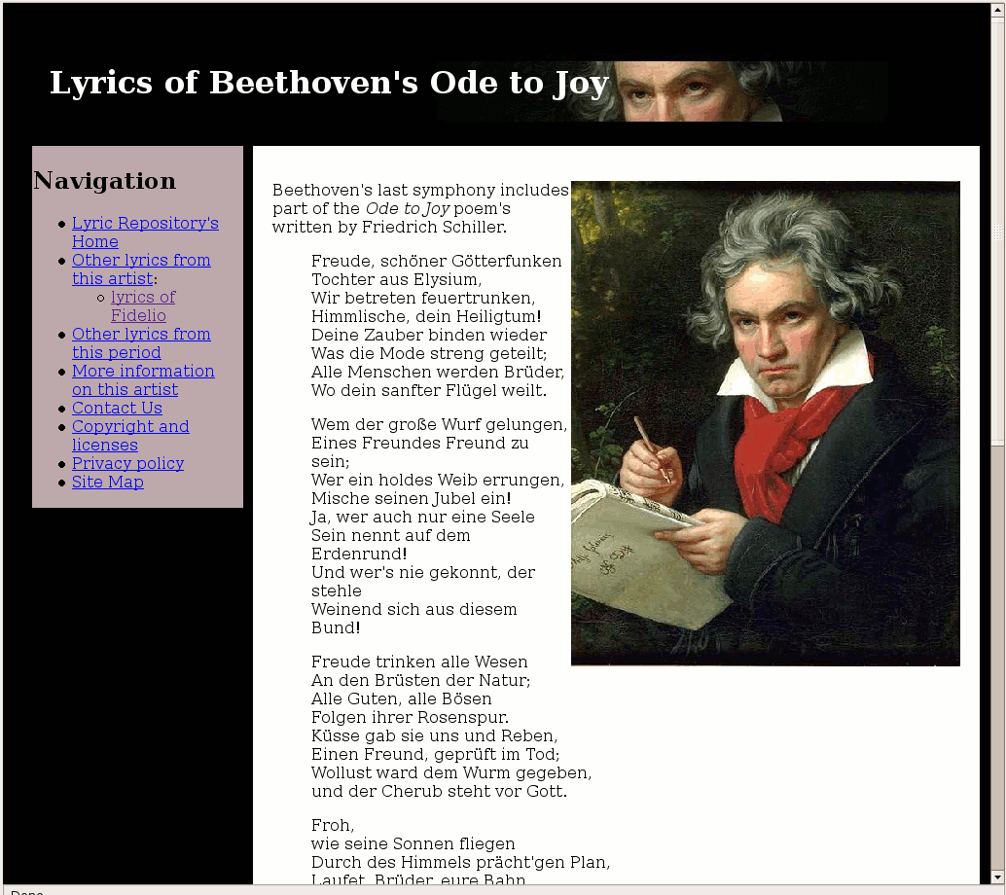
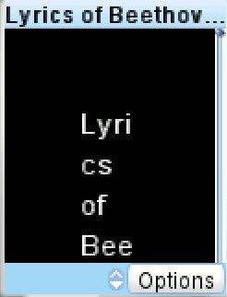
Mobile Web: the ugly

Slide 43
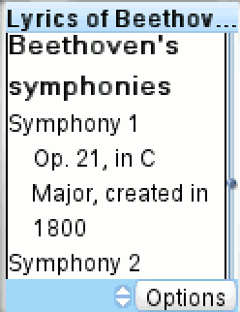
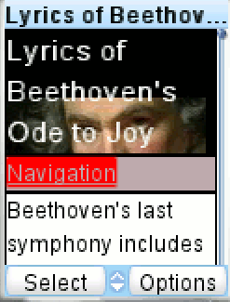
Mobile Web: the acceptable

Slide 44
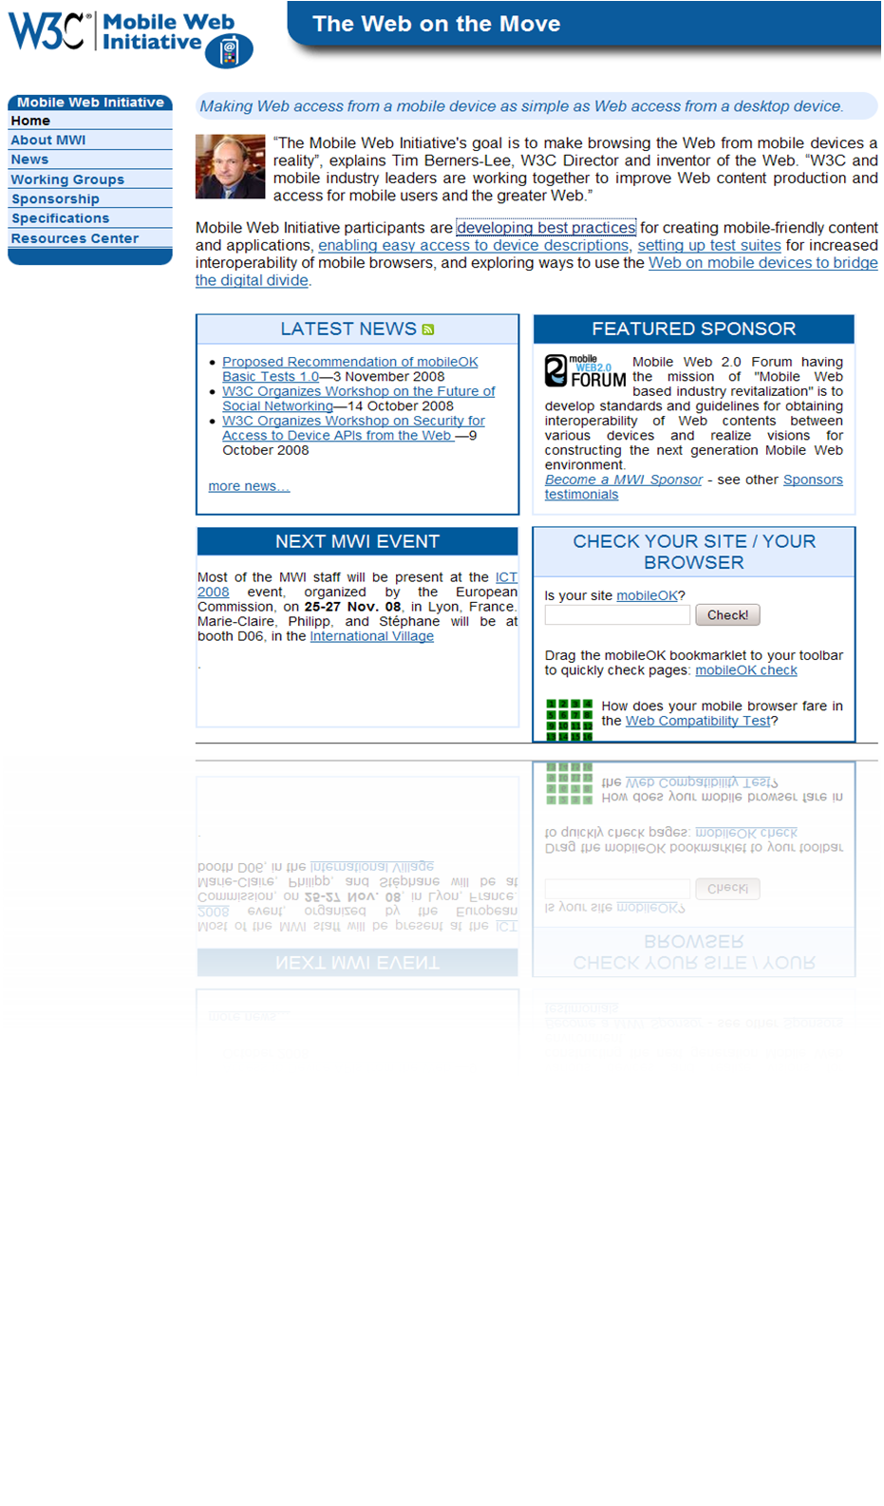
Mobile Web Initiative
It requires some “education” to construct proper web sites for mobile devices
  the content should be the same and the rendering should be well separated
MWI develops:
  education materials, test cases, “MobileOK” trustmarks, guides, …

Slide 45
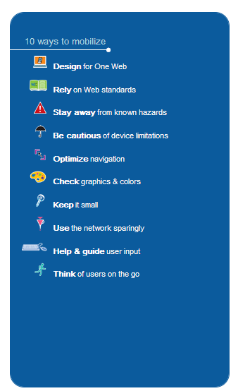
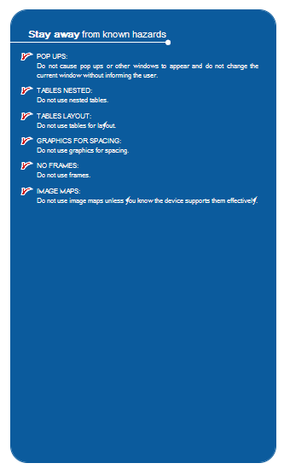
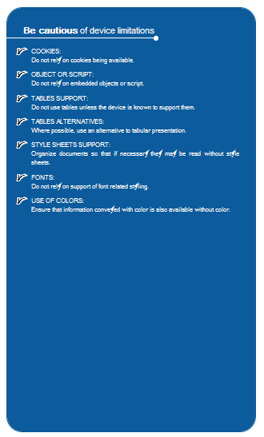
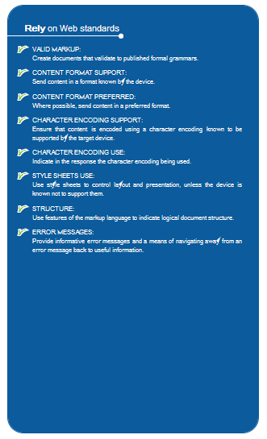
MWI Best Practices

Slide 46
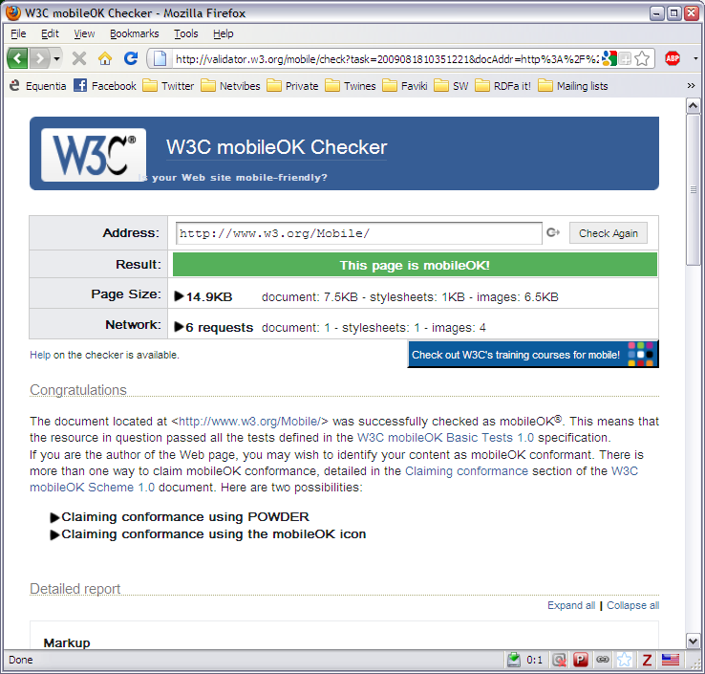
MobileOK Checker

Slide 47
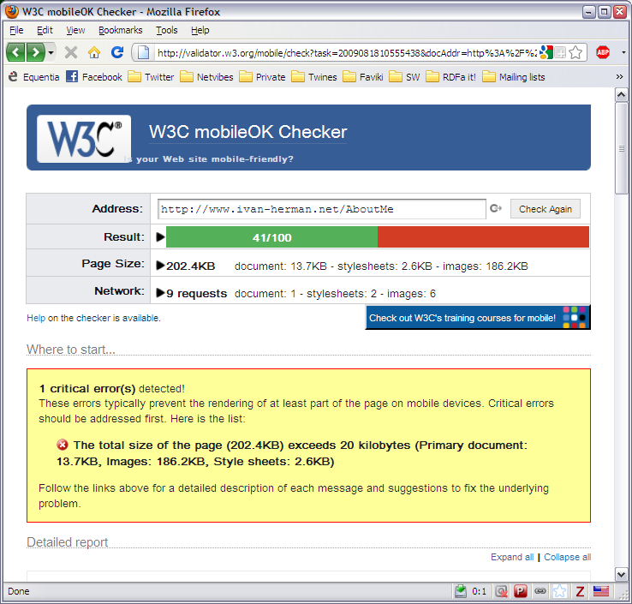
MobileOK Checker

Slide 48
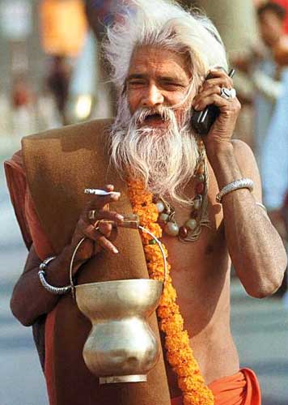
The social context: mobile for developing society
Track the social impact of mobile web in the developing world
Ensure that standards are o.k.

Slide 49
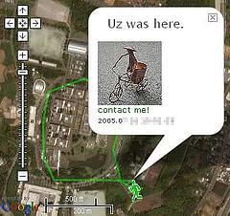
Mobile Web: there is also specification work
Standard ways to describe devices
  vocabulary, like display sizes, colour, input devices
  an API to construct device description vocabularies
Geolocation API

Slide 50
Semantic Web

Slide 51
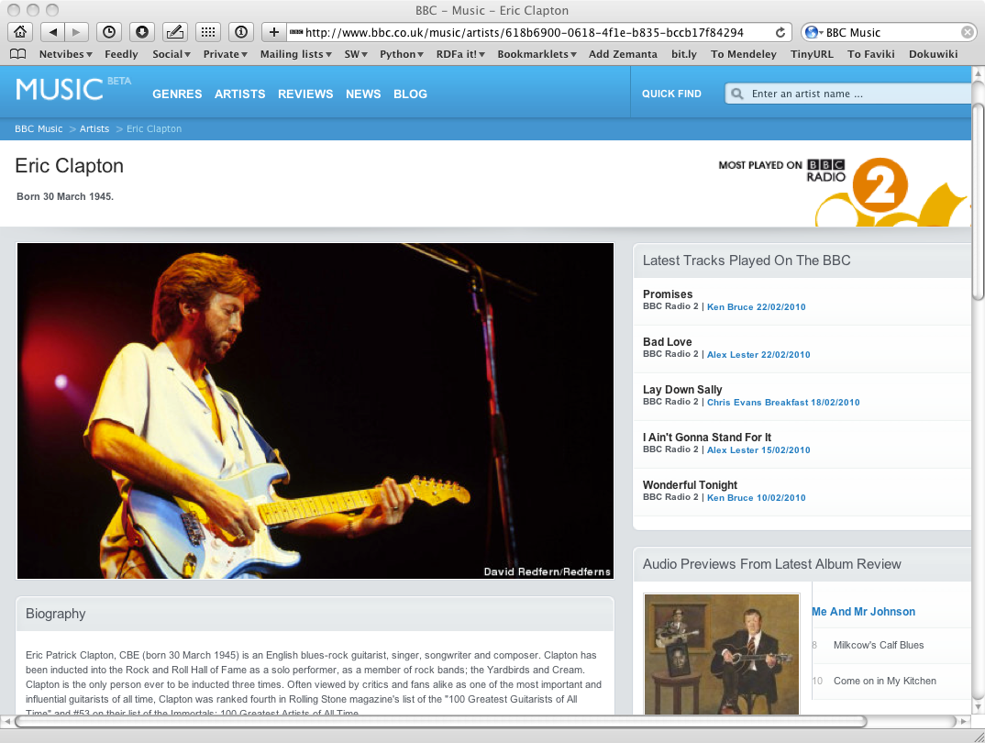
The Music site of the BBC

Slide 52
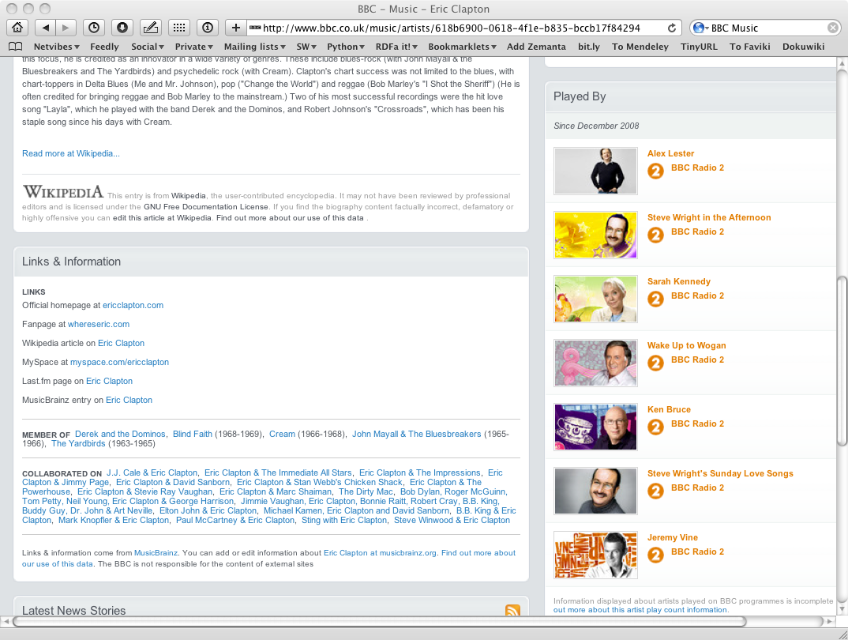
The Music site of the BBC

Slide 53
How to build such a site 1.
Site editors roam the Web for new facts
  may discover further links while roaming
They update the site manually
And the site gets soon out-of-date

Slide 54
How to build such a site 2.
Editors roam the Web for new data published on Web sites
“Scrape” the sites with a program to extract the information
  Ie, write some code to incorporate the new data
Easily get out of date again…

Slide 55
How to build such a site 3.
Editors roam the Web for new data via API-s
Understand those…
  input, output arguments, datatypes used, etc
Write some code to incorporate the new data
Easily get out of date again…

Slide 56
The choice of the BBC
Use external, public datasets
  Wikipedia, MusicBrainz, …
They are available as data
  not API-s or hidden on a Web site
  data can be extracted using, eg, HTTP requests or standard queries

Slide 57
In short…
Use the Web of Data as a Content Management System
Use the community at large as content editors

Slide 58
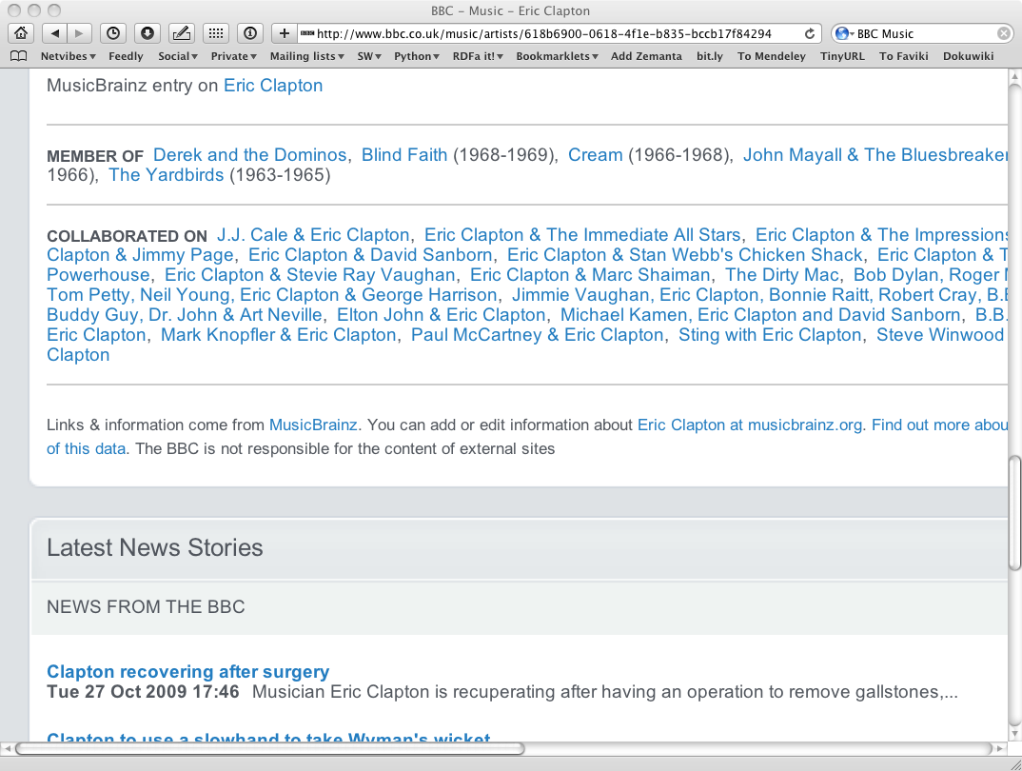
And this is no secret…

Slide 59
Data on the Web
There are more an more data on the Web
  government data, health related data, general knowledge, company information, flight information, restaurants,…
More and more applications rely on the availability of that data

Slide 60
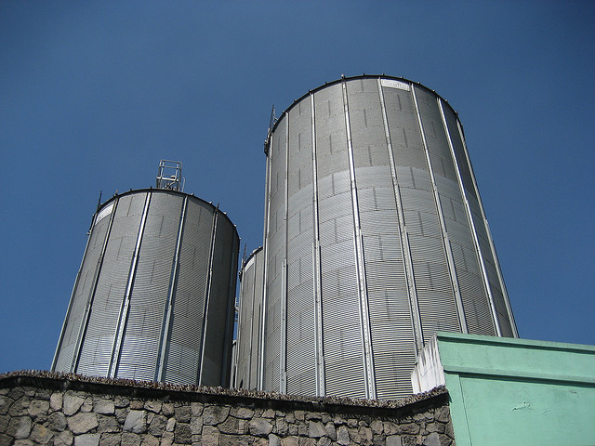
But… data are often in isolation, “silos”
Photo credit “nepatterson”, Flickr

Slide 61
Imagine…
A “Web” where
  documents are available for download on the Internet
  but there would be no hyperlinks among them

Slide 62
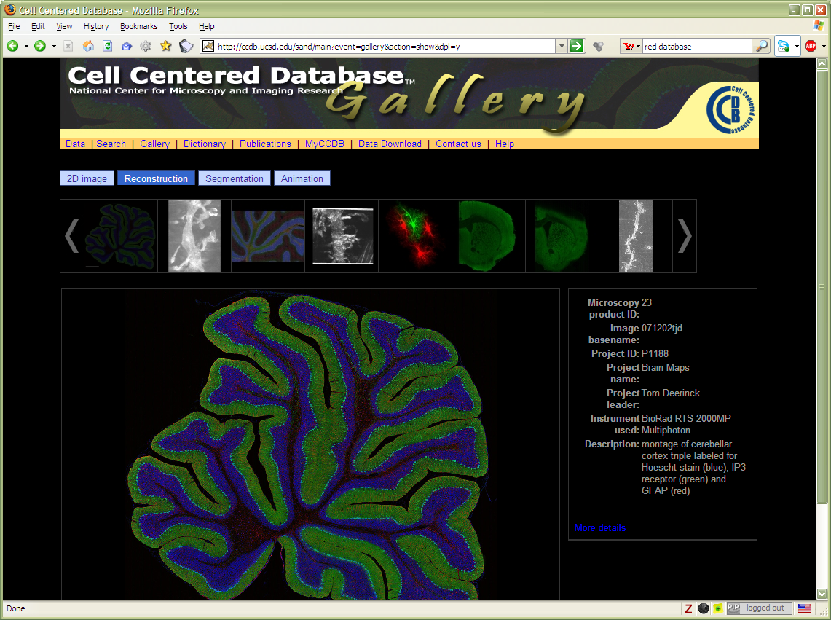
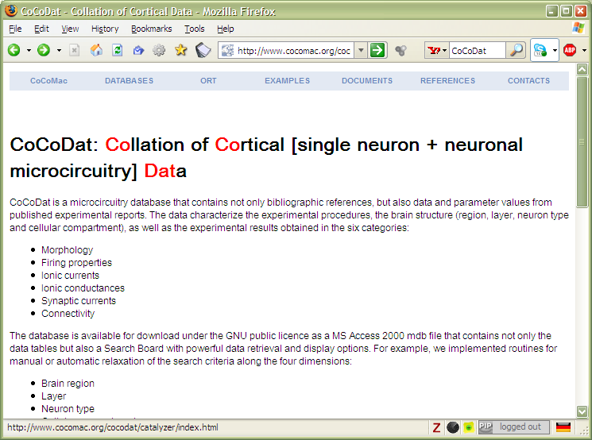
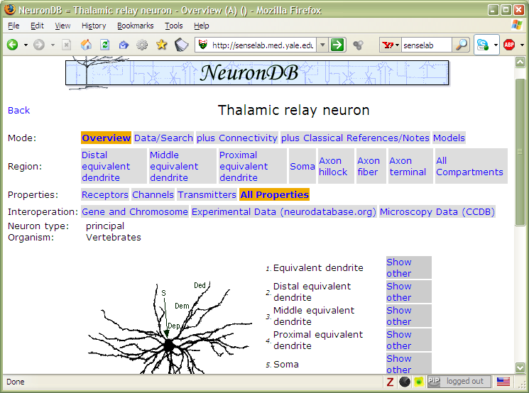
And the problem is real…

Slide 63
Data on the Web is not enough…
We need a proper infrastructure for a real Web of Data
  data is available on the Web
    accessible via standard Web technologies
  data are interlinked over the Web
  ie, data can be integrated over the Web
This is where Semantic Web technologies come in

Slide 64
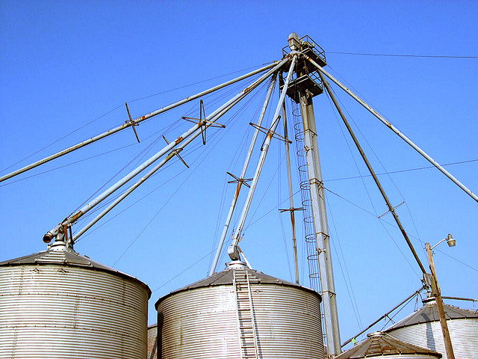
I.e.,… connect the silos
Photo credit “kxlly”, Flickr

Slide 65
So What is the Semantic Web?

Slide 66
It is a collection of standard technologies to realize a Web of Data

Slide 67
Why is all this good?
A huge amount of data (“information”) is available on the Web
Sites struggle with the dual task of:
  providing quality data
  providing usable and attractive interfaces to access that data

Slide 68
Why is all this good?
Semantic Web technologies allow a separation of tasks:
  publish quality, interlinked datasets
  “mash-up” datasets for a better user experience
“Raw Data Now!”
Tim Berners-Lee, TED Talk, 2009
http://bit.ly/dg7H7Z

Slide 69
But standards are boooring…

Slide 70
Wrong!!

Slide 71
A standard is...
… a synthesis on what is happening out there in terms of a R&D
… a synthesis on what is possible in an industrial setting
And that requires lots of knowledge and experience!

Slide 72
Standard writing is also a social process
It requires reaching a consensus among conflicting parties
Sometimes, it requires accepting majority opinions...
And that is not easy…

Slide 73
Standard creation at W3C
It is done by groups, with members delegating experts
Altogether, we are talking about 1000 experts from around the globe
Each group has at least one W3C staff member to help the process and contribute to the technology
  there is a formal process that has to be followed
  the price to pay…

Slide 74
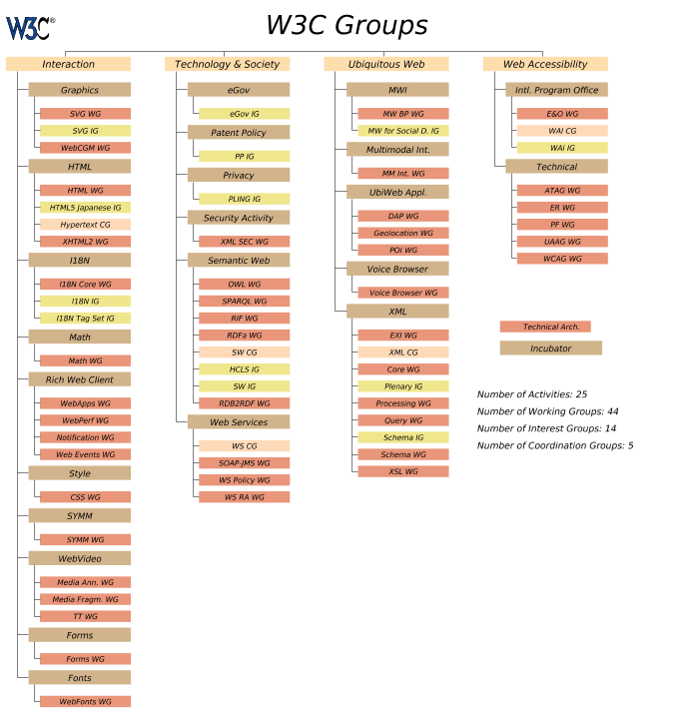

Slide 75
There is also a public scrutiny
The public can comment at specific points in the process
Groups must take all comments into account
  the number of comments can be in the hundreds...

Slide 76
Life of a group
Regular telecons (usually once a week)
Possible 1-2 face-to-face meetings a year
Lots of email discussions
Editorial to get everything properly written down
Average life-span: 2-3 years

Slide 77
Summary
W3C is the place where open standard technologies are developed for the Web
Work on standards involves lots of challenging issues related to the future evolution of the Web
Anybody can participate on a certain level, by commenting, implementing… so join the club!

Slide 78
Thank you for your attention!

